Slide 1
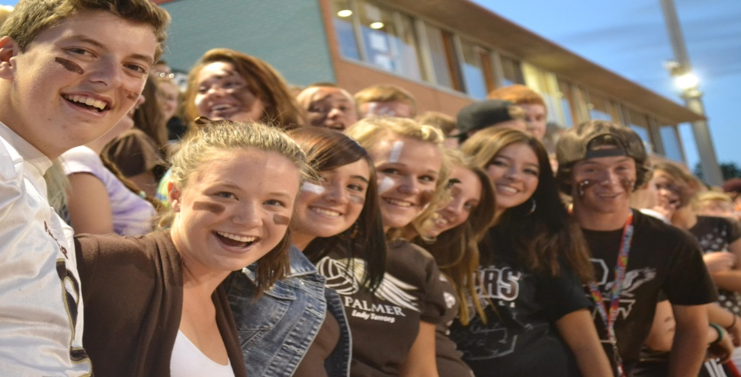
Welcome to Palmer High School!
Class of 2028

Slide 2
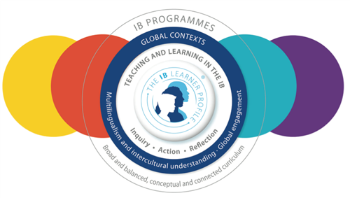
Palmer is an IB World School!
IB = International Baccalaureate
IB Diploma
Career Related Program
Course Candidacy
We also offer the following options for college credit:
Concurrent Enrollment
Career Start
Career Pathways
CTE Courses
Edu Ready
Articulation
IB Middle Years Programme

Slide 3
Palmer High School Bell Schedule
Tuesday/ Thursday
7:35-9:15 | Period 1
9:20-11:04 | Period 2 (announcements)
11:09-11:39 | Lunch
11:44-1:24 | Period 3
1:29-3:09 | Period 4
Monday Late Start
7:20-8:20 8:25-9:25 | PLC/PD (no students)
9:35-10:07 | Period 1
10:12-10:50 | Period 2 (TTV)
10:55-11:27 | Period 3
11:32-12:04 | Period 4
12:09-12:41 | Lunch
12:46-1:18 | Period 5
1:23-1:55 | Period 6
2:00-2:32 | Period 7
2:37-3:09 | Period 8
Wednesday/Friday
7:35-9:15 | Period 5
9:20-11:04 | Period 6 (announcements)
11:09-11:39 | Lunch
11:44-1:24 | Period 7
1:29-3:09 | Period 8

Slide 4
What Classes Will I Be Taking?
Core Classes:
English
Math
Science
Social Studies
World Language (Spanish, German, French & Chinese)
Terror Tracks OR AVID
Elective Pathway Options:
PE/ Computer Applications/ Tech & Design
Art/ Theater/ Digital Photo
Culinary Essentials
Game Design/2D & 3D Computer Animation/ Filmmaking/Drawing for Illustrators
Speech & Debate/Journalism
Social Studies Elective, ie. Constitutional Criminal Law, Pop Culture, etc.
Music – Band, Orchestra, Choir, Beginning Music Theory & Technology (DJ), Dance, Jazz Choir
Science Research

Slide 5
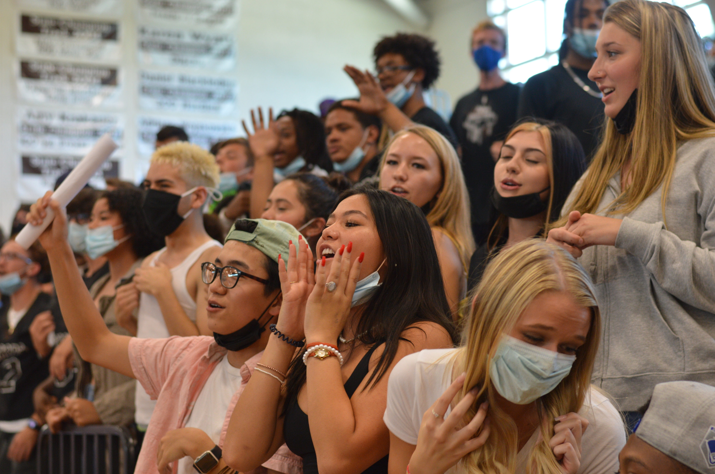
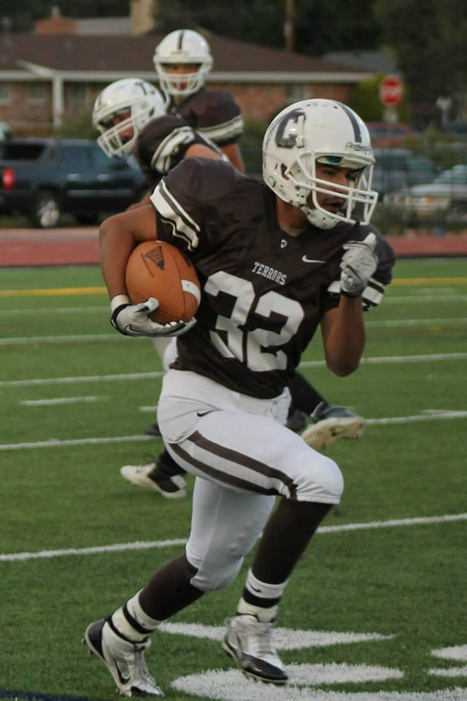
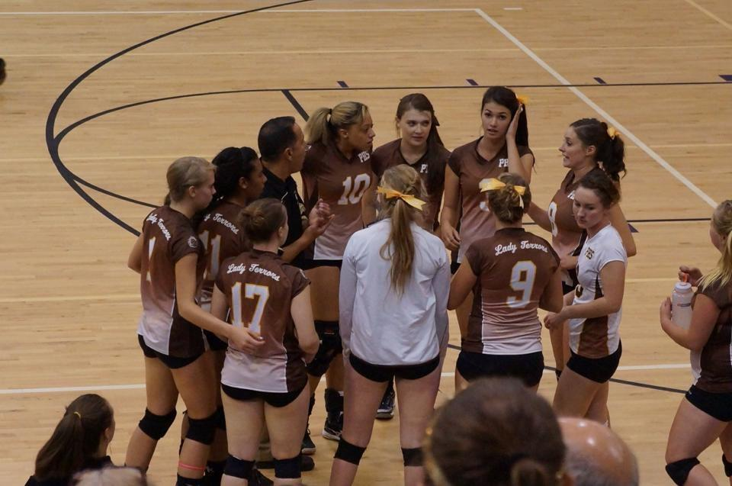
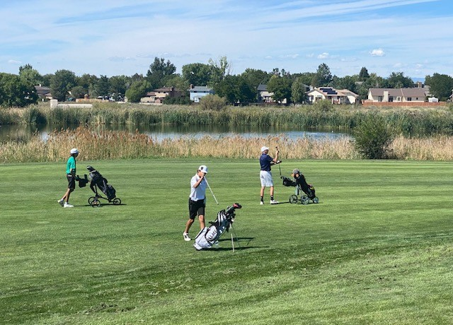
Sports! ...and Sports Fans!
Fall Sports:
Cheer
Cross Country
Football
Boys Golf
Boys Soccer
Softball
Boys Tennis
Volleyball
eSports
Spring Sports:
Baseball
Girls Golf
Girls Lacrosse
Boys Lacrosse
Girls Soccer
Boys Swim
Girls Tennis
Track & Field
eSports
Winter Sports:
Boys Basketball
Girls Basketball
Hockey
Girls Swim & Dive
Wrestling

Slide 6
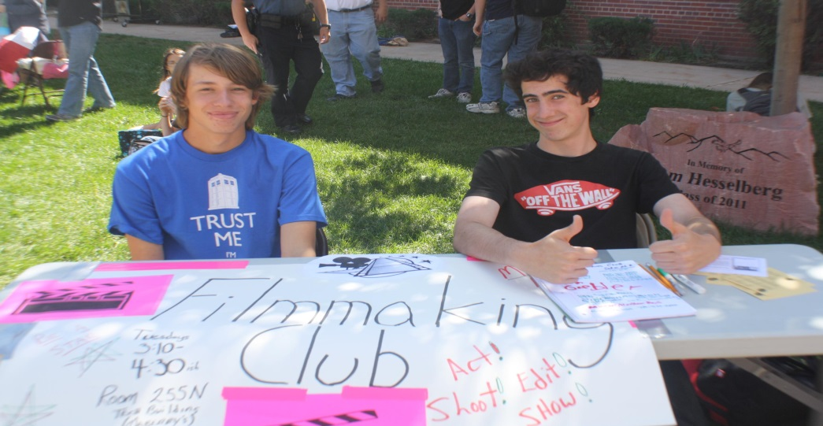
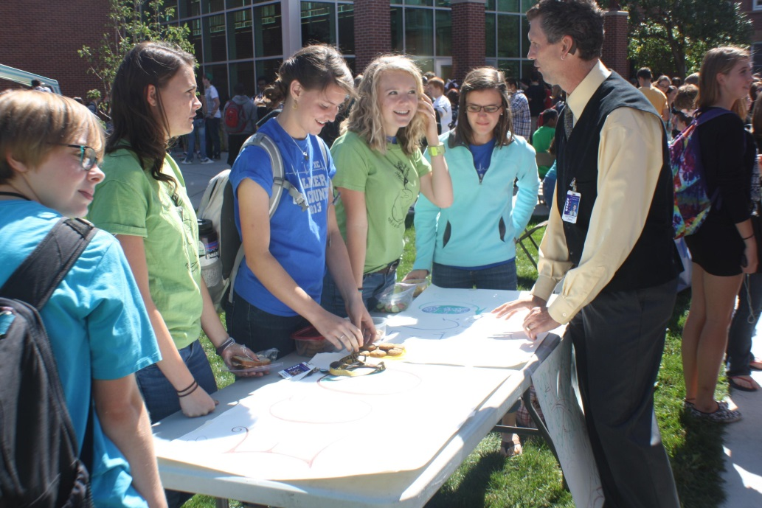
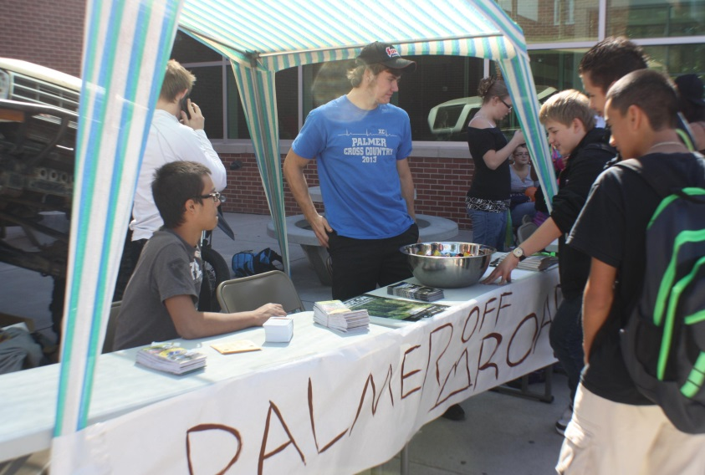
Opportunities at Palmer H.S.
Clubs!!!

Slide 7
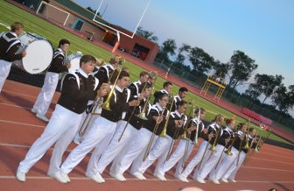
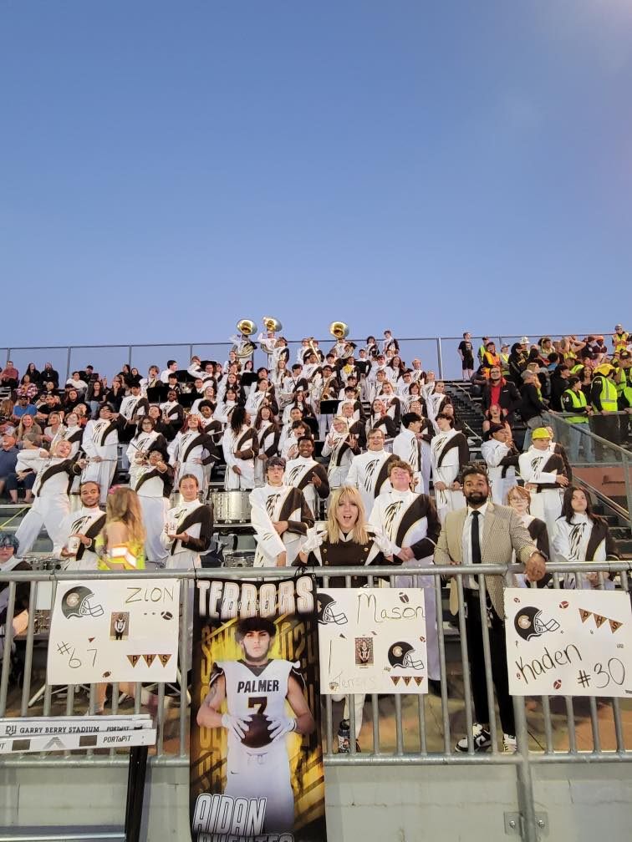
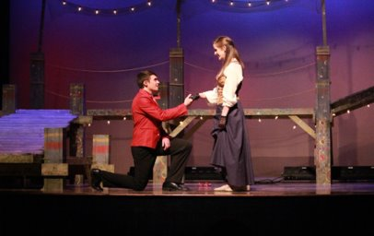
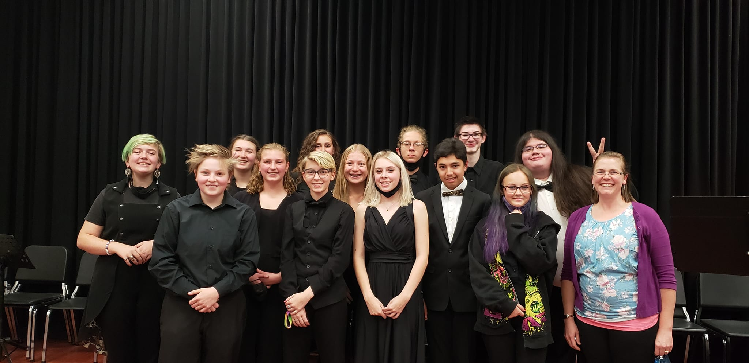
Performing Arts @ Palmer High School
Music Programs!
Band – Mr. Ward
Choir – Mr. Peckham
Orchestra – Mr. Rodine
And more...
Theatre
Stagecraft
Dance
DJ Course

Slide 8
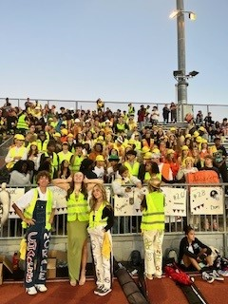
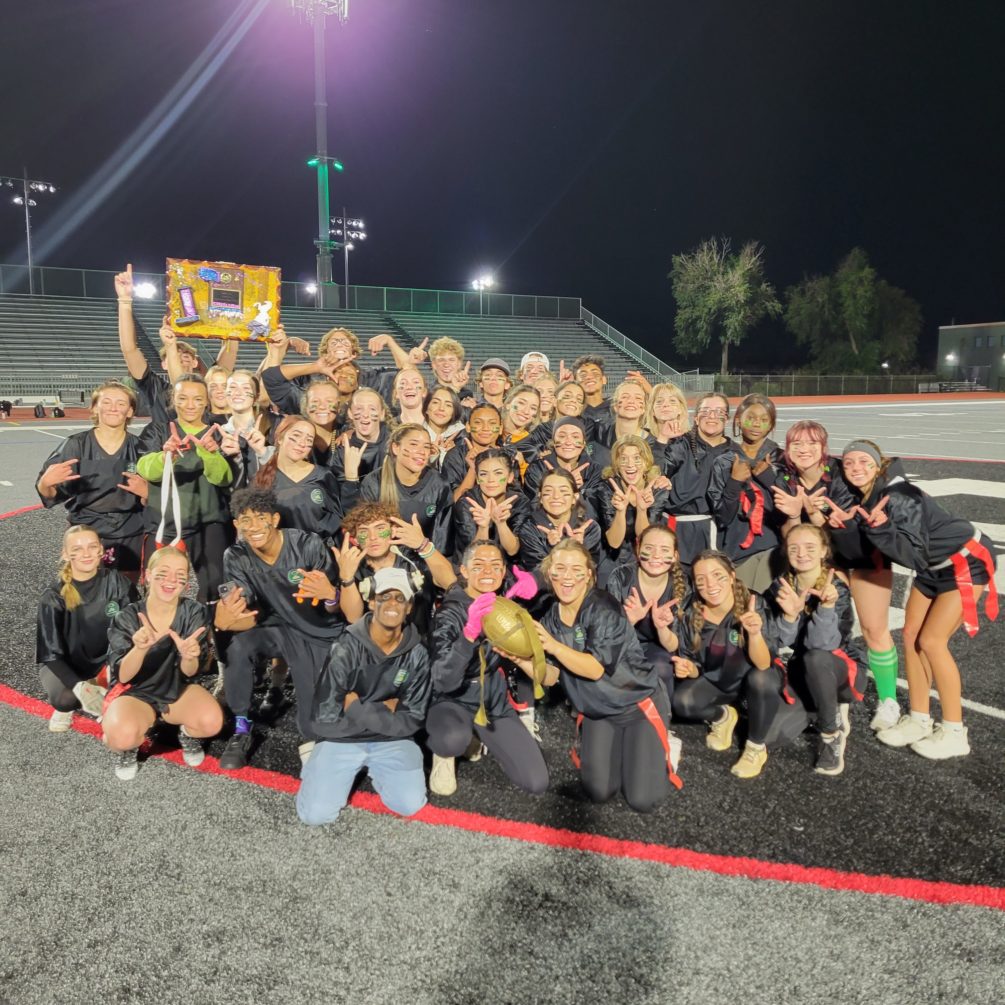
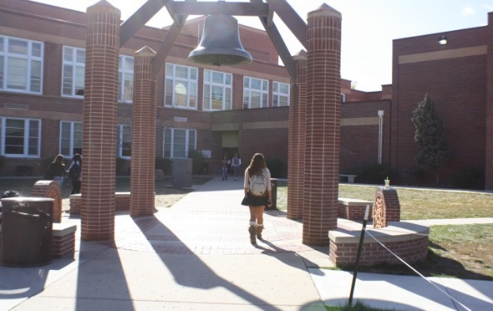
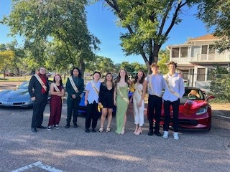
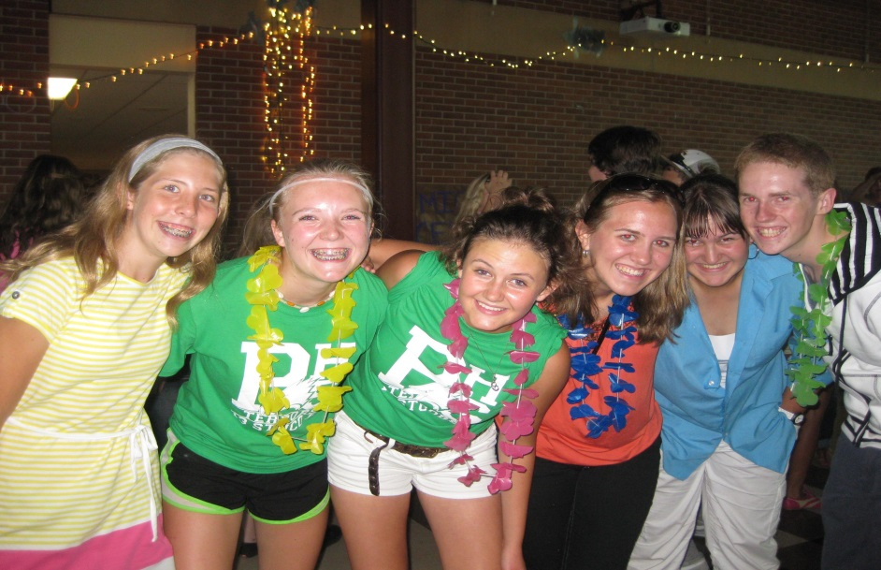
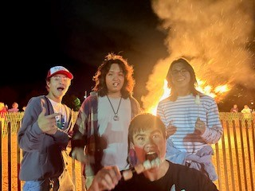
And More...
Ring the Bell!!!
Student Council
Meet New People
AVID
Dances
Assemblies
Homecoming

Slide 9
8th Grade Registration
Form

Slide 10
Before Registration Day
Know your registration date!!​
1
Talk with parents/guardians about class choices (honors, grade level, world language)​
2
Talk with teachers about recommendations for honors vs. grade level courses​
3
Complete ALL parts of your registration form
4

Slide 11
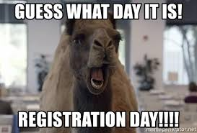
On Registration Day
Have your course registration form ready to submit with a signature from a parent/guardian
Talk with our counselors about any registration questions you still have
2024 Registration Dates
North – Wednesday, January 17th, 2024
Galileo – Tuesday, January 26th, 2024
Mann – Wednesday, January 31st, 2024

