Slide 1
Hamline Elementary Title I Annual Meeting

Slide 2
Agenda
Dinner & Title 1 Presentation
Scavenger Hunt!!!

Slide 3
Introductions
What is the most important to you for your child’s education?

Slide 4
Outcomes:
To help families understand Title 1 funding for schools and what funding targets.
To partner with families and gain input around how we prioritize Title 1 funding.
Have fun!!!

Slide 5
What is Title I?
United States Federal Government’s largest education program to support public schools.
The Purpose:
To help every child receive a high quality education and to achieve the high academic standards set by the State of Minnesota.

Slide 6
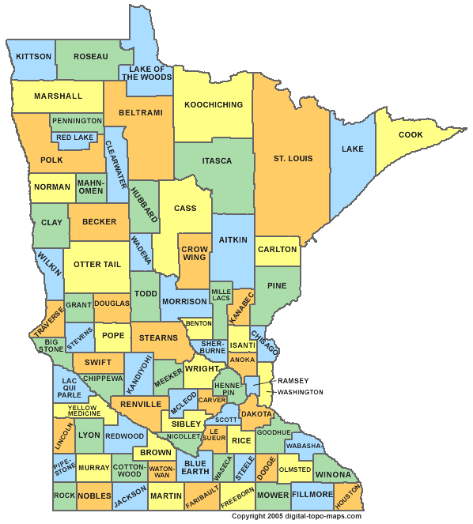
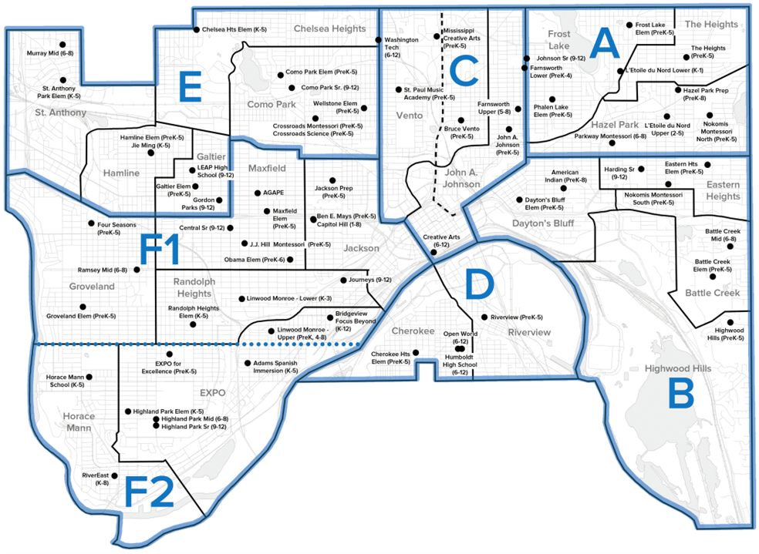
How is Title I funded?
Title I funds flow from the U.S. Department of Education to the Minnesota Department of Education (MDE). Then to the school district based on poverty data.
The district allocates Title I funds to schools based on the percentage of students receiving free or reduced lunch.

Slide 7
Title I in the Schools
Each school community decides how Title I funds will be used in their school to improve education for all children.
Data is reviewed to determine the greatest need for improvement in the school.
The school staff, with the input of parents, develops a school improvement plan with specific strategies to improve student achievement across the school.
Notes:
Possibly stop here and ask parents to write down on a post it what they want for their children

Slide 8
How are Title I resources used at our school?
Currently Title 1 funds pay for:
Academic Support Content Coach to support
Teacher Professional Development
Coaching Cycles
PLC: Professional Learning Communities
Social Emotional Learning
Social Worker (.30)
Counselor (.50)
Part time Family Engagement Liaison (15 hours per week)
Build resources to support families
Outreach
Family Event Planning
Notes:
Review the funding that you receive and how you use those fund in your building.

Slide 9
Our School Continuous Improvement Plan
Our school continuous improvement foci are:
Creating a Culturally Responsive and Equitable Learning Environment
PD on Culturally Responsive Teaching and the Brain
Inquiry Based Instructional Model
School-wide systems and structures aligned to Culturally Responsive practices
Math: Evidenced Based Practice: Math Review/Number Talks
Reading: Evidenced Based Practice: Small Group Instruction/Guided Reading
SCIPs are continuously monitored, reviewed and revised based implementation and student data. Input from parents in that process is valuable.
Notes:
Title I funds may be used for activities and strategies designed to raise the achievement of low-achieving students identified by a school’s needs assessment and articulated in the school’s comprehensive schoolwide plan or in SPPS the School Continuous Improvement Plan (SCIP).
Q: How does your school continuous improvement plan address these three components?
Meeting the educational needs of historically underserved populations; and
Addressing the needs of all students but particularly the needs of low-achieving students and those at risk of not meeting the State’s standards who are members of the target population of any program included in the schoolwide plan.
A schoolwide program must provide effective, timely additional assistance to students who experience difficulty mastering the State’s academic achievement standards.

Slide 10
Families are an important part of the educational team
Working together in partnership, what can our school do to support you as you support your child’s learning?

Slide 11
How does Title I support families?
Removes barriers so all caregivers can participate, and feel seen and heard!
Provide translations and interpreters during school meetings and educational activities.
Provide child care
Resources to support families around basic needs such as food pantry, clothes, books
Offers classes and resources for caregivers based upon need and interest. (family groups, English classes, computer classes, resume building, housing, jobs, etc.)
Host activities to partner with parents in helping their children learn.
Notes:
Discuss how and when parents can help determine how Family Engagement funds are used.

Slide 12
Parents have the right…
Request information about the qualifications of your child’s teacher.
Be notified if your child is being taught for more than four consecutive weeks by a teacher not licensed in the area of instruction.
2 SPED Teachers
To receive progress reports for your child and the school.
Assessment results
Progress reports
Report cards
Reports as requested
Help decide if the school is meeting your child’s needs and offer suggestions for improvement.
Notes:
Your Right to Know Notices
ESEA directs schools and districts to notify parents about four key requirements of a Title I, Part A program.
1. Professional qualifications of teachers and paraprofessionals who instruct
2. Notification if your child’s teacher is not highly qualified
3. Individual report card that lets you know how your child is progressing
4. Notification that the school has entered school improvement status.
Your Right to Know —Professional Qualifications of Teachers
Parents of children, who attend schools that receive Title I, Part A funding, have the right to request and receive information about the qualifications of the educators who teach their children in the core subjects. The same applies to paraprofessionals who instruct.
At a minimum, the information you receive must provide information on these 3 essential components of an educator’s qualifications.
Whether or not the teacher met state qualifications and certification requirements for the grade level and subject(s) he or she is teaching,
Whether or not the teacher has an emergency or conditional certificate by which state qualifications were waived.
What undergraduate and graduate degree(s) the teacher holds, including graduate certificates and additional degrees, and major(s) or area(s) of concentration.
Your Right to Know—Qualifications of Paraprofessionals Who Instruct
You have the right to know and request information about Paraprofessionals who instruct in a Schoolwide Title 1 school including paraprofessionals supporting students receiving special education services.
Paraprofessionals who work in a Title I program must meet federal qualification requirements.
All paraprofessionals who work in the Title I program must have a high school diploma or its equivalent.
Paraprofessionals who assist with instruction must meet additional requirements in one of three ways:
Option A: Completed at least two years of study at an institution of higher education (a minimum of 60 semester credits or the amount required to complete two years of full-time enrollment as defined by the institution attended); or
Option B: Obtained an associate's (or higher) degree; or
Option C: Demonstrate, through a formal state or local academic assessment, knowledge of and the ability to assist in instructing, reading, writing, and mathematics (or, as appropriate, readiness for each of these subject areas). This third option is usually accomplished by obtaining a minimum score of 460 on the ParaPro test.
Your Right to Know —Notification If Your Child’s Teacher Is Not Licensed
ESEA directs schools to send timely notice to parents and guardians IF their child has been assigned to, or taught
for more than four consecutive weeks by—a teacher of a core academic subject—who is not appropriately licensed to teach the grade and/or subject area.

Slide 13
We Need Your Voice:
Creating a Culturally Responsive Culture and Climate
How can we connect in ways that work for families?
What communication format works best for you?
Email, Phone, Texting, Newsletter
What ways can we ensure that our school systems are equitable and Culturally Responsive so that every family and student feels seen and heard?
What are some barriers that you see that exist between home and school that make it difficult?
Notes:
Your Right to Know Notices
ESEA directs schools and districts to notify parents about four key requirements of a Title I, Part A program.
1. Professional qualifications of teachers and paraprofessionals who instruct
2. Notification if your child’s teacher is not highly qualified
3. Individual report card that lets you know how your child is progressing
4. Notification that the school has entered school improvement status.
Your Right to Know —Professional Qualifications of Teachers
Parents of children, who attend schools that receive Title I, Part A funding, have the right to request and receive information about the qualifications of the educators who teach their children in the core subjects. The same applies to paraprofessionals who instruct.
At a minimum, the information you receive must provide information on these 3 essential components of an educator’s qualifications.
Whether or not the teacher met state qualifications and certification requirements for the grade level and subject(s) he or she is teaching,
Whether or not the teacher has an emergency or conditional certificate by which state qualifications were waived.
What undergraduate and graduate degree(s) the teacher holds, including graduate certificates and additional degrees, and major(s) or area(s) of concentration.
Your Right to Know—Qualifications of Paraprofessionals Who Instruct
You have the right to know and request information about Paraprofessionals who instruct in a Schoolwide Title 1 school including paraprofessionals supporting students receiving special education services.
Paraprofessionals who work in a Title I program must meet federal qualification requirements.
All paraprofessionals who work in the Title I program must have a high school diploma or its equivalent.
Paraprofessionals who assist with instruction must meet additional requirements in one of three ways:
Option A: Completed at least two years of study at an institution of higher education (a minimum of 60 semester credits or the amount required to complete two years of full-time enrollment as defined by the institution attended); or
Option B: Obtained an associate's (or higher) degree; or
Option C: Demonstrate, through a formal state or local academic assessment, knowledge of and the ability to assist in instructing, reading, writing, and mathematics (or, as appropriate, readiness for each of these subject areas). This third option is usually accomplished by obtaining a minimum score of 460 on the ParaPro test.
Your Right to Know —Notification If Your Child’s Teacher Is Not Licensed
ESEA directs schools to send timely notice to parents and guardians IF their child has been assigned to, or taught
for more than four consecutive weeks by—a teacher of a core academic subject—who is not appropriately licensed to teach the grade and/or subject area.

Slide 14
Time for Questions

Slide 15
For More Information About Title I
Call the Title I Office
651-632-3790
Or
Kristin Reilly, Principal at kristin.reilly@spps.org

