Slide 1
5th Grade MCA III Review
Answer Key

Slide 2
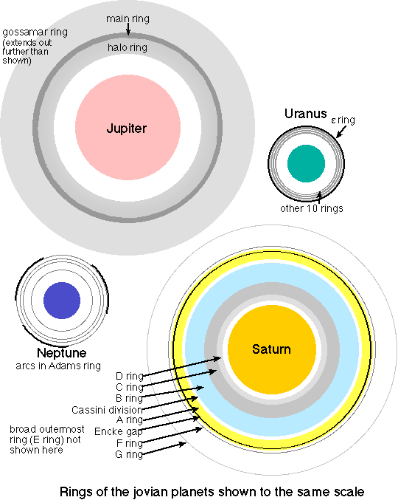
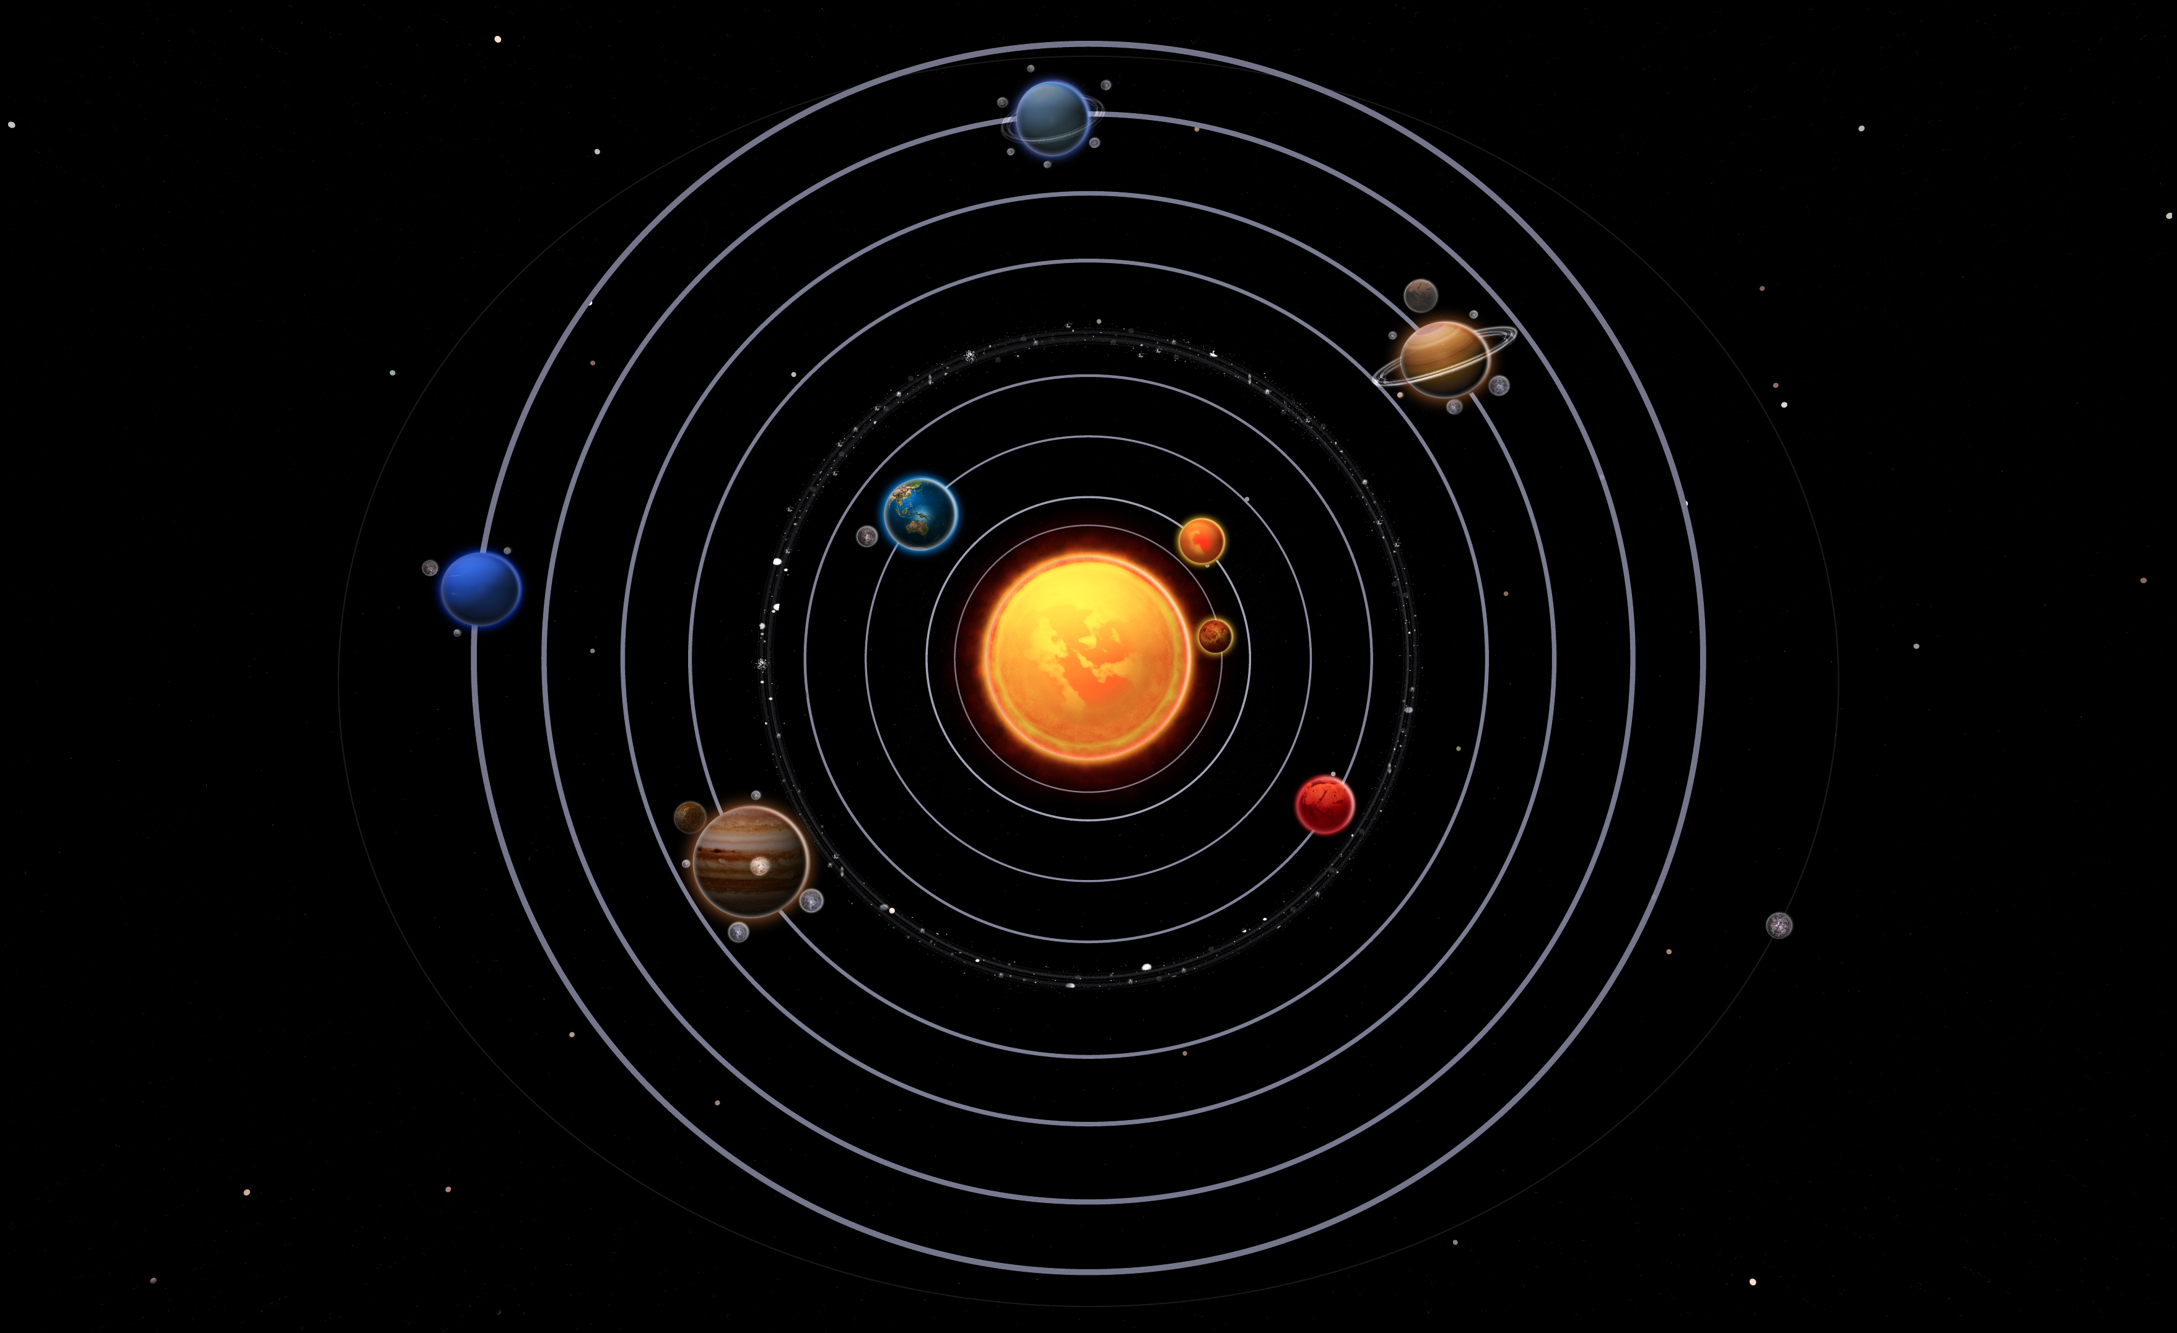
Solar System
The planets in our solar system orbit the sun.
How many planets are in the solar system? 8
How many planets have rings? 5
How many planets have moons? 6

Slide 3
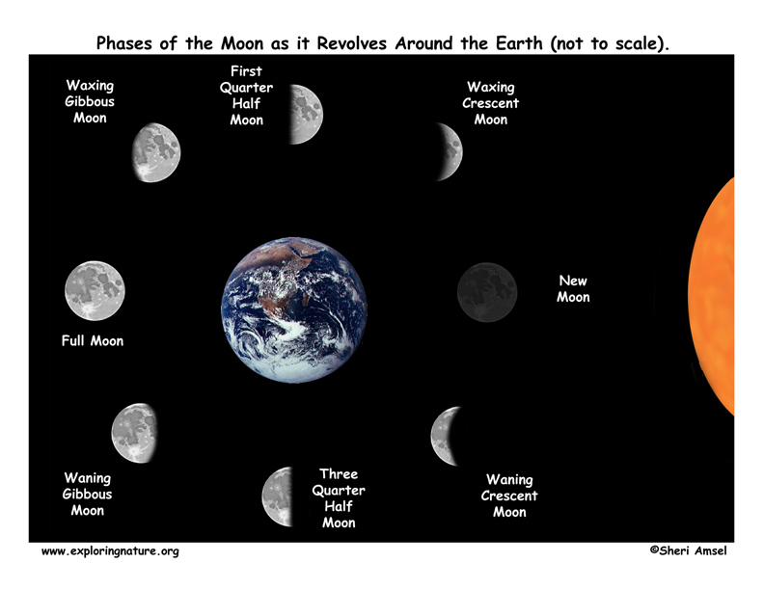
Solar System
How many days does it take to go around the Earth? 27.3 = 28

Slide 4
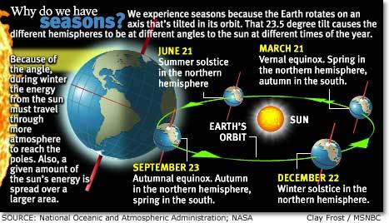
Solar System
How many days does it take to go around the sun? 365 days or 1 year
How long does it take for Earth to rotate around once? 24 hrs. or 1 day
What causes Earth’s seasons? Earth’s tilt

Slide 5
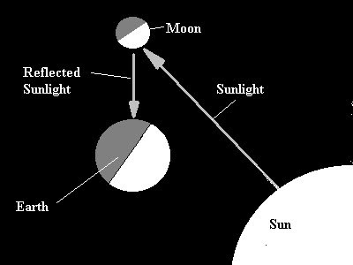
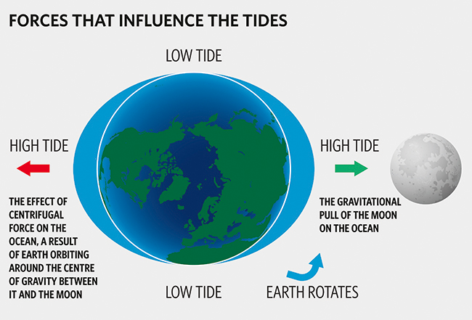
Solar System
Does the moon produce or reflect light? Reflect
The moon affects Earth’s ocean tides.

Slide 6
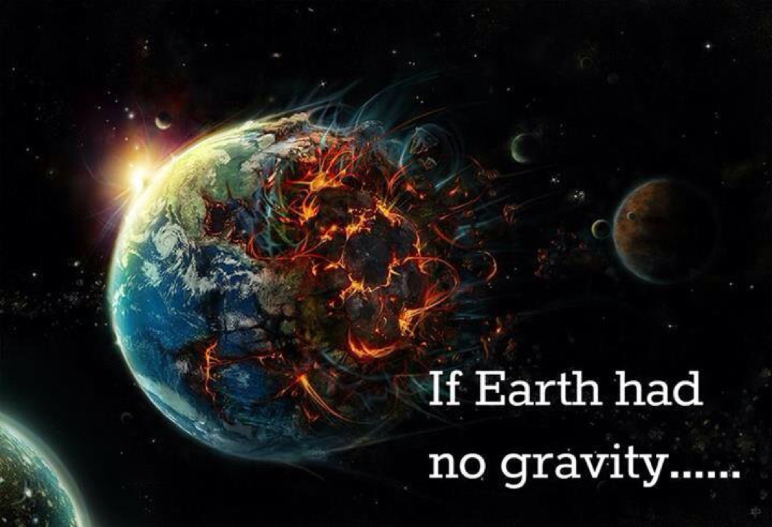
Solar System
If Earth had no gravity:
- All living things would die
- We would all float into out space
- Everything would be pulled into space

Slide 7
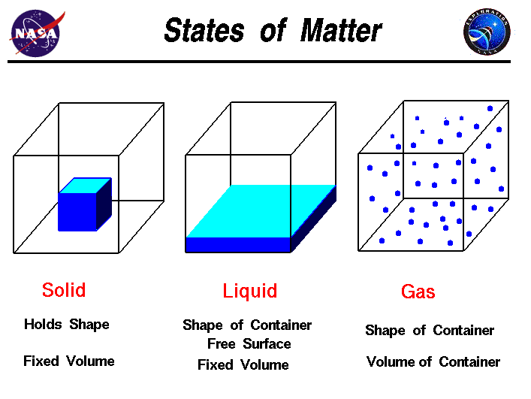
States of Matter
What are the three states of matter and examples of each?
What is the name of the phase change from a solid to a gas? Evaporation
Possible examples could be:
Solid- Ice, table, chair , etc.
Liquid- water, juice, etc.
Gas- water vapor, oxygen, etc

Slide 8
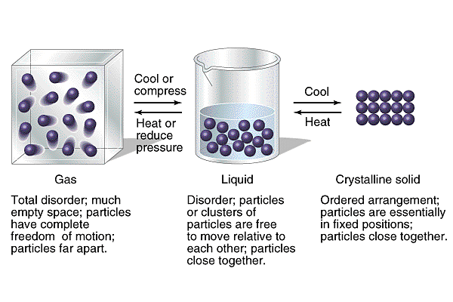
States of Matter
What substance transfers from one stat of matter to another easily? Water
A solid must be heated to turn to a liquid
A liquid must be cooled to turn into a solid.

Slide 9
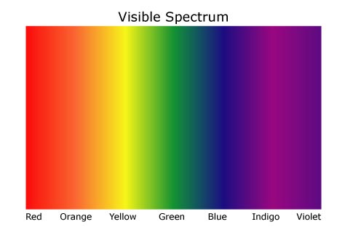
Light
List the colors in the visible color spectrum in order.
Red, Orange, Yellow, Green, Blue, Indigo and Violet
(ROY G BIV)

Slide 10
Light
What happens when a large amount of light energy is being absorbed?
Turns to heat

Slide 11
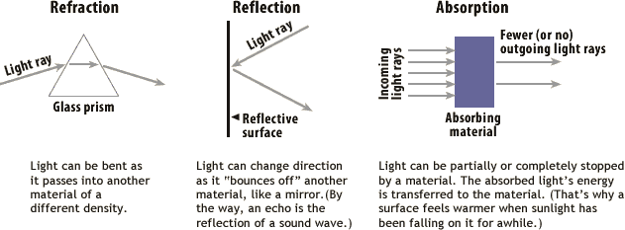
Light
Why are some colors brighter than others because more light energy is being? Reflected
What three things happen to light when it strikes an object? 1. Reflect 2. Refract (Redirect) 3. Absorb

Slide 12
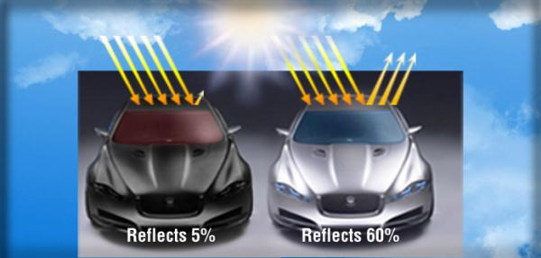
Light
Why is a black road hot to walk barefoot on sunny summer day? Because the color black absorbs all the light spectrum colors (turning all into heat energy)
Why isn’t a white cement sidewalk as hot? Because the color white reflects all colors of light

Slide 13
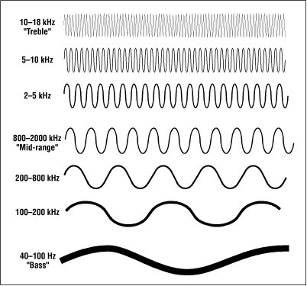
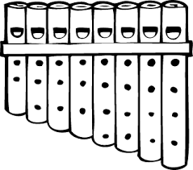
Sound
What allows some substances to make quieter sound vibrations than the others?
A. They absorb the energy
When your breath moves through the straws from the left to the right The pitch changes from low to high.
What is responsible for this change? Length of the straws

Slide 14
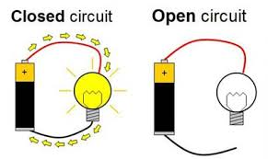
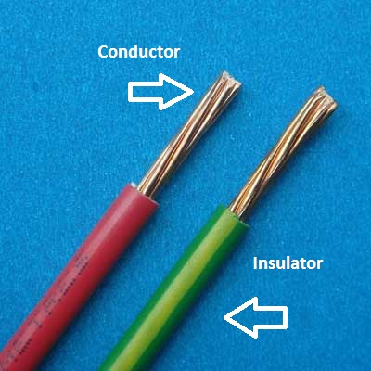
Magnets and Electricity
Pictures of :
What type of material
should be used to connect
to the two sides of a switch?
Conductors (Metal)

Slide 15
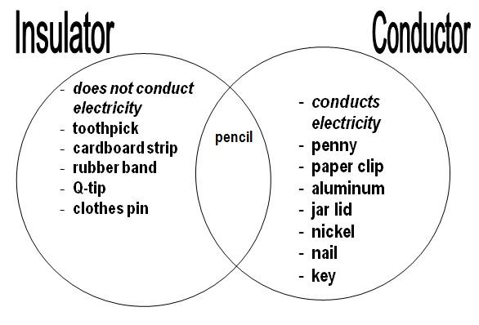
Magnets and Electricity
List three objects in your home that are insulators and three objects that are conductors.
Insulator: Conductor:
Toothbrush Metal Spoon
Oven mitt Baking Sheet
Plastic Spoon Pan
Name the four types of energy that can come from electricity:
Mechanical (Movement)
Sound
Light
Heat

Slide 16
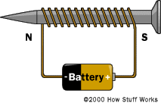
Magnets and Electrcity
This is called an electromagnet.
If you had more coils or more batteries (volts) it will pick up more metal objects.

Slide 17
Motion and Forces
What two advantages can you get from a lever?
Less work or effort is required
Can move objects farther distance
As you move the fulcrum closer to the load it requires less force

Slide 18
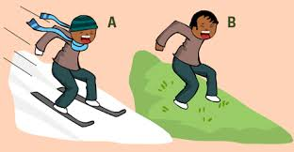
Motion and Forces
List the motion and forces shown for both A and B
Gravity
Friction
Momentum (Mass or Acceleration)
Inertia or Speed
Compare the motion/speed of A and B above:
A will move faster because the snow and skies have less friction
B will move slower because the grass will create more friction.

Slide 19
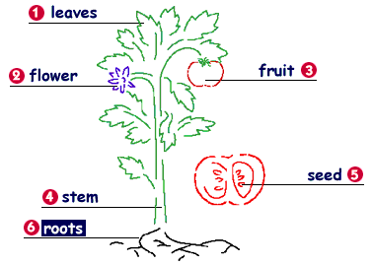
Plants
What is the initial source of all energy? The Sun
Which part of the plant is responsible for making seeds?
The flower
What are three forms of seed dispersal?
Animals
Wind
Water

Slide 20
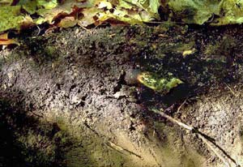
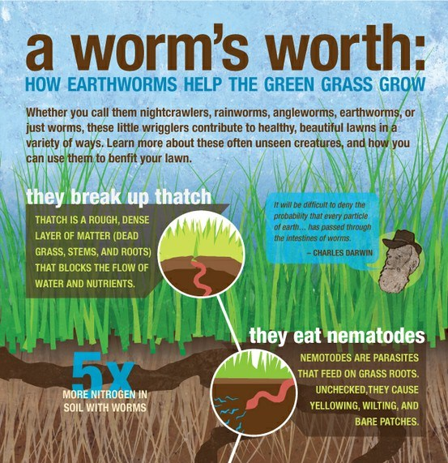
Animals
What is an example of a harmful and helpful role earthworms have in soil?
Harmful: Take nutrients away from forests ecosystems
Helpful: Create holes in the soil for gardens and crops to get air and water

Slide 21
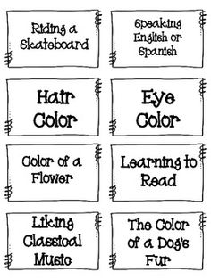
Animals
Sort the following cards to the correct type of trait they represent
Acquired Traits Inherited
Riding a Skateboard 1. Hair Color
Speaking English or Spanish 2. Eye Color
Learning to Read 3. Flower Color
Liking Classical Music 4. Dogs Fur Color

Slide 22
Animals
Producer | Consumer | Decomposer
Corn | Crow Fly | Fungi
Grass | Deer Bear | Mushroom
Trees | Cow | Worm
 | Wolf | Bacteria
 | Spider
 | Frog

Slide 23
Animals
Herbivore | Carnivore | Omnivore | Scavenger
Deer | Frog Spider | Bear | Crow
Cow | Wolf
 | Fly

Slide 24
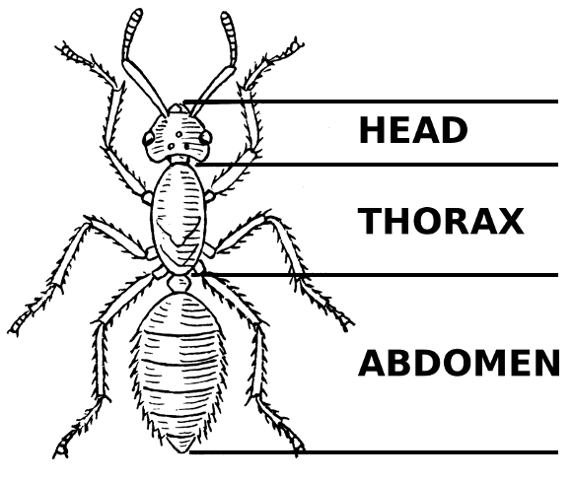
Animals
What is an exoskeleton? Skeleton (bone/shell) covering on the outside of the body.

Slide 25
Testable Questions
1. How does temperature affect the mealworm life cycle?
2. How does the type of soda affect the amount of gas inside?
3. How does putting the balloon under water determine the volume? Putting the balloon in a graduated cylinder takes up space and moves the water to show how much space it takes up.
4. How does shoe type affect how fast you run?
Claim: Cleats will allow you to run faster than crocks or tennis shoes.
Evidence: The average showed cleats only took 35 seconds to run whereas the tennis shoes took 43 seconds and crocks too 63 seconds.

Slide 26
Measurement
Is 20 cm of a rain a lot? Explain how you know.
Yes, 20 cm is about 4 inches of rain! This could cause a flood conditions in many places.
How many cm is on a ruler? About 31 cm
What is the metric measurement of temperature?
Celsius
Does our mass or weight change if we go to the moon?
Weight because weight is how our mass plus the pull of gravity. Mass is just how much space our body takes up this will not change on the moon.

Slide 27
Earth
Which Tool…
Measures the wind speed: Anemometer
Measures the amount of water: Rain Gauge
Measures the temperature: Thermometer
Shows wind direction: Weather Vane
Shows air pressure: Barometer

Slide 28
Earth
Renewable | Non-Renewable
Solar | Coal
Wind | Natural Gas
Geothermal – Earth Heat | Nuclear
Hydro- Water | Fossil Fuel Oil

Slide 29
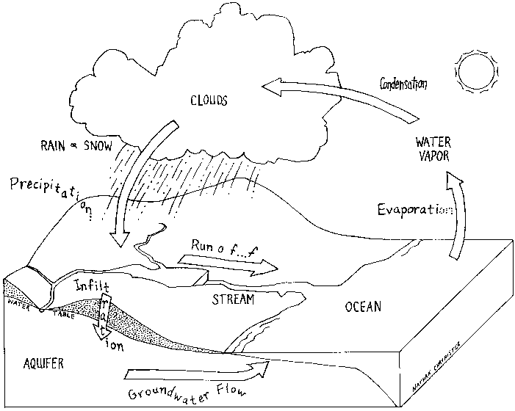
Earth

