Slide 1
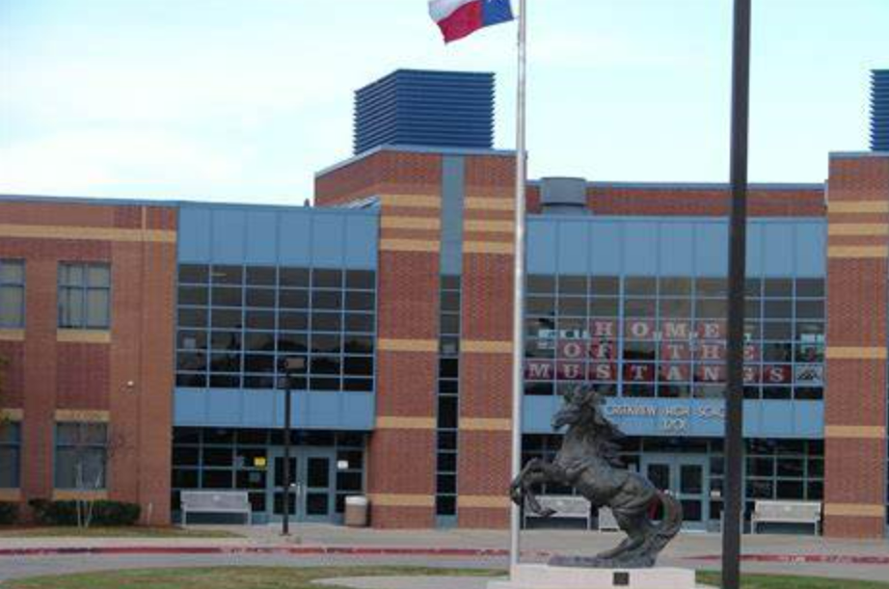
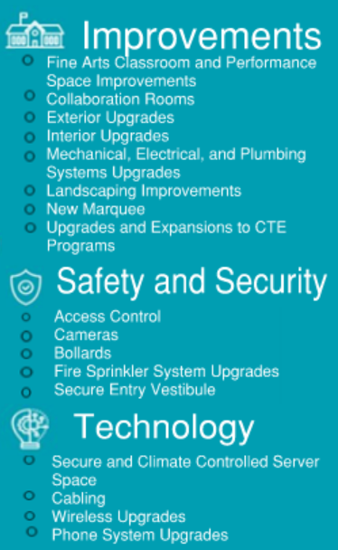
CREEKVIEW HIGH SCHOOL
cfbbond.com

Slide 2
Improvements
Fine Arts Classroom and Performance Space Improvements
Upgrades to the Auditorium
Collaboration Rooms
Upgrades in CTE Spaces to Include Collaboration Spaces
Exterior Upgrades
Roof Replacement/Repair
Parking Lot Striping
Interior Upgrades
Library Renovation
Mechanical, Electrical, and Plumbing Systems Upgrades
New LED Site Lighting and Controls
Conversion to VRF System
RTU Replacement
Water Bottle Fillers
Landscape Improvements
Exterior Concrete Replacement
Marquee – Existing Digital Marquee
Upgrades and Expansions to CTE Programs
JROTC
Law Academy
Auto Technology
Access Control
Intercom
Card Readers
Security Alarm
Cameras
Bollards
Fire Sprinkler System Upgrades
Secure Entry Vestibule
Secure Climate Controlled Server Space
Cabling
Wireless Upgrades
Phone System Upgrades
PROMISES MADE
PROMISES KEPT
PROMISES MADE
PROMISES KEPT

Slide 3
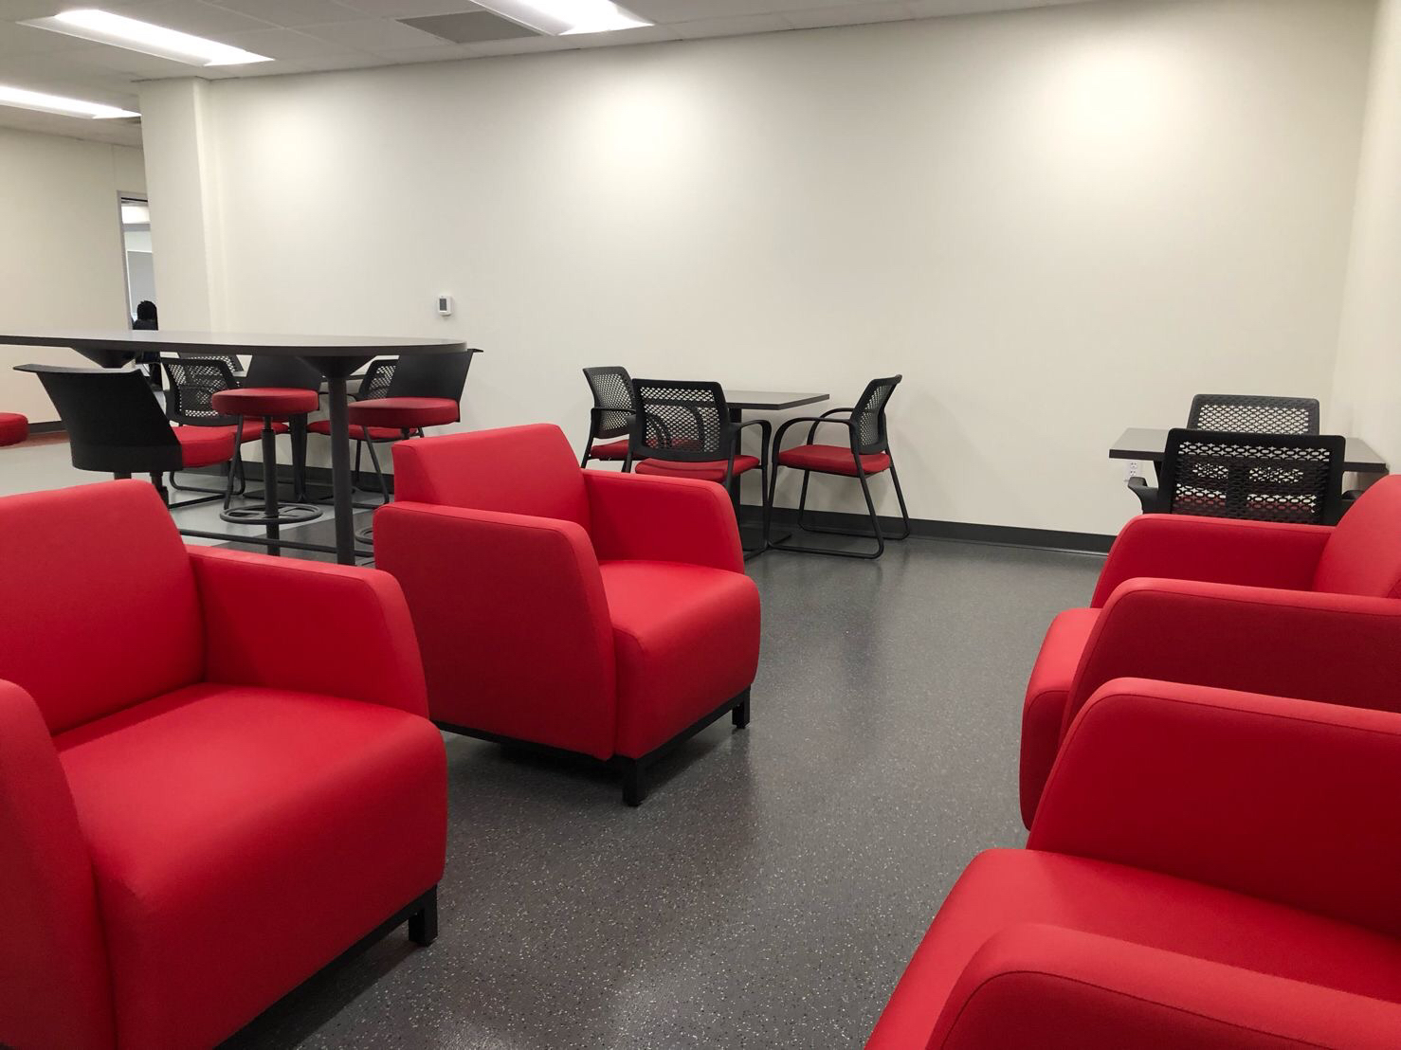
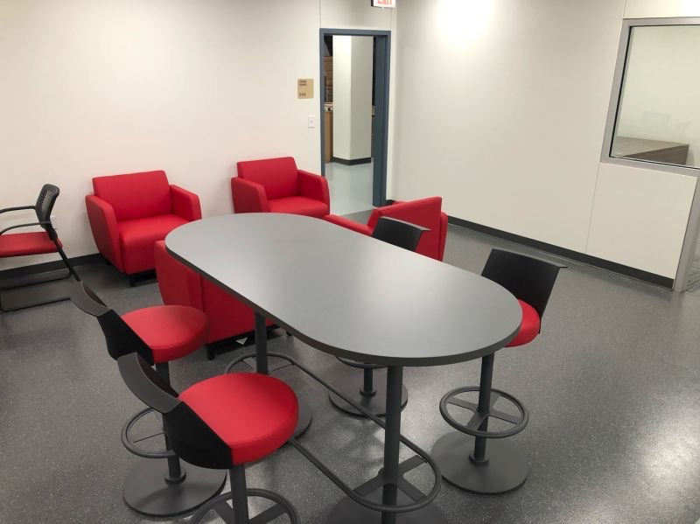
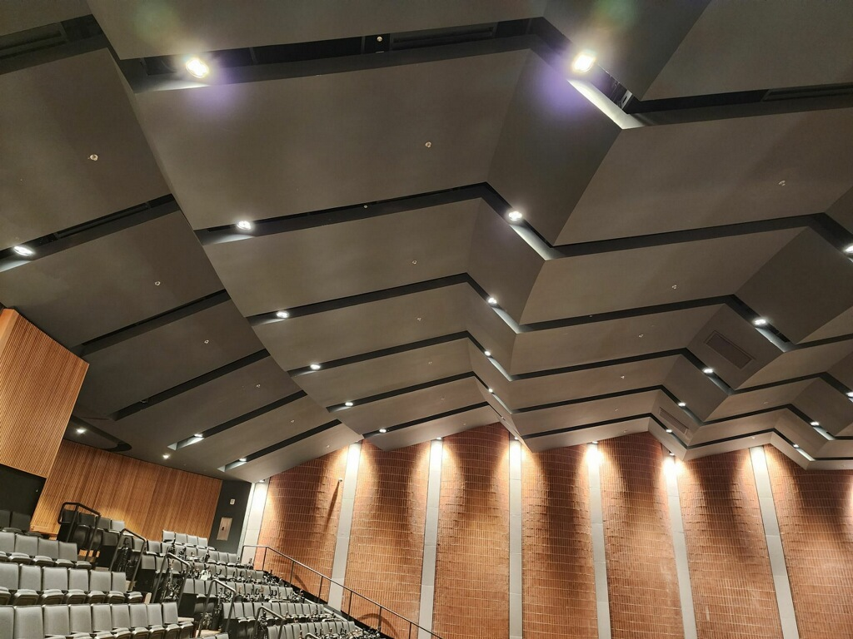
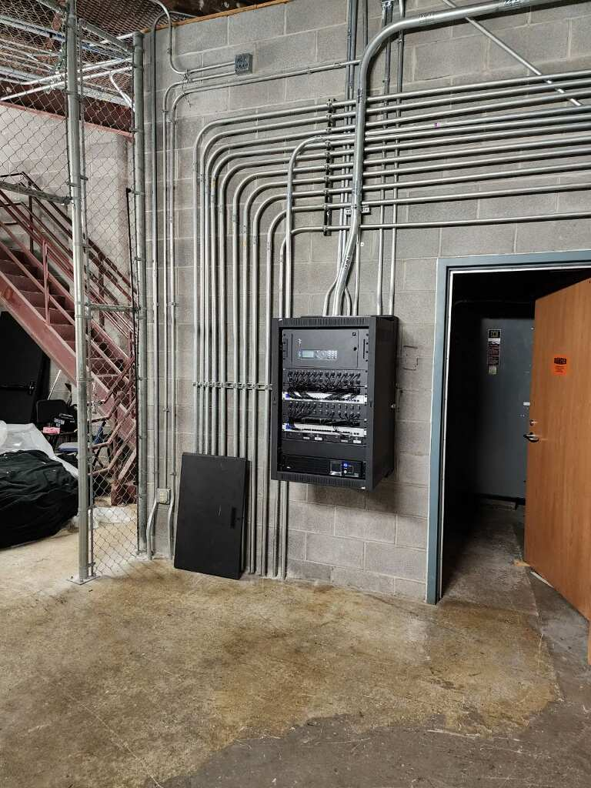
Improvements
Fine Arts Classroom and Performance Space Improvements
Upgrades to the Auditorium
Collaboration Rooms
Upgrades in CTE Spaces to Include Collaboration Spaces
Exterior Upgrades
Roof Replacement/Repair
Parking Lot Striping
Interior Upgrades
Library Renovation
Mechanical, Electrical, and Plumbing Systems Upgrades
New LED Site Lighting and Controls
Conversion to VRF System
RTU Replacement
Water Bottle Fillers
Landscape Improvements
Exterior Concrete Replacement
Marquee
Upgrades and Expansions to CTE Programs
JROTC
Law Academy
Auto Technology
Collaboration Spaces
Collaboration Spaces
PROMISES MADE
PROMISES KEPT
Auditorium House Lighting
Lighting Control Panel

Slide 4
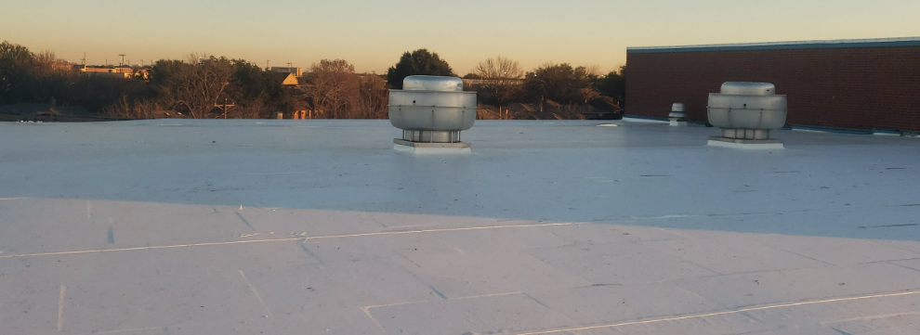
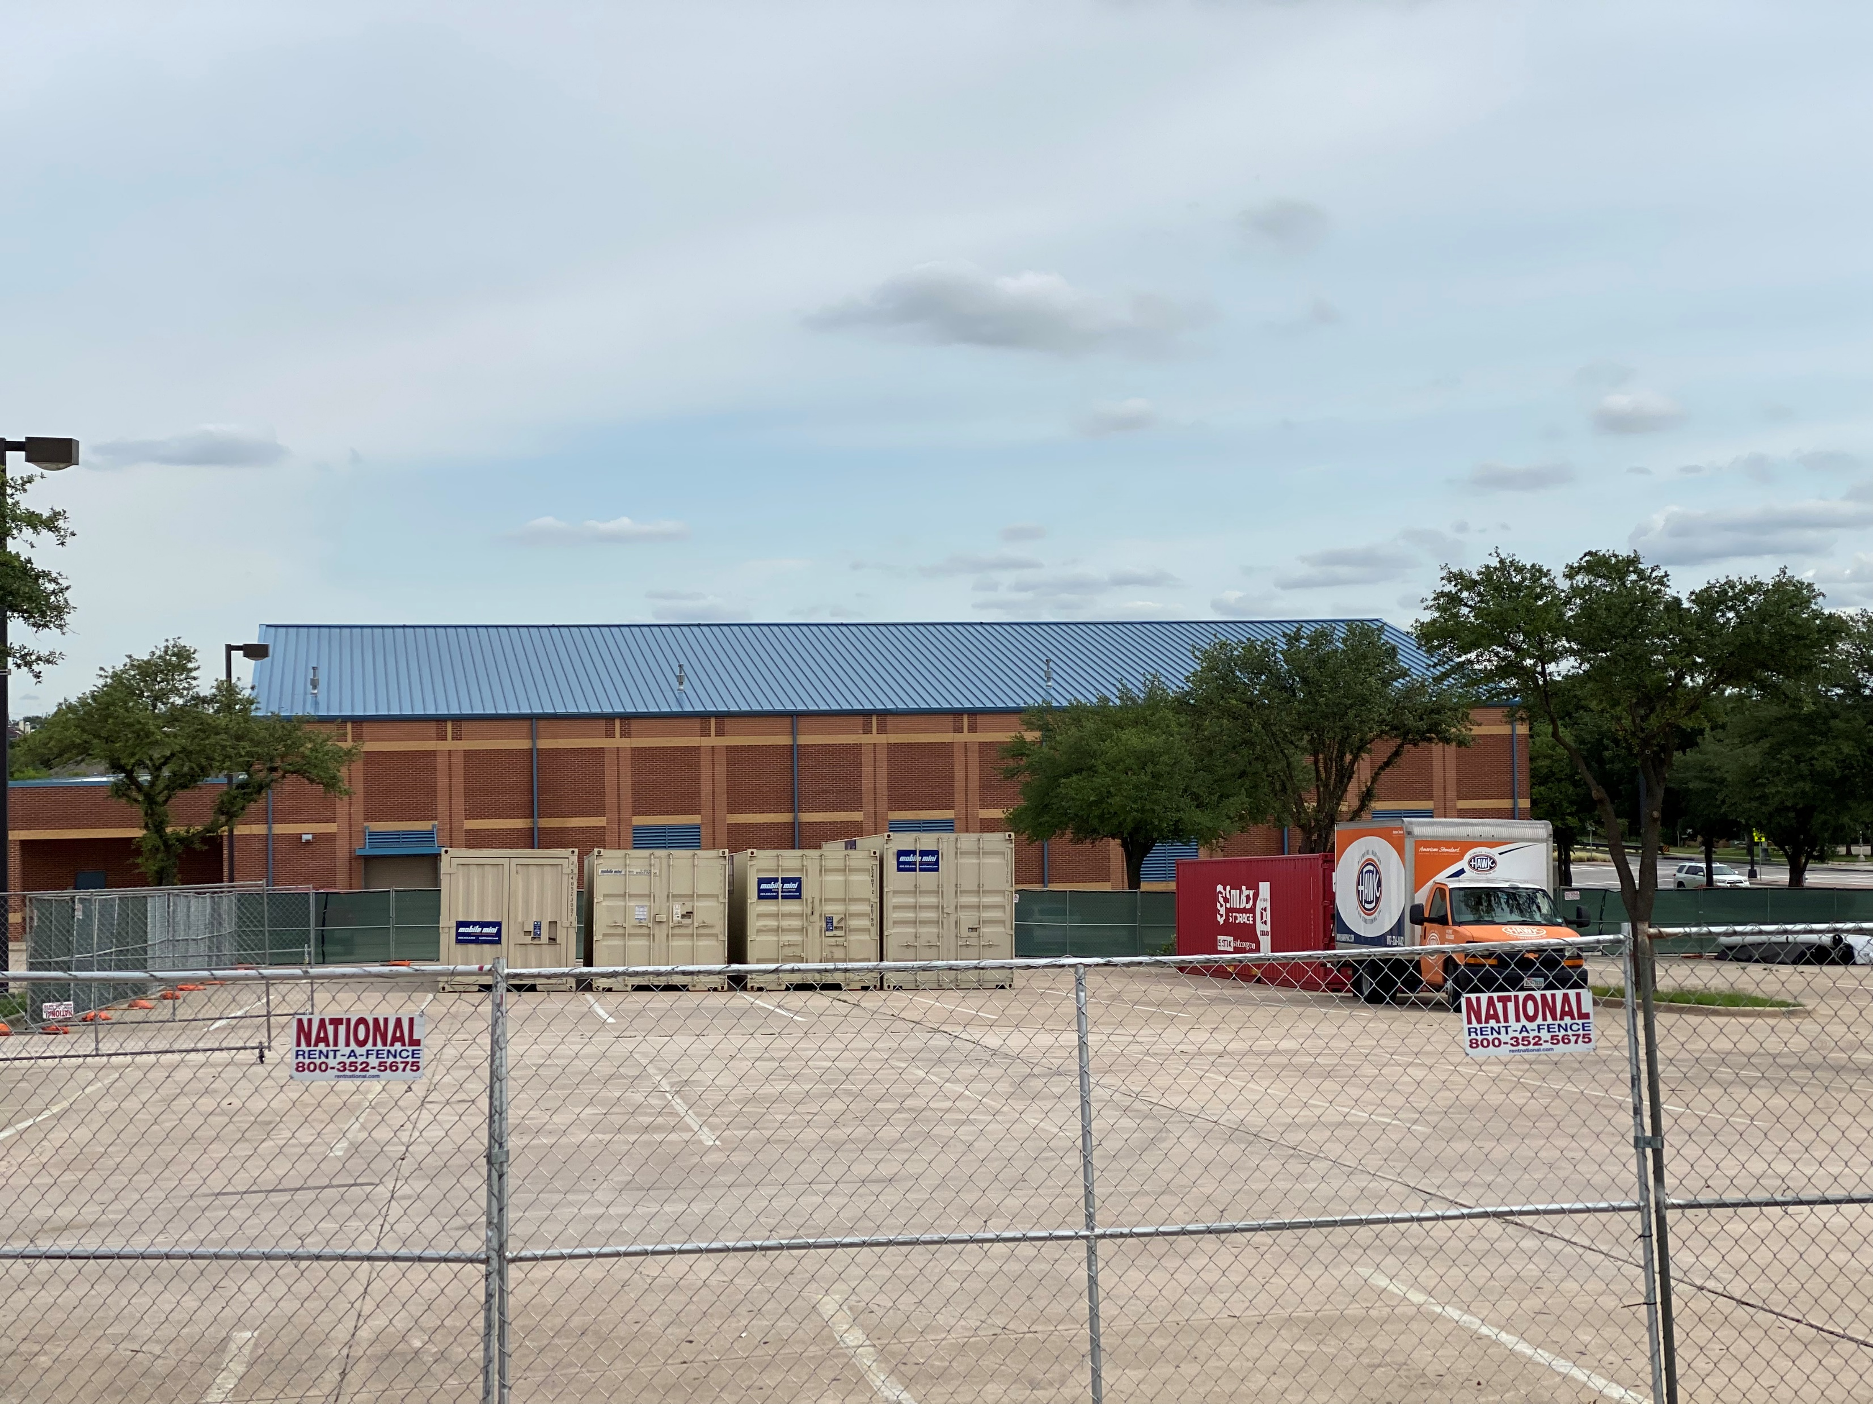
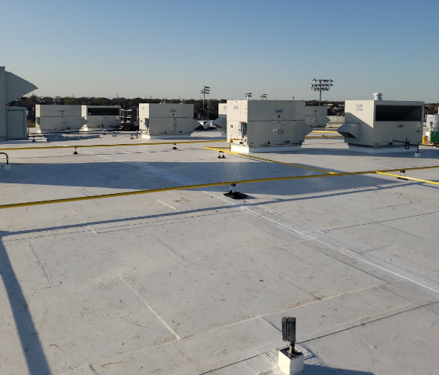
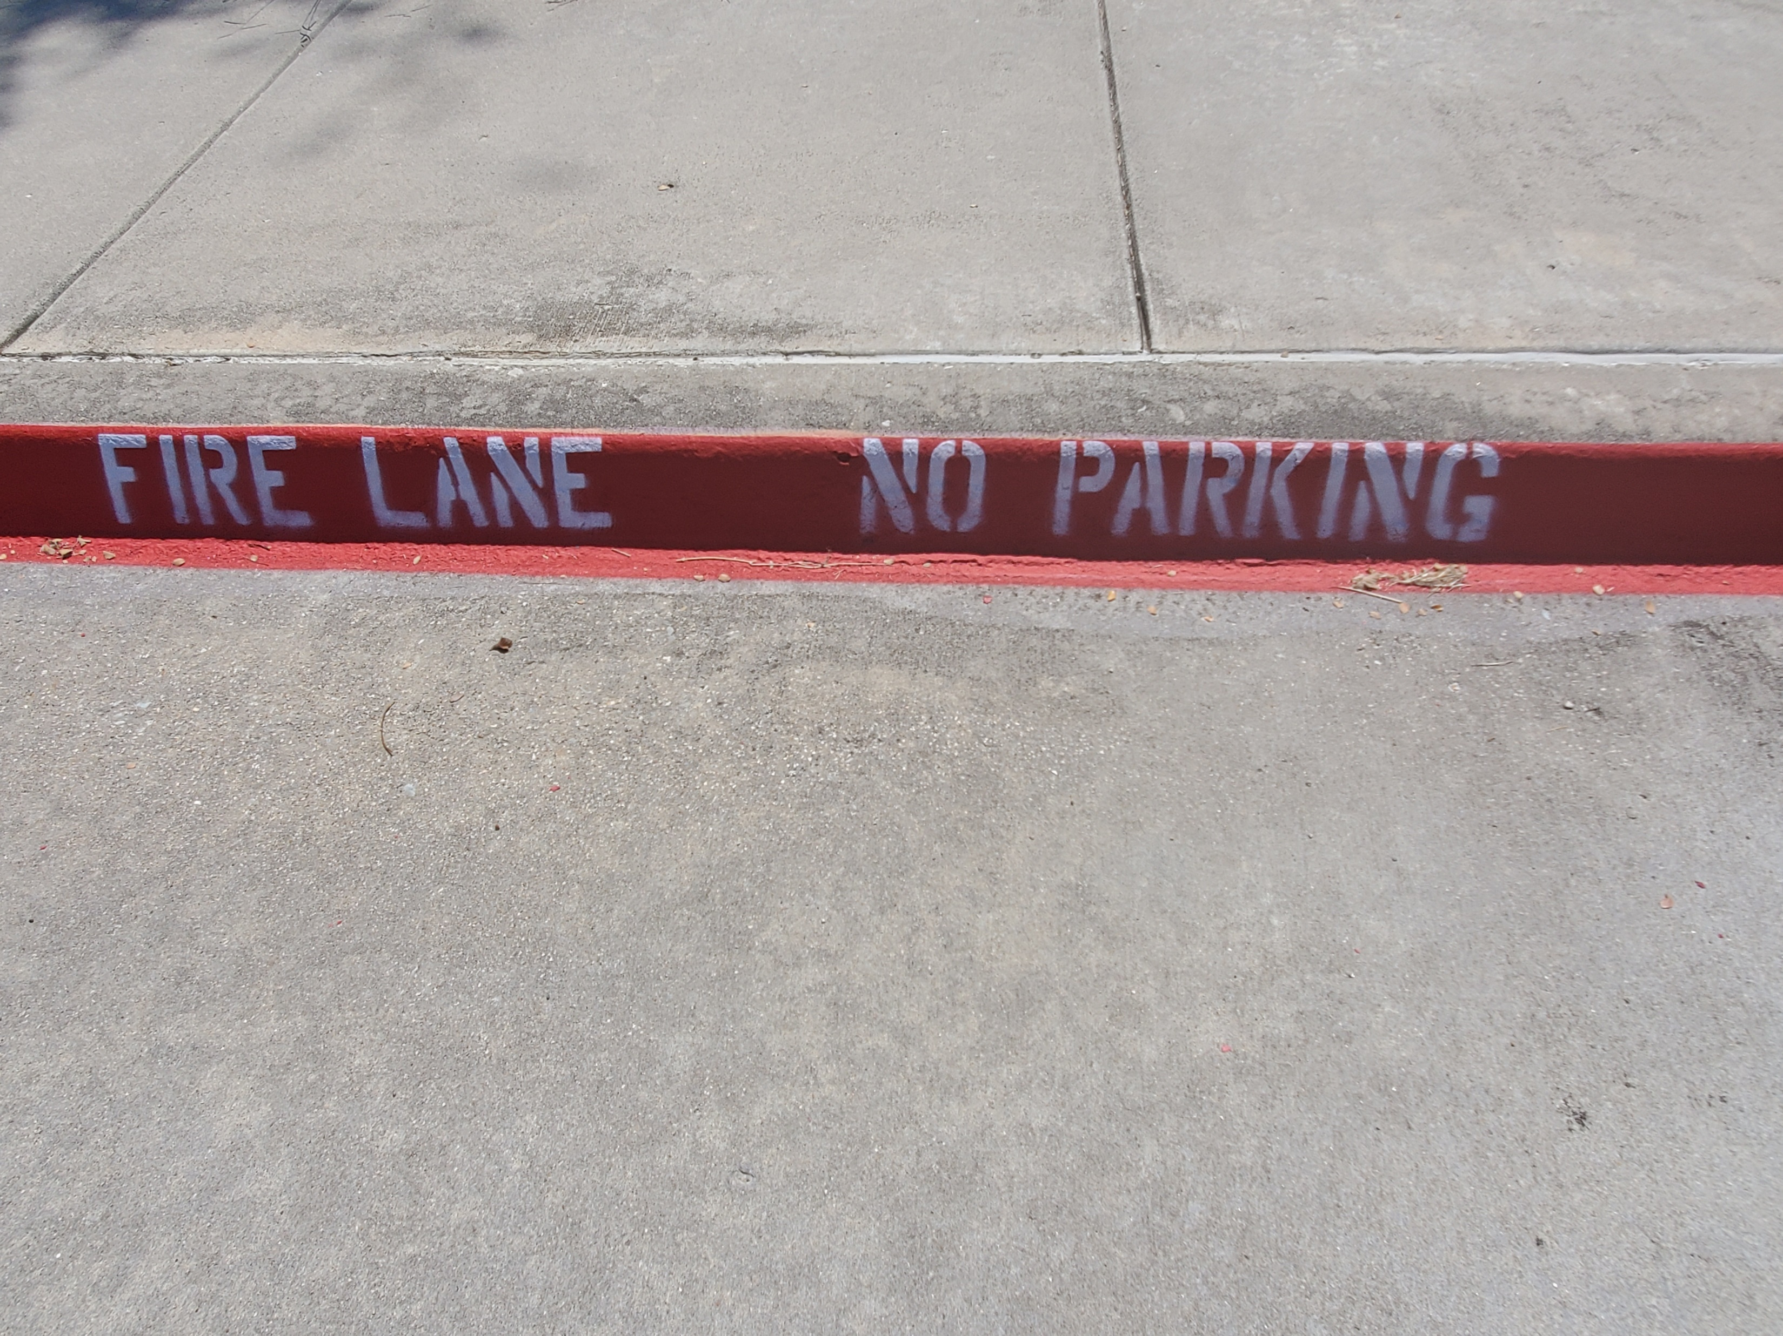
Improvements
Fine Arts Classroom and Performance Space Improvements
Upgrades to the Auditorium
Collaboration Rooms
Upgrades in CTE Spaces to Include Collaboration Spaces
Exterior Upgrades
Roof Replacement/Repair
Parking Lot Striping
Interior Upgrades
Library Renovation
Mechanical, Electrical, and Plumbing Systems Upgrades
New LED Site Lighting and Controls
Conversion to VRF System
RTU Replacement
Water Bottle Fillers
Landscape Improvements
Exterior Concrete Replacement
Marquee
Upgrades and Expansions to CTE Programs
JROTC
Law Academy
Auto Technology
Roof Replacement
Newly Painted Roof
PROMISES MADE
PROMISES KEPT
Roof Replacement
Parking Lot Restriping

Slide 5
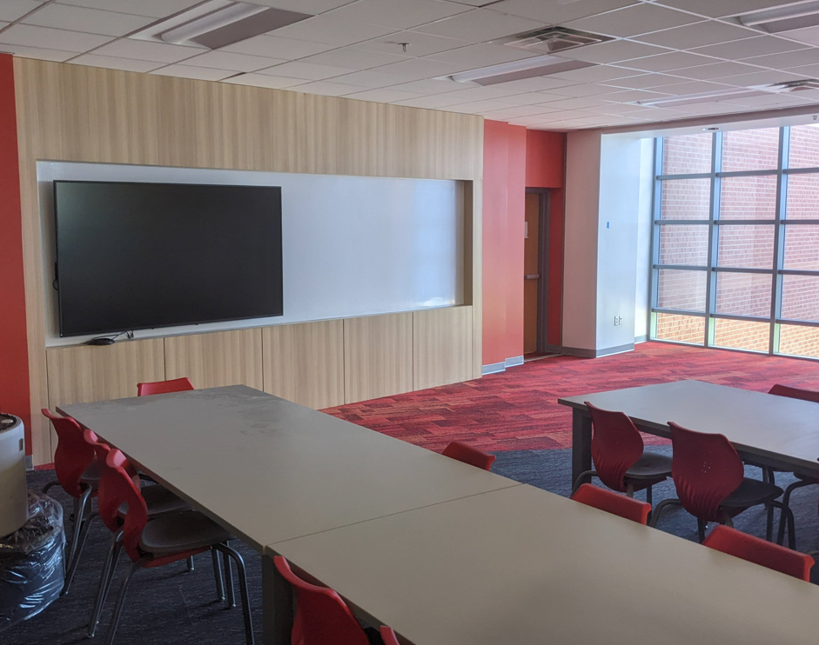
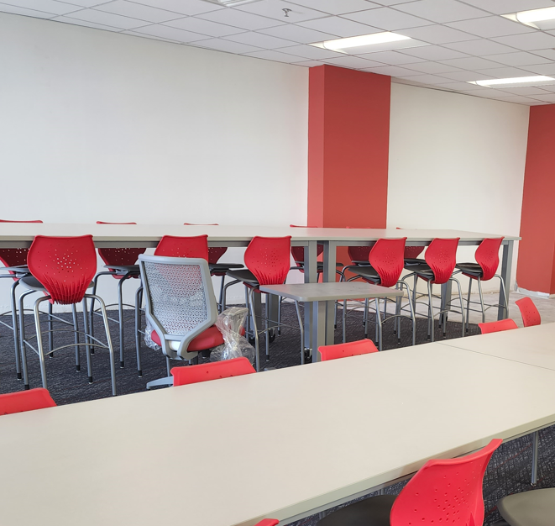
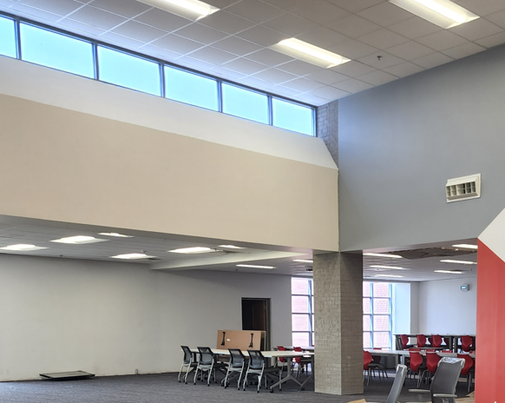
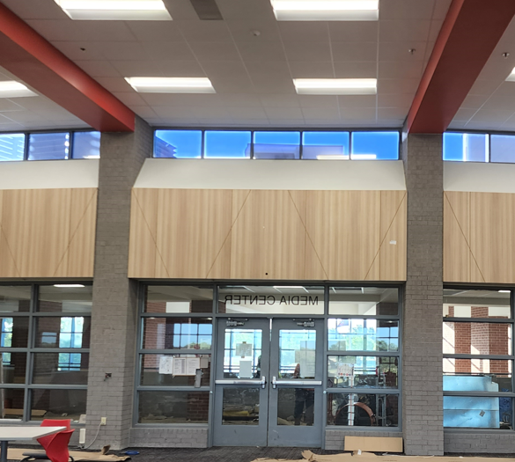
Improvements
Fine Arts Classroom and Performance Space Improvements
Upgrades to the Auditorium
Collaboration Rooms
Upgrades in CTE Spaces to Include Collaboration Spaces
Exterior Upgrades
Exterior Concrete Replacement
Roof Replacement/Repair
Parking Lot Striping
Interior Upgrades
Library Renovation
Mechanical, Electrical, and Plumbing Systems Upgrades
New LED Site Lighting and Controls
Conversion to VRF System
RTU Replacement
Water Bottle Fillers
Landscape Improvements
Exterior Benches
Marquee
Upgrades and Expansions to CTE Programs
JROTC
Law Academy
Auto Technology
PROMISES MADE
PROMISES KEPT

Slide 6
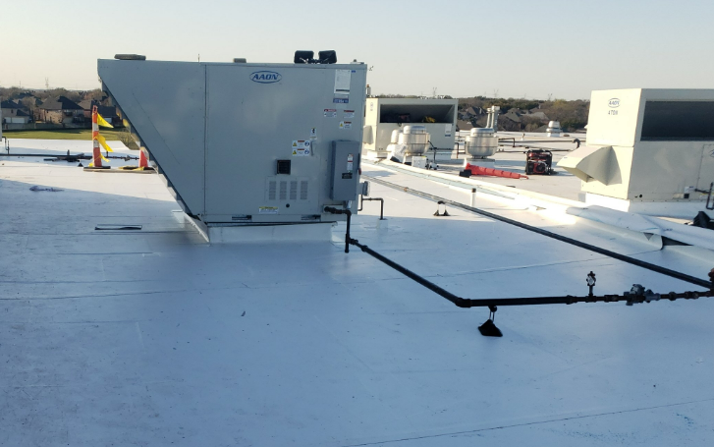
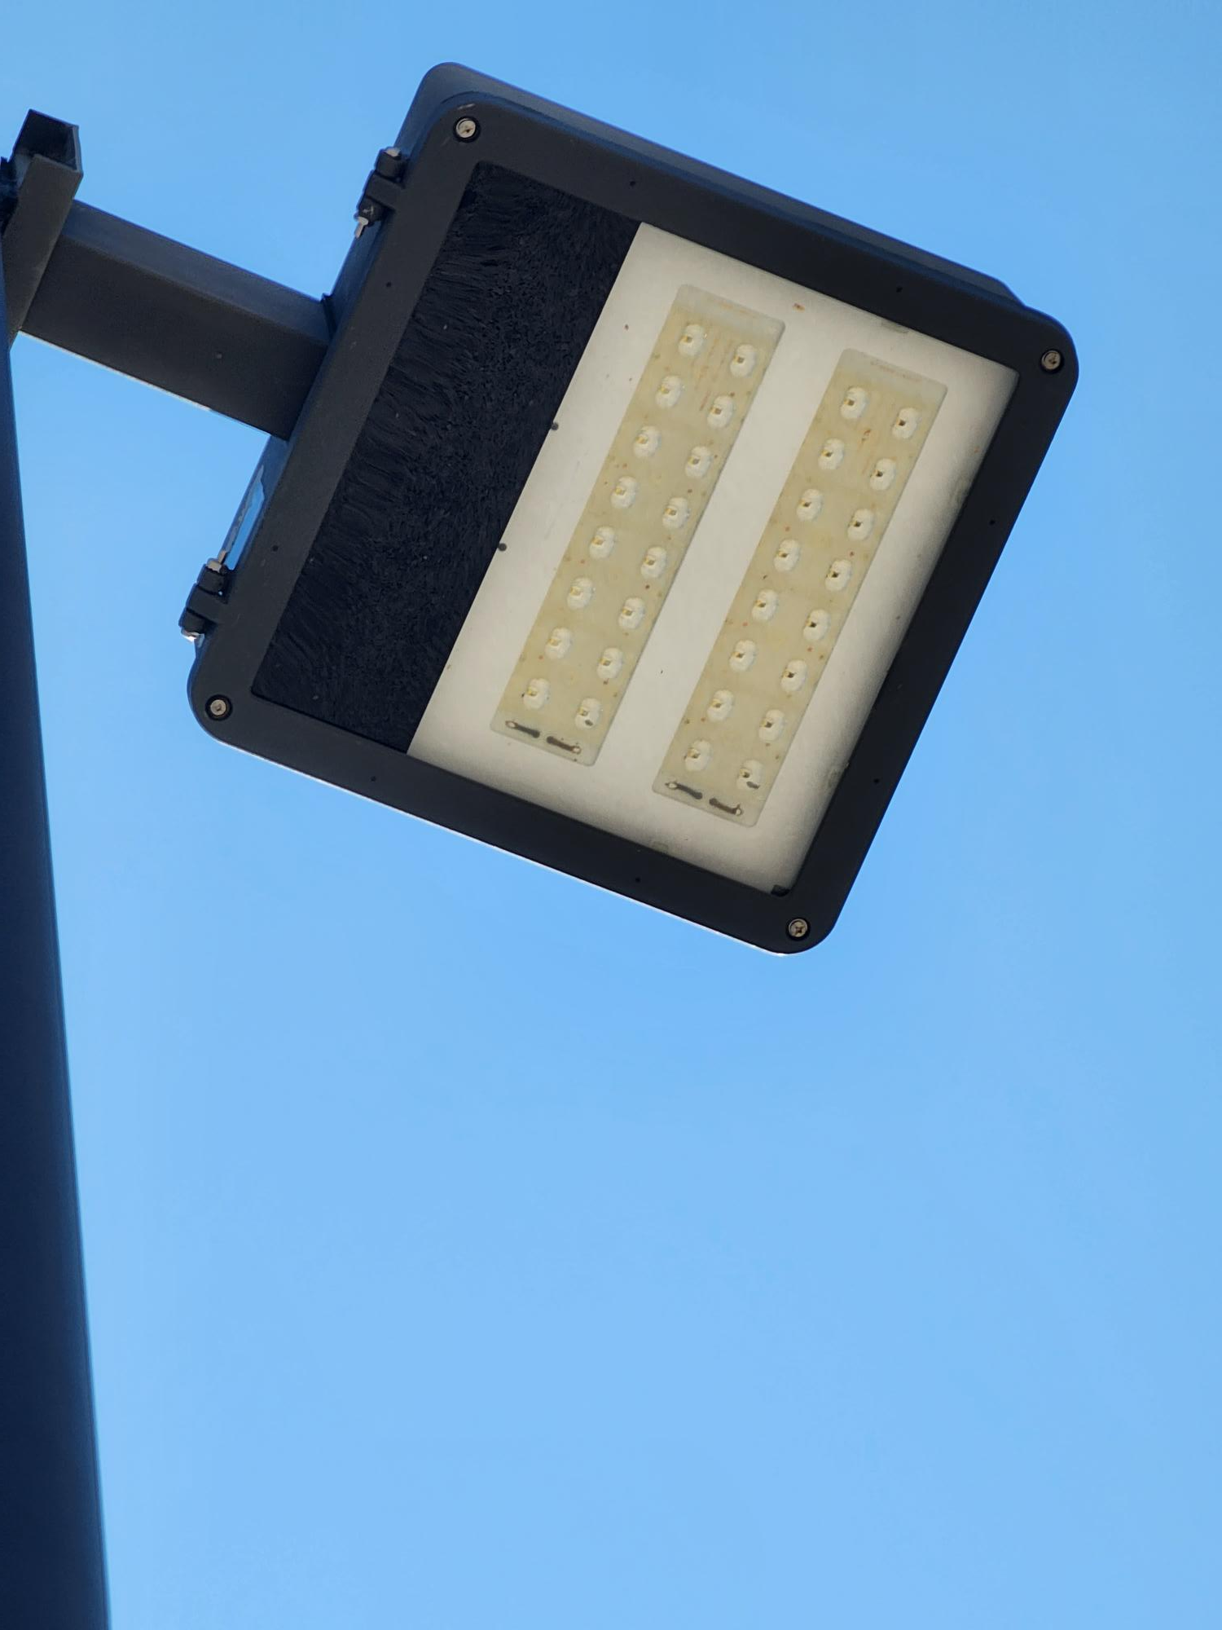
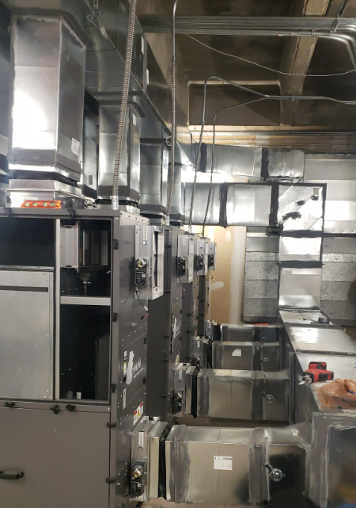
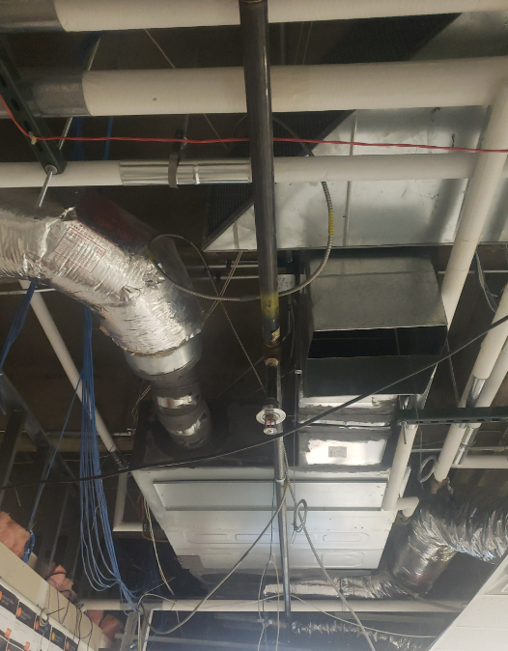
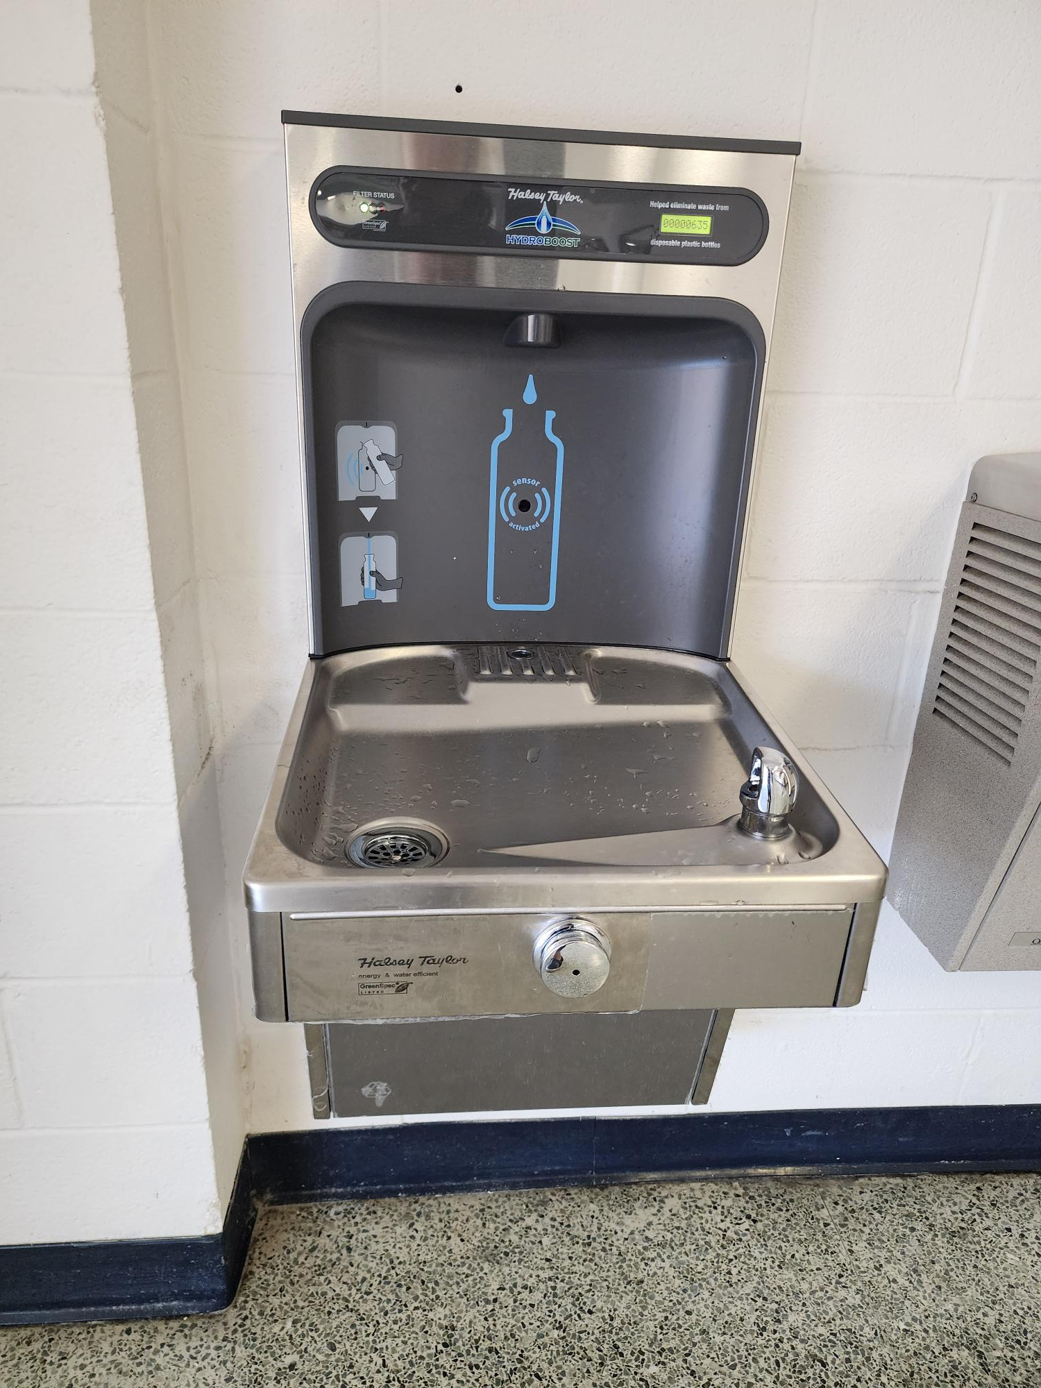
Improvements
Fine Arts Classroom and Performance Space Improvements
Upgrades to the Auditorium
Collaboration Rooms
Upgrades in CTE Spaces to Include Collaboration Spaces
Exterior Upgrades
Exterior Concrete Replacement
Roof Replacement/Repair
Parking Lot Striping
Interior Upgrades
Library Renovation
Mechanical, Electrical, and Plumbing Systems Upgrades
New LED Site Lighting and Controls
Conversion to VRF System
RTU Replacement
Water Bottle Fillers
Landscape Improvements
Exterior Benches
Marquee
Upgrades and Expansions to CTE Programs
JROTC
Law Academy
Auto Technology
RTU Replacement
Site Lighting
PROMISES MADE
PROMISES KEPT
Water Bottle Fillers
Scrubbers
VRF System

Slide 7
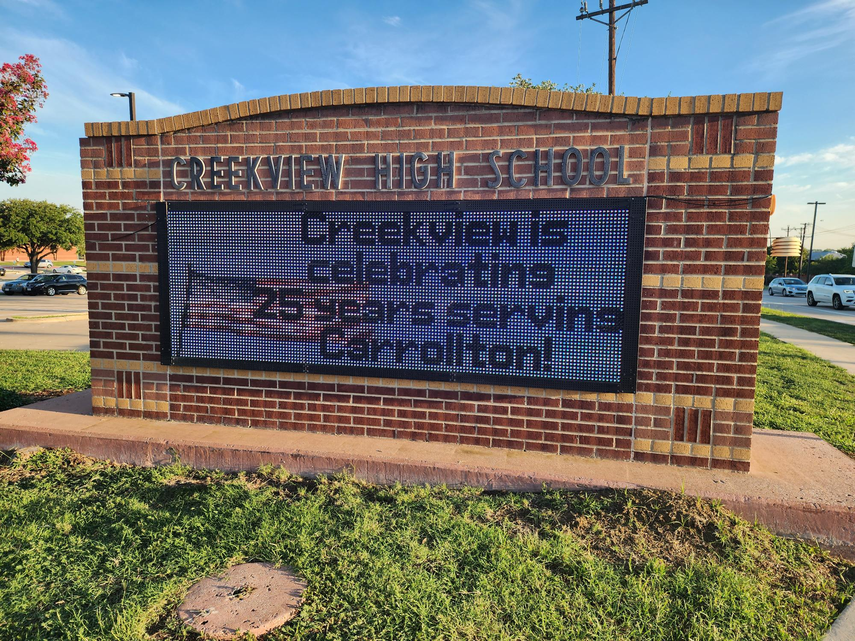
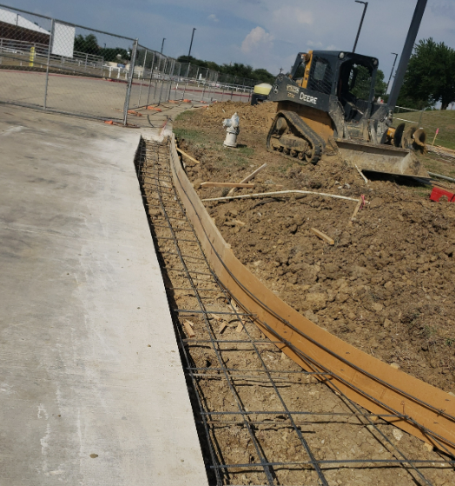
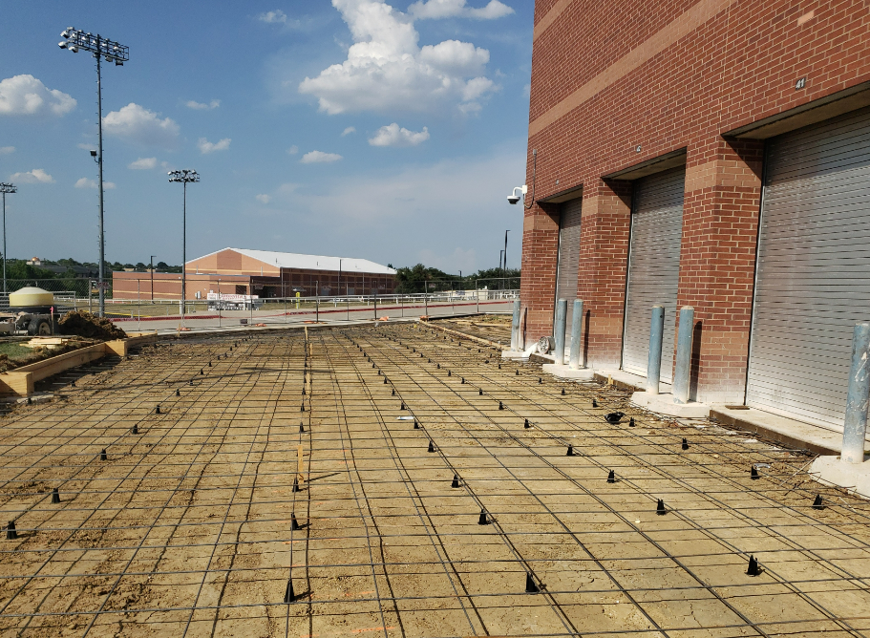
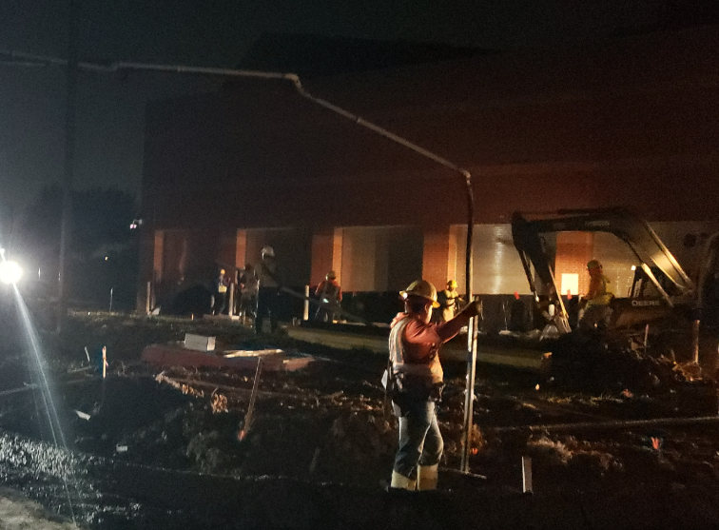
Improvements
Fine Arts Classroom and Performance Space Improvements
Upgrades to the Auditorium
Collaboration Rooms
Upgrades in CTE Spaces to Include Collaboration Spaces
Exterior Upgrades
Roof Replacement/Repair
Parking Lot Striping
Interior Upgrades
Library Renovation
Mechanical, Electrical, and Plumbing Systems Upgrades
New LED Site Lighting and Controls
Conversion to VRF System
RTU Replacement
Water Bottle Fillers
Landscape Improvements
Exterior Concrete Replacement
Marquee- Existing Digital Marquee
Upgrades and Expansions to CTE Programs
JROTC
Law Academy
Auto Technology
Exterior Concrete
Existing Digital Marquee
PROMISES MADE
PROMISES KEPT
Exterior Concrete
Exterior Concrete

Slide 8
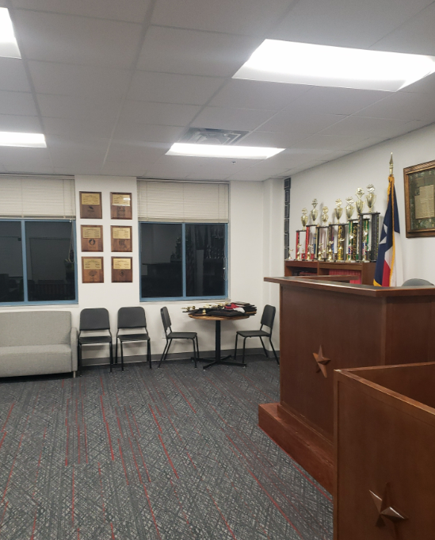
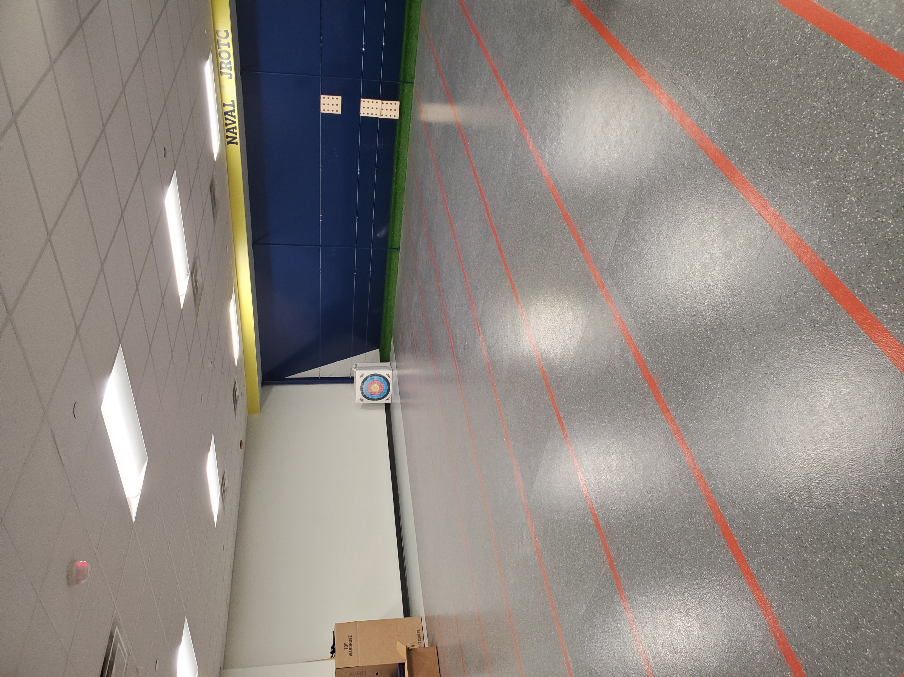
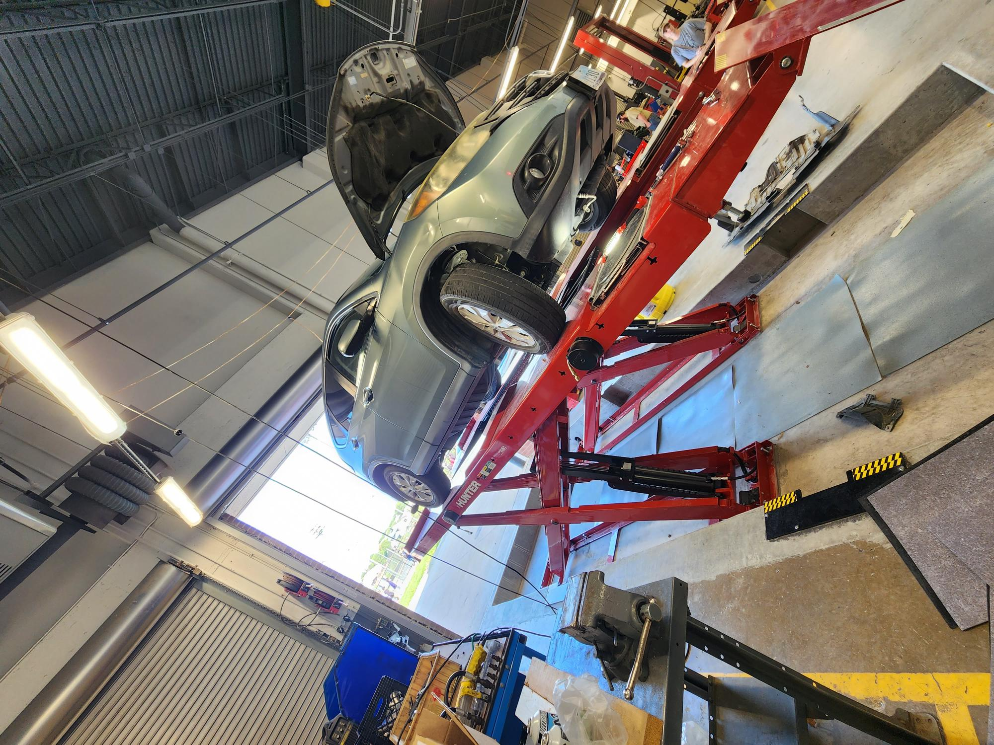
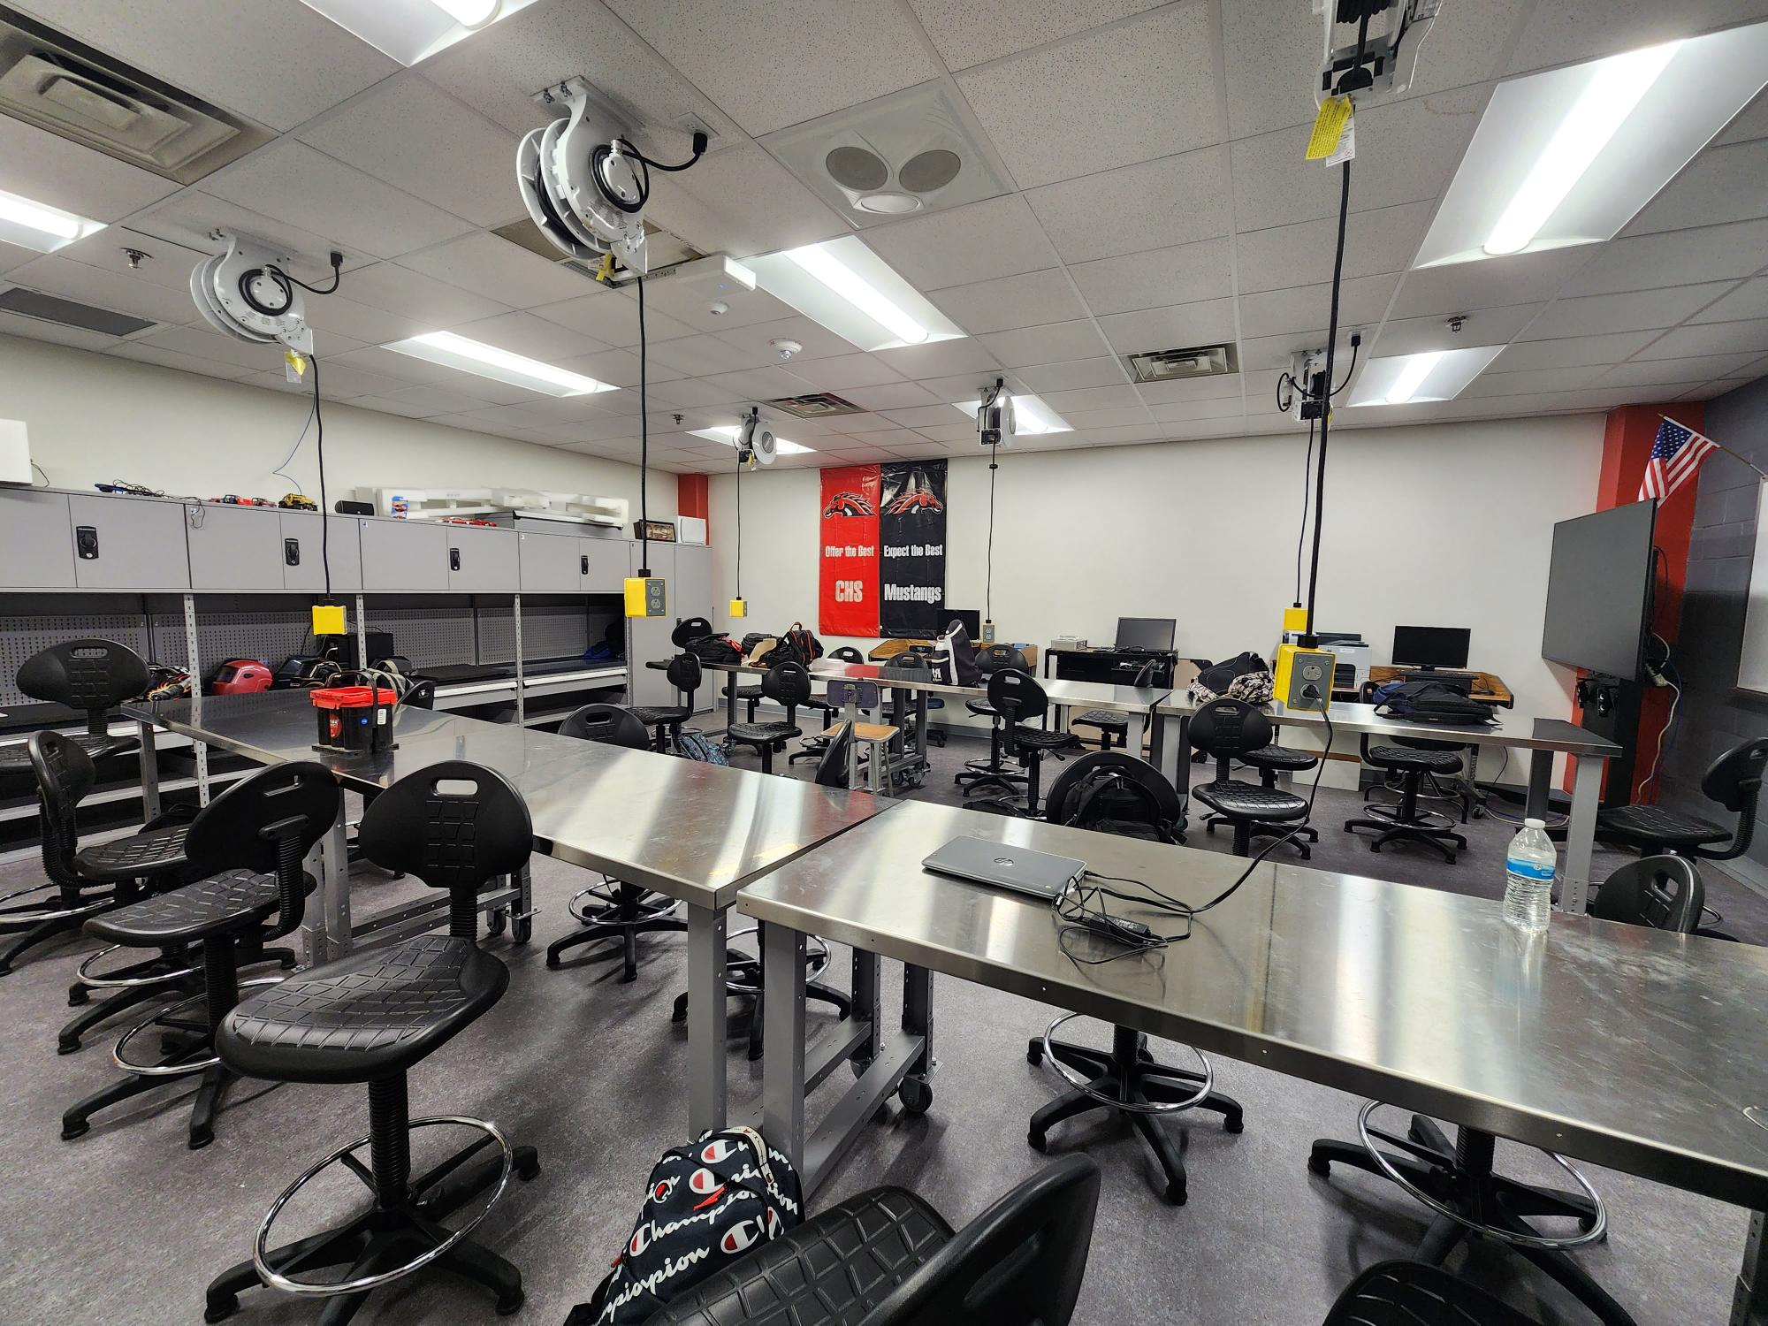
Improvements
Fine Arts Classroom and Performance Space Improvements
Upgrades to the Auditorium
Collaboration Rooms
Upgrades in CTE Spaces to Include Collaboration Spaces
Exterior Upgrades
Exterior Concrete Replacement
Roof Replacement/Repair
Parking Lot Striping
Interior Upgrades
Library Renovation
Mechanical, Electrical, and Plumbing Systems Upgrades
New LED Site Lighting and Controls
Conversion to VRF System
RTU Replacement
Water Bottle Fillers
Landscape Improvements
Exterior Benches
Marquee
Upgrades and Expansions to CTE Programs
JROTC
Law Academy
Auto Technology
Law Academy
JROTC
PROMISES MADE
PROMISES KEPT
Autoshop
Auto Tech Class

Slide 9
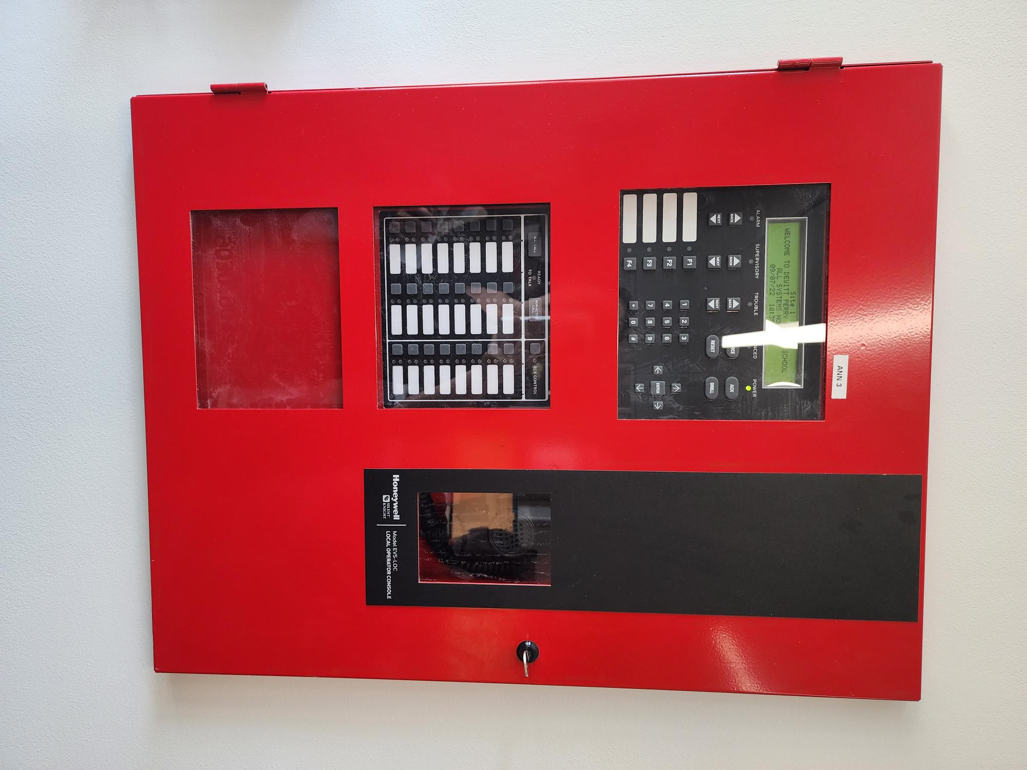
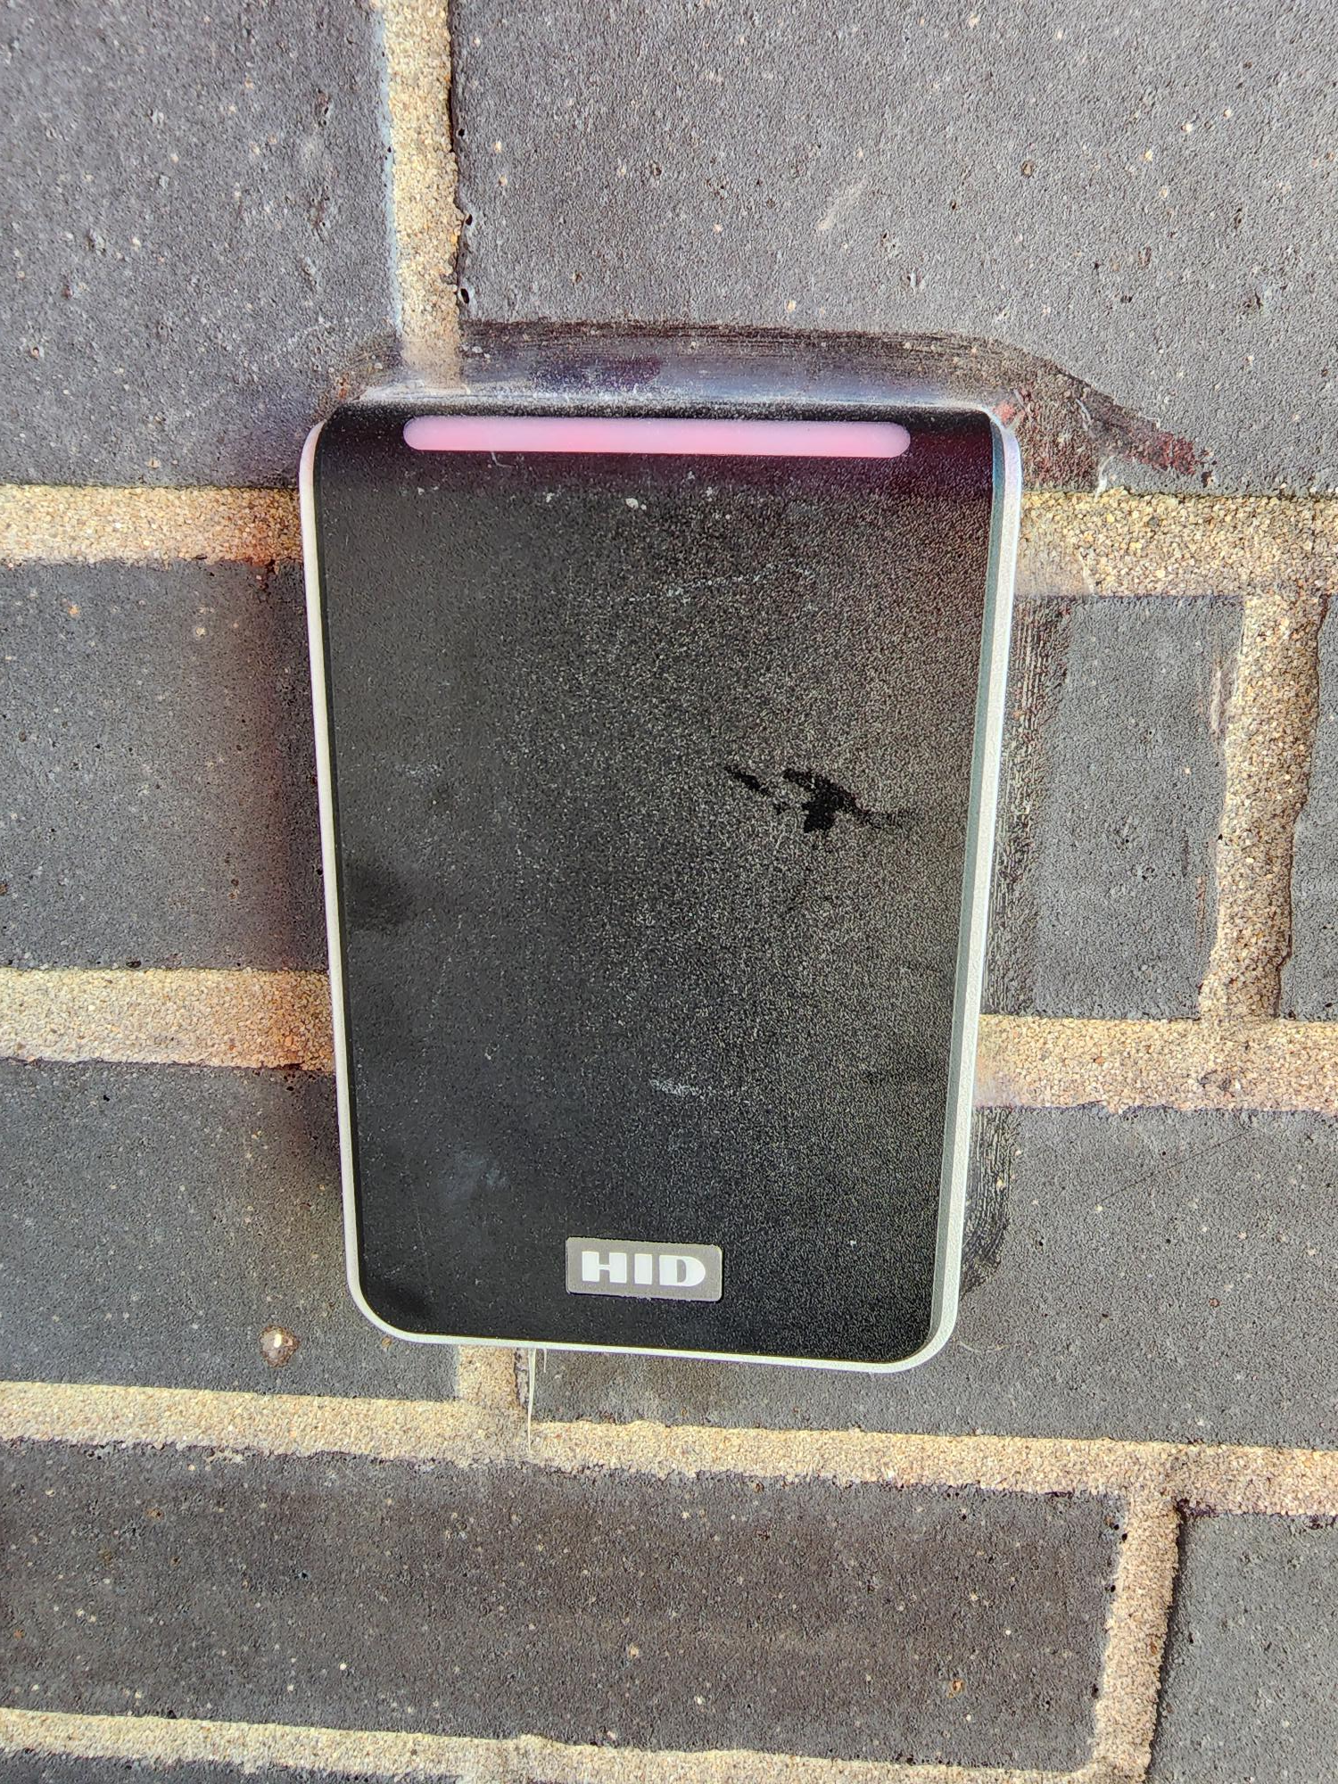
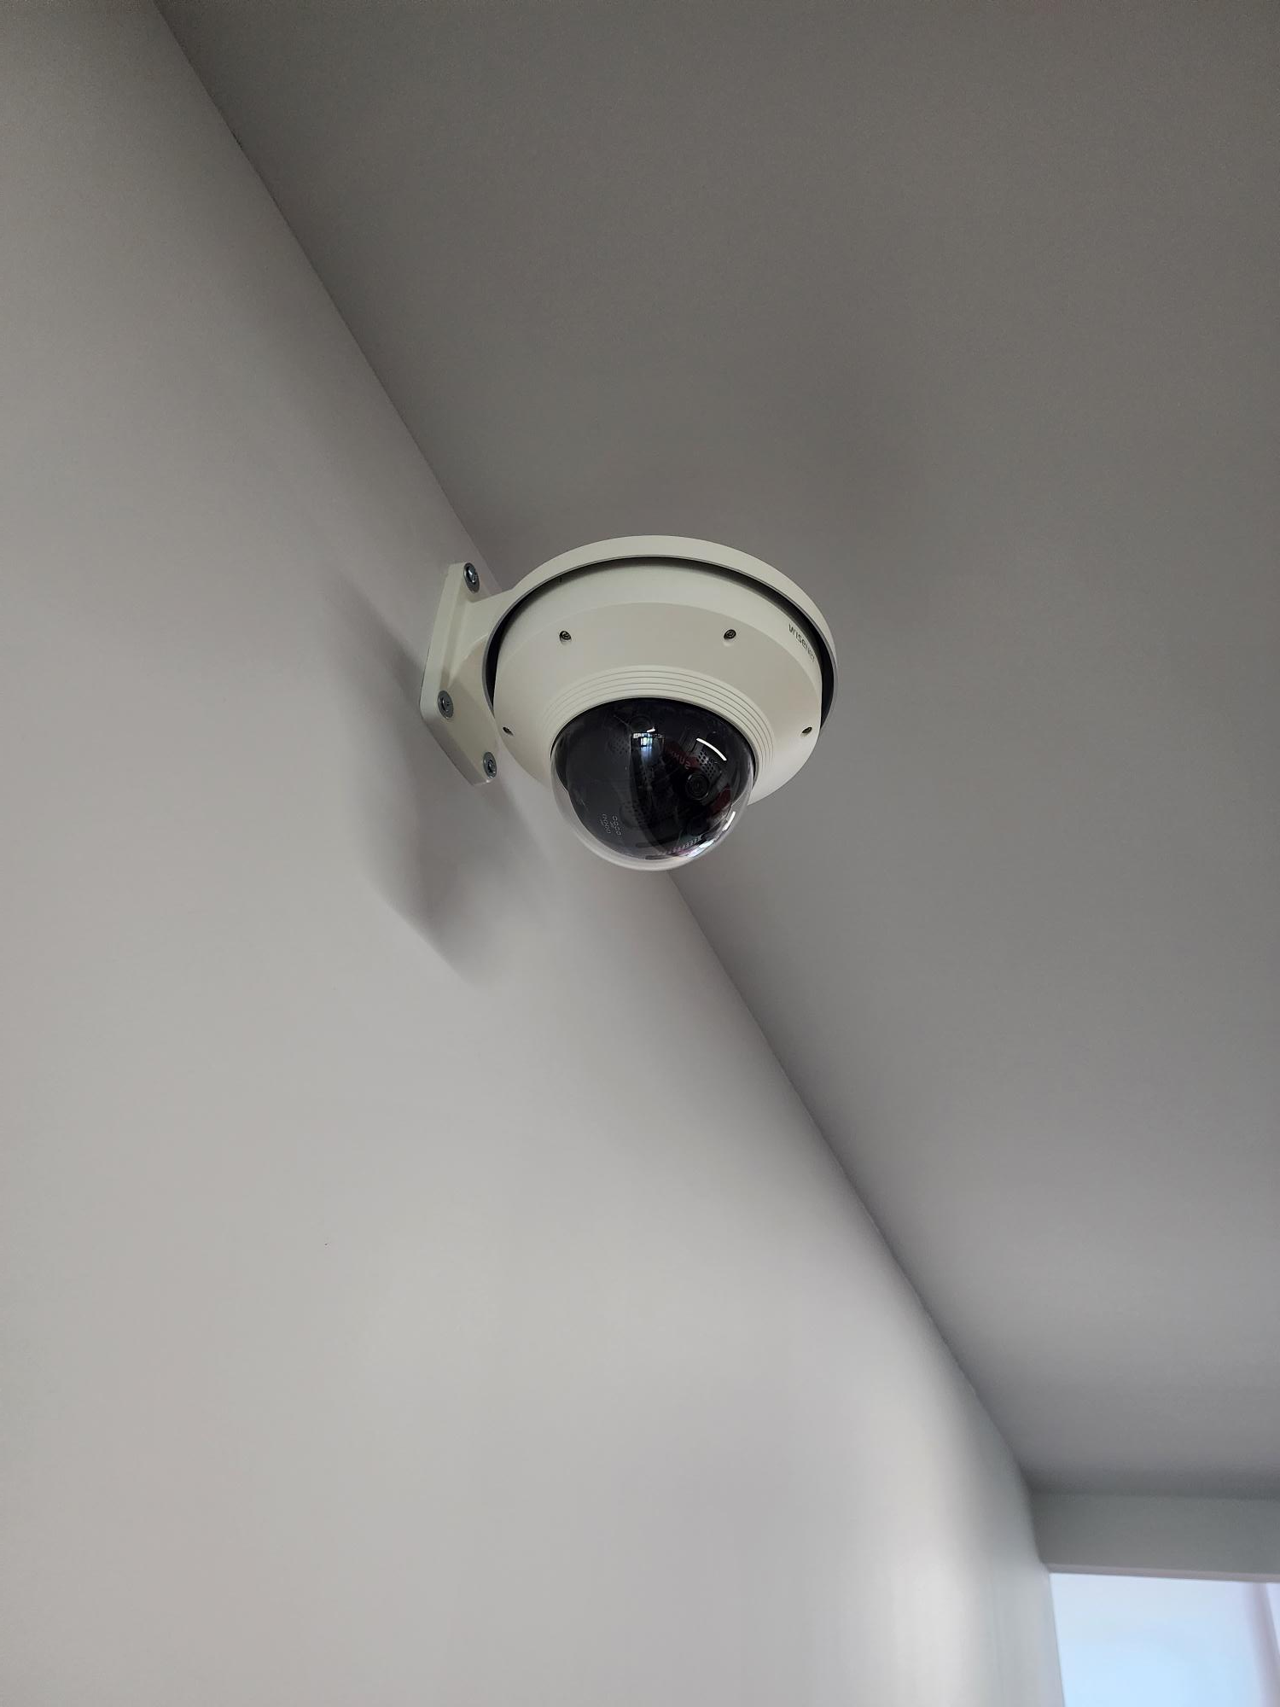
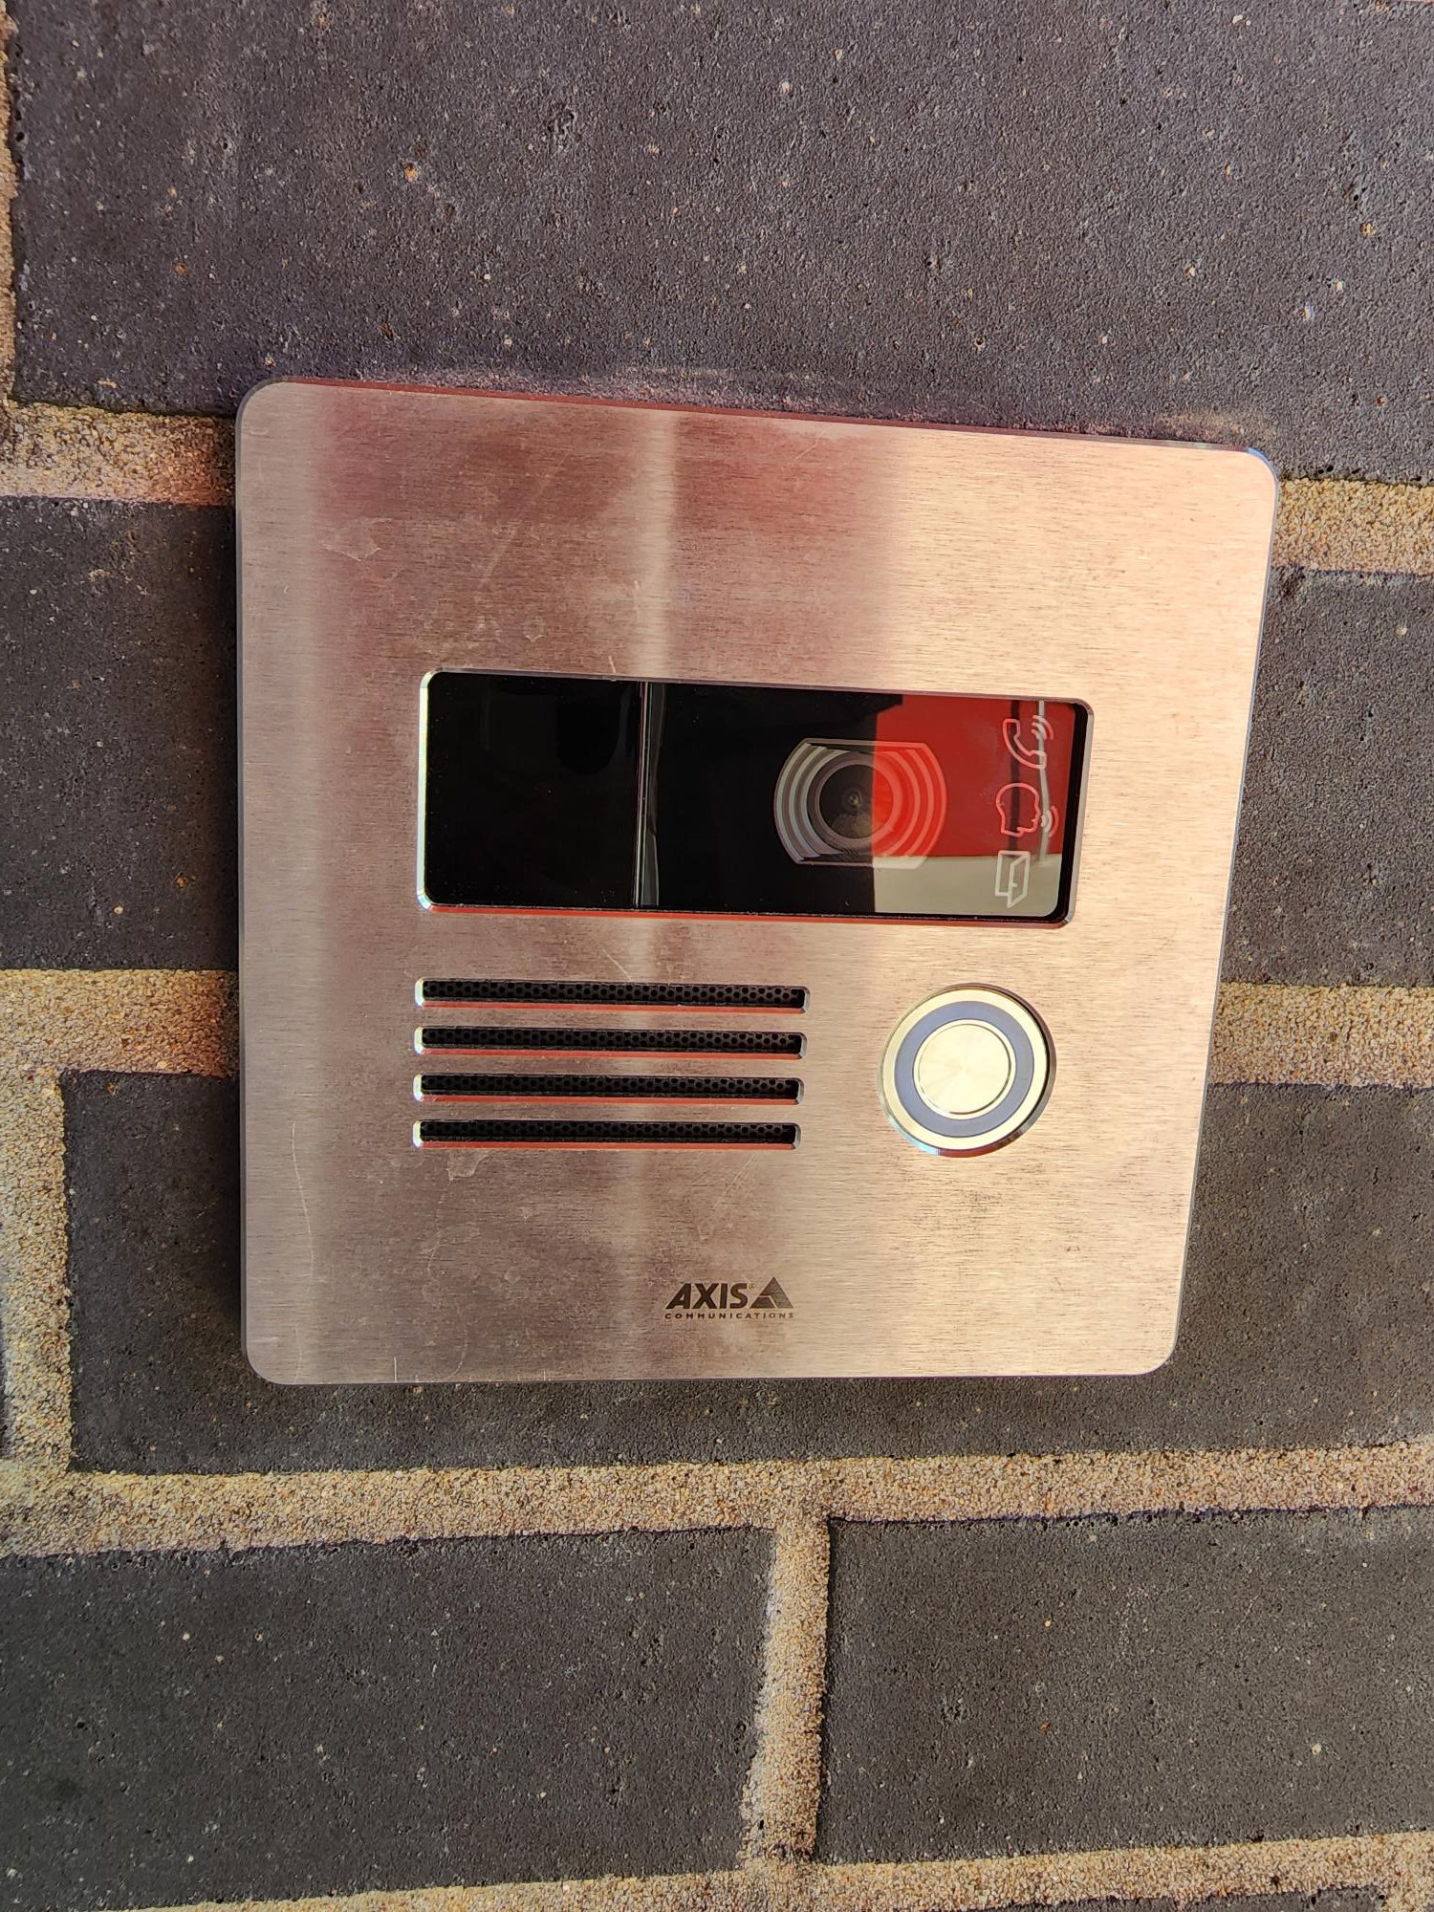
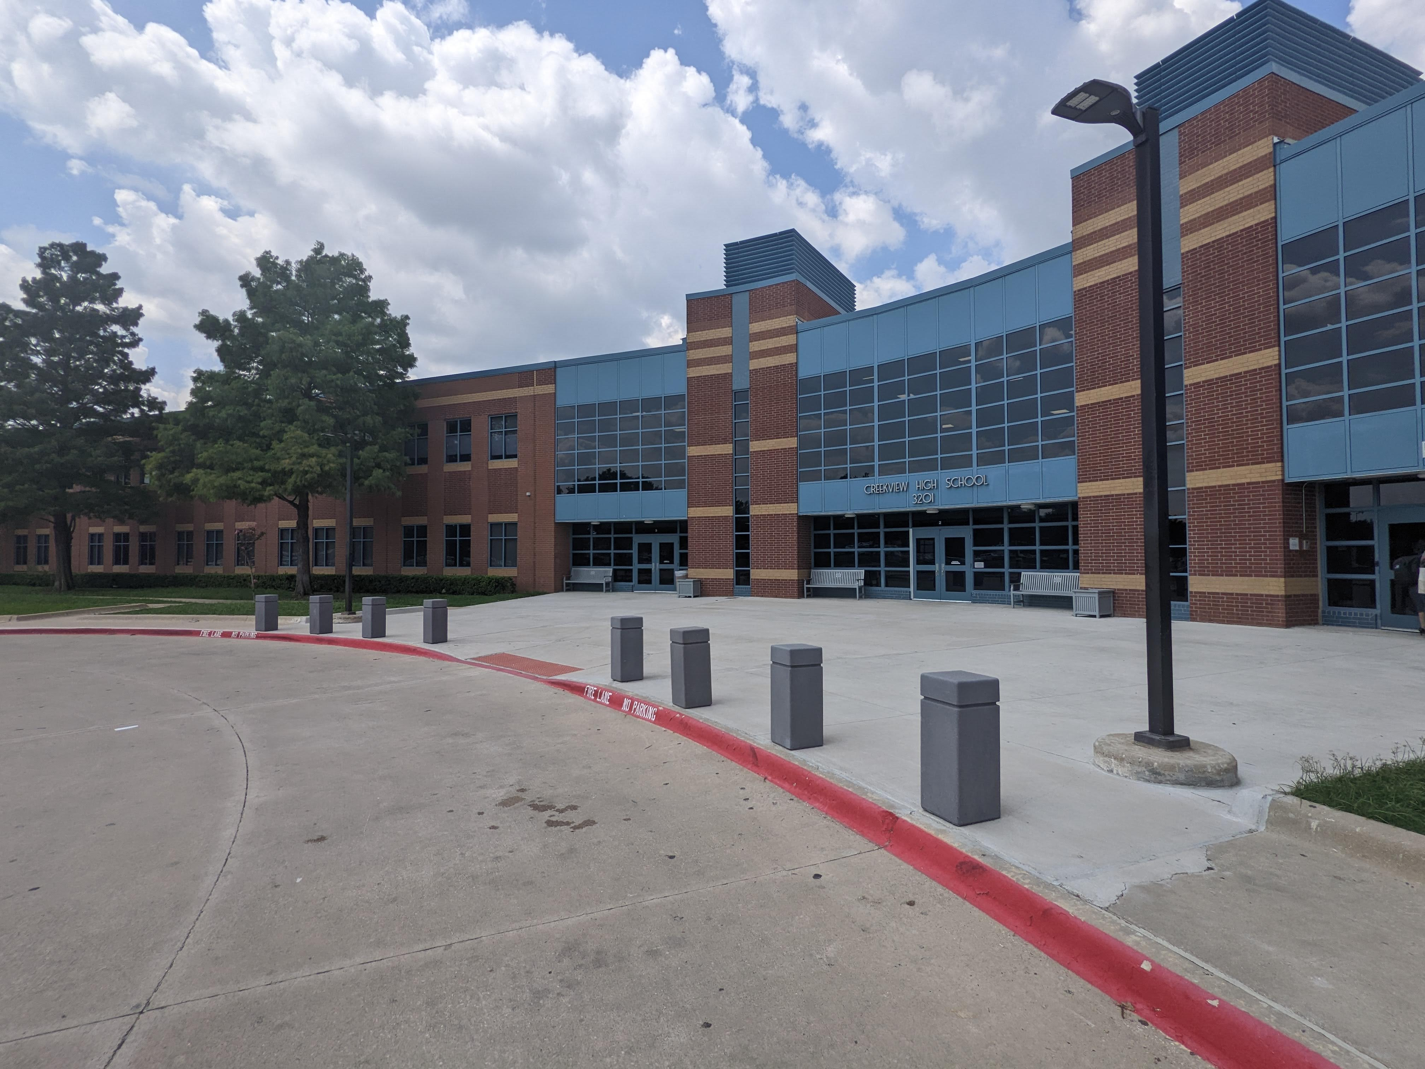
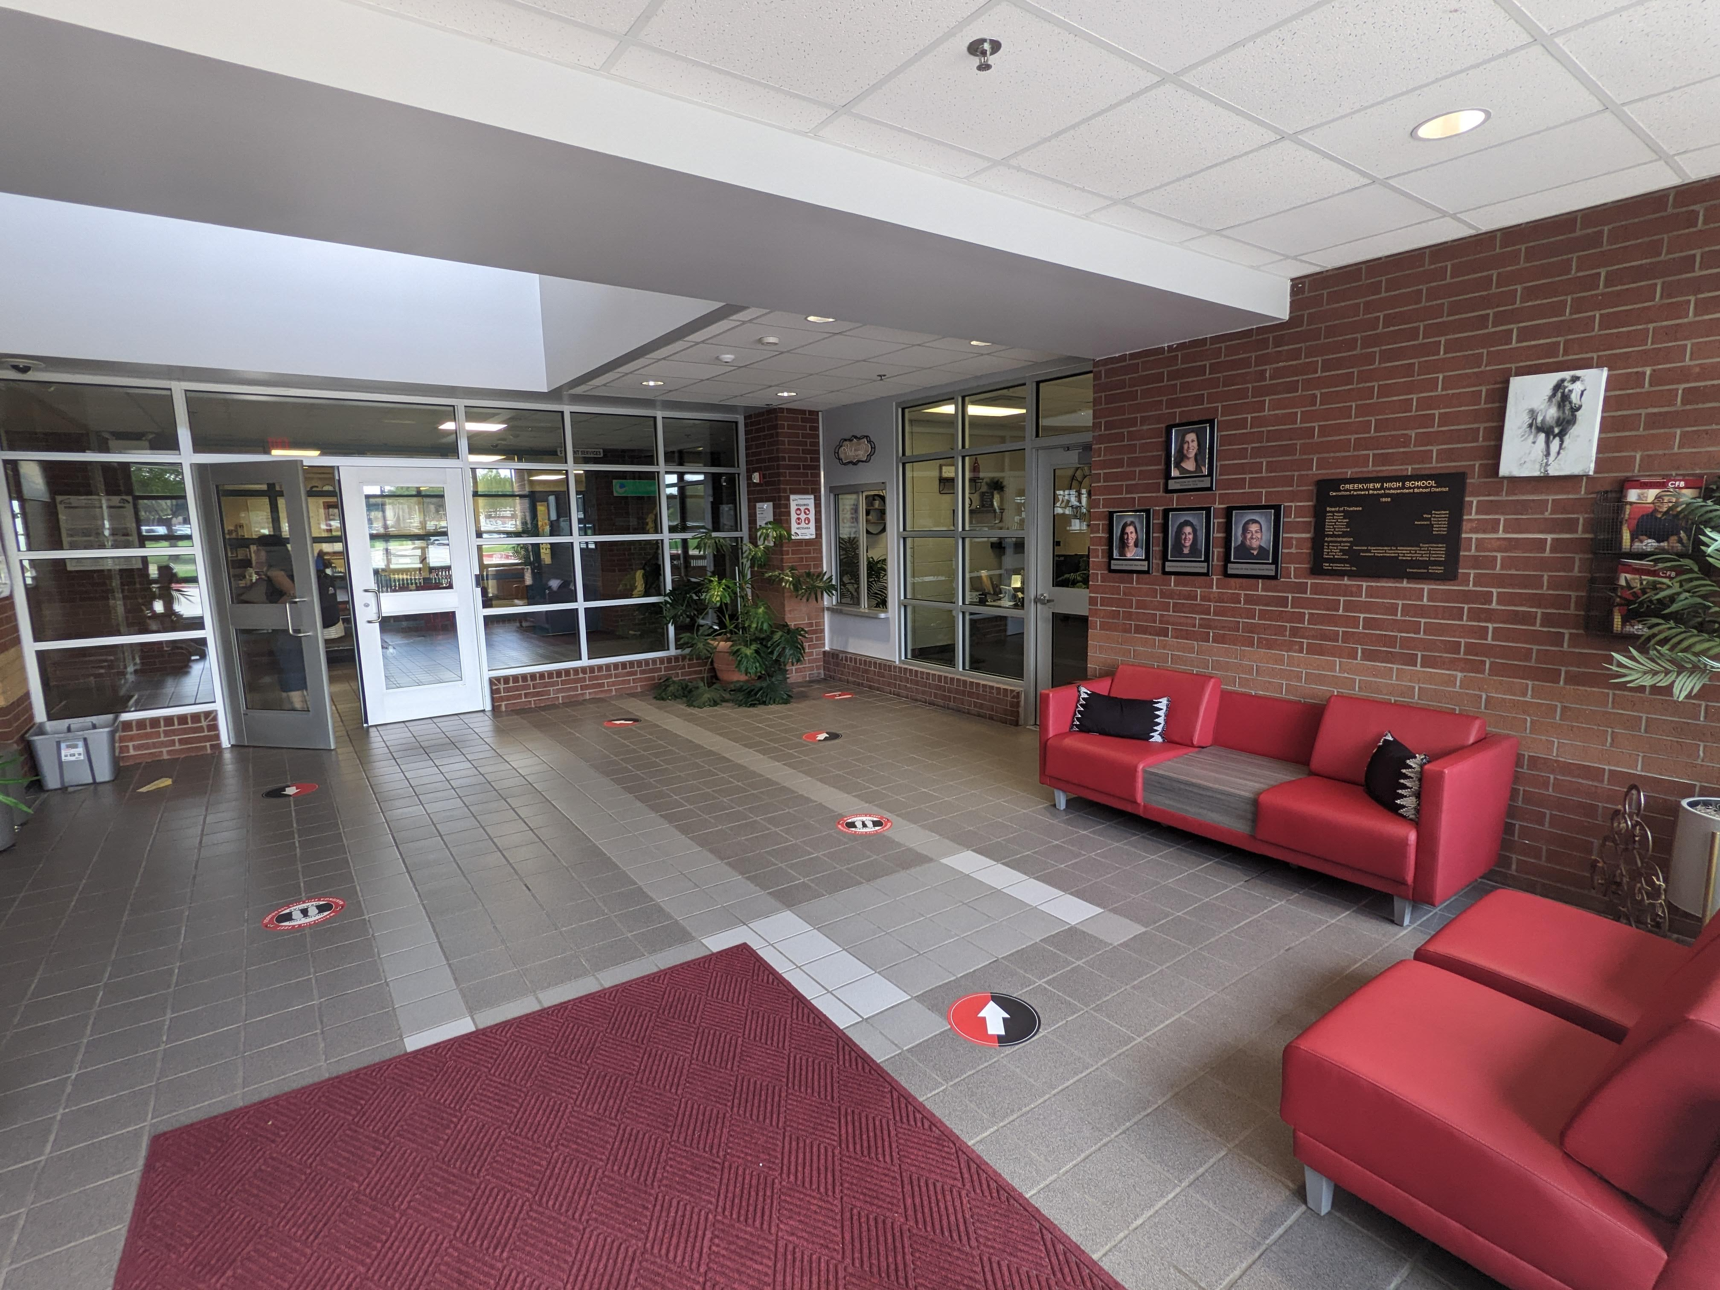
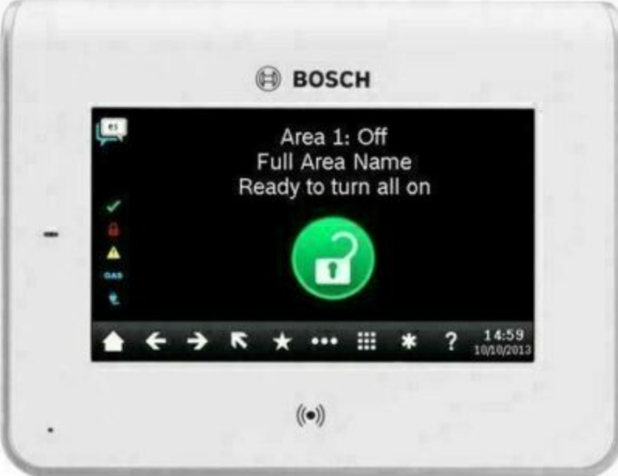
Safety and Security
Access Control
Intercom - 2023
Card Readers
Intrusion
Cameras
Bollards
Fire Sprinkler System Upgrades
Secure Vestibule
Coming Soon
Card Readers
Cameras
Fire Alarm
Card Reader
Exterior Camera
Coming Soon
Intercom
Bollards
PROMISES MADE
PROMISES KEPT
Intrusion
Intercom
Bollards/Benches
Secure Vestibule

Slide 10
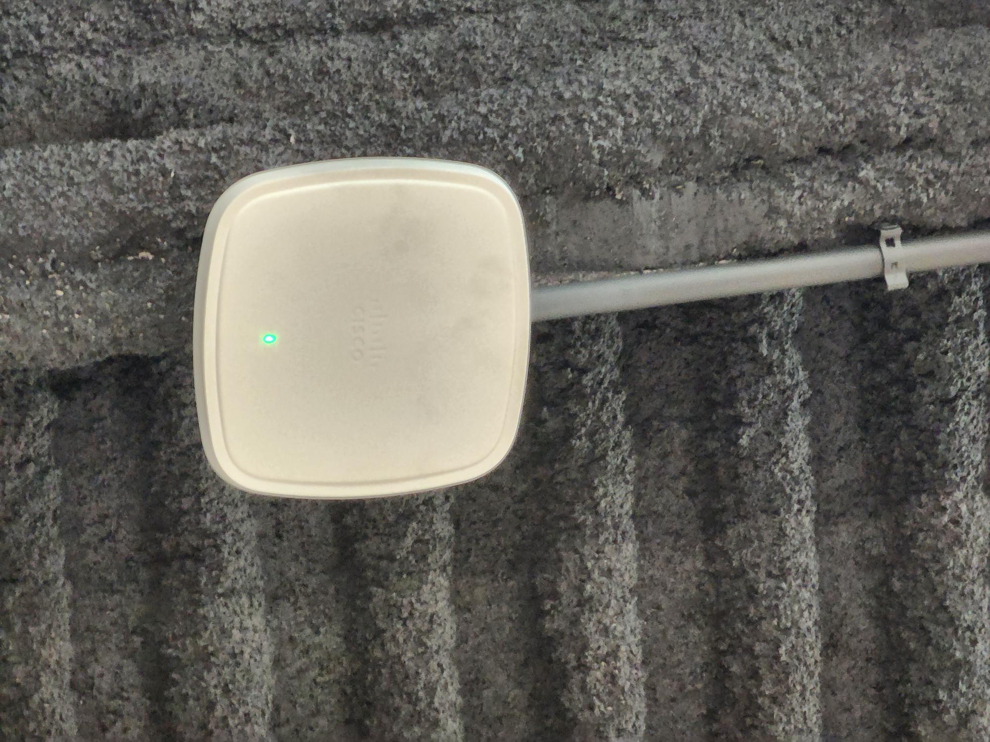
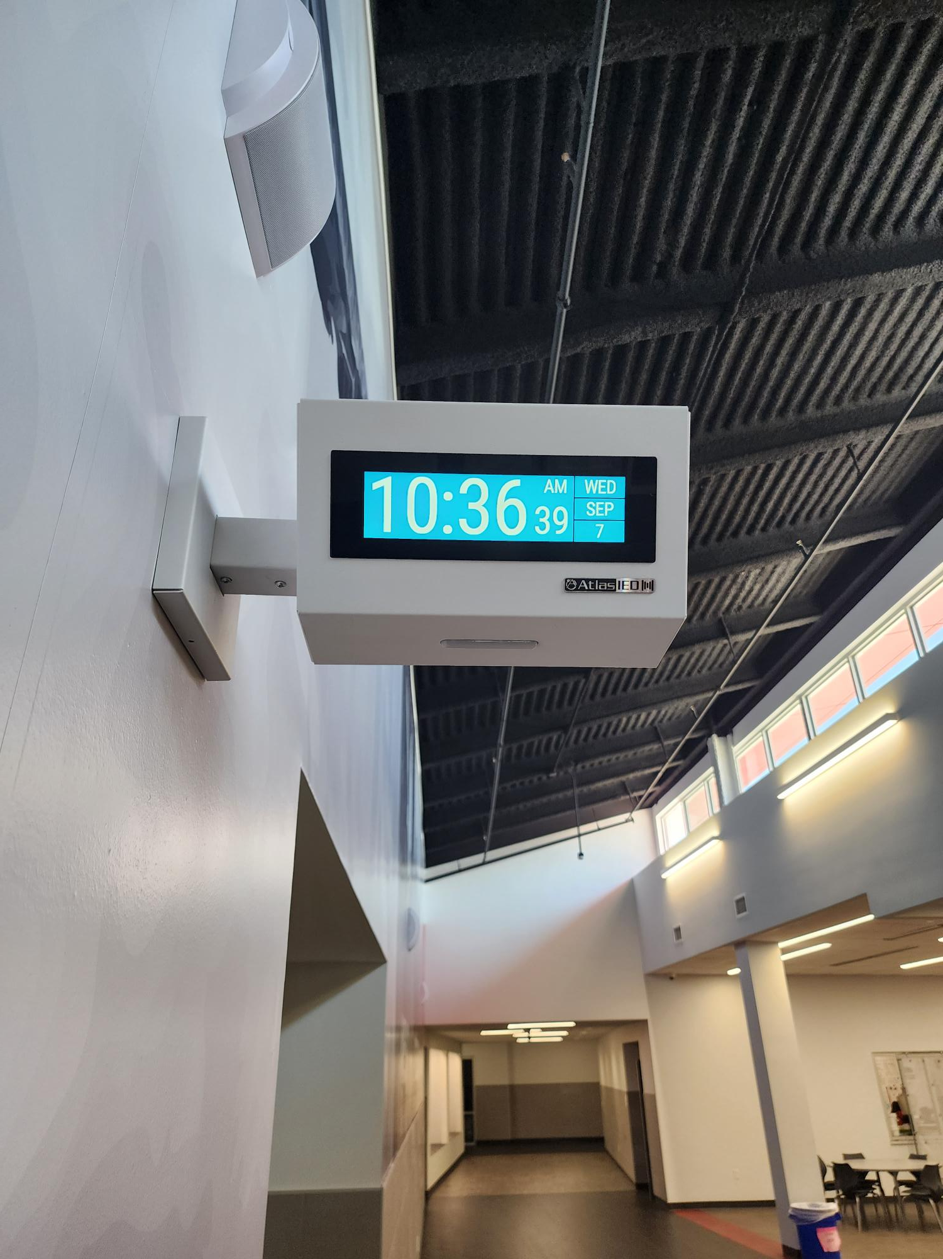
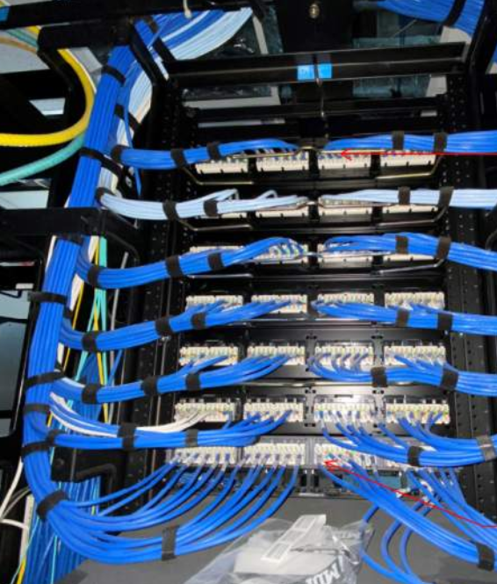
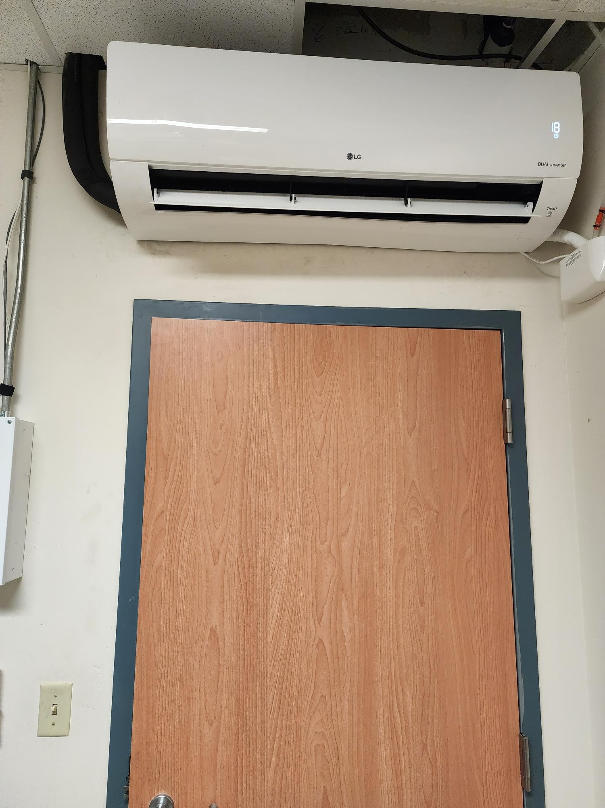
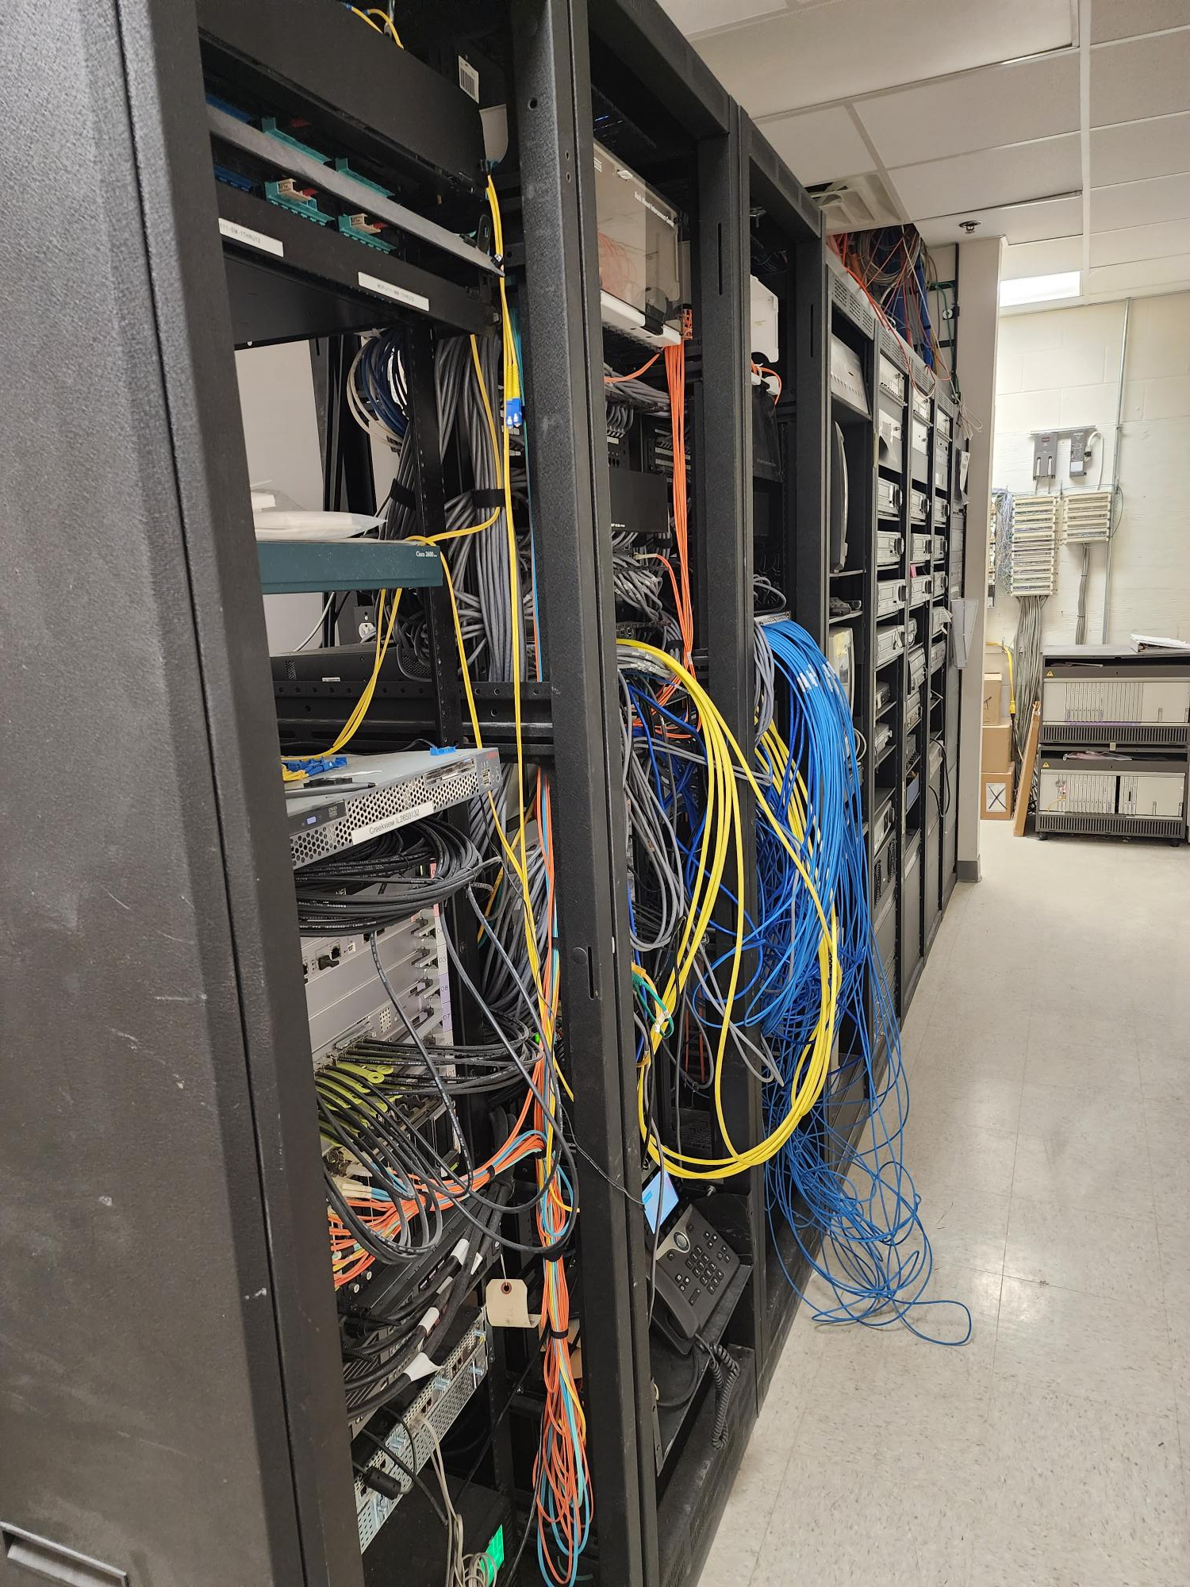
Technology
Secure Climate Controlled Server Space
Cabling
Wireless Upgrades
Phone System Upgrades
Wireless Upgrades
Clocks
PROMISES MADE
PROMISES KEPT
Cabling
Climate Control
Server Space
Secure Climate Controlled Server Space

Slide 11
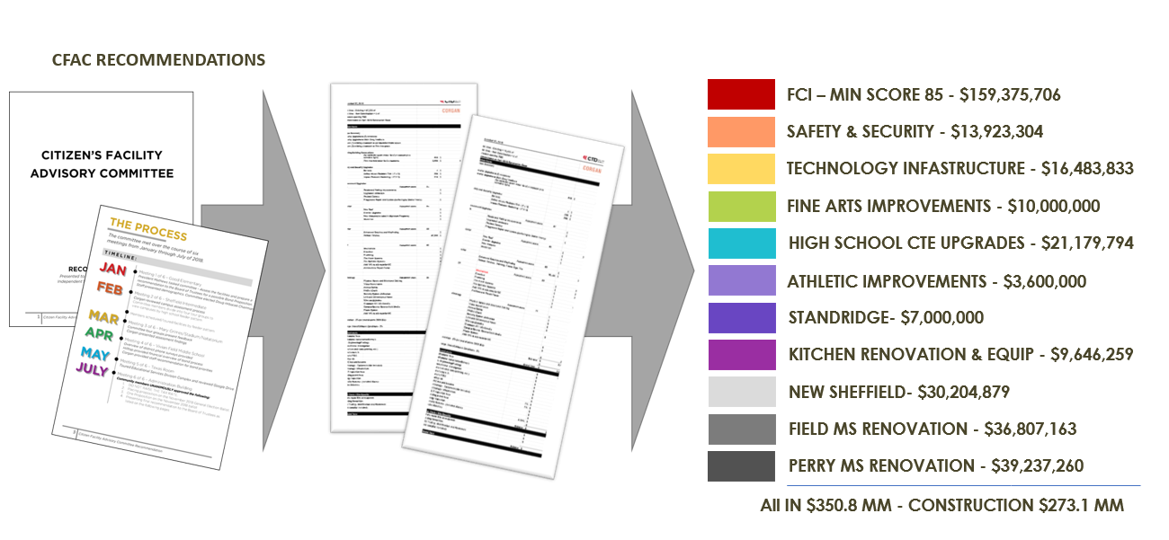
FCI Update
PROMISES MADE
PROMISES KEPT

Slide 12
FCI Update
 | Building Element |  |  |  |  | Type/Material | Prior Condition | Current | Prior Description | 2022 Reno Comments
 | On-Site Utilities & Drainage
 |  | Site Drainage / Erosion Control |  |  |  |  | Good | Good | Positive slope away from building, no visible signs of erosion or ponding water.
 |  | Site Lighting - Parking Lots |  |  |  |  | Good | Good
 |  | Exterior Concrete Pads & Pavement-Around building, mechanical yards |  |  |  |  | Fair | Good |  | Reaplced
 |  | Fire Hydrants / Utility Vaults / Misc. |  |  |  |  | Fair | Fair
 |  | Grease Trap |  |  |  |  | Fair | Good |  | Replaced
 | Site Parking & Drives
 |  | Pavement - Roads / Drives / Parking Areas |  |  |  |  | Good | Good | Clean and clear of cracks, heaving, potholes. Joint Sealer is properly in place.
 |  | Fire Lanes |  |  |  |  | Good | Good | Fire lane paint striping in good condition.Clean and clear of cracks, heaving, potholes. Joint Sealer is properly in place.
 |  | Striping - Parking lot and fire lane |  |  |  |  | Poor | Good | Incomplete, missing or severely deteriorated/aged. No handicapped parking spaces provided. | Restriped Parking Lot
 |  | Curbs |  |  |  |  | Fair | Fair | Minor to moderate signs of age and deterioration, no major damage.
 | Site Lighting
 |  | Site Lighting |  |  |  |  | Fair | Good | Very few fixtures have minor damage or are not working. Lighting is adequate for security. | Replaced Site Lighting with LED
 | Site Security
 |  | Security Cameras |  |  |  | Megapixels of Resolution | 24 | 1253 |  | Replaced all low resolution cameras and doubled coverage
 |  | Chain Link Fencing / Gates |  |  |  |  | Good | Good | No damage to material and poles, gates are working properly.
 | Misc. Stuctures
 |  | Site Walls - Retaining / Screen |  | Material: | Material: | Conrete | Good | Good | No signs of damage, settling or rotation.
 |  | Dumpster Service Area |  |  |  |  | Fair | Fair | Moderate to Minor signs of damage to dumpster walls, may need a refresh of finish paint if applicable and additional bollards. Gates function as required.
 |  | Bollards |  | Material: | Material: | Steel | Good | Good | Clearly marked and strongly visible. Almost new in appearance. | Replaced Bollards
 |  | Site Signage - Directional / Handicapped |  |  |  |  | Good | Good
 |  | Misc. Site work / Site Structures |  |  |  |  | Good | Good
 | Circulation
 |  | Sidewalks |  |  |  |  | Good | Good | Clean and clear of cracks or heaving. Joint Sealer is properly in place.
 |  | Stairs |  |  |  |  | Good | Good | Clean and clear of cracks or heaving. Joint Sealer is properly in place. Rise and Run is compliant. Handrails (if present) are compliant & finish is in good standing.
 |  | Ramps |  |  |  |  | Good | Good | Clean and clear of cracks or heaving. Joint Sealer is properly in place. Slope is compliant. Handrails (if present) are compliant & finish is in good condition.
 | ADA Compliance / Accessiblity
 |  | Compliant Sidewalks/Curbs |  |  |  |  | Good | Good
 |  | Compliant Ramps & Handrails |  |  |  |  | Good | Good
 |  |  |  |  |  | Scored Categories | 21 | 21
 |  |  |  |  |  | Good | 14 | 18
 |  |  |  |  |  | Fair | 6 | 3 | Previous Aggregate Score: | 87
 |  |  |  |  |  | Poor | 1 | 0 | Reno Aggregate Score: | 95
 |  |  |  |  |  | N/A | 0 | 0
Site

Slide 13
FCI Update
Building Element |  |  |  |  |  | Type/Material | Prior Condition | Current | Prior Description | 2022 Reno Comments
Building Structure/Foundation
 | Foundation |  |  |  | Type: | Slab on Grade | Good | Good | No signs of cracking or heaving.
 | Substructure - Slab - on - Grade
 |  | Basement / Below Grade Exterior Walls |  |  |  |  | Good | Good
 |  | Miscellanous
 | Superstructure
 |  | Fireproofing
 |  | Pre-Engineered Metal building |  |  |  |  | Good | Good |  | Athletic Facility
Building Exterior Shell
 | Roofing
 |  | General Roof Condition (Visual Inspection) |  |  |  |  | Fair | Good | Roof is nearing the end of it's expected useful life. Some leaks are reported with areas of ponding. Some sealants and flashings are in need of repair or replacement. | Roof Replacement
 |  | Roof Warranty Status |  |  |  |  |  |  |  | New
 |  |  | Roofing Manufacturer / Warranty Issuer |  |  |  |  |  | Eubanks ('98) CBS ('08) | Duro-Last
 |  |  | Years Remaining in Warranty Period |  |  |  |  |  | 11 years on '08 roof. Majority of roof is out of warranty
 |  | Skylights |  |  |  |  | N/A | N/A
 |  | Roof Curbs / Openings / Misc. |  |  |  |  | Fair | Good |  | New Curb Adapters
 | Exterior Walls
 |  | Exterior Wall Material |  |  | Material: | Brick | Good | Good | Veneer is free of cracks, signs of settling, rotation or damage.
 |  | Building Caulking/Sealant |  |  |  |  | Poor | Poor | Major signs of wear or are missing.
 |  | Exterior Painting |  |  |  |  | Fair | Fair | Minor wear or fading, minimal stains apparent.
 | Windows/Glazed Walls
 |  | Windows
 |  |  |  | Glazing Type: | Glazing Type: | Single Pane | Good | Good | No visible damage, proper weatherproofing apparent.
 |  |  |  | Frame Type: | Frame Type: | Aluminum
 | Exterior Doors Systems
 |  | Exterior Doors
 |  |  |  | Frame Type: | Frame Type: | Aluminum Storefront | Good | Good | No visible damage, proper weatherproofing/threshold apparent, door hardware compliant and functioning properly.
 |  |  |  | Panel Type: | Panel Type: | Aluminum Storefront
 |  | Exterior Overhead Doors |  | Type: | Type: | Manual | Good | Good | No visible damage, proper weatherproofing/threshold installed, door hardware compliant and functioning properly, motor works as required (if applicable).
 |  | Card Access Reader
 |  | Door Bell
 |  | Peep Hole
 | Canopies
 |  | Canopy |  | Type: | Type: | Attached to Building | Fair | Fair | Minor scratches or signs of wear, may need a refresh of finish (if applicable). No signs of water leaking, settling or movement.
 | Loading Area
 |  | Raised Loading Dock |  |  |  |  | Good | Good | No visible damage, no signs of settling or movement. Dock bumpers present and almost new in appearance.
 |  | Independent Loading Area |  |  |  |  | Good | Good | No visible damage, no signs of settling or movement.
 | Misc. Exterior
 |  | Exterior Soffit - Material |  |  | Material: | Plaster | Good | Good | Almost new in appearance, no visible fading or stains.
 |  | Exterior Louvers / Sunscreens |  |  |  |  | Good | Good | Almost new in appearance.
 |  |  |  |  |  | Scored Categories | 16 | 16
 |  |  |  |  |  | Good | 11 | 13
 |  |  |  |  |  | Fair | 4 | 2 | Previous Aggregate Score: | 88
 |  |  |  |  |  | Poor | 1 | 1 | Reno Aggregate Score: | 92
 |  |  |  |  |  | N/A | 1 | 1
Exterior

Slide 14
FCI Update
Interior

Slide 15
FCI Update
Interior

Slide 16
FCI Update
CREEKVIEW HIGH SCHOOL |  | AGE:19 YEARS |  | 369,718 SF
ITEM | DESCRIPTION | DESCRIPTION |  |  |  |  | PRIOR GRADE | CURRENT
OPERATIONAL, SYSTEMS & CODE DEFICIENCIES | Assessed Scope | Performed Scope
HVAC | Task: Replace 1997 Carrier DX packaged rooftop units and condensing unit. | Replaced |  |  |  |  | 60 | 95
 | Task: Replace 2007 Lennox DX packaged rooftop units. (60 Tons) | Replaced
 | Task: Replace Chiller Plant and all CW HW Air Handlers. | Replaced
 | Total HVAC Cost:
EMCS | Task: Replace controls for DX equipment that is over 15 years old, Included in cost of DX replacement. | Replaced
 | Task: Replace controls for hydronic system. Includes Plant and Air Handlers. | Replaced
 | Total EMCS Cost:
PLUMBING | Task: Replace 200 gallon LAARS natural gas water heater. | Replaced |  |  |  |  | 85 | 95
 | Task: Replace Rhreem Ruud 120 gallon electric water heater installed in 2007. | Replaced
 | Task: Replace two State 99 gallon natural gas water heaters installed in 2004. | Replaced
 | Task: Replace State 19.5 electric water heater installed in 1996. | Replaced
 | Task: Provide new electric water coolers with bottle fillers. | Replaced
 | Task: Perform smoke test on sanitary piping system to Identify rotten sections of vent piping. | Not in Scope
 | Total Plumbing Cost:
ELECTRICAL SYSTEM | Task: |  |  |  |  |  | 93 | 93
 | Total Electrical Cost:
INTERIOR LIGHTING | Task: Provide tunable lighting for special education classrooms. | Not in Scope |  |  |  |  | 80 | 90
 | Task: Replace remaining T12 lighting fixtures from facility. | Replaced in Areas of Renovation
 | Task: Replace metal halide fixtures in gym with LED fixtures. | Not in Scope
 | Total Interior Lighting Cost:
EXTERIOR LIGHTING | Task: Replace all existing exterior wall packs with LED fixtures. | Replaced |  |  |  |  | 82 | 95
 | Task: Renovate outdoor activity area lighting to LED. | Replaced
 | Task: Renovate all exterior parking lot lighting to LED. | Replaced
 | Total Exterior Lighting Cost:
FIRE ALARM SYSTEMS | Task: Replace 1997 Notifier fire alarm system | Replaced |  |  |  |  | 60 | 95
 | Total Fire Alarm Cost:
FIRE PROTECTION SYSTEM | Task: |  |  |  |  |  | 93 | 93
 | Total Fire Protection Cost:
OTHER | Task: Replace cooler/freezer units. | Not in Scope |  |  |  |  | NA | NA
 | Task: Replace sound systems. | Will Be Replaced in Auditorium
 | Total Cost:
TOTALS |  |  |  |  |  |  | 77 | 94
MEP

Slide 17
FCI Update
Creekview HS Technology and Security Status
System | Possible Score | Corgan Score (2018) | TNCG Score (2022) | Notes
Cabling Infrastructure | 10 | 8 | 8 | Small improvements to renovation areas.
Local Area Network | 15 | 13 | 13 | No upgrade (that True North is aware of)
Wireless LAN | 15 | 13 | 13 | Wireless could use a refresh in the next few years but in good condition right now.
Unified Comm (Phone) System | 10 | 8 | 10 | Upgraded prior to renovation project
Video Management System | 10 | 7 | 10 | Complete upgrade to Genetec
Public Address | 10 | 7 | 10 | Complete upgrade to Informacast
Premise Access Control (and Intrusion) | 10 | 8 | 10 | Complete upgrade to Genetec
Intercom System | 5 | 4 | 5 | Replaced front intercom and added to Kitchen receiving door
Special Space AV | 5 | 4 | 4 | District item. AV upgrade as part of technology package
Instruction Space Presentation | 10 | 8 | 9 | New Interactive Displays in renovation areas matching distirct standard
Total Score | 100 | 80 | 92
Technology

Slide 18
FCI Update
Creekview HS
Assessment
Site : 87
Exterior: 88
Interior: 92
MEP: 77
Technology: 80
Score: 85
After Bond
Improvements
Site : 95
Exterior: 92
Interior:
MEP: 94
Technology: 92
Score:
PROMISES MADE
PROMISES KEPT

