Slide 1
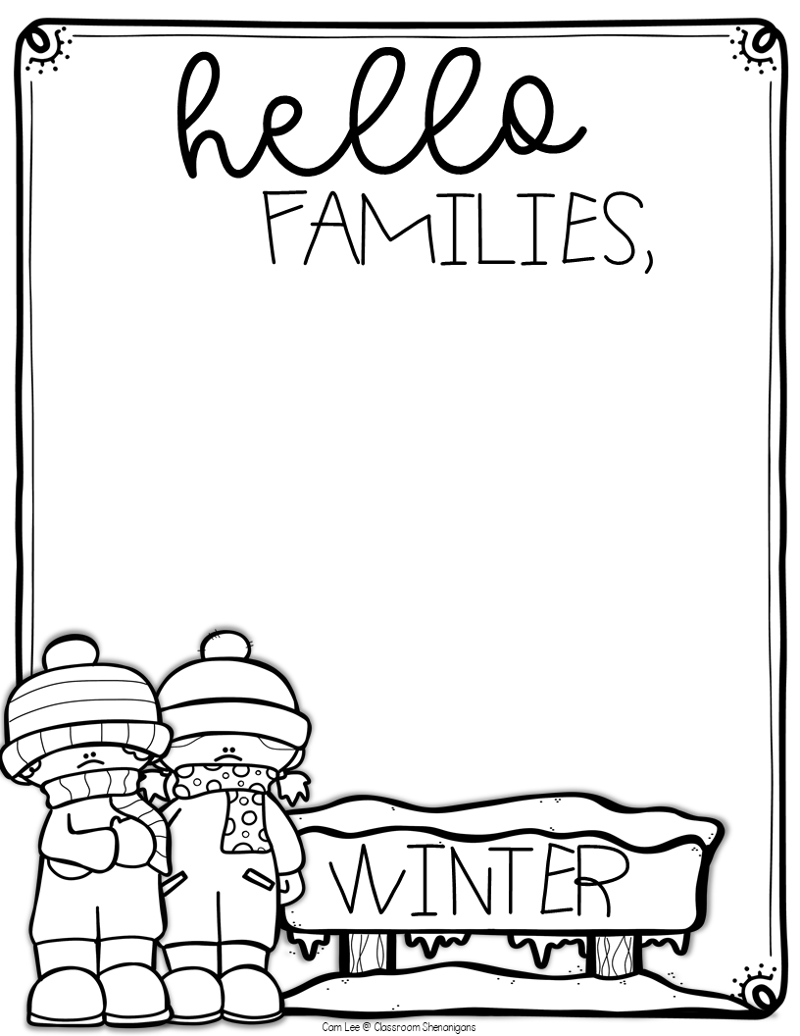
Students must check into the zoom
and do the choice board to count for
attendance for the day.
Zoom Class Meet: 11:00-11:30
  Zoom Codes: 3813038661
  Zoom Password: 6PRfgU
REQUIRED: Reflex:
go-el.com
  Username: miss.moos
  Class: 3rd Grade 23/24
Additional online resources:
Abcya.com
Typing.com
Code.org
https://artforkidshub.com/
We know that winter is not ideal, as we possibly reach a day where we would have a snow day. Here is a choice board of ideas that will help your child learn at home when weather does not cooperate with us. Here are some options I would like your child to pick from, they must choose 1 from each category. Thank you again!
If you need anything you can email or seesaw me.

Slide 2
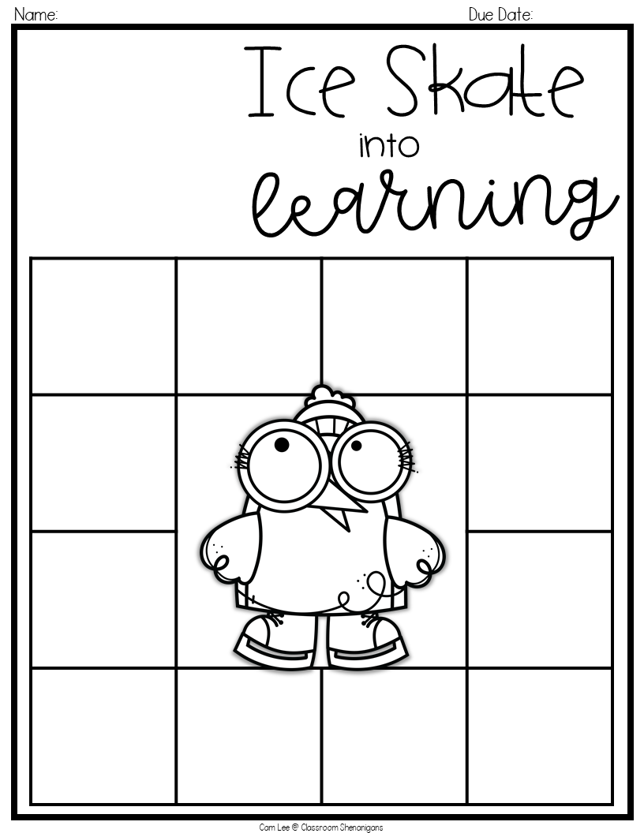
Choose 1 of each category unless required
Due the next school day
Math:
REQUIRED:
Reflex Math
on Chromebook until you get a green light
Science/ Social Studies:
Do some research on a plant. Tell me all the cool facts about it!
Science/ Social Studies:
Make a map of your house/ room.
Don’t forget to label everything. Including, North, South, East, & West
Reading:
Read to self, family member pet, stuffed animal for 30 min. Tell me your favorite part of the story.
Math:
Create your own multiplication/ division flashcards
and practice them for 10 minutes.
Reading:
Think about the main character. What are some traits that your main character has?
The main character is __________ because __________.
Math:
Write 4 math word problems. Each problem should include the word snow. Each equation should be different by using addition, subtraction, multiplication, and division. Answer your word problems.
Reading:
What lesson does the main character learn by the end of the story? Why is this lesson important?
Writing:
In LA this week we talked about voting. Have your family vote on if they like snow. Then, tell me why.
Writing:
Write me an email! Send me something on google classroom about your day!
PE / Music/ Art:
Watch a directed drawing on art for kids hub.
PE / Music/ Art:
Do a goNoodle with a family member.

