Slide 1
23-24 Clark Creek Elementary
Literacy
Night
01/23/24
Virtual Event
Website at 8:00am

Slide 2
Overview
Welcome/Sign in
Grade Level Literacy Focus
Parent Engagement
Literacy Activities
Literacy Bags
Feedback Form

Slide 3
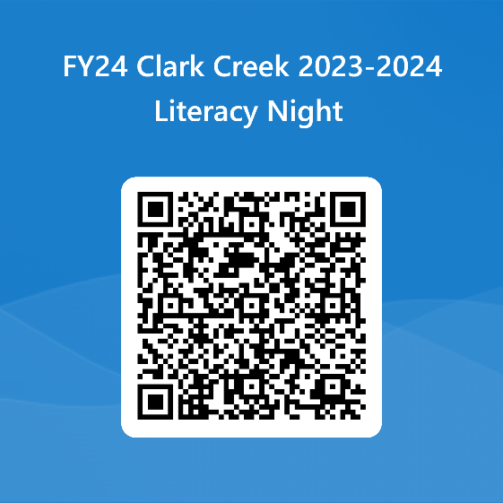
Welcome
Overview
Welcome to Literacy Night! Our goal is that you learn about some of the skills we teach at school and can help your student (s) by practicing those skills at home.
Sign in
Please sign in you can use the following link: https://forms.office.com/r/a8rda8UX8a
or QR Code

Slide 4
Kindergarten
Literacy Night Focus
Parent Help at Home
Recognizing letter sounds is a foundational skill we work on in Kindergarten. It is a skill necessary for learning to read.
Once students are able to recognize letters and sounds, they can begin reading CVC words.
CVC word: consonant, vowel, consonant
For example: cat, bed, him, not, mug
• We practice these skills daily
Practice reading and spelling CVC words – example list included in bag
Read together

Slide 5
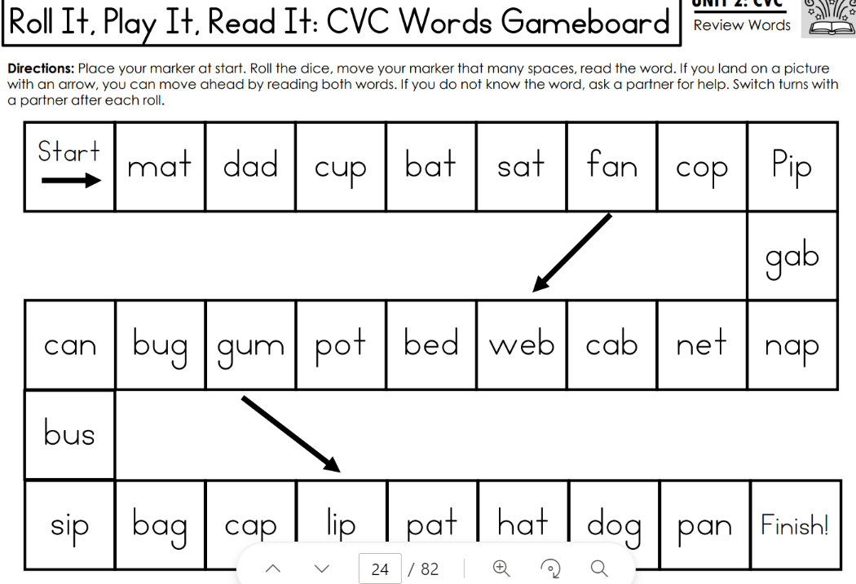
What is in your bag?
Kindergarten Instructions
Handouts
Materials
CVC word list is included as an example of extra words to practice.
Gameboard
Dice
Game Pieces
Activity 1
Activities to work on with your child.
Place your marker at start. Roll the dice, move your marker that many spaces, read the sound. If you land on a sound
with an arrow, you can move ahead by reading both sounds. If you do not know the sound, ask a partner for help. Switch turns with a partner after each roll.
Practice working on letter and letter sound recognition. Once that is mastered, work on reading and spelling CVC words.
Activity 2
Place your marker at start. Roll the dice, move your marker that many spaces, read the word. If you land on a picture with an arrow, you can move ahead by reading both words. If you do not know the word, ask a partner for help. Switch turns with a partner after each roll.

Slide 6
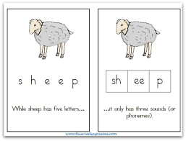
First Grade
Literacy Night Focus
Parent Help at Home
We are focusing on phoneme segmentation (breaking a word apart into its sounds) and spelling
Phoneme segmentation is important because it is the foundation of reading and spelling
We work on phoneme segmentation and spelling during our phonics instruction and during small group instruction
To work on phoneme segmentation, parents can give their students a word, then the student taps out (or say) each individual sounds.

Slide 7
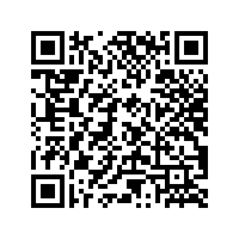
What is in your bag?
First Grade Instructions
Handouts
Scan code for video:
3 sound mat on one side, 4 sound mat on other side
Words:
(3 sound: Orange
3 sound + Digraphs: yellow
4 sounds: White)
Materials
In your bag, you will find:
4 lists of words (words with 3 sounds and words with 4 sounds
Elkonin mat inside a page protector
Marker
Activity 1
Activities to work on with your child.
Pick a word from the list (either 3 sound list or 4 sound list)
Say the word to your student
Have the student repeat the word
Students tap out the word using the dots
Students map the word in the boxes
Students write the word
Make sure that your child can do the 3 sound words first. Then, if they are mastering that, move on to 3 sound digraphs and then 4 sound words.

Slide 8
Second Grade
Literacy Night Focus
Parent Help at Home
Our activities focus on reading fluency.
Fluency is an essential component of reading. Fluent readers can read texts quickly and accurately. They also read with expression. It takes less effort for fluent readers to read a text; this allows them to focus on comprehending what they are reading.
Students practice fluency with their teachers during small group reading instruction as well as during independent reading.
Listen to your child read aloud.
Reread favorite books.
Read aloud to your child.
Buddy read with your child (take turns reading).
Create audio books together. Record your child reading a book and share the recording with family and friends.

Slide 9
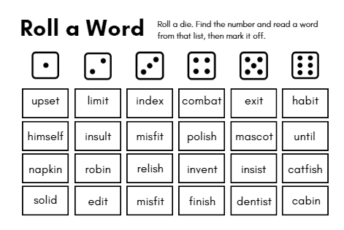
What is in your bag?
Second Grade Instructions
Handouts
Materials
The words and sentences to help promote fluency are included on the gameboards.
Game boards
Dry erase sleeve
Dry erase marker
Die
Activity 1
Activities to work on with your child.
Roll a Word- Roll a die and find a word from the matching number list. Read the word and mark it off. Make it more fun by playing with your child!
Roll a Word and Roll a Sentence will help to build your child's reading fluency. Start with Roll a Word and then transition to Roll a Sentence when student can read all the words fluently.
Parents can support their reader with decoding words when needed. The activities can also be turned into 2 players games, and parents can play along.
Activity 2
Roll a Sentence- Roll a die and find a sentences from the matching number list. Read the sentence and mark it off. Make it more fun by playing with your child!

Slide 10
Third Grade
Literacy Night Focus
Parent Help at Home
Our activities focus on reading comprehension & writing.
Reading comprehension: understanding, remembering, and connecting to what you are reading
Understanding what you read is the goal as a reader. It is what every reader is aiming for, but it takes practice & hard work to get there.
Writing is an excellent way to express yourself & to share what you have learned. It is an essential skill for everyday life.
Both focuses are taught in large group mini lessons & small group guided lessons during our day.
How you can help your child with their reading comprehension:
-Read with your child daily. Allow them to read to you, too.
-Ask them questions about what they are reading.
-Talk with them about the characters or topics in the books.
How you can help your child with their writing:
-Give them time to practice.
-Encourage their ideas.
-Ask them to add more details or more reasons to their writing.
-Allow them time to share their writing.

Slide 11
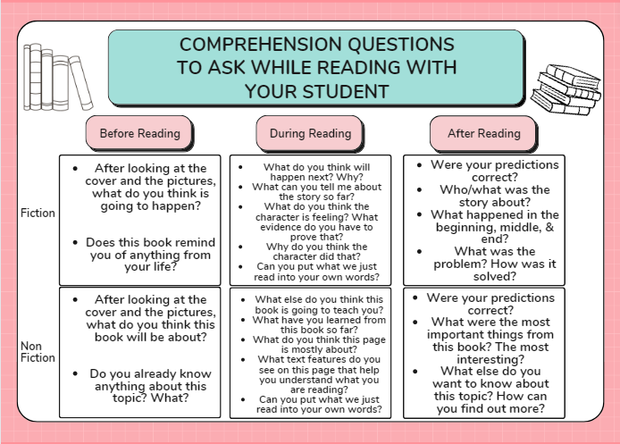
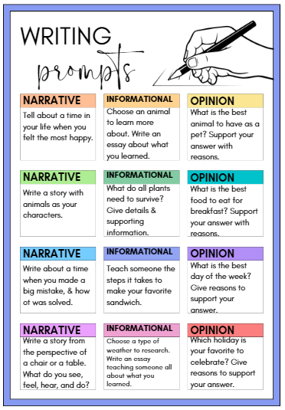
What is in your bag?
Third Grade Instructions
Handouts
Materials
Comprehension questions for both fiction & nonfiction books.
Writing checklists
Bookmark to track & rate books your student has read this year.
Reading passages
Writing Prompts
Highlighters
Activity 1 – Reading Comprehension
Activities to work on with your child.
-Find your reading comprehension question page & a reading passage.
-Ask the "before reading" questions first. Then allow your student to read.
-While reading, as the "during reading" questions..
-Once your student is finished reading, as the "after reading" questions.
Reading Comprehension: Read a passage or story with your student & ask questions!
Writing: Be there for support as your student writes, Remind them to use their checklists. Let them share the final product with you!
Activity 2 - Writing
-Have your student choose a prompt from the list of choices.
-Give them any paper to write on. Allow them to research information with you if needed.
-Provide them time to write. Be sure they have the writing checklist with them as they write.
-Allow your student time to share what they wrote!

Slide 12
Fourth Grade
Literacy Night Focus
Parent Help at Home
Narrative writing is our focus
This is an important skill to develop as it helps students improve reading skills, develop writing skills, refine thinking, practice organizational skills, and develop their imagination
Narrative writing is practiced in writer's workshop in your student's class.
One way parents can help at home is to use the enclosed checklist and have students self-reflect on their work. Narrative writing should have:
A clear sequence of events
Descriptive detail
An established narrator and characters
Using
transitional words
and phrases to control and direct the narrative

Slide 13
What is in your bag?
Fourth Grade Instructions
Handouts
Materials
Reading Response Menu
Game Board
Roll and Write
Narrative writing gameboard
Narrative Rubric (on back of gameboard)
1 die
Pencil
Composition Notebook
Activity
Activities to work on with your child.
The gameboard has choices for characters, setting, and problem. Students roll the die and select one of each element that matches the number rolled. Once they have chosen their character, setting, and problem students will plan their story and then write it in the composition notebook that has been provided. This activity can be repeated several times as there are many different combinations possible.
Parents will work alongside their child to help support and facilitate learning.

Slide 14
11l
Fifth Grade
Parent Help at Home
Literacy Night Focus
“Roll a Winter Story” is a writing activity. Students will learn how to create a story from roll the dice to create the elements of a narrative writing piece.
‘Write a Summary with 5 Finger Retell is a great way to summarize and comprehend what a student has read. The five questions to as after a student reads a book, passage, or paragraph: Questions: Somebody? Wanted? But? So? Then?
Parents can help at home by taking a moment to help their child summarize the events of a story using the SWBST strategy.
Somebody – Who is the main character?
Wanted – What did the character want?
But – What was the problem?
So – How did the character solve the problem?
Then – What happened as a result?

Slide 15
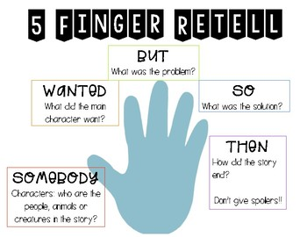
What is in your bag?
Fifth Grade Instructions
Handouts
Materials
“Roll a Winter Story” Directions and Handout
“Write a Summary” Directions and Handout
1 Die
1 Dry-erase marker (with eraser top)
Plastic sheet protector
Activity directions and Handouts.
Activity 1
Activities to work on with your child.
For the “Roll a Winter Story” Activity, take the foam die and roll three times to determine the characters, setting, and problem of your story (according to the included guide sheet). Once you have determined the characters, setting, and problem, you and your child can create a story using those ideas.
Parents will work alongside their child to help support and facilitate learning.
Activity 2
After reading a story with your child, take a moment to summarize the story events. You can use the included summary template to quickly go over the story’s events and increase reading comprehension.

Slide 16
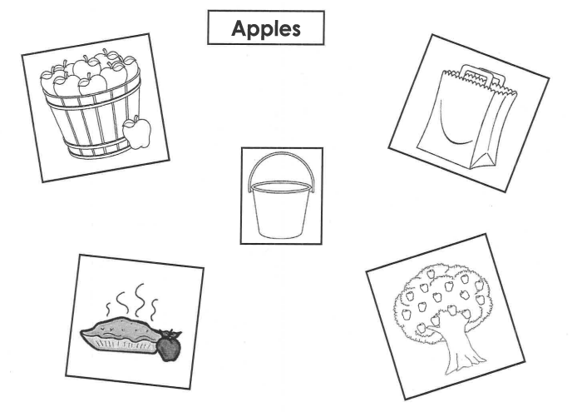
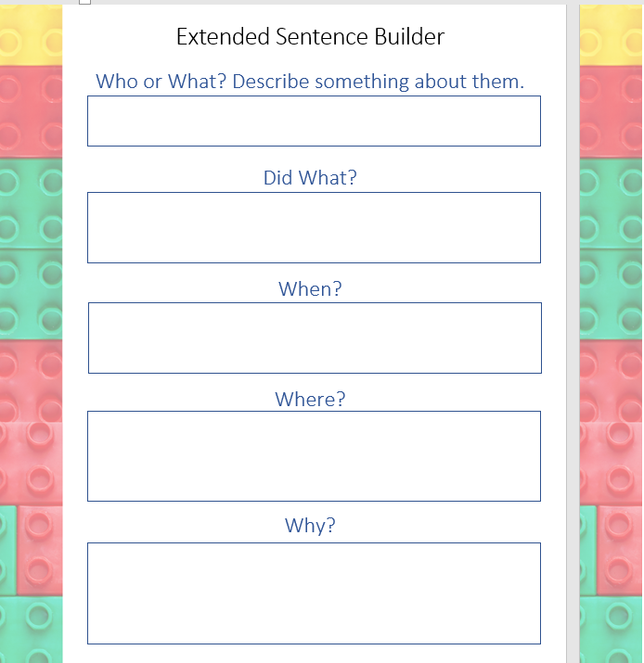
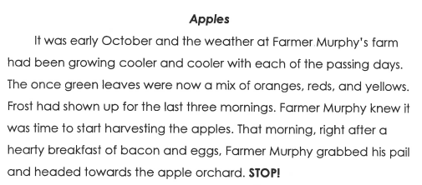
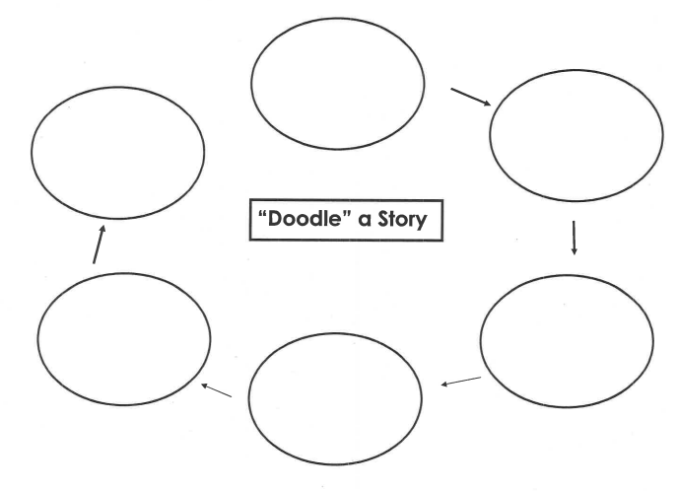
Additional Support
Activity 1:
Give the Apples Picture Mat to your child. On the Apples text page, notice the six pre-selected sections
in the text. Read the Apples story until you reach the word STOP. Ask your child to think about what is happening in the part of the story you've just read. They will point to the picture on the mat that represents that part of the story. Continue this process until the end. Feel free to reread the story for fun!
Handouts
Activity 1 Materials
Apples Picture Mat
Apple Story
Activity 2 Materials
Doodle Story Sheet
Activity 3 Materials
Extended Sentence Builder Sheet
Activity 2:
Chose any story to read and pre-select six stopping points in the text. Give your child the "Doodle" a Story sheet. Read the selection to your first stopping point. Ask your child to "doodle" one image that would help them remember that specific piece of text. Remind them that a "doddle" is a quick drawing. Allow 30 seconds for completion before moving to the next stopping point. Your child may use their "doodle" to write a story summary.
Activities to work
on with your child.
Your child can remember and react to reading and writing in multiple ways. Feel free to involve the five senses! As you read to your child, ask what the author wants the reader to see, hear, feel and experience as you read. These 3 activities will encourage your child to picture their story and write amazing sentences!
Activity 3:
Give your child the Extended Sentence Builder sheet. Ask your child to think of an object and write the object in the first rectangle. In the second rectangle, extend the sentence to reflect what the object did or might do. In the third rectangle, rewrite the sentence to include when the object did the action. In the last two rectangles, your child decides where and why the action occurred. Reference the example page. Ask your child to read to you their extended sentence!
Please click here to print the extra the activities. Aditional support Activities

Slide 17
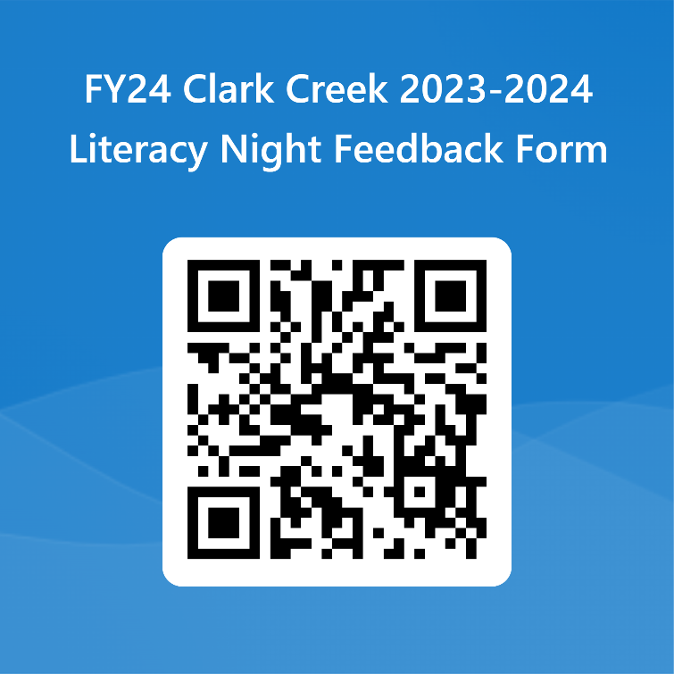
Thanks For Attending
Your opinion is important to us!
Please complete the survey using this link: https://forms.office.com/r/pM4TtFWs1t
Or by scanning the QR Code below:

