Slide 1
Highland Middle School
2023-24
Welcome to Parent Night
Bienvenido a la Noche de los Padres

Slide 2
ParentSquare
Highland School District's communication tool
  Teachers, principal, attendance
  Conferences, emergencies, school closure
Text or Email
Easy to communicate & stay up to date on classes

Slide 3
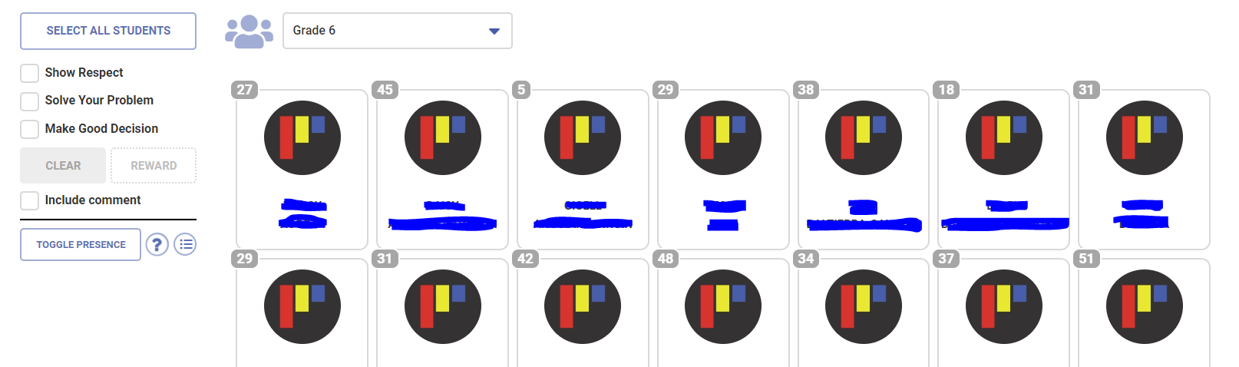
PBIS - Rewards

Slide 4
PBIS - Reflections
Classroom expectations
Grade, teacher, period, core value
Feeling, description, reflection of behavior and future prevention

Slide 5

PBIS - Referrals
Referrals - Office managed
Skyward

Slide 6
Skyward
Parent Username
  Advisors have username if needed
Student attendance & grades
If you do not know password, “Forgot your Login/Password?”
Help?
  tconnolly@highland.wednet.edu (reference student name)

Slide 7
Social Emotional Learning
Advisory
  Check In & Check Out time
  Executive Functioning
Second Step, Committee for Children

Slide 8
Student Laptops
Laptops needed everyday
  With charger
Laptops charged every night
Student responsibility (family)
  Fines range up to $400

Slide 9
Harassment, Intimidation, Bullying
HIB
HIB is not OK
Respect other people
  You may not touch others
  You may not talk about others – verbally or online
  Racism & racist language is never ok

Slide 10
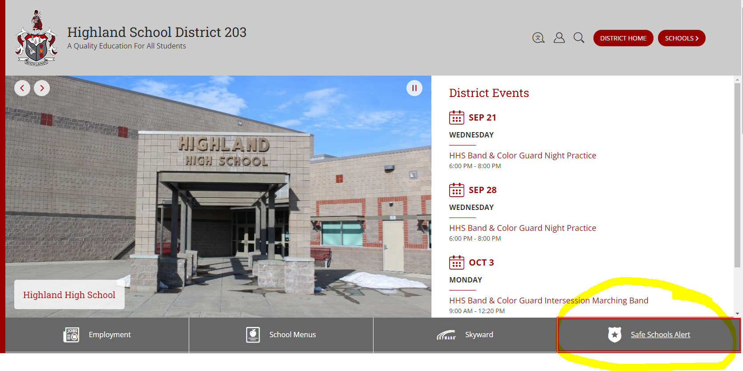
Safe Schools Alert – Vector Alert
Anonymous way of alerting administration to a safety concern.
IF YOU SEE SOMETHING, SAY SOMETHING.
Our goal is to keep school a safe place for all students and staff.
Vector Alert (safeschoolsalert.com)

