Slide 1
Cocoa and Conversation with
Mrs. Hendrix

Slide 4
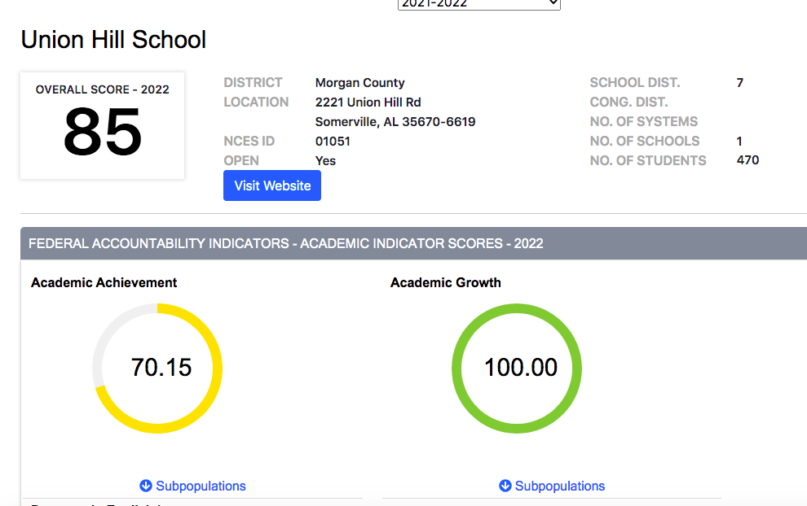
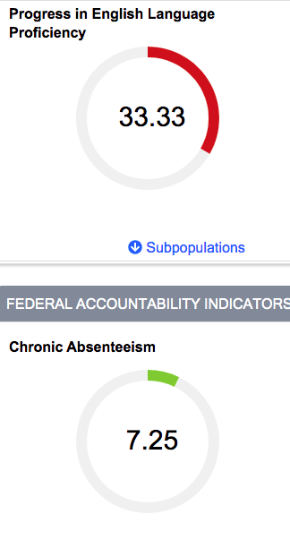
State Report Card

Slide 5
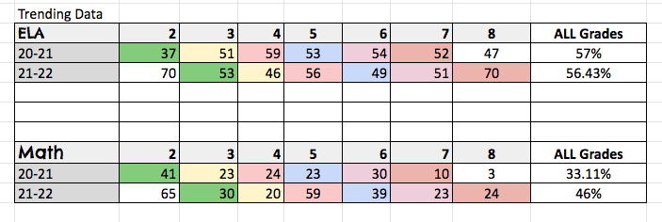
PAST ACAP Scores

Slide 6
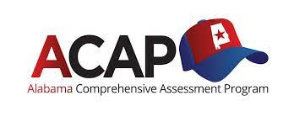
ACAP Testing

Slide 7
What is ACAP?
The Alabama ACAP Summative Assessment is a comprehensive program designed to provide information about what students know in core academic areas. This test is a part of the Alabama Comprehensive Assessment Program and it is given once a year.
The Alabama Comprehensive Assessment Program (ACAP) assessment will be administered to grades 2-8 in the spring.
The purpose is to establish a baseline for growth to measure students progress in subject areas of Reading, ELA, Science, and Math

Slide 8
Mark your calendars!

Slide 9
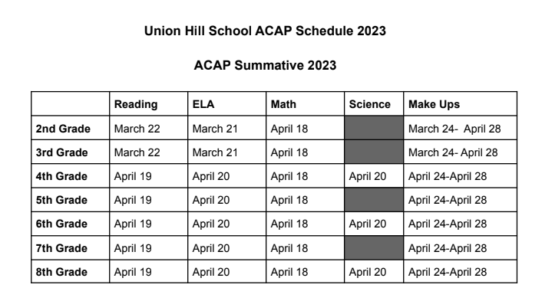

Slide 10
Things to help prepare for the test!
Allow them to participate in the online summative sample test, online tools
• Rest and be prepared for the test
• Arrive on time and be prepared to begin on time
• Schedule any appointments after school
• Constantly talk and communicate with your child’s teacher
• Students should bring their devices to the school for the assessment

Slide 11
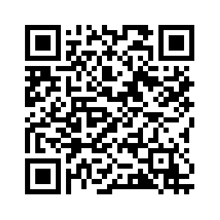
Online Training Tools
This is the location where your child can participate in a practice test and learn how to navigate through the various item specs.

Slide 12
ACAP & Alabama Literacy Act
ACAP is one of the Good Exemption Clauses

Slide 14
Thank you for coming!

