Slide 1
CIS
Launch
Launch
University’s College in the Schools
Como Park Senior High School

Slide 2
What are College in the Schools?
Como Park Senior High School
The University of MN Department of Extension Classes offers high school students opportunity to take U of M courses at Como Park Senior High School AND receive college and high school credit.

Slide 3
What are the enrollment requirements?
You Got This!
Varies, depending on the class; please refer to hand out in your folder
Have a teacher’s recommendation
The number of students per section is limited, depending on the course.

Slide 4
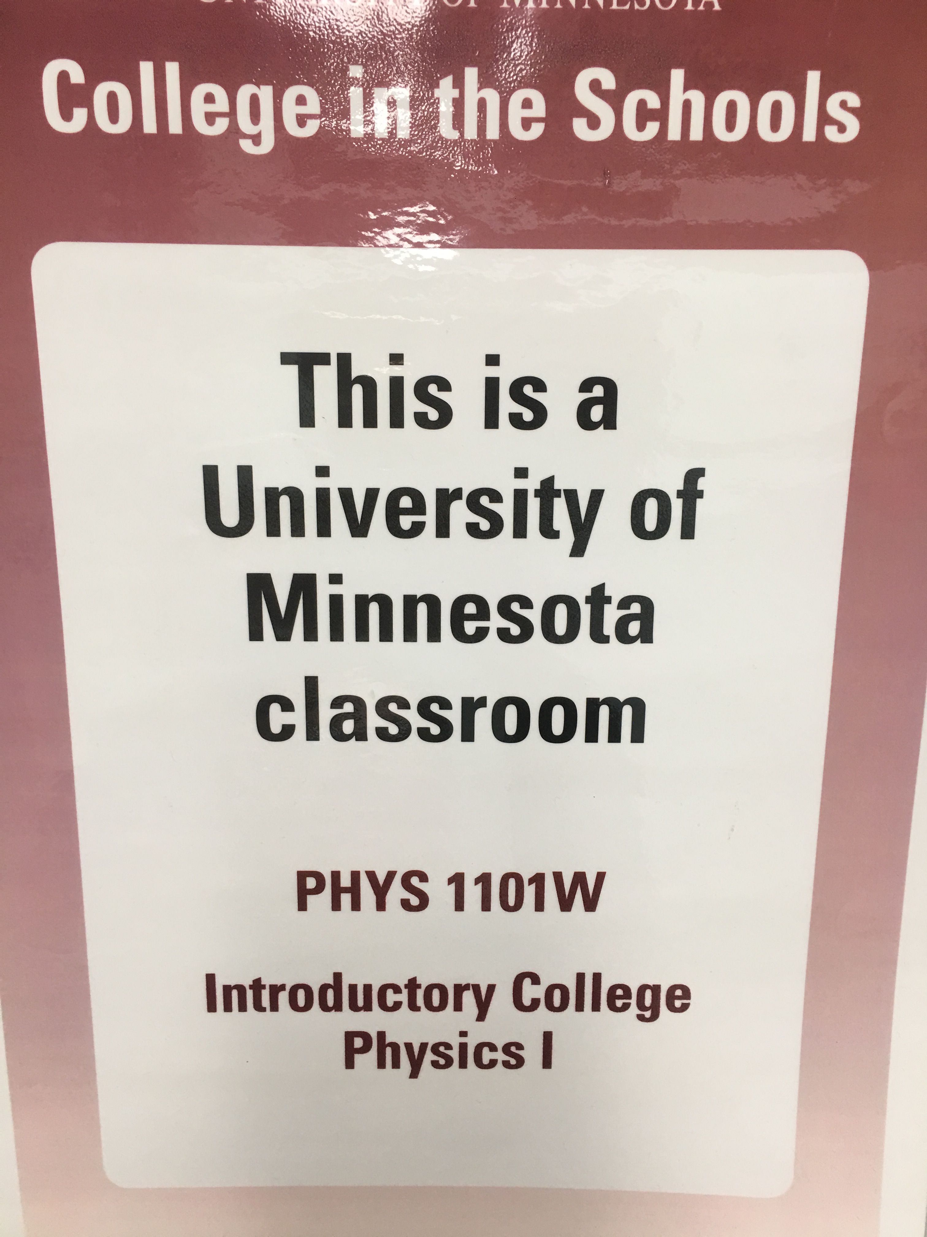
What are the course requirements?
Courses offered at Como Park Senior High School
Students are officially enrolled through the U of M, where grades earned will remain on their permanent academic records.
Students must be motivated and willing to perform on-going, independent work, and in group settings.
Each course has attendance requirements.
CIS Courses at Como Park Senior High School
Introduction to College Physics
Introduction to Public Speaking
Writing Studio
Introduction to Literature: Poetry, Drama, Narrative
College Writing
Intermediate French I

Slide 5
Comparison
How is CIS different from AP?
CIS Courses
AP Courses
The College in the Schools program delivers introductory-level University of Minnesota credit courses to advanced juniors and seniors
Complete assignments and classroom participation as required by University Syllabus
Earn U of M credit by passing the course
Advanced Placement Courses are based on college-level materials as authorized by College Board for high school students
Not necessary enrolled in an AP class to take the AP exam
Must take and passed AP exams in May to be eligible for college credits
VS.

Slide 6
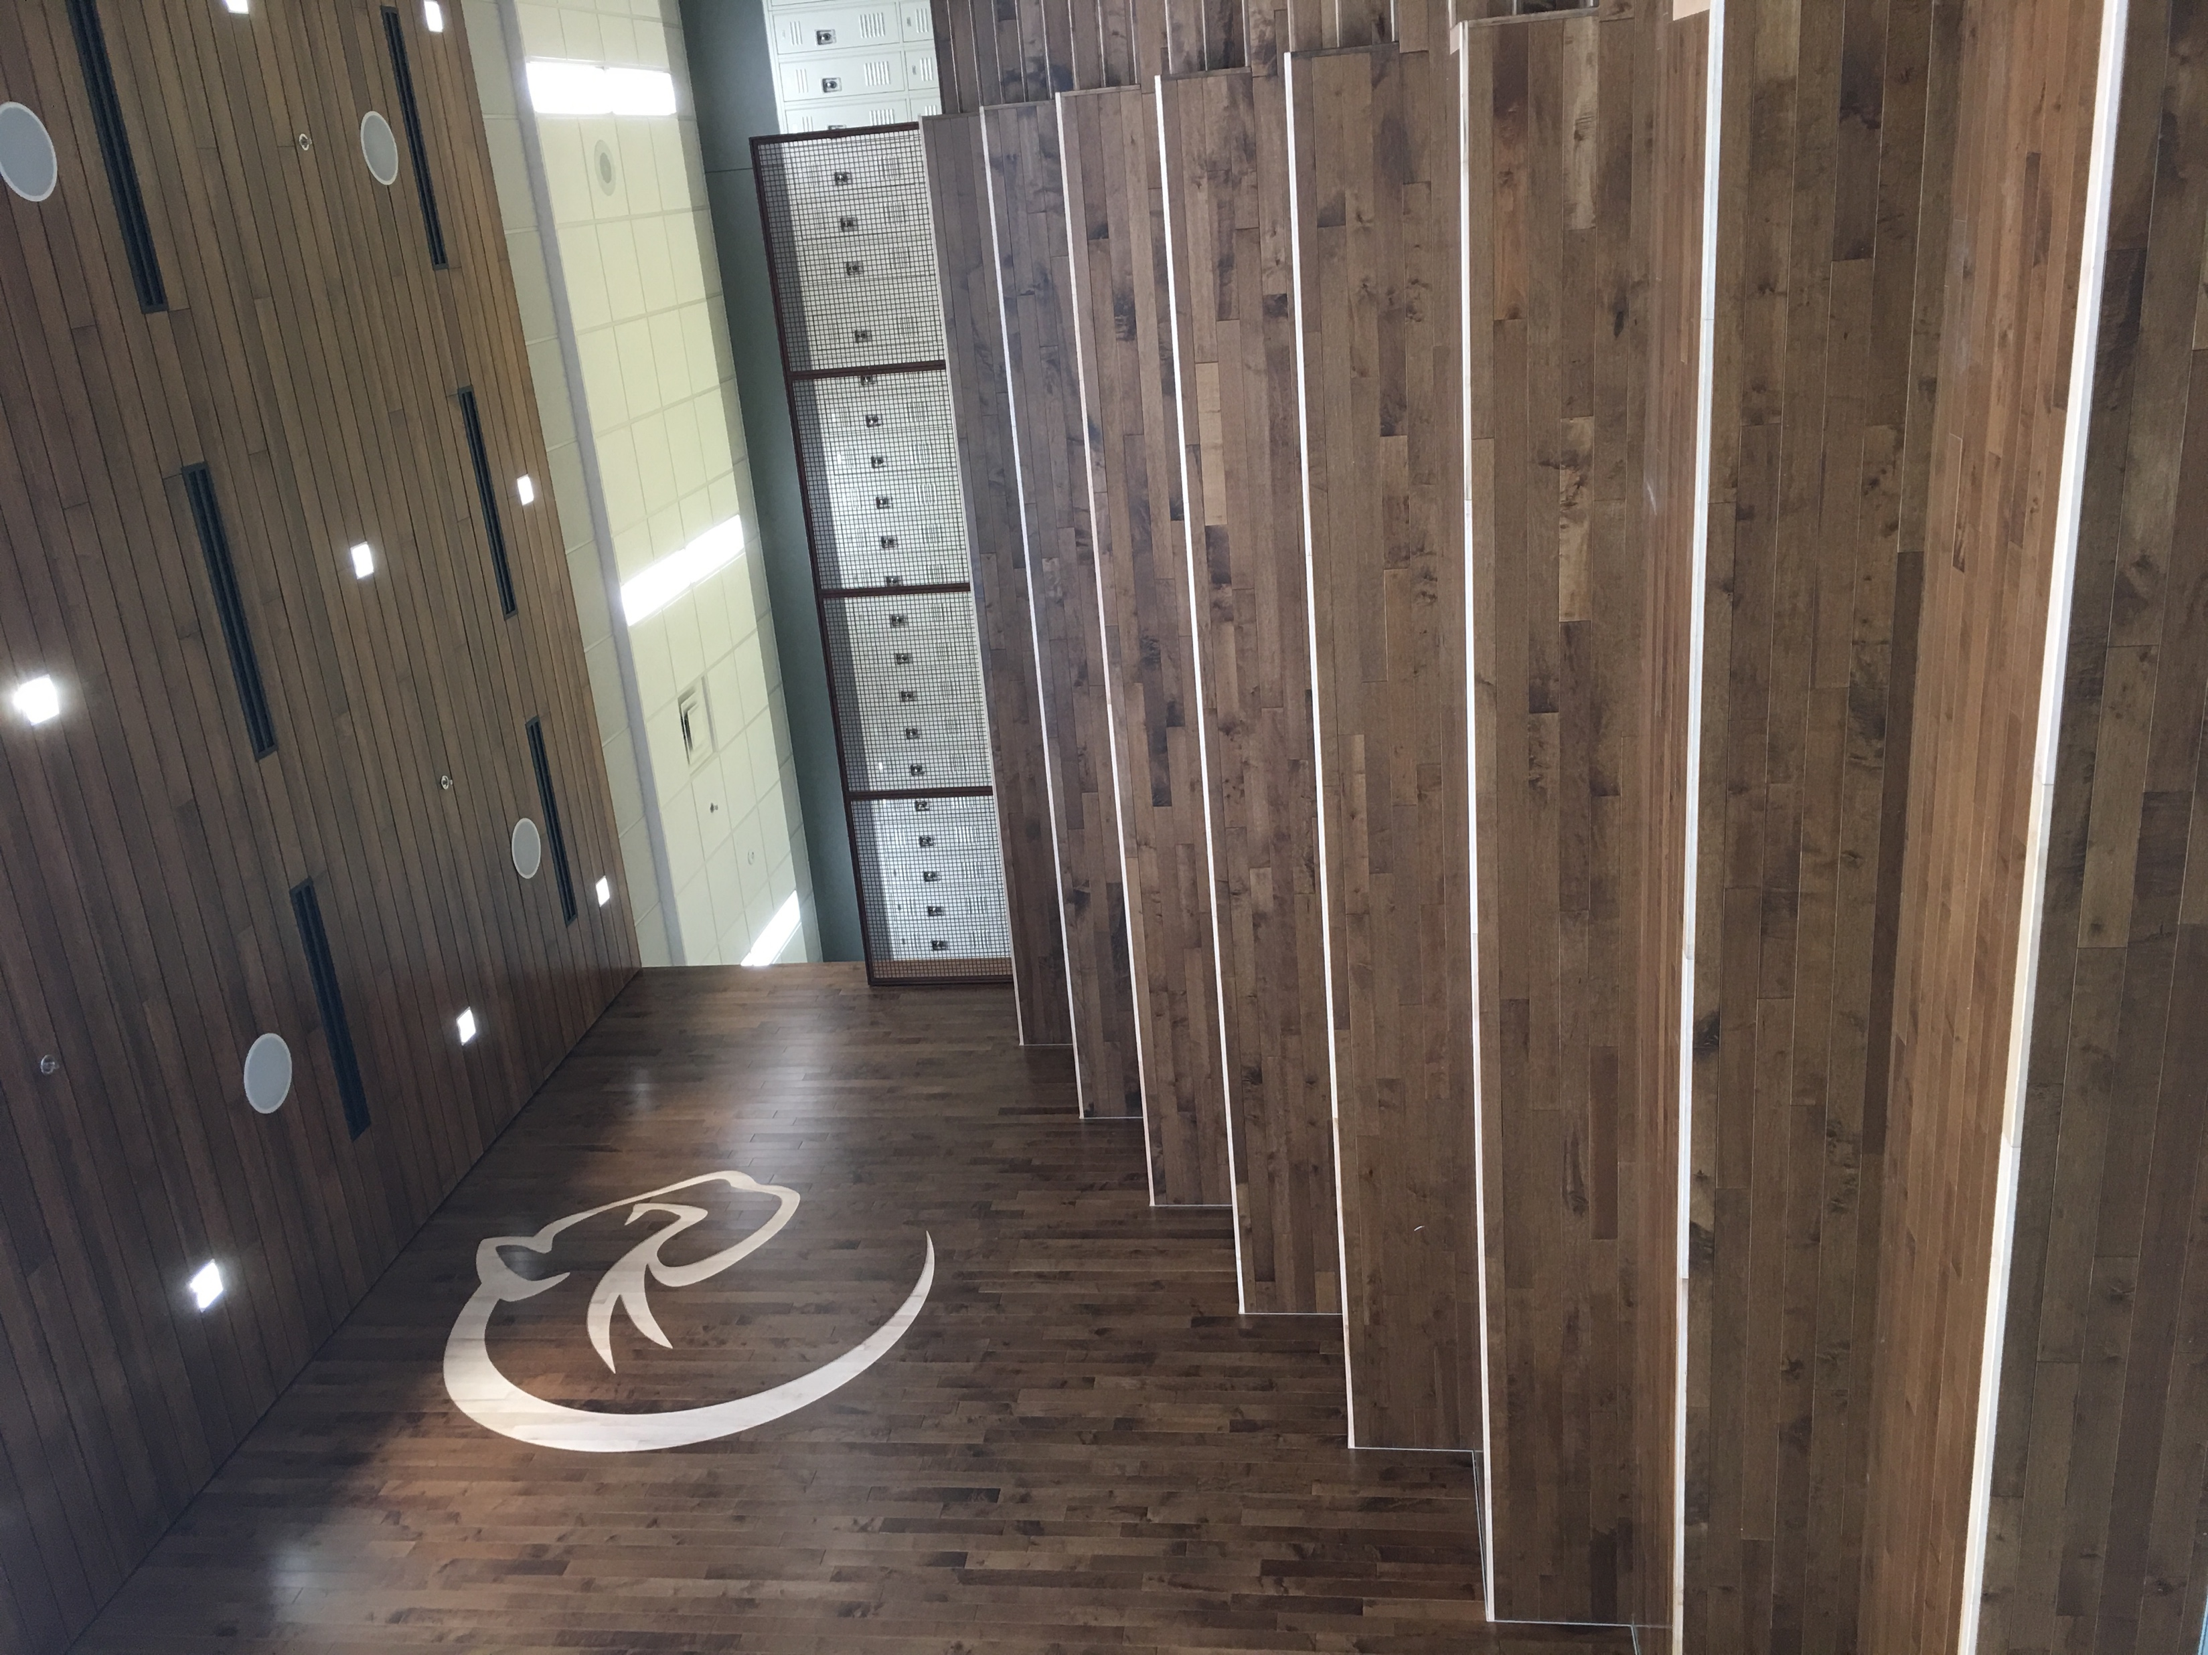
What’s in it for you?
Earn college credit from the U of M while completing your high school credits
Save thousands of dollars in tuition costs
Be better-prepared for college
Imagine Yourself
Here

Slide 7
How do I enroll?
Talk to your counselor or the instructor in the course you want to take.
Questions?

