Slide 1
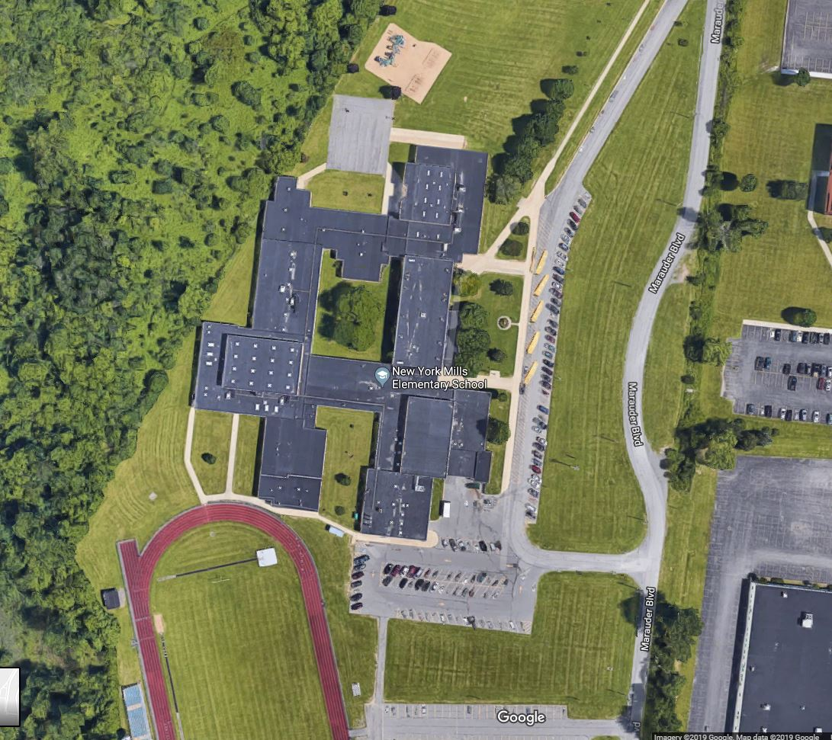
Energy Performance Contract Project
Public Information
Meeting – Nov. 17, 2020
Issues
Welcome and Company Introductions
Items of Discussion
Energy Performance Contract
What is an EPC ?
Review of Scope Items for the Project
Financial Project Summary
Please Vote on December 15th
Questions

Slide 2
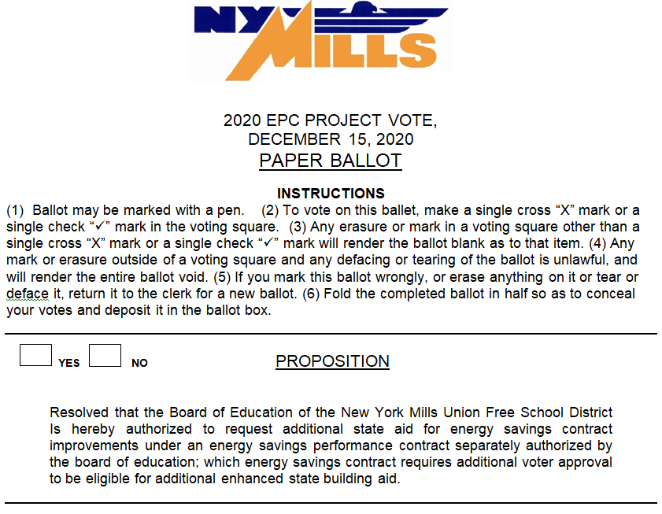
Welcome and Company Introductions

Slide 3
Brian A. Manning – Vice-President Teitsch – Kent – Fay Architects, P.C. – School District Architect
Eugene Waldbauer, Energy Executive Danforth – ESCO for NY Mills EPC Project
Energy Services Company (ESCO) Headquartered in Upstate NY since 1884.
One Stop Solutions Provider.
High Performance – No Compromise - Quality is #1!
Lighting Expertise & Mechanical Expertise
ESCO That Builds - Eliminates a Layer of Markup
Welcome and Company Introductions

Slide 4
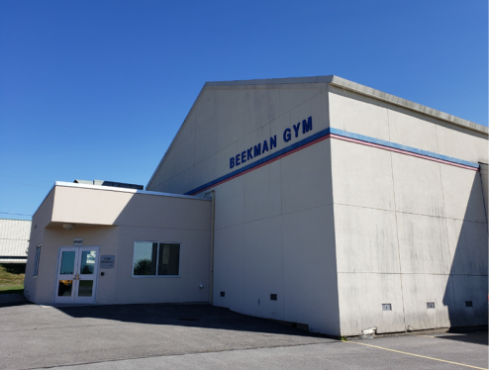
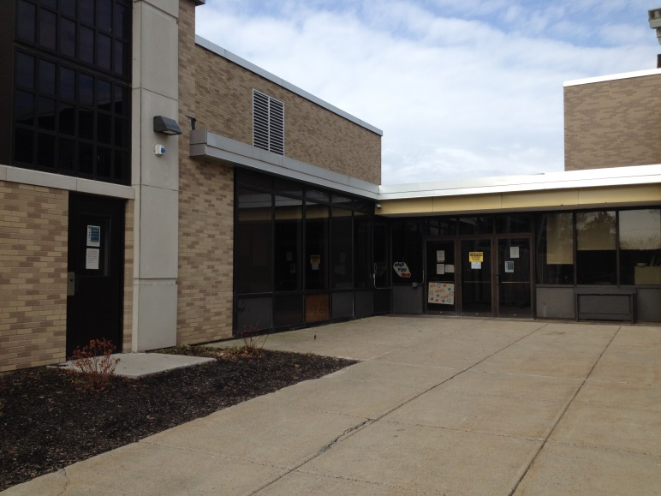
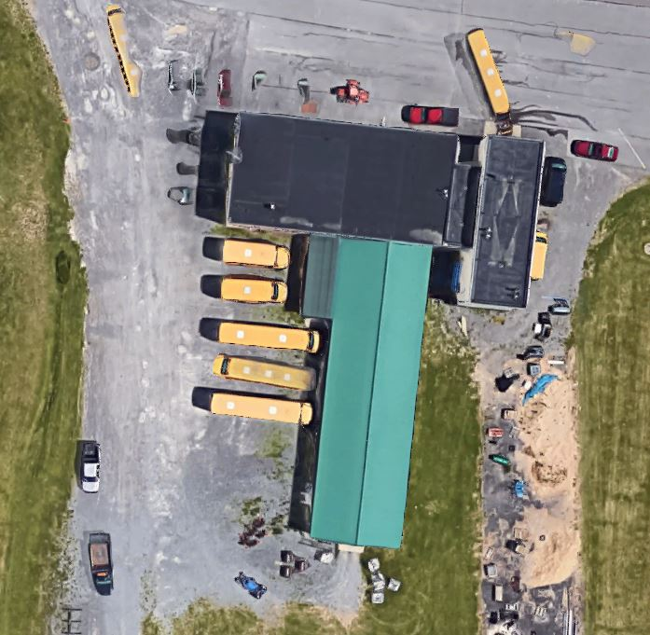
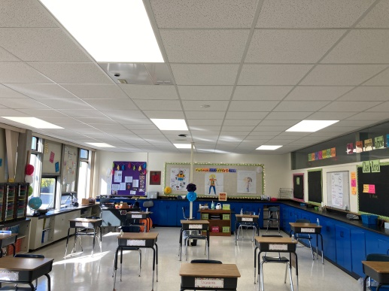
$1.33 Million Project Size
Previously approved by the Board of Education
Involves work at:
School Building
Beekman Gymnasium
Bus Garage Building
District is requesting voter approval for an additional 10% State Aid
Items of Discussion

Slide 5
Approved by the Board of Education
An energy performance contract (EPC) is an agreement with an energy service company (ESCO) for energy services in which energy systems are installed, maintained or managed to improve the energy efficiency of, or produce energy for, a facility …
An EPC can provide a school district (district) with an alternative to financing energy projects without requiring the issuance of bonds or notes.
State of New York
Office of the State Comptroler
What is an EPC ?
Enabled by New York State Energy Law –
Article 9
Funded by Guaranteed Energy Savings
No Impact on Tax Levy
Does Not Require Voter Approval
New York State Education Department Oversight
Encourages Energy Performance Contracts for Schools
Must Review and Approve the Project
Code Compliance
Energy Savings
Energy Performance Contract

Slide 6
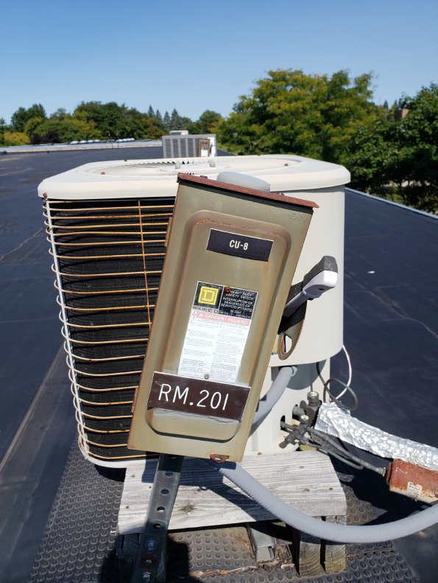
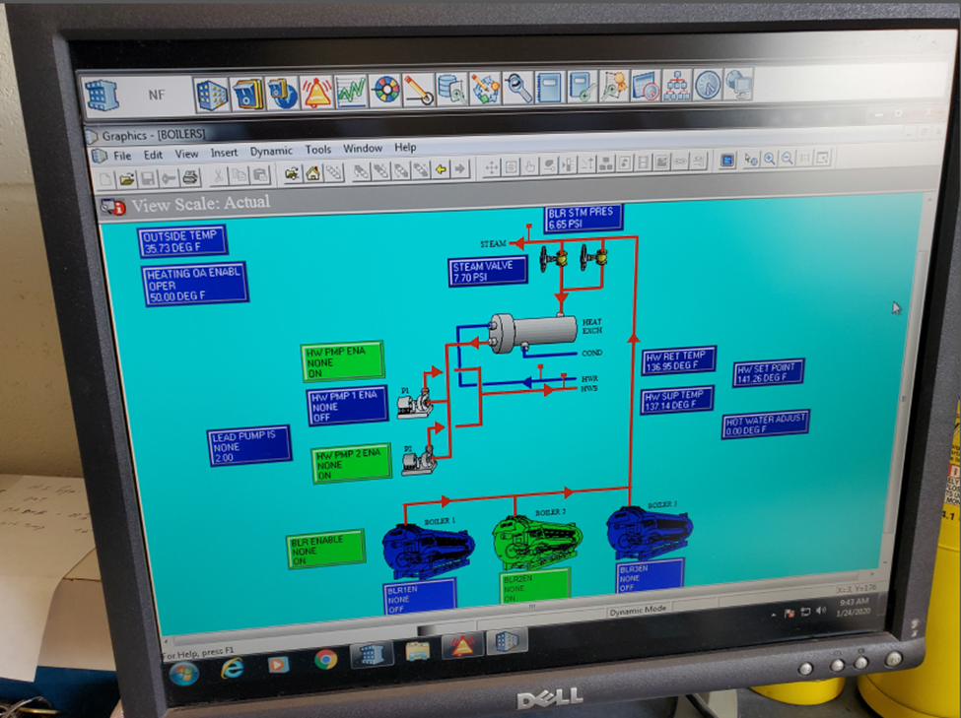
Facility Improvement Measures (FIMS)
3 Primary Issues to be Addressed
Classroom and Corridor Lighting
Mechanical Units at roof
Controls Systems
Scope Items

Slide 7
Energy Performance Contract
The NY Mills UFSD is moving forward with a $1.33 million dollar Energy Performance Contract (EPC) to reduce our energy consumption throughout the District and increase revenue through state aid. The project pays for itself through the energy savings that it creates and creates positive cash flow via the aid incentive.

Slide 8
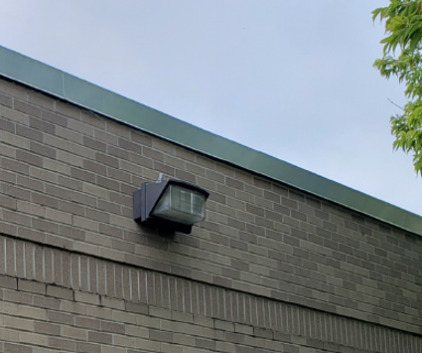
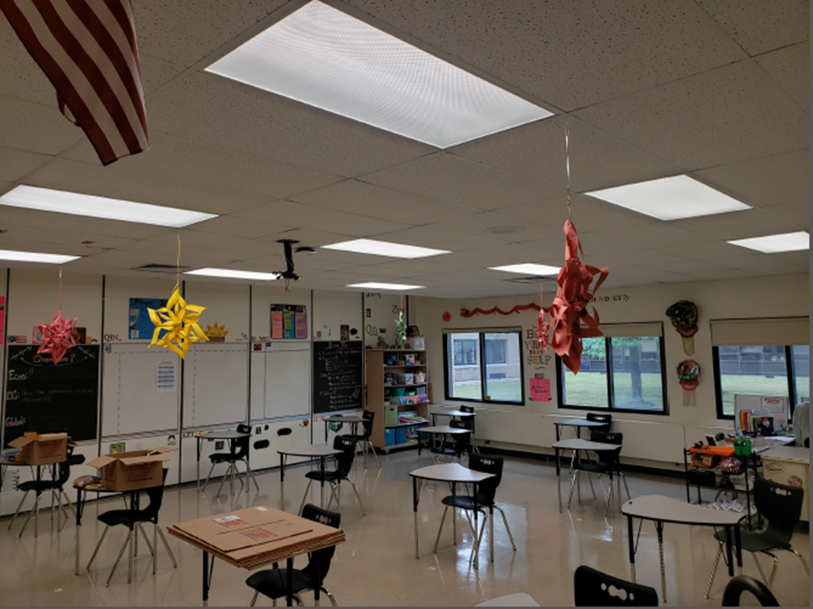
Scope Items of the Project
Infrastructure Upgrades
Controls: Replacement of 20 year old system
Mechanical: 15 Cooling Systems
Lighting
District Wide LED Retrofit (Classrooms and Corridor Lighting)
All lights that are not currently LED
Includes dimming in classrooms where new lights are being installed
All exterior wall packs

Slide 9
Scope Items of the Project (cont.)
Cooling Systems
15 Cooling System replacements
Rooftop Condensing Units
Classroom Cooling Coils
HVAC Control System
Replacement and upgrade of District HVAC Control System
Upgrade from Pneumatic Control to Direct Digital Control
Upgrade of Beekman Gym Systems to Direct Digital Control
Add remote access to system and software upgrade

Slide 10
Scope Items of the Project (cont.)
Other Items
Building weatherization
Server room efficiency upgrades
Plug load controllers
Steam valve re – design and replacement

Slide 11
Financial Project Summary
Investment:
$1,327,649
Average Annual Energy Savings:
$46,403
Annual Maintenance Savings:
$37,775
Utility Incentives:
$25,142
State Aid Reimbursement:
$1,120,552

Slide 12
Please Vote on an additional 10% State Aid!
December 15, 2020

Slide 13
Any Questions ?
Thank you for your time and attention this evening.
Brian A. Manning
Eugene Waldbauer

