Slide 1
How To Read a Transcript

Slide 2
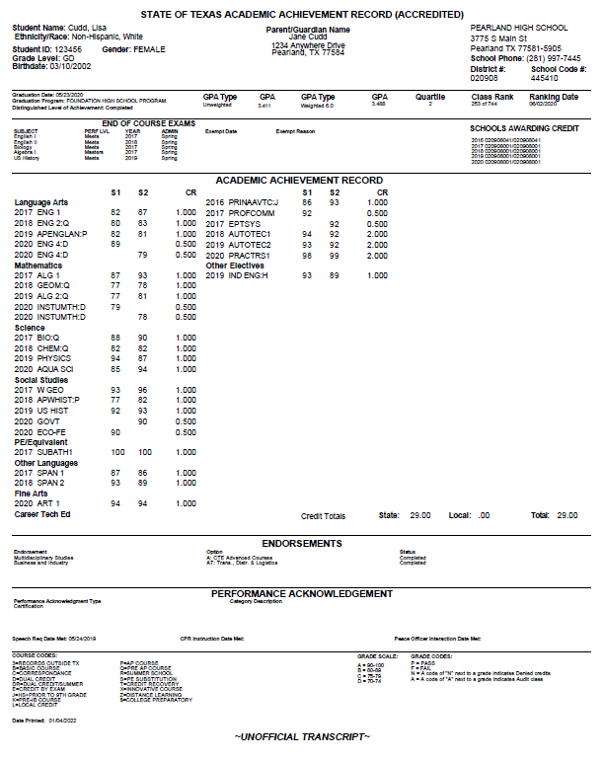
Sample Transcript
Notes:
Difference between official and unofficial transcript

Slide 3
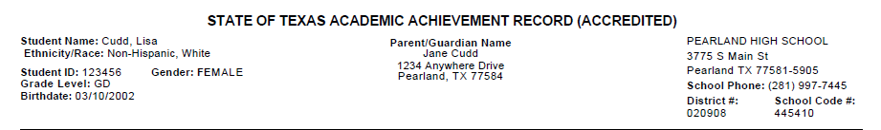
Demographics (Who, What, Where)
Notes:
Keep this document secure as it has student personal information
Student classification is based on total credits at the beginning of each school year
9th –> 0 – 0.5
10th -> 5.5 – 11.0
11th -> 11.5 – 16.5
12th -> 17.0+

Slide 4
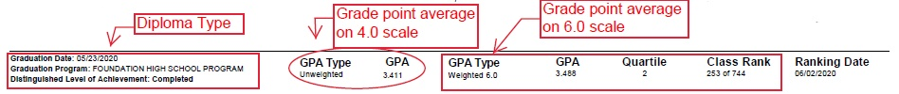
Grad Plan, GPA, Quartile, Class Rank
Notes:
GPA:
What is the gpa (grade point average)?
When is the gpa calculated?
What courses are not included in gpa calculation?
Why is the gpa important?
Rank:
What is a rank?
Why is a rank important?

Slide 5
STAAR / EOC Info

Slide 6
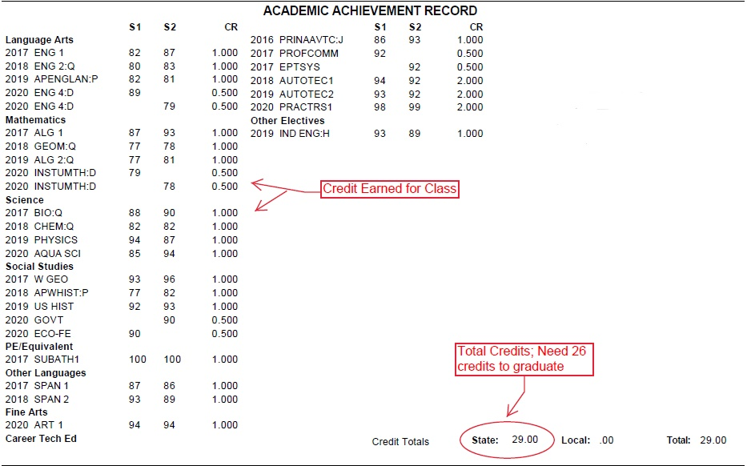
Academic Achievement Record
Notes:
The difference between state and local credits
State
Local

Slide 7
Endorsements
Notes:
Endorsement:
Number of credits needed for selected endorsement – 4 credits
Show chart from course selection handbook
How to change endorsement selection?

Slide 8
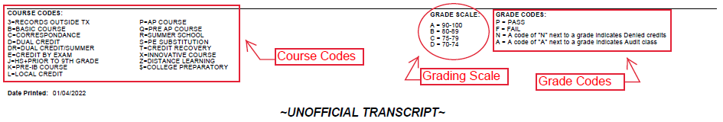
Course Codes (the key)
A = 90-100
B = 80-89
C = 70-79
F = Below 70
Notes:
Explain denied credits

