Slide 1
#BREAKTHESTIGMA
A Mental Health Guide for Coaches & Athletes

Slide 2
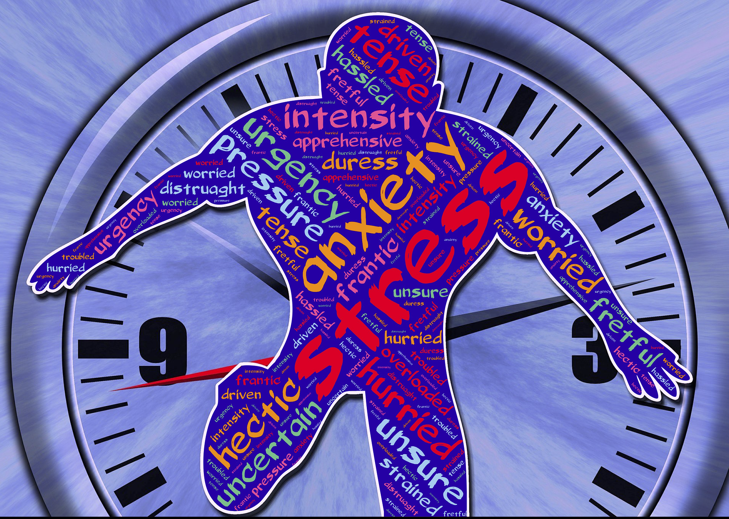
What Message Is The Artist Portraying Here, In Regards To Sports & Mental Health?

Slide 3
KNOWLEDGE CHECK

Slide 4
Fact or Myth?
A child and/or young adult with a psychiatric disorder is damaged for life.
MYTH, A psychiatric disorder is by no means an indication of a child’s potential for future happiness and fulfillment. If a child’s struggles are recognized and treated—the earlier the better—he/she has a good chance of managing or overcoming symptoms and developing into a healthy adult.

Slide 5
Fact or Myth?
Therapy for children and/or young adults is a waste of time.
MYTH, Therapy for childhood psychiatric disorders/illness focuses on changing the thoughts, feelings, and behaviors that are causing them serious problems. Research has shown that during the first few years, when symptoms first appear, treatment interventions are most successful.

Slide 6
Fact or Myth?
1 in 5 young adults aged 13 to 18 in the U.S. live with a serious mental health condition.
FACT, The contributing factors such as physical, emotional and social changes, including exposure to poverty, abuse, or violence, can and will make adolescents vulnerable to mental health problems.

Slide 7
Fact or Myth?
The average delay between the onset of mental health symptoms and intervention is 8 to 10 years.
FACT, There are several factors that delay mental health treatment such as, but not limited to: stigma, misdiagnosis, religious beliefs, self-denial, and financial constraints. However, early intervention can prevent most negative impacts of mental illness.

Slide 8
Mental Health Terminology
Mental Health: “A state of well-being in which an individual realizes his or her own abilities, can cope with the normal stressors of life, can work productively and is able to make a contribution to his or her community.”
Mental Illness: “A health condition involving changes in emotion, thinking or behavior (or a combination of all).”
Stigma: “A mark of disgrace that sets a person apart from others.”
Awareness: “A concern about and well-informed interest in a particular situation, development and/or cause.”

Slide 9
Common Signs & Symptoms of Mental Illnesses
Signs
Symptoms
Change in performance
Constant Irritability, Disobedience and/or Aggression
Change In Energy Level (Sudden Increase or Decrease)
Odd or Unusual Behavior
Increase or Decrease in Weight
Increase or Decrease in Eating Habits
Withdrawal
Loss of Interest in activities that were once enjoyable
Extreme Range in emotions (High to Low)
Neglect of Personal Hygiene and Grooming
Disorganized or Confused thoughts
Suicidal Ideation
Excessive worrying and fears
Unrealistic beliefs or ideas
*Signs and Symptoms listed are generalized and do not encompass all.

Slide 10
Noticing one or more of these symptoms DOES NOT mean your athletes have a mental illness, with the exception to suicidal/homicidal ideation, then treatment should be sought after immediately.
Major life events, like the loss of a loved one, break-ups, accidents and others, can take a normal toll on your athlete’s mood and ability to function.
A physical illness, a new medication and even changes in medication dosage can cause some of these symptoms.
IT IS IMPORTANT TO GET TO KNOW YOUR ATHLETES, SO YOU DON’T MISJUDGE A SITUATION!

Slide 11
When To Suggest or Encourage Help?
The signs or symptoms, as aforementioned, are observed over a reasonable period of time and they aren’t linked to any obvious event.
Suicidal or Homicidal ideation or intent should treatment as a crisis at all times, no matter the circumstances

Slide 12
Who Can Help?
School’s Guidance Counselor
Mental Health Service Coordinator (Senia Powell 334.382.2665 ext. 1220)
Butler County DHR: 334.382.4400
South Central Alabama Mental Health Center: 334.382.2018
National Suicide Prevention Hotline: 1.800.273.TALK
Crisis Text Line: text HOME to 741741
National Alliance on Mental Health Hotline: 1.800.950.NAMI

Slide 13
How To Promote Positive Mental Health in Athletes
Get To Know Your Players. Build relationships and take time to learn their background & history
Regularly support, praise and support your players
Encourage open conversations about their feelings
Ensure a sense of dignity and respect amongst the team
Promote and encourage autonomy of each player
Actively listen for understanding. Allocate appropriate time for conversations, if needed.
Help players identify and use their strength to build strong problem-solving skills
Be aware of your attitude, tone and verbiage

Slide 14
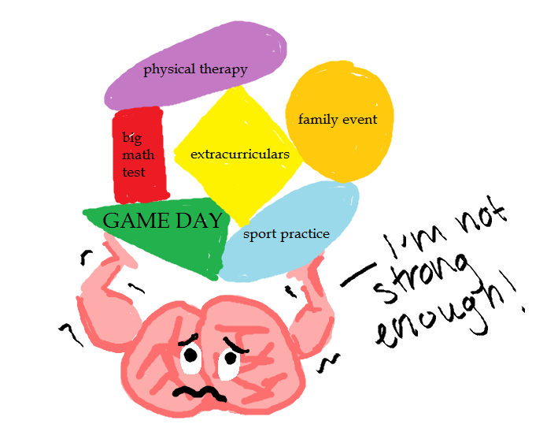
The Importance of Self-Care
As an athlete and coach, it is very easy to juggle many tasks and obligations at any given time (off-season and on-season) but it is very important to designate time to take care of yourself. Here you will find activities that can be done to support self-care. Though some may be simple, they are key to positive mental health.
Rest & Relax
Eat Real Food
Enjoy Time with Family & Friends
Address Your Pain
Get Some Sleep
Hydrate

Slide 15
