Slide 1

Focus District
Follow-Up Forum
Monday, March 28, 2016
Kathy Houghton
Superintendent of Schools

Slide 2
Essential Questions
What are the ramifications of continued identification under the ESEA Accountability Act?
What do we need to do to get our school district off of this accountability list?
What are the intervention, planning, and school improvement requirements for Focus Districts?

Slide 3
ELEMENTARY AND SECONDARY EDUCATION ACT
Focus District/School Designation
Madison Oneida BOCES
Office of labor Relations
Andrew V. Lalonde, Labor Relations Coordinator
March 28, 2016

Slide 4
NYS Elementary Secondary Education Act (ESEA)
On June 23, 2015, the US Dept. of Education approved New York’s ESEA Flexibility Waiver Renewal.
At the October 2015 Board of Regents meeting, the Board adopted permanent regulations to conform with the requirements of ESEA.
New York State of required by the ESEA Waiver to identify new Priority Schools, Focus Districts and Focus Schools.

Slide 5
How are Districts and Schools Identified?
New York State Education Department (SED) identifies low performing districts as “Focus Districts” and low performing schools within these districts as “Focus Schools.”

Slide 6
New York Mills Union Free School District
Designation
The N.Y.S. Education Department has designated the New York Mills Union Free School District as an underachieving “focus district.”
The designation came as a result of the performance index value identified by the State for students with disabilities.

Slide 7
What are “Focus Districts” and “Focus Schools”
Focus Districts have schools with low academic performance on Grades 3-8 ELA and Math Tests or low graduation rates with certain groups of students, such as those who are economically challenged, disadvantaged, students with disabilities, and English Language learners.
Focus Schools are schools within a Focus District that have low academic performances that are not improving.

Slide 8
SED Designations of “Focus” School
Schools with a 2014-2015 performance that places them among the lowest performing in an “accountability subgroup” are designated by the State as a “Focus School.”
“Focus School” designation is a result of one of the following:
One or more schools in the district being designate as a “priority school”.
One or more accountability groups in the district based on the 2014-2015 school year data as being among the lowest performing in the state for English language arts (ELA) and mathematics Performance Index (PI) results combined.
One or more of the accountability groups in the district being preliminarily identified for the 2010 graduation-rate total cohort as of August 31, 2014 as among the lowest performing in the state.

Slide 9
What is a “Focus” School
The accountability group(s) for which the district has been preliminarily identified have not met any of the progress filters listed in the methodology documents.
SEE: N.Y.S. Commissioner of Education Regulations Sections 100.18 and 100.19.

Slide 10
Criteria for the Identification of a Focus District and Focus Schools
The Department of Education identified Focus Schools based on the following factors, as defined by ESEA:
Schools with the lowest achievement of subgroups in terms of proficiency on the statewide assessments that are part of the state’s differentiated recognition, accountability and support system and are not making progress as defined by New York’s progress filters.
High schools with the lowest Graduation Rate for subgroups that are not making progress as defined by New York’s progress filters.

Slide 11
Criteria for Identification of Focus Districts/Schools
The Department identified Focus Schools using a two-stage process.
Stage 1: NYSED first identified Focus Districts with the lowest achieving subgroups for Performance Index (PI) and Graduation Rate that were not making progress.
Stage 2: NYSED then identified the lowest performing Title 1 schools statewide within the identified Focus Districts.
Non-Title 1 schools within the Focus Districts that met the Focus District cut points were also identified as Focus Schools.
Districts are identified as Focus Districts if any subgroup is identified either through the PI or Graduation Rate methodology.

Slide 12
What are “Progress Filters?”
Progress filters are alternate measures used to determine whether districts and schools have made sufficient educational growth and progress.
Some of the key progress filters are:
  Group has made a ten (10) point gain in the Performance Index from the prior school year.
  Median Student Growth Percentile is above Statewide average.
  Subgroup’s 4 and 5-year graduation rate is above Statewide average or has increased by ten percent (10%) over the last two years.

Slide 13
What Do Districts and/or Schools Have to Do?
Focus Districts and Focus Schools will undergo a school improvement process to help address the reasons why some students in the schools are not succeeding.
These districts and schools will participate in a State review process to identify the strengths and weaknesses of the district or school.
Districts and schools will use the information derived from these reviews to develop improvement plans.

Slide 14
District Effectiveness Reviews and Requirements
Commissioner’s Regulations 100.18 require that all Focus Schools participate in a diagnostic review of quality indicators.
The reviews are expected to inform subsequent:
1. School Comprehensive Education Plans (SCEPs); and
2. District Comprehensive Improvement Plans (DCIPs).

Slide 15
School and District Effectiveness Review (DTSDE)
This review evaluates school and district performance in 6 tenets:
1. district leadership and capacity;
2. school leadership practices and decisions;
3. curriculum development and support;
4. teacher practices and decisions;
5. student social and emotional development
health; and
6. family and community engagement.

Slide 16
School and District Effectiveness Review (cont.)
All Focus Schools are required to receive a DTSDE review in the 2015-2016 school year.
Focus districts with no focus school(s) will be expected to complete an annual, District Comprehensive Improvement Plan (DCIP).

Slide 17
What are the DTSDE Review Requirements?
This requirement can be fulfilled in one of three ways:
A NYSED-led IIT review;
A DTSDE review of three or more tenets led by an Outside Educational Expert with a District Lead Credential; or
A District-Supervised completed DTSDE School Self-Reflection.

Slide 18
District Comprehensive Improvement Plan Requirements
Focus Districts are required to develop a District Comprehensive Improvement Plan.
The purpose of this plan is to articulate how the district will use the full range of its resources to support improvements.
Focus Districts must utilize the Diagnostic Tool for School and District Effectiveness (DTSDE) and the DTSDE school visit review process as tools for improvement through the DCIP.

Slide 19
Requirements for the DCIP and SCEP
The DCIP and SCEP must specifically address the areas of need identified through the use of the diagnostic tool quality indicators.
They must be updated annually as approved by the Board of Education and implemented no later than the first day of school when students are in attendance.
Be developed in consultation with parents, school staff, and others pursuant to Commissioner’s Regulations Section 100.11.
Include an analysis of achievement of prior year goals.
Be made widely available through public means.
Are due to SED by Friday, July 31, 2016.

Slide 20
is a
Focus District without
Focus or Priority Schools
We were designated a Focus District due to the Performance of our SWD (Students with Disabilities) subgroup.

Slide 21
Requirements for the DCIP and SCEP
The DCIP and SCEP must specifically address the areas of need identified through the use of the diagnostic tool quality indicators.
They must be updated annually as approved by the Board of Education and implemented no later than the first day of school when students are in attendance.
Be developed in consultation with parents, school staff, and others pursuant to Commissioner’s Regulations Section 100.11.
Include an analysis of achievement of prior year goals.
Be made widely available through public means.
Are due to SED by Friday, July 31, 2016.

Slide 22
Additional Information Concerning Focus Schools
Additional information on the completion of the DCIPs and SCEP’s can be accessed by viewing archived webinars on the SED Office of Accountability website at:
http://www.p12.nysed.gov/accountability/Webinars.html.
SED further anticipates posting new technical assistance webinars regarding the DCIP process in the Spring of 2016.

Slide 23
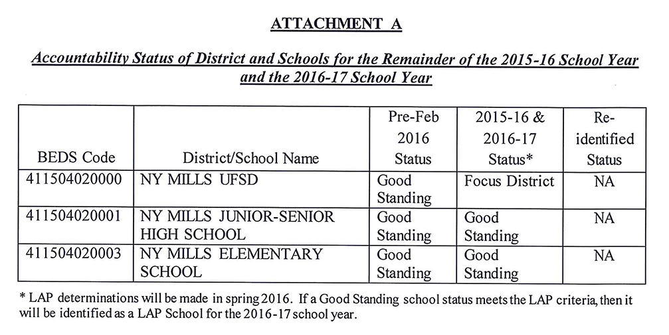
School District Status vs School Status

Slide 24

Focus District Identification
A district was identified as a Focus District for meeting one or more of the following criteria:
one or more schools in the district being preliminarily identified as a Priority School;
and/or
one or more accountability groups in the district, excluding the all students
accountability group, being preliminarily identified based on 2014-15 school year
data as among the lowest performing in the state for the English language arts
(ELA) and mathematics Performance Index (PI) results combined; and/or
one or more accountability groups in the district, excluding the all students accountability
group, being preliminarily identified for the 2010 4-year graduation rate total cohort as of
August 31, 2014 as among the lowest performing in the state; and
the accountability group(s) for which the district has been preliminarily identified has
not demonstrated improvement by meeting one or more the progress filters.

Slide 25
Two-Year Combination of Data for Performance if Group Fails for Participation
NY Mills UFSD
Grades 3-8 ELA (SWD)
2014-2015 Partic Enroll | 2014-2015 Partic Rate | 2013-2014 + 2014-2015 Partic Rate | Met Partic Criterion? | 2014-2015 Perf Enroll | 2014-2015 PI | 2013-2014 + 2014-2015 Perf Enroll | 2013-2014 + 2014-2015 Combined PI | 2014-2015 EAMO | 2014-2015 SH | Met Perf Criterion? | Made AYP
44 | — | 51% | û | — | — | 39⁰ | 10 | 44 | 20 | û | û
2014-2015 Partic Enroll | 2014-2015 Partic Rate | 2013-2014 + 2014-2015 Partic Rate | Met Partic Criterion? | 2014-2015 Perf Enroll | 2014-2015 PI | 2013-2014 + 2014-2015 Perf Enroll | 2013-2014 + 2014-2015 Combined PI | 2014-2015 EAMO | 2014-2015 SH | Met Perf Criterion? | Made AYP
45 | — | 40% | û | — | — | 30⁰ | 20 | 45 | 20 | ü | û
Grades 3-8 Math (SWD)
DRAFT

Slide 26
Focus School Removal Criteria
Subject to ESSA guidance, Focus Schools will be removed from status
if all of the following conditions are met:
Make progress: The school makes progress for two years in a row.
  To make progress, the identified subgroups’ PIs and 4-year graduation rates
  must be at least 10 points or higher than the cut points, or
  The identified subgroups meet one of the applicable progress filters.
Meet minimum requirements: In the second year, all subgroup PIs and 4-year
graduation rates must be above the cut points for identification.
  In the first year, the school’s 4-year or 5-year graduation rates must be above the
  cut points of identification.
NY’s current ESEA Flexibility Waiver requires that schools must meet participation
rate requirements for ELA and Mathematics for both years in order to be removed.

Slide 27
Districts and schools will not be removed from Focus designation unless all groups for which the district or school is accountable in ELA or math met the 95% participation requirements.
“
”
Ira Schwartz , Assistant Commissioner,
NYS Education Department
page 132 of
ESEA Flexibility Requests Updated June 10, 2015

Slide 28
Focus District Review Process:
  DTSDE (Diagnostic Tool for School and District Effectiveness)

Slide 29
Due to the Focus District Designation, New York Mills U.F.S.D. is required to:
conduct a DTSDE (Diagnostic Tool for School and District Effectiveness) review
complete and submit an official report including findings, evidence, impact, and recommendations to NYSED by 6/30/16
complete a DCIP (District Comprehensive Improvement Plan) and submit it to NYSED by 7/31/16

Slide 30
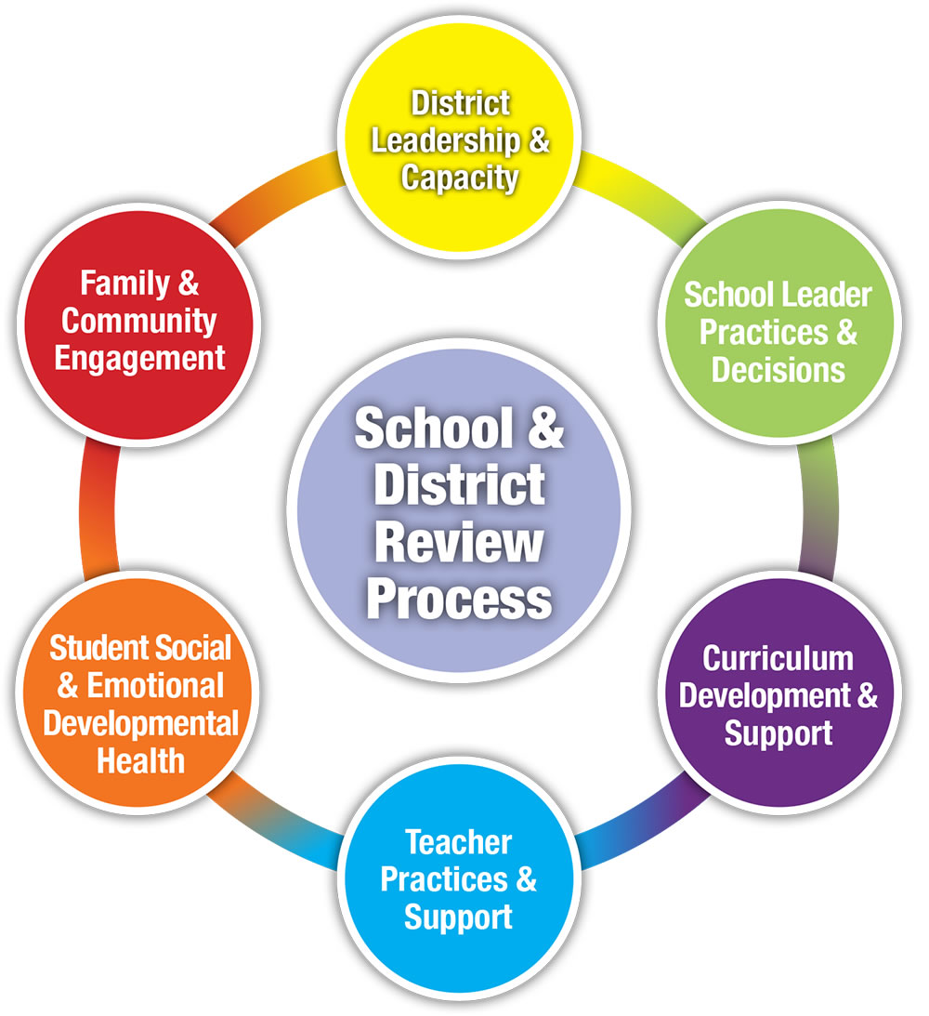
6 Tenets of the Diagnostic Tool for
School & District Effectiveness

Slide 31
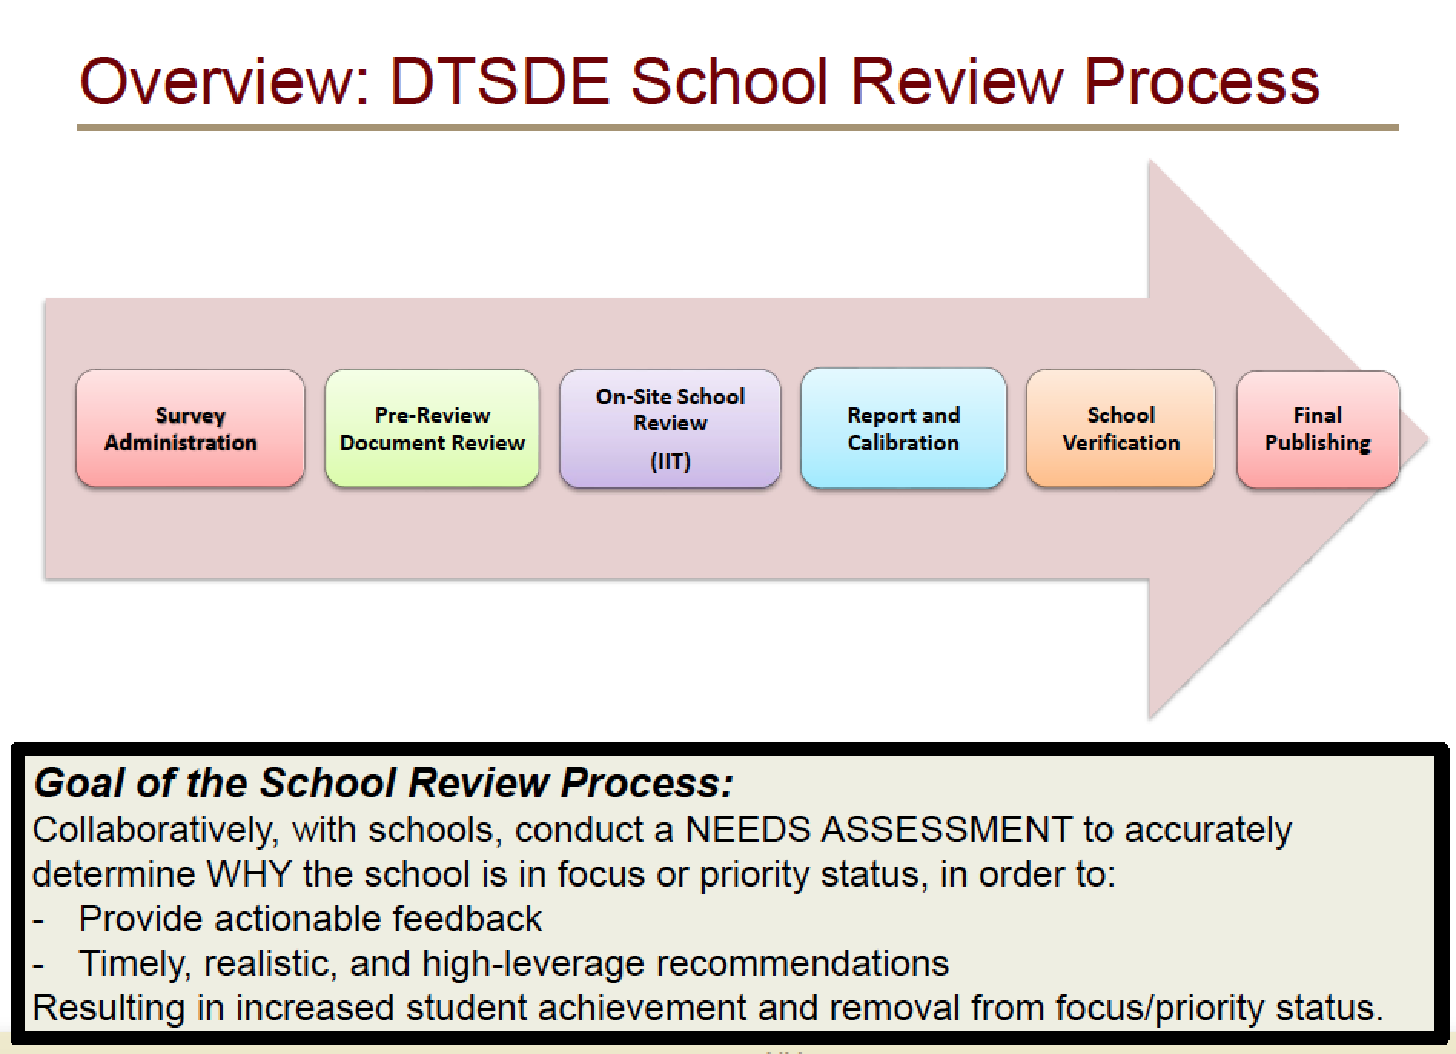

Slide 32
Three Types of Reviews:
IIT (Integrated Intervention Team) Review
District-led Review Using DTSDE Protocol
School Review (Focused on Common Core Conceptual Frame) with District Oversight

Slide 33
District-Led Review (must use DTSDE Protocol)
District-assigned lead reviewer must be DTSDE-trained/certified by NYSED.
Principals may not be a district representative on the IIT or District-Led Review Team
The Review Team may include other district reviewers that have received DTSDE training
Possible members: Content Specialists, Curriculum Coordinators, Special Education/PPS staff,

Slide 34
Other Review Requirements:
District-Led Reviews must include at least 3 focus tenets.
Districts must complete NYSED-approved surveys prior to (if possible) the District-Led Review
Members of Review Team chosen by district based on staffing needs/capacity must be DTSDE-trained.

Slide 35
Deadlines for Focus Districts:
June 30, 2016 -
July 31, 2016 -
Review and written report must be completed and submitted to NYSED, including principal interviews, focus groups (students, parents, staff), data and document reviews, classroom observations, presentation of findings,evidence, and improvement goals completed with written report submitted to NYSED; including surveys, self-reflections
District Comprehensive Improvement Plan (DCIP0 using findings and goals developed during review must be completed; written plan must be approved by Board of Education and submitted to NYSED.
Annual review of progress towards goal attainment required

Slide 36
Ramifications of Continued Identification as a Focus District
Focus Districts can make improvements in performance and participation rate for two (2) years in a row to be removed from that status.
If these do not improve, the District will continue to be Focus status.
Focus Districts do not become Priority schools.

Slide 37
Essential Questions
What are the ramifications of continued identification under the ESEA Accountability Act?
What do we need to do to get our school district off of this accountability list?
What are the intervention, planning, and school improvement requirements for Focus Districts?

Slide 38
Question and Answer Session

