Slide 1
Estacada School District
2023 Longitudinal Performance Growth Targets Presentation
In Alignment with “Aligning for Student Success: Integrated Guidance for Six ODE Programs”

Slide 2
Purpose for Presentation
To share back information about Longitudinal Performance Growth Targets (LPGTs) and measuring progress related to the Integrated Plan for 6 ODE Programs.
To provide additional context on LPGTs.
To seek board approval for the Integrated Grant Agreements with embedded LPGTs.

Slide 3
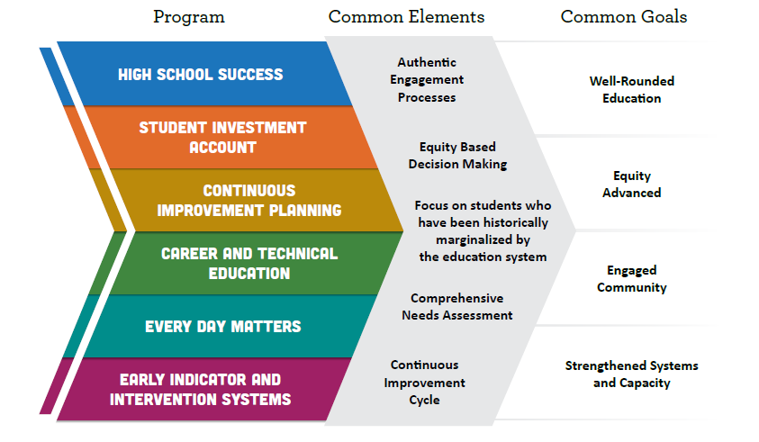
Background: Six Programs & Common Goals

Slide 4
Our Integrated Plan
Outcomes and Strategies
Build stronger community relations and partnerships with local businesses, families, and community organizations with a focus on focal groups.
Increase the number of adults supporting learning in the classroom for our Emerging Bilingual and Special Services students.
Increase the awareness and practice of equity and culturally responsive teaching in our system with staff, students, and families.
Improve our systems of social emotional and behavioral supports through trauma informed practices and adult interventions.
Increase our 9th grade on track rate by 9% and our graduation rate by 10% for all sub groups*.
Increase by 25% the number of students completing career pathways and earning college credit.
Meet ODE physical education requirements for instructional minutes at our middle school and provide class size reduction FTE.
Notes:
This is a placeholder slide to remind your board on the key investments of your integrated application as they align with or inform your LPGTs closely or loosely

Slide 5
Context for LPGTs
The final stage of our application process
Statutorily required under the Student Investment Account
Embedded in our Grant Agreement
Reported on Annually
Performance Review Required every Four Years
Notes:
These came after we had submitted our application which explains why some of our outcomes are different then the goals.

Slide 6
ODE’s Approach to Shared Responsibility
Shared Responsibility. ODE is responsible for ensuring that taxpayer dollars are being expended appropriately for compliance with federal and state laws, regulations and policies, while also meeting the intent of the legislation and enacting real change in districts, charter schools, communities and the lives of students.
Monitoring and reporting progress is a responsibility and opportunity to share a performance review back to our communities and boards whether our investments are reaching outcomes we were aiming for.
Previous accountability measures often served to narrow the curriculum, using shame and blame of schools as an overly simplistic tactic while offering over-promised or oversimplified outcomes.

Slide 7
Additional Performance Measures
Besides LPGTs, these additional inputs inform progress:
High School Success Eligibility Requirements
State CTE Perkins Performance Targets
Progress Markers
Quarterly and Financial Reporting
Annual Reporting
Auditing (SIA funds only)
Performance Reviews
Notes:
To help build context about the other mechanisms and forms of information that help illustrate progress over time. Here, if the district or school developed LOMs, highlighted the purpose and reasons may be appropriate alongside more context on why local optional metrics may help tell the story of growth in your setting in a more nuanced or construction way

Slide 8
Co-Development Process
ODE has supported applicants in co-developing LPGTs in collaboration with ESD Liaisons.
This work will included finalizing baseline, stretch and gap-closing targets for each of the common metrics detailed on the next slide.
The aim of this co-development effort was to create meaningful opportunities for grantees to re-analyze current data, center focal student groups, and support public transparency and learning, while not being penalized for complexities in the current available data.

Slide 9
LPGTs - What’s Required
Four-year Graduation: The percentage of students earning a regular or modified diploma within four years of entering high school.
Five-year Completion: The percentage of students earning a regular, modified, extended or adult high school diploma, or a GED within five years of entering high school.
Third Grade Reading: The percentage of students proficient on statewide English Language Arts (ELA) assessments in 3rd grade.
Ninth Grade On-Track: The percentage of students earning at least one-quarter of their graduation credits by the end of the summer following their 9th grade year.
Regular Attenders: The percentage of students attending more than 90 percent of their enrolled school days.

Slide 10
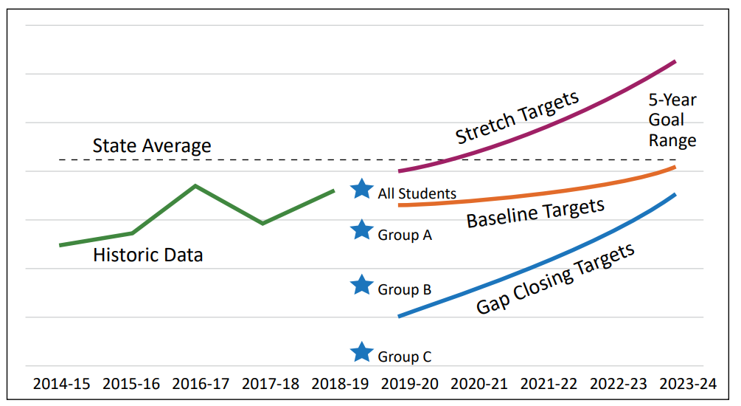
LPGTs – What’s Required, con’t
5 Year Targets
Visual Example
Baseline – the minimum level of realistic growth
Stretch – more ambitious, still realistic
Gap Closing – reduction of academic disparities for focal student groups

Slide 11
LPGTs Must Be:
Realistic and Attainable
Districts and schools working with ODE considered:
Historic trends for that metric
An evaluation of the likely impact of new or expanded programs on that metric
Statewide averages and trends for LPGTs

Slide 12
CoDeveloped Targets
Four Year Graduation
Four-Year Graduation: District-Wide
 | Year 1 2023-24 | Year 2 2024-25 | Year 3 2025-26 | Year 4 2026-27 | Year 5 2027-28
Stretch Target 83% Trend 3,2,2,2,1% | 86 | 88 | 90 | 92 | 93
Baseline Target 83% Trend 2,2,2,1,1% | 85 | 87 | 89 | 90 | 91
Gap Closing For Focal Groups 73% 3% rate | 75 | 78 | 81 | 84 | 87

Slide 13
CoDeveloped Targets
Fifth Year Completion
Five-Year Completion: District-Wide
 | Year 1 2023-24 | Year 2 2024-25 | Year 3 2025-26 | Year 4 2026-27 | Year 5 2027-28
Stretch Target 87% Trend 4,3,2,1,1% | 91 | 94 | 96 | 96 | 96
Baseline Target 87% Trend 2,2,2,1,1% | 88 | 90 | 92 | 93 | 94
Gap Closing For Focal Groups 79% Trend 2.5% | 81.5 | 84 | 86.5 | 89 | 91.5

Slide 14
CoDeveloped Targets
Regular Attenders
Regular Attendance: District-Wide
 | Year 1 2023-24 | Year 2 2024-25 | Year 3 2025-26 | Year 4 2026-27 | Year 5 2027-28
Stretch Target Tend 5,4,3,2,2% | 73.8 | 77.8 | 80.8 | 82.8 | 84.8
Baseline Target 75.8% 5 yr Trend -3.6 2 yr Avg. 68.8 Target Trend +3,3,2,2,1% | 71.8 | 74.8 | 76.8 | 78.8 | 79.8
Gap Closing For Focal Groups 2 yr avg 49.5% Trend 5,5,4,4,3% | 54.5 | 59.5 | 63.5 | 67.5 | 70.5

Slide 15
CoDeveloped Targets
3rd Grade ELA
3rd Grade ELA (Reading): District-Wide
 | Year 1 2023-24 | Year 2 2024-25 | Year 3 2025-26 | Year 4 2026-27 | Year 5 2027-28
Stretch Target 31% Trend 4% | 36 | 40 | 44 | 48 | 52
Baseline Target 34% Trend 1.3% | 35.3 | 36.6 | 37.9 | 39.2 | 40.5
Gap Closing For Focal Groups 27% Trend 2% | 29 | 31 | 33 | 35 | 37

Slide 16
CoDeveloped Targets
9th On Track
9th Grade On Track: District-Wide
 | Year 1 2023-24 | Year 2 2024-25 | Year 3 2025-26 | Year 4 2026-27 | Year 5 2027-28
Stretch Target 59% Trend 7,7,6,5,4% | 66 | 73 | 79 | 84 | 88
Baseline Target 59% Trend 5,4,4,4,4% | 64 | 68 | 72 | 76 | 80
Gap Closing For Focal Groups 53% Trend 4.75% | 57.75 | 62.5 | 67.25 | 72 | 76.75

Slide 17
What we learned through this process
We learned that our 9th grade success program has proven to be effective and we are now extending that program to other grade levels.
Integrating the applications, we can look at a systemic solution to address our strengths and weaknesses.
No matter how much we plan or prepare we have to be ready for mid-term change, and this system has made it easier for us to make those adjustments.

Slide 18
Questions & Comments
‹#›

