Slide 1
Overlook Avenue/McKinley Drive
Storm Drainage Improvements
Public Involvement Meeting
December 12, 2023
ROOM 504

Slide 2
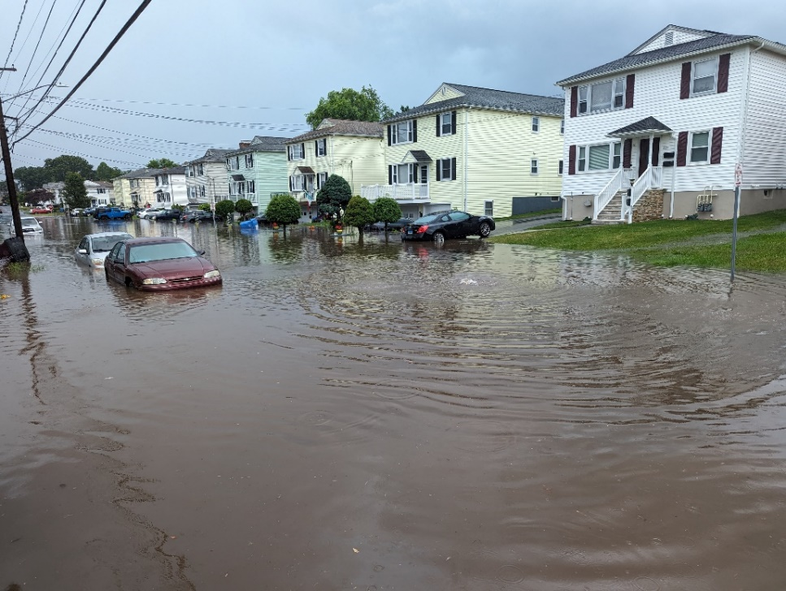
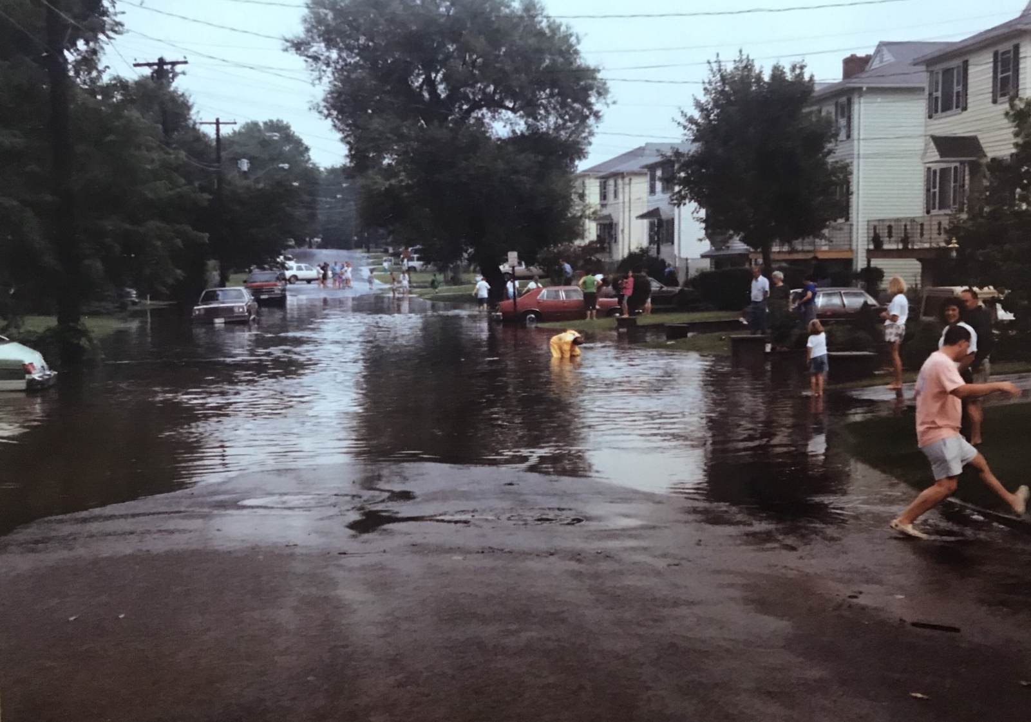
OVERLOOK AVENUE FLOODING
July 4, 2023 – Overlook Avenue
1985 – Overlook Avenue

Slide 3
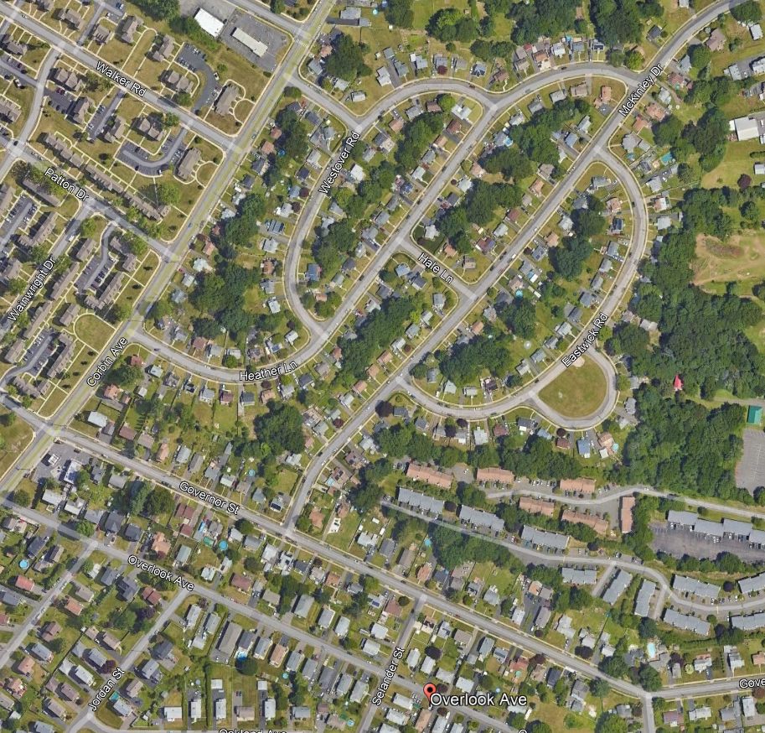
PROJECT AREA
PHASE 2
PHASE 1
McKinley Dr
LOCATION OF PHOTOS

Slide 4
FLOOD STUDIES
Tata & Howard (2019)
Analyzed the 450-acre watershed
Developed peak flows
Identified 2 phases to address issues with existing drainage system
Weston & Sampson (2020)
Reviewed hydraulics and modifying drainage on McKinley Drive
Developed plans and cost estimate
Phase 1 Completed December 2021
Construction Cost $100,000
Install new manhole to eliminate turbulence on Overlook, completed December 2021
Phase 2 Currently in Design and scheduled for Spring 2024 Construction
Estimated Cost $3.0M ($2.0M in ARPA funds and $1.0M in City Clean Water Fund)
Replace approximately 850 feet of existing 54” and 48” RCP with a 4’x8’ Box Culvert on McKinley Drive between Governor Street and Hale Lane
Sidewalks, driveway aprons will be replaced

Slide 5
PHASE 1 DEC. 2021
54” RCP
72” RCP
42” RCP

Slide 6
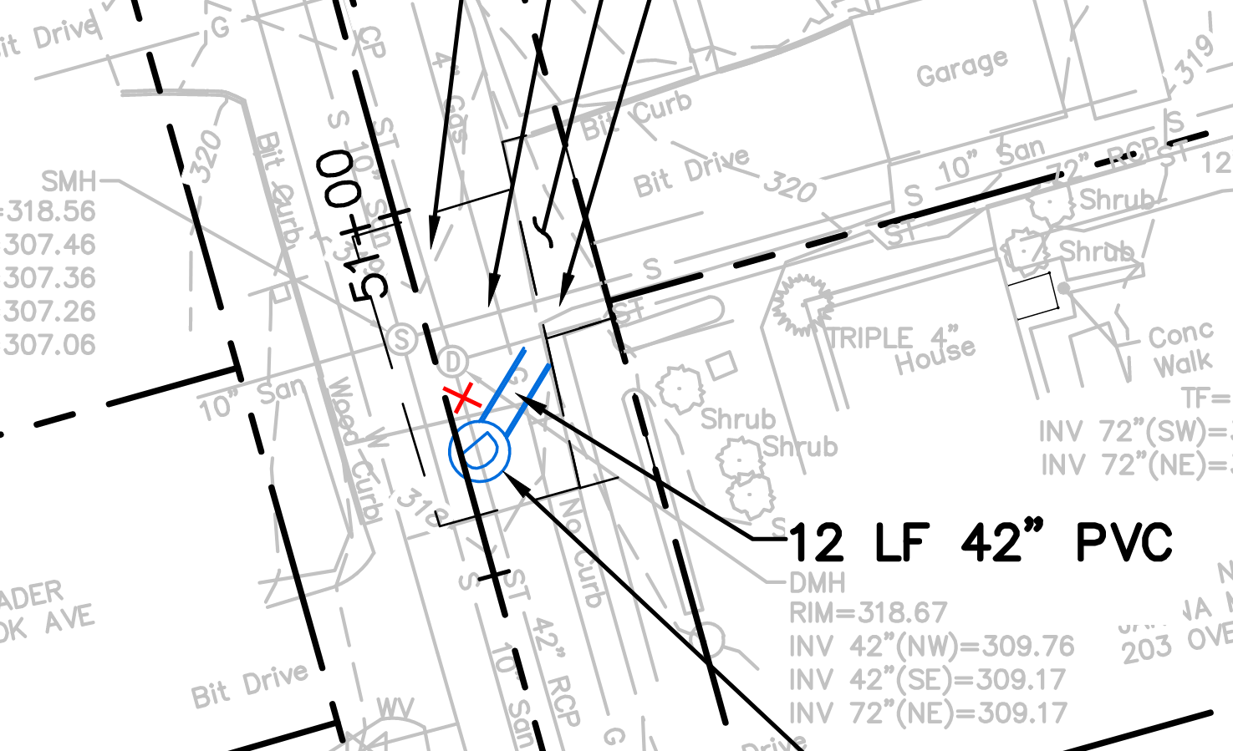
PHASE 1 DEC. 2021
72” RCP
54” RCP
42” RCP

Slide 7
PHASE 1 OVERLOOK AVE 12/2021

Slide 8
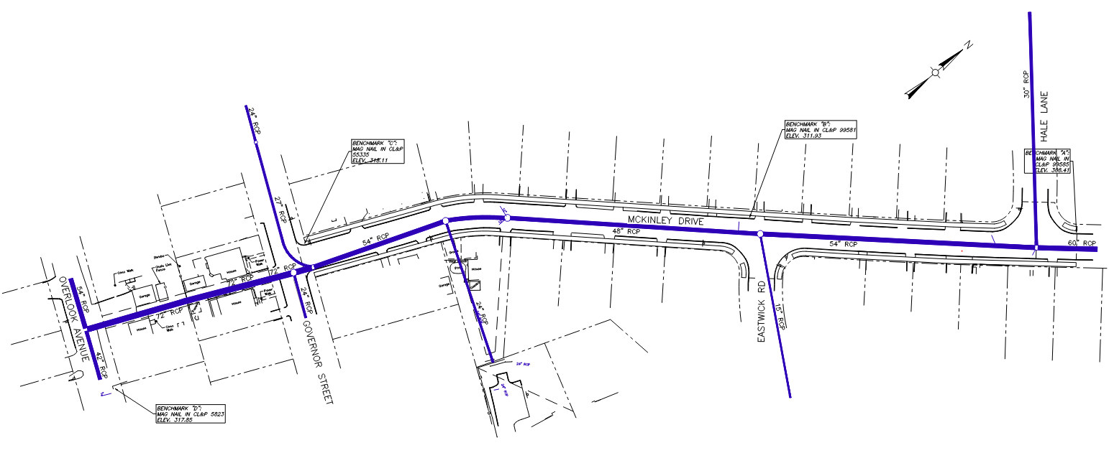
EXISTING CONDITIONS
Hale Lane
30” RCP
Project Length 850’
27” RCP
McKinley Drive
54” RCP
54” RCP
48” RCP
54” RCP
60”
RCP
Governor Street
Overlook Avenue
24” RCP
72” RCP
15” RCP
24” RCP
42” RCP
IN: 72”+24”+27” DIAMETER PIPES
OUT: 54” DIAMETER PIPE

Slide 9
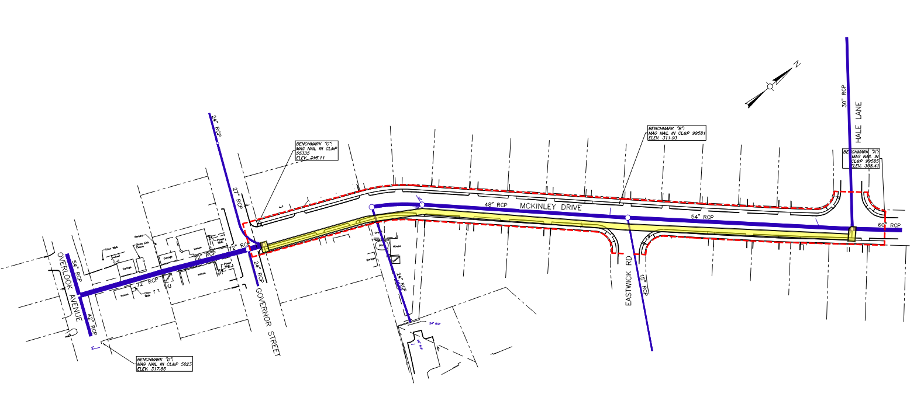
PROJECT DESCRIPTION
Replace 48”/54” Diameter Concrete Pipes with 4’x8’ Concrete Box
New Sidewalks and Ramps
PROJECT LIMITS
Hale Lane
Project Length 850’
McKinley Drive
Governor Street
Overlook
4’ HEIGHT X 8’ WIDE CONCRETE BOX
SPECIAL STRUCTURE
SPECIAL STRUCTURE

Slide 10
PROJECT CONSIDERATIONS
Coordination with CNG to relocate gas main (Completed)
Resident access during construction
Temporary rights to grade for sidewalk and driveways
Lead time on Box Culvert and Special Structures
Handling water during construction
Project restoration
Please provide contact information to make communication easier mostly for residents between 18-92 McKinley Drive

Slide 11
Discussion & Questions
Thank you
City of New Britain Public Works

