Slide 1
NORTH CAROLINA TEACHER EVALUATION PROCESS TRAINING
Notes:
*
*

Slide 2
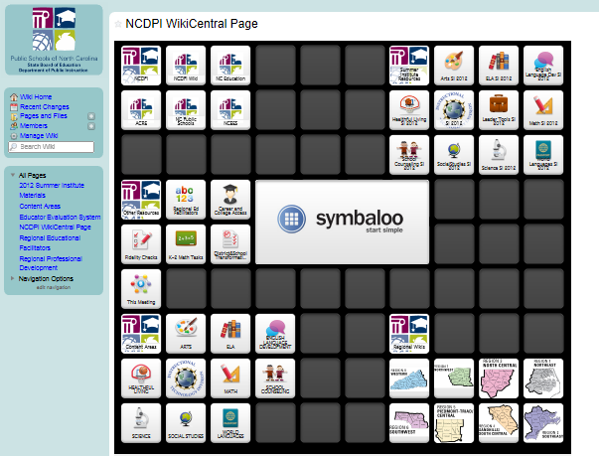
http://wikicentral.ncdpi.wikispaces.net/NCDPI+WikiCentral+Page
Notes:
This is the landing page for all DPI wikis. The regional wikis are in the bottom right hand corner.
*

Slide 3
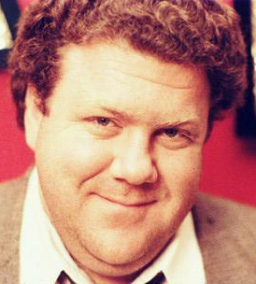
Norms
To be actively involved
Value differences
Agree to disagree
Listen
Don’t take it personally
Be honest
Stay focused on established purpose and goals
Refrain from conducting ‘sidebar’ conversations
www.peoplequiz.com/norm_perterson
*
Notes:
Discuss “Norms” for the day. Explain reminders on tables.
*

Slide 4
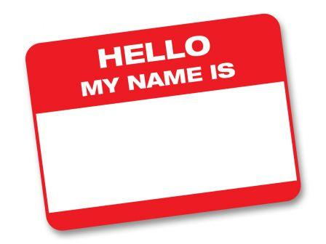
Introductions
Your Name
School
Your Role
Identify 1 Professional Learning Goal for
this Session
Notes:
Participants should state name, school system or charter school, role, and 1 PD Goal for this session
*

Slide 5
Housekeeping
Parking Lot
Penzu.com
Breaks
Reflection - Your input is essential and valued!
Notes:
AGENDA:
Sign-in, Parking Lot, and Penzu completed while visiting wiki
Breaks – Breaks are scheduled throughout the session. Please take breaks as needed.
Evaluation – your input is essential and valued! Evaluation will be an electronic Google form (plus, delta, and future directions) and also available in hard copy.
This activity uses digital and data literacy (formative assessment via sign-in google form)
*

Slide 6
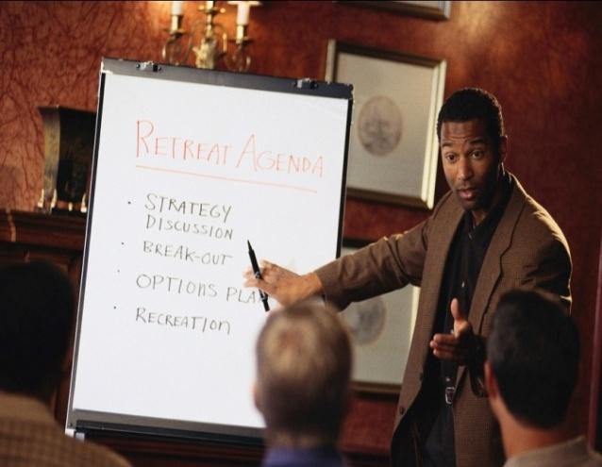
Our Agenda
Our State School Board’s Mission
Teacher Evaluation Process
A Look at the Standards
Answer Questions
Reflection
*
Notes:
*

Slide 7
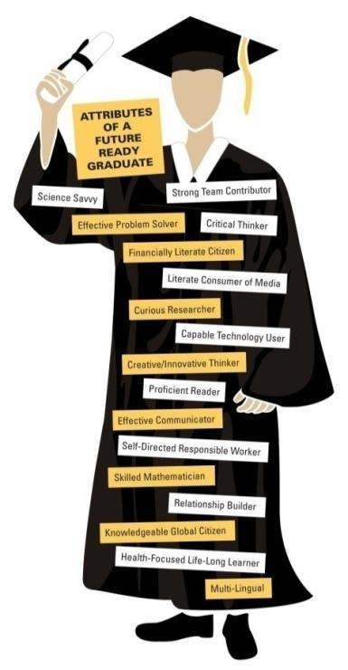
State Board of Education’s
Mission Statement
The guiding mission of the North Carolina State Board of Education is that every public school student will graduate from high school, globally competitive for work and postsecondary education and prepared for life in the 21st Century.
Produce globally competitive students
Be led by 21st century professionals
Be governed and supported by 21st Century Systems
*
Notes:
*

Slide 8
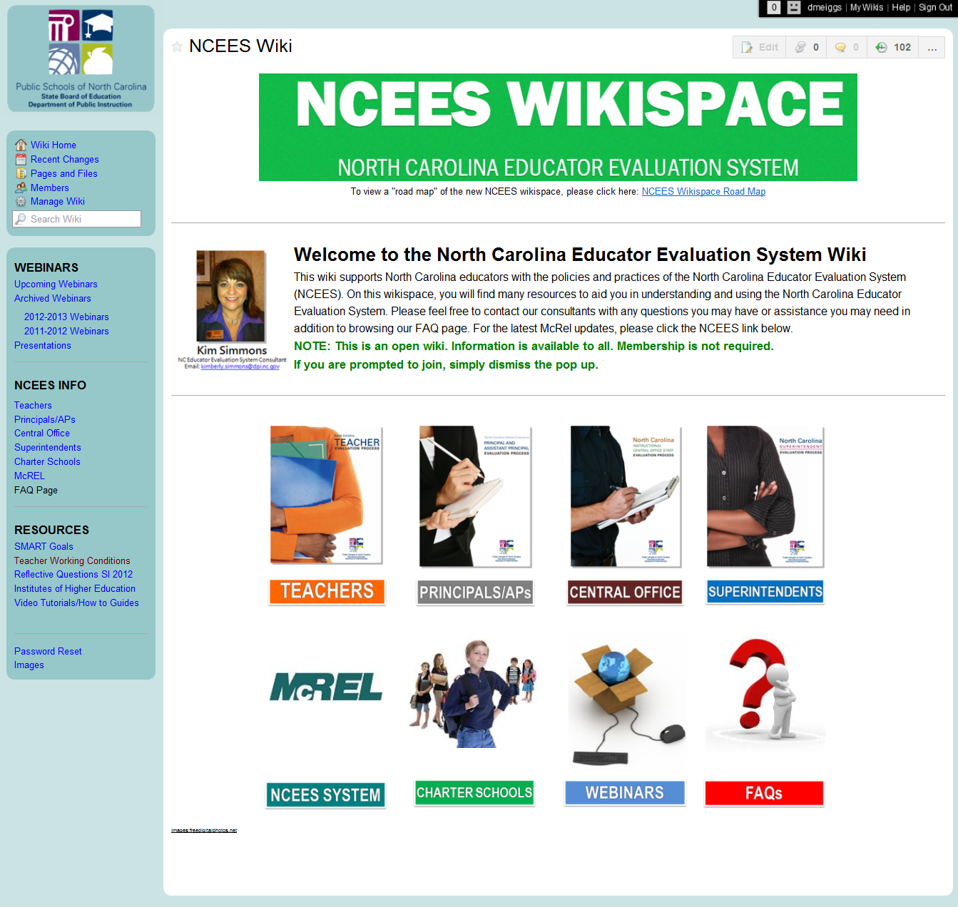
http://ncees.ncdpi.wikispaces.net/NCEES+Wiki
Notes:
*

Slide 9
Let’s Review the Teacher Evaluation Process
Notes:
On your table, you should find a copy of the chart shown on the screen. You will want to follow along with us as we review the process.
*

Slide 10
Notes:
What component is the greatest barrier for you as an evaluator?
*

Slide 11
Before Week 3 of School Year
Component 2: Orientation
Within two weeks of teacher’s first day, the principal will provide:
A. The Rubric for Evaluating North Carolina Teachers;
B. Teacher Evaluation Policy ID Number: TCP-C-004
C. A schedule for completing evaluation process.
STEP 1:
Training and Orientation
Component 1: Training
Before participating in the evaluation process, all teachers, principals and peer evaluators must complete training on the evaluation process.
Notes:
Resources in Red
*

Slide 12
Before First Formal Observation
Component 3: Teacher Self-Assessment
Using the Rubric , the teacher shall rate their performance and reflect on his or her performance throughout the year.
STEP 2:
Self-Assessment, Goal Setting and Pre-Conference
Component 4: Pre-Observation
Conference
Before the first formal observation,
the principal meets with the teacher to discuss: self assessment, professional development plan, and a written description of the lesson(s) to be observed.
Goal: To prepare principal for
the observation.
Notes:
Self Assessment –PAGE 21 of Teacher Evaluation process Manual
*

Slide 13
Self Assessment
The purpose of the self assessment is allow educators to reflect on their practice, identifying their own professional strengths and areas of development. Your Self‐Assessment will lead directly into the development of your Professional Development Plan Goals.
Lets Look at the Self Assessment. Go to the on line manual:
http://ncees.ncdpi.wikispaces.net/NC+Teachers
Notes:
Need to go to McRel Demo site (or real site) if they have their UID numbers to look at self-assessment and discuss how they should prepare it.
*

Slide 14
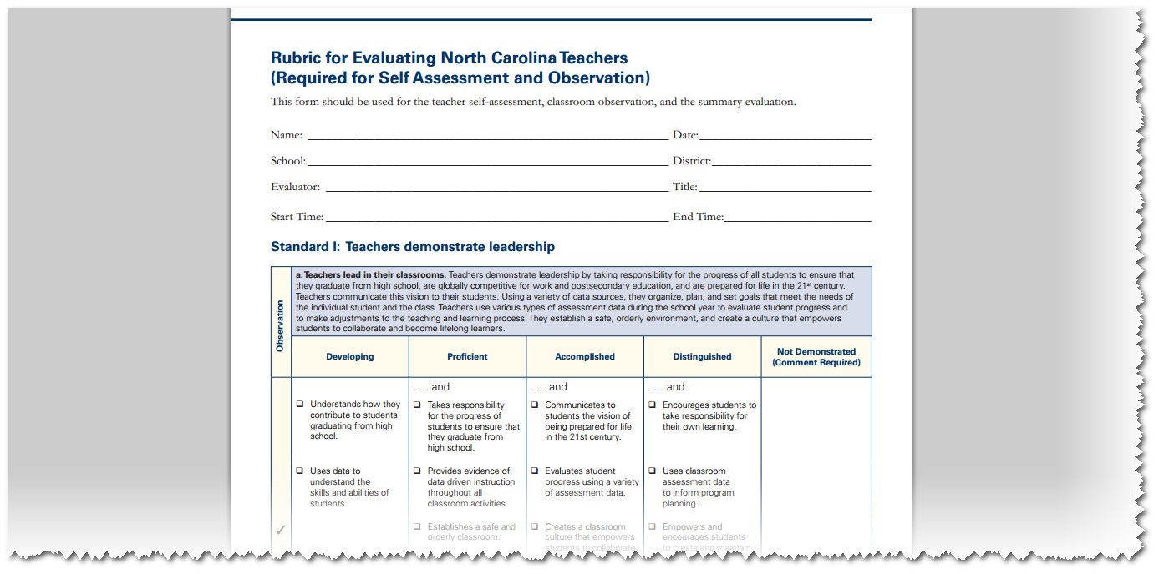

Slide 15
Professional Development Plans
The New Preliminary Professional Development Plan is created by the teacher.
The teacher and the administrator have the ability to add content to the form.
You will meet THREE times per year with your administrator and mentor to review your PDP goals and sign off (Beginning, Middle, and End of year)
Notes:
PAGE 43 of NC Teacher Evaluation Process Manual
*

Slide 16
Professional Development Plans
Individual PDP | Monitored PDP | Directed PDP
Rated “Proficient” or higher on all standards | Rated “Developing” on one or more standards | Rated “Not Demonstrated” on any standard or Rated “Developing” on one or more standards for two consecutive years
Teacher sets individual goals for growth | Not recommended for dismissal, demotion, or non-renewal at this time | Not recommended for dismissal, demotion, or non-renewal at this time
Administrator and teacher meet to discuss PDP 3 times – Beginning of the year, Mid-year, End-of-Year | Administrator and teacher meet to discuss and set goals together – Meet at least 3 times (beginning of the year, mid-year, and end-of-year to review progress) | Administrator sets goals for teacher based on observations and documentation – meets with teacher to review the development plan. Meet at least 3 times to review progress.
 | One school year to reach proficiency | One school year or less to reach proficiency (as determined by the LEA)

Slide 17
Within the 1st Nine Weeks
Component 5: Observations
A. Formal observation:
45 min. or entire class period
B. Probationary Teachers:
3 formal by principal and 1 formal by peer
C. Career Status Teachers: Evaluated annually.
During the renewal year: 3 total- 1 must be formal
Observations shall be noted using the Rubric.
STEP 3:
Observation Cycle
(Administrative and
Peer)
STEP 3:
Observation Cycle
(Administrative and Peer)
Component 6: Post-Observation Conference
The principal shall conduct a post-observation conference no later
than ten school days after each formal observation.
Discuss and Document strengths and weaknesses on the Rubric

Slide 18
Before the End of the School Year
Component 8: PD Plans
Individual Growth Plans-“Proficient” or better
Monitored Growth Plans-At least 1 “Developing”
Directed Growth Plans-“not Demonstrated” or
“Developing” rating for 2 sequential yrs.
STEP 4:
Summary Evaluation and Goal Setting
Component 7: Summary Evaluation Conference and
Scoring the Teacher Summary Rating Form-
A. Give rating for each Element in Rubric
B. Comment on “Not Demonstrated”
C. Overall rating of each Standard
D. Provide teacher with opportunity to add comments to the Summary Rating Form
E. Review completed Teacher Summary Rating Form with teacher and
F. Secure the teacher’s signature on the Record of Teacher Evaluation Activities and Teacher Summary Rating Form.
Notes:
Summary Rating Form- PAGE 36 of Manual
*

Slide 19
Rubric for Evaluating North Carolina Teachers
Rating Scale
Notes:
The rubric for evaluating teachers includes four ratings and one designation.
This is a pass-through slide. ☺
*

Slide 20
Performance Rating Scale
Distinguished
Consistently and significantly exceeded basic competence on standards of performance
Not Demonstrated
Did not demonstrate competence on, or adequate growth toward, achieving standard(s) of performance
*Requires documentation
Knowledge and skills replicated
Exemplar of performance
Accomplished
Exceeded basic competence on standards for performance most of the time
Innovation + High Performance
Demonstrated basic competence on standards of performance
Proficient
Solid, effective application + success
Demonstrated adequate growth during the period of performance, but did not demonstrate competence on standard(s) of performance
Developing
Never demonstrated
Skill not mature or unsuccessful
*
Notes:
*
*

Slide 21
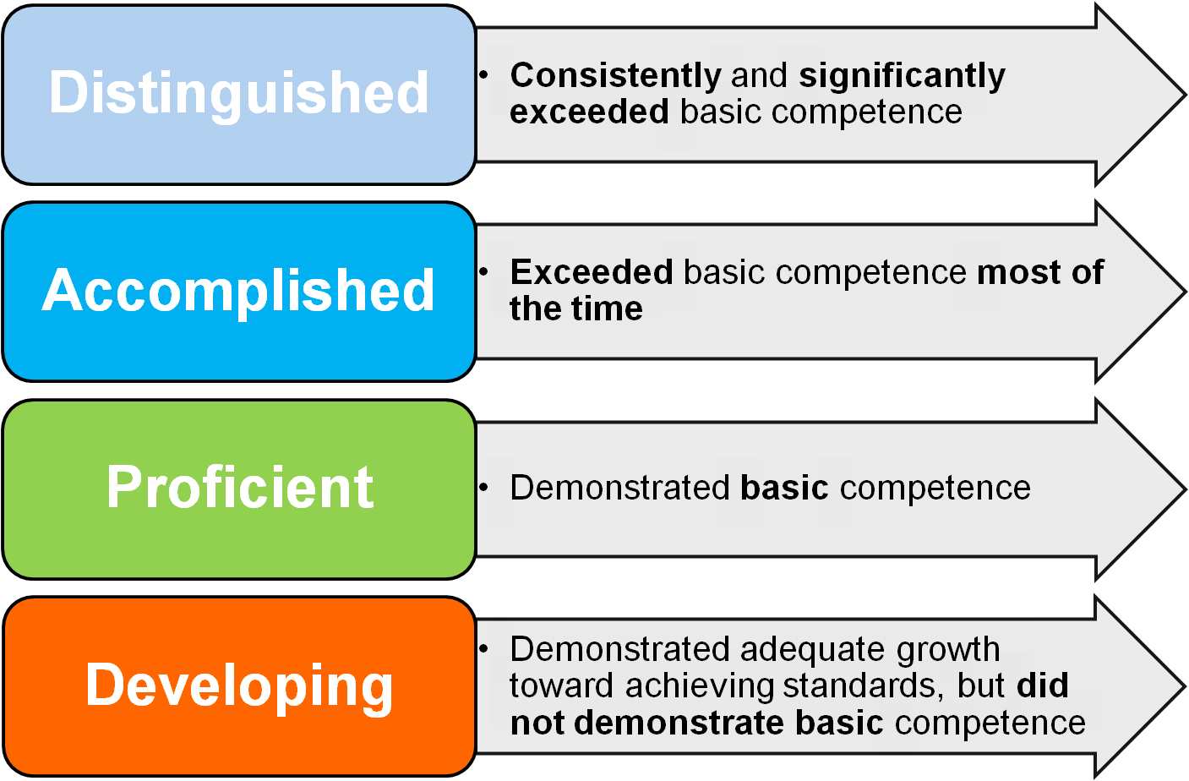
Notes:
Now, think about this in the context of teaching.
*

Slide 22
The developing teacher tells The proficient teacher explains The accomplished teacher demonstrates The distinguished teacher inspires
*

Slide 23
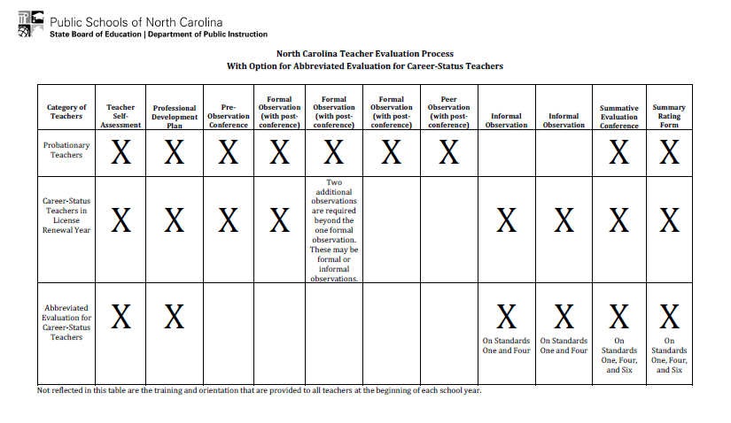
*
Notes:
*

Slide 24
Let’s Summarize
Notes:
Before you begin the Summative Process you should have completed the following:
Probationary Teachers should have four formal observations (3 Administrative and 1 peer) completed in the McRel system. Career status teachers in their formal year of evaluation need to have 3 observations (1 formal and 2 informal) completed in the McRel system. Career teachers NOT in license renewal should have received two informal observations on standards one and four.
You should have signed and completed a year end reviewed of the Professional Development Plan for this school year (2011-2012)
The completed North Carolina Educator Evaluation Process for every teacher must be completed in the McRel System by ___________. To be completed all forms must be properly electronically signed by ________
*

Slide 26
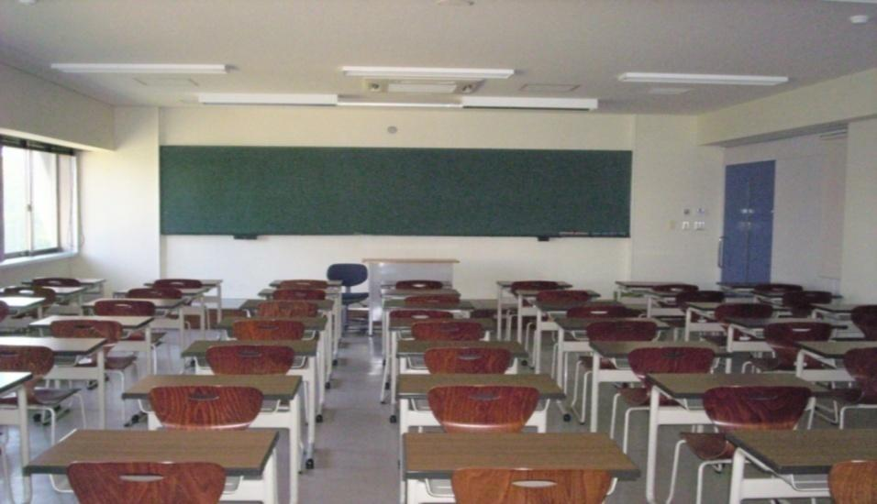
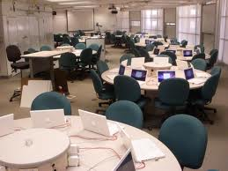
20th Century vs. 21st Century
Teacher Centered
Students work in isolation
Memorizing facts
Textbook Driven
Student Centered
Students work collaboratively
Solving Problems
Research Driven
*
Notes:
Use 20th Century Classroom vs. 21st Century Classroom handout
Discussion with your staff: How can we make our school look like a 21st century school—start at the heart of your school—inside the classroom.
Here we have some comparisons of the 20th century classroom and the 21st century classroom. At your tables, brainstorm other differences;
Time-based
Outcome-based
Focus: memorization of discrete facts
Focus: what students Know, Can Do and Are Like after all the details are forgotten.
Lessons focus on the lower level of Bloom’s Taxonomy – knowledge, comprehension and application.
Learning is designed on upper levels of Blooms’ – synthesis, analysis and evaluation (and include lower levels as curriculum is designed down from the top.)
Textbook-driven
Research-driven
Passive learning
Active Learning
Learners work in isolation – classroom within 4 walls
Learners work collaboratively with classmates and others around the world – the Global Classroom
Teacher-centered: teacher is center of attention and provider of information
Student-centered: teacher is facilitator/coach
Little to no student freedom
Great deal of student freedom
“Discipline problems" – educators do not trust students and vice versa. No student motivation.
No “discipline problems” – students and teachers have mutually respectful relationship as co-learners; students are highly motivated.
Fragmented curriculum
Integrated and Interdisciplinary curriculum
Grades averaged
Grades based on what was learned
Low expectations
High expectations – “If it isn’t good it isn’t done.” We expect, and ensure, that all students succeed in learning at high levels. Some may go higher – we get out of their way to let them do that.
Teacher is judge. No one else sees student work.
Self, Peer and Other assessments. Public audience, authentic assessments.
Curriculum/School is irrelevant and meaningless to the students.
Curriculum is connected to students’ interests, experiences, talents and the real world.
Print is the primary vehicle of learning and assessment.
Performances, projects and multiple forms of media are used for learning and assessment
Diversity in students is ignored.
Curriculum and instruction address student diversity
Literacy is the 3 R’s – reading, writing and math
Multiple literacies of the 21st century – aligned to living and working in a globalized new millennium.
Factory model, based upon the needs of employers for the Industrial Age of the 19th century. Scientific management.
Global model, based upon the needs of a globalized, high-tech society. Driven by the NCLB and standardized testing mania.
Standardized testing has its place. Education is not driven by the NCLB and standardized testing mania.
*

Slide 27
North Carolina Professional Teaching Standards
*
Notes:
Let’s have a quick review of the standards before we delve into them more deeply.
St. 1 - Leadership in and beyond the classroom. Teachers take responsibility for all students’ learning and use data to drive instruction. They establish a safe learning environment. They strive to lead the profession and serve as an advocate for students.
St. 2 - Teachers provide an environment in which each child has a positive, nurturing relationship with caring adults. They embrace diversity, treat students as individuals, adapt their teaching, and work collaboratively.
St. 3 - Teachers align their instruction w the NCSCOS, know their content, and teach relevant, connected lessons.
St. 4 - Teachers understand learning, and they know the appropriate levels of intellectual, physical, social, and emotional development of their students.
St. 5 - Teachers analyze student learning and think critically about learning in their classrooms. They seek appropriate pd that matches their professional goals, and they are active learners.
When you are finished sharing the posters, you can talk about standard 6. Use this if you would like:
This is the newest standard, and there is much more work underway to determine how this standard will be measured.
While principals should, of course, always be looking for evidence of student learning, there will be no “observation-based” component to Standard Six. Some are concerned that the sixth standard means more work for principals. It really doesn’t since the rating will be based squarely on data that are collected and aggregated by the state.
Here is some help for responding if there are questions: (Tread carefully here…and remind principals not to shoot the messenger!)
This info was on the Superintendent's update from Dr. Atkinson and I think it provides a good "blurb" to include somewhere in our training. Teacher Effectiveness: Sixth Standard Update - Effective this school year, the State Board of Education has added a sixth standard to the Teacher Evaluation Instrument. A teacher’s rating on the sixth standard will be based on whether a teacher’s students meet growth expectations, exceed growth expectations, or fail to meet growth expectations. An average of three years of student growth information will be used to determine the teacher’s rating. Only teachers with three or more years of data will receive a formal rating on the sixth standard, although principals are encouraged to discuss any student growth information with teachers. For the 2011-12 school year, there will be no state-mandated consequences for teachers based on their sixth standard rating. The sixth standard requires no change to the evaluation process during the school year. The standard will be automatically populated through the use of three years of data points on student growth. Principals and other classroom observers do not need to take additional action during the year to ensure that data is included. Detailed webinar information will be included in the next communication. For additional information please contact Jenn Preston, Race to the Top Project Coordinator for Teacher Effectiveness, at jennifer.preston@dpi.nc.gov.
*

Slide 28
Focusing on the “Why”
NC has implemented a new curriculum, new assessments, new technology tools to improve instruction, new ways of engaging students, and the list goes on
So why is the State focusing on educator effectiveness in the face of so many other changes?
Because all our efforts in other areas depend on an effective teacher in every classroom and an effective leader in every school building!
Notes:
*

Slide 29
The Standards and Evaluation System
Formative, Growth
Data-driven
PD
Alignment
*
Notes:
*

Slide 30
Standard I Teachers Demonstrate Leadership

Slide 31
Standard 1 Teachers Demonstrate Leadership
5 Elements
Teachers lead in the classroom
Teachers lead in the school
Teachers lead in the profession
Teachers advocate for school and students
Teachers demonstrate high ethical standards
Notes:
*

Slide 32
Carousel Assessment
In what ways can a teacher model or demonstrate teacher leadership in the classroom, school and the teaching profession?
Go to the numbered poster
Identify a recorder
Record your answer to the question above
Move to the next poster when you hear the signal
*
Notes:
*
*
10 Minute Activity
10 Minute Report Out

Slide 33
Ms. Noonan
Managing Transitions
https://www.teachingchannel.org/videos/managing-transitions

Slide 34
Standard II Teachers Establish a Respectful Environment for a Diverse Population of Students

Slide 35
Standard 2 Teachers Establish a Respectful Environment for a Diverse Population of Students
5 Elements
Teachers provide an environment with a positive, nurturing relationship
Teachers embrace diversity in school and world
Teachers treat students as individuals
Teachers adapt their teaching for the benefit of students with special needs
Teachers work collaboratively with families

Slide 36
Universal Design for Learning at a Glance https://www.youtube.com/watch?v=bDvKnY0g6e4&noredirect=1
http://www.udlcenter.org/resource_library/videos/udlcenter/udl
Notes:
A short You Tube video created by the Center for Applied Special Technology (CAST) illustrates the three principles of UDL.
http://www.udlcenter.org/resource_library/videos/udlcenter/udl
*

Slide 37
How will YOU build the Culture of your classroom?
How will you collaborate with others to create a classroom culture that is positive and safe for all students?
How will you adapt your classroom design to accommodate students’ learning, social, and physical needs?
Will a token/ reward system be effective in your room? Explain
How do you plan to build meaningful, positive relationships with your students and parents?
What will be your plan for intolerant behaviors or derogatory language?
Notes:
A short You Tube video created by the Center for Applied Special Technology (CAST) illustrates the three principles of UDL.
http://www.udlcenter.org/resource_library/videos/udlcenter/udl
*

Slide 38
Six-Step Partner Share
Walk 6 steps, find a colleague:
Share one strategy you have seen or done that models an environment that is inviting, respectful, supportive, inclusive and flexible.
When time is called, go to a second person:
Share one strategy for maintaining high expectations for students.
http://goo.gl/Vb2g8
Notes:
Direct participants to stand and find a partner at least six steps from their seat. This partner should be someone from another LEA or charter. Each participant will introduce himself/herself and engage in a conversation around the question provided. When the facilitator indicates it is time to find a new partner, each participant will find a new partner a minimum of six steps from the original partner. Again, the partner should be someone from another LEA/Charter. The process continues until the facilitator sends participants back to their seats.
*

Slide 39
Standard 2 Teachers establish a respectful environment for a diverse population of students
Element:
Provide an environment in which each child has a positive nurturing relationship with caring adults
Embrace diversity in the school community and in the world
Treat students as individuals
Adapt their teaching for the benefit of students with special needs
Work collaboratively with the families and significant adults in the lives of their students
Reflective Question:
Record your answer in your Penzu or turn to a table buddy and discuss.
Do you have any ideas for involving those hard to get parents in a project with your class?
Notes:
Type a participant reflective question for standard 2- challenge participant to identify which element the question is linked to AND what teacher rating the question is coaching
*

Slide 40
Standard III Teachers know the content they teach

Slide 41
Standard 3 Teachers Know the Content they Teach
4 Elements
Teachers align their instruction with the NCSCS
Teachers know the content appropriate to their teaching specialty
Teachers recognize the interconnectedness of content areas/ disciplines
Teachers make instruction relevant to students

Slide 42
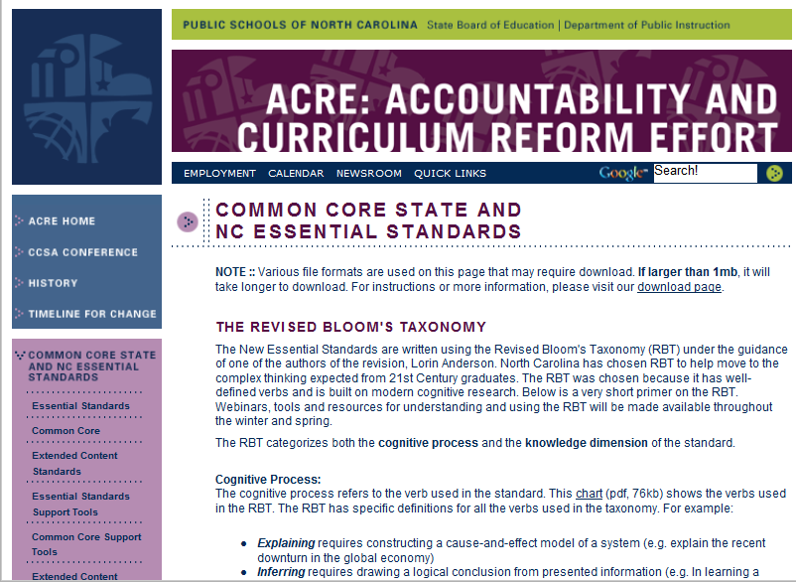
http://www.ncpublicschools.org/acre/
Notes:
Go to ACRE site to demonstrate where all the SCoS materials are located. Go to Literacy standards for next activity.
*

Slide 43
Standard 3 Teachers know the content they teach
Element:
Align their instruction with the NCSCS
Know the content appropriate to their teaching specialty
Recognize the interconnectedness of content areas/ disciplines
Make instruction relevant to students
Reflective Question:
Record your answer in your
Penzu or turn to a table buddy
and discuss.
How will you integrate literacy and technology skills into all content areas?
Notes:
*

Slide 44
Standard IV Teachers Facilitate Learning for their Students

Slide 45
Standard 4 Teachers Facilitate Learning for their Students
8 Elements
Teachers know the ways in which learning takes place, and they know the appropriate levels of intellectual, physical, social, and emotional development of their students
Teachers plan instruction appropriate for their students
Teachers use a variety of instructional methods
Teachers integrate and utilize technology in their instruction

Slide 46
Continued Standard 4
Teachers help students develop critical thinking and problem solving skills
Teachers help students work in teams and develop leadership qualities
Teachers communicate effectively
Teachers use a variety of methods to assess what each student has learned

Slide 47
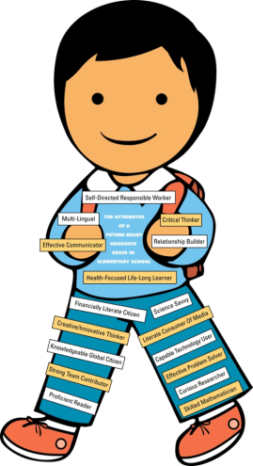
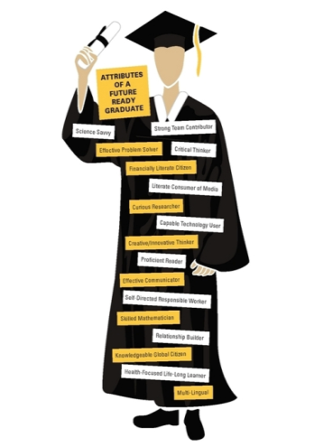
Exploring 21st Century Student Attributes
Sit with your preferred level
Elementary
Future Ready Elementary Student “Nicky”
Middle
Future Ready Middle School Student
High
Future Read Graduate
Choose at least 3 attributes found on your 21st Century Learner
Discuss the “teaching” necessary to develop each attribute (What would you see in the classroom?)
Creatively Chart your response.
Notes:
*

Slide 48
Standard IV: Group Activity
Count off a-h
Meet with your element partners
Using your corresponding element (a - h) for your group, select 2 of the indicators under your element (page 9 or 10 in your manual)
Brainstorm 2-3 specific behaviors a teacher might use to demonstrate each of the items selected (What would the students be doing?)
Pick one of the two items and be prepared to report out to the group
*
Notes:
*
8 groups (small class – divide into 4 groups and assign each group 2)
Turn to page 9 and write letter beside each element in book.
Select 2 bullets to discuss specific teacher behaviors (some just have 2 bullets, so choose those!)
Pick 1 of the 2 bullets to share with group.

Slide 49
Standard V Teachers Reflect on their Practice https://www.teachingchannel.org/videos/unique-class-culture

Slide 50
Standard 5 Teachers Reflect on Their Practice
3 Elements
Teachers analyze student learning
Teachers link professional growth to their professional goals
Teachers function effectively in a complex, dynamic environment
Notes:
*

Slide 51
4 Questions to Think About
What do we want students to learn?
How will we know if they have learned it?
How will we respond when they don’t learn it?
How will we respond when they already know it?
Summer Institute 2011-2012 Rebecca DuFour
http://www.youtube.com/embed/Ds7fmtamZ5w?rel=0%22%20frameborder=%220%22%20allowfullscreen
Notes:
The institute objectives relate to the four questions posed (DuFour, Professional Learning Communities). The Summer 2011 Institute focused on Question 1, “What do we want students to learn?” Last summer’s institute provided an overview of the standards and instructional support tools including Crosswalks and Unpacking Documents. This preview of the standards allowed participants to become familiar with the content and organization in preparation for training at the local level and ultimately implementation in classrooms.
Question 2 focuses on mastery of the standards and data literacy.
Questions 3 and 4 focus on differentiation to meet the needs of a variety of learners.
Optional video clip: http://youtu.be/Ds7fmtamZ5w
Activity: (Think, Pair, Share) Write on a sticky note what you think the most important point is from this video clip (Think).
Sharing: Share at the table (Pair) and address questions briefly as whole group (Share).
Rebecca DuFour briefly reviews the four critical questions professional learning communities need to ask to continuously focus on student learning. http://solution-tree.com
*

Slide 52
Reflection
Answer each question using your Penzu journal
How will you use feedback from your observations to improve your practice?
What artifacts demonstrate the ways you are a reflective practitioner?
Notes:
Audio:
To conclude our experience with the Standards, open your journal and respond to the following reflective prompts:
-How will you use feedback from your observations to improve your practice?
-How will dialogue with your mentor or Professional Learning Community impact your instructional practices?
-What artifacts demonstrate the ways you are a reflective practitioner?
*

Slide 53
Standard VI Teachers Contribute to the Academic Success of Students

Slide 54
Standard 6 is a measure of Growth

Slide 56
Teacher Ratings Categories
Teachers
1
2
3
4
5
6
Demonstrate Leadership
Establish Environment
Know Content
Facilitate Learning
Reflect on Practice
Contribute to Academic Success
5 Rating Categories
3 Rating Categories
Not Demonstrated
Developing
Proficient
Accomplished
Distinguished
Does Not Meet Expected Growth
Meets Expected Growth
Exceeds Expected Growth
Notes:
Let’s take a few seconds to look at the different rating categories presented on this slide. For teachers, nothing changes about the first five standards. For standard six, the rating options are the following: does not meet expected growth, meets expected growth, and exceeds expected growth.
*

Slide 58
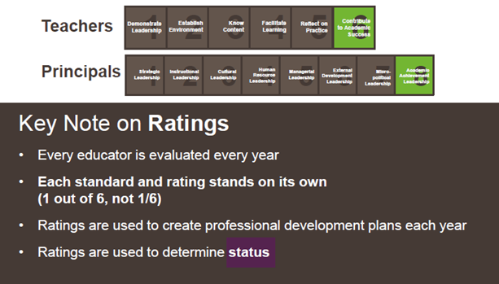
Key Notes

Slide 59
What is the difference between ratings and a status?

Slide 60
Rating
Status

Slide 62
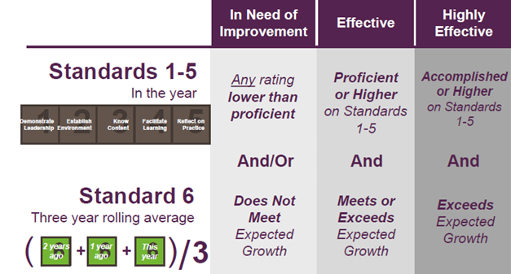
Teachers

Slide 63
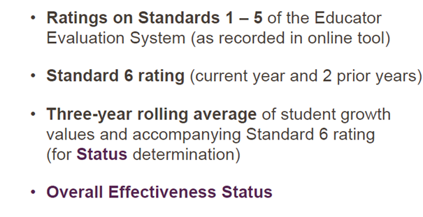
What will teachers see?

Slide 64
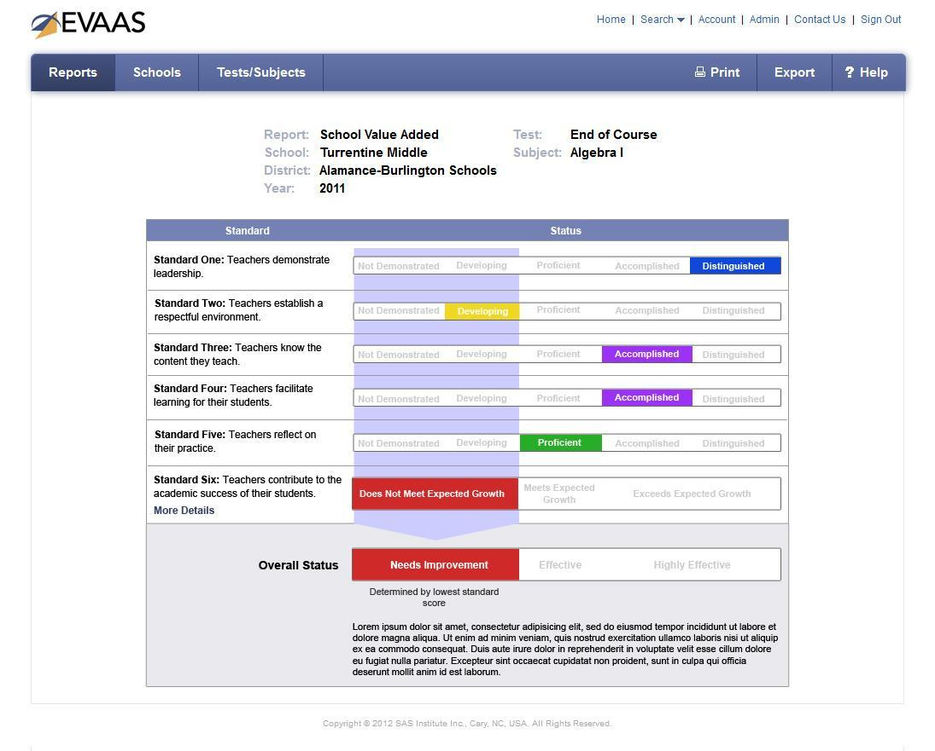
Notes:
*

Slide 65
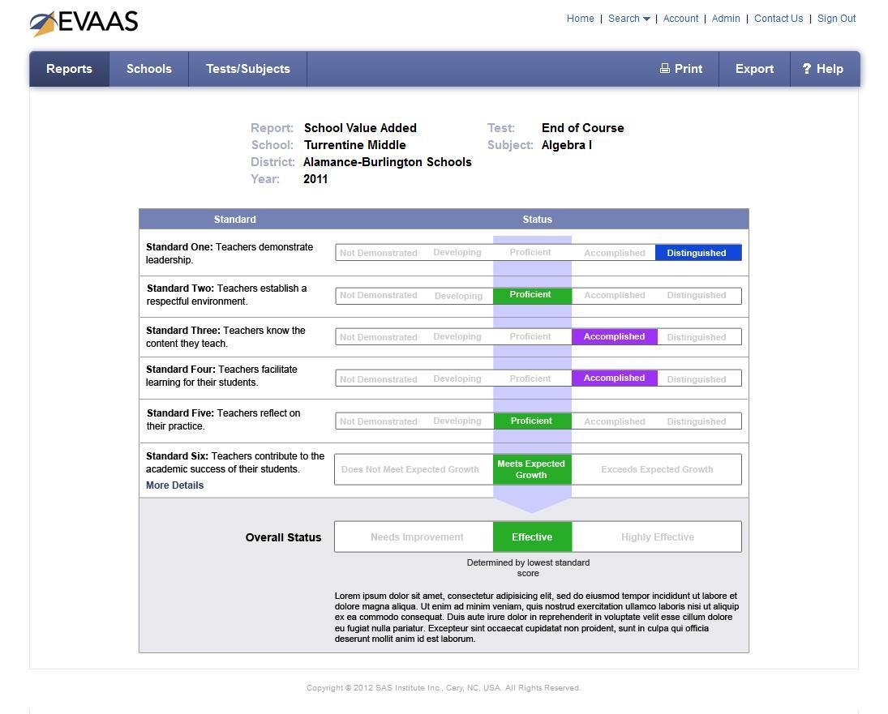
Notes:
*

Slide 66
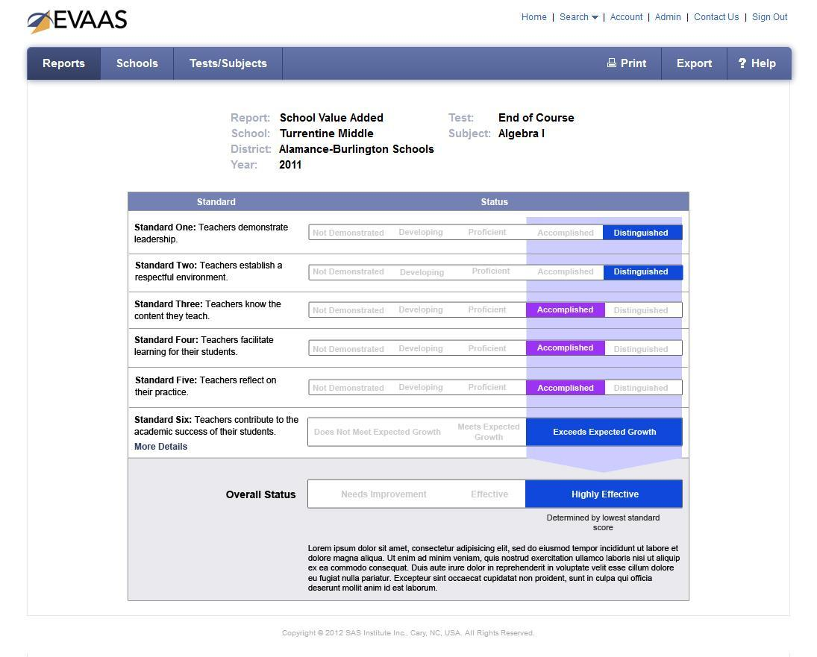
Notes:
*

Slide 67
Four Buckets of Assessments for Growth
A
B
C
D
EOCs,EOGs and VoCATS
NC Final Exams
Courses Focused on Performance
(ASW)
Locally Developed Courses
Assessment Common Across Districts
Growth using EVAAS
Guidance from DPI with local implementation options
Growth determined by
evaluator
Notes:
*

Slide 68
Remember Status and Standard VI
An educator receives an effectiveness status only when he or she has 3 years of data on standard 6
A 3-year rolling average of growth data from standard 6 is used as part of determining overall status
Notes:
The use of three years of data safeguards teachers and administrators from any statistical errors. A rolling average will be used to determine status, which means that the teacher’s current, and most recent two years of data, will inform a status determination.
*

Slide 69
New Resources for Teacher Effectiveness
“Rapid Response” Email Address:
educatoreffectiveness@dpi.nc.gov
New Educator Effectiveness Website:
http://www.ncpublicschools.org/effectiveness-model/
Notes:
*

Slide 70
Beginning Teachers
Effective 2010–2011, beginning teachers must be rated “Proficient” on all five North Carolina Professional Teaching Standards on the most recent Teacher Summary Rating Form in order to be eligible for the Standard Professional 2 License.

Slide 71
http://ncees.ncdpi.wikispaces.net/Reflective+Questions+SI+2012
http://ncees.ncdpi.wikispaces.net/NCEES+Wiki
Notes:
*

Slide 72
Follow Up
Questions?
Concerns?
Sonya Rinehart: srinehart@ecps.k12.nc.us
Regional Education Facilitator

