Slide 1
Using Canvas Studio
This webinar will begin soon.
In order to verify attendance, each person must be logged into Teams

Slide 2
Navigating Teams
Show
Participants
Emojis and
Raise Hand
Leave the Meeting
Show video
Show
Conversation
More actions
Mute

Slide 3
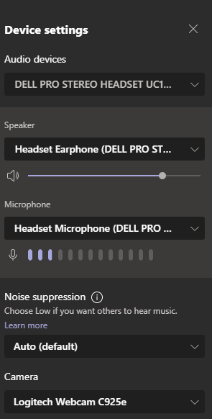
Audio Issues
Make sure the speaker on your device has its volume turned up and that it’s not muted. ​​
From the Teams navigation toolbar, click on the … and More Options will expand. You can click on Device settings to expand the menu. Check to make sure to choose the correct Audio device, Speaker, and Microphone using the drop-down arrow. ​​
If these steps do not resolve your issue, try leaving the Team meeting and rejoining it. ​​
​If that doesn’t work, then there may be an issue with your device not able to be resolved at this time.
In this case, we are making a recording of this live webinar to be viewed as a video later which will be shared.​​

Slide 4
Housekeeping
You’ll get the slides via email
You’ll get a recording link via email
Participate to receive Tech Points

Slide 5
Using Canvas Studio
Ashley Guillory
Technology Facilitator

Slide 6
Agenda
Creating a Video in Canvas Studio
Create Quiz
Annotate Video
Share Video
Adding Video to Assignment or Module
What is Canvas Studio

Slide 7
What is Canvas Studio
Notes:
https://fast.wistia.net/embed/iframe/7jn7ehgmim

Slide 8
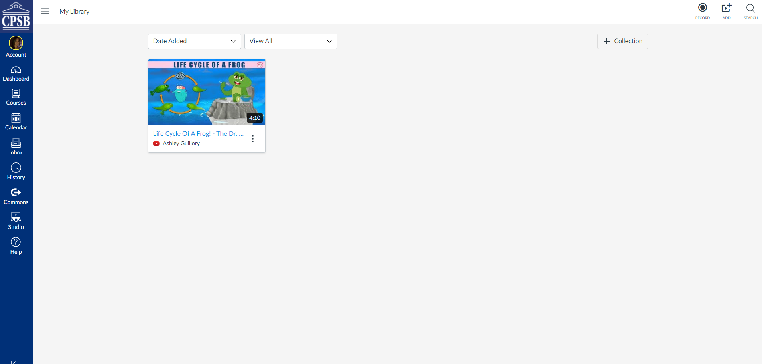
Accessing Canvas Studio From Global Navigation
1
2
3
4
Within the Studio interface, Studio includes a navigation toolbar at the top of every page. The toolbar includes the Navigation Menu icon [1], as well as icons to record media [2], add media [3], and search media [4].
Notes:
Studio defaults to the My Library page, which shows all the media you've uploaded to Studio. Collections display first and then media files display in the order they were uploaded, starting with the most recently uploaded media.
The Shared with Me page contains media shared with you by other Studio users. You can also share your media with other Studio users as well.
If you are an instructor, you can view media uploaded to your courses.
Note: Media must be added to the course before the course appears in the navigation menu.

Slide 9
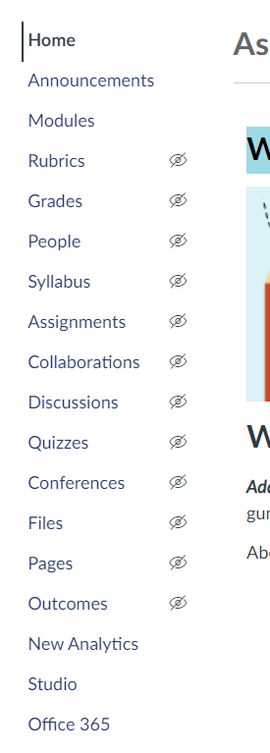
Accessing Canvas Studio From Course Navigation

Slide 10
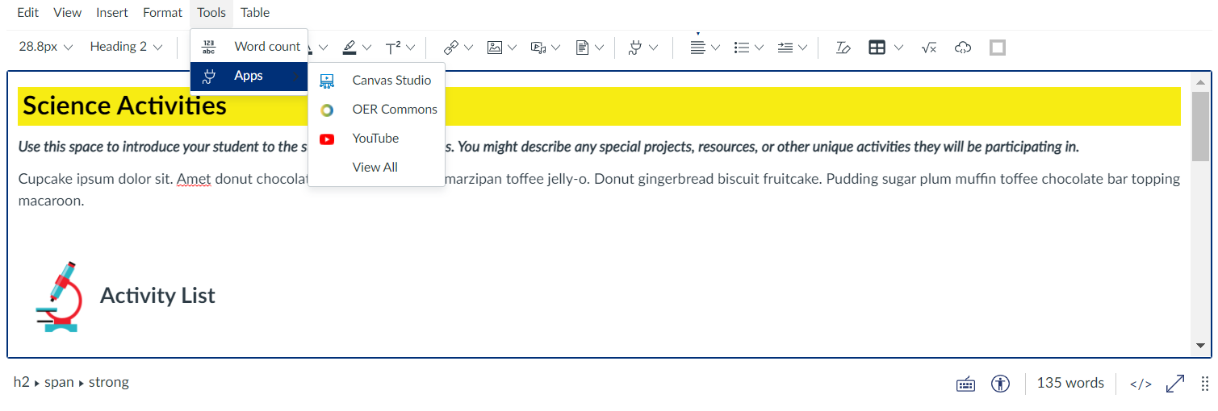
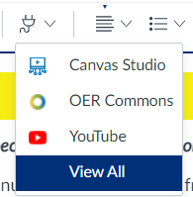
Accessing Canvas Studio From Rich Content Editor
From the Rich Content Editor, access Canvas Studio in two ways.
Tools > Apps > View All > Canvas Studio (Once you have accessed it from the all apps list, the option will appear under Apps.)
Tools Icon > View All > Canvas Studio

Slide 11
Creating a Video in Canvas Studio

Slide 12
Commenting and Replying in Canvas Studio

Slide 13
Ways to Integrate Canvas Studio Content
Canvas Studio Media may be used both inside and outside of a course, and for student viewing or submissions.
Sharing Directly - Share audio and video directly with specific teachers or students. You may share Canvas Studio Media content only to others who are enrolled in the same course as you.
Sharing Publicly - Create a Public Link so that anyone can view the Canvas Studio Media. Comments will not be included in public links.
Adding to a Module - Add Canvas Studio directly to a Module using the External Tool option. You may then edit the name of the content to reflect the media title.
Using the Rich Content Editor - The Canvas Studio Library can be accessed in the Rich Content Editor. The RCE is used to edit Pages, Assignments, Quizzes, Discussions and Announcements. You can embed Canvas Studio Media in all of these spaces with or without comments.
Assignment or Assessment - Students can submit Canvas Studio media through the Assignments, Quizzes and Discussions you assign to them. Instructors can provide real-time feedback to students within the video using Speedgrader. Additionally, Studio Quizzes that are assigned to students provide them with correct and incorrect answers to video quiz questions. Check out the resources below to learn how to use Canvas Studio Quizzes in your courses.

