Slide 1
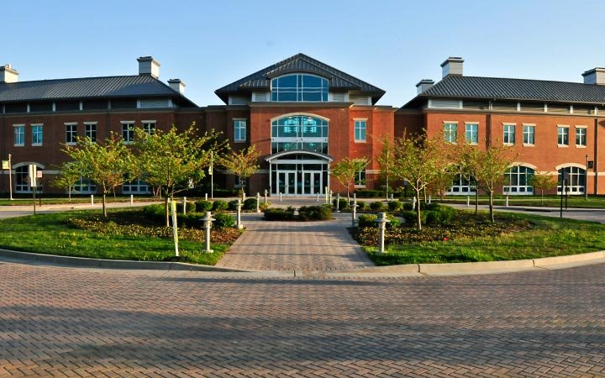
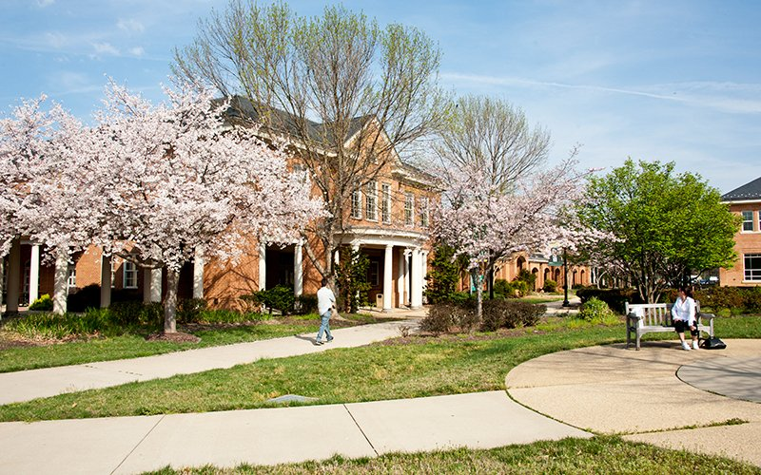
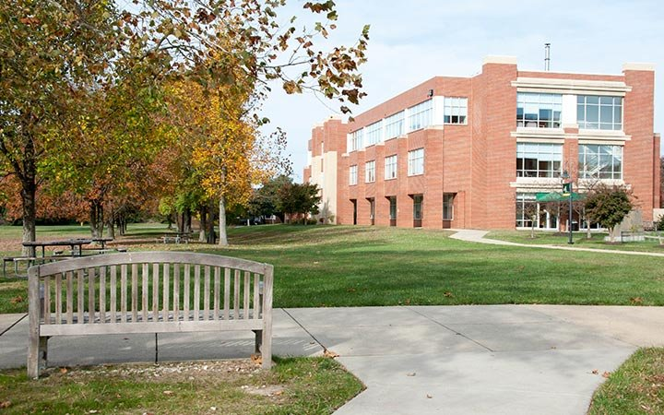
College of Southern Maryland
Financial Assistance

Slide 2

What is Financial Aid?
Financial aid consists of funds provided to students and families to help pay for postsecondary educational expenses.

Slide 3
Sources of Financial Aid
Federal Government
Employers
State
Private Sources
College and Universities

Slide 4
Requirements for Financial Aid
Federal Aid
U.S. citizen or permanent resident
High School graduate or equivalent
Must meet need eligibility criteria
State Aid
Residency requirement
Generally, must attend college in state
Application deadline
College or University
Meet school’s criteria (G.P.A., test scores, etc.)

Slide 5
What Types of Aid Are There?
Gift Aid
Scholarships
Grants
Self-Help
Loans
Work Study

Slide 6
Gift Aid
Scholarships
Money that does not have to be paid back
Awarded on the basis of merit, skill or unique characteristic
Grants
Money that does not have to be paid back
Usually awarded on the basis of financial need

Slide 7
Self Help Options
Loans
Money students and parents borrow to help pay college costs. Repayment usually begins after education is finished
Work Study
Money earned to help pay college expenses via a paycheck or non-monetary compensation, such as room and board

Slide 8

Types of Aid from Maryland
Legislative Scholarships
  Delegate Scholarship
  Senatorial Scholarship
Need-based grants
  Guaranteed Access Grant
  Educational Assistance Grant
  Part-Time Grant
Unique Populations
  Edward T. Conroy Memorial Award
  Veterans of Afghanistan and Iraq Conflicts
Tuition Waivers
  Foster Care Recipients
  Unaccompanied Homeless Youth
  Maryland National Guard
  Students with Disabilities

Slide 9

What is Financial Need?
Cost of Attendance (COA)
Student Aid Index (SAI)* New for 2024-25
________________________________
= Financial Need

Slide 10




What Is Cost of Attendance (COA)?
Tuition and fees
Housing and food
Books and supplies
Transportation
Miscellaneous and personal

Slide 11
Cost of Attendance - Examples
Institution | Tuition & Mandatory Fees | Housing and Food | Total Costs (2023-2024)
Georgetown University | $ 64,896 | $ 19,831 | $84,727
Stevenson University | $ 39,648 | $ 14,978 | $ 54,626
U. Of Maryland – College Park | $ 11,505 | $ 15,416 | $ 26,921
Salisbury University | $ 10,638 | $ 13,416 | $ 24,054
College of Southern Maryland | $ 4,200 | $ 4,637 * | $ 8,837
Notes:
All tuition & fees based on in-state or in-county residency.
Costs do not include, books / supplies, personal expenses or transportation.
* Assumes student is living at home with parent.

Slide 12
What is the Student Aid Index?
Number resulting from the evaluation of a student’s (and family’s) approximate financial resources for a student’s postsecondary education
Stays the same regardless of college
Student contribution
Parent contribution
(for dependent students)

Slide 13

Free Application for Federal Student Aid (FAFSA)
A standard form that collects demographic and financial information about the student and family
May be filed at any point during the academic year
  Typically available October 1st prior to the academic year for which the student requests aid using prior, prior, year information (late for 2024-25)
  Complete the application every academic year
  Academic year is Fall-Spring just like secondary school (2024-2025 FAFSA is for Fall 2024 and Spring 2025)
  Should be completed online

Slide 14
When to Complete The FAFSA ?
The FAFSA will be available sometime in December using “prior, prior” year tax information.
The 2024-2025 FAFSA will be using 2022 income tax information.
The FAFSA is completed every year
Maryland State Priority Deadline is March 1, 2024, but application remains open
Schools may have their own deadlines

Slide 15
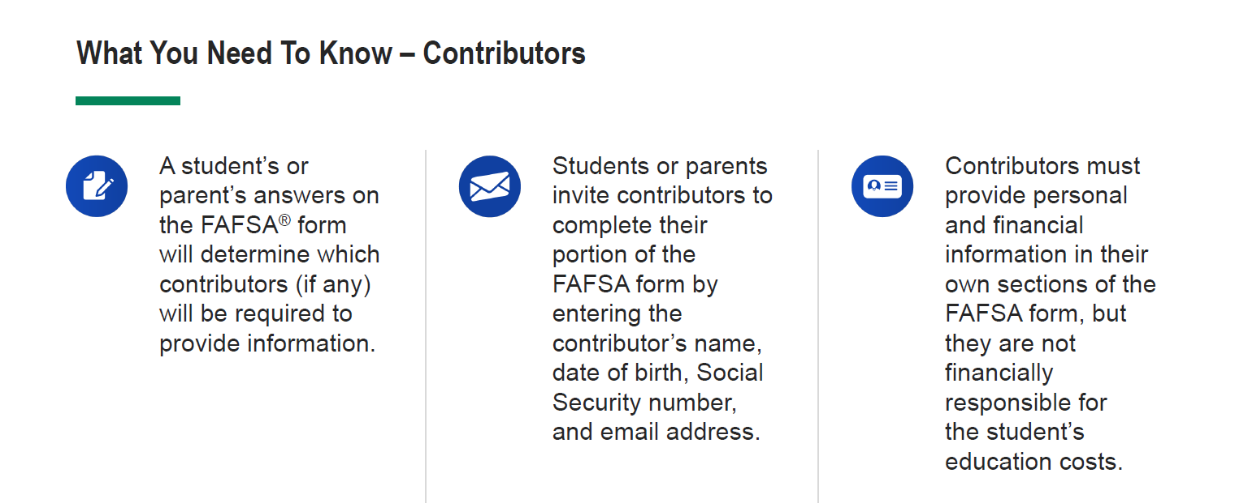
Who Completes the FAFSA?

Slide 16
Free Application for Federal Student Aid
FAFSA is accessed from the studentaid.gov portal
Student and parent log in with FSA ID

Slide 17
Federal Student Aid ID
The FSA ID is the electronic signature for the FAFSA
Used by students and parents throughout financial aid process, including subsequent school years
  FAFSA Corrections
  FAFSA Renewal
  Student Loan Promissory Note Signatures
Only the owner should create an FSA ID
All “contributors” must have their own FSA ID

Slide 18
FUTURE Act Direct Data Exchange (FA-DDX)
Allows for an individual’s federal tax information (FTI) to be directly transferred from the IRS to the FAFSA
Consent is required by all contributors on FAFSA
IRS transfers information to populate FAFSA income questions for most tax filers
Eliminates manual entry of tax and income information

Slide 19
How much federal aid can you receive?
Example: First-year, dependent student in 2023-24
Maximum amounts allowed:
Federal Pell Grant: $7,395
Federal Supplemental Educational Opportunity Grant: $4,000
TEACH Grant: $4,000 *
Federal Direct Stafford Loan: $5,500
Federal Work-Study: determined by school *
Federal Direct PLUS Loan (for parents): COA minus other aid received
* Not available at all post secondary educational institutions

Slide 20

Special Circumstances
Unusual uncovered medical/dental expenses
Secondary school tuition
Extraordinary dependent care
Parent or spouse death
Additional family members in college
Loss of employment or income
Divorce

Slide 21
Scholarship Finder
Scholarship Finder is a database that CSM students can use to find scholarships; scholarships are available for both credit and continuing education courses.
Please sign in to Scholarship Finder using your my.CSMD information once you receive your admissions letter via email (which will include your my.CSMD username and password.
Complete the General and Conditional Applications
Once the applications are complete, check the opportunities page so you can complete any additional supplemental scholarship questions for specific opportunities.

Slide 22
CSM Scholarships
STEM Scholarship
  Up to $6,000 / year for 2 years
  Funded by National Science Foundation
CSM Academic Excellence Scholarship
  Scholarship is $1,000 / year for 2 years
  Provided to high achieving students from tri-county public schools
CSM Scholarship Finder
  CSM Foundation scholarships
  Application available: Early March 2024

Slide 23
What Should You Do Now?
Upperclassmen:
Continue challenging courses
  Avoid “senioritis”; second semester grades can affect scholarships
Gather information for admissions and financial aid deadlines for potential schools
Attend college fairs or schedule campus visits
Utilize the College Navigator

Slide 24
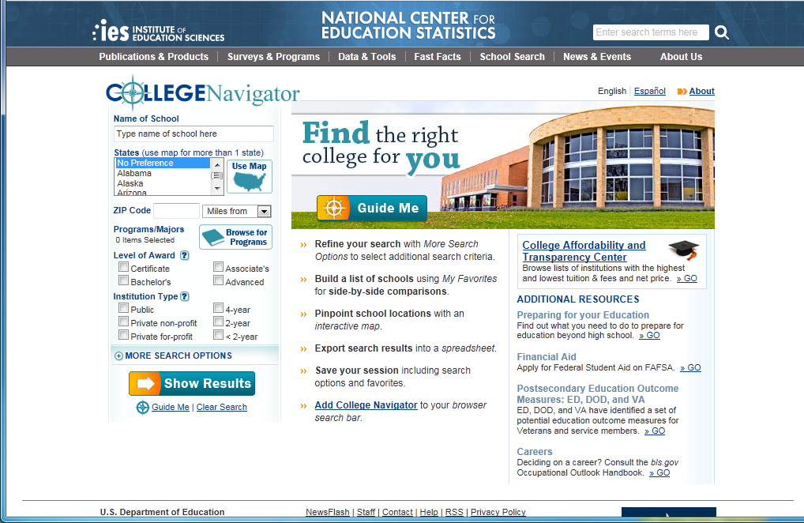
College Navigator
Available information:
  Search colleges by state, private or public
  View school statistics
  See list of available programs
  Create spreadsheet for side by side comparisons
  https://nces.ed.gov/collegenavigator/

Slide 25
What Should You Do Now?
Underclassmen:
Take challenging courses all four years of high school
  Consider AP, Dual Enrollment, or Dual/Concurrent
Get involved in school and civic organizations
  Remember quality over quantity
Start a record of awards and accomplishments

Slide 26




Scholarship Search Engines
Department of Education: https://studentaid.gov/understand-aid/types/scholarships
Fastweb: www.fastweb.com
Scholarships.com: https://www.scholarships.com
College Board: https://bigfuture.collegeboard.org/pay-for-college/scholarship-search

Slide 27
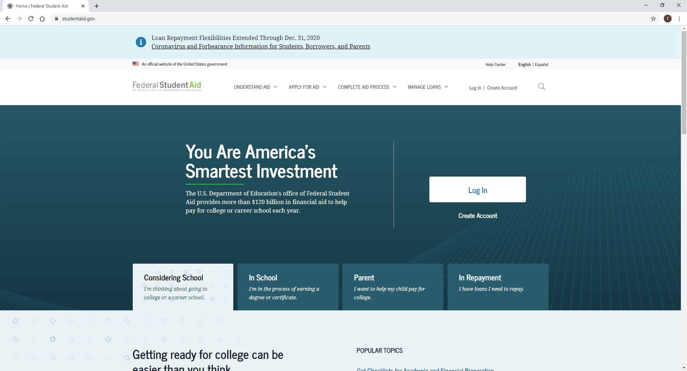
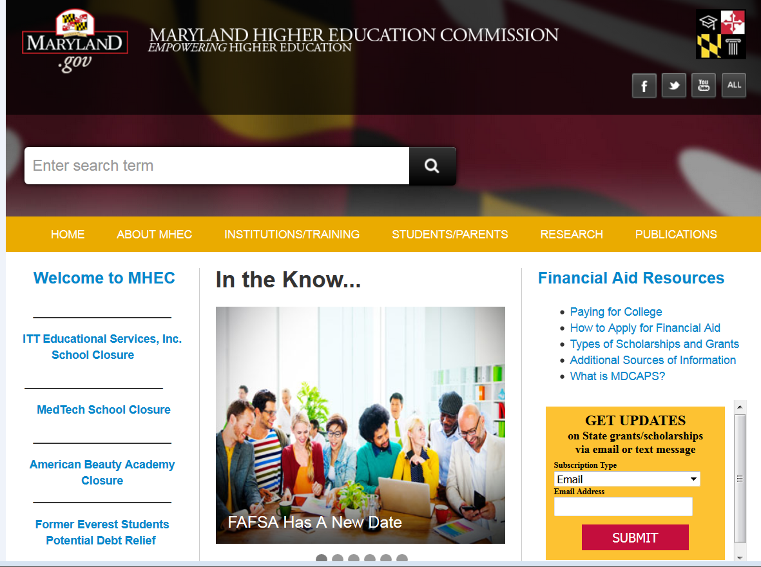
Helpful Websites
Federal Student Aid
  Provides information on various financial aid programs
studentaid.gov
Maryland Higher Education Commission
  Provides information on various Maryland state programs
mhec.maryland.gov/preparing/pages/default.aspx

Slide 28

Questions?
Contact us at:
301-934-7531 or
finaid@csmd.edu

Slide 29

Financial Assistance for Continuing Education Courses www.csmd.edu/CEAid
Non-Credit CSM Foundation
  For select and approved eligible Workforce Development Programs.
Workforce Sequence Scholarship
  Specific eligibility requirements and select approved sequenced Workforce Development Programs.
Maryland Promise Scholarship
  For more information go to the Maryland Higher Education Commission website: https://mhec.state.md.us/preparing/Pages/FinancialAid/ProgramDescriptions/prog_MDCommunityCollegePromiseScholarship.aspx
Veterans Benefits:
  Please contact a VA advisor via email at: veteransbenefits@csmd.edu or 301-934-7656
Workforce Innovation & Opportunity Act (WIOA)
  Please visit the Southern Maryland Job Source website for your county’s Job Source Center location and contact information. https://www.dllr.state.md.us/county/smd/
Notes:
As mentioned on the previous slide, we offer various scholarships and financial assistance for select Workforce Development Training Programs:
Some examples of what we offer includes our Non-Credit Foundation Scholarships. Applicants must meet financial eligibility requirements BUT we encourage everyone who has a need to apply.
We also offer two state funded Maryland Higher Education Commission Scholarships:
The first one is the Workforce Sequence Scholarship
For eligibility requirements and list of approved programs, please visit our website.
The second is The Maryland Promise Scholarship
To apply for this scholarship, you will have to visit the MD Higher Education Commission webpage.
For our military and Veteran community, please contact our VA Advisor to discuss your VA Benefits eligibility and the list of approved programs.
Lastly, under the Southern Maryland Job Source, there may funds available for you through the Workforce Innovation & Opportunity Act (WIOA). Please visit their website for more information.
For additional information on all of these scholarships and financial assistance options, please visit our website at www.csmd.edu/CEAID.

Slide 30


How to Register for a Non-Credit Course
Registration Options
Register Online thru Lumens Registration System
Registrar's Office: webreg@csmd.edu or 301-934-7588.
  AD Building in La Plata Campus
  A Building in Prince Frederick Campus
  C Building in Leonardtown Campus
Hours of Appointments:
  Monday – Thursday between 9:00AM – 3:00PM
Notes:
Hello Everyone. My name is Frances Raynes, Financial Aid Advisor specifically for Non-Credit Continuing Education Programs and Courses. Now that you have heard about our wonderful Workforce Development Training Programs and Personal Enrichment courses, I will go over the Registration and Financial Assistance Options.
You may register in one of three ways.
Your first option is to register online. You will be expected to pay in full with a credit card at the end.
Another option is you may register by mailing in your completed registration form along with a check or money order.
Or lastly, you may register in person BUT you must first make an appointment.

Slide 31
Websites and Contact Information
Scholarships and Financial Aid
  www.csmd.edu/CEAid
  finaid@csmd.edu or 301-934-7531
Third-Party or Employer Paid
  www.csmd.edu/employerpaid
  Contact information: 301-934-7717 or tap@csmd.edu
Notes:
We have several options to help you pay for your Non-Credit Continuing Education courses.
First, we offer a Tuition Payment Plan to allow you to spread out your payments. We also offer a Third-Party or Employer Paid option if your employer is willing to pay for your courses.
We also offer various Scholarships and Financial Assistance opportunities.
For more detailed information on these options, please visit our website.

