Slide 1
Flex Card Grade Entry
Calcasieu Parish
Kindergarten

Slide 2
After logging into WebPams, click on “Flex Card Grade Entry”

Slide 3
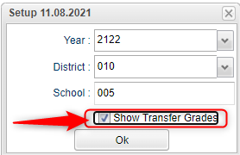
In the Setup Box, make sure you have the correct year, district (10) and check “Show Transfer Grades”, and click OK

Slide 4
From the “Courses” drop down menu, select “KINDERGARTEN”

Slide 5
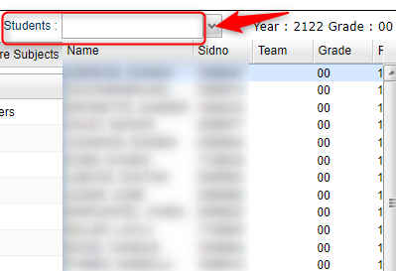
Select the desired student to enter scores from the “Students” drop down menu:

Slide 6
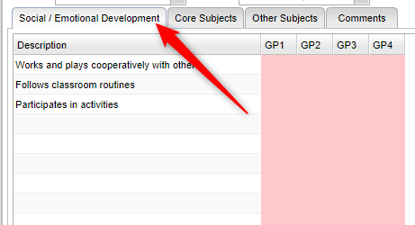
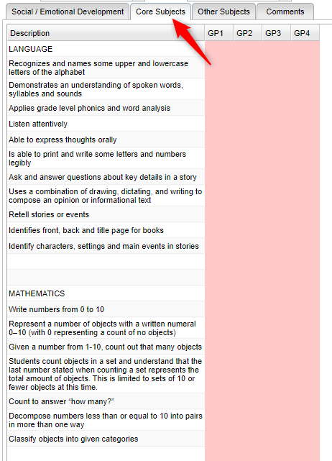
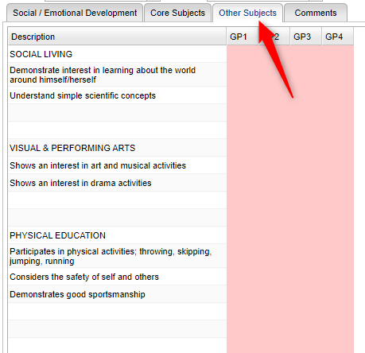
Tabs will appear below the Courses and Students drop down:

Slide 7
Clicking each tab, click the appropriate cell to enter a rating for the student

Slide 8
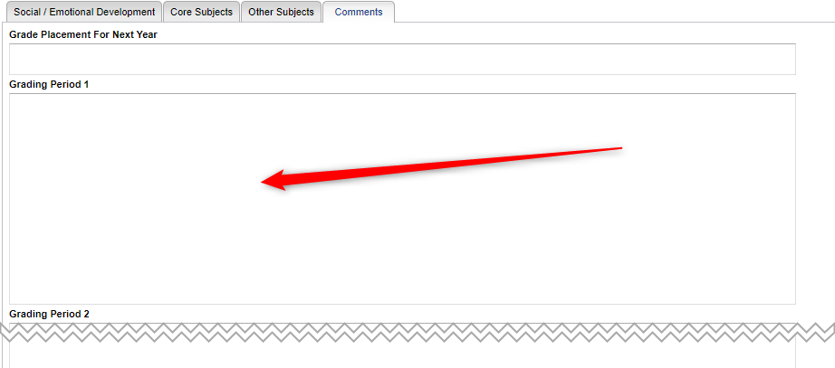
You may enter comments by opening the “Comments” tab and typing in “Grade Period 1”

Slide 9
Once all grades are entered for all tabs, click the “Save” button at the bottom of the screen.

Slide 10
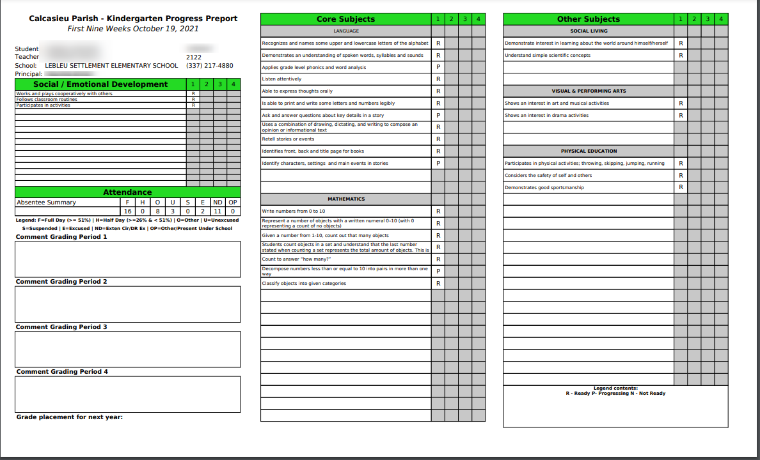
Kindergarten Progress Report

Slide 11
Feel free to watch this video again if needed.
If you still have questions, please contact Tracey Winn at MIS.
tracey.winn@cpsb.org
217-4180 x2519

