Slide 1
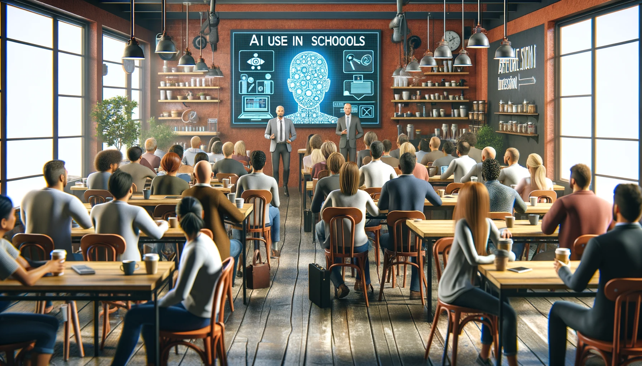
NIS AI 업데이트
November 27, 2023
OpenAI. (2023). [”Parent Coffee in a Café about AI in Schools"]. Created using DALL-E on [November 26, 2023].

Slide 2
“AI가 우리 일자리를 빼앗지는 않겠지만 AI를 사용하는 사람들은 그럴 수도 있습니다.” -Dr. Richard Baldwin

Slide 3
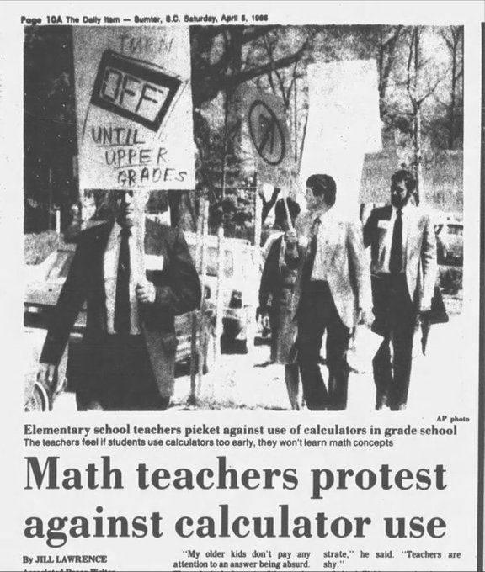
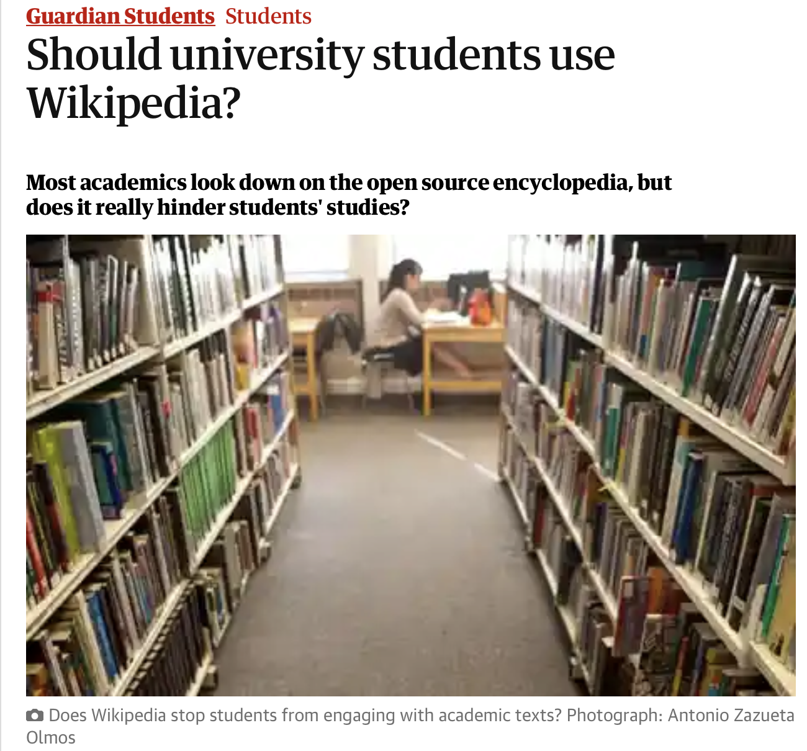
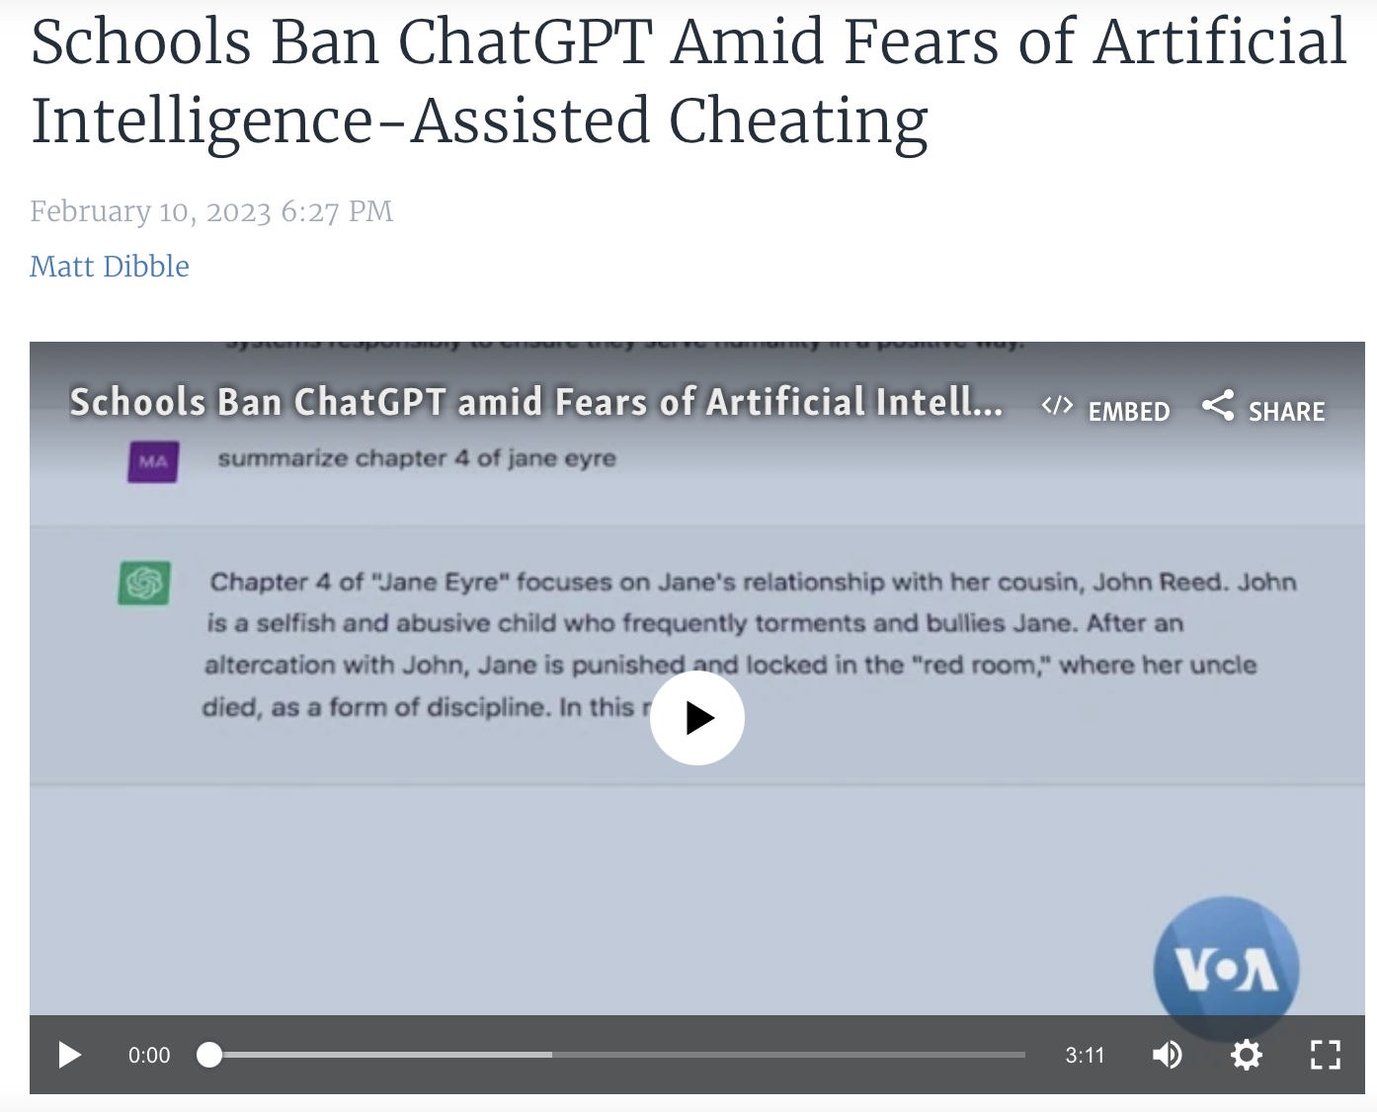
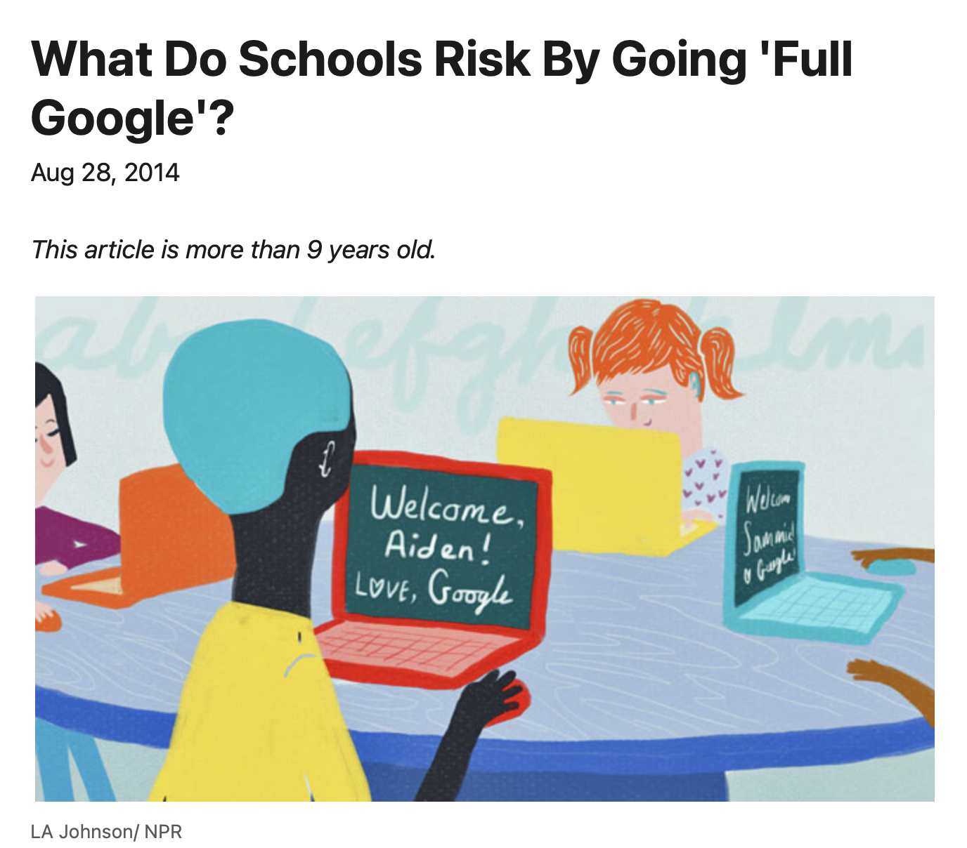
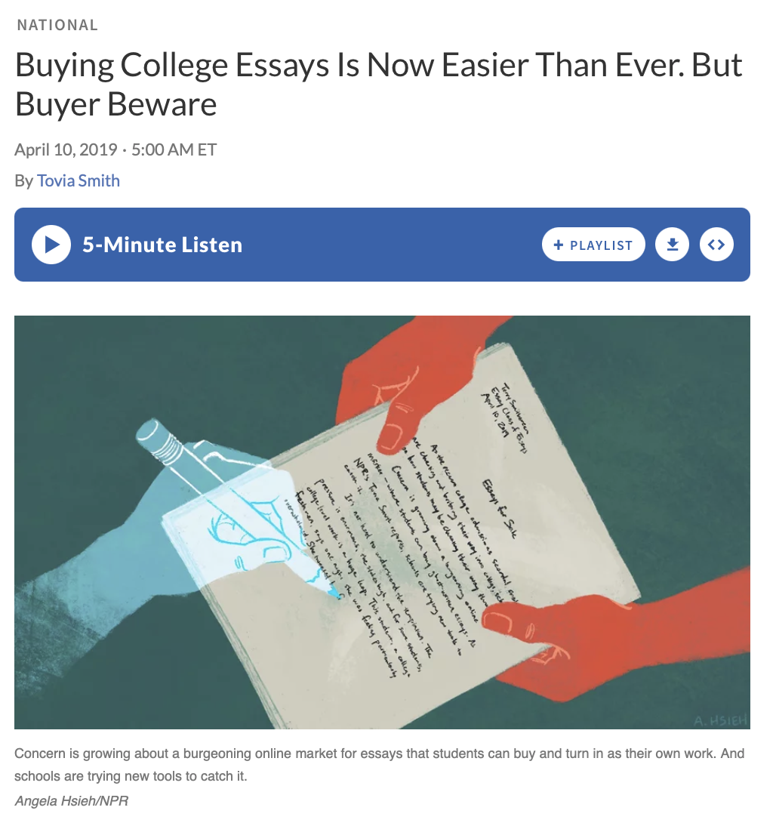
기술 혁신은 새로운 것이 아닙니다

Slide 4
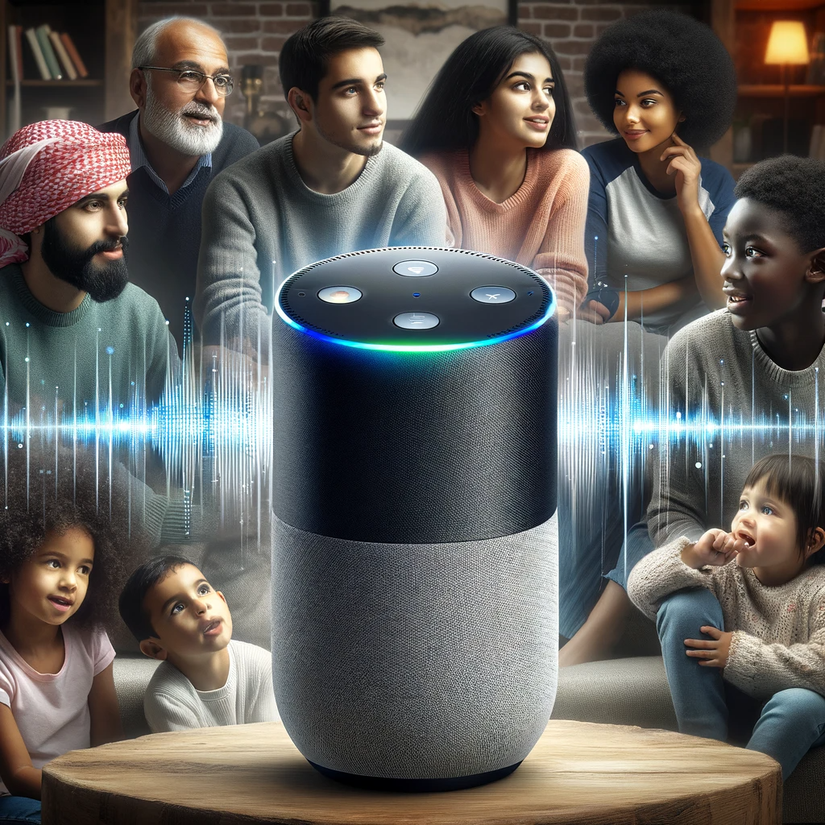
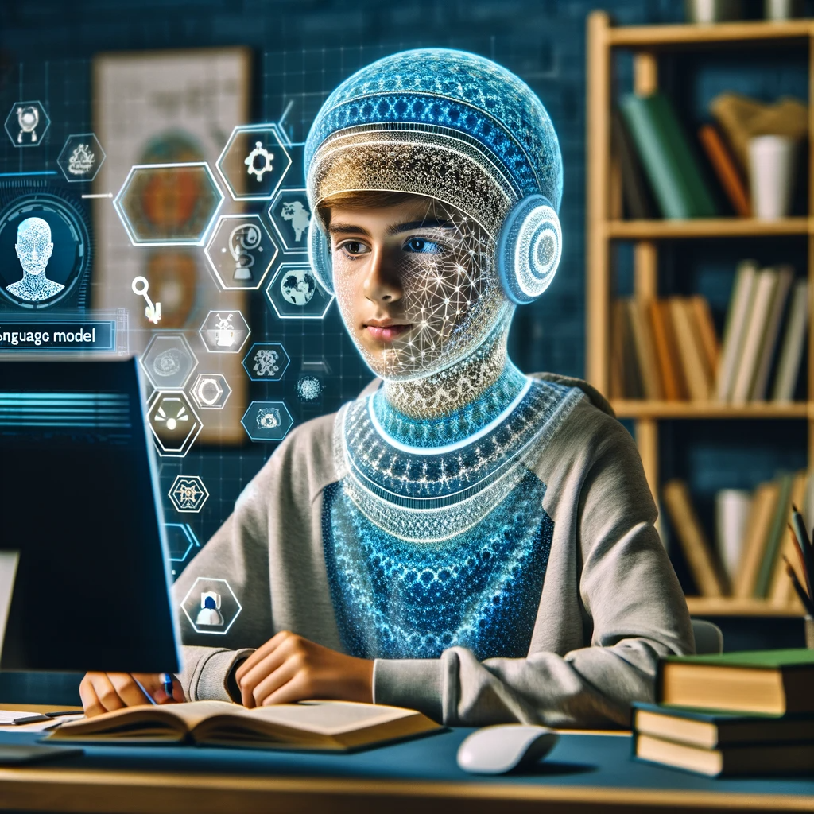
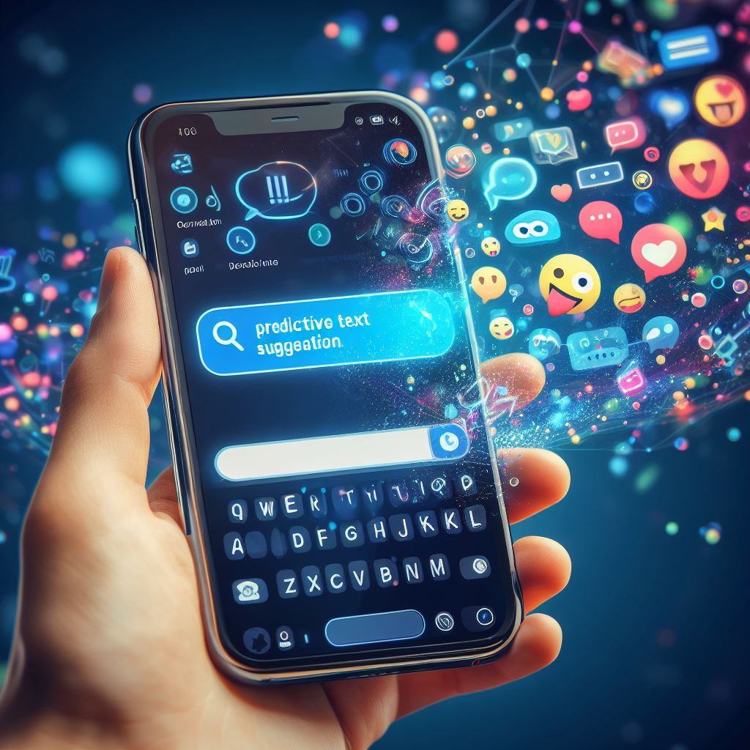
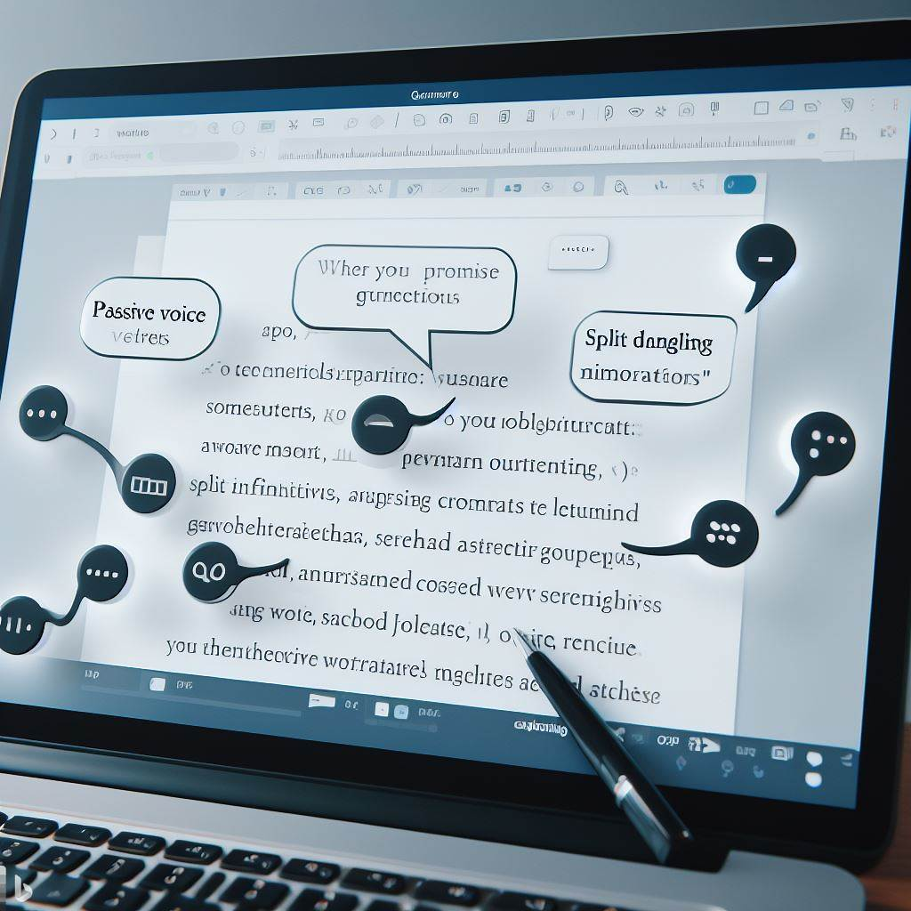
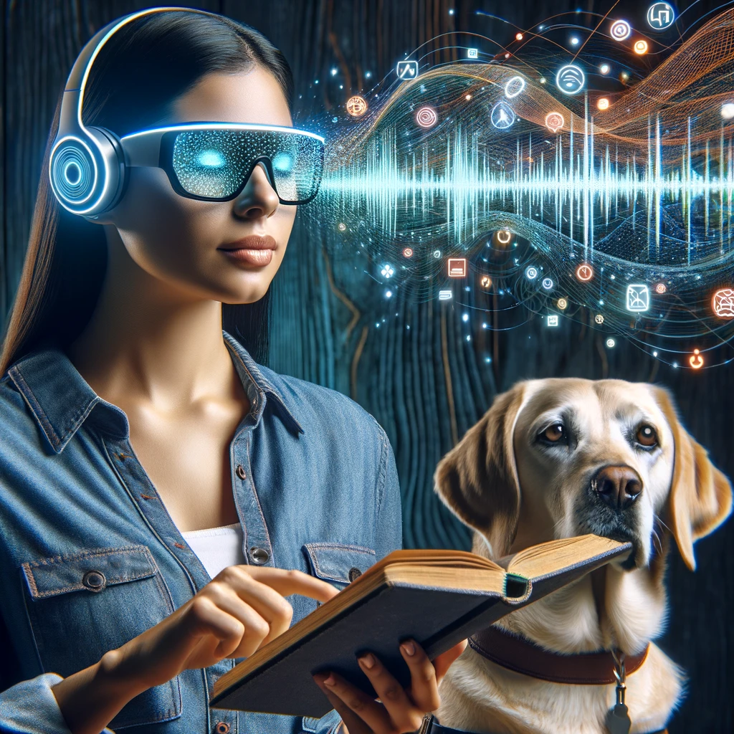
AI 혁신은 어떻게 다를까요?
All images created using Dalle-3 via ChatGPTPlus and Bing Create
Notes:
Traditional language models were limited in scope, trained on small datasets for specific tasks such as grammar correction or keyword search, using simpler algorithms like n-gram statistics.
The advent of deep learning spurred the creation of large language models (LLMs) like GPT, which employ transformer architectures capable of processing vast datasets and generating more complex, context-aware text.
LLMs offer versatility in performing diverse language tasks, from writing and summarizing to conversation and translation, without task-specific retraining.
Their ability to understand extended context and maintain textual coherence mirrors human-like interaction, enhancing applications like virtual assistants and accessibility tools.
The shift to LLMs represents a technological leap, promising economic efficiency and a transformative impact on how we use AI in natural language processing.

Slide 5
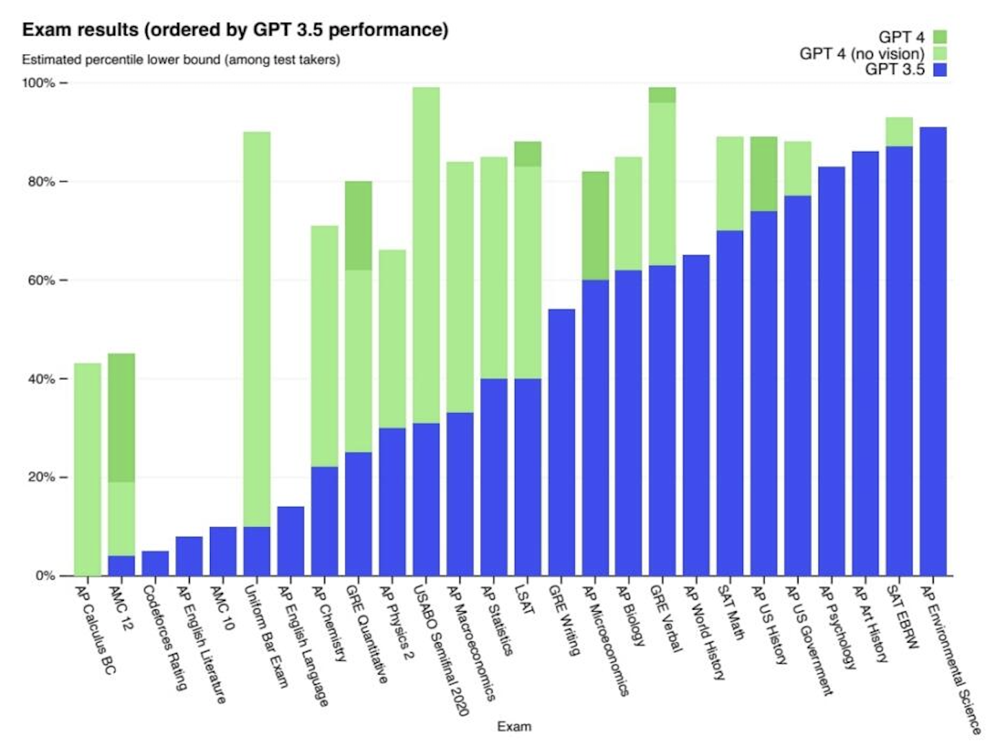
Open AI Releases Chat GPT November 30, 2022, then on March 2023

Slide 6
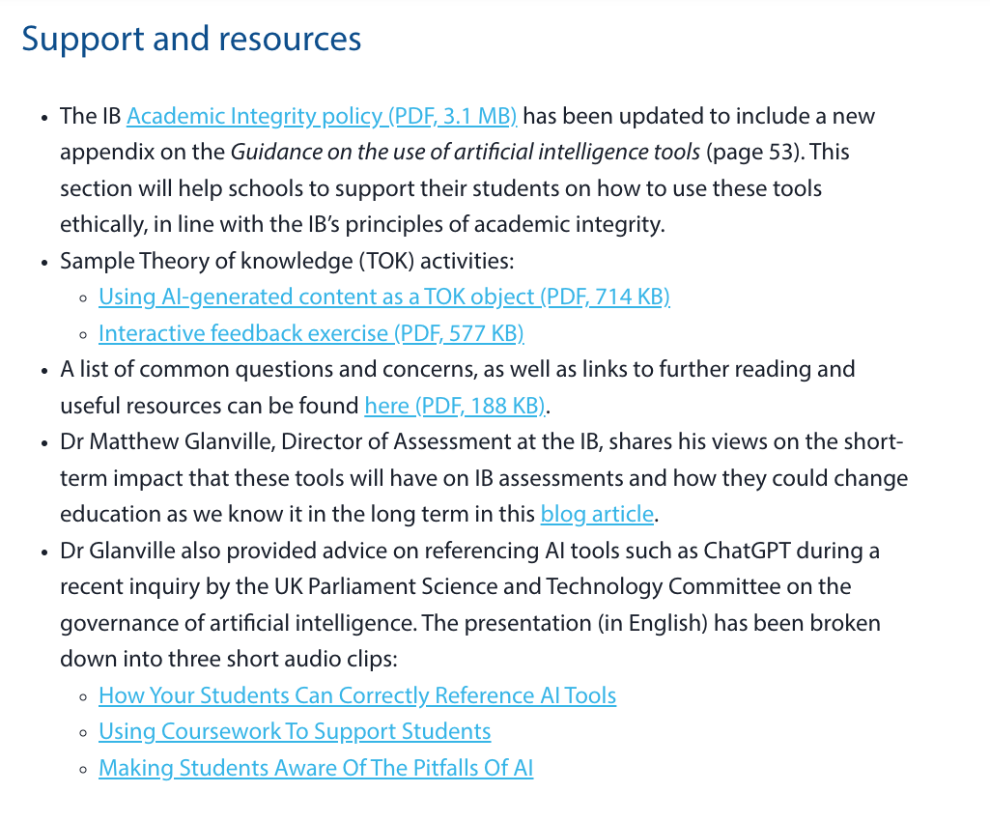
AI는 어디에 있습니까?

Slide 7
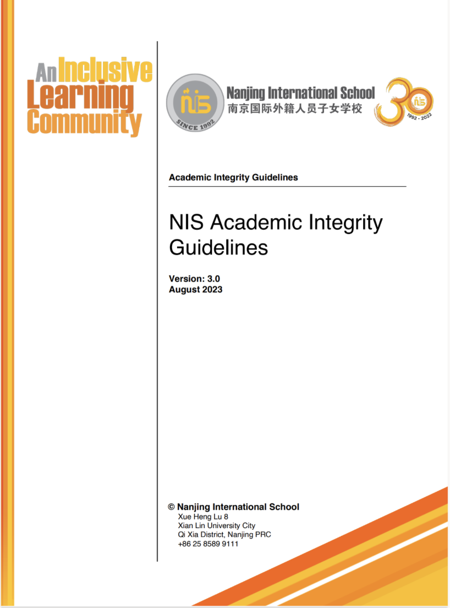
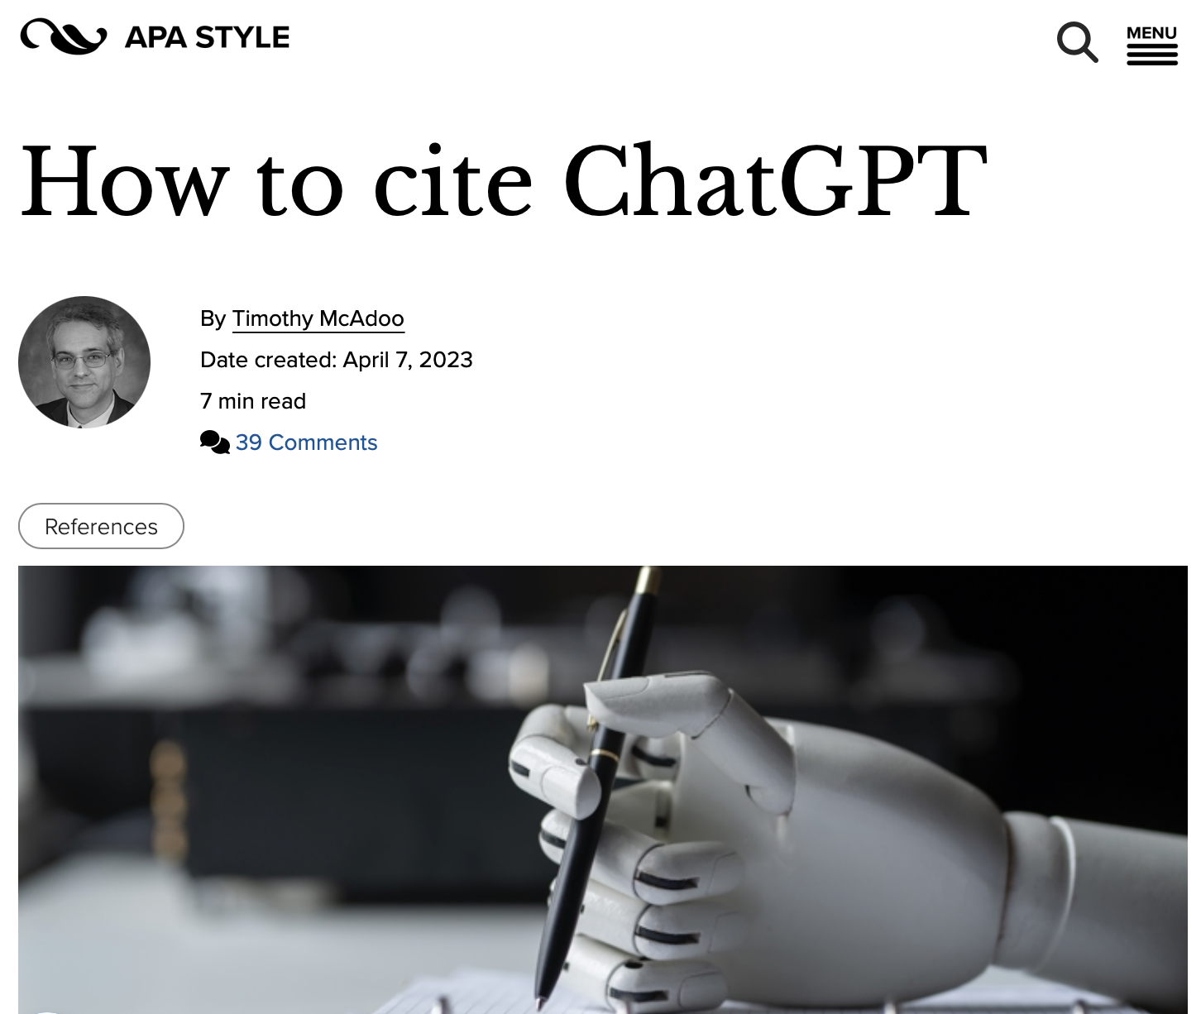
AI는 어디에 있습니까?

Slide 8
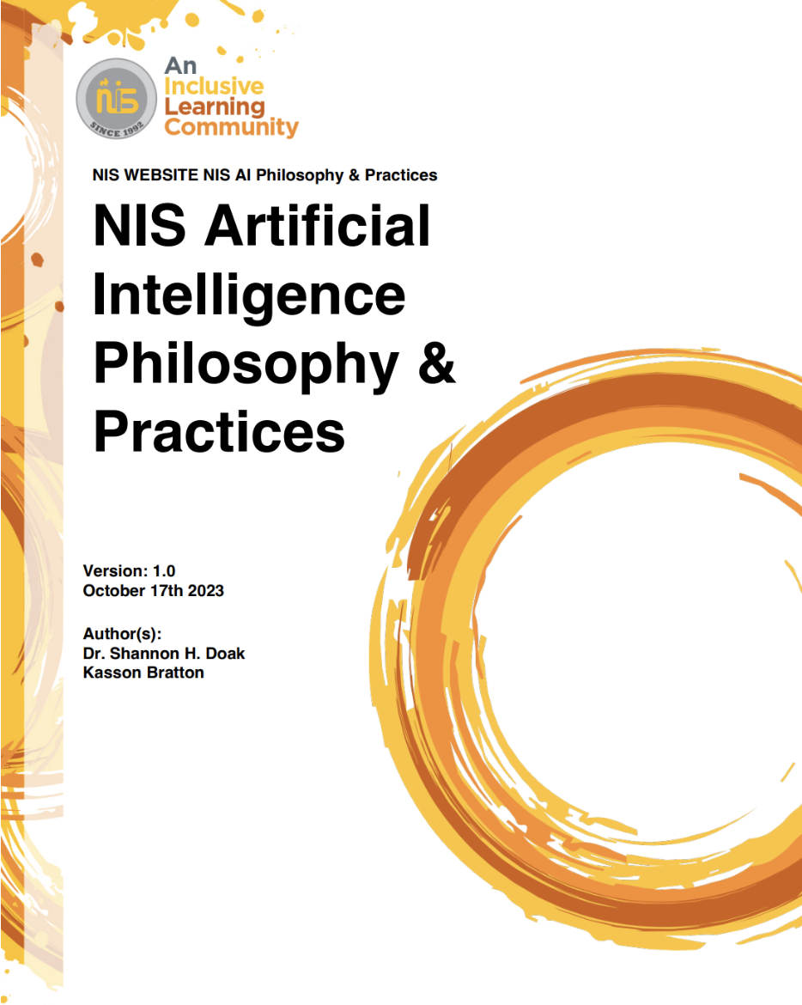
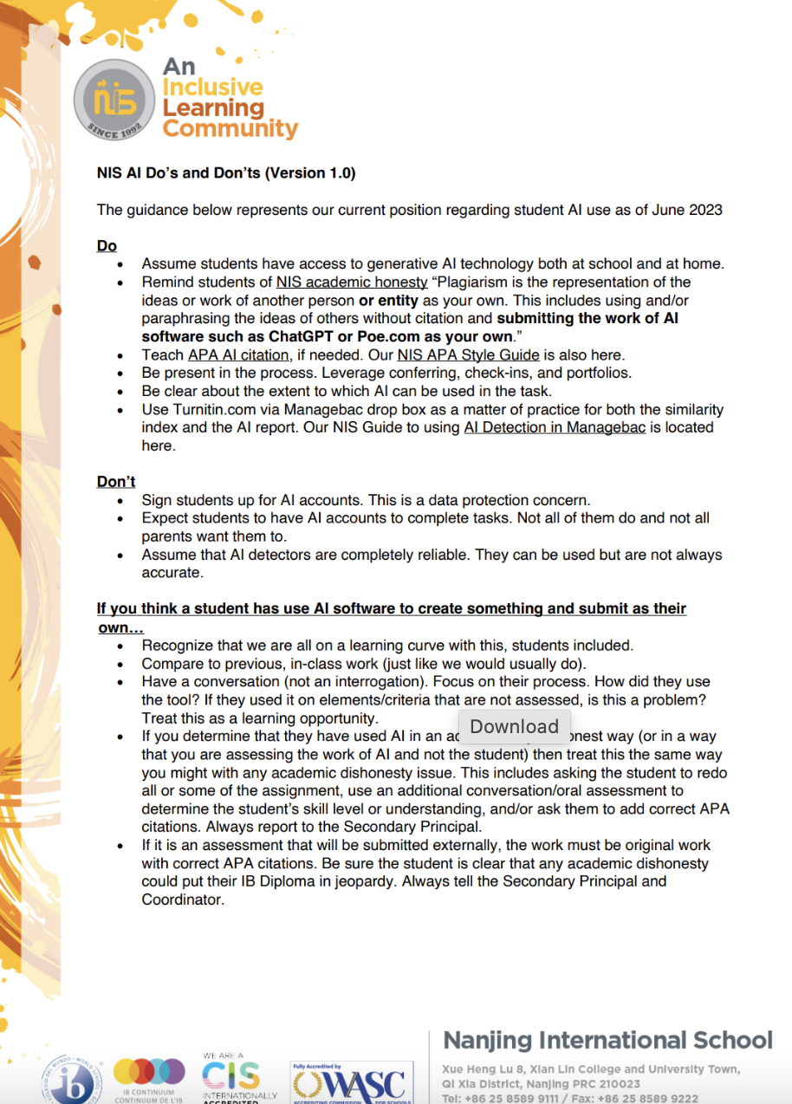
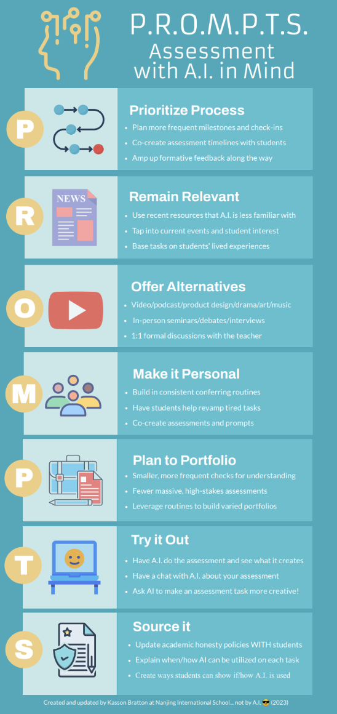
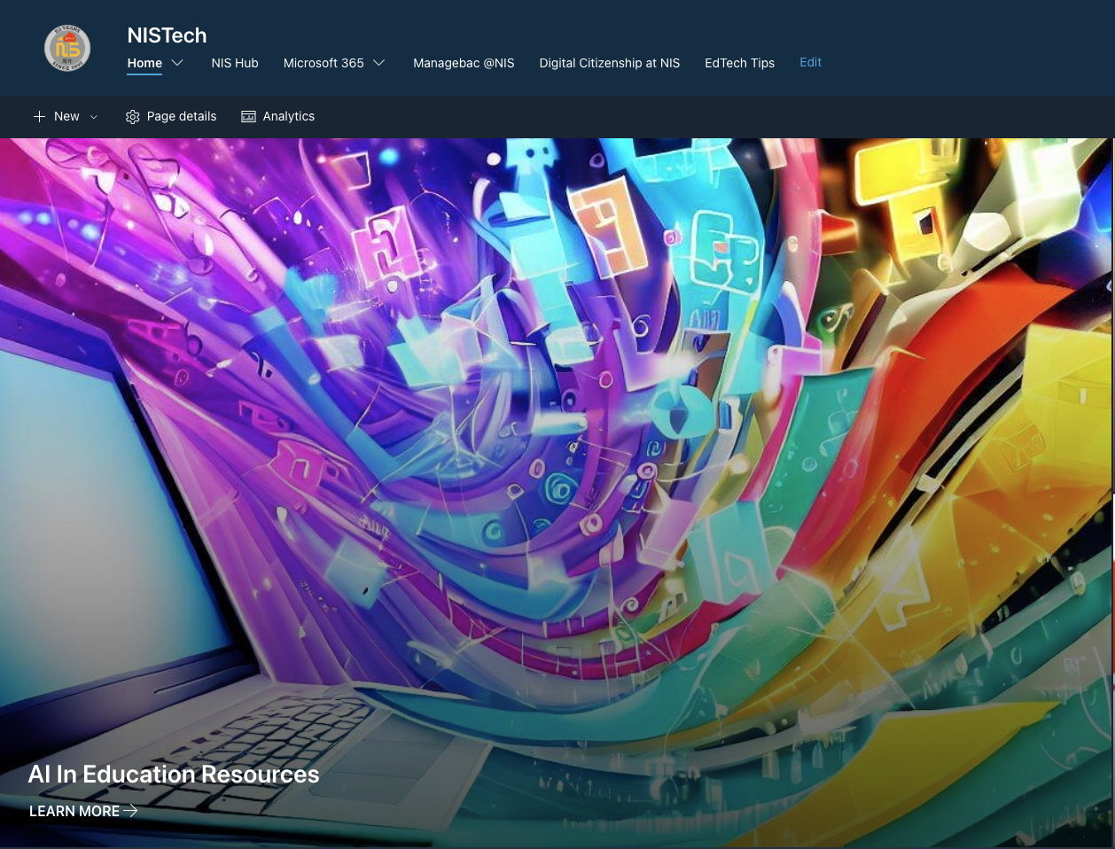
AI는 어디에 있습니까?

Slide 9
학생 목소리 (184)
2023년 11월 현재 중고등학교 학생 중 138/184(75%)가 정기적으로 AI 도구(Chat GPT, Poe, Bard, Papago 등)를 사용한다고 보고했습니다.
이 도구를 어떻게 적절하게 사용할 수 있습니까? (15)
어떻게 작동하나요? (10)
이러한 도구를 어떻게 윤리적으로 사용할 수 있습니까? (7)
All images created using Poe https://poe.com/LogoDsigner

Slide 10
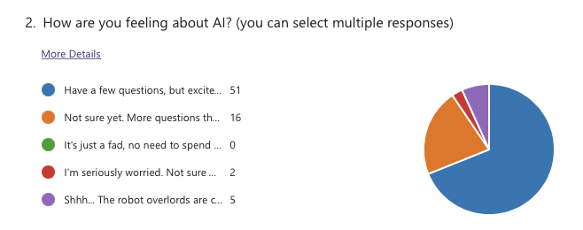
교사 목소리 (67)

Slide 11
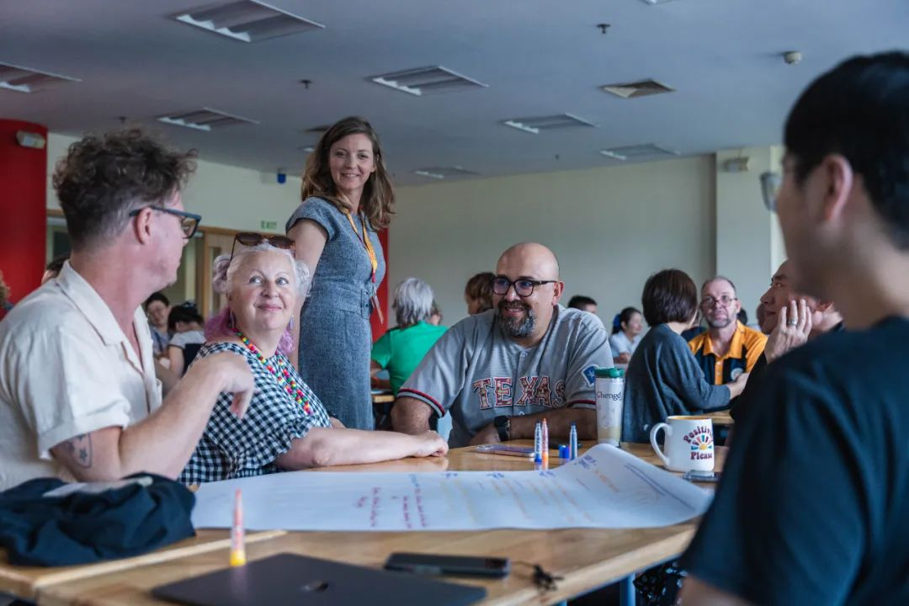
Teacher Input
A.I. Efficient and Effective Use: 17
A.I. Teacher Use in the Classroom: 16
A.I. Student Use in the Classroom: 18
15 teachers put their names forward as advanced users

Slide 12
교육적 접근
Knee Jerk
In-class only
Paper and pencil
Track digital docs
Teach AI citation
AI detection
Forms and signatures

Slide 13
NIS 학습의 정의
우리는 학습을 교실 안팎에서 창의적으로 적용되는 새로운 기술과 이해를 개발하는 개인적인 과정으로 정의합니다.
이를 염두에 두고 우리는 학생들이 다음과 같이 할 때 가장 잘 배울 수 있다고 믿습니다.
학습에 관해 의미 있는 선택을 할때
문화와 관점을 넘어 연결이 될 때
강한 소속감과 소속감을 느낄 때
도전과 지원의 적절한 균형을 경험할 때

Slide 14
교육적 접근
Knee Jerk
In-class only
Paper and pencil
Track digital docs
Teach AI citation
AI detection
Forms and signatures
Re-Think
Co-create assessments
Focus on process and milestones
More recent and relevant
More creative and personal
More formative and feedback
Be explicit about amount AI use

Slide 15
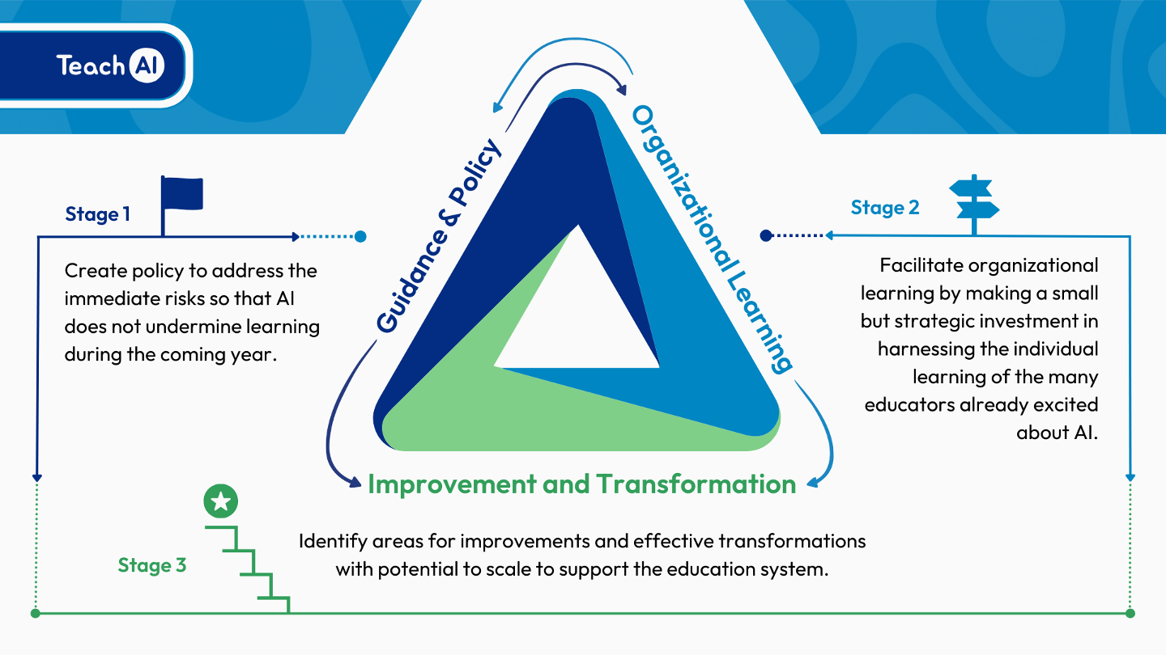
AI는 어디에 있습니까?
Notes:
Stage 1
Ensure that AI use at NIS complies with existing security and privacy and educational policies,
Provide guidance to students and staff on topics such as the opportunities and risks of AI
Clarify responsible and appropriate uses of AI tools, by teachers and students
Define academic integrity standards related to AI.
Stage 2
Focusing on professional development for all staff
Bring together individual educators' experiences with AI to build collective organizational knowledge and capacity.
Include operational considerations such as evaluating AI tools already in use and reviewing our practices, particularly around assessment with AI in mind
Stage 3
Personalized learning and PD for staff based on individual needs and goals
Embedding of targeted AI practices in learning and assessment
NIS is consolidating Stage 1 and moving into Stage 2

Slide 16
어떤 어려움이 있을까요?
윤리 및 법률
정확성 고려
평가 및 커리큘럼
정보 격차
Notes:
Ethical Considerations
Bias and Fairness: Generative AI models may inadvertently perpetuate or amplify biases present in their training data, potentially leading to unfair outcomes for certain groups of students.
Privacy: The use of AI in educational settings raises concerns about student privacy, especially if the AI processes sensitive or personal data.
Intellectual Property: There are questions about the ownership of content created by AI, such as essays or art, and whether it can be considered original work by the student.
Transparency: Students and educators may not fully understand how AI systems make decisions, which can lead to trust issues.
Legal Considerations
Compliance with Regulations: Schools must ensure that their use of AI complies with educational laws and regulations, such as the Family Educational Rights and Privacy Act (FERPA) in the U.S., which protects student education records.
Liability: There could be legal implications if the AI provides incorrect information that leads to negative consequences for students.
Accuracy Considerations
Reliability of Content: AI-generated information may not always be accurate, and relying on it for educational content could lead to misinformation.
Data Quality: The output quality of AI is contingent on the quality of the input data; inaccurate data can lead to flawed conclusions or recommendations.
Assessment Considerations
Cheating and Plagiarism: AI makes it easier for students to generate essays and answers that are not their own work, complicating academic integrity efforts.
Evaluation of AI-generated Work: Teachers may need new tools and methods to assess work created with the aid of AI, as traditional metrics may no longer apply.
Curricular Considerations
Integration into Existing Curricula: Deciding how AI fits into the existing curriculum can be challenging, as it may not align with current learning objectives or standards.
Teacher Preparedness: Educators may require additional training to effectively incorporate AI tools into their teaching methods and to understand their limitations.

Slide 17
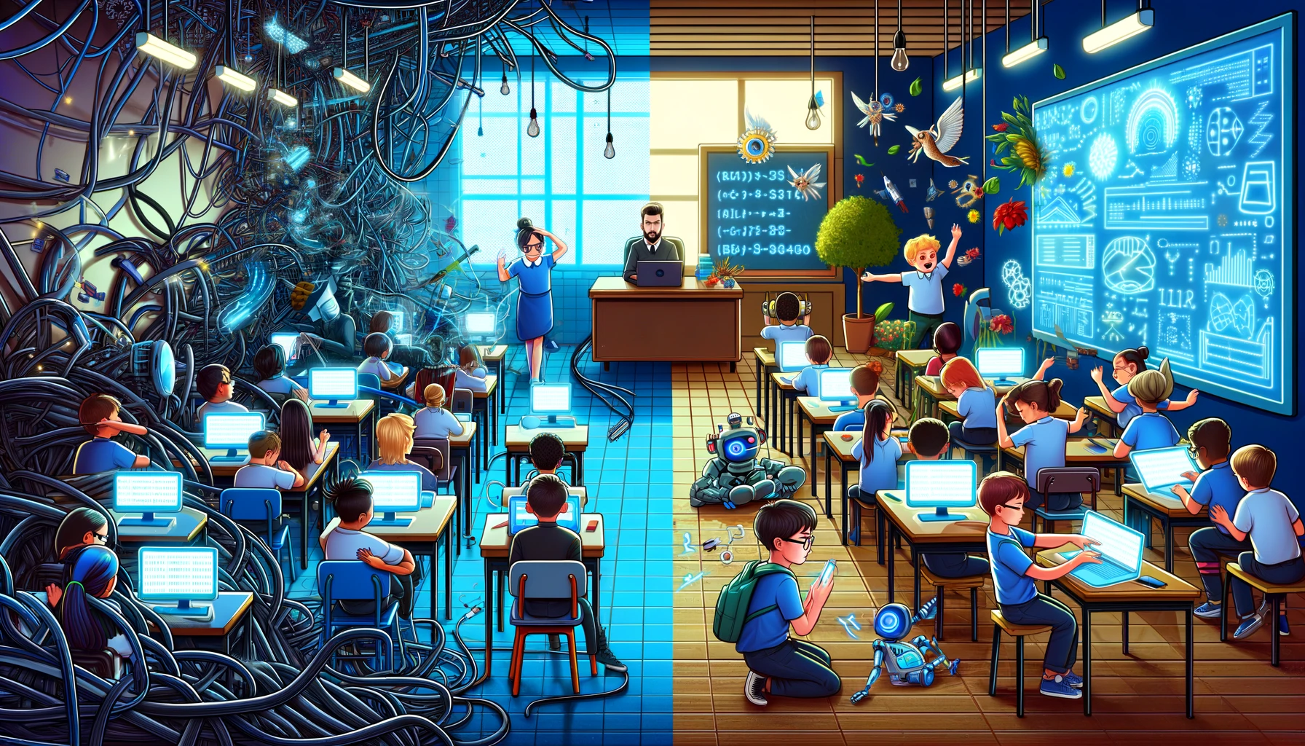
지금과 다음…
소통과 실험
전문적인 학습
교사에 의한 사용 지원
평가 재검토
최초 "Poe 파일럿" 진행 중(G9)
OpenAI. (2023). ["Split image depicting challenges and opportunities of AI use in schools"]. Created using DALL-E on [November 23, 2023].
Notes:
Take a look at our AI Documentation (Link shared in Tuesday Tech Tips or scan the QR Code)
Play around with AI chatbots like Poe.com (Guide on how to install POE in Latest Tech Tip)
Share what you are doing with others
Begin to use in planning and instruction, when appropriate
Be conscious of the “digital divide”
Begin to reconsider assessments in the age of AI (PROMPTS)

Slide 18
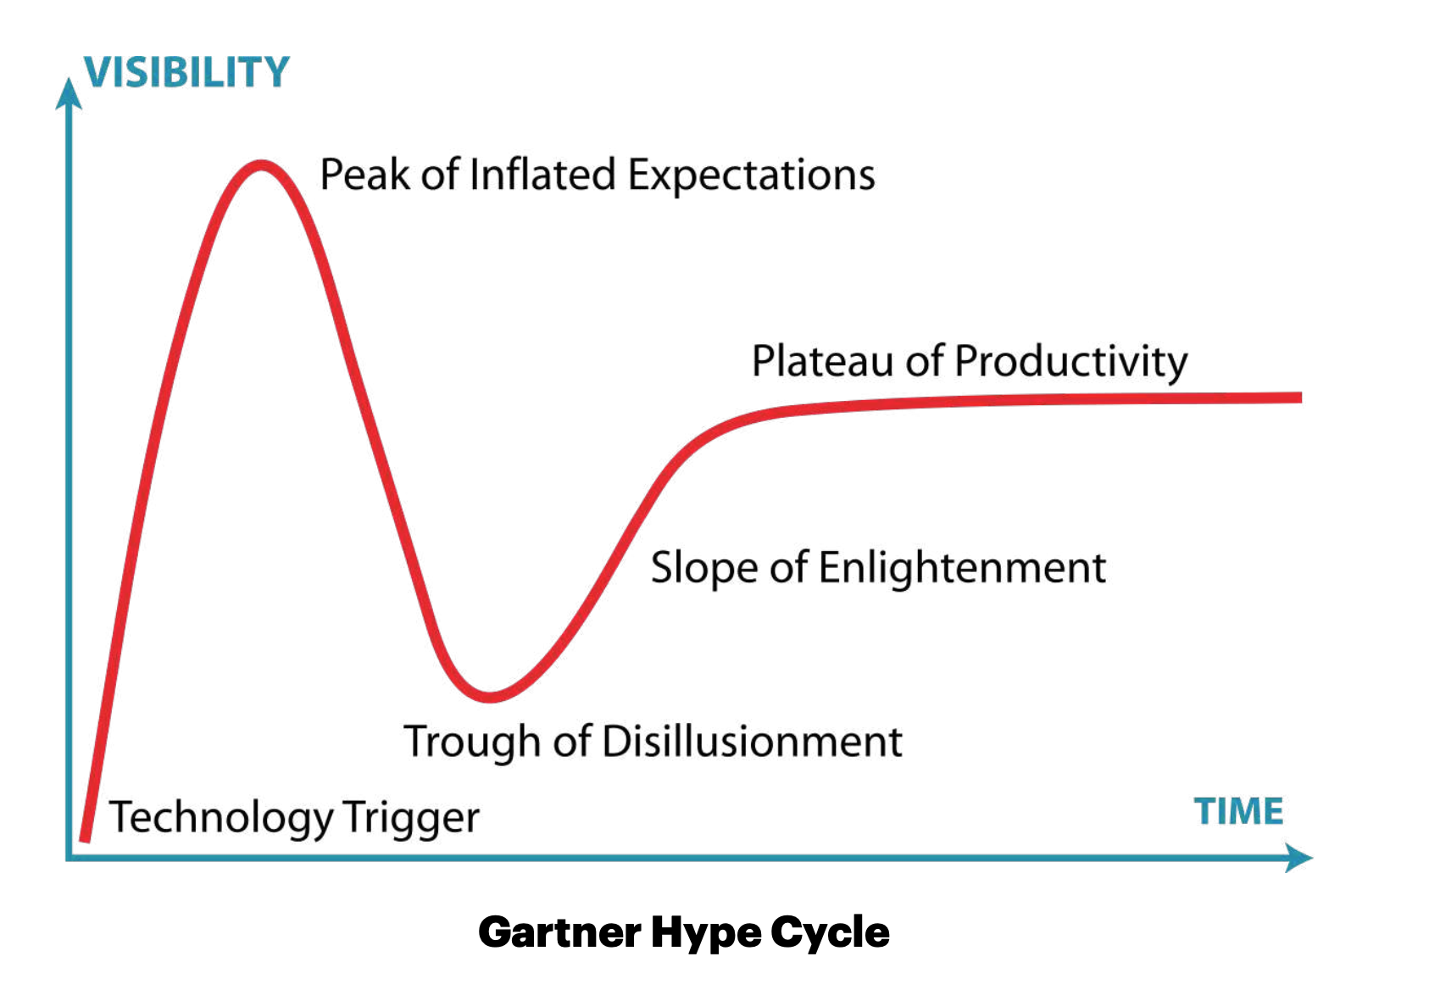
AI
https://www.gartner.com/en/newsroom/press-releases/2023-08-16-gartner-places-generative-ai-on-the-peak-of-inflated-expectations-on-the-2023-hype-cycle-for-emerging-technologies
"Generative artificial intelligence (AI) is positioned on the Peak of Inflated Expectations on the Gartner, Inc. Hype Cycle for Emerging Technologies, 2023, projected to reach transformational benefit within two to five years." (STAMFORD, Conn., August 16, 2023)

Slide 19
몇 가지 가능한 프롬프트
원하는 언어를 사용하세요!
아동심리학자로 활동해 주시기 바랍니다. 나는 당신에게 내 아이를 가장 잘 양육할 수 있도록 조언을 해주기를 바라는 상황을 설명하겠습니다. 참고로 제 아이는 [X]살입니다.
교육공학 전문가로 활동해 주시기 바랍니다. 나는 당신에게 상황을 알려줄 것이며 내가 아이를 잘 양육할 수 있도록 도와주기를 바랍니다. 참고로 제 아이는 [X]살입니다.
나는 당신이 전문적인 여행 기획자 역할을 해주기를 바랍니다. 우리가 여행할 곳, 여행 날짜, 여행할 성인과 어린이 수에 대한 정보를 알려드리겠습니다. 제가 제공한 정보를 바탕으로 답변해 주시기 바랍니다.
우리 아이의 [학년] [과목] 선생님께 가정에서 자녀를 어떻게 도울 수 있을지 피드백을 요청하는 이메일을 작성해주세요.
집에서 [x]살 아이의 핸드폰 사용에 대한 디지털 약속을 맺을 수 있도록 도와주세요.
Poe에게 물어보세요!

