Slide 1
NIS A.I. Update
November 14, 2023

Slide 3
“AI won’t take our jobs, but those who can use it might.”
-Dr. Richard Baldwin

Slide 4
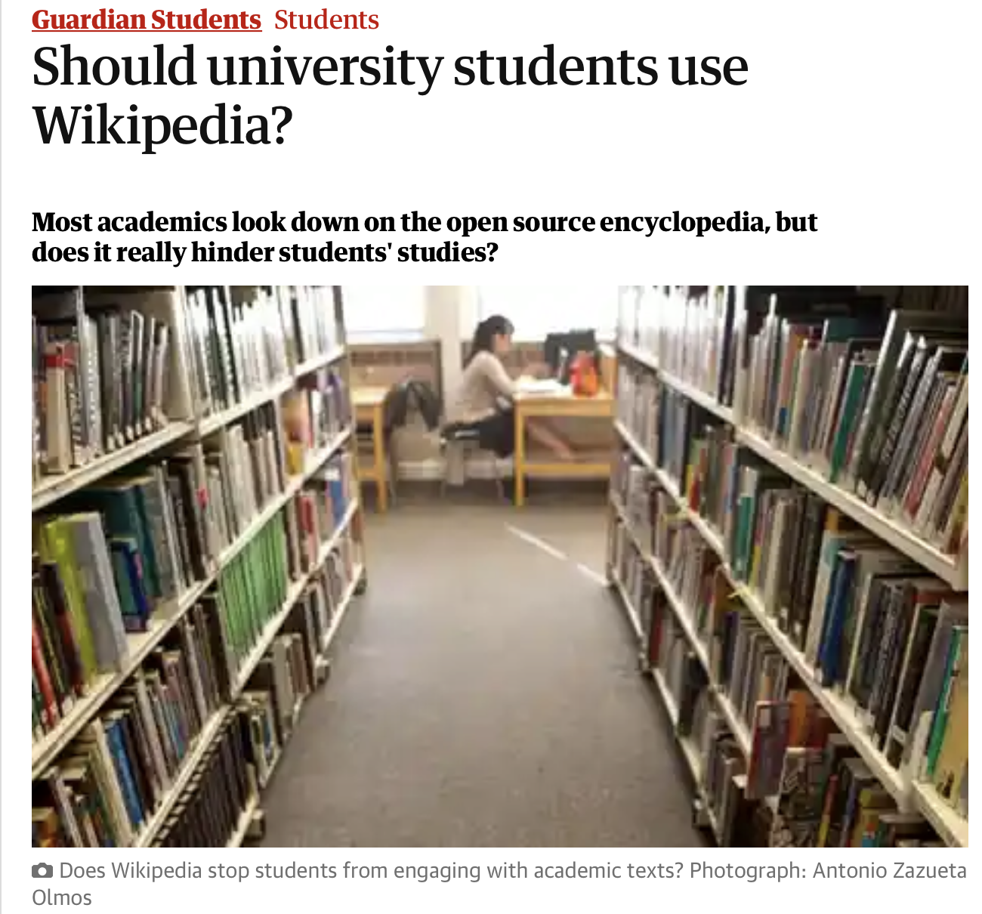
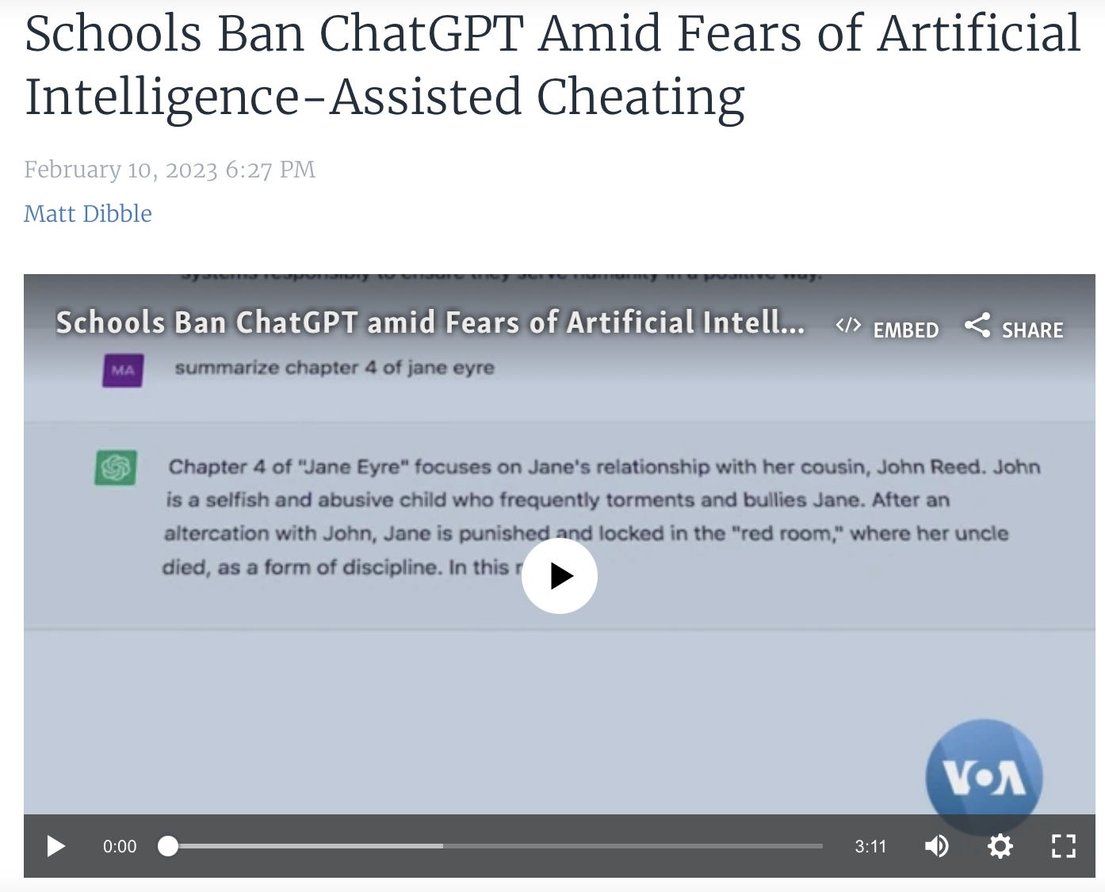
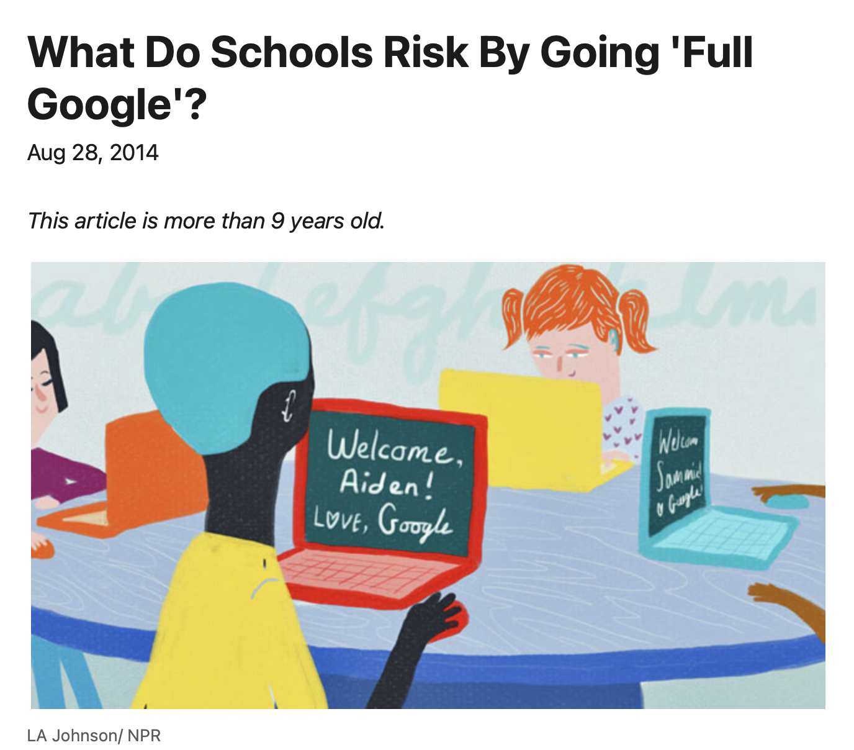
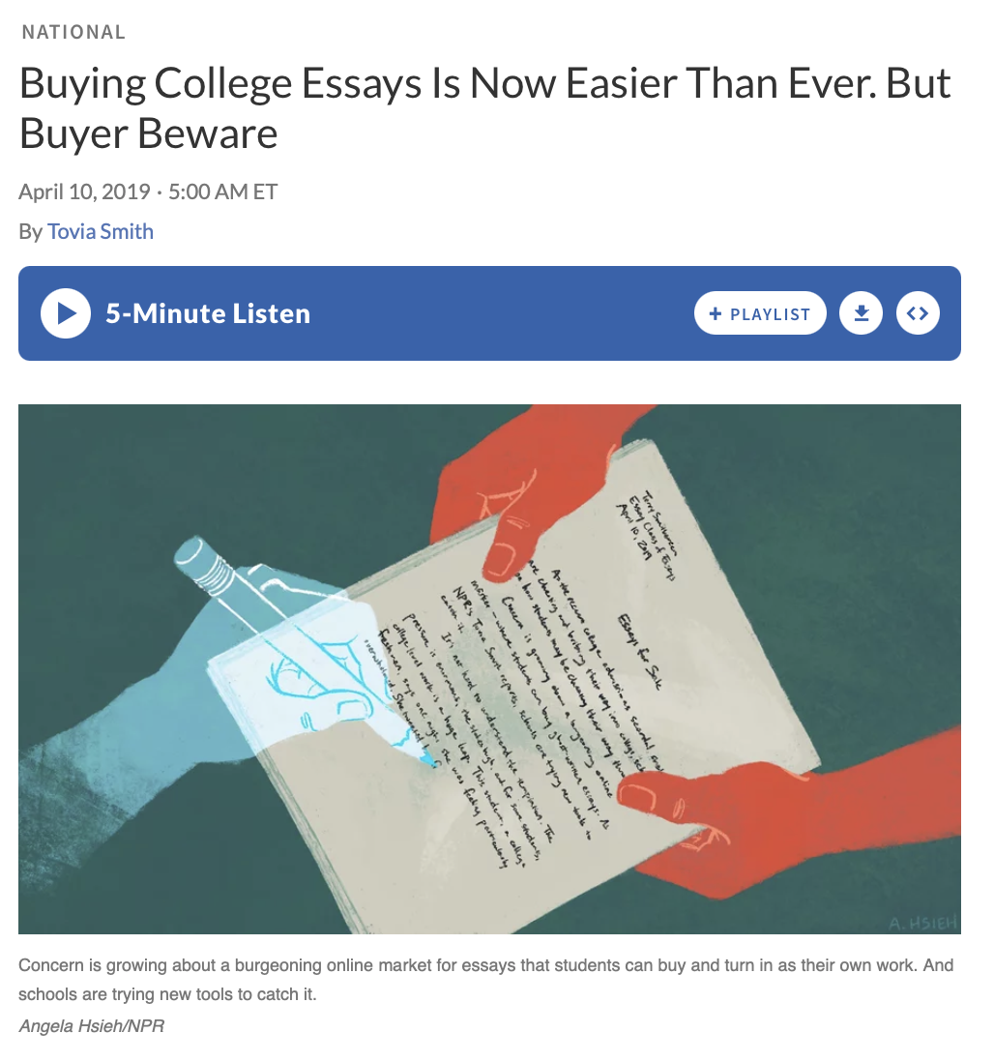

Slide 5
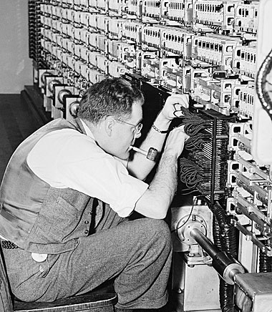
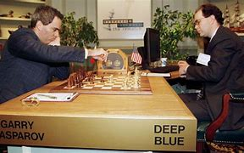
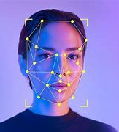
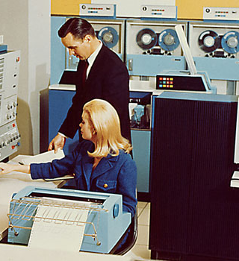
How is AI Disruption Different?
Notes:
It all started back in the 1950’s with Alan Turing, one of the guys responsible for cracking the Enigma machine during WWII who came up with the Turing test, the method we could use to determine if a machine was demonstrating intelligence
In the 70’s and 80’s with the rise in smaller, cheaper computing power, systems were developed to mimic human experts in the fields of banking and finance, crunching numbers
From 2000 onward, there has been a growth in AI research, from developments in speech and image recognition to natural language processing. This was applied in areas ranging from facial recognition to self-driving cars. AI systems were being trained using games as their rule base including Deep Blue to play Chess and IBM Watson to play Jeopardy.
Now (in the last 5 years) we have billions of dollars being invested into companies like Google, OpenAI, Anthropic and Meta. We have neural net systems like Deepmind which can beat the World Champion at GO, Tesla’s Self driving Semi trucks, and LLM’s like ChatGPT that can have nuanced conversations on any topic imaginable. As a result there are some who believe we have systems which can pass the Turing test.
So AI based Tech (like voice recognition) which we once thought would destroy jobs is now ubiquitous and we wonder how we could live without it.

Slide 6
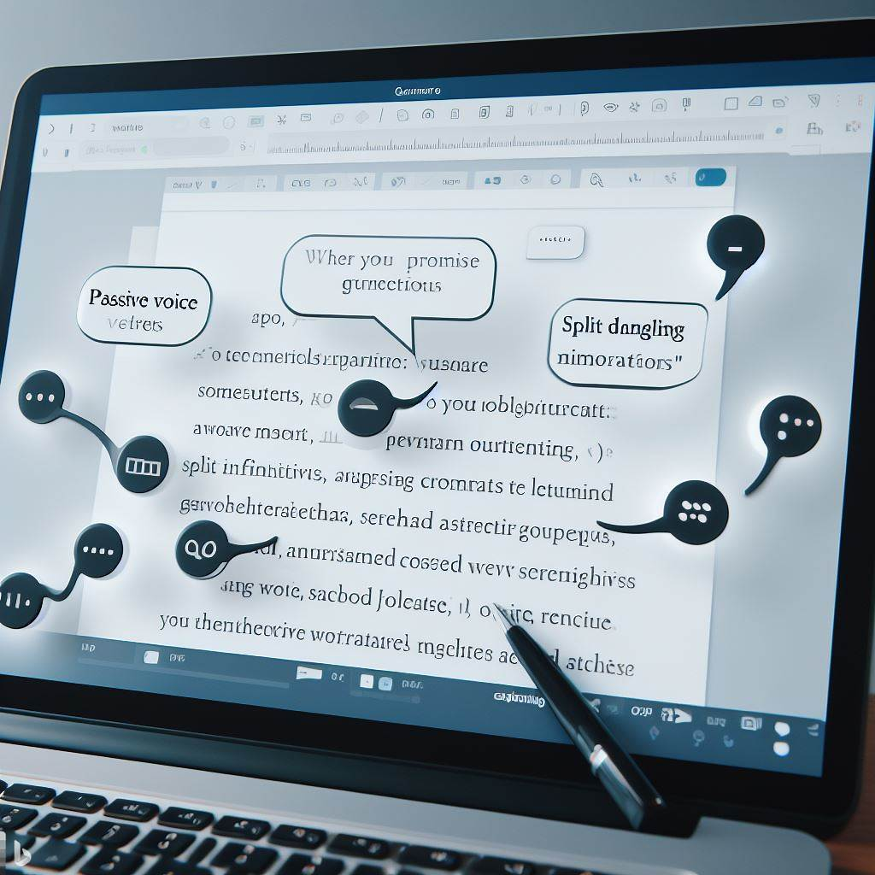
How is AI Disruption Different?
All images created using Dalle-3 via ChatGPTPlus and Bing Create
Notes:
Traditional language models were limited in scope, trained on small datasets for specific tasks such as grammar correction or keyword search, using simpler algorithms like n-gram statistics.
The advent of deep learning spurred the creation of large language models (LLMs) like GPT, which employ transformer architectures capable of processing vast datasets and generating more complex, context-aware text.
LLMs offer versatility in performing diverse language tasks, from writing and summarizing to conversation and translation, without task-specific retraining.
Their ability to understand extended context and maintain textual coherence mirrors human-like interaction, enhancing applications like virtual assistants and accessibility tools.
The shift to LLMs represents a technological leap, promising economic efficiency and a transformative impact on how we use AI in natural language processing.

Slide 7
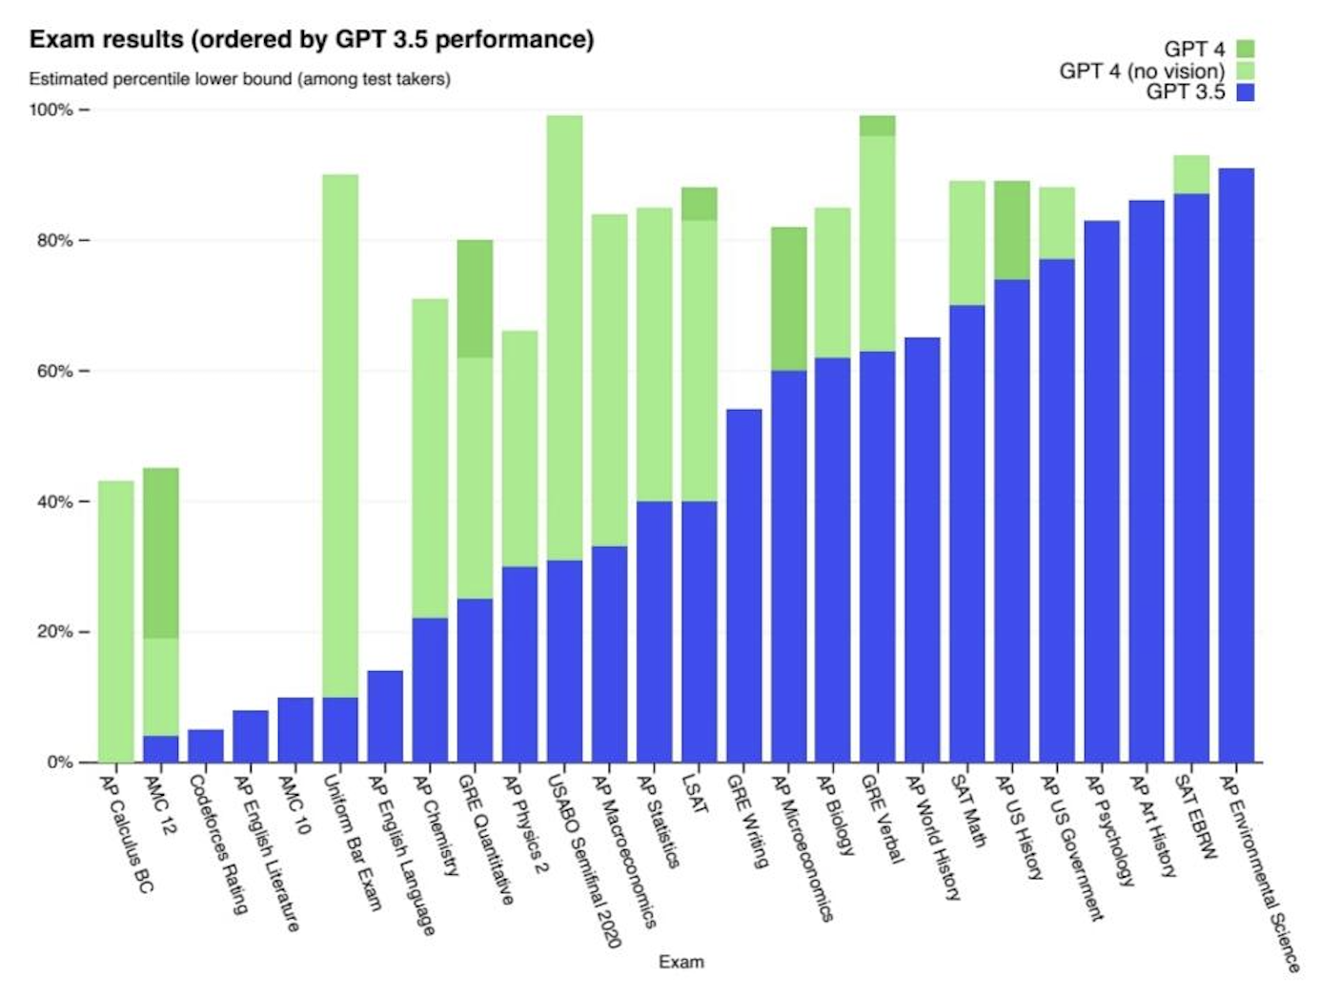
Open AI Releases Chat GPT November 30, 2022, then on March 2023

Slide 8
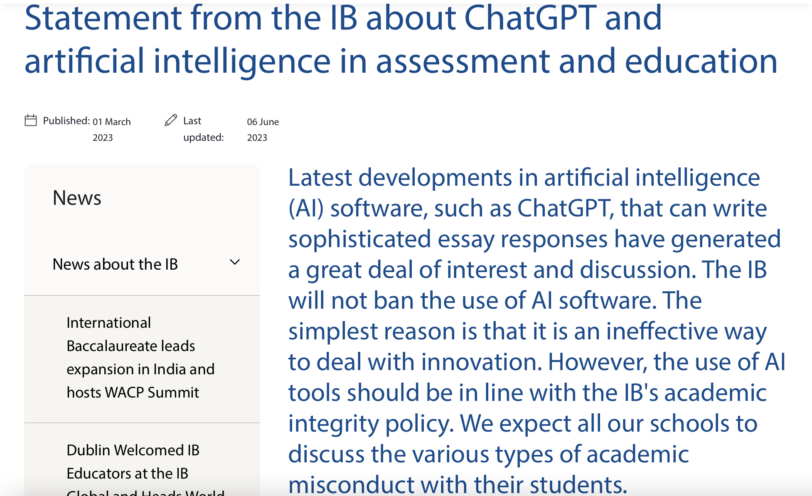
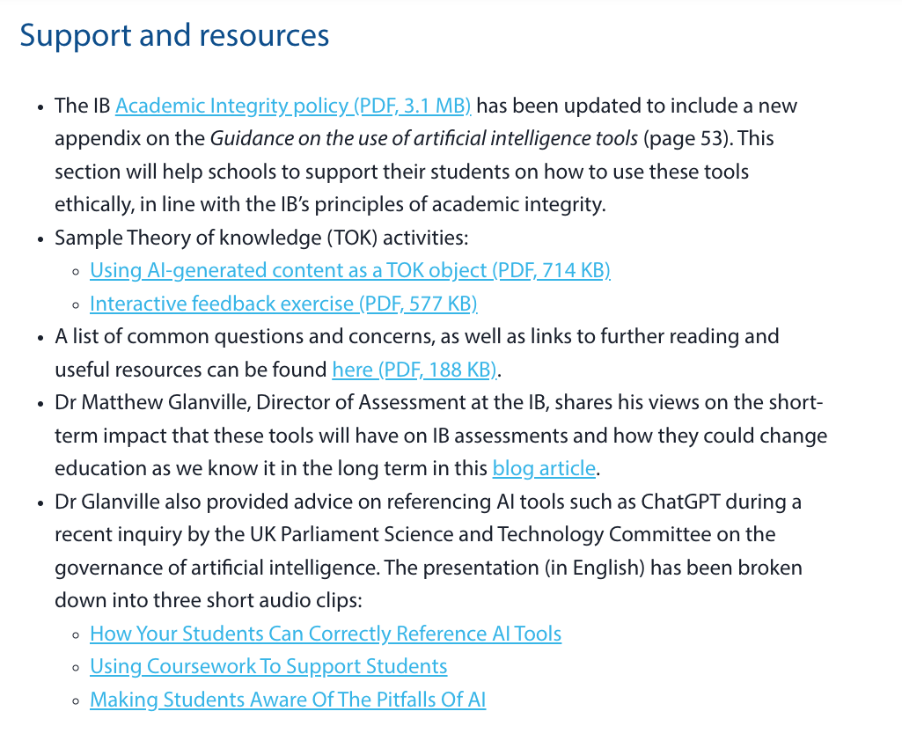
Where are we with AI?

Slide 9
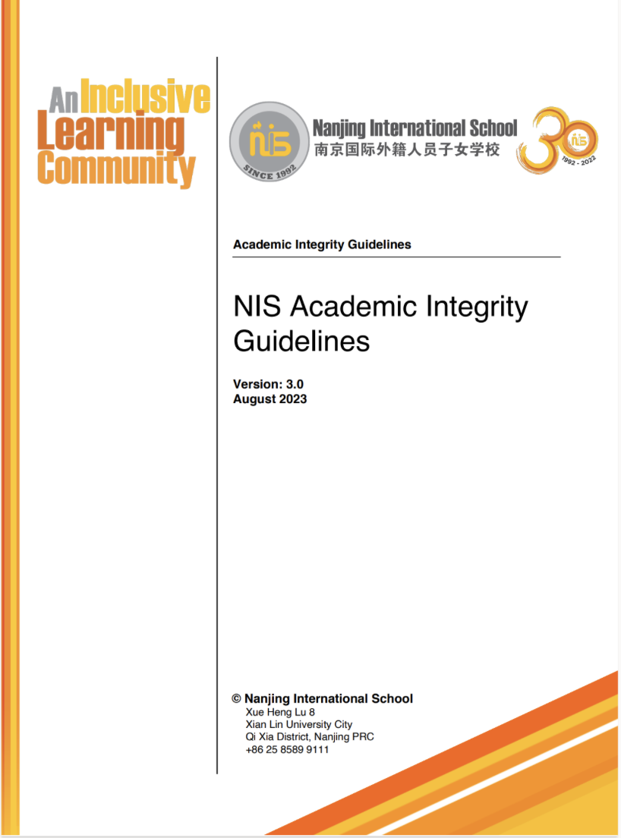
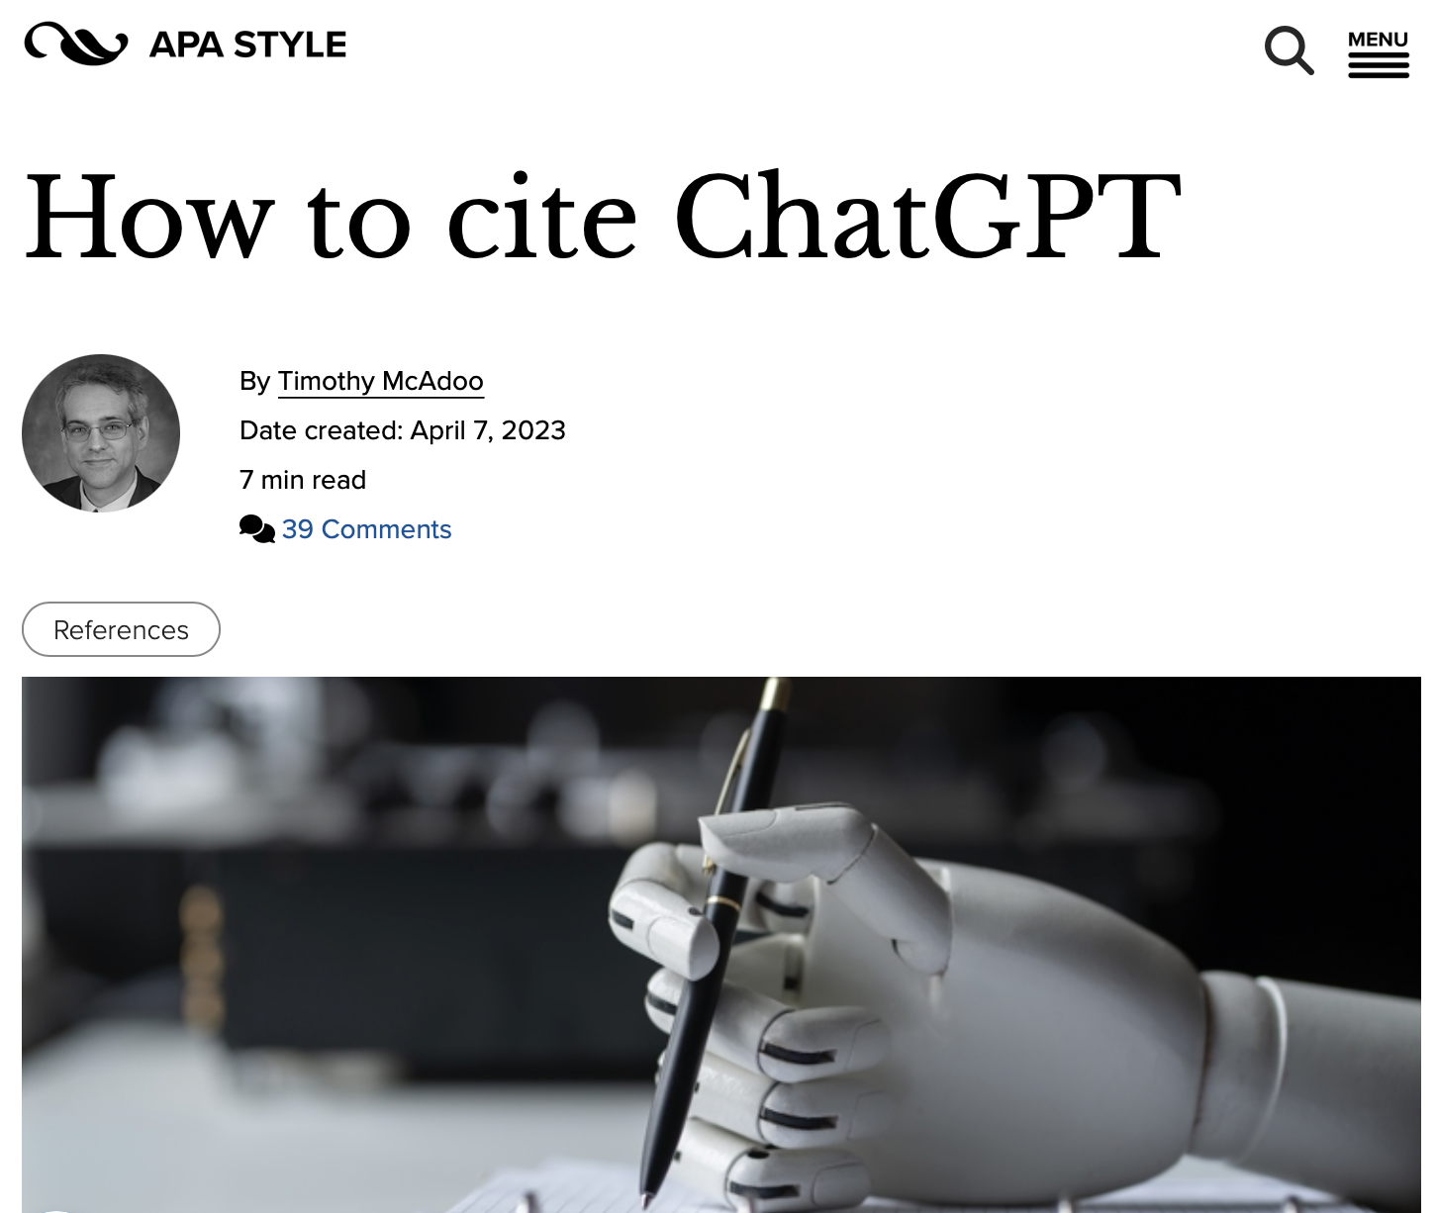
Where are we with AI?

Slide 10
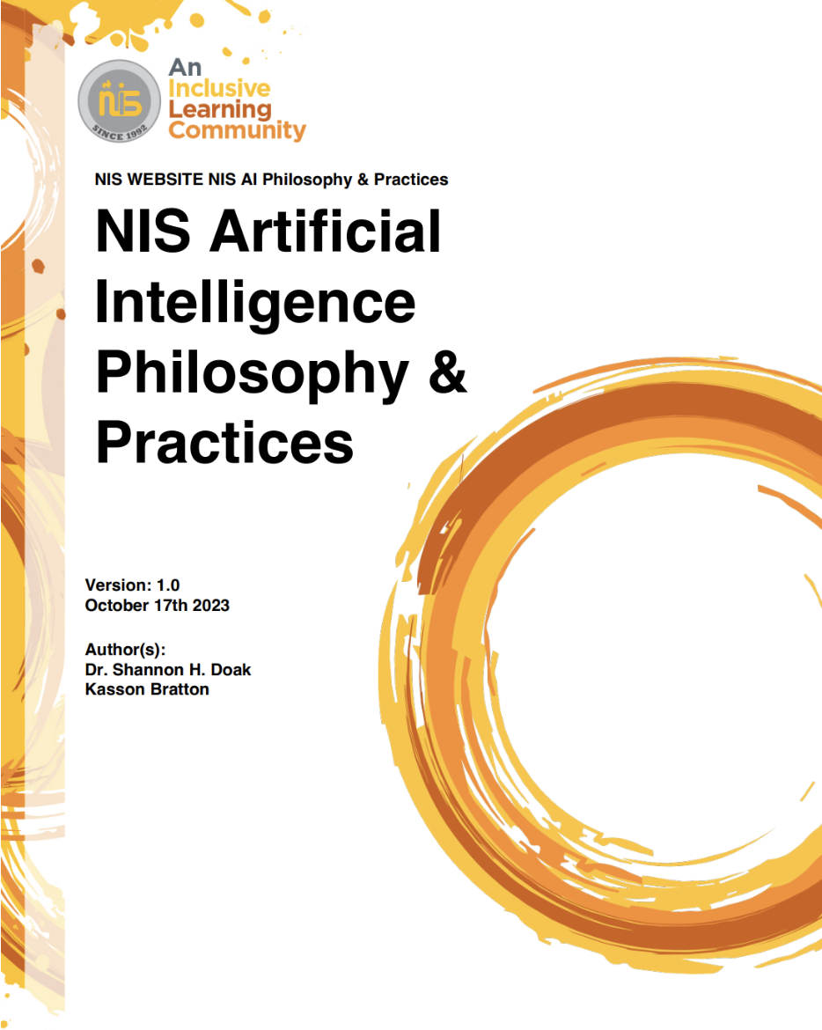
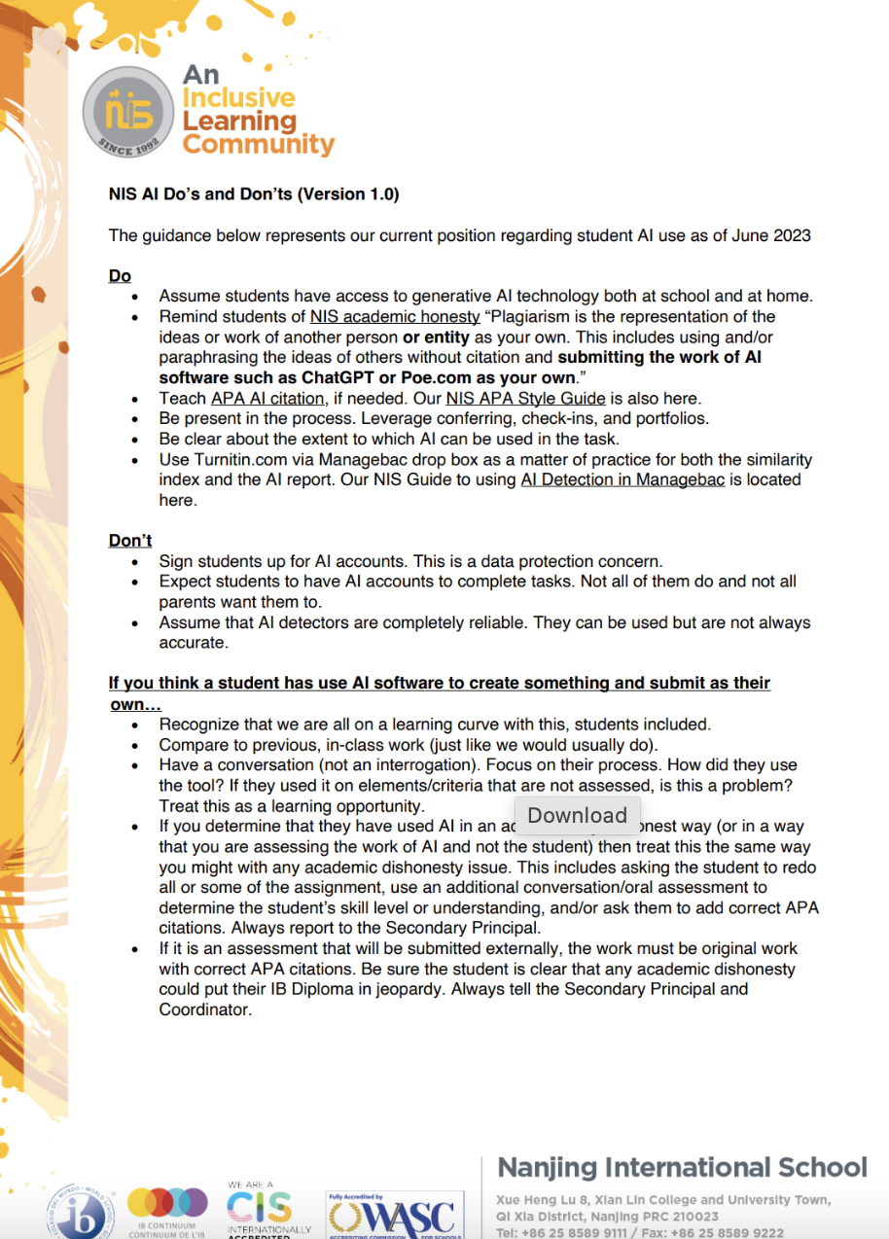
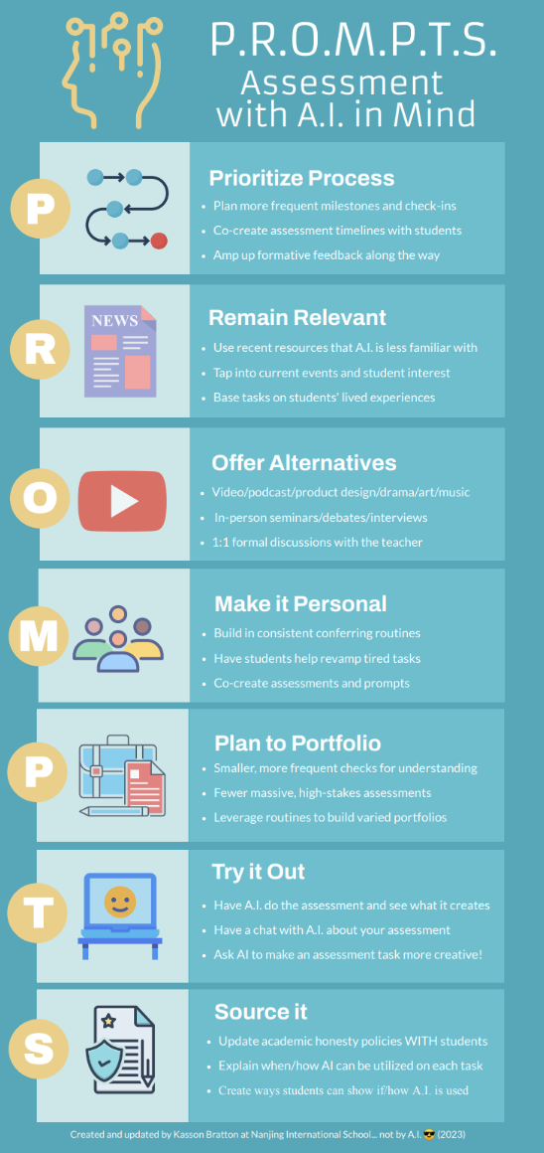
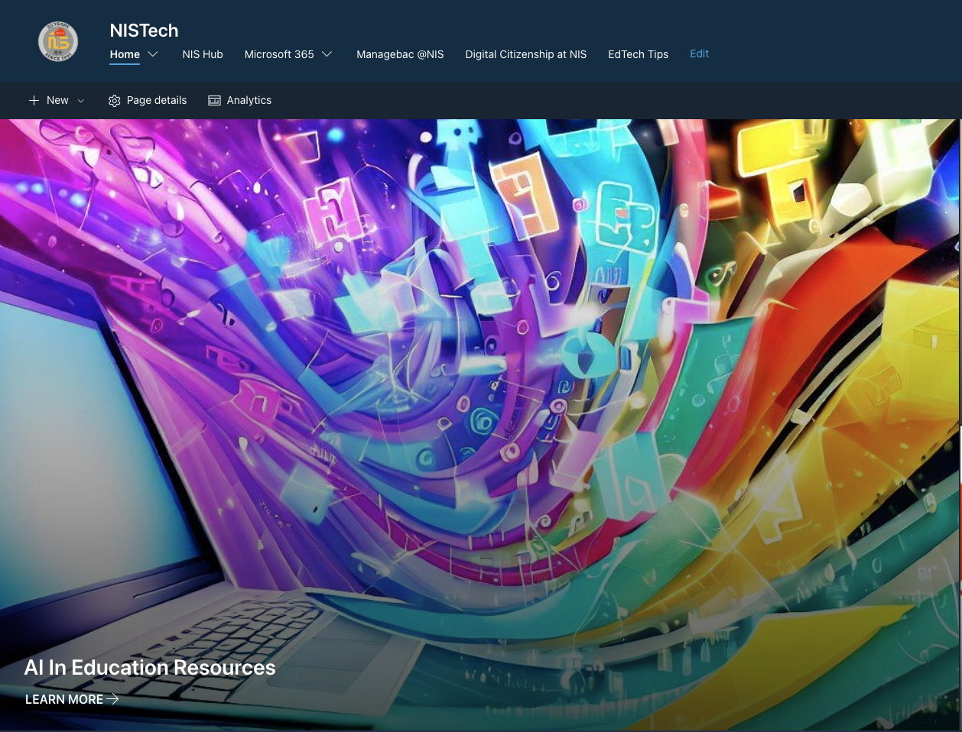
Where are we with AI?

Slide 11
AI Tools and You
Student Session

Slide 12
Student Input
138/184 (75%) of students in the secondary school reported using AI Tools on a regular basis (Chat GPT, Poe, Bard, Papago, etc.) as of November 2023.
How can I use these tool appropriately? (15)
How does it work? (10)
How can I use these tools ethically? (7)
All images created using Poe https://poe.com/LogoDsigner

Slide 13
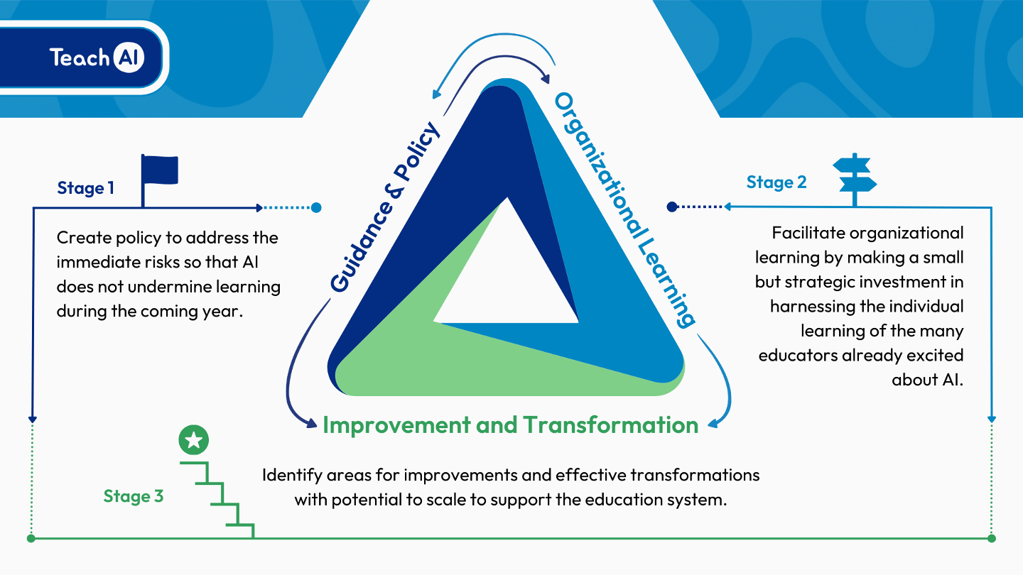
Where are we with AI?
Notes:
Stage 1
Ensure that AI use at NIS complies with existing security and privacy and educational policies,
Provide guidance to students and staff on topics such as the opportunities and risks of AI
Clarify responsible and appropriate uses of AI tools, by teachers and students
Define academic integrity standards related to AI.
Stage 2
Focusing on professional development for all staff
Bring together individual educators' experiences with AI to build collective organizational knowledge and capacity.
Include operational considerations such as evaluating AI tools already in use and reviewing our practices, particularly around assessment with AI in mind
Stage 3
Personalized learning and PD for staff based on individual needs and goals
Embedding of targeted AI practices in learning and assessment
NIS is consolidating Stage 1 and moving into Stage 2

Slide 14
“Three Buckets”
Student Use for Learning
Intelligent Tutoring
Personalized Feedback
Virtual Simulations
Summarizing Long Texts
Revision Questions/Games for Any Topic
Teacher Use for Teaching
Creating Exemplars
Recommending Content and Resources
“UDL-ing lessons”
Creative Assessment Ideas
Drafting Feedback
Generating Questions
Teacher Use for Efficiency
Drafting Comments
Editing/Revising Recommendation Letters
Drafting Emails/Comms
Data Analysis
Most Administrative Tasks!

Slide 15
What’s the hold up?
Ethical Considerations
Legal Considerations
Accuracy Considerations
Assessment Considerations
Curricular Considerations
Photo Credit: Noun Project
Notes:
Ethical Considerations
Bias and Fairness: Generative AI models may inadvertently perpetuate or amplify biases present in their training data, potentially leading to unfair outcomes for certain groups of students.
Privacy: The use of AI in educational settings raises concerns about student privacy, especially if the AI processes sensitive or personal data.
Intellectual Property: There are questions about the ownership of content created by AI, such as essays or art, and whether it can be considered original work by the student.
Transparency: Students and educators may not fully understand how AI systems make decisions, which can lead to trust issues.
Legal Considerations
Compliance with Regulations: Schools must ensure that their use of AI complies with educational laws and regulations, such as the Family Educational Rights and Privacy Act (FERPA) in the U.S., which protects student education records.
Liability: There could be legal implications if the AI provides incorrect information that leads to negative consequences for students.
Accuracy Considerations
Reliability of Content: AI-generated information may not always be accurate, and relying on it for educational content could lead to misinformation.
Data Quality: The output quality of AI is contingent on the quality of the input data; inaccurate data can lead to flawed conclusions or recommendations.
Assessment Considerations
Cheating and Plagiarism: AI makes it easier for students to generate essays and answers that are not their own work, complicating academic integrity efforts.
Evaluation of AI-generated Work: Teachers may need new tools and methods to assess work created with the aid of AI, as traditional metrics may no longer apply.
Curricular Considerations
Integration into Existing Curricula: Deciding how AI fits into the existing curriculum can be challenging, as it may not align with current learning objectives or standards.
Teacher Preparedness: Educators may require additional training to effectively incorporate AI tools into their teaching methods and to understand their limitations.

Slide 16
What can we do now?
Take a look at our AI Documentation
Play around with AI chatbots like POE.com
Share what you are doing with colleagues
Begin to use in instruction, when appropriate
Be conscious of the “digital divide”
Begin to reconsider assessment in the age of AI (PROMPTS)
NIS-Curated AI Resources
Notes:
Take a look at our AI Documentation (Link shared in Tuesday Tech Tips or scan the QR Code)
Play around with AI chatbots like Poe.com (Guide on how to install POE in Latest Tech Tip)
Share what you are doing with others
Begin to use in planning and instruction, when appropriate
Be conscious of the “digital divide”
Begin to reconsider assessments in the age of AI (PROMPTS)

Slide 17
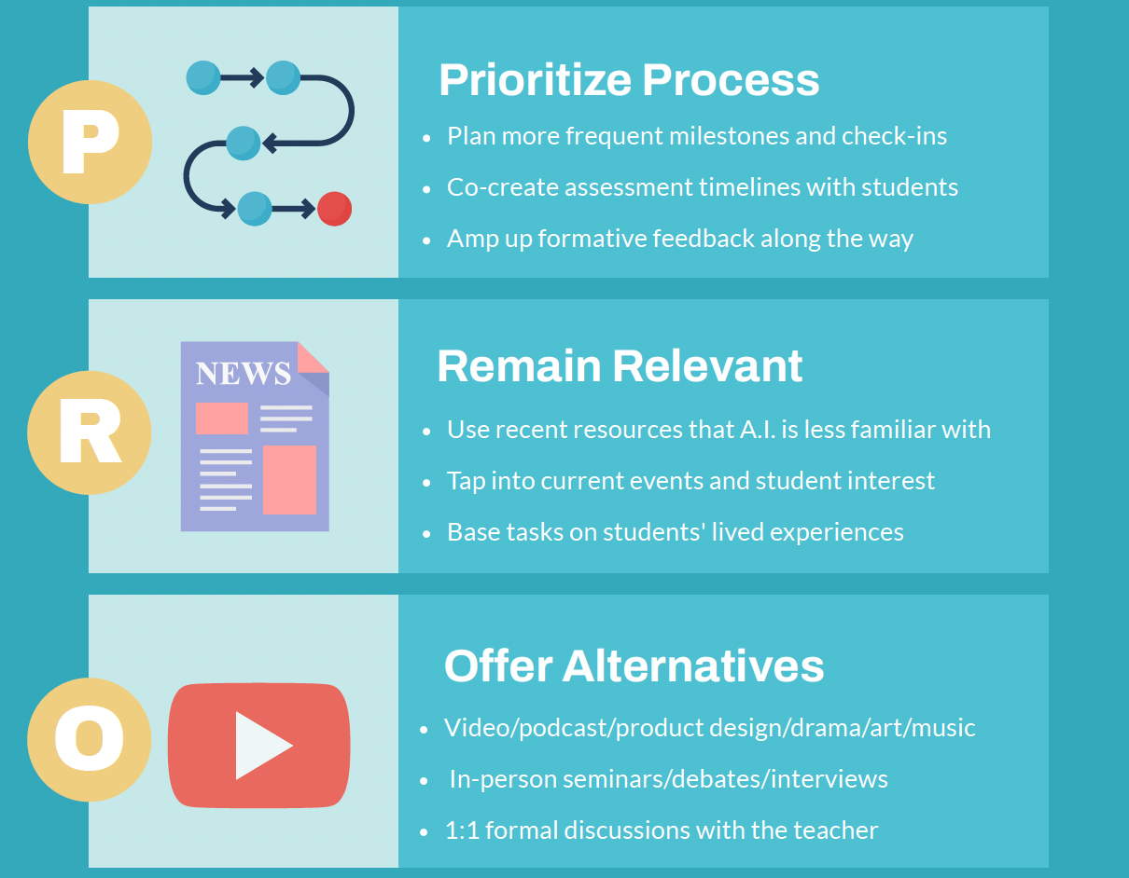

Slide 18
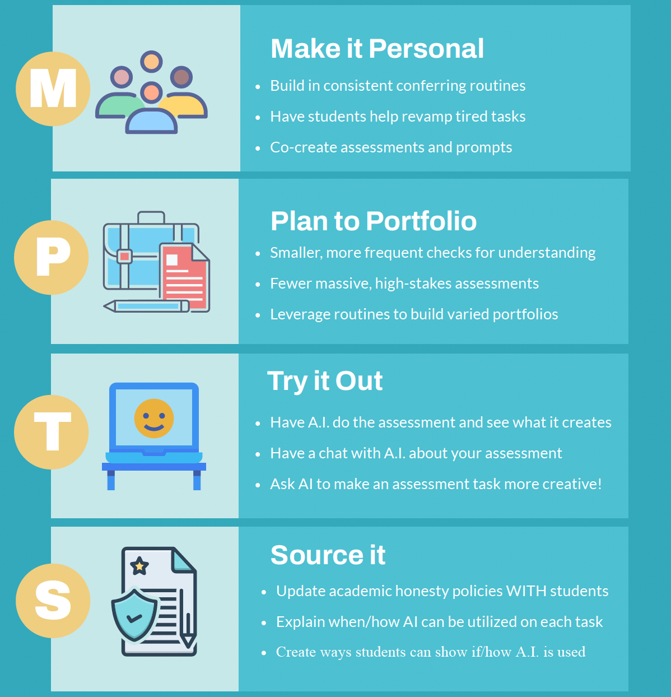

Slide 19
What’s coming?
Secondary student session
Open parent session November 29th
Grade 9 English A "POE Pilot"
Informal “Lunch Bytes” sessions
February PLDs and beyond
Questions/input now!

