Slide 1
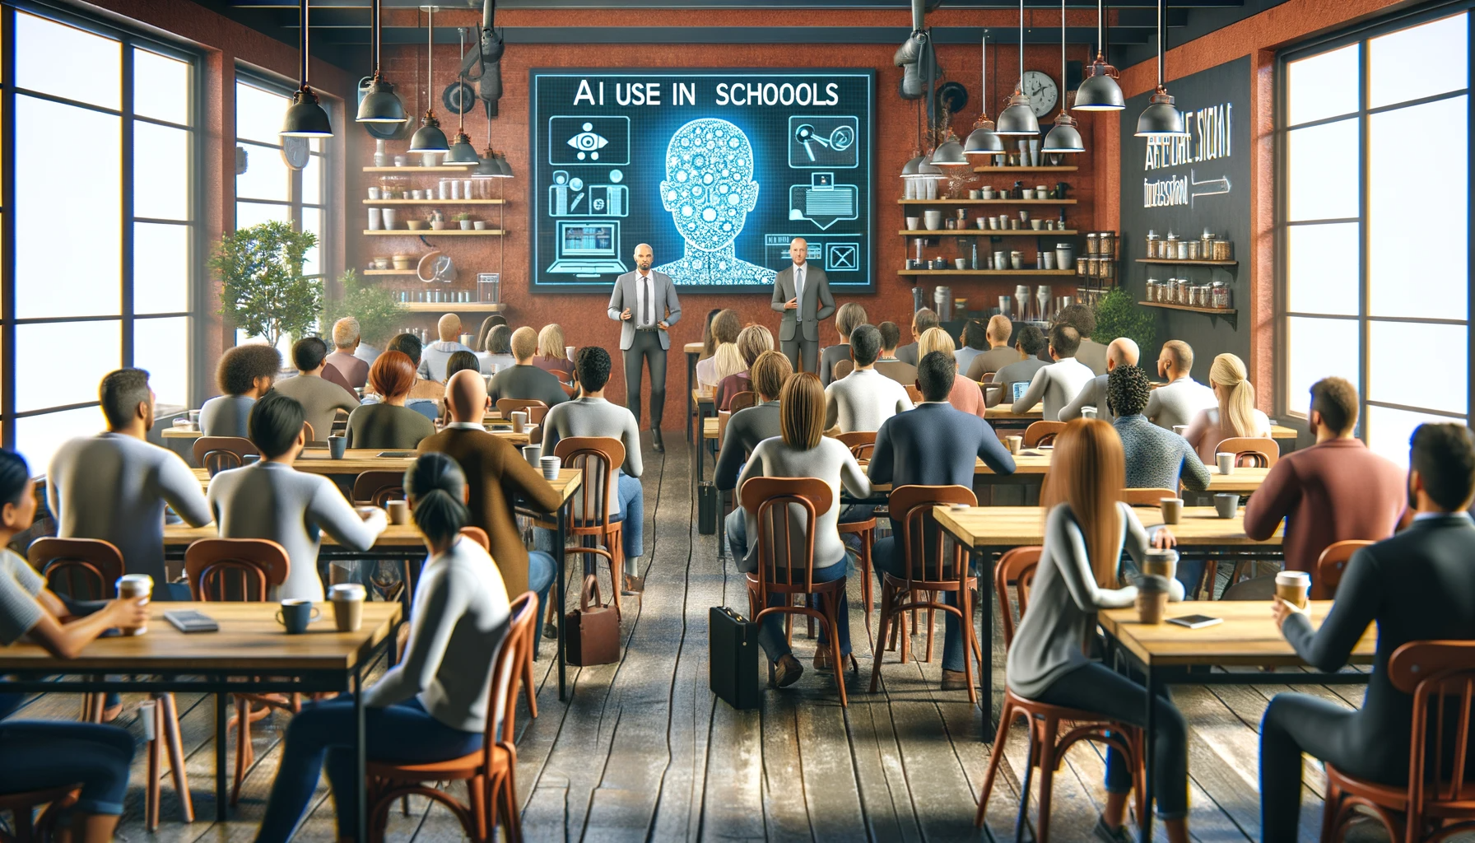
NIS人工智能更新
November 27, 2023
OpenAI. (2023). [”Parent Coffee in a Café about AI in Schools"]. Created using DALL-E on [November 26, 2023].

Slide 2
“人工智能不会抢走我们的工作，但那些使用它的人可能会抢走我们的工作。” -Dr. Richard Baldwin

Slide 3
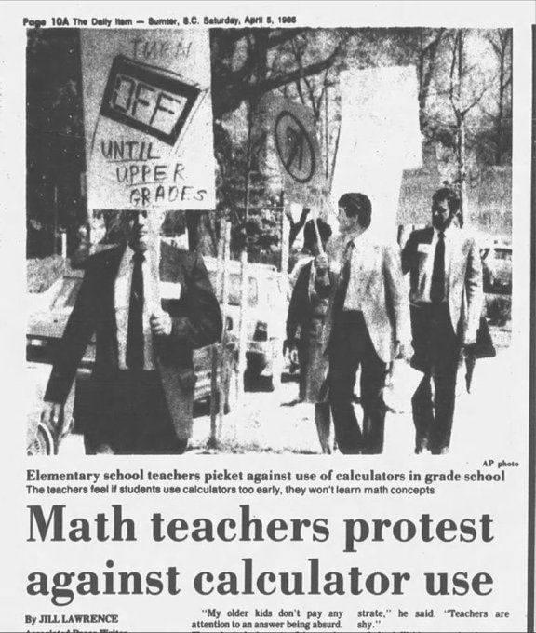
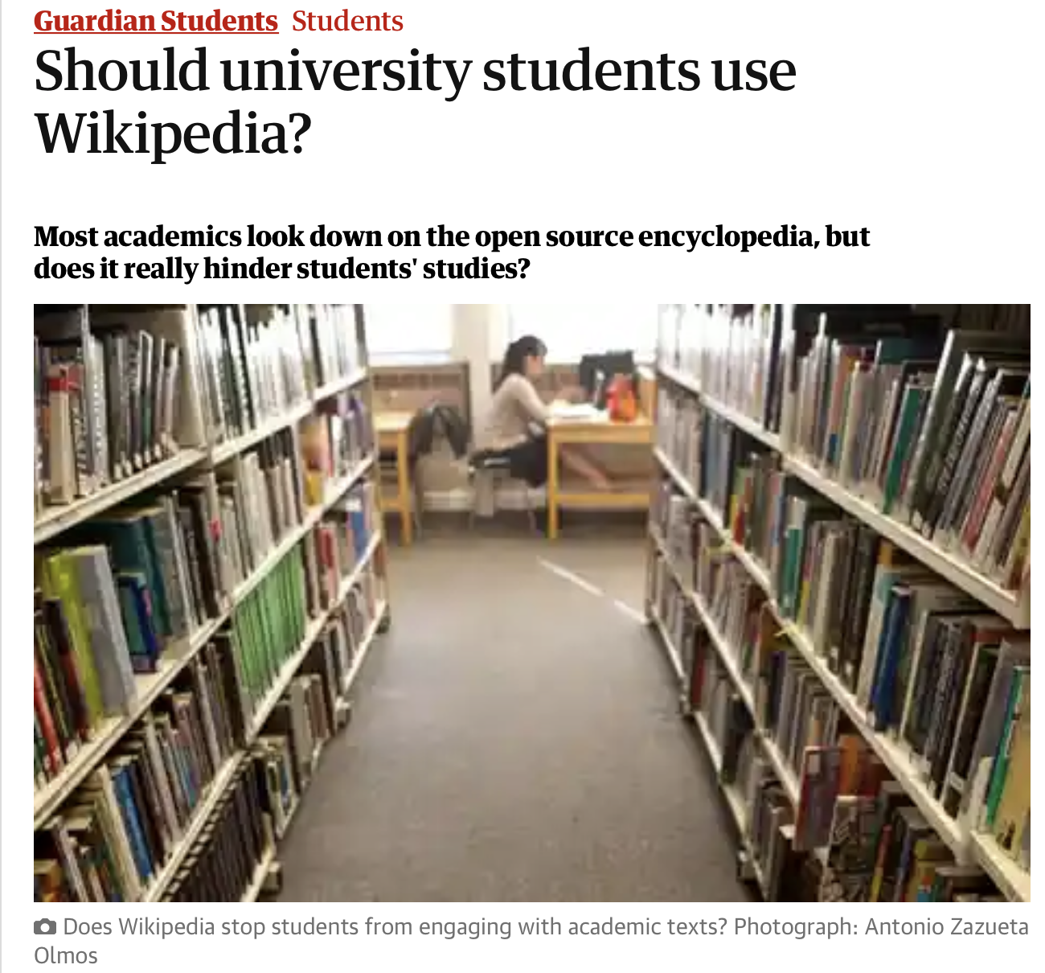
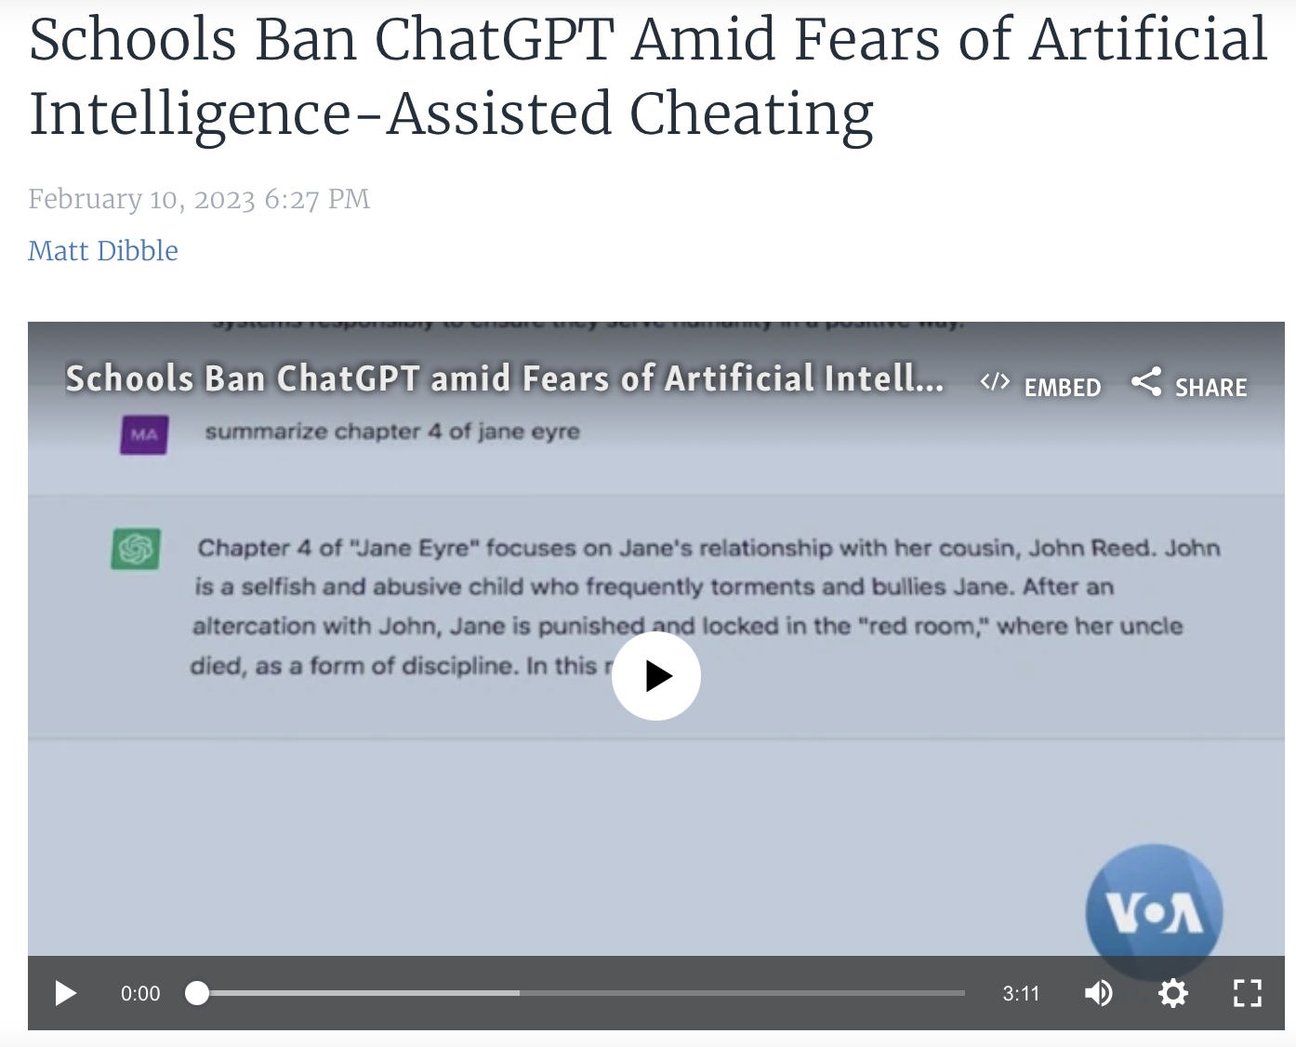
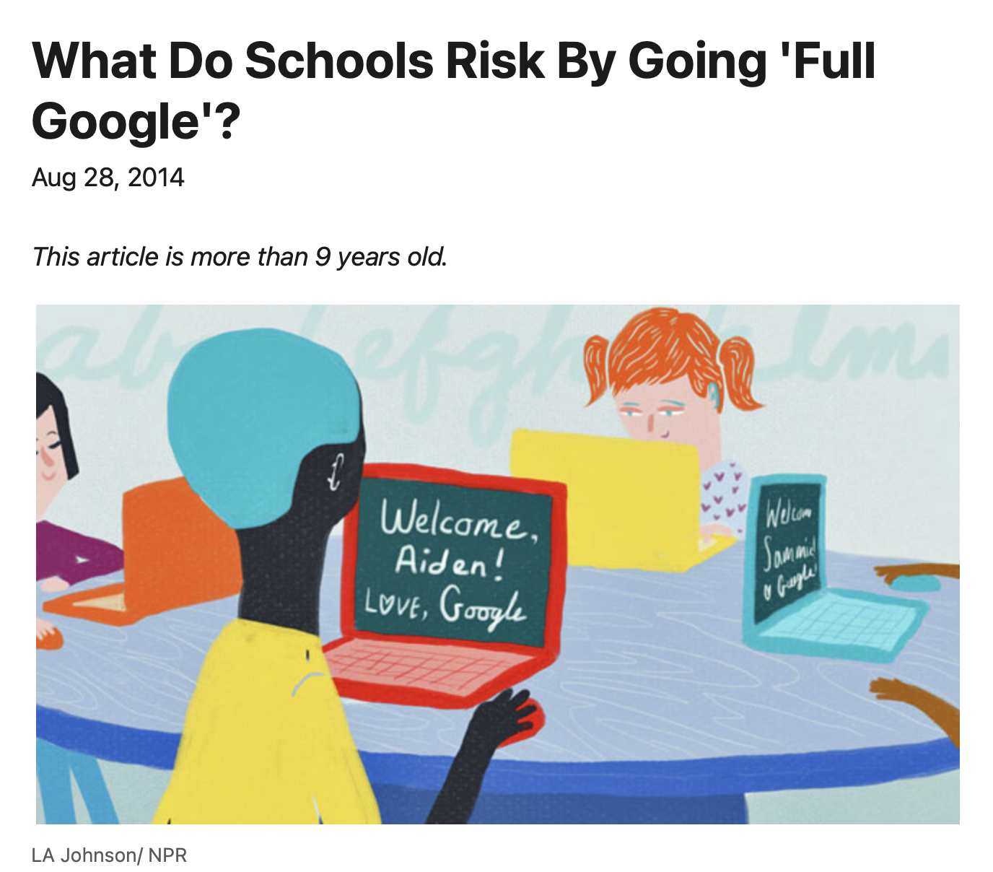
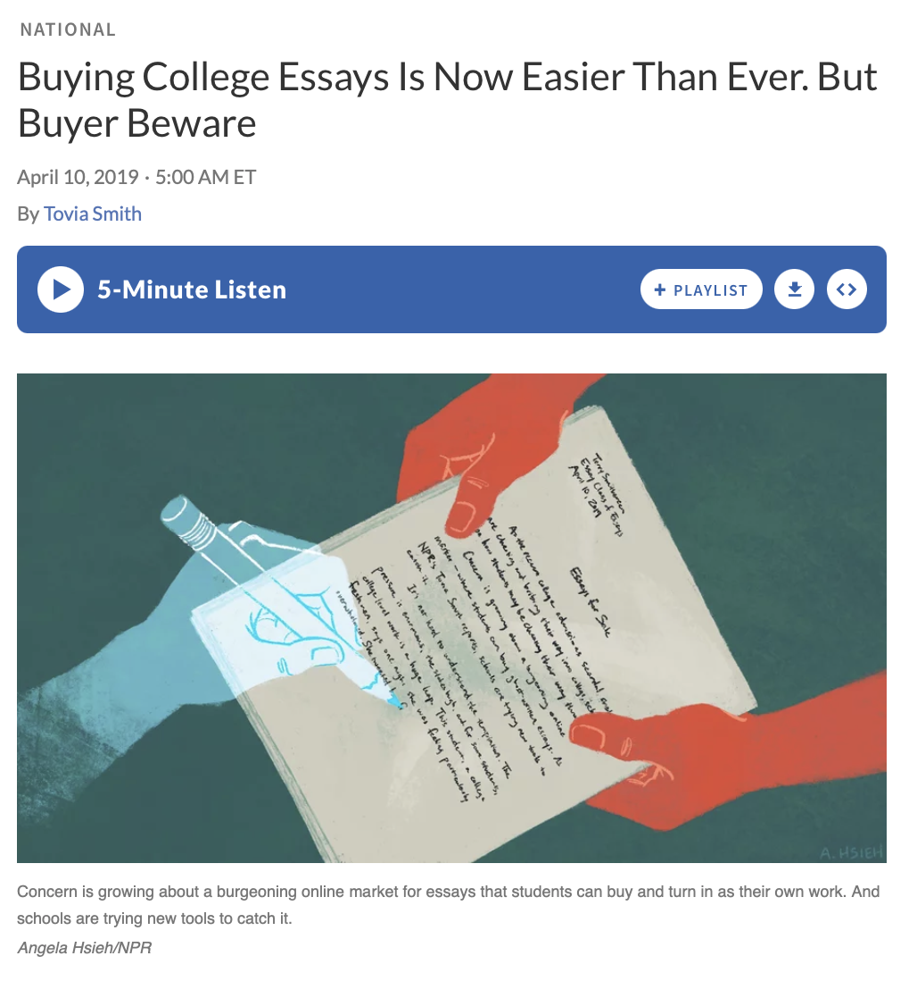
技术颠覆并不是什么新鲜事

Slide 4
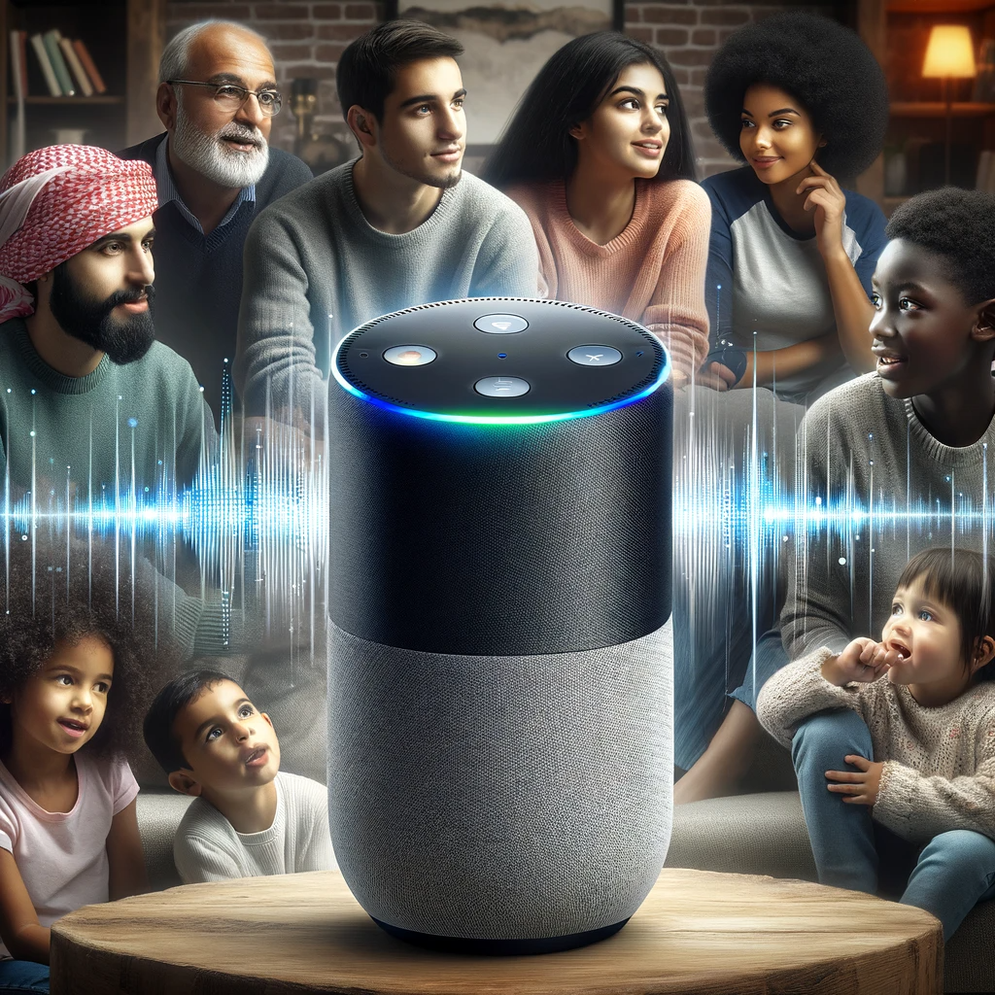
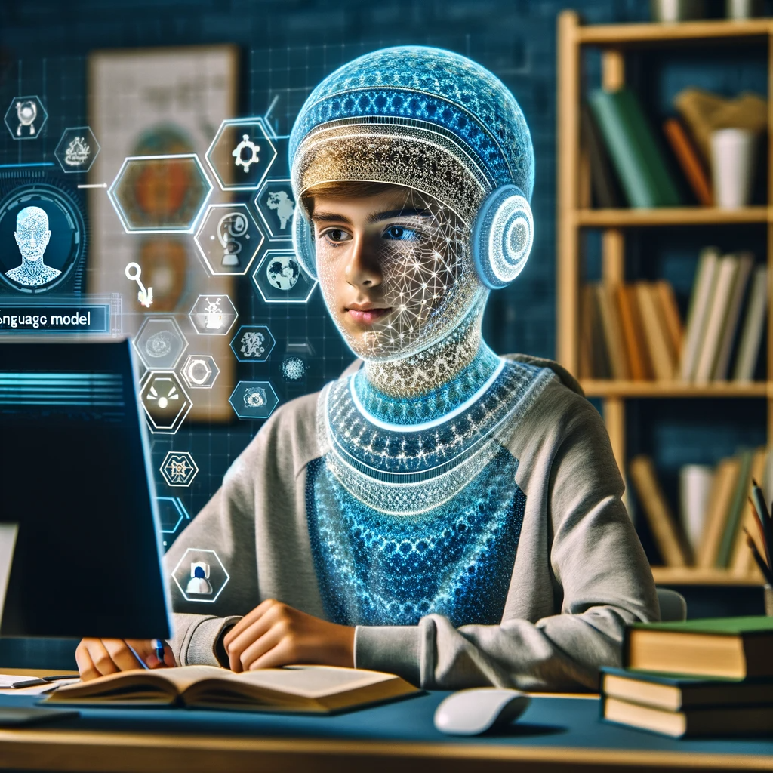
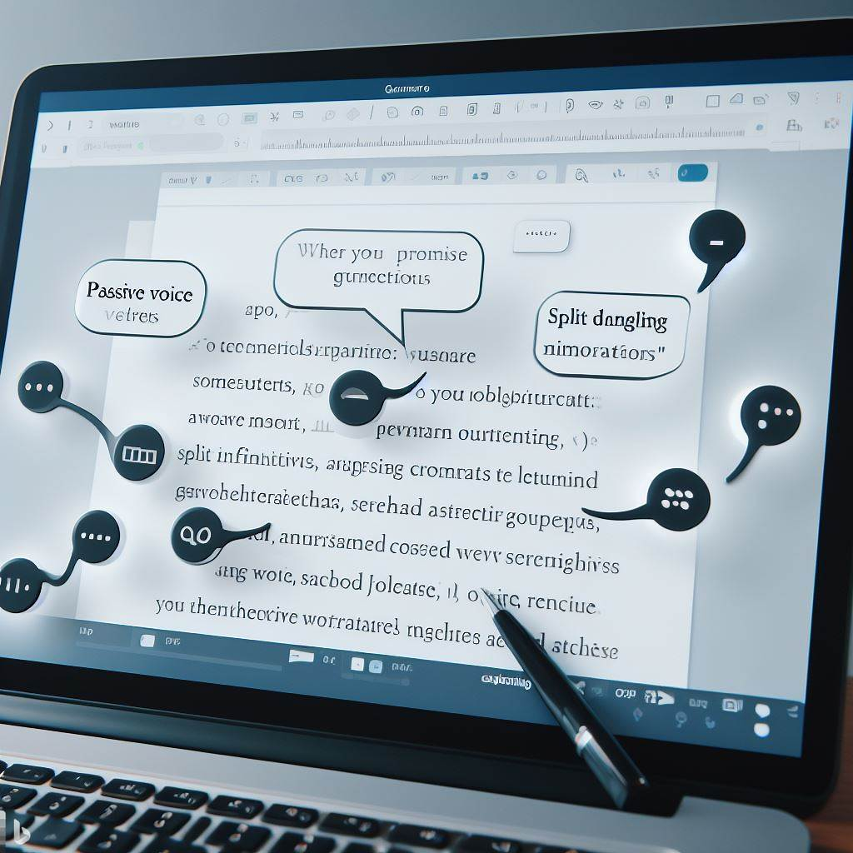
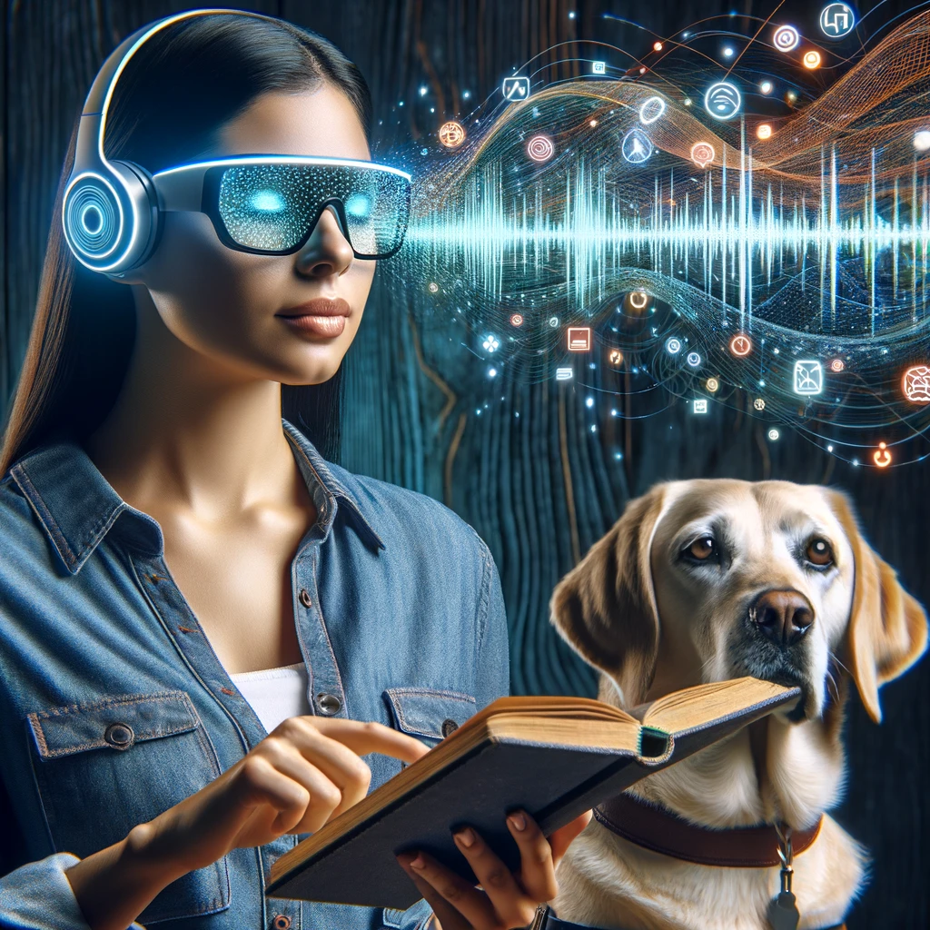
人工智能颠覆有何不同？
All images created using Dalle-3 via ChatGPTPlus and Bing Create
Notes:
Traditional language models were limited in scope, trained on small datasets for specific tasks such as grammar correction or keyword search, using simpler algorithms like n-gram statistics.
The advent of deep learning spurred the creation of large language models (LLMs) like GPT, which employ transformer architectures capable of processing vast datasets and generating more complex, context-aware text.
LLMs offer versatility in performing diverse language tasks, from writing and summarizing to conversation and translation, without task-specific retraining.
Their ability to understand extended context and maintain textual coherence mirrors human-like interaction, enhancing applications like virtual assistants and accessibility tools.
The shift to LLMs represents a technological leap, promising economic efficiency and a transformative impact on how we use AI in natural language processing.

Slide 5
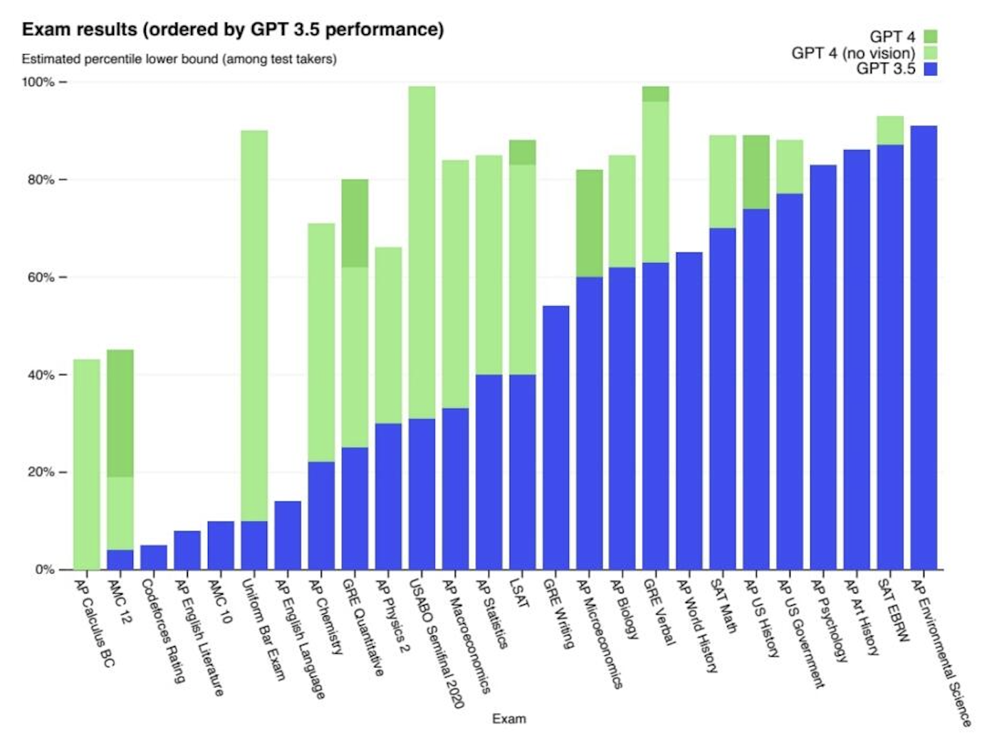
Open AI Releases Chat GPT November 30, 2022, then on March 2023

Slide 6
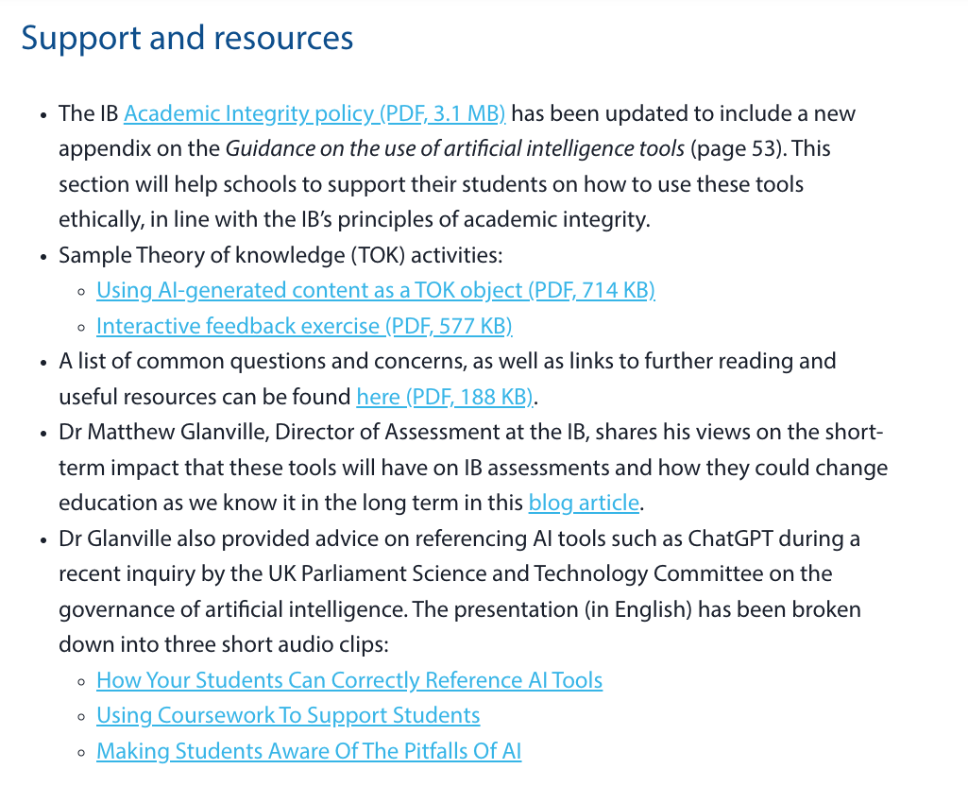
在人工智能道路上我们在哪里？

Slide 7
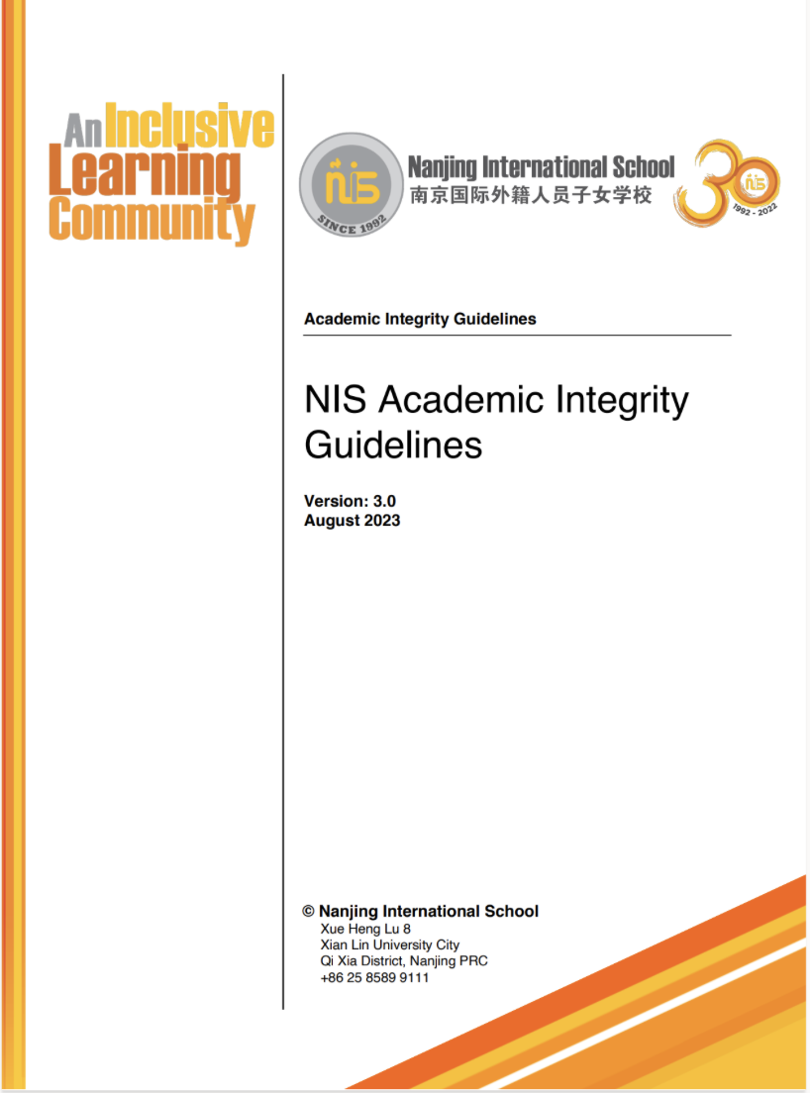
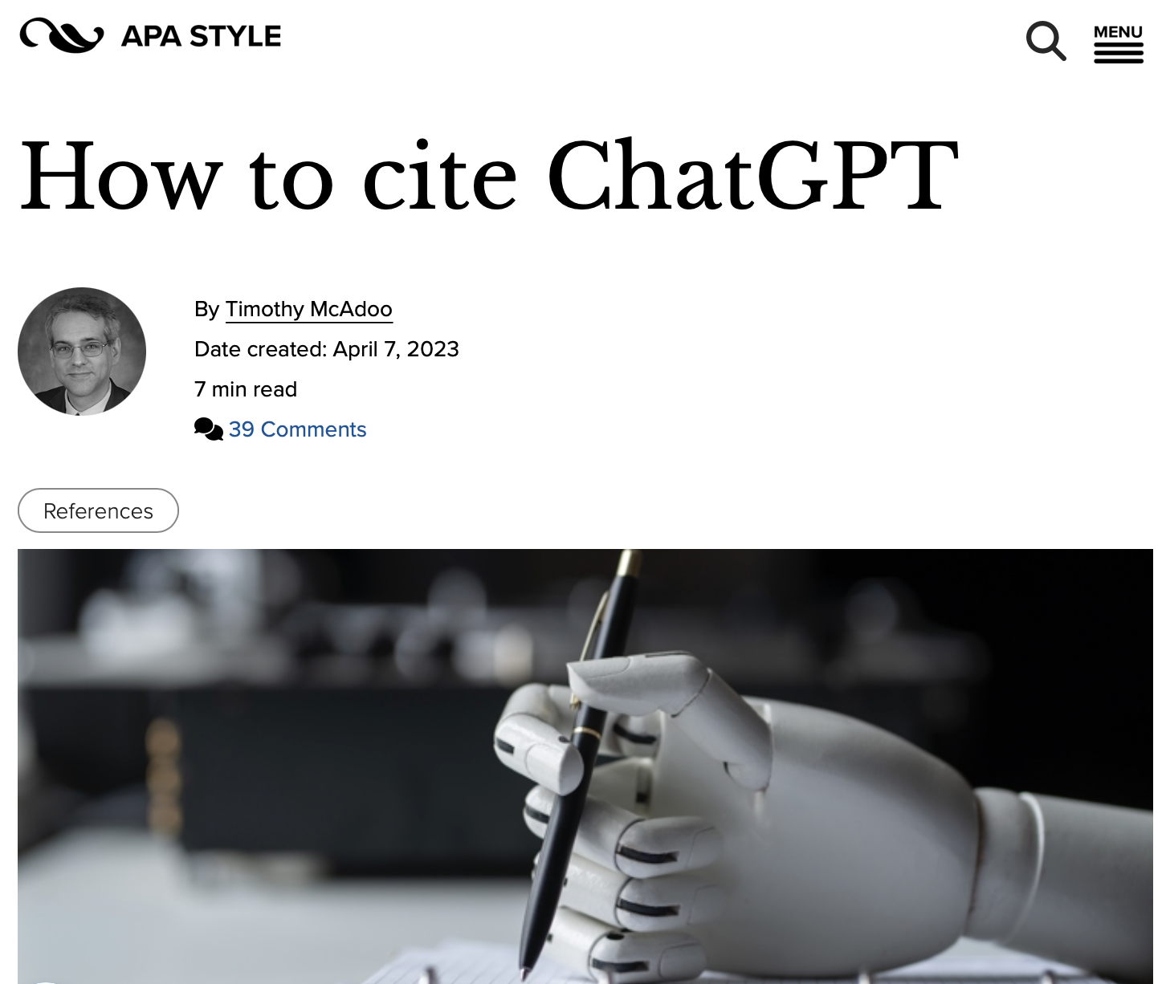
在人工智能道路上我们在哪里？

Slide 8
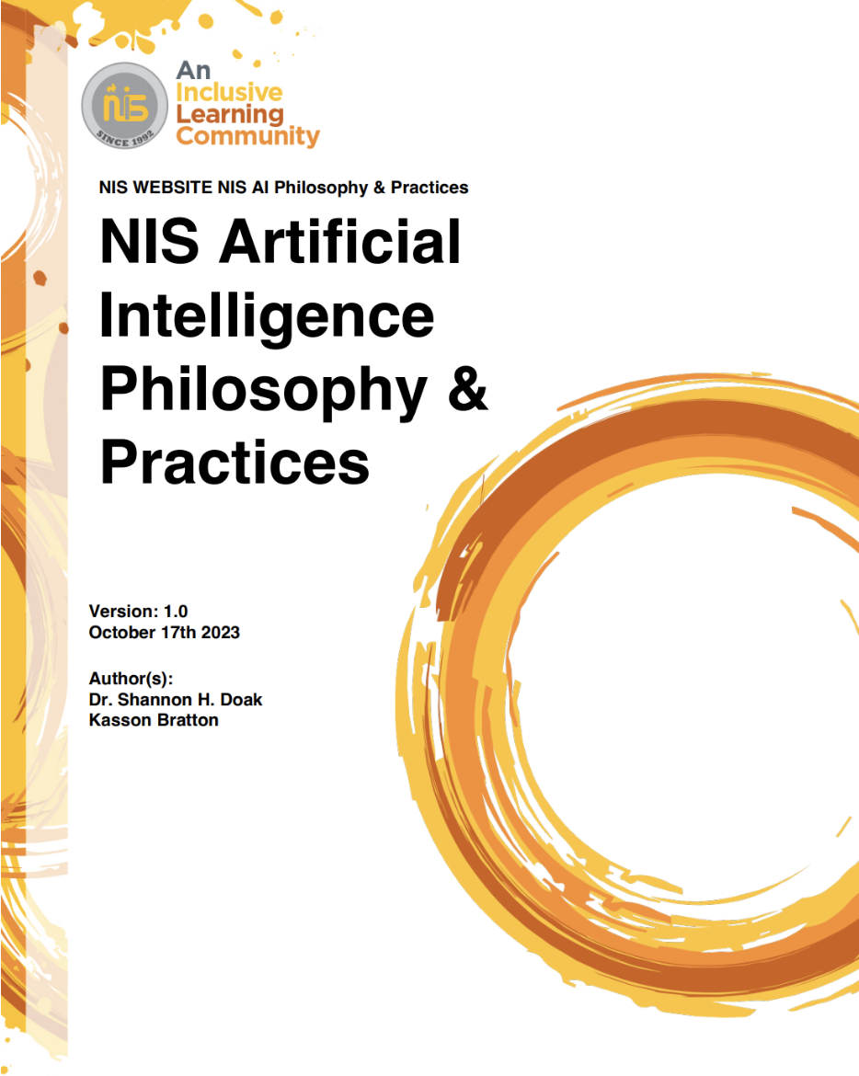
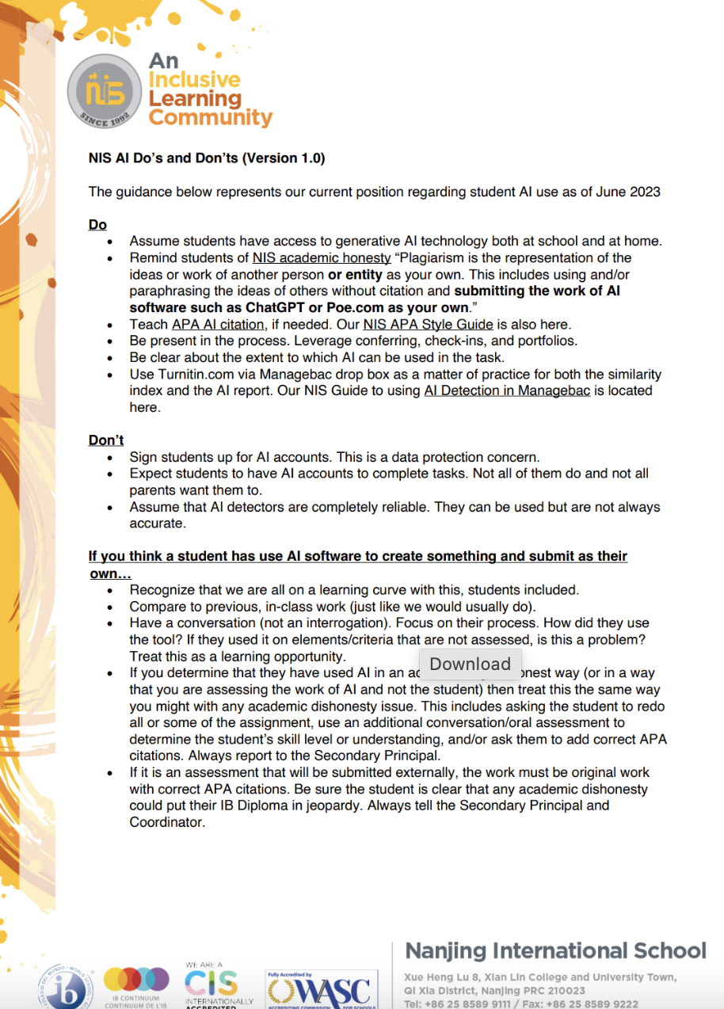
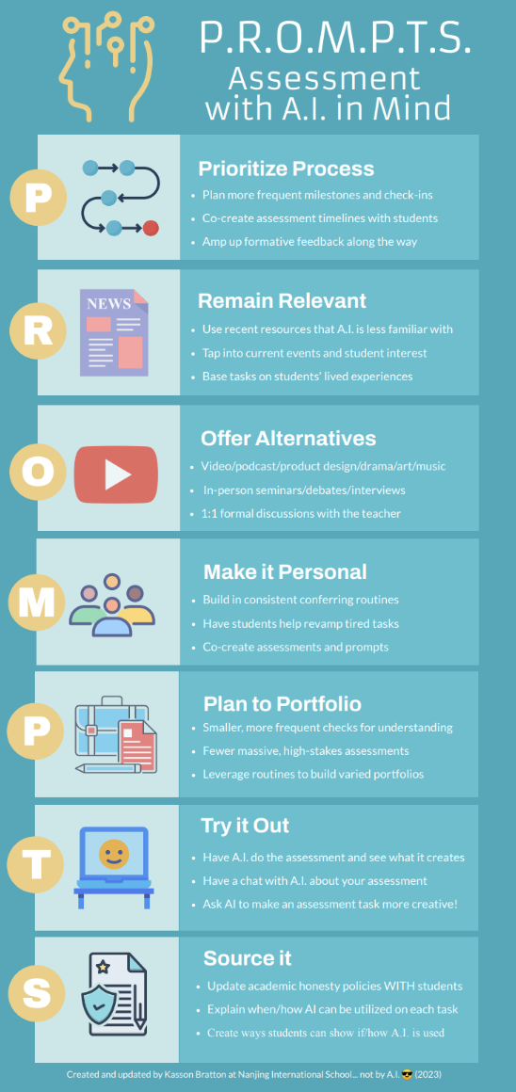
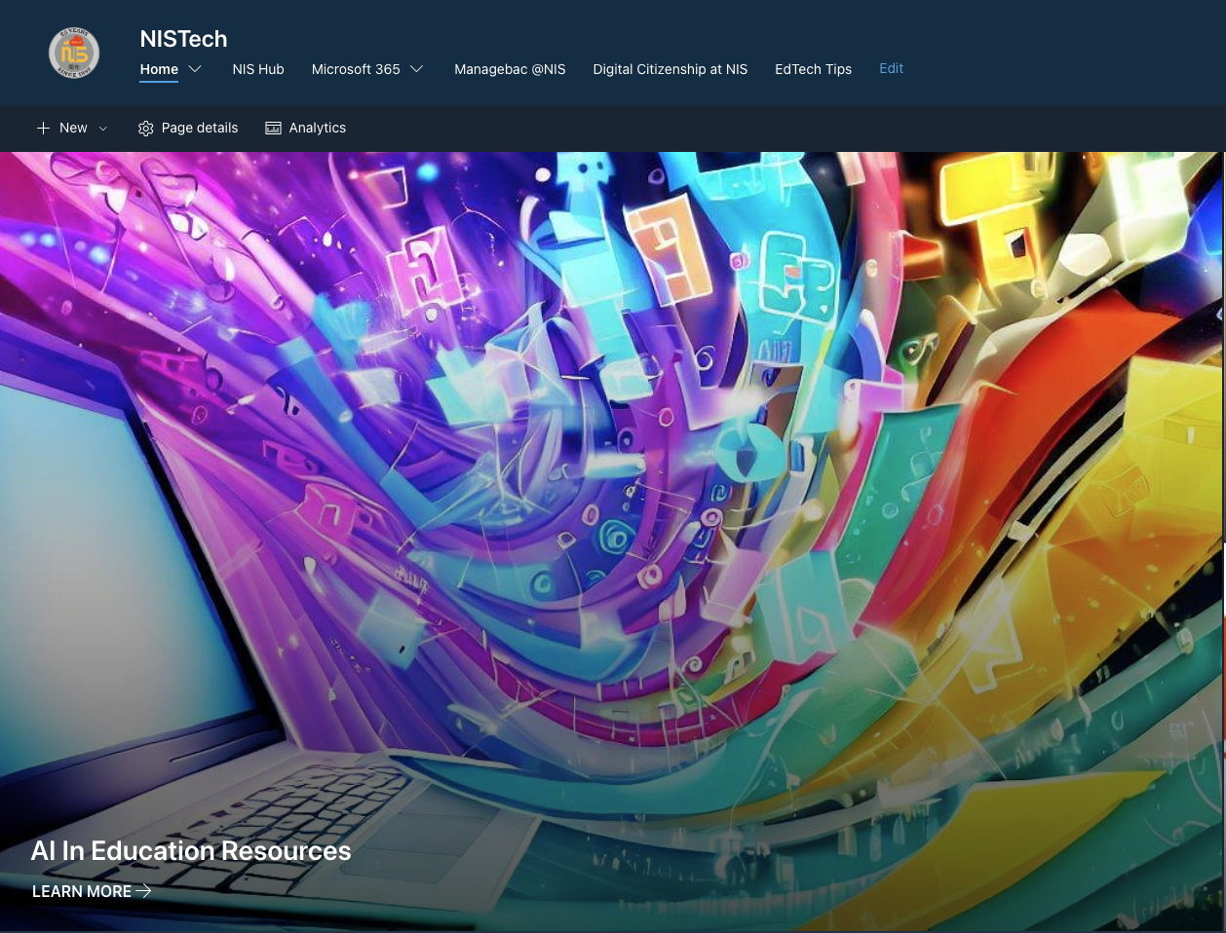
在人工智能道路上我们在哪里？

Slide 9
学生输入 (184)
截止至 2023 年 11 月，138/184 (75%) 的中学生定期使用人工智能工具（Chat GPT、Poe、Bard、Papago 等）。
我怎样才能正确地使用这些工具？ (15)
它是如何工作的？ (10)
我如何才能合乎道德地使用这些工具？ (7)
All images created using Poe https://poe.com/LogoDsigner

Slide 10
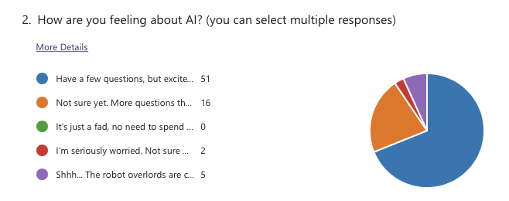
教师投入 (67)

Slide 11
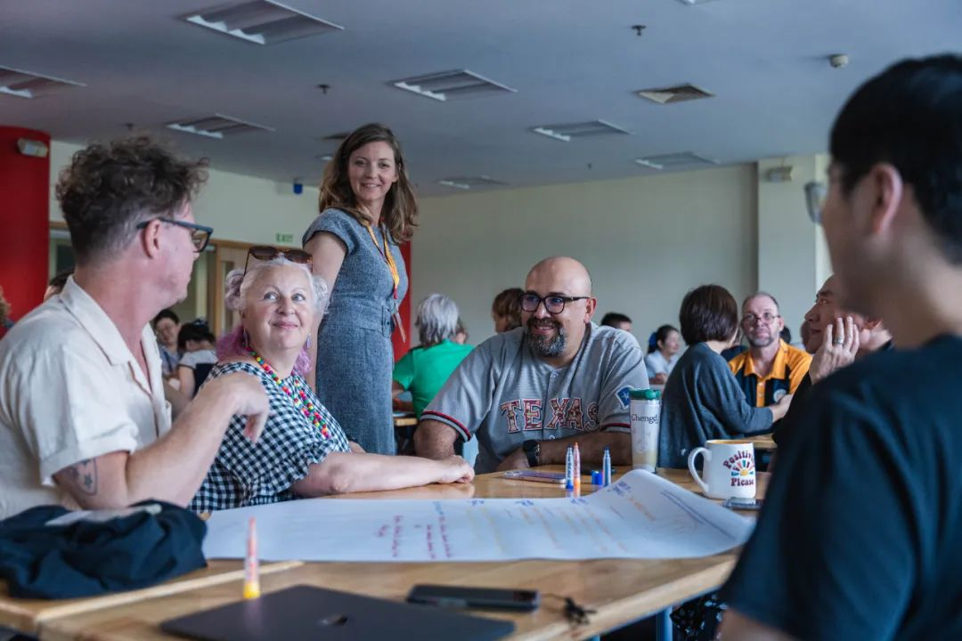
教师投入
A.I. Efficient and Effective Use: 17
A.I. Teacher Use in the Classroom: 16
A.I. Student Use in the Classroom: 18
15 teachers put their names forward as advanced users

Slide 12
教学方法
Knee Jerk
In-class only
Paper and pencil
Track digital docs
Teach AI citation
AI detection
Forms and signatures

Slide 13
NIS 学习的定义
We define learning as a personal process that develops new skills and understandings applied creatively within and beyond the classroom.
我们将学习定义为个人培养新技能和理解并创造性地应用于课堂内外的过程。
With this in mind, we believe students learn best when they…
考虑到这一点，我们相信学生在如下情况时学得最好。
Make meaningful choices about their learning.
对他们的学习做出有意义的选择。
Build connections across cultures and perspectives.
建立跨文化和跨观点的联系。
Feel a strong sense of inclusion and belonging.
感受到强烈的被包容和归属感。
Experience an appropriate balance of challenge and support.
体验挑战与支持之间的适当平衡。

Slide 14
NIS 学习的定义
Knee Jerk
In-class only
Paper and pencil
Track digital docs
Teach AI citation
AI detection
Forms and signatures
Re-Think
Co-create assessments
Focus on process and milestones
More recent and relevant
More creative and personal
More formative and feedback
Be explicit about amount AI use

Slide 15
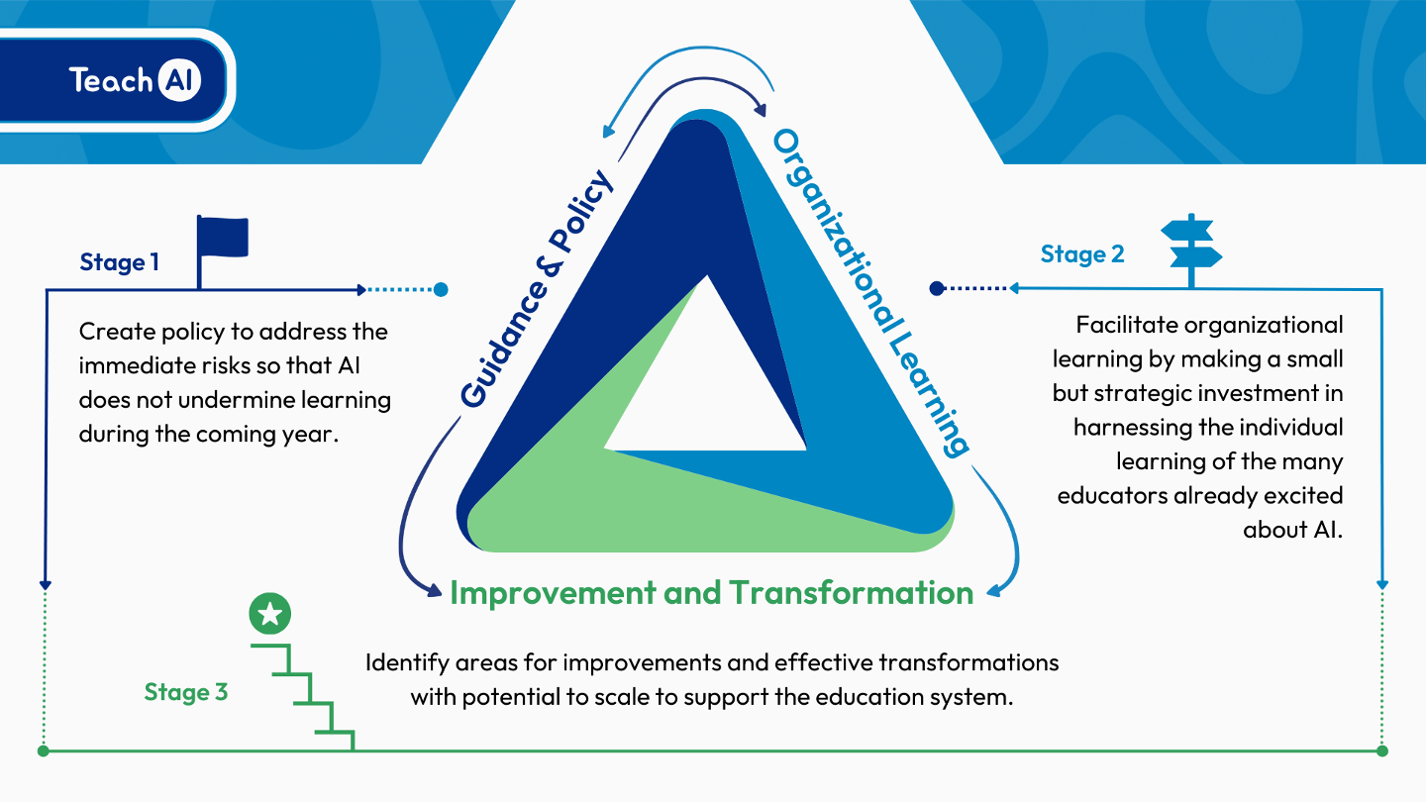
在人工智能道路上我们在哪里？
Notes:
Stage 1
Ensure that AI use at NIS complies with existing security and privacy and educational policies,
Provide guidance to students and staff on topics such as the opportunities and risks of AI
Clarify responsible and appropriate uses of AI tools, by teachers and students
Define academic integrity standards related to AI.
Stage 2
Focusing on professional development for all staff
Bring together individual educators' experiences with AI to build collective organizational knowledge and capacity.
Include operational considerations such as evaluating AI tools already in use and reviewing our practices, particularly around assessment with AI in mind
Stage 3
Personalized learning and PD for staff based on individual needs and goals
Embedding of targeted AI practices in learning and assessment
NIS is consolidating Stage 1 and moving into Stage 2

Slide 16
有什么困难吗？
道德与法律
精确的思考
测评和课程
数字划分
Photo Credit: Noun Project
Notes:
Ethical Considerations
Bias and Fairness: Generative AI models may inadvertently perpetuate or amplify biases present in their training data, potentially leading to unfair outcomes for certain groups of students.
Privacy: The use of AI in educational settings raises concerns about student privacy, especially if the AI processes sensitive or personal data.
Intellectual Property: There are questions about the ownership of content created by AI, such as essays or art, and whether it can be considered original work by the student.
Transparency: Students and educators may not fully understand how AI systems make decisions, which can lead to trust issues.
Legal Considerations
Compliance with Regulations: Schools must ensure that their use of AI complies with educational laws and regulations, such as the Family Educational Rights and Privacy Act (FERPA) in the U.S., which protects student education records.
Liability: There could be legal implications if the AI provides incorrect information that leads to negative consequences for students.
Accuracy Considerations
Reliability of Content: AI-generated information may not always be accurate, and relying on it for educational content could lead to misinformation.
Data Quality: The output quality of AI is contingent on the quality of the input data; inaccurate data can lead to flawed conclusions or recommendations.
Assessment Considerations
Cheating and Plagiarism: AI makes it easier for students to generate essays and answers that are not their own work, complicating academic integrity efforts.
Evaluation of AI-generated Work: Teachers may need new tools and methods to assess work created with the aid of AI, as traditional metrics may no longer apply.
Curricular Considerations
Integration into Existing Curricula: Deciding how AI fits into the existing curriculum can be challenging, as it may not align with current learning objectives or standards.
Teacher Preparedness: Educators may require additional training to effectively incorporate AI tools into their teaching methods and to understand their limitations.

Slide 17
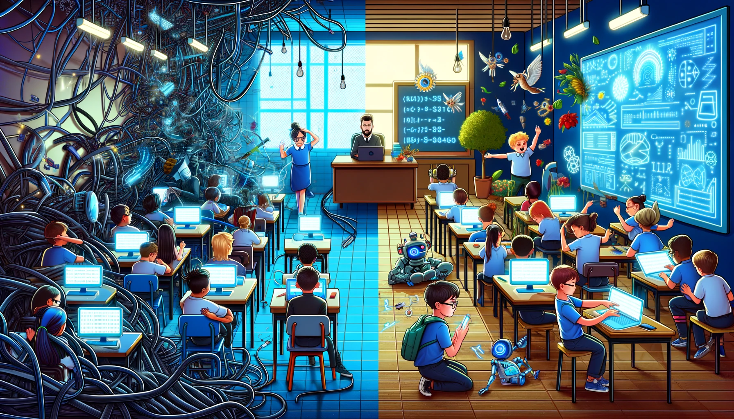
现在和下一步……
沟通和尝试
专业学习
教师指导下使用
重新考虑测评方式
第一个“Poe Pilot”测试正在进行中（G9）
OpenAI. (2023). ["Split image depicting challenges and opportunities of AI use in schools"]. Created using DALL-E on [November 23, 2023].
Notes:
Take a look at our AI Documentation (Link shared in Tuesday Tech Tips or scan the QR Code)
Play around with AI chatbots like Poe.com (Guide on how to install POE in Latest Tech Tip)
Share what you are doing with others
Begin to use in planning and instruction, when appropriate
Be conscious of the “digital divide”
Begin to reconsider assessments in the age of AI (PROMPTS)

Slide 18
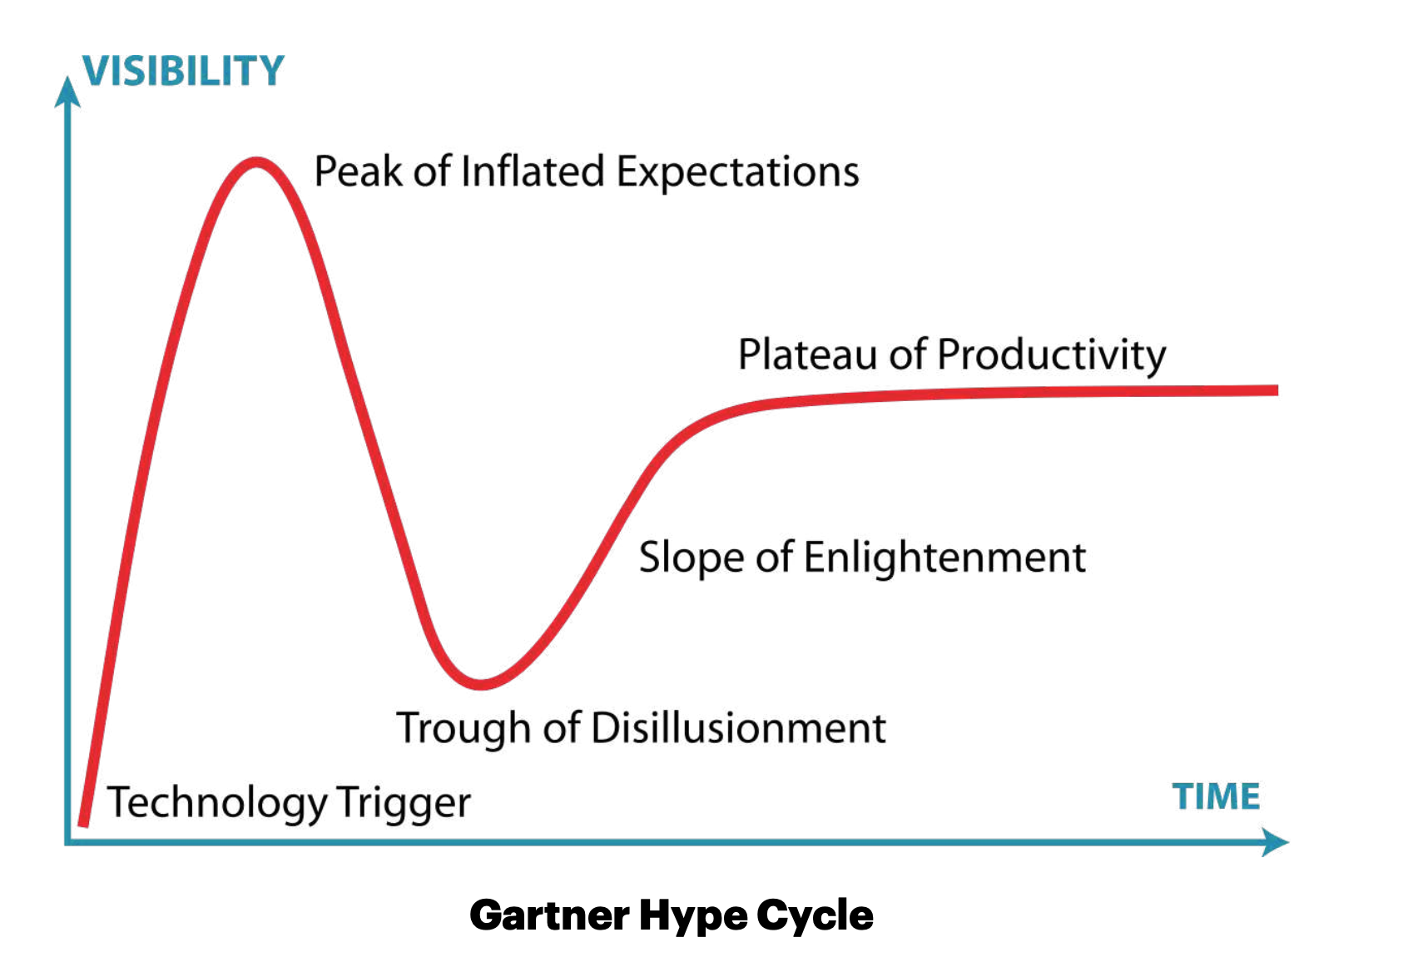
AI
https://www.gartner.com/en/newsroom/press-releases/2023-08-16-gartner-places-generative-ai-on-the-peak-of-inflated-expectations-on-the-2023-hype-cycle-for-emerging-technologies
"Generative artificial intelligence (AI) is positioned on the Peak of Inflated Expectations on the Gartner, Inc. Hype Cycle for Emerging Technologies, 2023, projected to reach transformational benefit within two to five years." (STAMFORD, Conn., August 16, 2023)

Slide 19
一些可能的提示
使用您选择的语言
我希望您假设自己是儿童心理学家。我会给你一个情景，希望你给我提出建议，帮助我更好地养育我的孩子。供您参考，我的孩子今年 [X] 岁。
我希望您假设自己是教育技术专家。我会给您一个情景，希望你能帮助我更好地养育我的孩子。供您参考，我的孩子今年 [X] 岁。
给我孩子的[年级][科目]老师写一封电子邮件，询问有关如何在家帮助我的孩子的意见。
帮助我为我[x]岁孩子在家使用手机制定一些数字协议
使用以下语言为 [X] 岁的孩子制作有趣的生日聚会邀请函……
• 问 Poe！

