Slide 1

The Speech That Brought This Entire School To Tears (The Most Inspiring Motivational Video of 2017) - YouTube

Slide 2
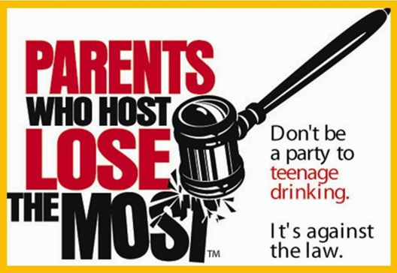
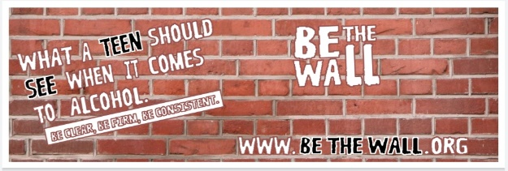



Partners In Prevention Project (PIPP)
Positive Social Norms
Be The Wall – social marketing model
Crazy Real – social marketing model
Social Host Liability Education
PIPP is “Strengthening Families” in Troup County through Education, Awareness, Caring, and a Helping hand (E.A.C.H.) to achieve long term community success using the following strengthening tools:
Environmental Strategies are Social Host Liability Education (PWH-targeting adult population) and PSN (BTW-targeting adult and youth population and Crazy Real-targeting youth population)
Individual Strategy “Too Good for Drugs”
Tobacco Cessation “Ask, Advise, Refer”
Teen Empowerment and Teen On The M.O.V.E. members, and FB and Instagram pages are instrumental in disseminating environmental strategy messages
Program sustainability through collaboration
Too Good for Drugs
Ask, Advise, Refer (Connect)
1-877-270-STOP

Slide 3
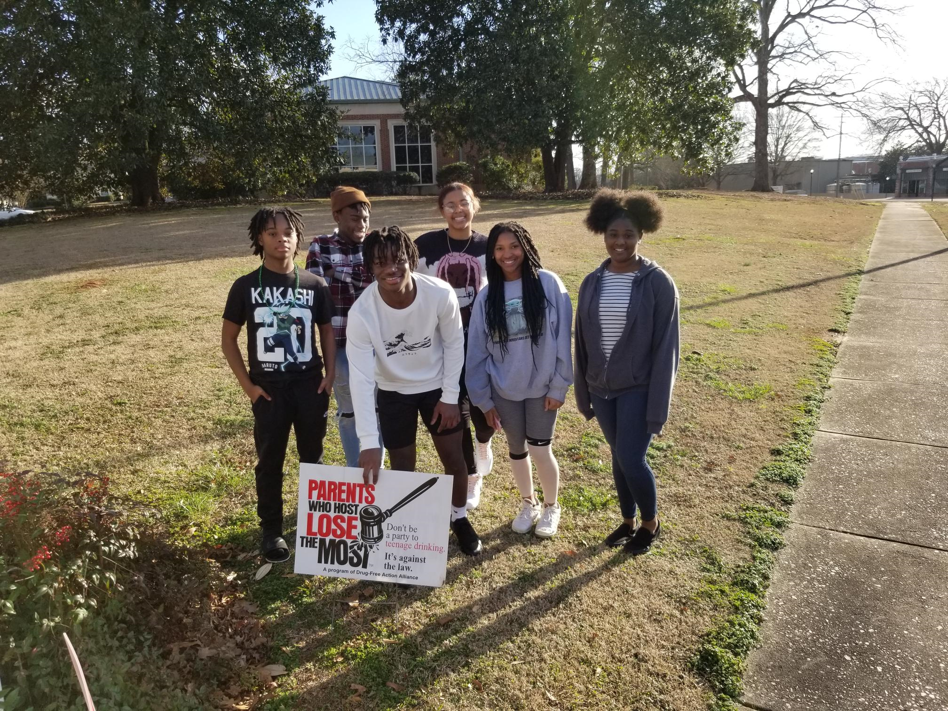
Troup County Stage of Readiness (Alcohol) 2022: Vague Awareness– Score 3.62
Troup County Stage of Readiness (Alcohol) 2023: Vague Awareness– Score 3.64
Troup County Stage of Readiness (Marijuana) 2022: Denial/Resistance– Score 2.48
Troup County Stage of Readiness (Marijuana) 2023: Vague Awareness – Score 3.25
Over the years, due to community readiness scores staying around denial or vague Awareness and denial/resistance, it is apparent that changes had to take place based on information obtained from various community members/leaders during CRA interviews due to challenges, gaps, lack of awareness and knowledge of issues. However, there has been a shift and change in which drug or issue is in denial/resistance or vague awareness. Community members/leaders know or believe there is a big problem with youth smoking marijuana (THC) so the score changed from denial last year to vague awareness this year. During the interviews it is apparent that not many people are willing to step up and/or make sure resources are available to help combat the issue that may or may not exist in Troup County.

Slide 4

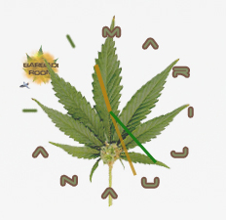
These two statements are still true to date based on CRA and local community surveys conducted by Project Coordinator randomly during community events/activities.
Q: Why are Troup County youth drinking alcohol in 2023?
A: Underage drinking is easily accessible and affordable. Youth are getting alcohol from home and friend’s homes, and it is considered acceptable among youth and adults. Currently in Troup County alcohol is not the most abused drug among youth, it is vaping. However, adults surveyed say they know that some youth are allowed to drink by parents.
Q: What is the most drug of choice now in Troup County for youth in 2023?
A: Vaping THC is now perceived to be the drug of choice among youth per youth.

Slide 5
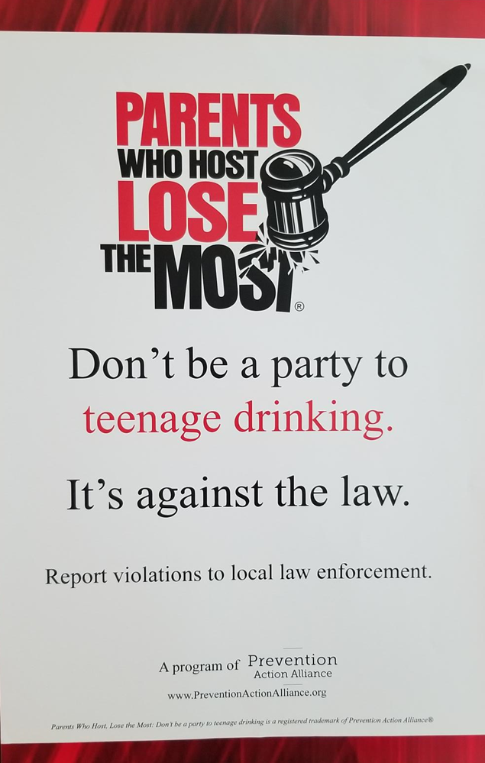

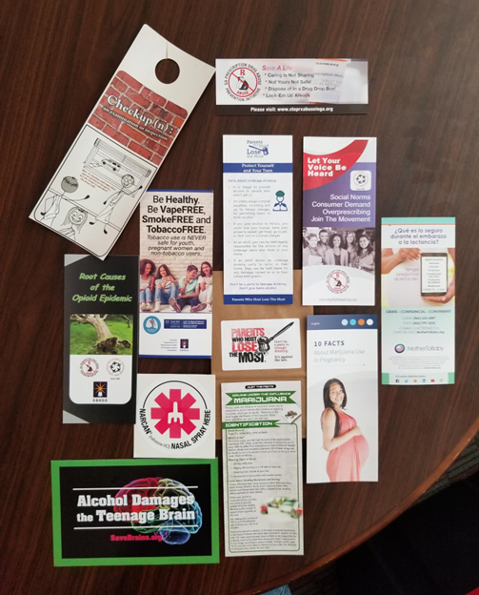

Old logo before changes in 2020
Shown here is materials put in bags to disseminated to community members during events/activities w/PWH logo
After: New logo design for PWH, 2020
New logo created in 2020
PWH has a new facelift moving forward due to creative changes being made in order to update materials to make it more appealing to agencies, businesses, school, etc doing social media campaigns. The community members/leaders seem to like the original PWO logo with the new phrase added. “Don’t be a party to teenage drinking. It’s against the law.

Slide 6
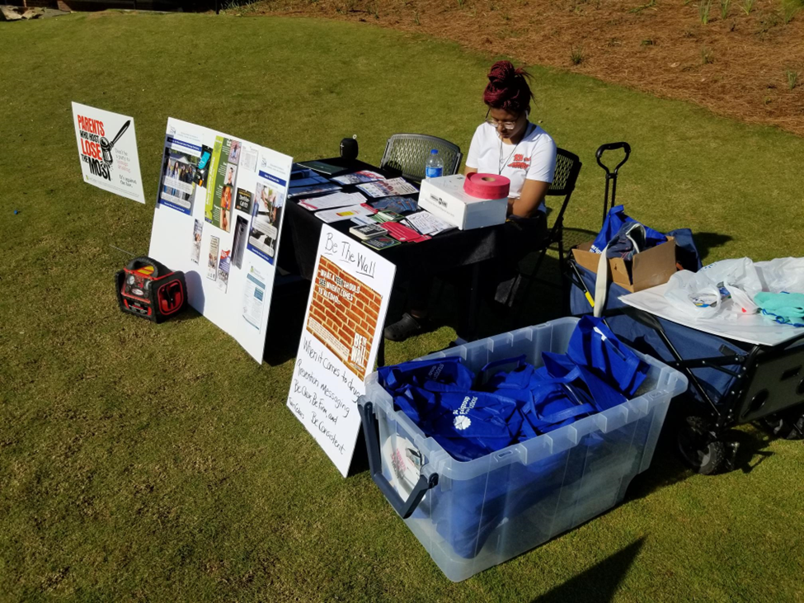
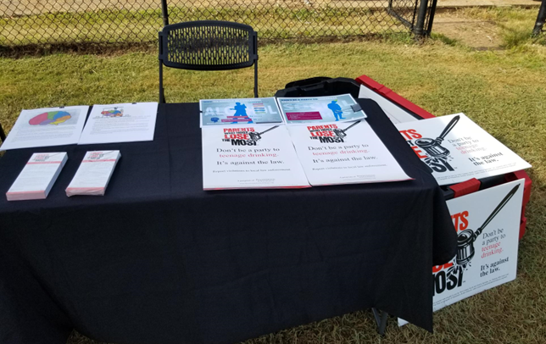
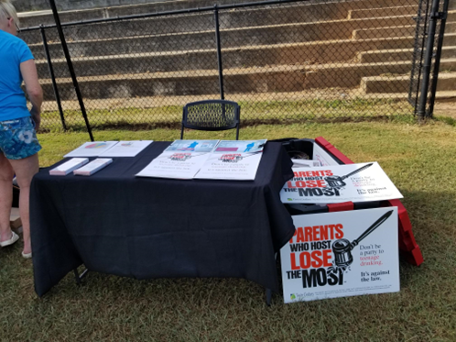
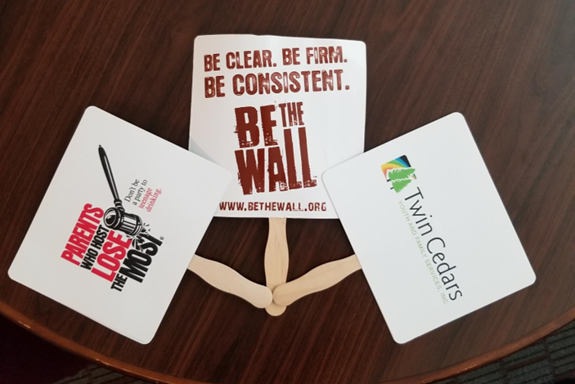
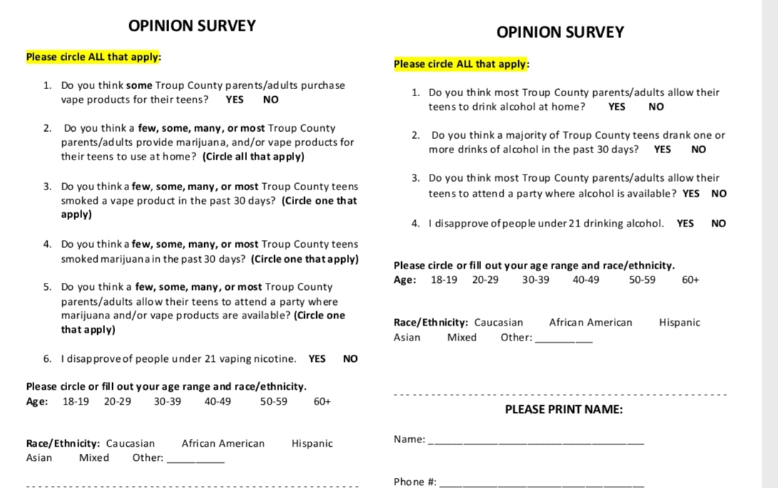
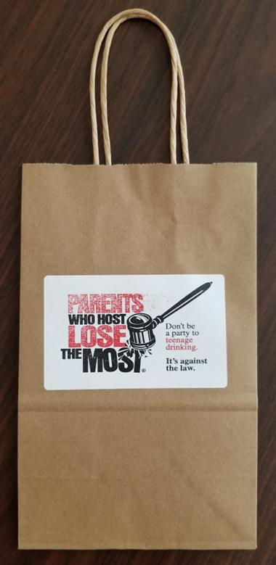
Below are community surveys edited and used to survey adults throughout Troup County at several events.

Slide 7
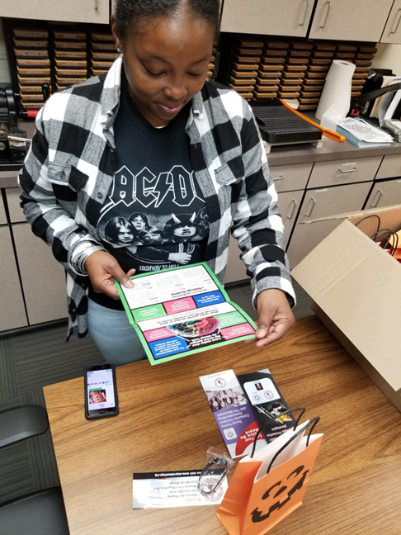
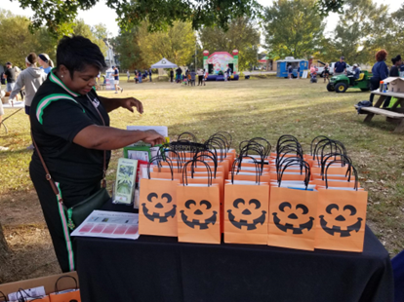
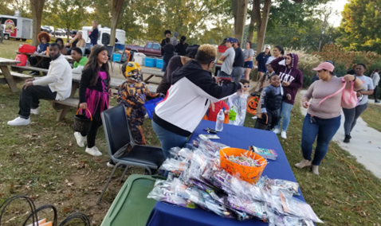
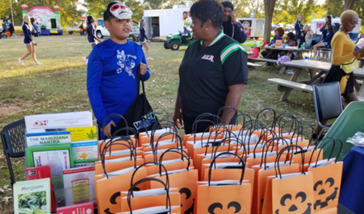
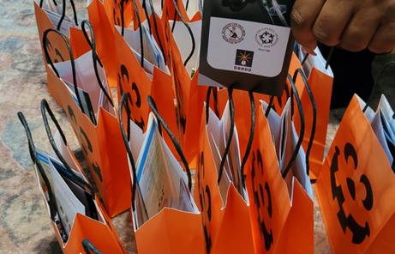
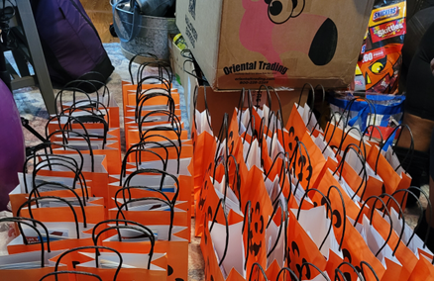
October is National Prevention Awareness Month, and we also celebrate Red Ribbon Week (RRW) during the last week of the month. We filled over 200 bags with various materials such as alcohol, tobacco (vaping), marijuana, and other illegal drugs prevention resources, mental health awareness pamphlets, PWH, and other information for parents and youth. There were students from Point University at the October Festival in West Point on October 31st along with lots of youth, adults, Law Enforcement, City Council members, community members, etc. I conducted adult surveys at several events FY22-FY23 for a total of over 200 surveys to be evaluated by our local evaluator.

Slide 8

What is a Positive Social Norms or PSN Campaign?
A Positive Social Norms Campaign is one way to clarify or (correct) certain misperceptions of norms and promote
positive social norms or (behavior).
Information comes from GUIDE, Inc’s PSNs Campaign Packet.
Conduct your own Social Norms Campaign! Here’s how:
Step 1: Look at the 2014 substance abuse data from your school with your team at this link: http://bit.ly/studenthealthsurvey. If you aren’t able to find your school data, you can use the data from your county that you were given at GTI.
Step 2: Look at the sample campaign messages and links provided to figure out what message you want. Some of these sample messages may be trademarked. You can use them as a guide to create your own message.
Step 3: Create your message and display it on a banner at your school, or put it on your school’s newsreel. The best time to conduct your campaign may be during Red Ribbon Week in October or in April for Alcohol Awareness Month.
In collaboration with Emory MSACD Health Educator, we created the billboard below, which was displayed in 4 locations between Meriwether County and Troup County from September 2022 through December 2022 for sustainability. However, one of the four posters located on I-85 on the West Point exit remained there until someone wanted the space until July 2023.

Slide 9
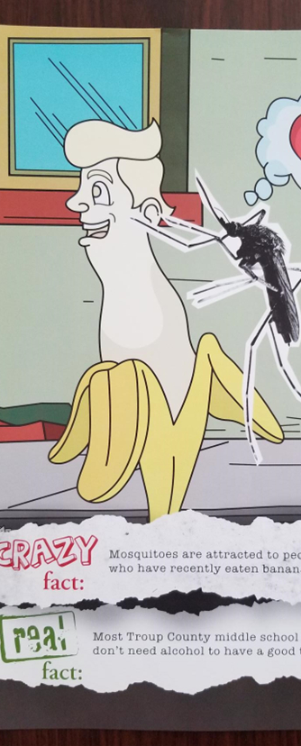
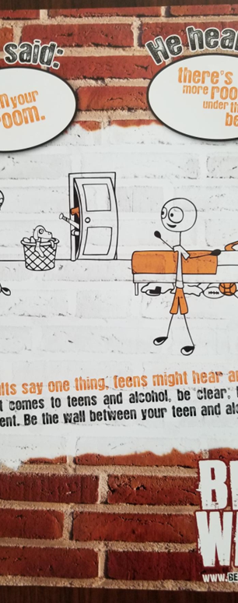
PSN - According to GSHS-ll 2022, overall, at least 90% students surveyed in grades 6th – 12th in Troup County School System choose not to smoke marijuana or drink alcohol.

Slide 10
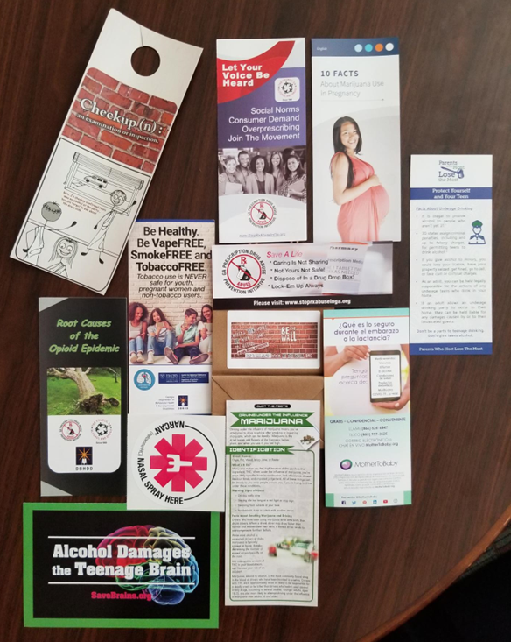
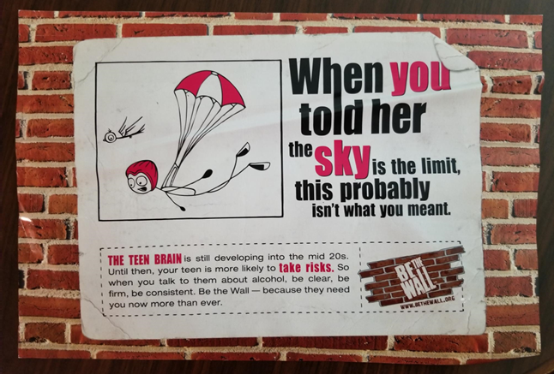
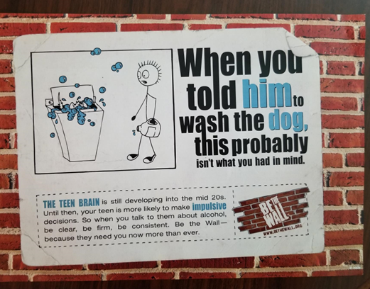
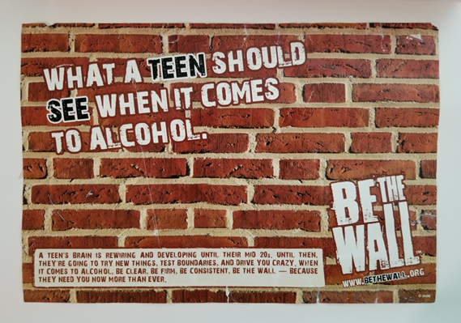
Shown here are BTW posters, banners, and yard sign materials to be posted throughout Troup County and in schools.

Slide 11
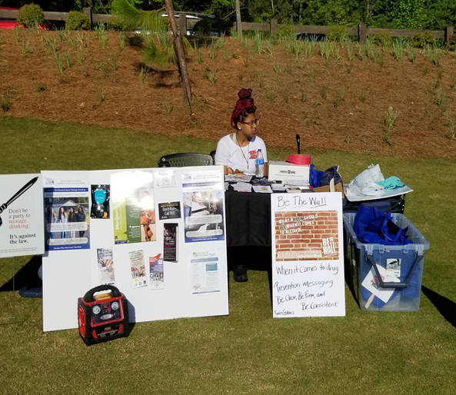
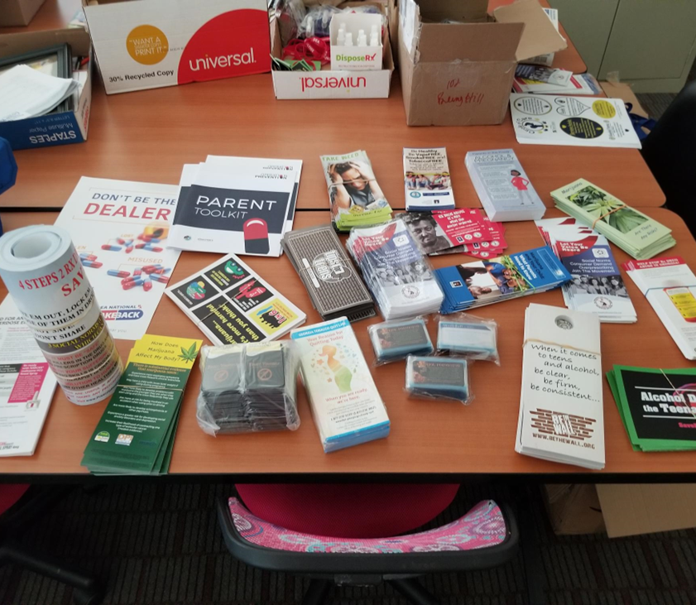
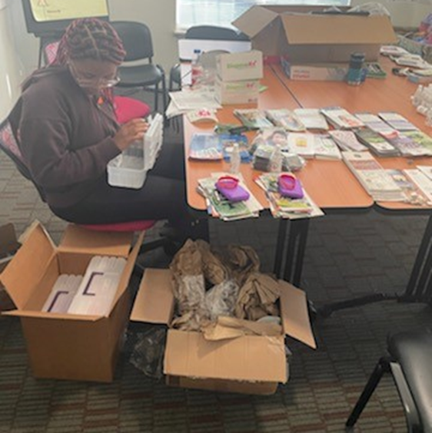
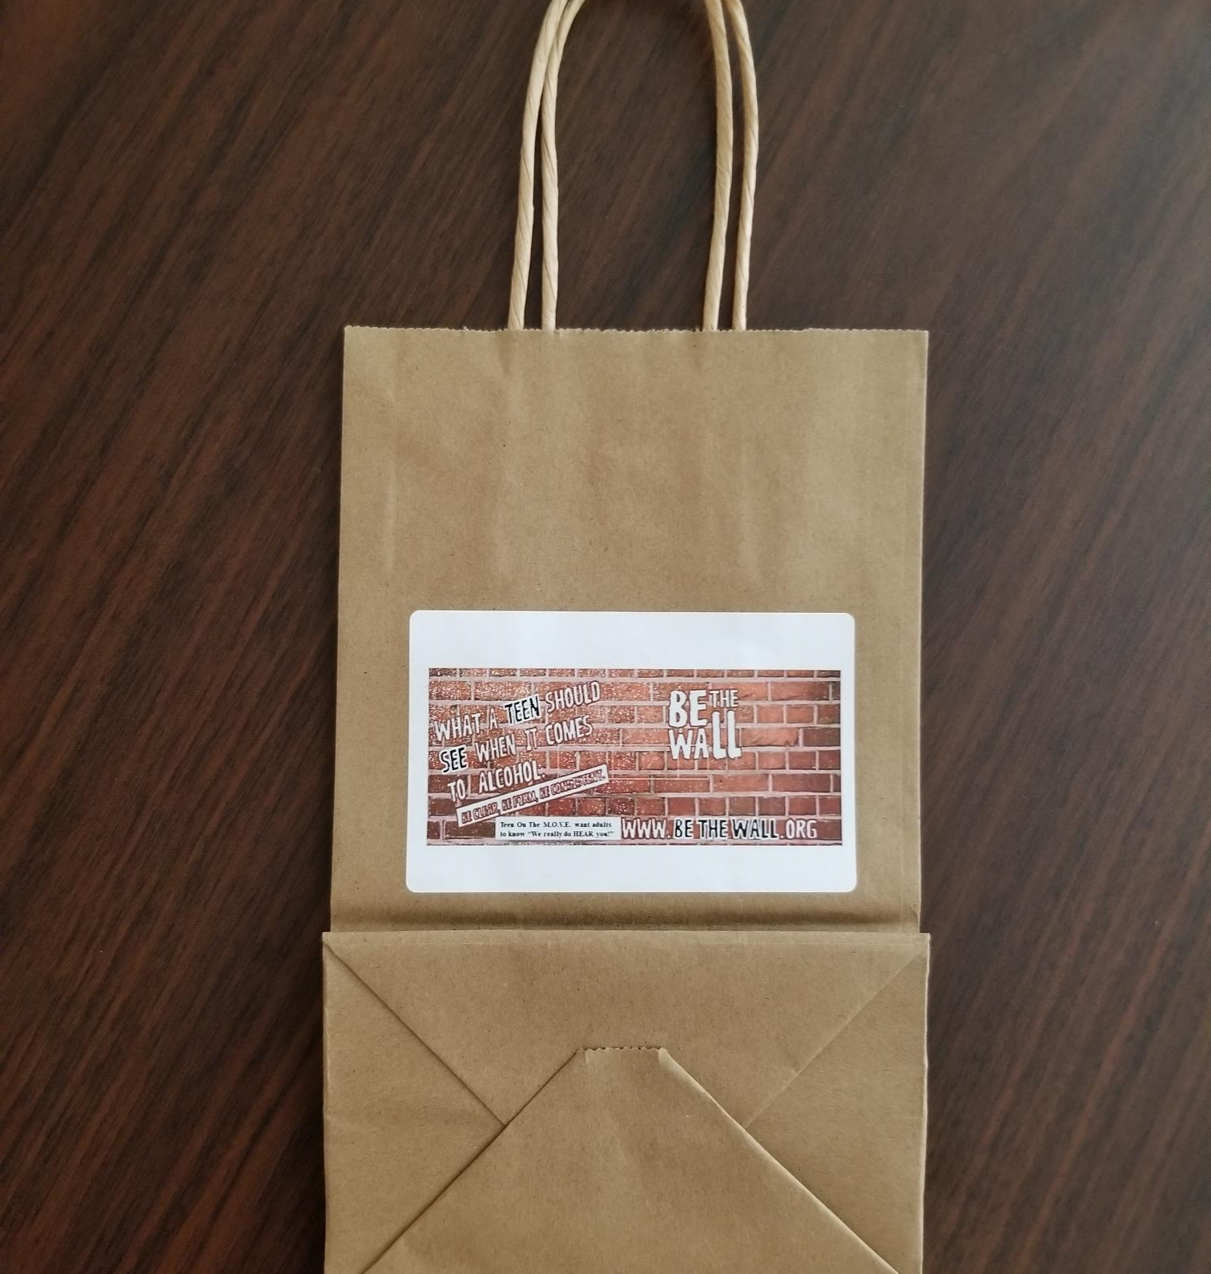
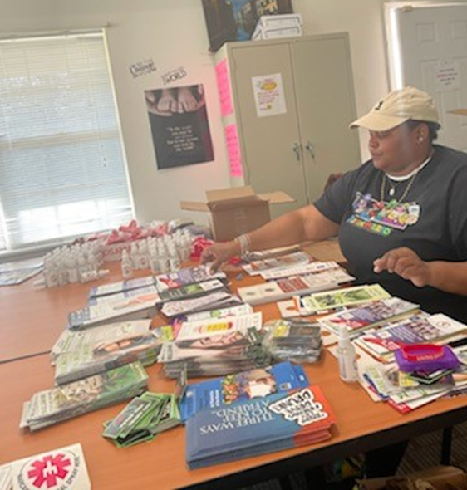

Slide 12
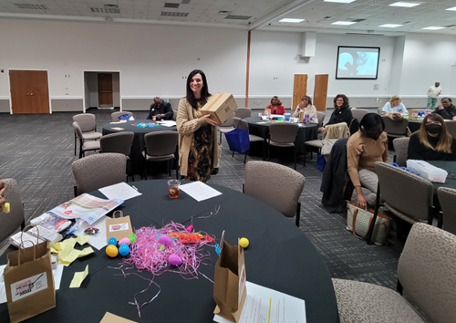
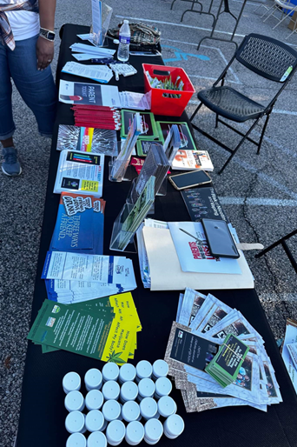
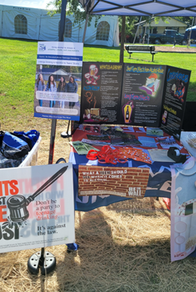
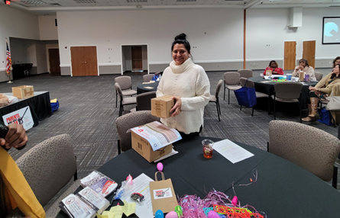
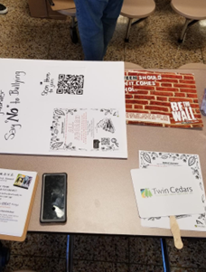
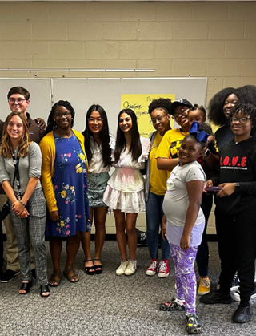

Slide 13
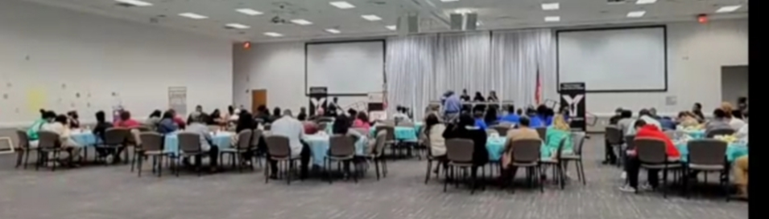
Real Talk: “Conversation with Teens”
Teen On The M.O.V.E. & Teen Empowerment Youth Advisory Team Members are hosting our 1st FREE Health and Wellness Educational Event during Mental Health Awareness Month

Slide 14
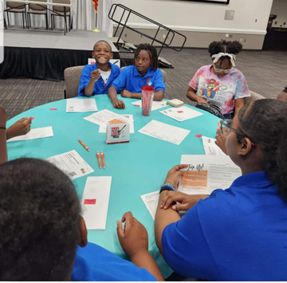
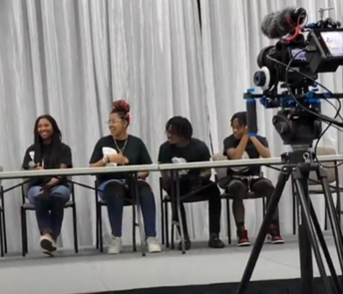
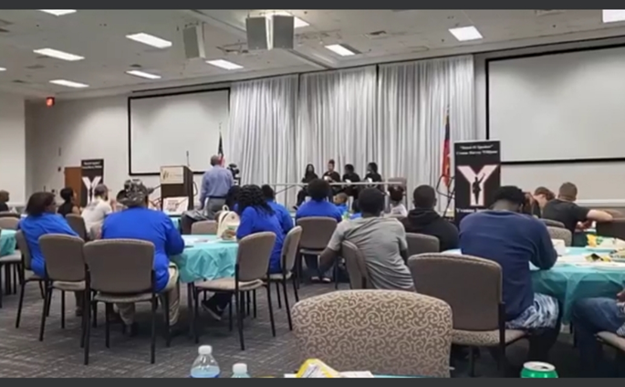
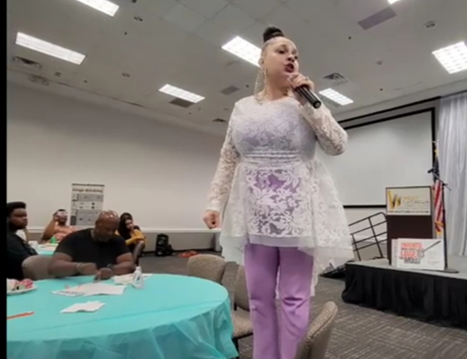
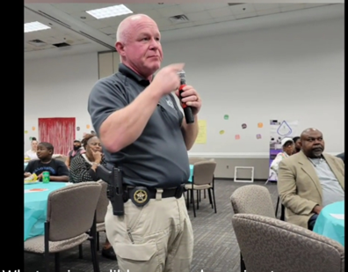

Slide 15
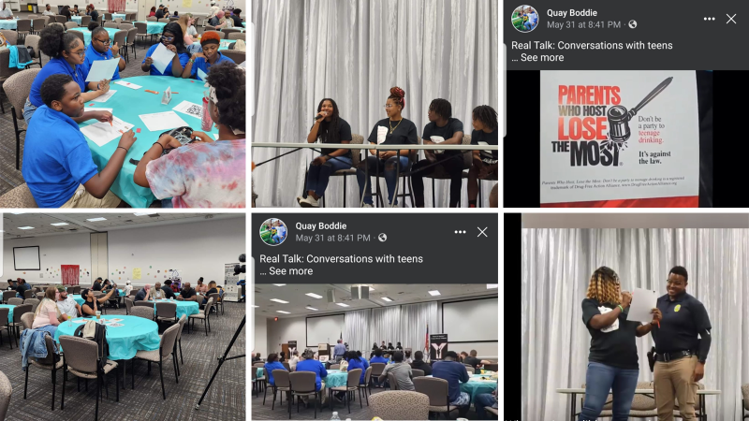

Slide 16
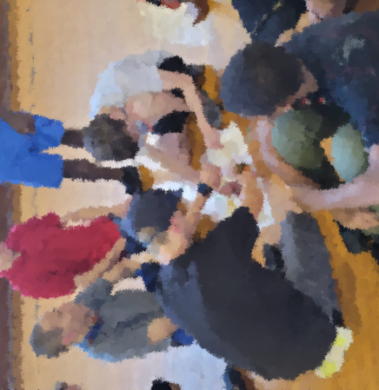

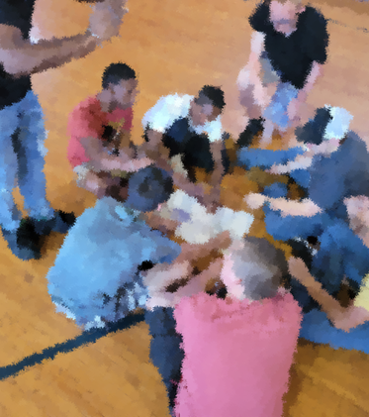
Bridging The Gap Activity with TGFD participants
“Too Good for Drugs”
“Too Good for Drugs” is an evidence-based program that prepares students with the skills they need for academic, social, and life success. This is done through interactive games and activities that provide practical guidance on dating and relationships, building healthy friendships, and refusing negative peer influence. Each lesson fosters analysis and discussion of the effects of alcohol, tobacco, and other drugs (ATOD) use as well as prescription and over the counter (OTC) drug use and various nicotine delivery devices.
Skill development is at the core of Too Good for Drugs, a universal K-12 prevention education program designed to mitigate the risk factors and enhance protective factors related to alcohol, tobacco, and other drug (ATOD) use. The lessons introduce and develop social and emotional skills for making healthy choices, building positive friendships, developing self-efficacy, communicating effectively, and resisting peer pressure and influence.
Too Good for Drugs teaches five essential social and emotional learning skills, which research has linked with healthy development and academic success:
Setting Reachable Goals
Making Responsible Decisions
Bonding with Pro-social Others
Identifying and Managing Emotions
Communicating Effectively

Slide 17
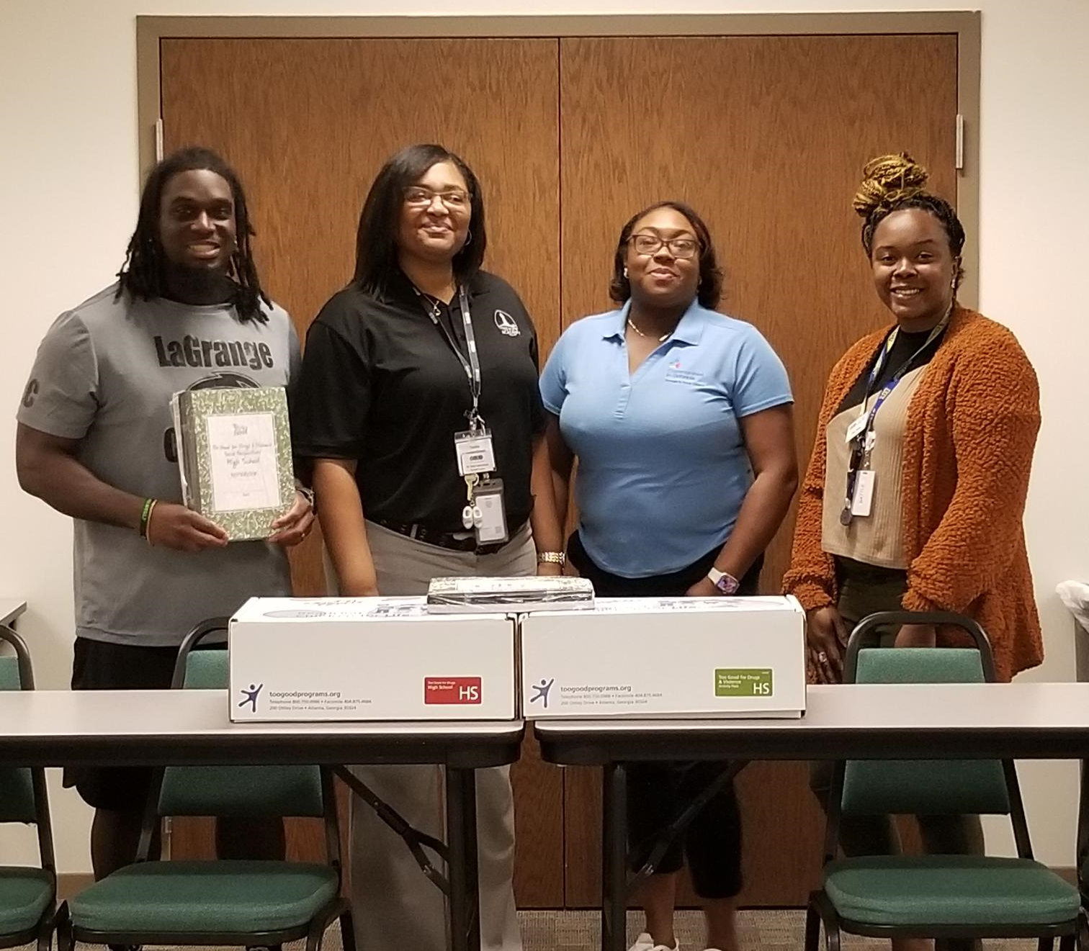
Shown here is Troup County School System (TCSS) Staff and Communities In Schools (CIS) Staff, now TGFD Facilitators after completing training.
Too Good for Drugs
Project Coordinator trained two CIS staff and two TCSS staff to facilitate TGFD in Troup County Schools. Now for sustainability we have 6 trained TGFD instructors to facilitate program during afterschool, health classes, at the alternative school, and during summer programs for sustainability. In addition, Project Coordinator purchased TGFD and Too Good for Drugs and Violence program kits . The only thing staff will have to do is purchase additional participant books as needed.

Slide 18

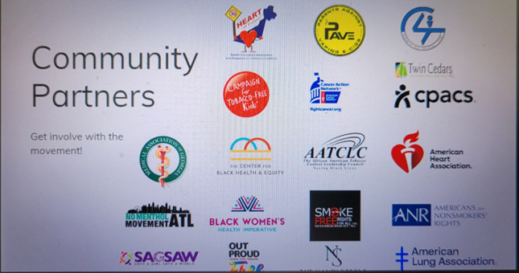

Ask, Advise, Refer – Tobacco Cessation Model
YOU can quit smoking, vaping, and using smokeless tobacco today! When you are ready, we can help. Improve your chances of quitting by calling or texting the Georgia Tobacco Quit Line (GTQL). (877) 270-
STOP (877-270-7867) | Español (877) 2NO-FUME (877-266-3863)
Hearing Impaired: 1-877-777-6534 Text READY to 34191| Español Text LISTO to 34191
Available 24 hours a day, 7 days a week (including holidays)
Shown to the left are pictures community partners from PAVe (Parents Against Vaping e-cigarettes, No Menthol Movement ATL, CPCS, etc. who are collaborating to do tobacco cessation work. What we do is network as committees to exchange resources, materials, and tools and make them interchangeable to work in our communities and as well as on social media.

Slide 19
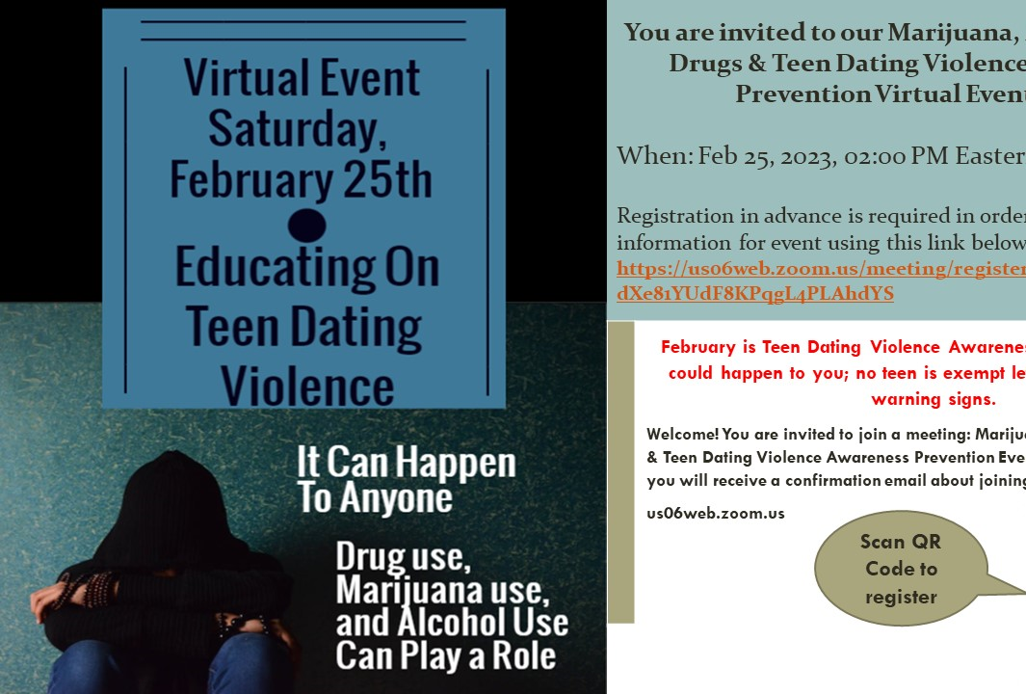
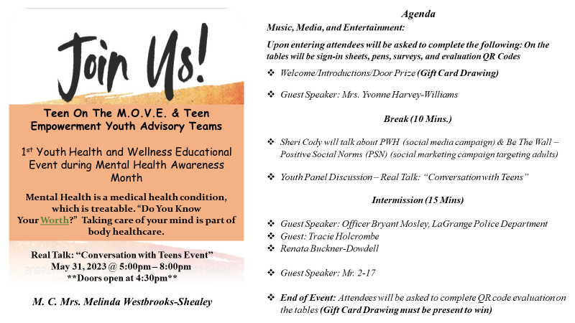
Believe YOU can
make a difference
In the life of a child. It takes a community!

Slide 20
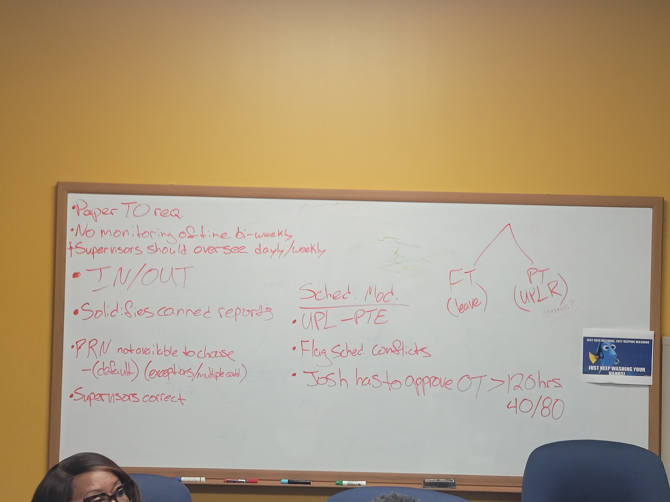
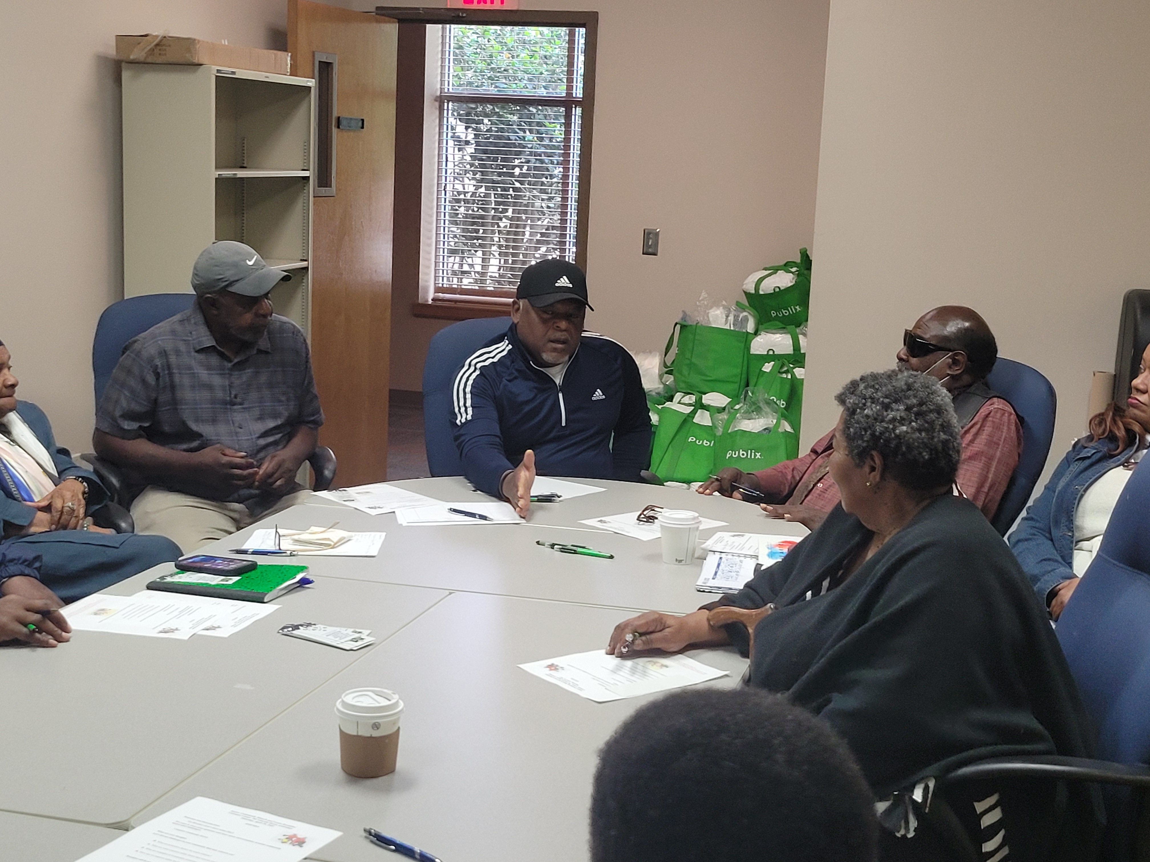



In collaboration with Beyond The Bell (BYTB), we did a Senior, Mature Focus Group aimed at learning health concerns.

Slide 21

Shown here is our PWH yard sign on our Coleman Center site.

Slide 22


Questions???
Veronica R. Dowell, Prevention Specialist
Partners In Prevention Project
Office: (706)298-2148 ext. 1222
Cell: (706)616-2144
vdowell@twincedars.org

