Slide 1
School board meeting
Nov. 21, 2023

Slide 2
Superintendent’s Report
Presented by Supt. Dr. Kim Hiel
Notes:
Kim:
Good evening Chair Mosequda-Jones and school board members.
I would like to take this time to thank our community members that helped to support our bond referendum. Your support of our school community and our scholars can’t be understated. Your partnership, not just monetarily will help our school district excel even further.
Thank you as well to:
our partnership with Education Minnesota Osseo or EdMN and all of the staff who helped with phone calling
Building sites and district staff who helped to provide communication on the bond
Our communication department who worked tirelessly to inform our public
Brooklyn Park City Hall who worked closely with Osseo Area Schools to ensure the voting process was completed smoothly.
Last but not least, our staff and our kids..it is and will alway be about you.
As always, thank you parents and guardians for choosing Osseo Area Schools to teach your children. We do recognize that this is a privilege. We will continue to work toward achievement for all of our babies and becoming One Community for All.

Slide 3
Points of Pride
Notes:
KIM
A regular part of the superintendent’s report is to share Points of Pride in our district.
By sharing our Points of Pride, we are taking time to recognize and celebrate, the scholars, staff and community members who are contributing to the accomplishment of our mission which is:
to inspire and prepare each and every scholar with the confidence, courage and competence to achieve their dreams; contribute to community; and engage in a lifetime of learning.
I have members of our District Cabinet here to assist in sharing some examples from the last few weeks.

Slide 4
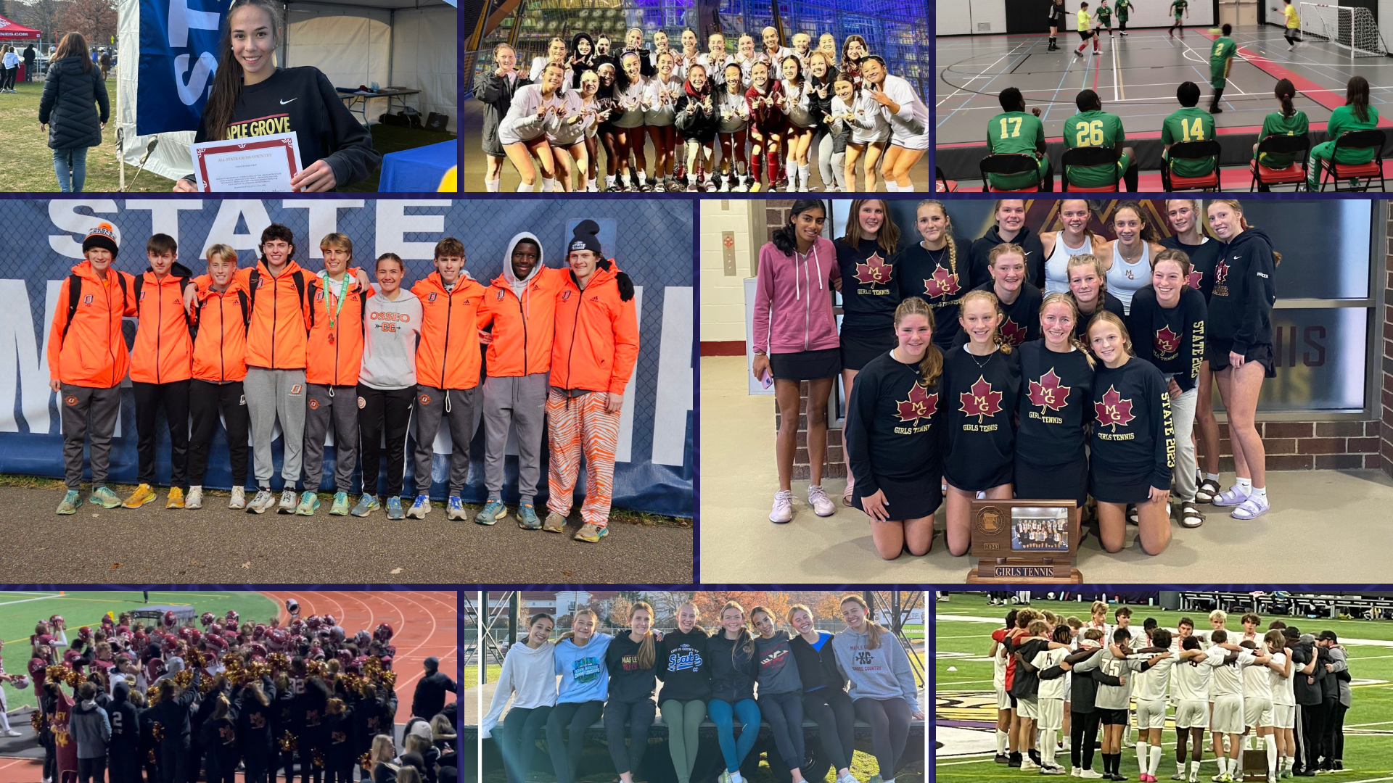
Notes:
In the area of ACHIEVING DREAMS
The fall sports season is winding down! Congratulations to all of our student-athletes on successful seasons! A few highlights include:
The Maple Grove Senior High School boys soccer team placed second in the state tournament.
The Maple Grove Senior High girls swimming team placed fifth overall in the state tournament.
The Maple Grove Senior High girls soccer team placed fourth in the state tournament.
The Maple Grove Senior High girls tennis team placed fourth in the state tournament.
The Osseo Senior High School boys cross country team placed 13th in the state tournament.
The Maple Grove Senior High School girls cross country team placed 14th in the state tournament.
The Maple Grove Senior High School football team made it to the second round of the state tournament.
The Park Center Pirates Adapted Soccer, CI team, representing all three high schools, competed in the quarterfinals of the state tournament.
The Park Center Pirates Adapted Soccer, PI team, representing all three high schools, competed in the Consolation Championship of the state tournament.

Slide 5
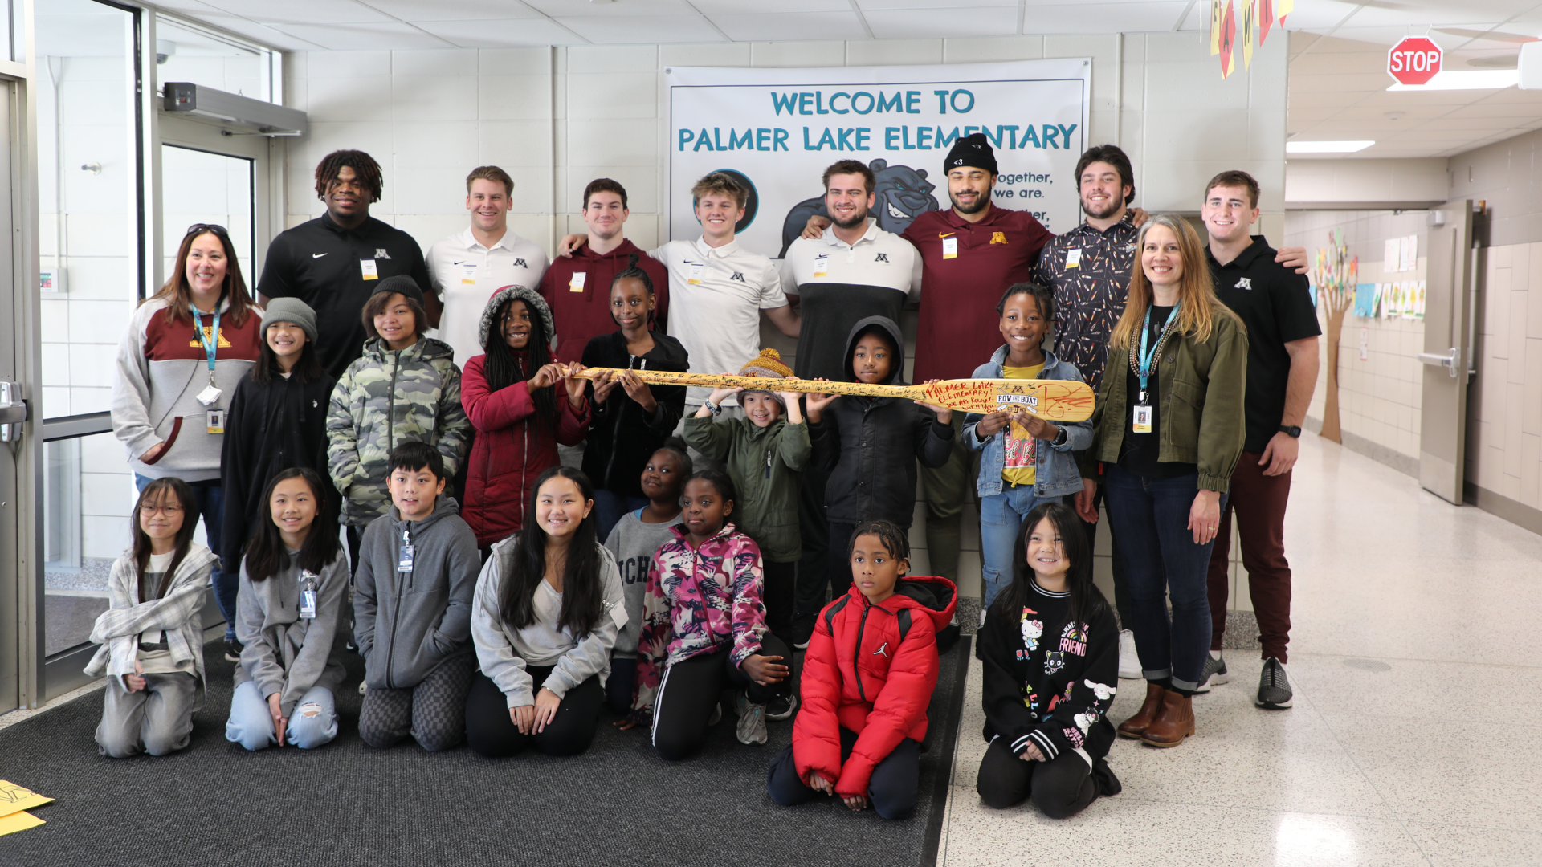
Notes:
Players from the University of Minnesota’s Gopher football team spent the morning at Palmer Lake Elementary on Nov. 13, where they stopped into several classrooms each to read a book and talk to the students.

Slide 6
Notes:
Students at Maple Grove Senior High recently stepped into a world where jazz meets justice with their production of Chicago.
The production showcases the talents of all of the scholars in the show as they performed various singing and dancing routines while telling the story. A talented pit orchestra accompanied the performers during every song and were featured in the back of the stage.

Slide 7
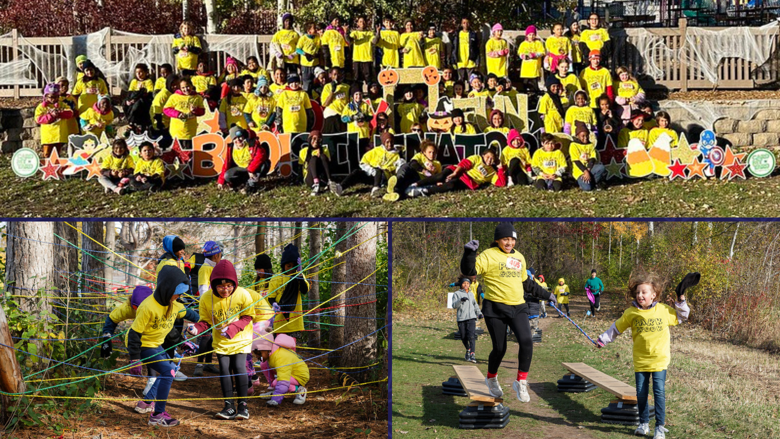
Notes:
Seventy Park Brook Elementary School scholars took part in the Resilinator event on Oct. 29, hosted by the YMCA of the North at Bloomington's Highland Hills Park. Park Brook has participated in this outdoor obstacle course event for several years, and it has become a much-anticipated part of Park Brook’s Focus on Fitness initiative.

Slide 8
Notes:
Minnesota Education Commissioner Willie Jett began his educational journey at Crest View Elementary School, and he revisited some childhood memories with a visit to the school on Oct. 25.

Slide 9
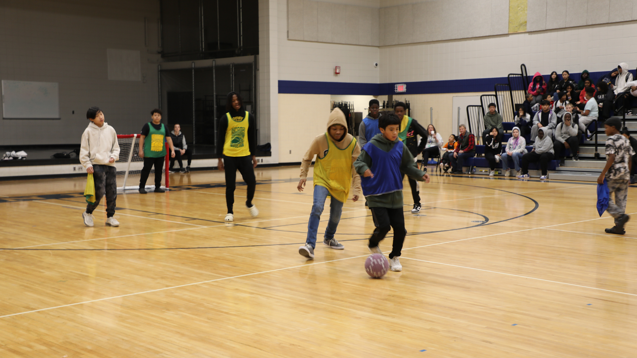
Notes:
North View Middle School scholars had active mornings throughout the month of October, as the school's advisory groups battled it out in a World Cup soccer tournament that culminated in a championship match Oct. 27. Congrats to the winning team, Mr. Corrigan's eighth grade advisory class!

Slide 10
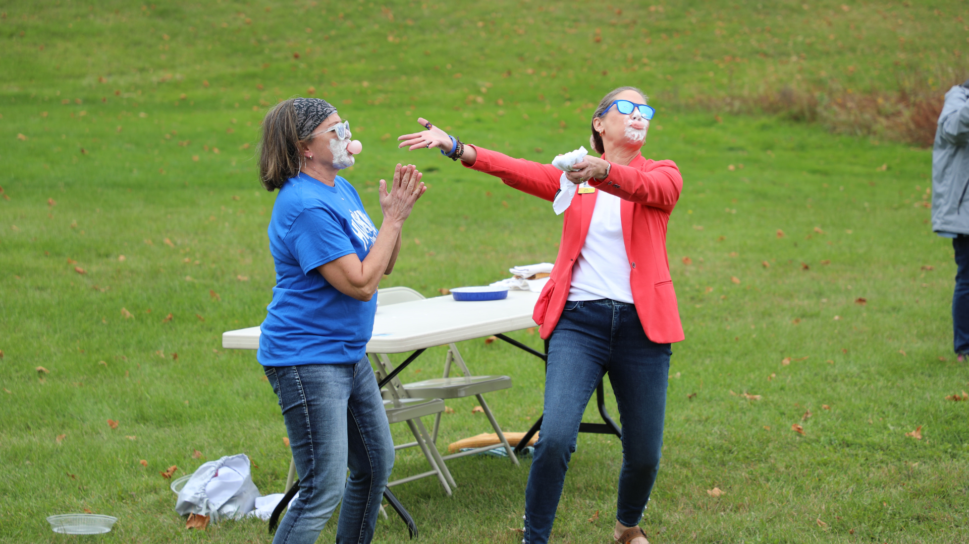
Notes:
Students at Oak View Elementary School recently celebrated their successful fun run. The school raised $37,500 in the fundraiser to use for various fun events and activities this year, which was $7,500 over their goal.

Slide 11
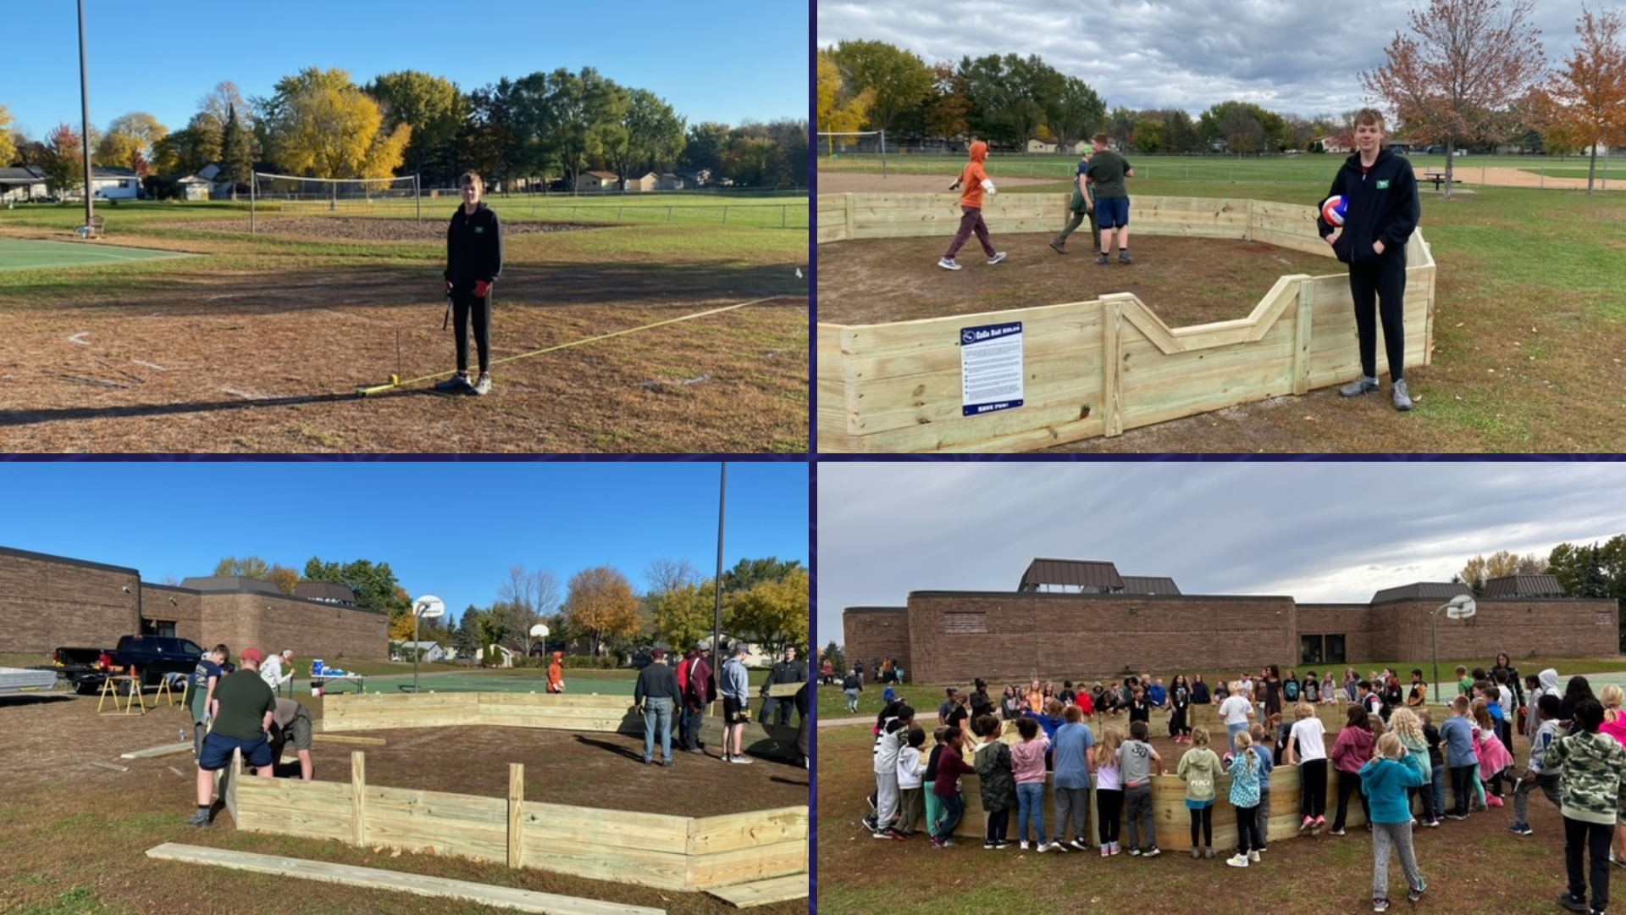
Notes:
In the area of CONTRIBUTING TO COMMUNITY:
Osseo Senior High School sophomore Brennen Horbal, a former Elm Creek Elementary School student, raised money to build a Gaga pit at the Elm Creek playground for his Eagle Scouts project. Horbal built the pit with assistance from his troop. The elementary students have already enjoyed utilizing the space!

Slide 12
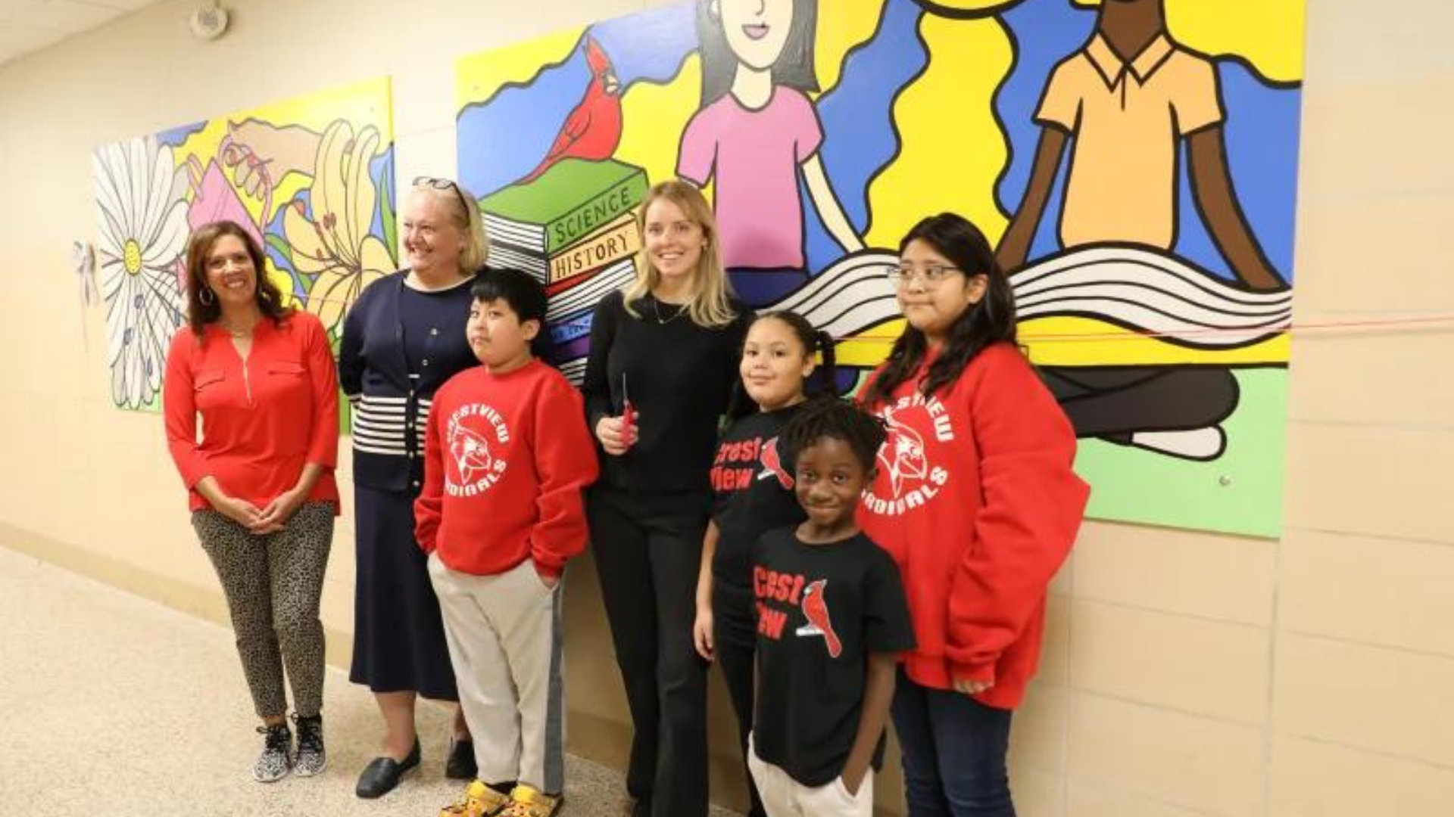
Notes:
An artist-in-residency recently helped beautify Crest View Elementary School's main hallway with two murals that each student and staff also had a hand in creating.

Slide 13
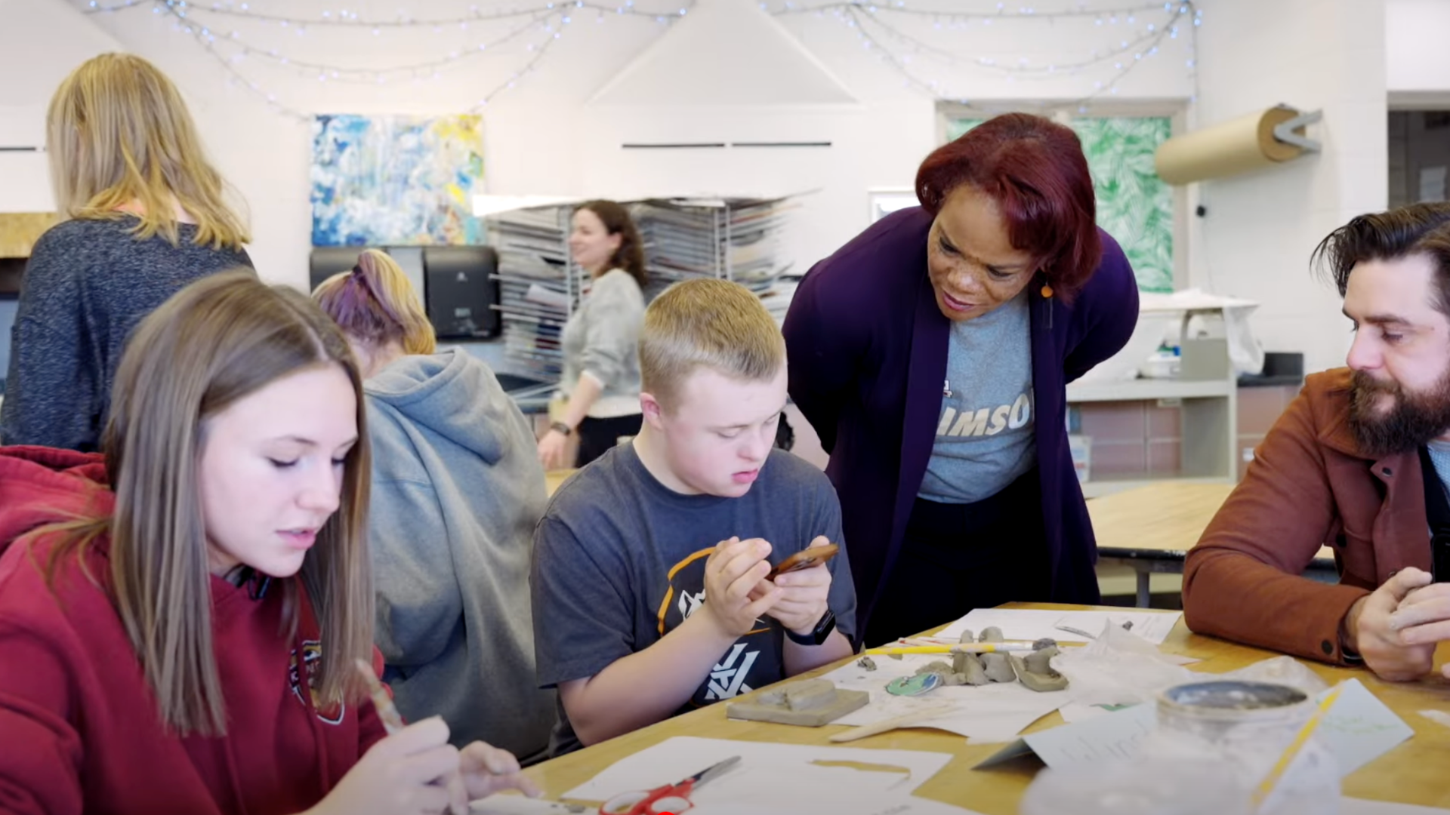
Notes:
In the area of LIFELONG LEARNING
Supt. Dr. Kim Hiel recently visited the Unified Art Class at Maple Grove Senior High to kick off her video series called “Holding Space with Dr. Hiel.” In this class led by Art Teacher Erin Boe, the special education and general education scholars come together to create beautiful works of art through the curriculum Boe created especially for Unified classes across the state.

Slide 14
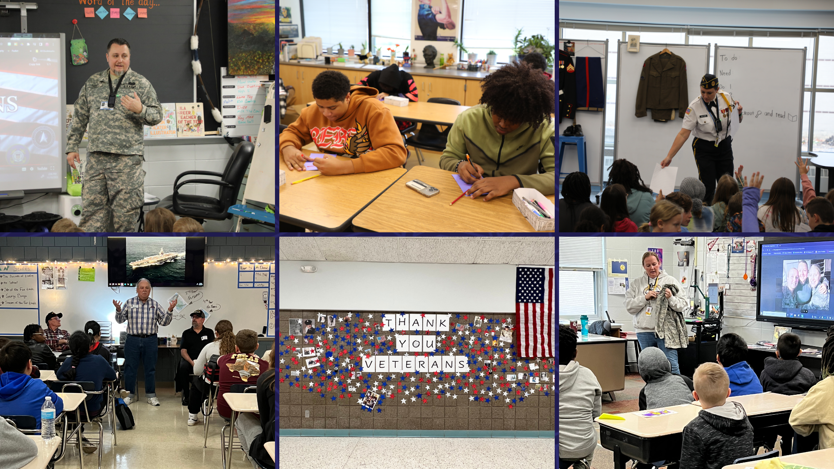
Notes:
Each year on Nov. 11, Osseo Area Schools recognizes Veterans Day to celebrate and honor military veterans of the United States Armed Forces. Across the district, students participated in various activities to commemorate Veterans Day. Here are just a few examples of how Veterans Day was honored.

Slide 15
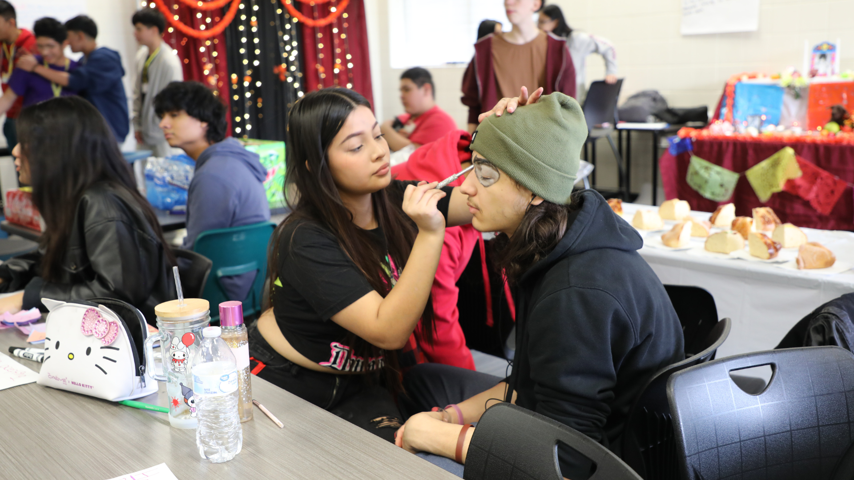
Notes:
Park Center Senior High School scholars in a Spanish Heritage class had the option to host a Dia de los Muertos event to share this cultural tradition with their school community, and they jumped at the chance, putting on a colorful two-day event Nov. 1 and 2 that other classes could visit.

Slide 16
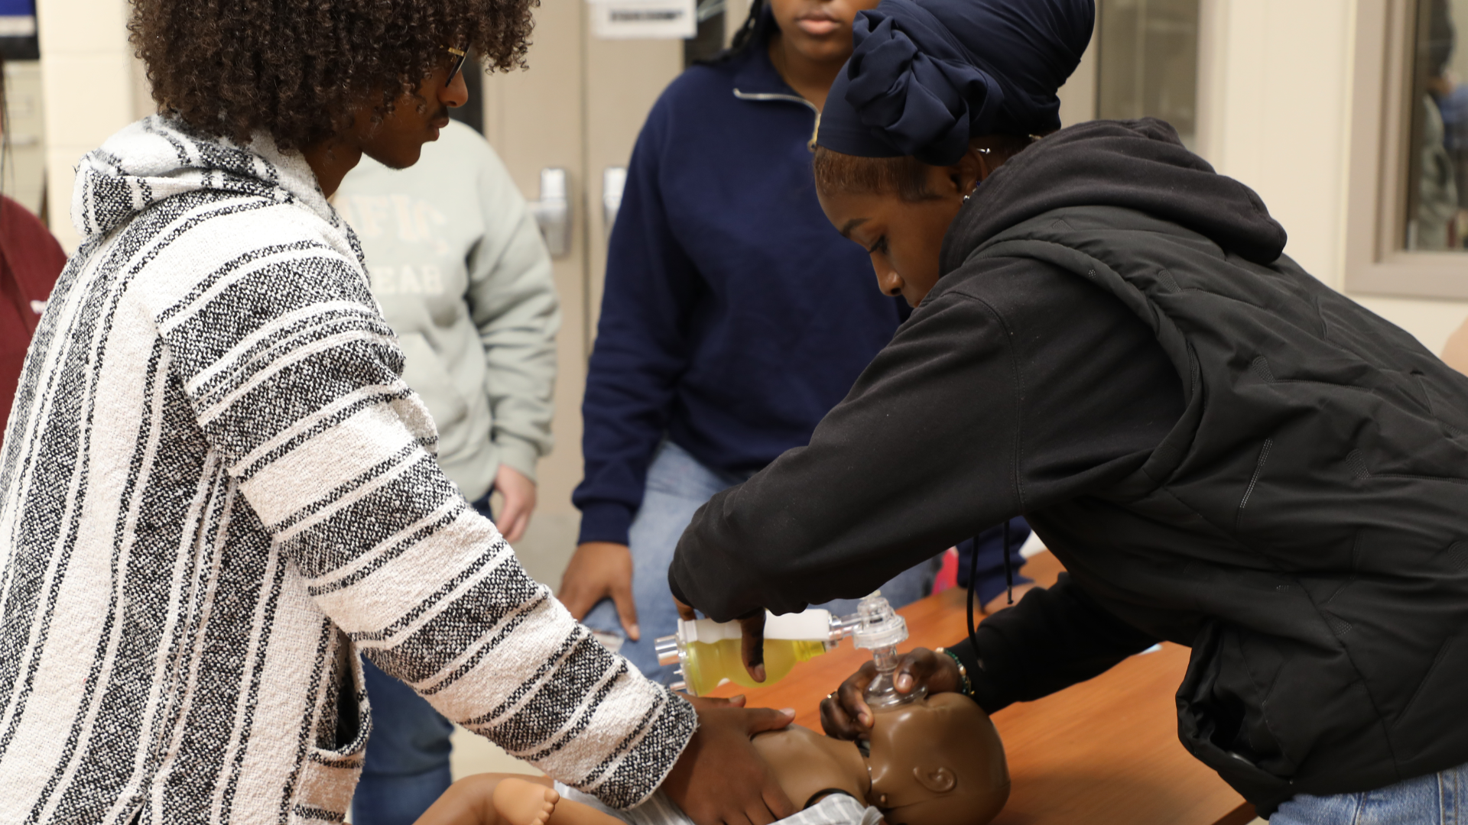
Notes:
At Osseo Senior High School, students in the Health Science Magnet Program get hands-on, work-ready experience in the health science and medical fields. While the program takes place at OSH, scholars from Maple Grove and Park Center Senior High Schools have the opportunity to enroll in the program as well.
Ryan Spanier, a senior who participates in the Health Science Magnet Program said: “These classes can get you somewhere. You are already in the certified working part, you can start working right away. You can apply to any hospital in the country when you get the certification through this program and you are qualified to be there.”

Slide 17
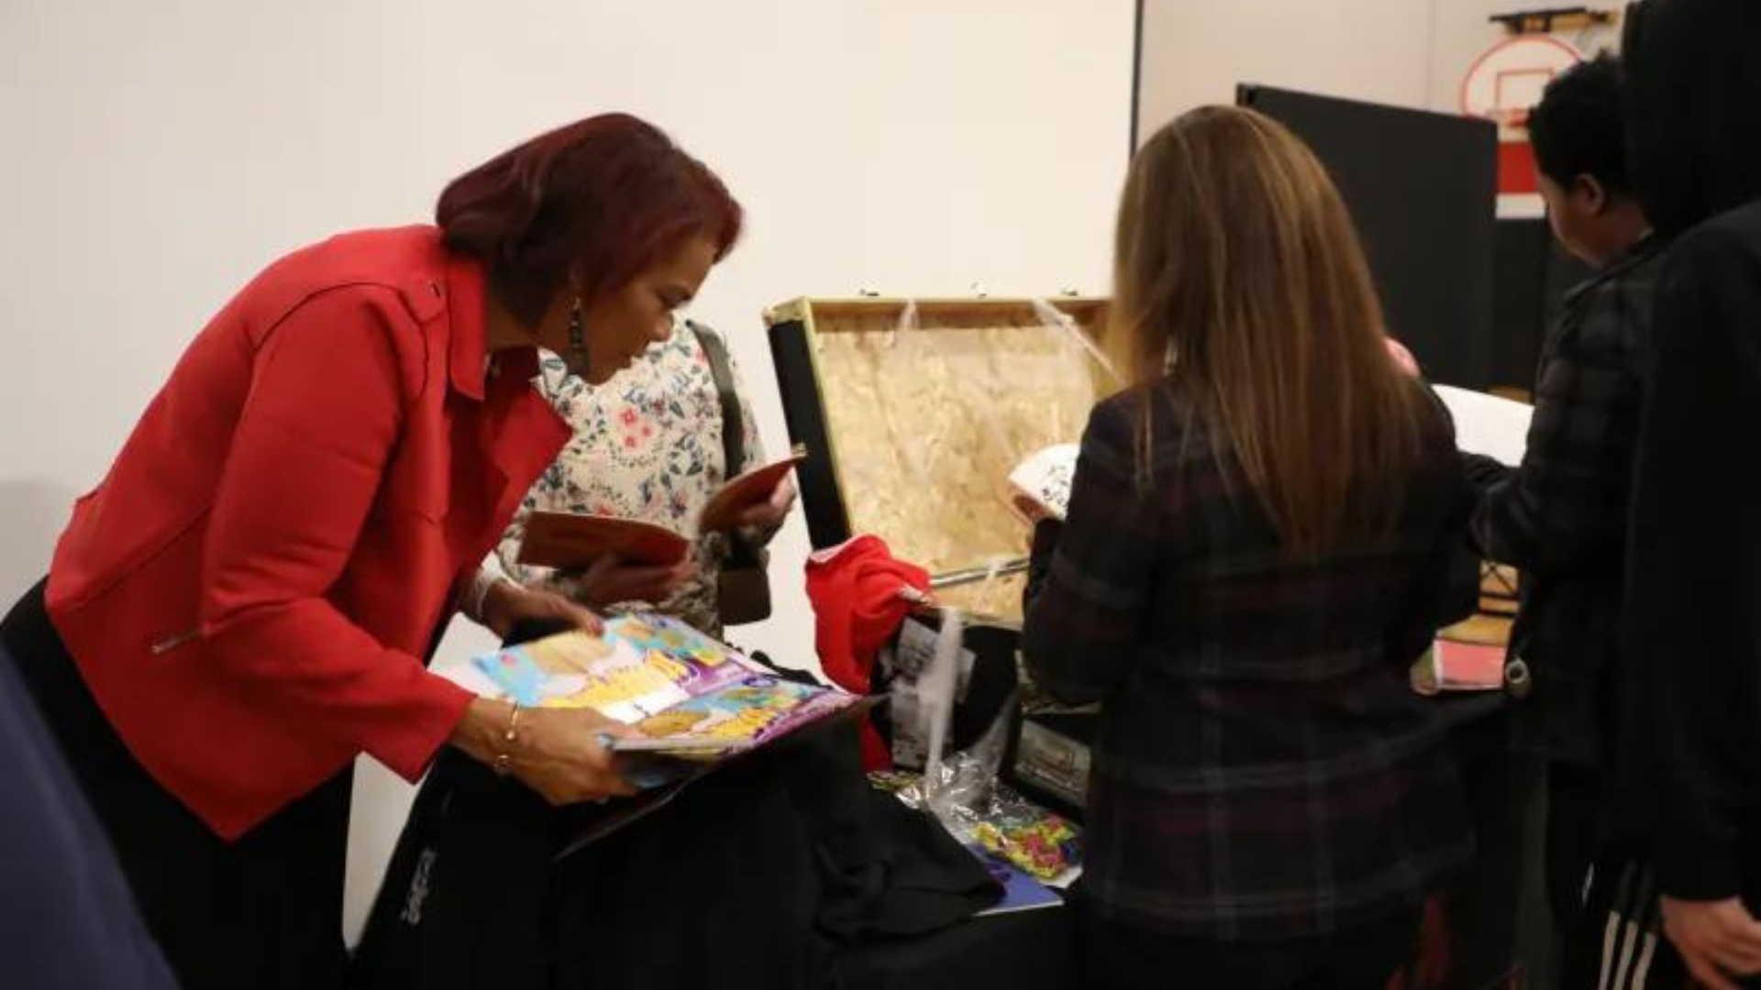
Notes:
Brooklyn Middle STEAM School closed out their conference night with the opening of a time capsule created by the school's students from 1993. Attendees had fun checking out 90s technology, popular snacks and Brooklyn Junior High swag. The school intends to put a new time capsule together for the students of 2053.

Slide 18
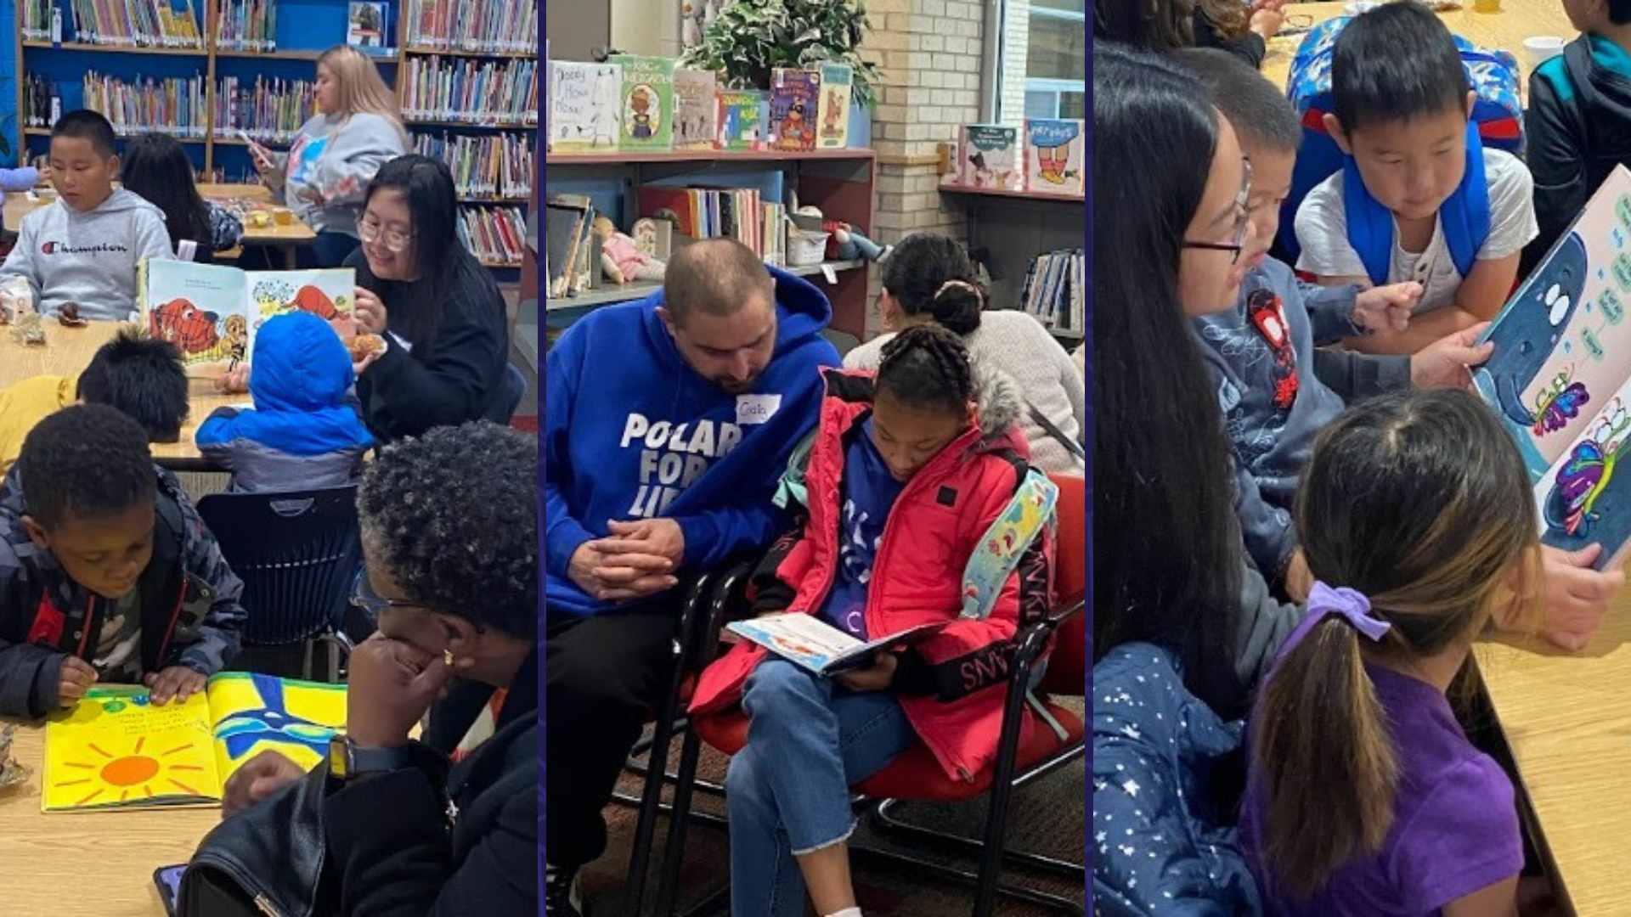
Notes:
Fair Oaks Elementary hosted a Breakfast with Books event in the school's library media center on Oct. 27, inviting families to start their day at the school and read books with their scholars while enjoying breakfast together.

Slide 19
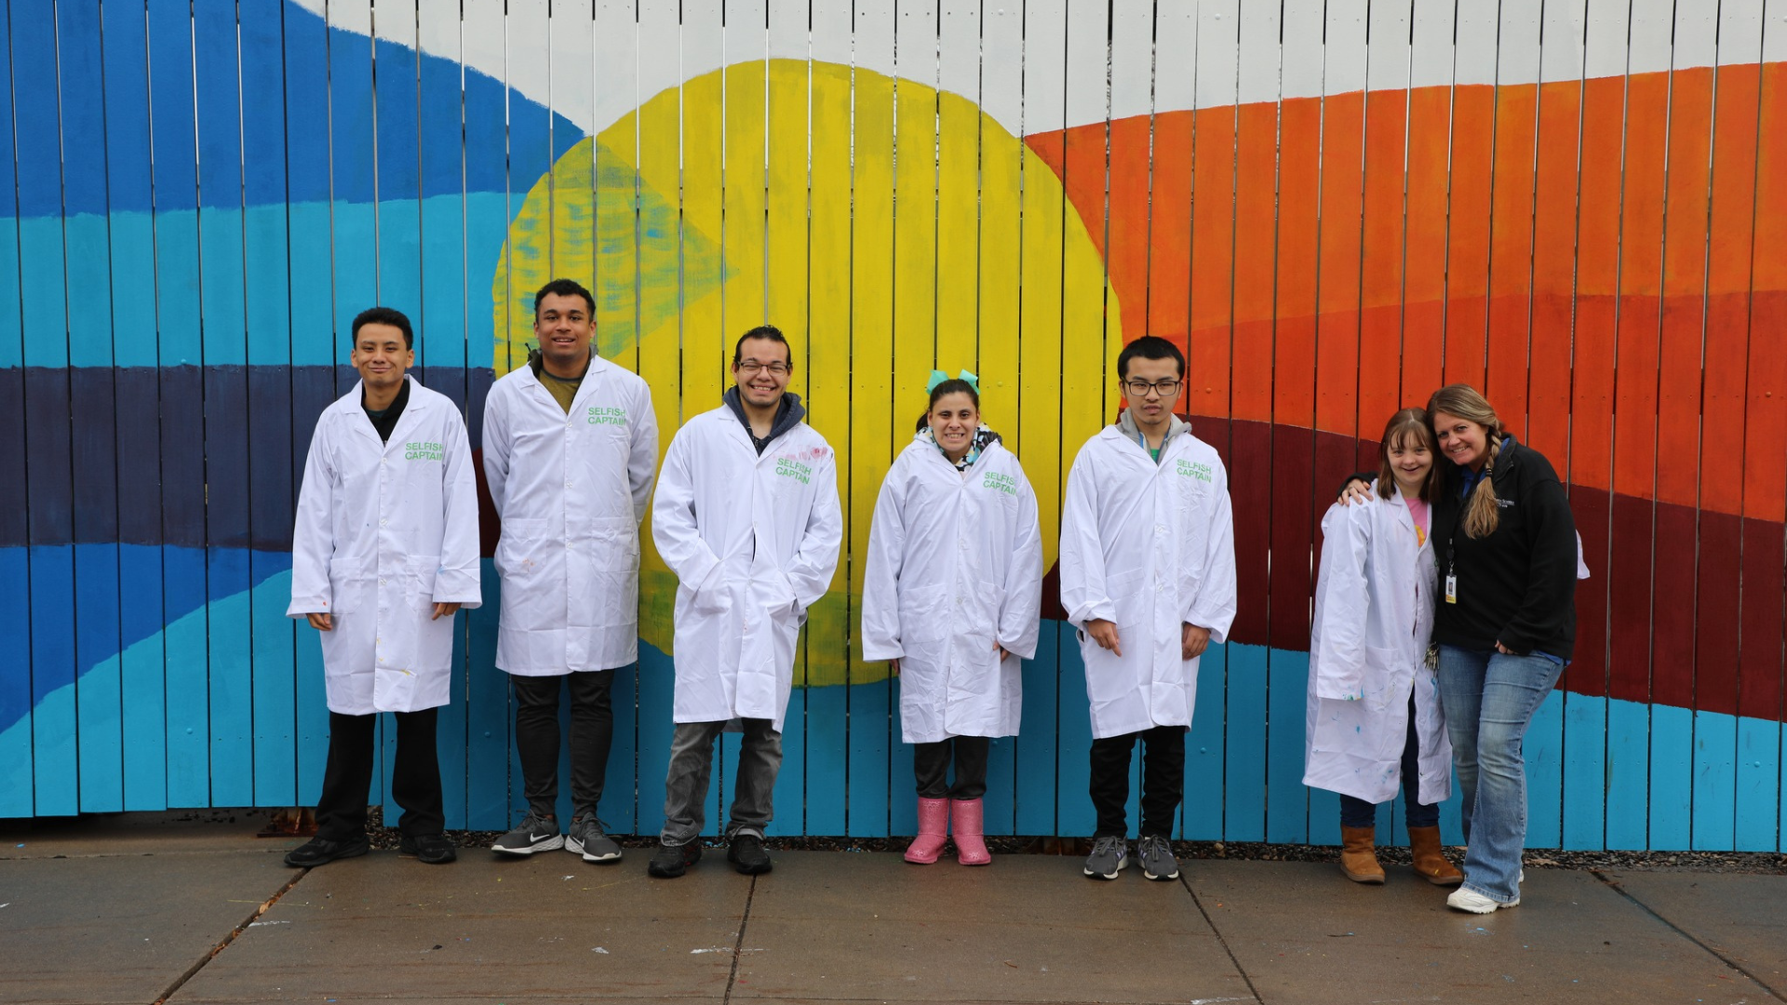
Notes:
Students at the Osseo Education Center have been hard at work painting a beautiful mural on a shed located near their building. The students worked as a team to pick out colors and a design and get the project completed!

Slide 20
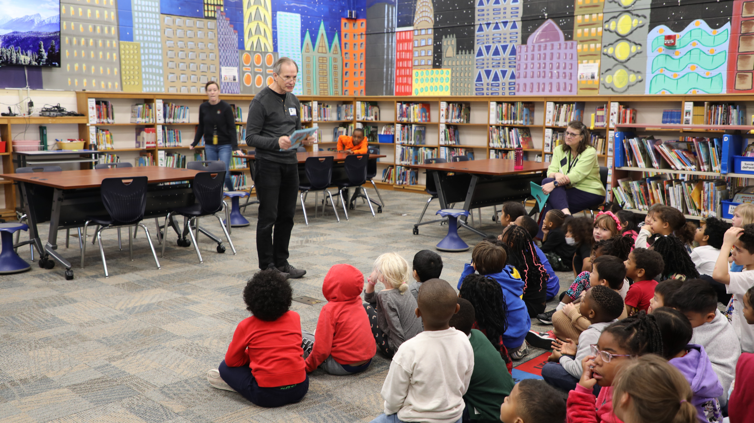
Notes:
Jerry Hale, a Brooklyn Park author and grandfather of three students in the district, has been spending time at local elementary schools in his home city of Brooklyn Park this month to share his new book, Swimming in Grandpa’s Pool.
At Birch Grove School for the Arts on Nov. 15, Hale read his book to all of the school’s first grade scholars and then sent each one of them home with a copy of the book. Hale plans to do the same for all first graders at the district’s Brooklyn Park-area elementary schools.

Slide 21
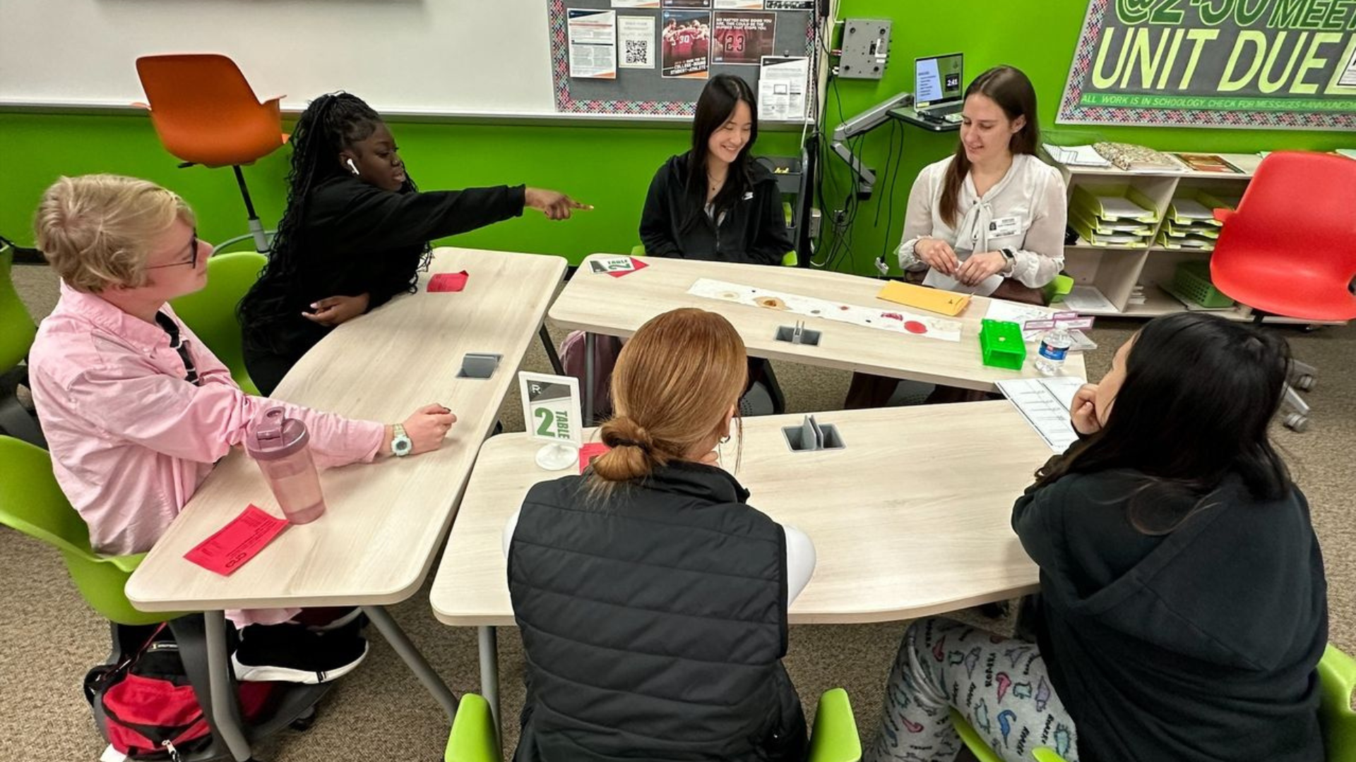
Notes:
Park Center Senior High School students interested in a career in the legal field had the opportunity to attend a legal career panel Oct. 26. The students talked to local professionals about their career path, current position and all aspects of their job. The panel included a paralegal, forensic scientist and two attorneys.

Slide 22
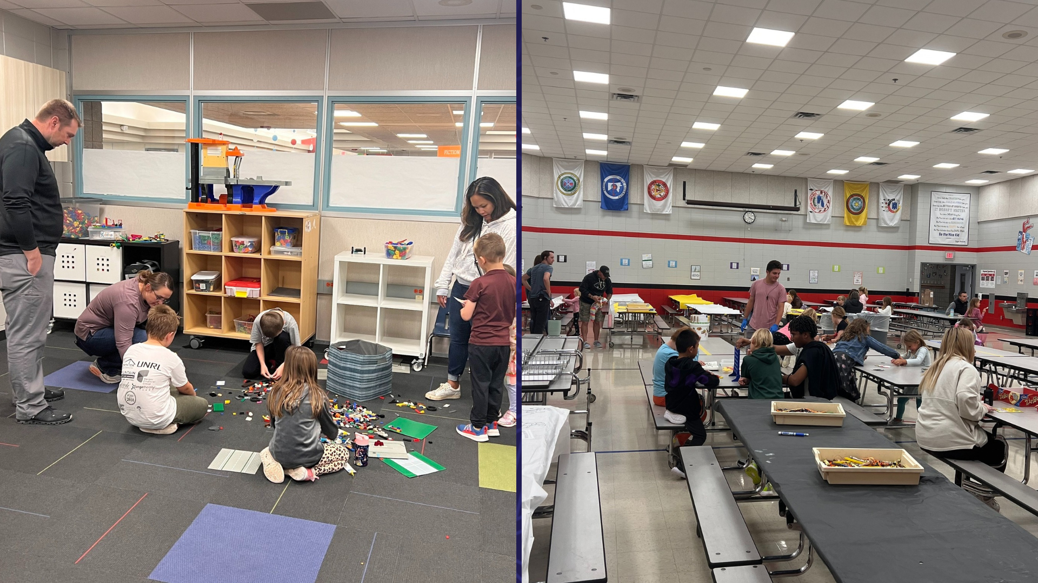
Notes:
Oct. 26 was Lights on Afterschool- the only nationwide event celebrating after school programs and their important role in the lives of children, families and communities. At Kidstop and Four Star locations across the district, staff and students planned events to celebrate, inviting parents/guardians to join.
At Basswood Elementary School Kidstop and Four Star, students walked their families through various activities including an art project, dramatic play, outside play at the playground an activity in the gym and a treat in the cafeteria.

Slide 23
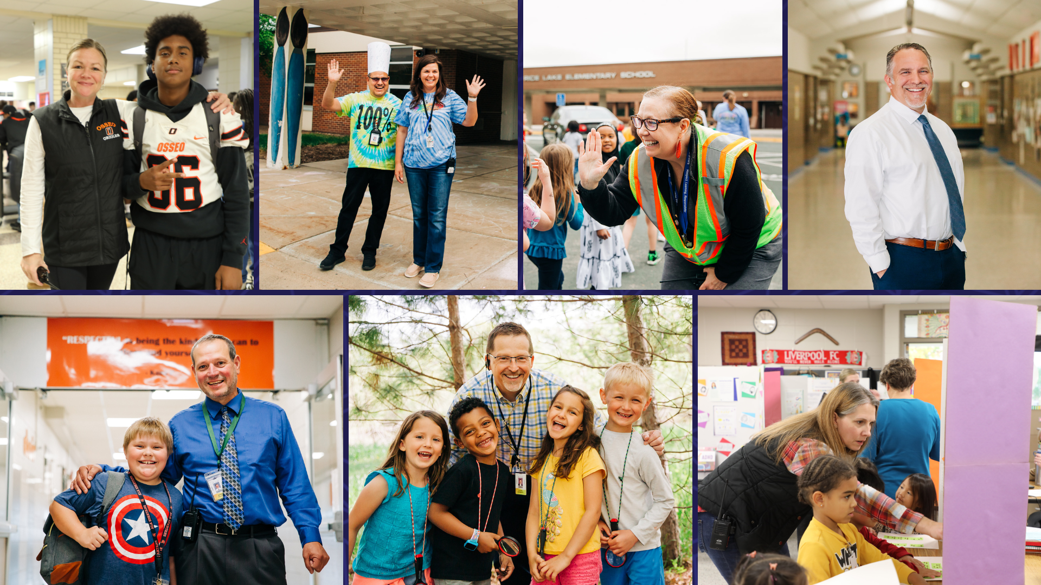
Notes:
In the area of MISSION DRIVEN EMPLOYEES
October was National Principal Month! The principals and assistant principals of Osseo Area Schools are second to none. They work hard and care deeply for the scholars, staff and school communities they serve everyday. Thank you principals for all that you do for our students!

Slide 24
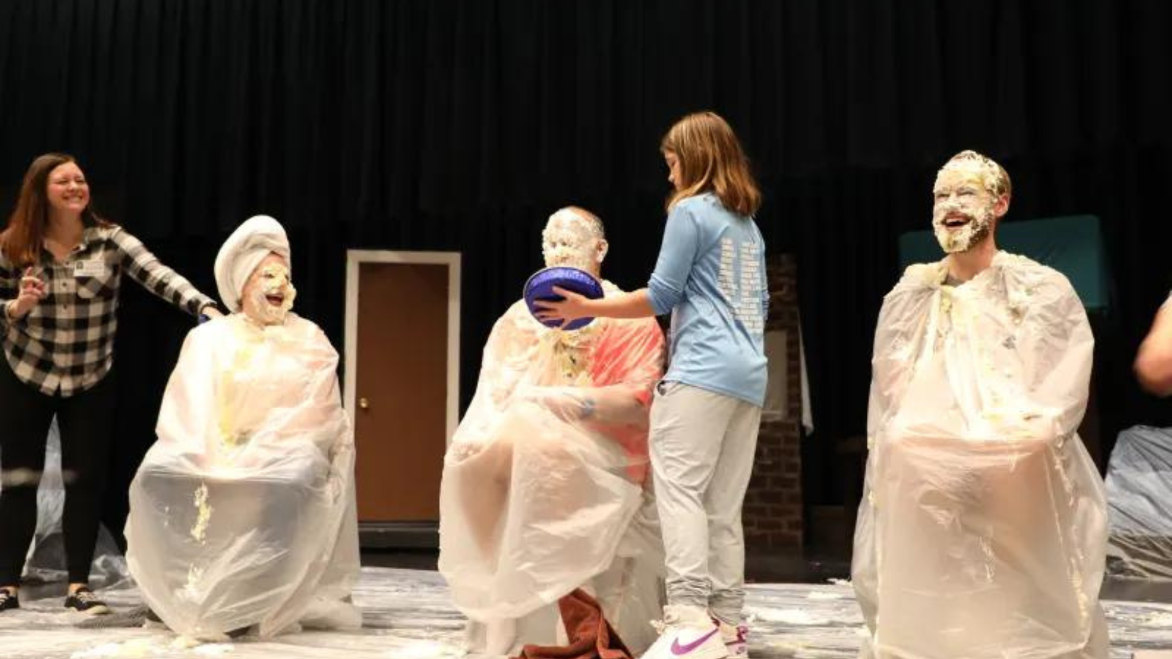
Notes:
When Maple Grove Middle School students hit their fundraising goal in their recent fall fundraiser, school administrators knew they had a sweet, messy task ahead. The administrators had several pies smashed into their faces as a reward for students.

Slide 25
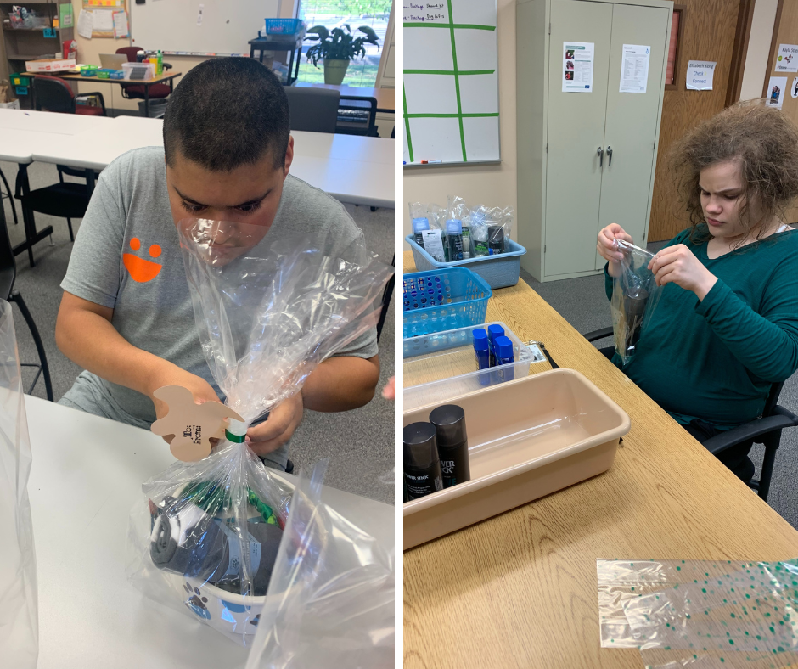
Notes and Reminders
Nov. 29: CBVAT Annual Winter Sale and Open House
Thank you for taking the time to learn about Building a Better Future, Phase II and your support of our schools and scholars.
Notes:
KIM
Thank you team and thank you to each and every district staff person who works each day in our district. You are appreciated!
Community-Based Vocational Assessment & Training, or CBVAT, students have been hard at work preparing for their annual winter sale and open house, which takes place Nov. 29 from 5- 7 p.m. at 7600 Boone Ave Suite 72, Brooklyn Park. Handcrafted items created by CBVAT students, including greeting cards, gift sets and gift bags, will be for sale and are the perfect holiday gift.
Last but not least, thank you for taking the time to learn about Building a Better Future, Phase II and your support of our schools and scholars. We’ll take a look back at the informational campaign a little further into our meeting tonight.
Thank you for allowing us to teach your child. That concludes tonight’s Superintendent's Report.

Slide 26
School board meeting
Nov. 21, 2023

