Slide 1
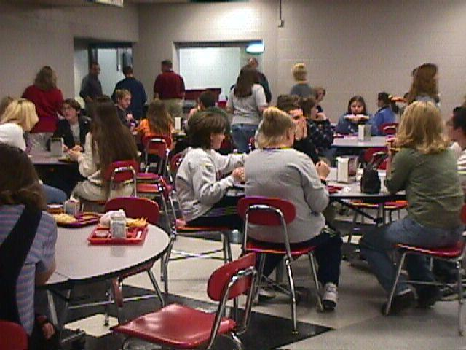
Nutrient Analysis
Averaged over the course of a week, lunch menus offered in our schools provide the following:
“Promoting healthy and safe behaviors among students is an important part of the fundamental mission of schools.”
School Health Index-Centers for Disease Control (CDC)
Gallatin County Schools
Nutrition & Physical Activity Report Card
2023
Nutrient | Target* | Actual
Calories | 785 | 782
Iron (Mg) | 4.2 Mg | 3.07 Mg
Calcium (Mg) | 370 Mg | 468.8 Mg
Vitamin A (RE) | 285 RE | 499 RE
Vitamin C (Mg) | 17 Mg | 37.11 Mg
Protein (G) | 15 G | 26.16 G
Total Fat (G) | 30% of Calories | 21.98%
Saturated Fat (G) | 10% of Calories | 8.12%
School Physical Activity Environment Assessment
Program/activity
Elem
Middle
High
Provide daily recess
100%
N/A
N/A
Provide at least 150 minutes of physical education per week
100%
N/A
N/A
Provide at least 225 minutes of physical education
N/A
100%
Fresh-men
*Grades 4-12
Provide classroom physical activity integrated into school day
100%
100%
100%
Provide intramural physical activity opportunities
All
100%
100%
Offer facilities to families/
community for physical
activity opportunities
All
All
All
The data presented above is a summary from the assessment of our physical activity environment.
The food and nutrition department does not deep fry any items. All fries and potato items are baked. We offer whole wheat, lower sodium and low fat items. All of our pizzas contain whole wheat crust. The Gallatin County Nutrition Department’s goal is to offer all students healthy and nutritious food to help enable them to better concentrate and excel in their educational goals.
Physical Activity & Achievement
Schools play a crucial role in influencing physical activity behaviors. Sound curriculum, policies, and facilities create an environment encouraging students and staff to engage in a variety of physical activity opportunities. Evidence supports a correlation between SAT scores and the physical well-being of students.
The Gallatin County Schools are dedicated to serving nutritious meals and providing multiple physical activity opportunities as a means of helping our students reach proficiency.
Intense physical activity programs have positive effects on academic achievement , including increased concentration; improved mathematics, reading, and writing test scores; and reduced disruptive behavior.
-- Curricular Physical Activity and Academic Performance, Pediatric Exercise Science

Slide 2
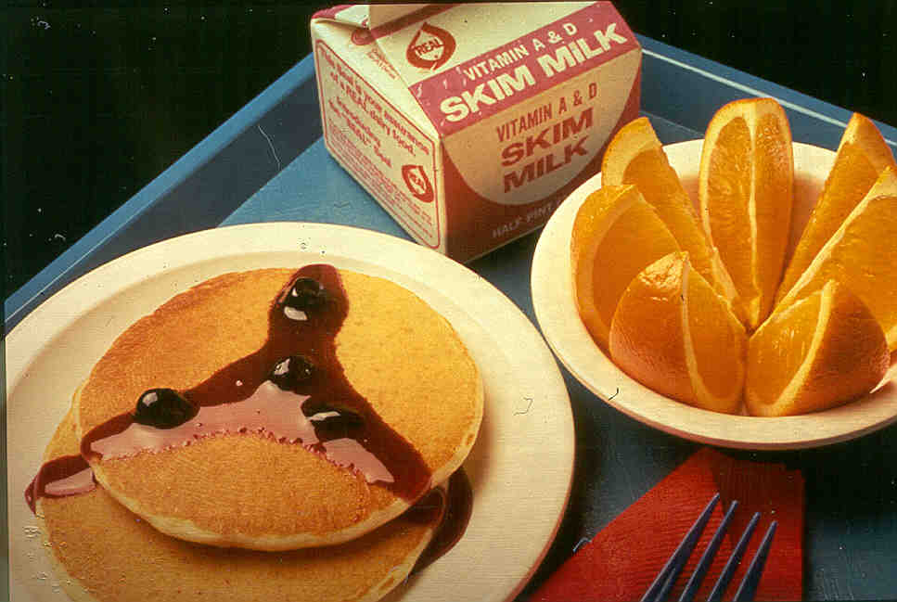
National School Lunch
The National School Lunch Program (NSLP) was conceived in 1946 as a “measure of national security to safeguard the health and well-being of the Nation’s children.” School districts receive federal reimbursement for each school lunch served that meets the United States Department of Agriculture nutrition guidelines. These guidelines promote meal quality while commodity donations help the farmer and help schools keep down meal prices.
Our lunch meals are planned on a two-week menu cycle. Federal regulations require that we offer minimum portion sizes of meat, fruit and/or vegetable, grains/breads and fluid milk during every lunch meal service. The portion sizes are designed to meet the needs of growing children and, as a rule, we increase the sizes as the children grow older. Whole grains are offered every day and we offer fresh fruits and vegetables every day. Students are allowed to serve themselves all the fresh fruits and vegetables they will eat. The menu cycle provides for variety and allows us to make the most efficient use of the donated commodities, especially seasonal fresh fruits .We offer, 1% and skim milk, as well as 100% fruit and vegetable juices.
An analysis of our lunch menus is found elsewhere in this report card. The table below provides a synopsis of the lunch program, including participation and financial data.
School Breakfast
The School Breakfast Program (SBP) was established in 1966. School districts receive federal reimbursement for each school breakfast served that meets the U.S. Department of Agriculture’s nutrition guidelines. Studies show that children who participate in the School Breakfast Program have significantly higher standardized achievement test scores than non-participants. Children with access to school breakfast also had significantly reduced absence and tardiness rates.
Due to the great importance of breakfast, Gallatin County Schools offer a second chance breakfast at the Upper Elementary, Middle and High Schools.
“Protecting children’s health and cognitive development may be the best way to build a strong America.”
-- Dr. J. Larry Brown, Tufts University School of Nutrition
Federal Reimbursement | $389,051
# Schools Participating | 4 Schools, 3 Cafeteria’s
Total Breakfasts Served | 145,675
Average Daily Participation | 857
Breakfast Prices | Adult Price $3.00 CEP – ALL STUDENTS EAT AT NO CHARGE
A list of all food and beverage items available to students during the day can be downloaded from our web site at www.ovec.org
Food and beverage items that are sold as extras on the cafeteria lines or through vending machines or school stores all meet the Smart Snacks standards required by the Kentucky Board of Education. These standards are designed to limit access to items with little or no nutrient density. No sales from machines or school stores take place until 30 minutes after the last lunch period ends. All other sales of food that does not meet federal regulations does not take place until ½ hour after school.
Federal Reimbursement | $837,864
# Schools Participating | 4 schools, 3 cafeteria’s
Total Lunches Served | 186,549
Average Daily Participation | 1,097
Cost of Food Used | $513,521.32
# Students Approved for Free Meals | ALL STUDENTS
# Students Approved for Reduced-price Meals | 0
# Students approved for Paid Meals | 0
Lunch Prices | Adult: $5.00 CEP – ALL STUDENTS EAT AT NO CHARGE
After-School Supper Program
The Supper Program was started in October of 2016. The After-School Supper Program allows students in after-school care programs with regularly scheduled activities to eat supper before departing for home. This program is offered through the Child and Adult Care Food Program.
A USDA study showed students who eat school meals are more likely to consume milk, meats, grain mixtures and vegetables compared to students who did not, including students who brought meals from home. Also, students who eat school meals have higher intakes of some vitamins and minerals, including calcium and Vitamin A -- nutrients that tend to be “problem nutrients” for kids.
Cost-wise, schools work very hard to make sure that school meals are a good value. Take a look at the number of items typically offered to students at lunch -- an entrée, two servings of fruits and vegetables, a bread or grain item and 8 ounces of milk. It takes a real balancing act to beat that value with a bag lunch.
--National Dairy Council
Federal Reimbursement | $48,681.02
Total Supper’s Served | 17,194
Average Daily Participation | 170

