Slide 1
School board meeting
Oct. 24, 2023

Slide 2
Superintendent’s Report
Presented by Supt. Dr. Kim Hiel
Notes:
Kim:
Good evening Chair Mosequa-Jones and school board members. We are here this evening once again with one goal. This goal is for Osseo Area Schools to create “One Community for All..where all voices are valued and heard.
This time is even more important now in our world as we are seeing conflict abroad, nationally and locally. I want to take my time during my report this evening to take some time to pause and reflect on the opportunity we have this evening- to be present and for us to remember to experience the positive moments in life, particularly positive moments with our scholars. It is important that these moments are never taken lightly.
Our job will be to continue to model for our babies, or our scholars on the importance of collaboration, having multiple perspectives and having the excitement of creating pathways for our children to reach their dreams, and to live in a world of peace.
In the words of Henry David Thoreau:
“Could a greater miracle take place than for us to look through each other’s eyes for an instant?”
Take some time today and over the next few days and seek out the positive, because it's there waiting for us and our scholars to see.

Slide 3
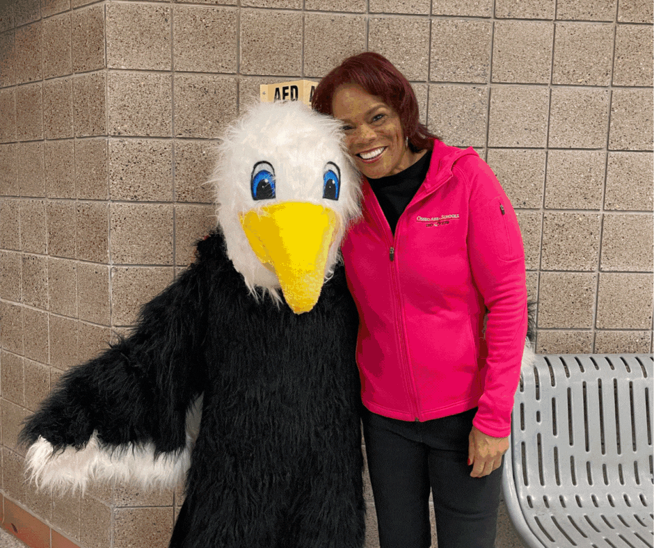

Slide 4
Points of Pride
Notes:
KIM
A regular part of the superintendent’s report is to share Points of Pride in our district.
By sharing our Points of Pride, we are taking time to recognize and celebrate, the scholars, staff and community members who are contributing to the accomplishment of our mission which is:
to inspire and prepare each and every scholar with the confidence, courage and competence to achieve their dreams; contribute to community; and engage in a lifetime of learning.
I have members of our District Cabinet here to assist in sharing some examples from the last few weeks.

Slide 5
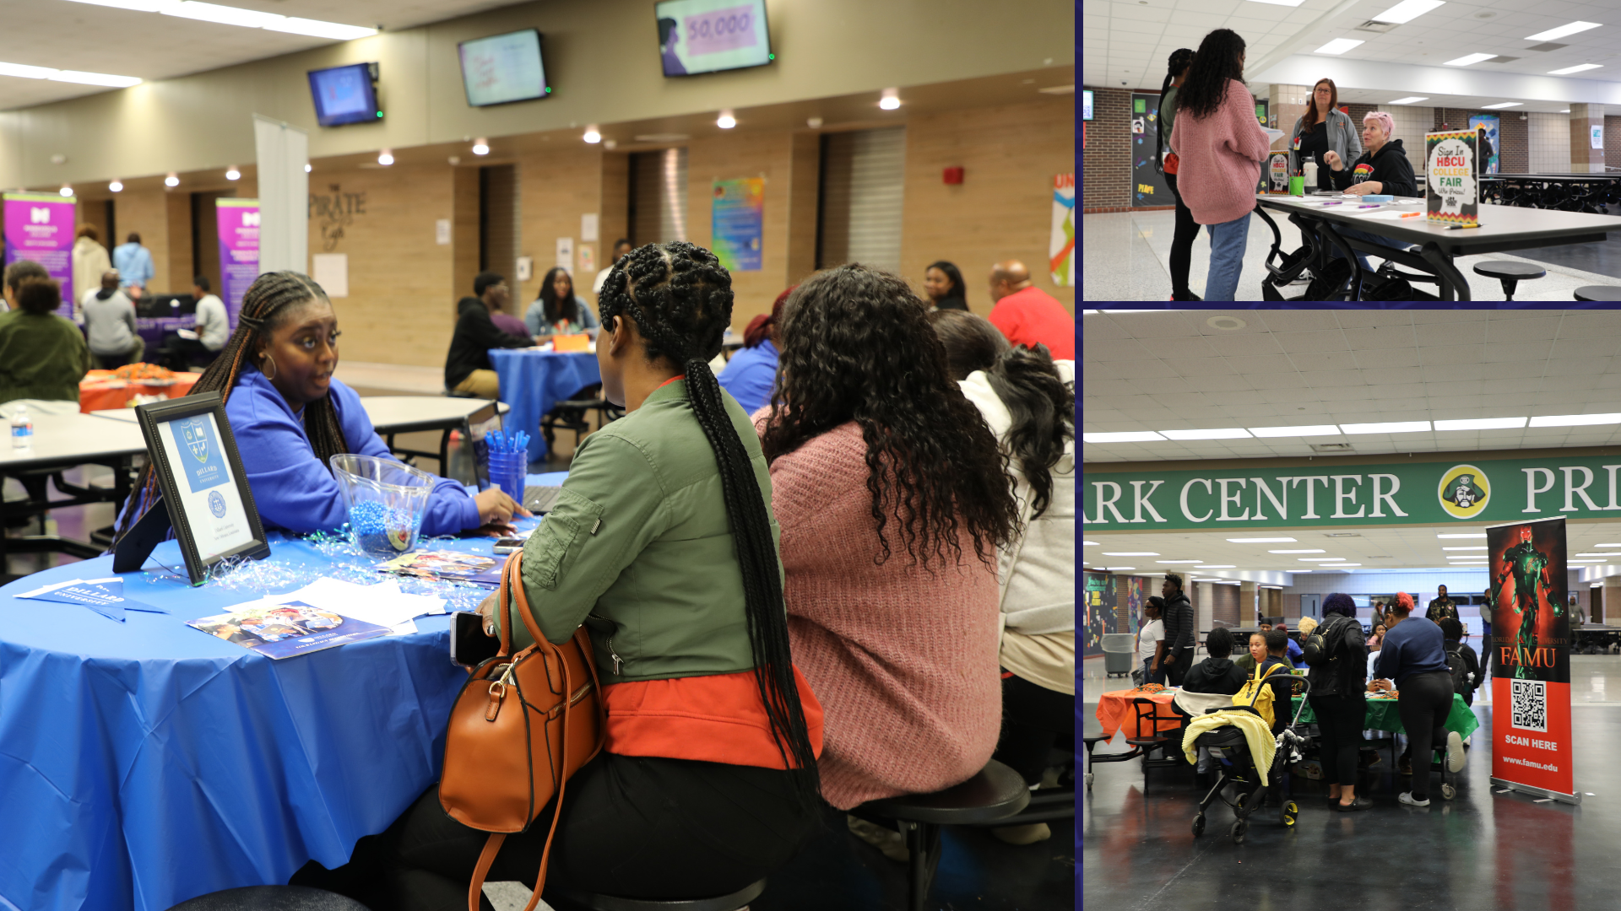
Notes:
In the area of ACHIEVING DREAMS
A beautiful fall evening didn't slow down attendance at Park Center Senior High School's first Historically Black Colleges & Universities, or HBCU, college fair of the school year on Oct. 17. Around 20 historically black colleges/universities were in attendance, along with several local colleges and other organizations.

Slide 6
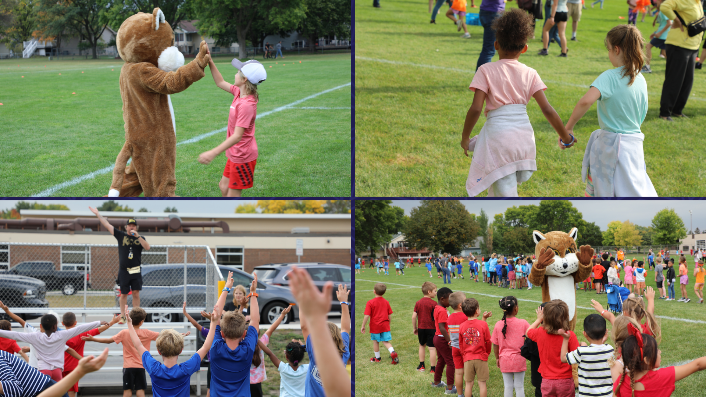
Notes:
Students at Cedar Island Elementary School recently participated in a fun run, raising funds for various Parent Teacher Organization (PTO) programs at the school. The fundraiser was kicked off with an all-school assembly the week prior.

Slide 7
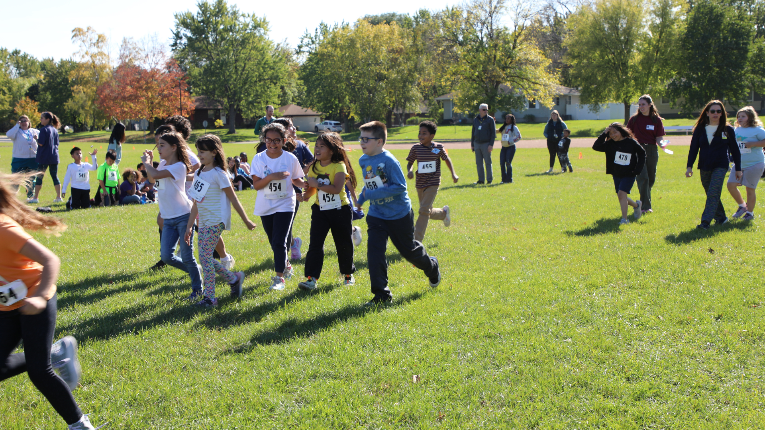
Notes:
Park Brook Elementary School students also got out and ran in their recent mile run.
The run serves as a tradition meant to further the school’s Focus on Fitness ideology.
Students in grades 1-5 complete a specified distance of one mile through the school’s adjoining parkland (pre-k and kindergarteners complete a short fun run.)
The scholars are pumped up before their run by Principal Scott Taylor, who keeps up his tradition of playing the song Chariots of Fire by Vangelis on the piano outside the school.

Slide 8
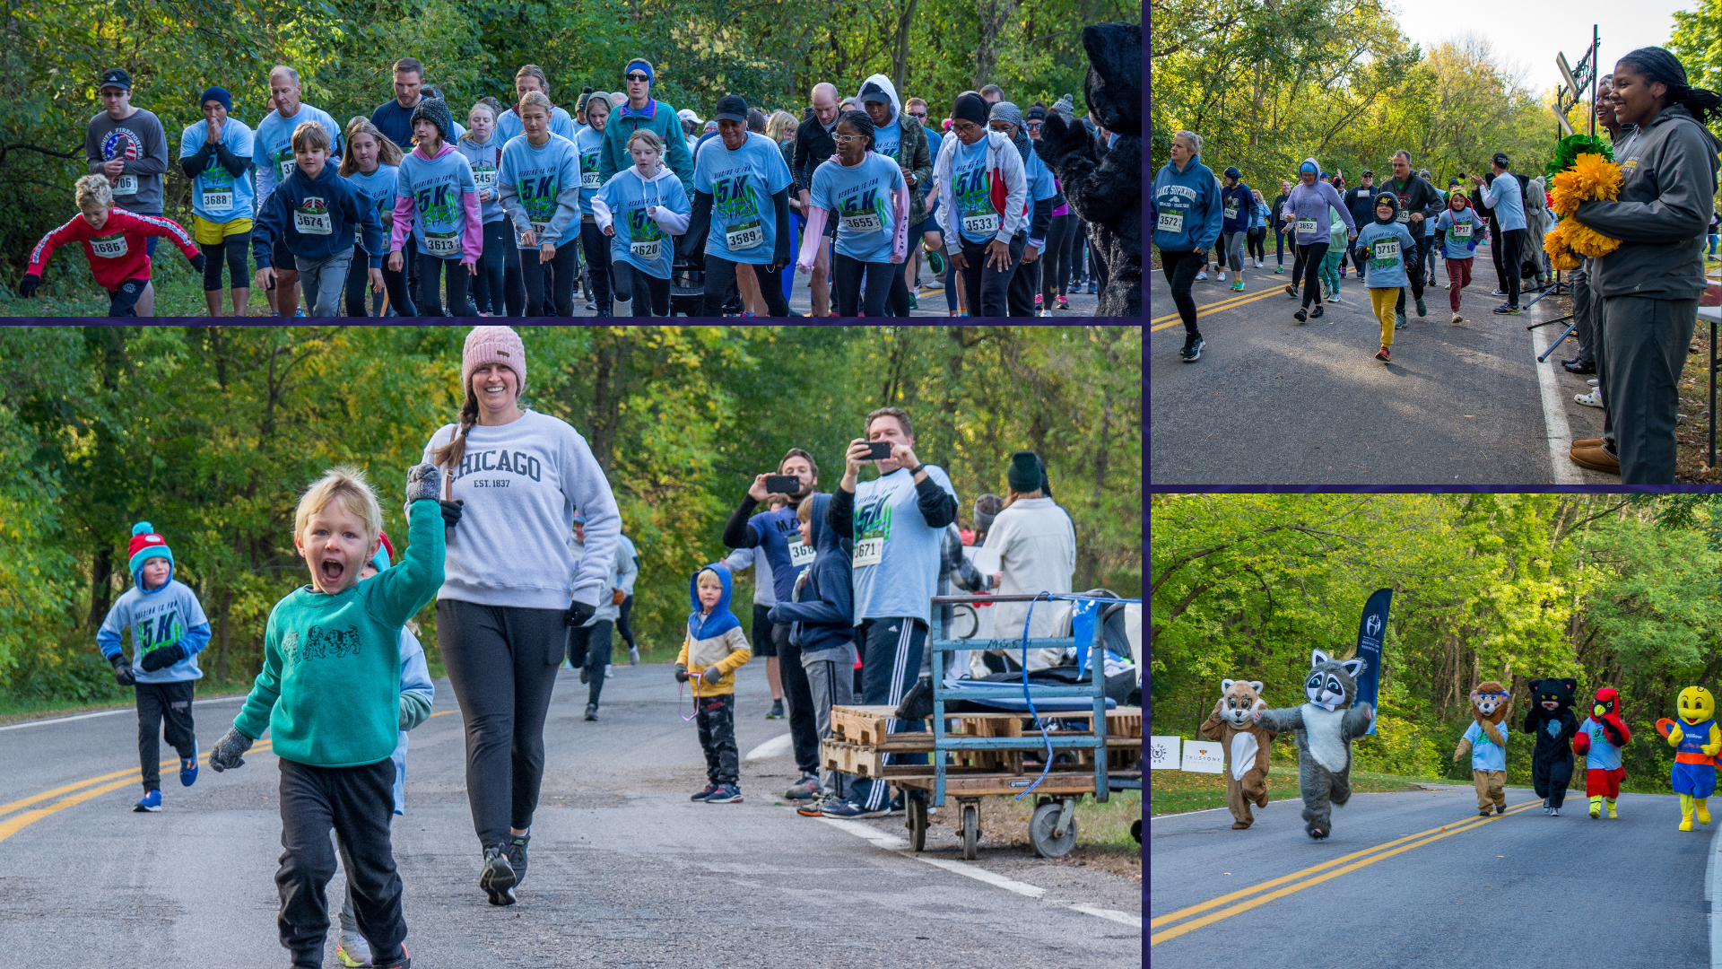
Notes:
In the area of CONTRIBUTING TO COMMUNITY:
Also getting out and running were the over 350 participants that took part in the District 279 Foundation’s Reading is Fun 5K at Elm Creek Park Reserve on Oct. 7. The event featured a 1K run/walk and mascot race in addition to the 5K run/walk and a community gathering.
Proceeds from the event go to the district’s library media centers for learning resources.

Slide 9
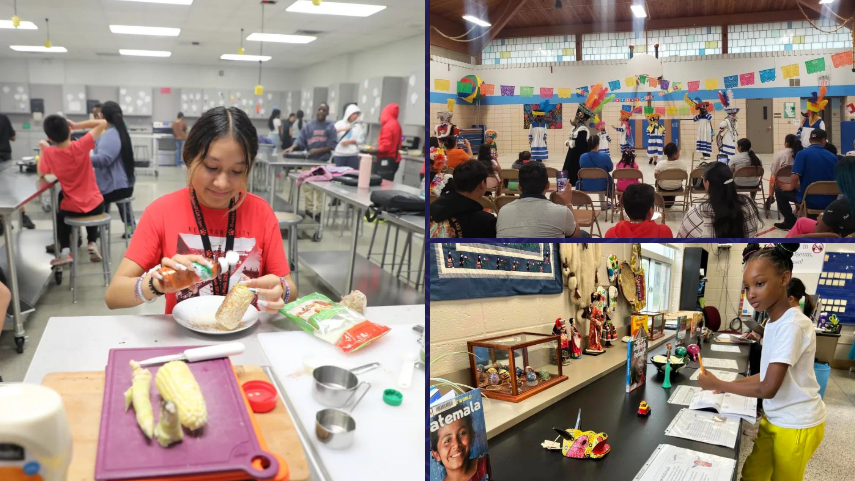
Notes:
In the area of LIFELONG LEARNING
Hispanic Heritage Month runs from Sept. 15-Oct. 15 each year, and schools around the district celebrated and commemorated the month in a myriad of ways.
At Brooklyn Middle STEAM School, scholars could be found making a variety of Hispanic foods throughout the month, such as Mexican street corn, or elote, and tostones, or fried plantains, in their family and consumer science (FACS) class. FACS teacher Beth Romano said her classes are also spending time learning about chefs of Hispanic heritage.
Fair Oaks Elementary School hosted a Hispanic Heritage month event Sept. 27 in partnership with the district’s Equity department. The event included food trucks, Hispanic vendors, activities, and three cultural dance groups, including Aztecas, Chinelos and baile Folklorico.
At Palmer Lake Elementary School, the school hosted a Hispanic Heritage museum that classrooms visited throughout the last week of September. The museum had a plethora of items and books that represent different Hispanic cultures, and scholars completed a short assignment on the exhibits as each class took a turn visiting the museum.

Slide 10
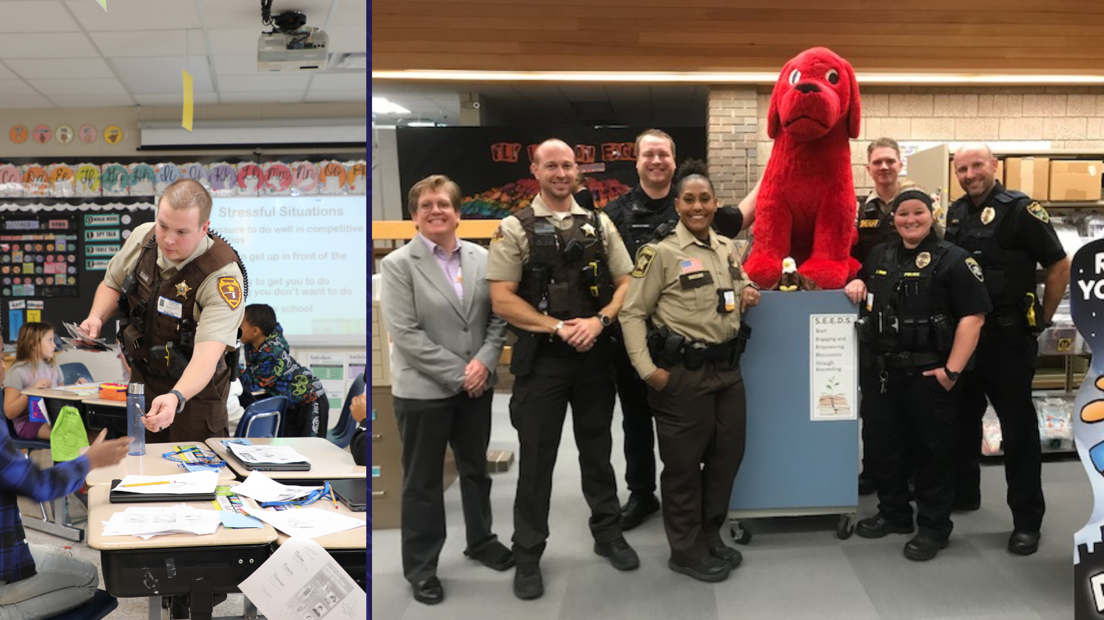
Notes:
About 20 police officers from throughout Minnesota and Wisconsin spent the morning at district elementary schools on Oct. 12, including at Birch Grove School for the Arts and Elm Creek Elementary School, where they completed their final training to become Drug Abuse Resistance Education, or D.A.R.E., educators.

Slide 11
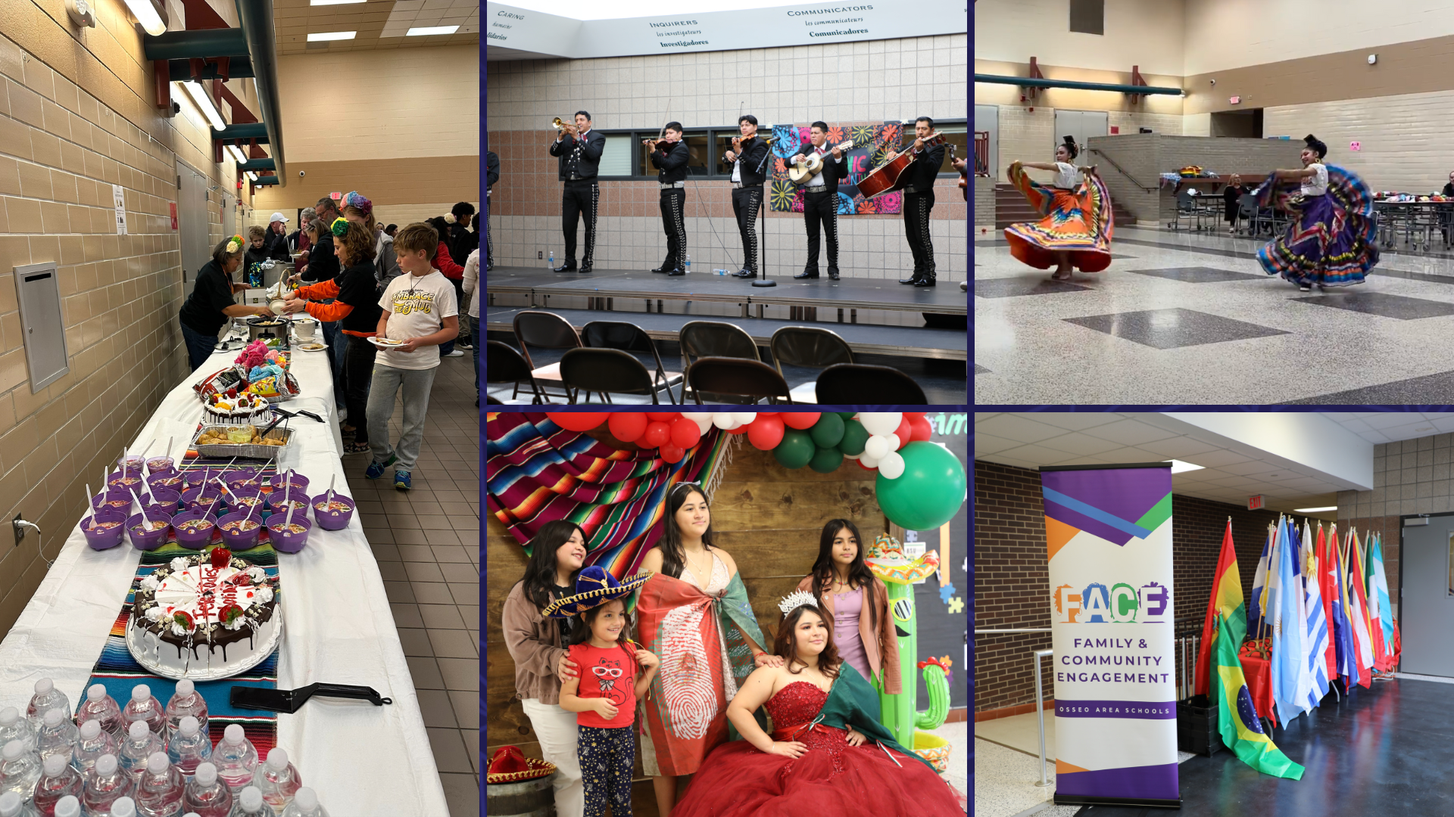
Notes:
At OSH, scholars and families enjoyed music with dancers in traditional outfits and delicious food celebrating Hispanic culture. It was a great opportunity for attendees to connect and see district scholars connect with others who share the same desire to celebrate Hispanic Heritage Month.
At PCSH, Family & Community Engagement (FACE) hosted an event where community members could gather to enjoy food, music and entertainment. At the event, a band played music while attendees danced along. Students in attendance walked across the stage to present flags from all of the Hispanic countries. Everyone there also shared a delicious meal together.

Slide 12
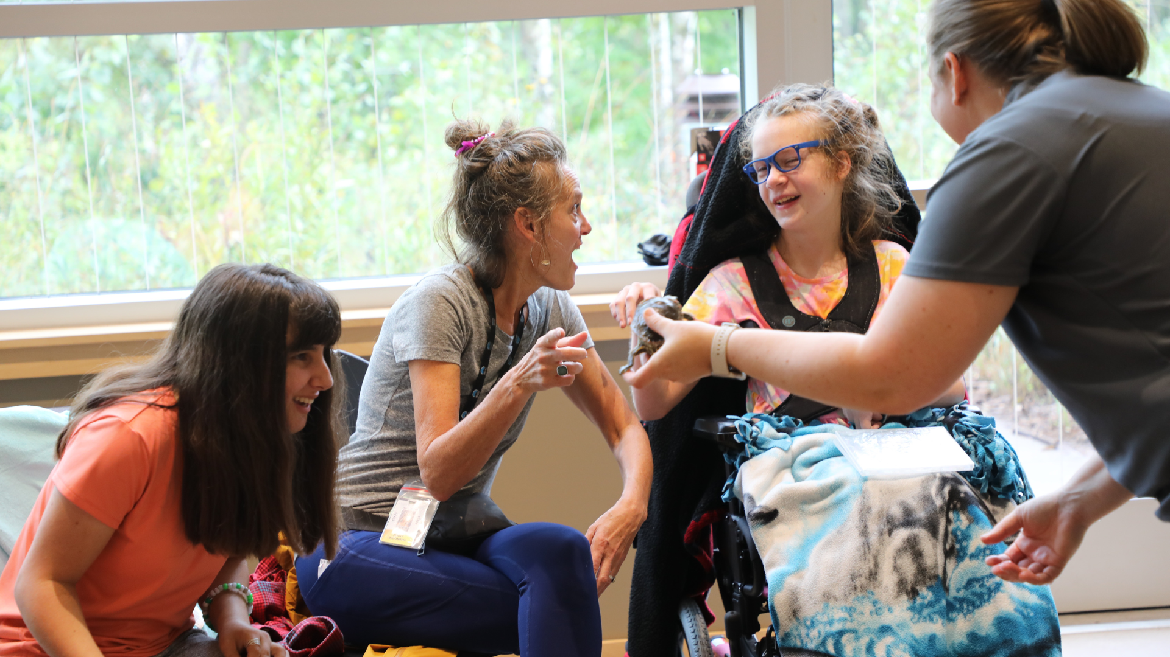
Notes:
Osseo Education Center students recently participated in a field trip to the Springbrook Nature Center. Students and teachers were able to get up close and personal with a variety of animals and learn more about how they live and eat.

Slide 13
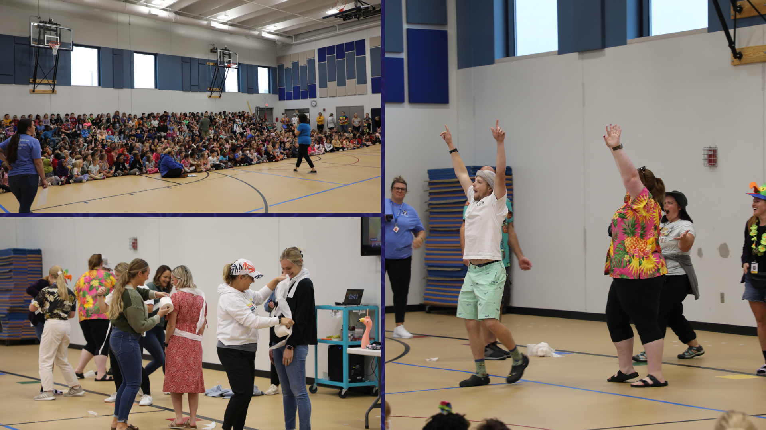
Notes:
Rice Lake Elementary School recently hosted their first all-school morning meeting. Students participate in morning meetings each day with their teachers to go over what is planned for the school day. At the end of September, students gathered in the newer gym space to meet as a school community.
The students went over recess behaviors, watching a video about how to act at recess. A few teachers then competed in a mummy challenge, where they paired up to see who could wrap one of the teachers in toilet paper the quickest. The teachers also competed in a cookie bar challenge, trying to move the bar from their forehead to their mouth without using their hands. The teachers were cheered on loudly by their students.

Slide 14
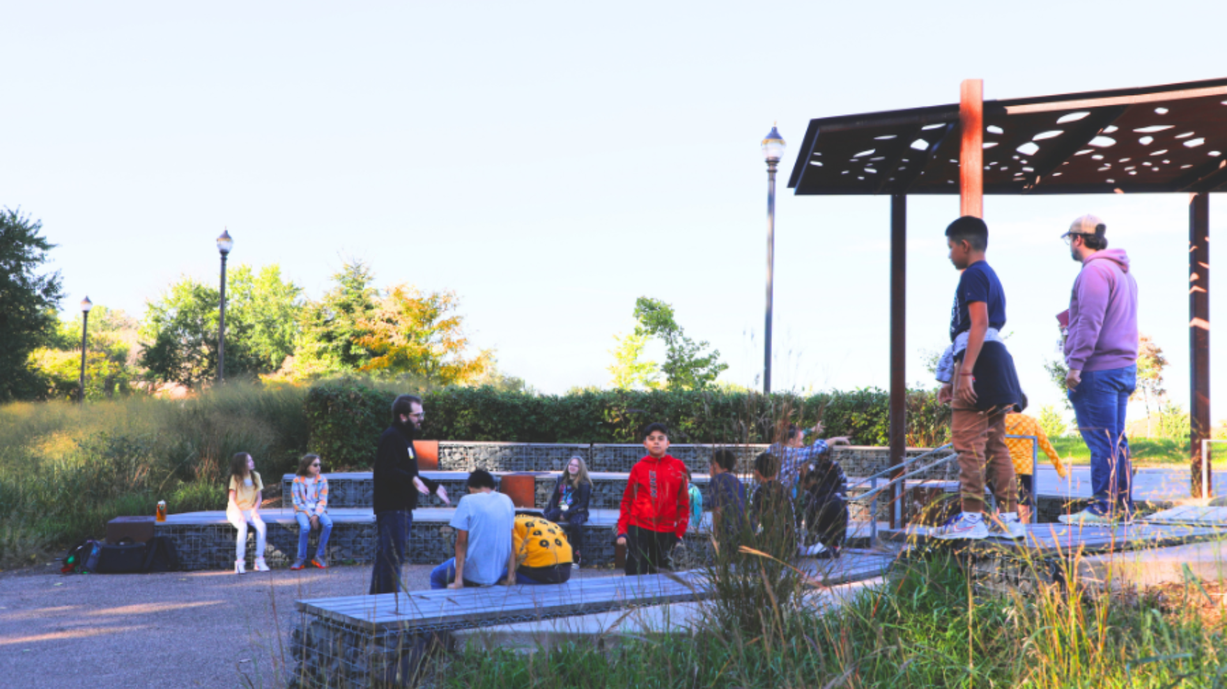
Notes:
Tucked at the edge of the Brooklyn Middle STEAM School’s open green space is an outdoor amphitheater that plays host to the school’s scholars throughout the year as staff work outdoor learning into their curriculum.
On Oct. 5 and 6, sixth-grade scholars could be found coming in and out of the amphitheater all day as they took turns spending time with Camp Fire Minnesota, a local youth development organization that provides outdoor experiences and educational programs for students.
The proposed Building a Better Future, Phase II plan, if approved, would add an outdoor classroom space to every district elementary and middle school that currently lacks one.

Slide 15
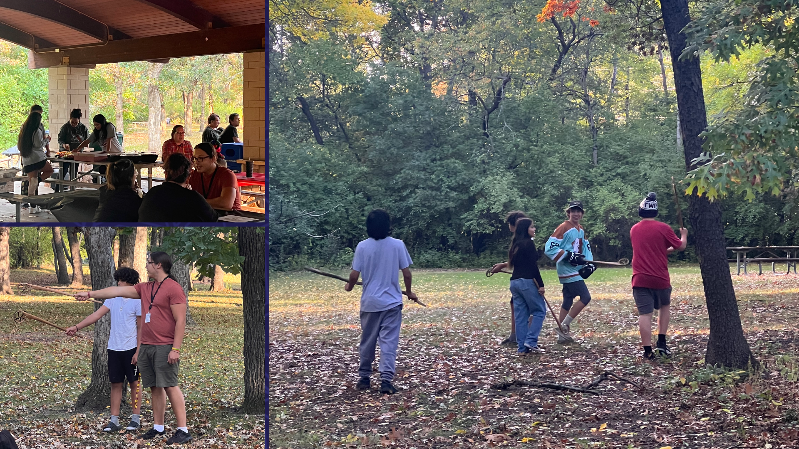
Notes:
The American Indian Education department hosted a school year kick off at a local park. Attendees participated in lacrosse lessons, a raffle, lawn games, a coloring contest and enjoyed dinner together.

Slide 16
Notes:
Zanewood Community STEAM School hosted an Engineering Night on Sept. 28, with plenty of opportunities for the school’s scholars and their families to explore, create and enjoy themselves with hands-on games and activities.

Slide 17
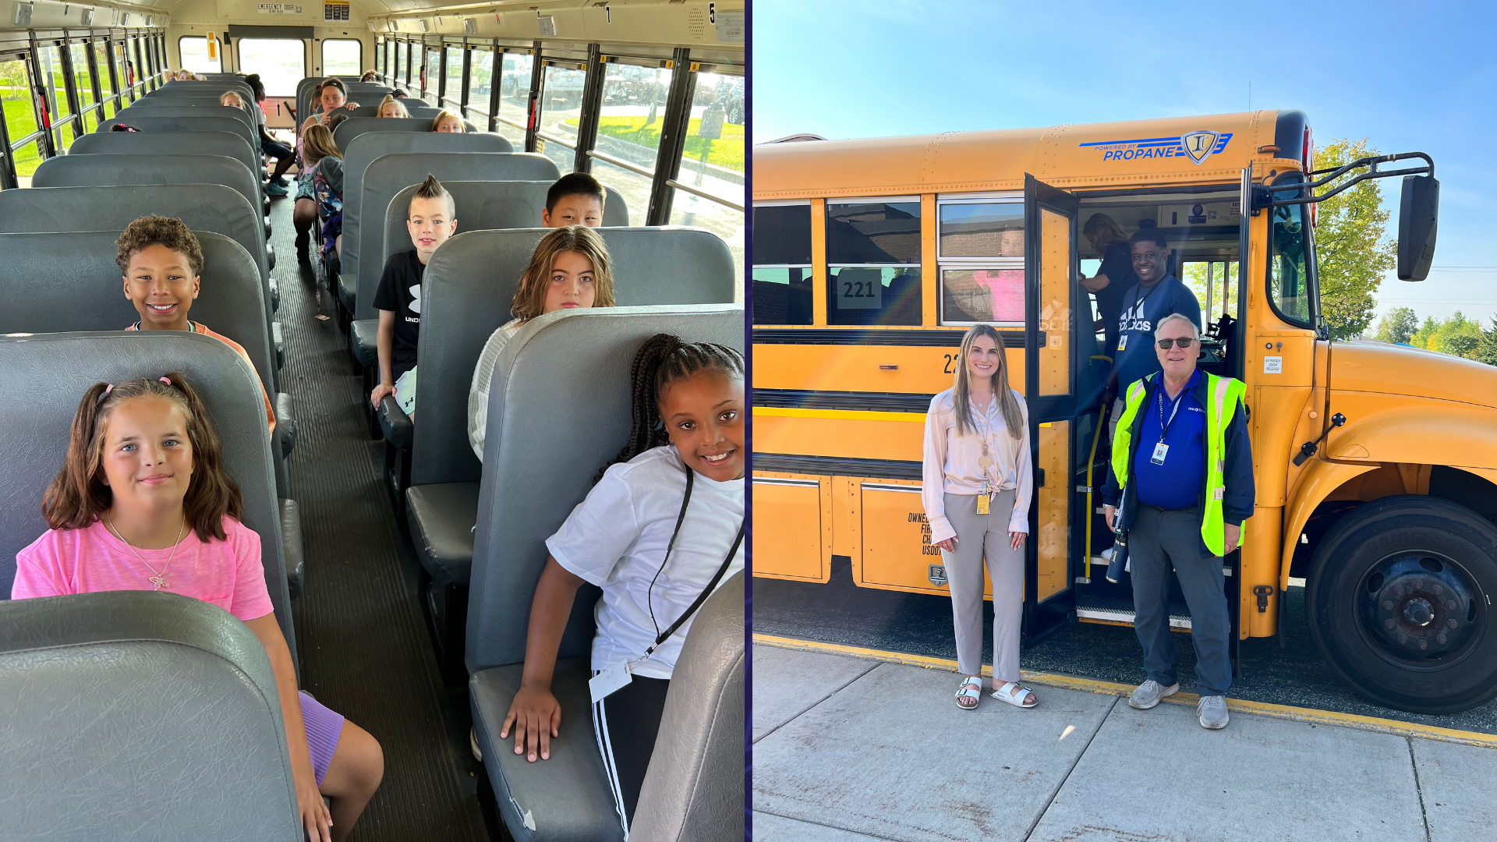
Notes:
Scholars across the district spent time learning about school bus safety last week during School Bus Safety week Sept. 18-22. They watched a video on bus safety, toured a school bus and learned about evacuation procedures to ensure all scholars are prepared to ride district buses safely.

Slide 18
Notes:
Indigenous Peoples' Day is celebrated each year on the second Monday of October and recognizes the contributions, resilience and diversity of Indigenous Peoples in the United States. Across the district, scholars learned about and honored Indigenous Peoples and their history and culture.
Learn about how Indigenous Peoples' Day was recognized in some of our district schools on our district website.

Slide 19
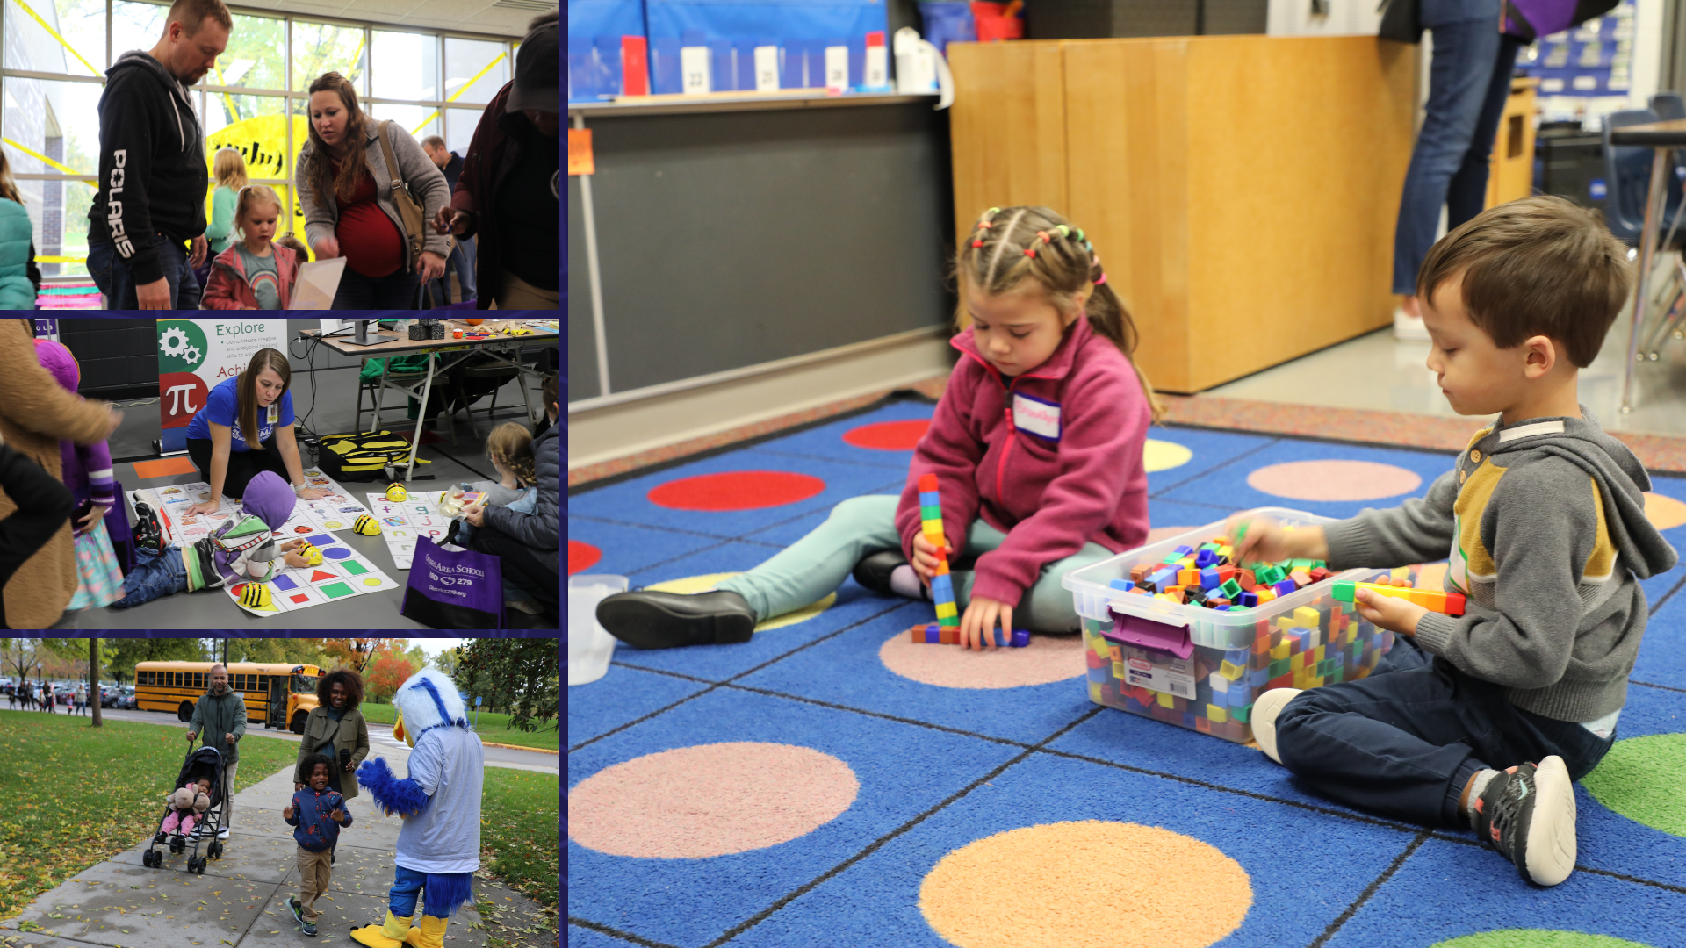
Notes:
Over 700 people attended the 2023 Kindergarten Information Fair on Oct. 14 at Fernbrook Elementary School, which was held for 2024-25 kindergarten scholars and their families.
At the event, future kindergarteners met a bus driver and took a short bus ride, attended a presentation to learn about kindergarten, met district principals and kindergarten teachers, toured classrooms, and gathered information from the different schools and departments in the gym. They also got a snack in the cafeteria to experience going through the lunch line, received a temporary tattoo, took pictures at a photo booth and played on the school’s playground.

Slide 20
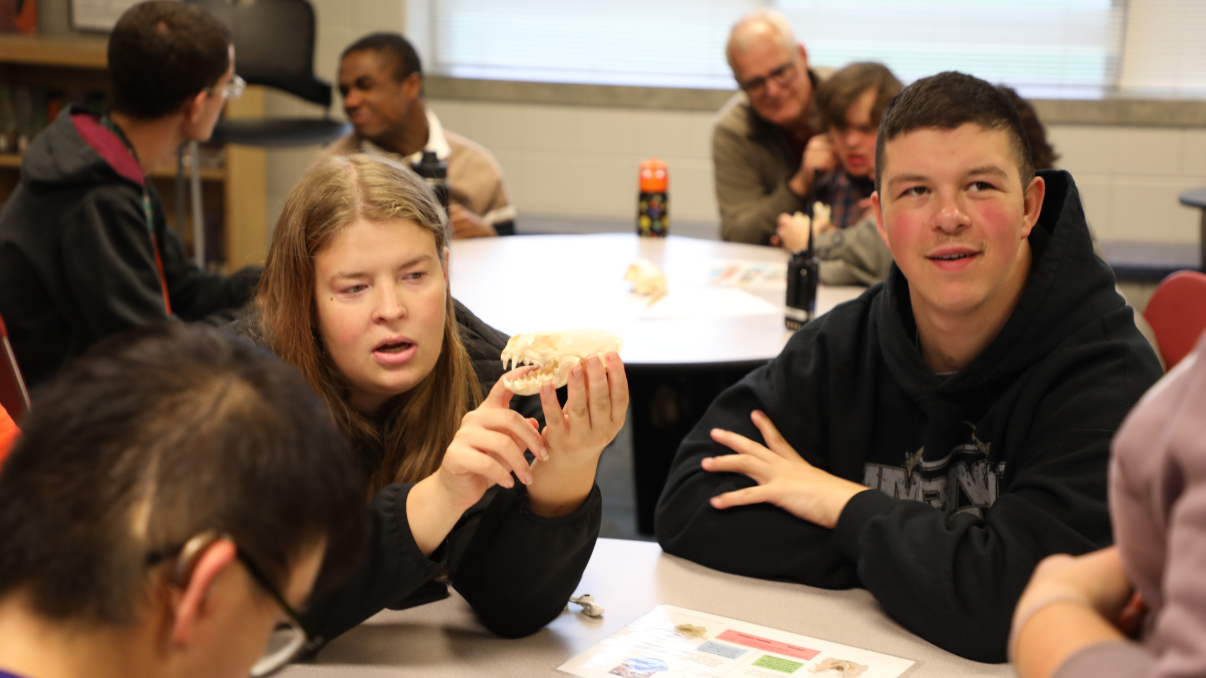
Notes:
Students at the Osseo Education Center (OEC) recently participated in an all-school event in partnership with the outdoor programs Friends of the Boundary Waters and Wilderness Inquiry. Students were exposed to various activities and skills development, including tent building, identifying animal skulls, orienteering and portaging a canoe.

Slide 21
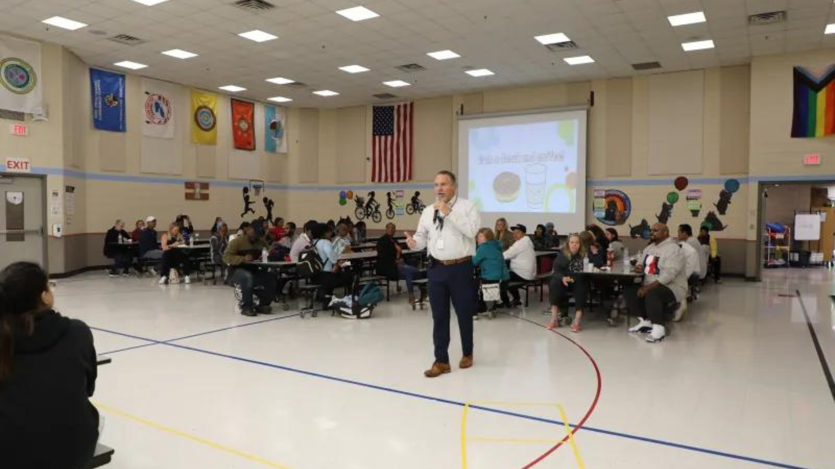
Notes:
Edinbrook Elementary School staff got scholars and families excited about AVID (Advancement via Individual Determination) on Sept. 27 with the first AVID event of the school year.
Classroom teachers invited parents/caregivers into classrooms for the first part of the event, where they could learn more about how AVID works in their scholar’s classroom, how the classroom begins its day, and other classroom-specific details about their daily routine.

Slide 22
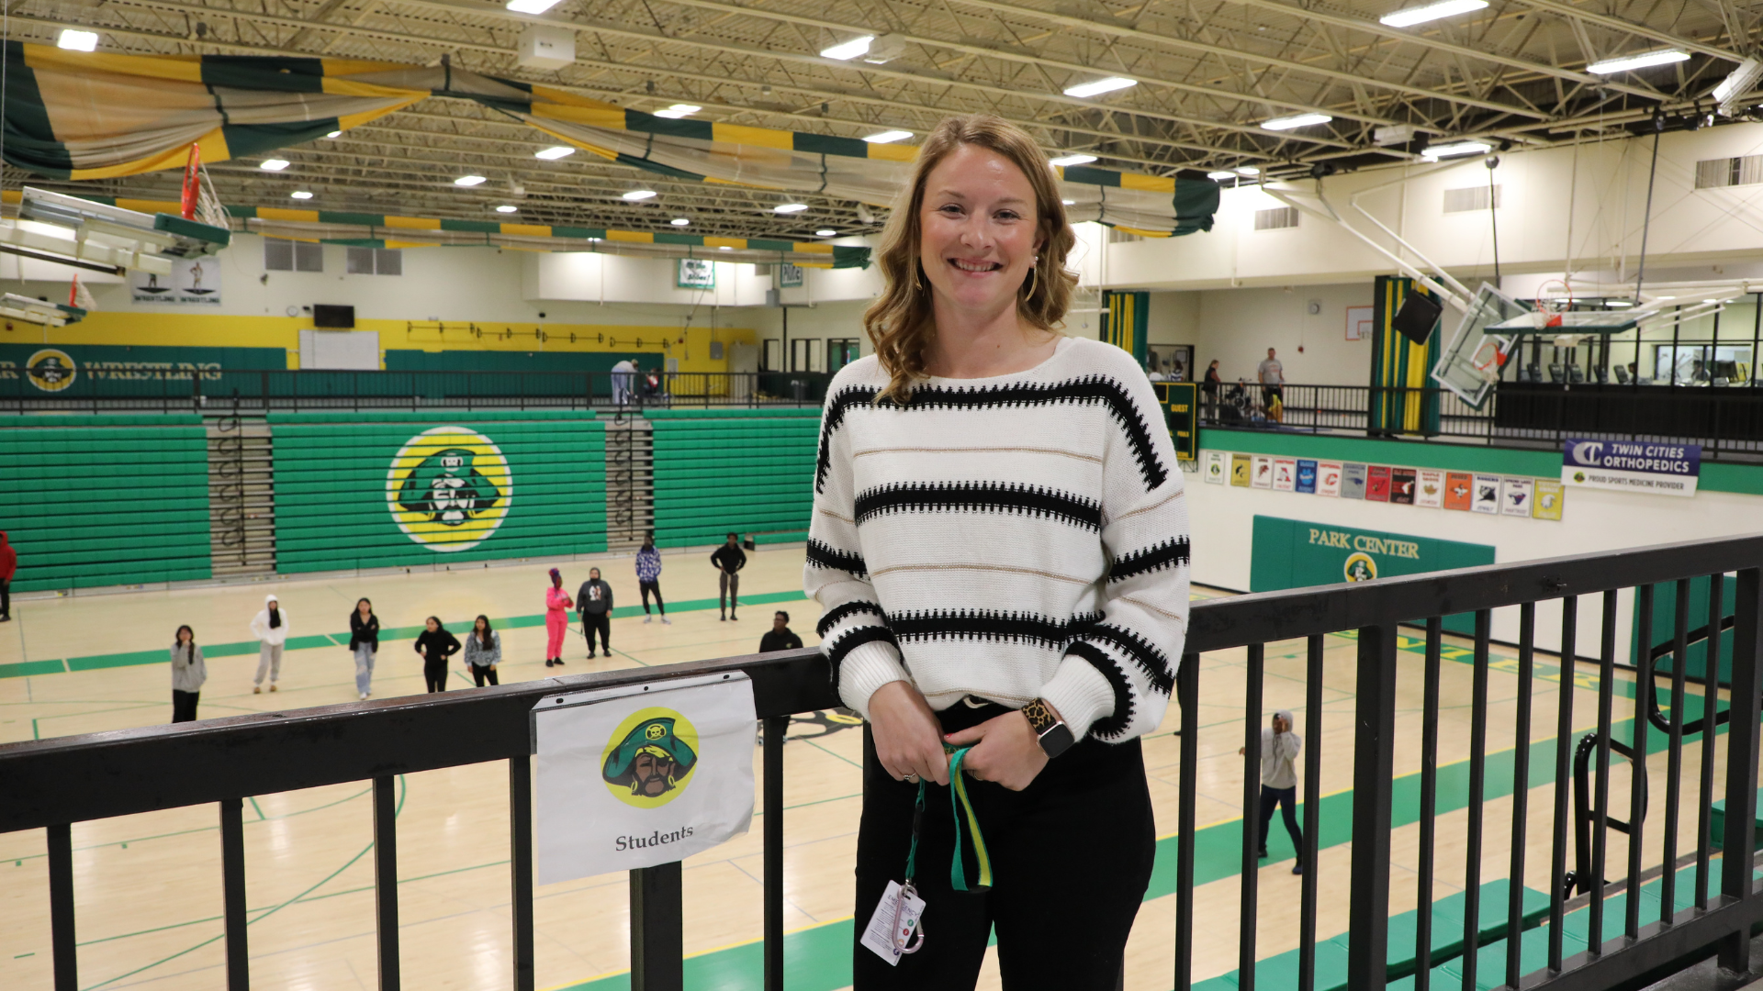
Notes:
In the area of MISSION DRIVEN EMPLOYEES
Park Center Senior High School has a new activities coordinator, Keelie Sorensen, who is no stranger to the school and community.
Sorensen spent her K-12 years in Osseo Area Schools, attending Palmer Lake Elementary School, Brooklyn Middle STEAM School and then Park Center, where she graduated in 2010. Learn more about our latest grad spotlight on our district website!

Slide 23
Notes:
Osseo Area Schools recognizes National School Lunch Week the week of Oct. 9-13. In schools across the district, our nutrition services team works diligently every day to provide meals.
To celebrate, we highlighted a few of the dedicated nutrition services workers who work each day to keep students fed and ready to learn on our district social media and website.

Slide 24
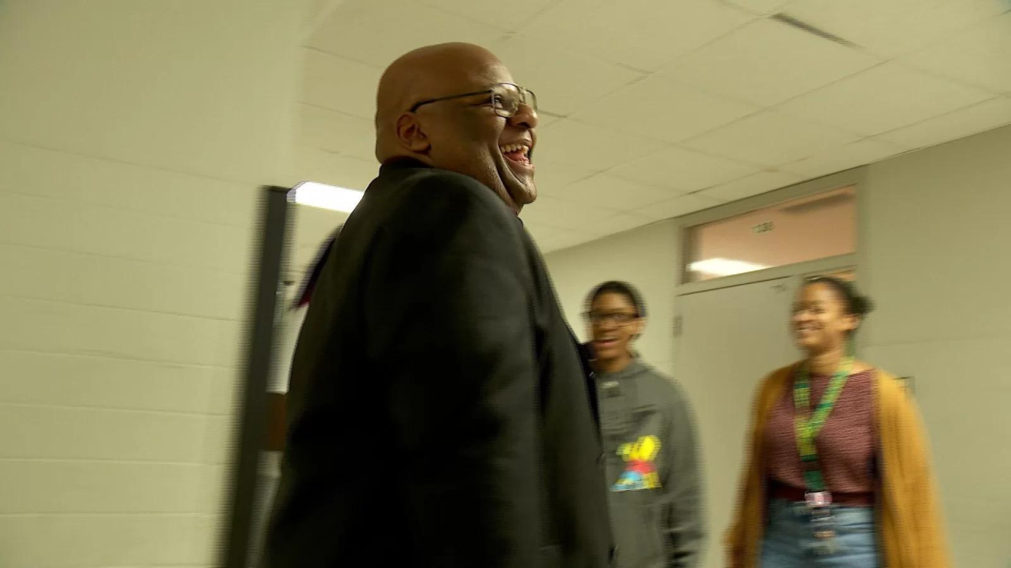
Notes:
Park Center Senior High School's new head principal, Dr. Antwan Harris, sat down for a chat with CCX Media to talk about collaboration and student success at the school.
Harris said “Every day is different. The first thing I begin with is being visible, being out in the hallways, speaking to kids, hanging out with kids, saying hello to my staff, moving around, and making sure my admin staff is visible.”

Slide 25
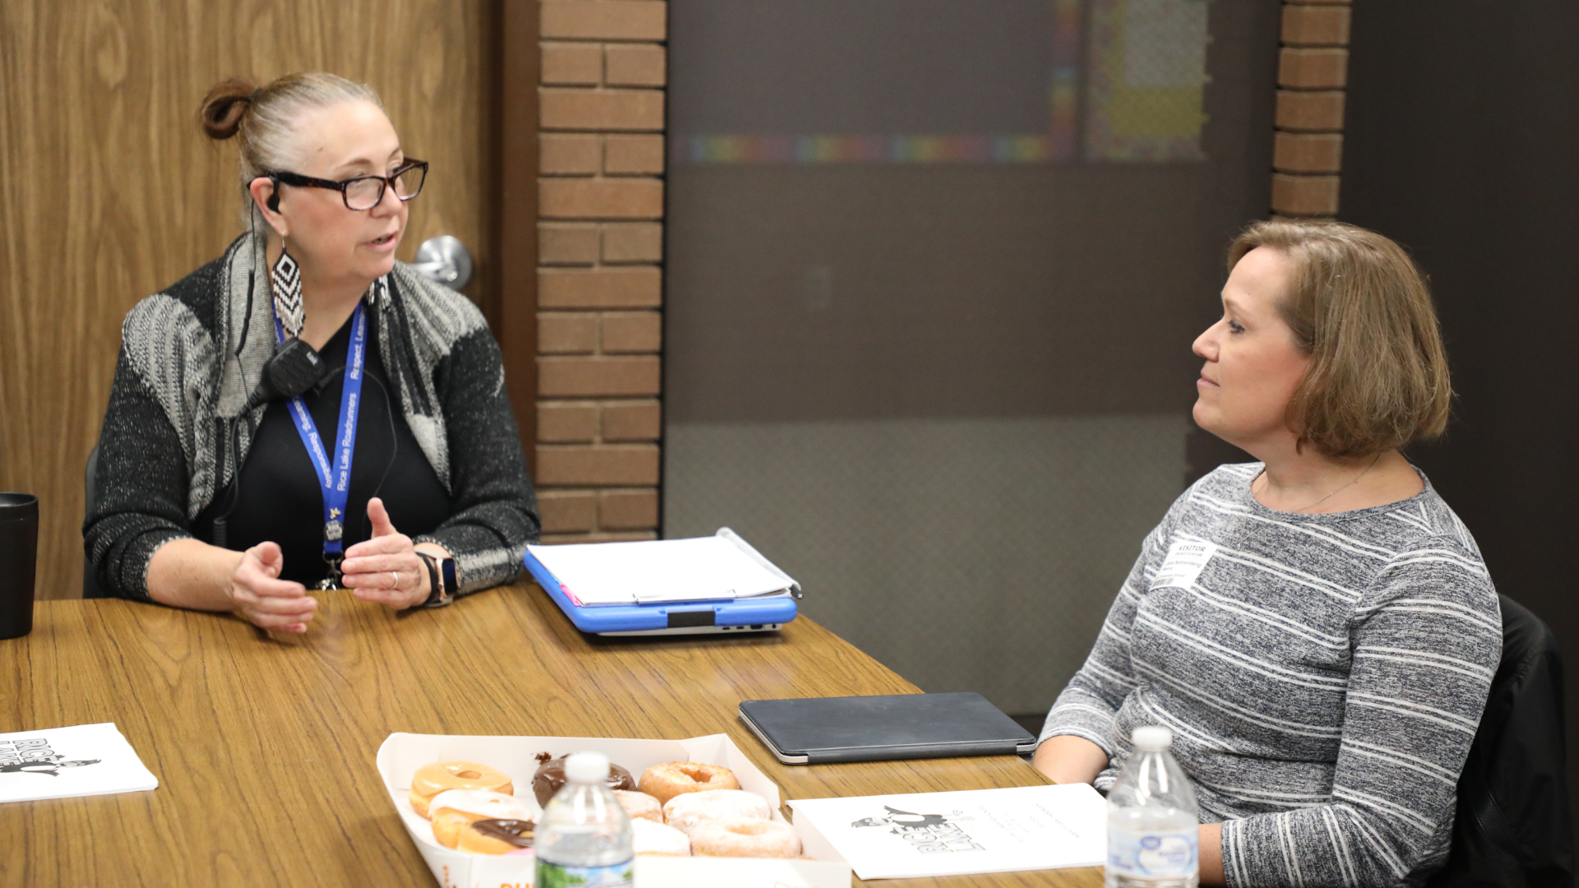
Notes:
JOHN
Rice Lake Elementary School principal Diane Bagley recently hosted Donuts with Diane, where parents of Rice Lake students were invited to come and sit down with her to discuss a variety of topics.
The group discussed what has been going on in the school, different policies including Positive Behavior Interventions and Support, or PBIS, learning, and how to get involved and volunteer at the school. Principal Bagley says she plans to have these meetings frequently over the next few months to invite parents to learn and give feedback.

Slide 26
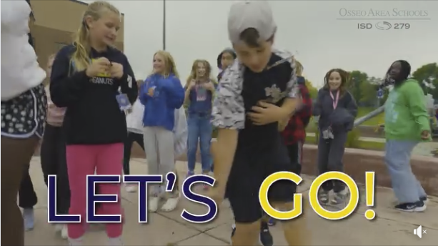
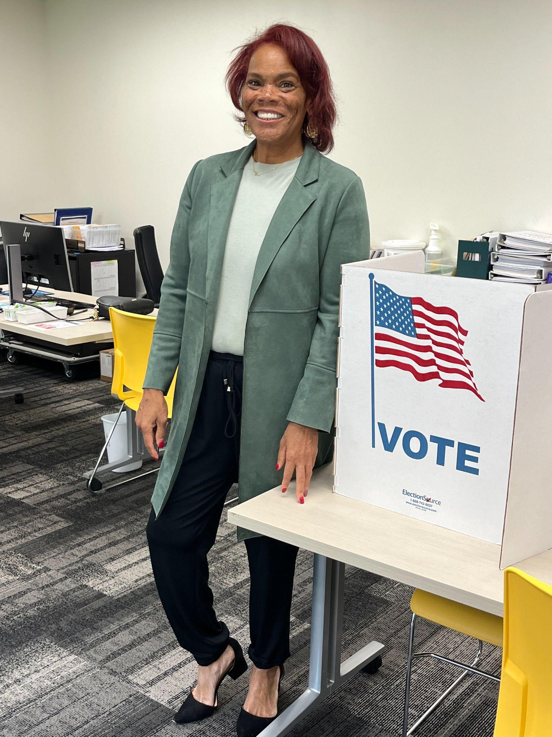
Notes and Reminders
Building a Better Future, Phase II voting has started! Visit district279.org/BetterFuture for details.
Notes:
Thank you team and thank you to each and every district staff person who works each day in our district. You are appreciated!
In two weeks, our Osseo Area Schools community will determine whether critical school building needs will be addressed. Please make a plan to vote, and encourage your family, friends and neighbors to do the same. Here’s a screen capture from our latest Get Out and Vote video. This can be found on our YouTube and social media channels. Please consider re-sharing! Early voting is running now until Nov. 6th. Here I’m also sharing a photo of myself voting early. Election day voting is on Tuesday, Nov. 7. Full voting details and ballot question info can be found at district279.org/BetterFuture.
Thank you. Thank you for allowing us to teach your child. That concludes tonight’s Superintendent's Report.

Slide 27
School board meeting
Oct. 24, 2023

