Slide 1
School board meeting
Sept. 26, 2023

Slide 2
Superintendent’s Report
Presented by Supt. Dr. Kim Hiel
Notes:
Kim:
Good evening Chair Mosequa-Jones and school board members. We are here this evening once again with one goal. This goal is for Osseo Area Schools to create “One Community for All..where all voices are valued and heard.
This could be seen this past few weeks where I was able to meet with several community organizations. I had the privilege of connecting with the:
City of Maple Grove Administration Team
Brooklyn Park Rotary
with Minnesota House of Representatives Kristin Robbins
Connection with Representative Kristin Bahner (bay-ner)
Brooklyn Park Business Council
and in the coming weeks:
Senator Bonnie Westlin and
the Maple Grove Rotary
The purpose of each meeting was to continue the connection between us and to understand how each of our work supports each other.
In recognizing this community work, it aligns to our strategic direction C “ To align community resources with district and sites.
Our district is appreciative of the collaborative and intentional work that is being done to ensure that our community receives the great support they need.

Slide 3
Points of Pride
Notes:
KIM
A regular part of the superintendent’s report is to share Points of Pride in our district.
By sharing our Points of Pride, we are taking time to recognize and celebrate, the scholars, staff and community members who are contributing to the accomplishment of our mission which is:
to inspire and prepare each and every scholar with the confidence, courage and competence to achieve their dreams; contribute to community; and engage in a lifetime of learning.
I have members of our District Cabinet here to assist in sharing some examples from the last few weeks. Anthony Padrnos, executive director of technology, will kick us off.

Slide 4
Notes:
In the area of ACHIEVING DREAMS
Magnet Schools of America created a national certification process to recognize the most exemplary magnet schools in the nation, and Weaver Lake: A Science, Math & Technology School was recently notified that they have met the criteria to remain among this esteemed list of programs.
Congratulations to the staff and students for their dedicated work that resulted in this distinction.

Slide 5
Notes:
Congratulations to Maple Grove Senior High School senior Benjamin Steele being named 2023 National Merit Scholarship Semifinalists! Steele was one of only 16,000 semifinalists named nationally.

Slide 6
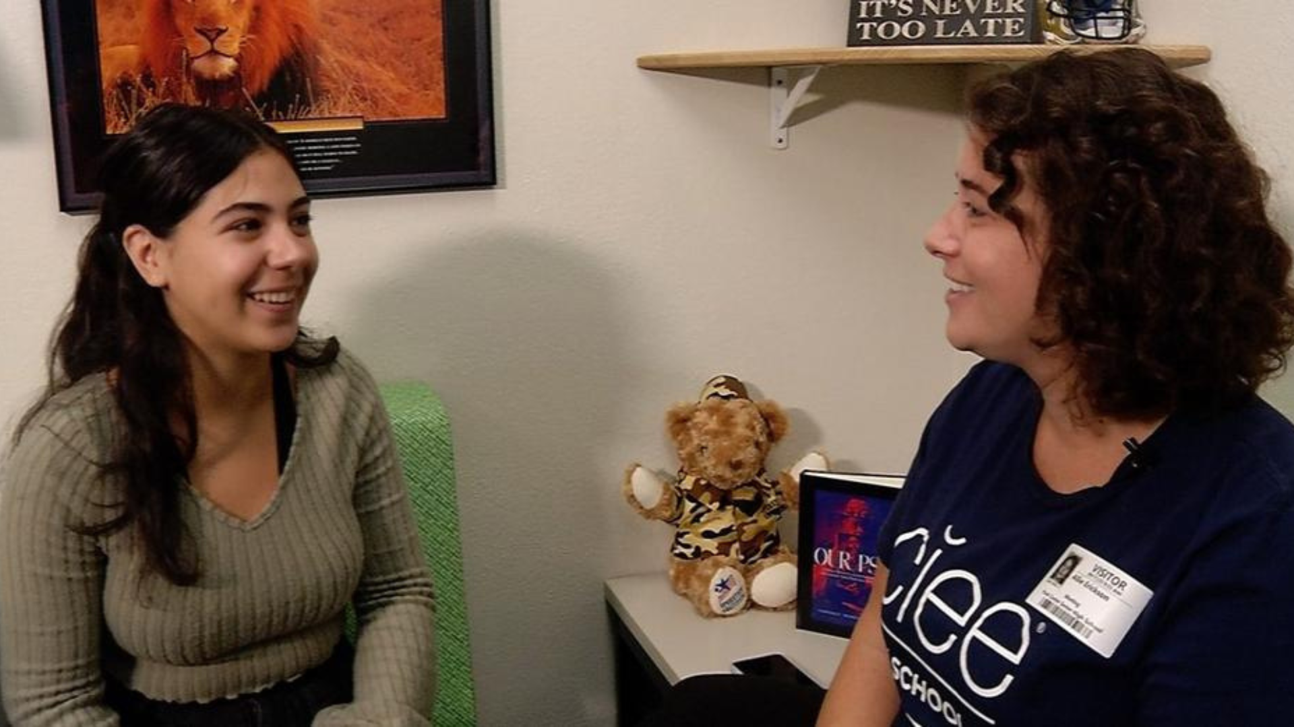
Notes:
CCX Media recently spoke with one of Park Center Senior High School's new exchange students, Gracia Dominguez (Grath-eeah), about her experiences so far in the United States and at Park Center Senior High School.
Dominguez has enjoyed participating in extracurricular activities like choir and sports, which are not part of her public education back home in Barcelona.

Slide 7
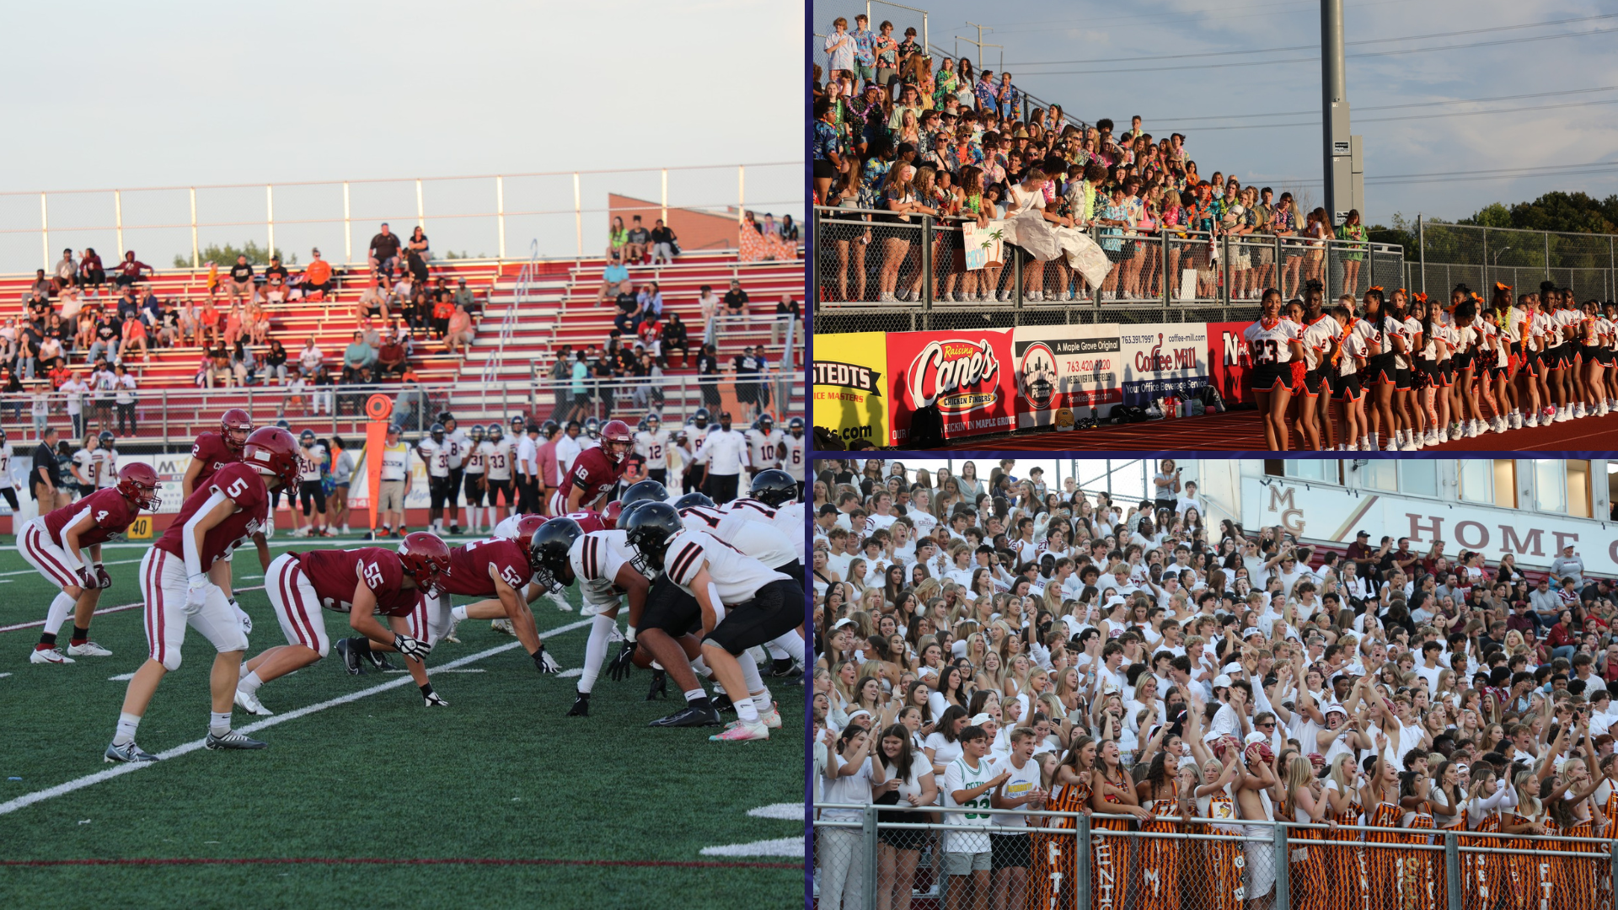
Notes:
Before summer break ended, many students and community members gathered to cheer on the Maple Grove Senior High School and Osseo Senior High School football teams in their season opener!

Slide 8
Notes:
In the area of CONTRIBUTING TO COMMUNITY
Open house night is always an exciting event, serving as the official kick-off to a brand new school year. Garden City Elementary School’s open house was especially eventful this year, with the Brooklyn Park Salvation Army teaming up with Vikings player Alexander Mattison’s foundation, I AM GIFTED, to make the school’s open house even more special.
While Mattison and Vikings cheerleaders met scholars and families and posed with them for photos, The Salvation Army was busy handing out free Crocs shoes, books, backpacks, shirts, wristbands and school supplies. Barbers were on hand giving free back-to-school haircuts, and a deejay kept the scene lively with upbeat music.

Slide 9
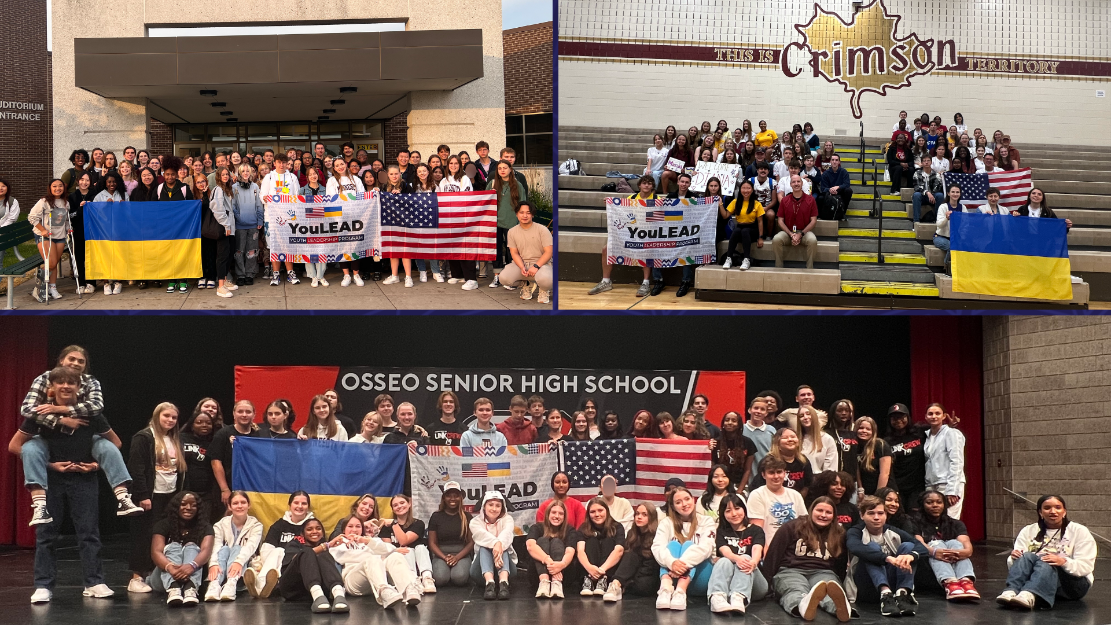
Notes:
Students from Ukraine recently visited Osseo Area Schools, meeting the students and teachers and experiencing a day in the schools. Each day, the visiting students partnered with Link Crew leaders at three of the high schools. These international students were a part of the YouLEAD program, sponsored by Global Synergy Group.

Slide 10
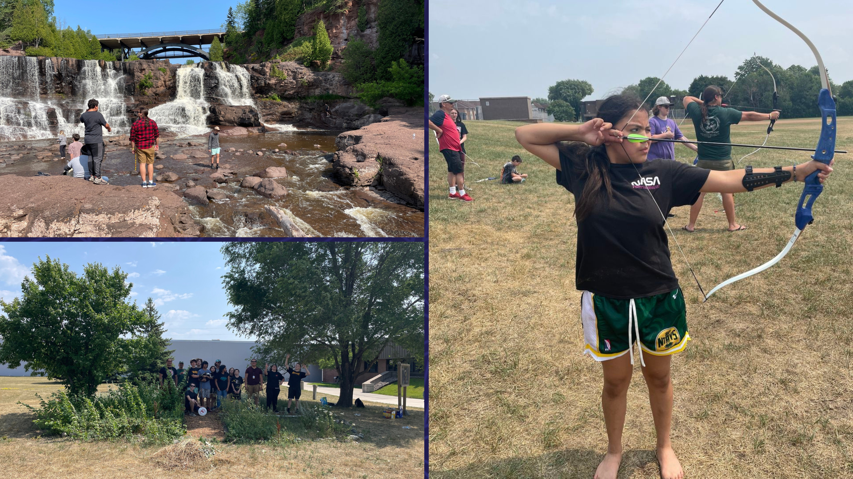
Notes:
In the area of LIFELONG LEARNING
Over the course of the summer, scholars participated in a variety of activities and trips during the American Indian Education summer program!

Slide 11
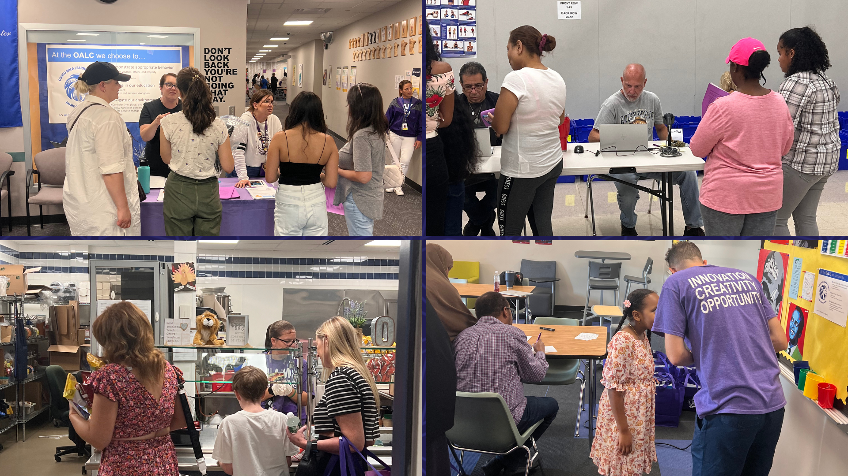
Notes:
Across the district, schools and programs held open house events to welcome scholars into a new school year! At 279Online, scholars had their school pictures taken, got their Chromebooks, met their teachers and advisor, got their materials for the year, connected with school counselors, participated in a community engagement wall and had dinner at their kickoff event!

Slide 12
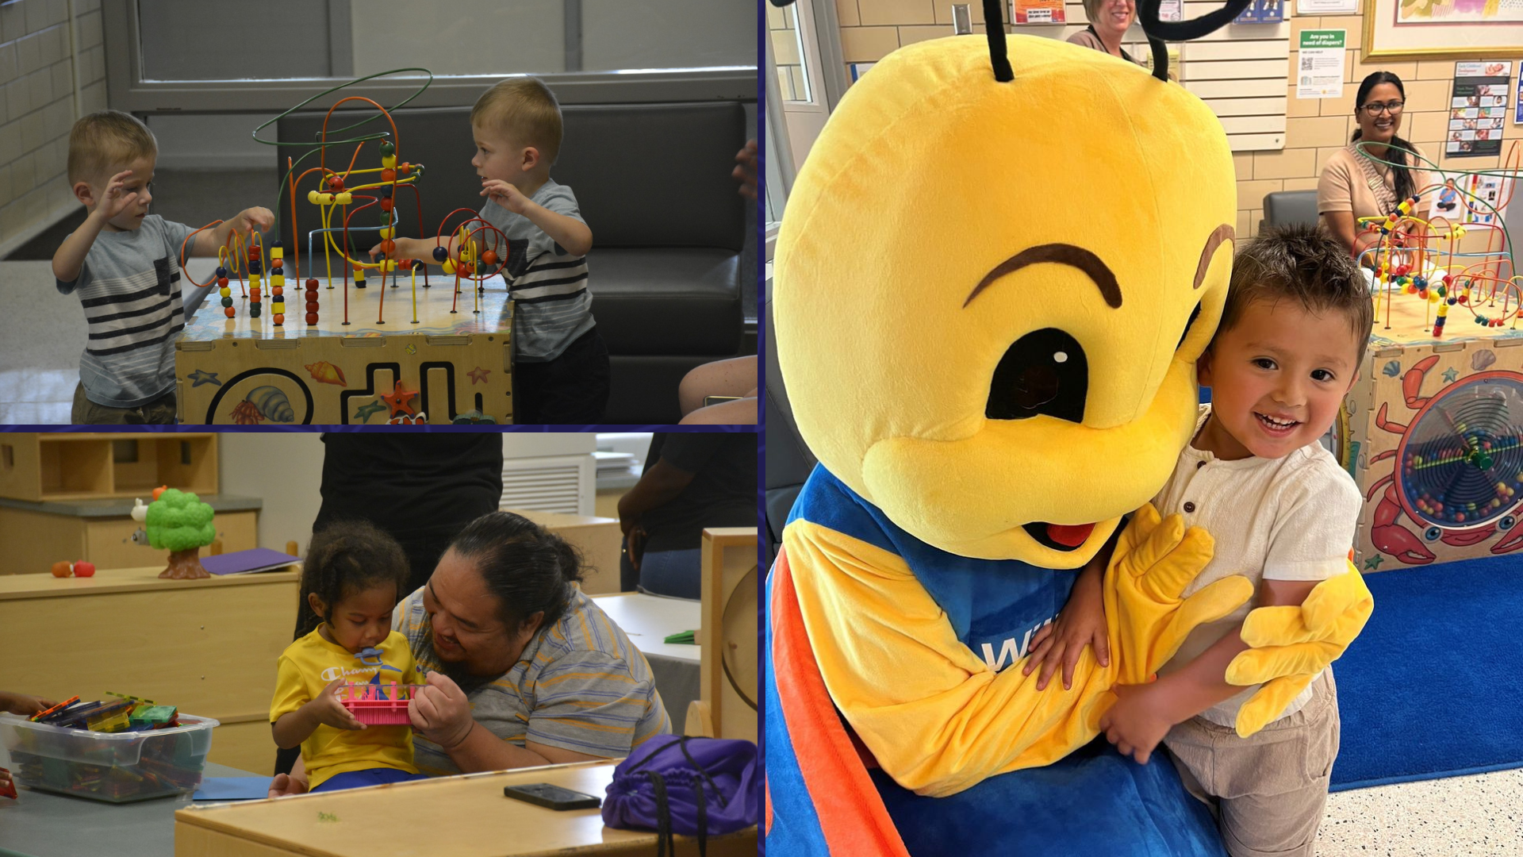
Notes:
Early Childhood Special Education, or ECSE, staff also hosted an open house for families at both Arbor View and Willow Lane Early Childhood Centers to welcome the start of the 2023-2024 school year! Parents and students had the opportunity to meet their teachers, see the classroom, play on the playground, climb aboard a school bus and meet Willow- the Early Childhood Special Education’s butterfly mascot.

Slide 13
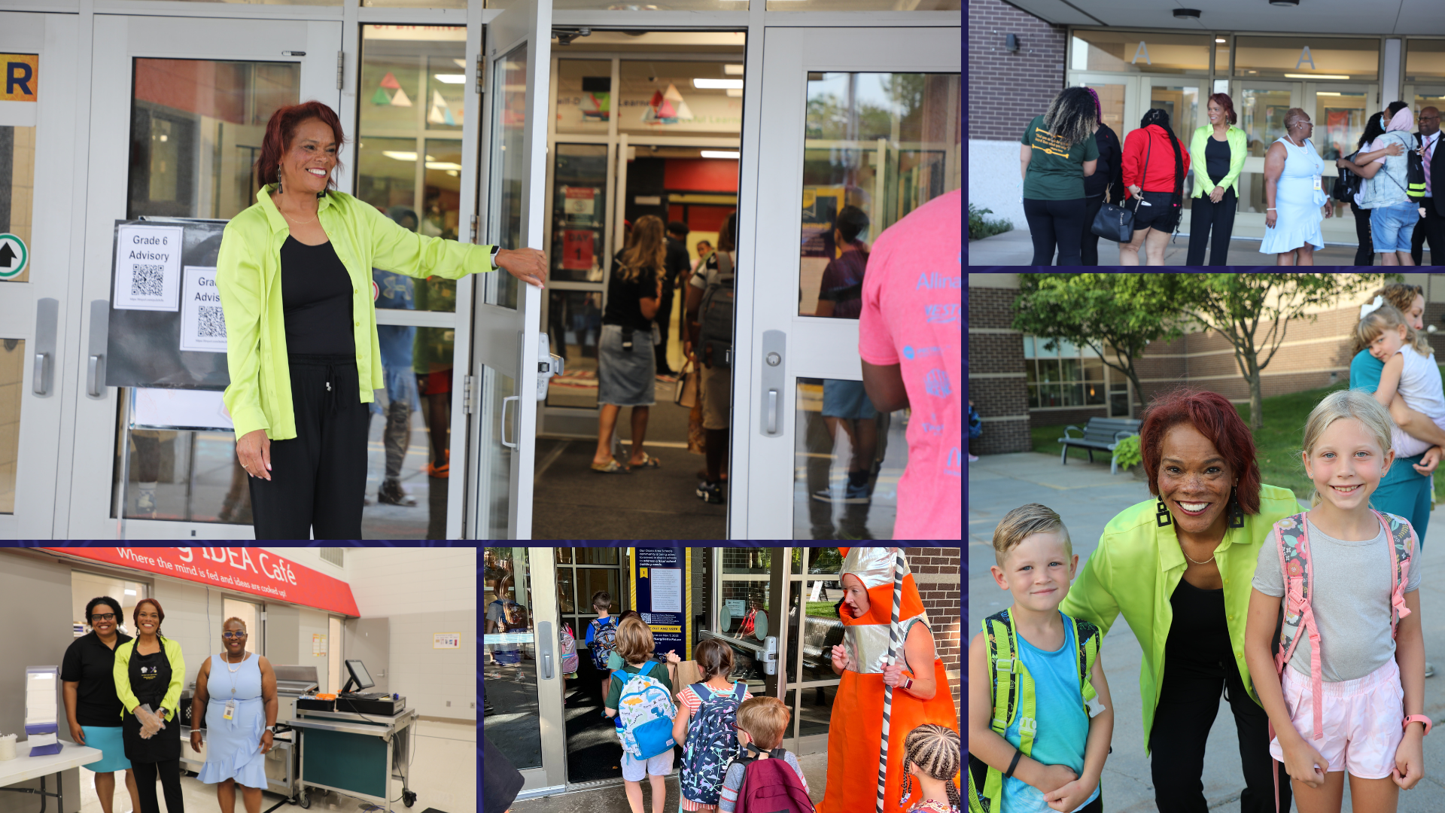
Notes:
On the first day of school, Superintendent Dr. Kim Hiel and staff across the district were excited to welcome back scholars to another great year of learning and making Osseo Area Schools one community for all-where all voices are valued and heard!

Slide 14
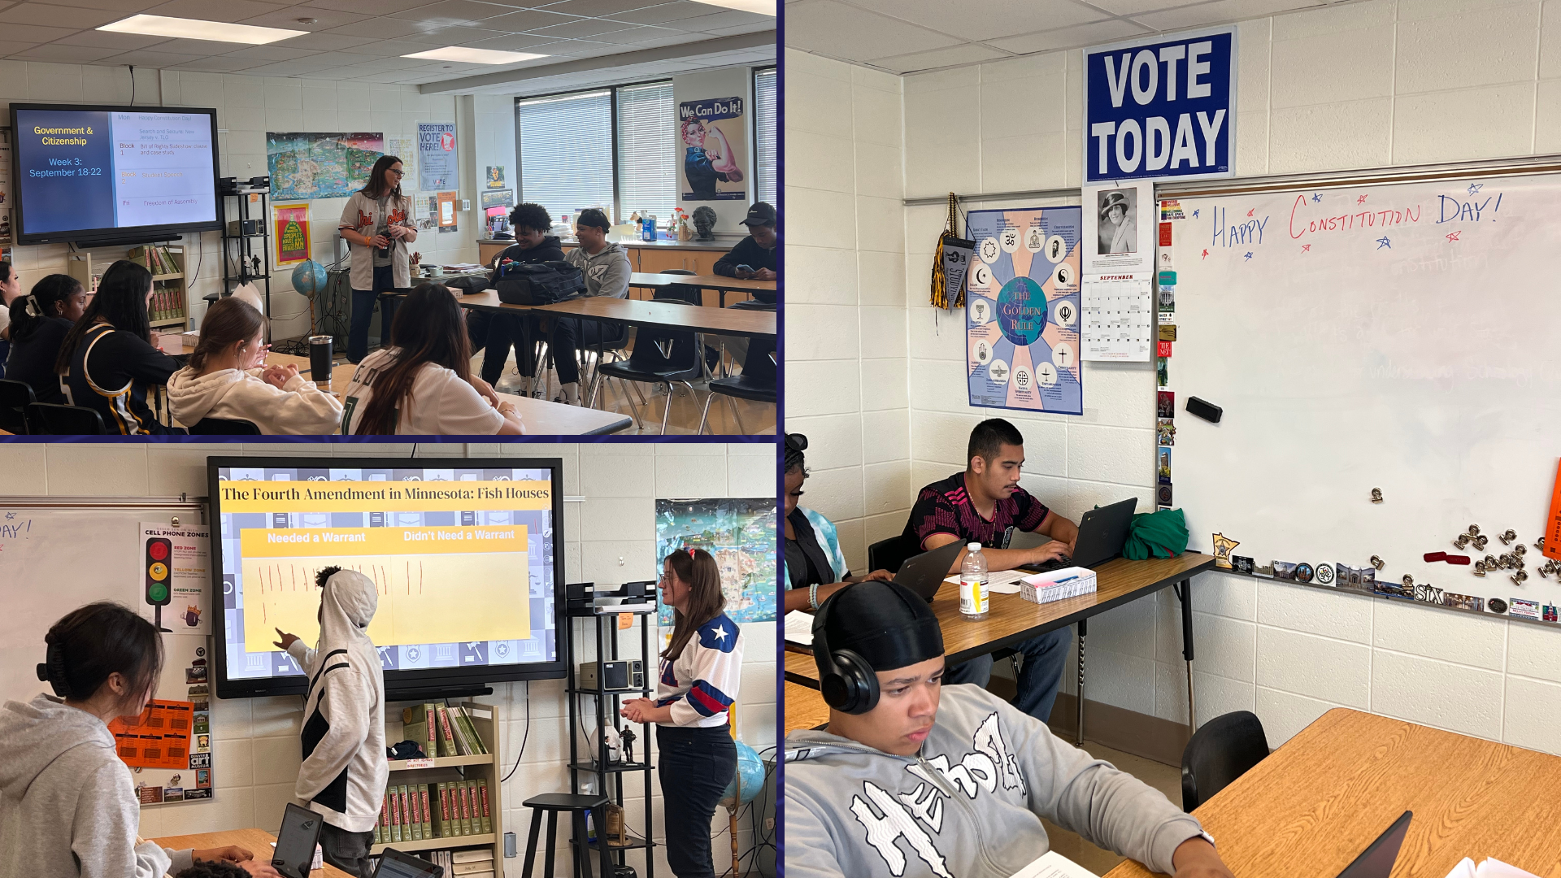
Notes:
Osseo Area Schools recognizes Constitution Day each year on Sept. 17 to celebrate the adoption of the United States Constitution and those who have become citizens. Across the district, students learned about the Constitution in their classes.
In the Crime and Justice and Government and Citizenship classes taught by Megan Thompson at Osseo Senior High School, students learned about the fourth amendment, including search and seizure, civil liberties and warrants. Students learned from a real life case of whether a warrant is needed to search an ice fishing house. After working independently and conducting research, the students voted on whether they thought a warrant was needed and discussed as a class topics such as needing evidence for a search, probable cause and expectation of privacy.

Slide 15
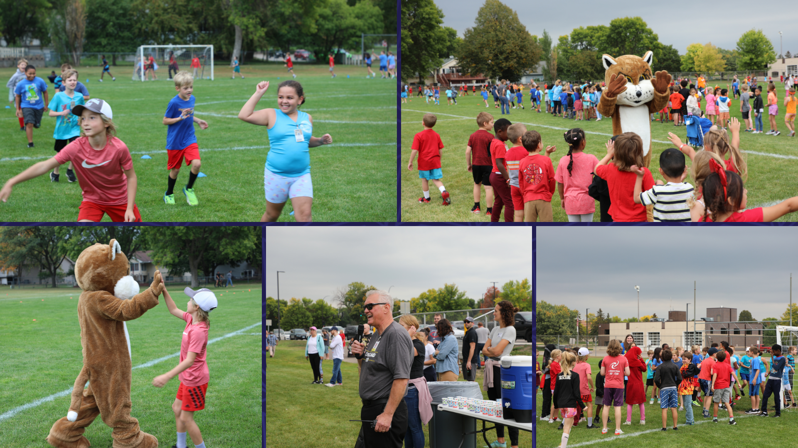
Notes:
Cedar Island Elementary School hosted their fun run last week to raise funds for their PTO programs!
Each class was assigned a color, and students were encouraged to wear that color in the week leading up to the fun run! Students competed to raise money as classes and also as teams of the same color.
The fun run was kicked off with an assembly in the week prior to get students excited.
During the run, students were encouraged and cheered on by their teachers and family members!

Slide 16
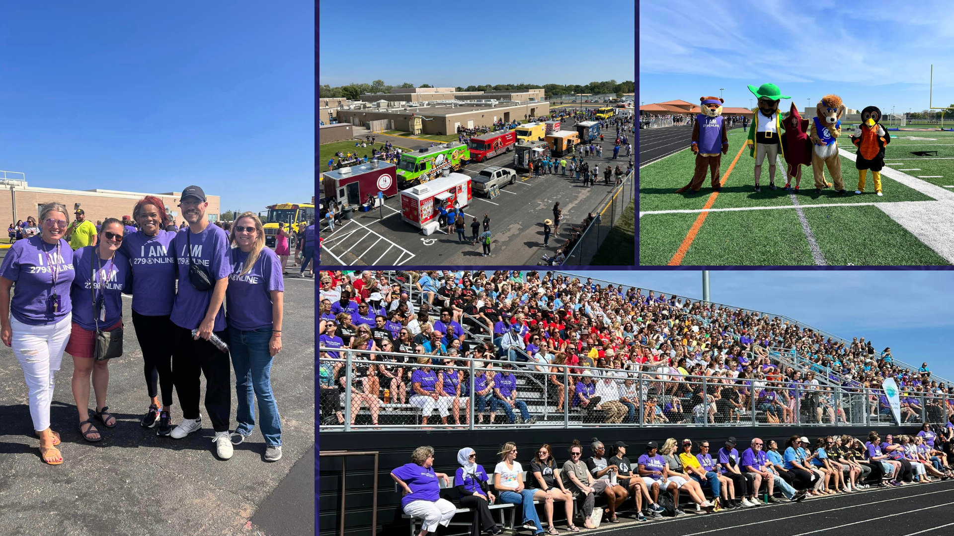
Notes:
In the area of MISSION DRIVEN EMPLOYEES
At the all-staff event held before school resumed, district staff gathered for an afternoon of food trucks, yard games, dancing, a mascot race and a speech from Superintendent Dr. Kim Hiel.

Slide 17
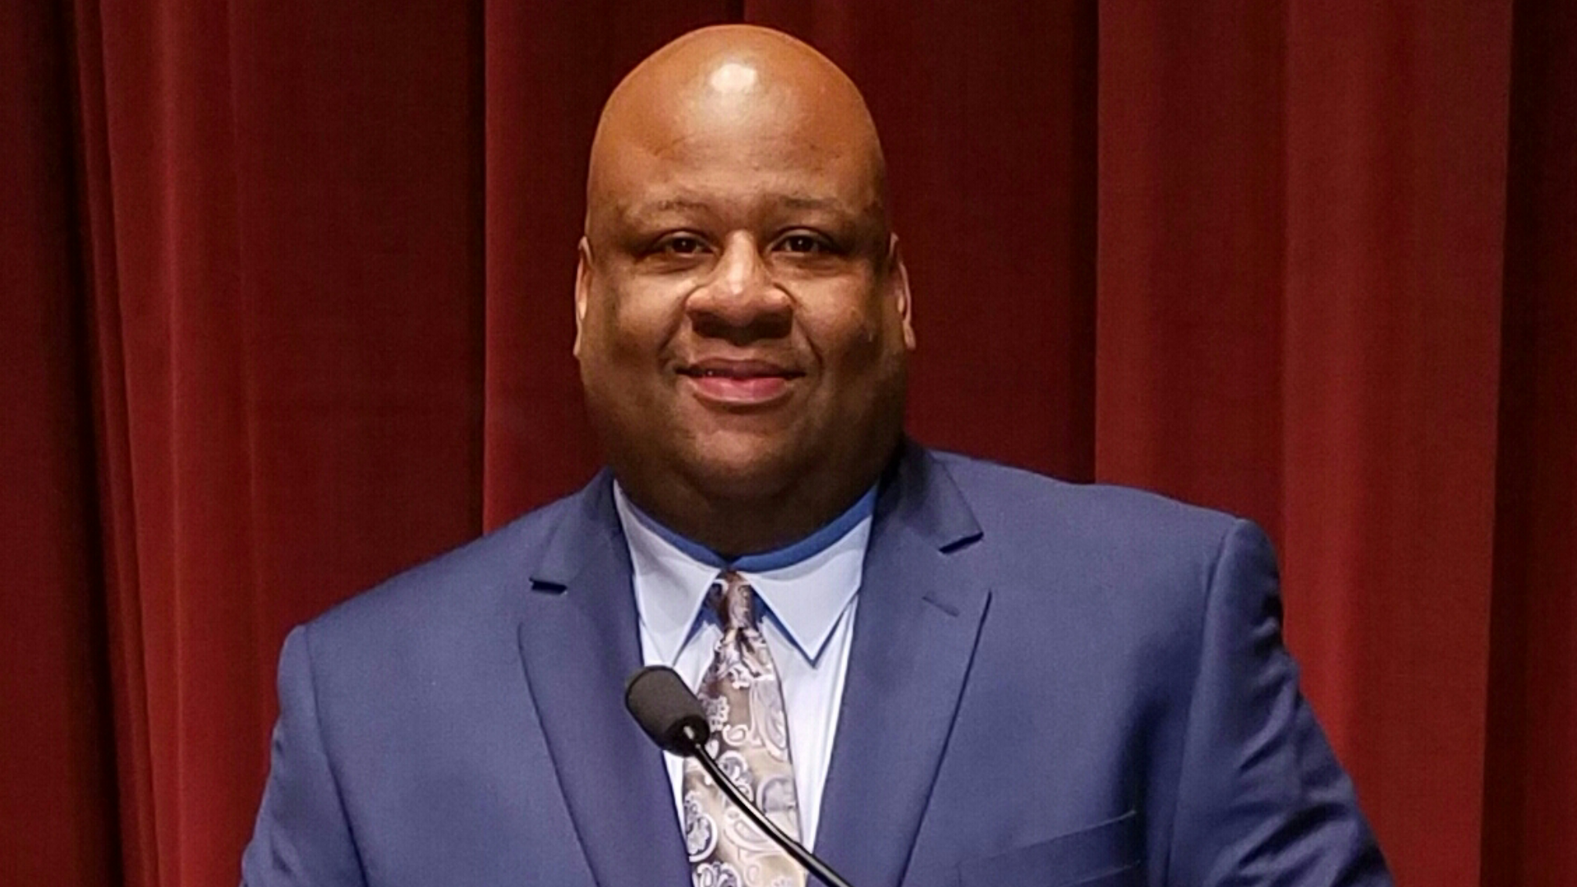
Notes:
Park Center Senior High School principal, Antwan Harris, has come full circle with his tenure at Park Center. Harris’s career began at Park Center’s next door neighbor, Brooklyn Middle STEAM School, where he taught physical education, health and chemistry 23 years ago. Learn more about Harris on our district website!

Slide 18
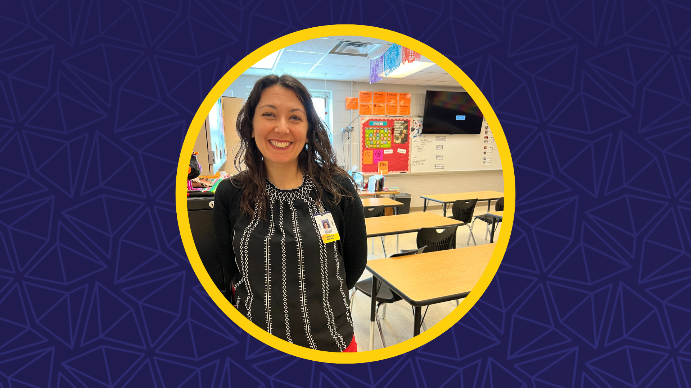
Notes:
Maple Grove Middle School spanish teacher Jennifer Hairrell recently won the Fulbright Award, the U.S. government’s flagship international educational exchange program where teachers are chosen for their academic merit and leadership potential. Hairrell has been a teacher at Osseo Area Schools for nearly 20 years.
As a winner of this award, Hairrell will receive a year’s worth of professional development, including a fall semester course on global education, a February symposium in Washington D.C., and a multi-week field experience opportunity somewhere in the world next spring. She will remain teaching full-time throughout her time as a Fulbright program participant.
Congratulations!

Slide 19
Notes and Reminders
Final days - Fill out Educational Benefits application and back to school forms
Building a Better Future, Phase II voting has started! Visit district279.org/BetterFuture for more.
Reading is Fun 5K: Saturday, Oct. 7
Notes:
Thank you team!
A few additional reminders and thoughts. Please make sure to fill out educational benefits and back to school forms if you have not already. These last few days of the month are the final days to do so. More information can be found at district279.org/back-to-school.
Our community is considering school building needs on Nov. 7th's ballot question - called Building a Better Future, Phase II. This final phase of Building a Better Future meets the overall needs of our schools for the foreseeable future – equipping students with what they need to succeed both today and many years to come. Get informed and get out and vote! Early voting has already started. To cast your vote early, request an early voting ballot via the City of Brooklyn Park's website or head to Brooklyn Park City Hall’s multipurpose room from 8 a.m. to 4:30 p.m., Monday through Friday. This applies to all Osseo Area Schools voters. Nov. 7 polling place locations, and other election details, can be found on the Minnesota Secretary of State website via mnvotes.org.
The District 279 Foundation’s 13th annual Reading is Fun 5K! Hosted at Elm Creek Park Reserve on Saturday, October 7. This family-friendly event will raise funds for media centers in Osseo Area Schools to purchase learning resources. You can register day of.
Thank you. That concludes tonight’s Superintendent's Report.

Slide 20
School board meeting
Sept. 26, 2023

