Slide 1
HACIENDA LA PUENTE UNIFIED SCHOOL DISTRICT
La Puente Quad
Los Altos Quad
Wilson Quad
Workman Quad
School Site Improvement Projects
Regular Board Meeting August 24, 2023
Business Services

Slide 2
PROJECT COMPLETE LIST
2023-2024
Site | Item Description | Funding Source | Completed Date
Wing Lane | K1 & K2 Flooring | Facilities | 6/2023
La Puente HS | Weight Room – Flooring and Painting | Facilities | 6/2023
Amar | Ramp Repair | Child Development | 6/2023
Mesa Robles | Kinder Asphalt | Facilities | 6/2023
Nelson ES | Asphalt Slurry and Paint | Site | 7/2023
Bixby | Parking Lot Re-Striping | Facilities | 7/2023
Del Valle | Parking Lot Re-Striping | Facilities | 7/2023
Nelson Elementary | Parking Lot Re-Striping | Facilities | 7/2023
Sierra Vista MS | Parking Lot Re-Striping | Facilities | 7/2023
Sparks ES | Parking Lot Re-Striping | Facilities | 7/2023
Sparks MS | Parking Lot Re-Striping | Facilities | 7/2023
Fairgrove | 3 Bottle Filling Station | Facilities | 7/2023
Kwis | 3 Bottle Filling Station | Facilities | 7/2023
La Puente HS | 2 Bottle Filling Station | Facilities | 7/2023
Sparks MS | 3 Bottle Filling Station | Facilities | 7/2023
Wilson HS | 3 Bottle Filling Station | Facilities | 7/2023
Stimson Building / Adjacent District Equity & Access | Refurbish (Facilities, Flooring, Painting, Ramp, and Roofing) | Facilities | 7/2023
Valley HS | C1 & C2 Renovations (Ceiling Tiles, Flooring and Painting) | Facilities | 7/2023
Cedarlane | Synthetic Turf | Facilities | 7/2023
Deep Cleaning of all School Facilities completed during Summer Break
Changes And Progress Since Last Report - Blue

Slide 3
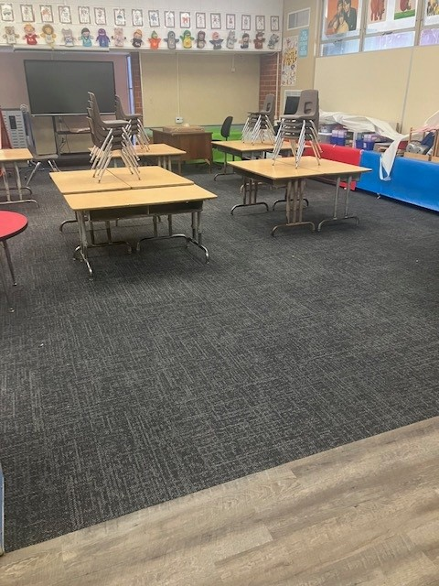
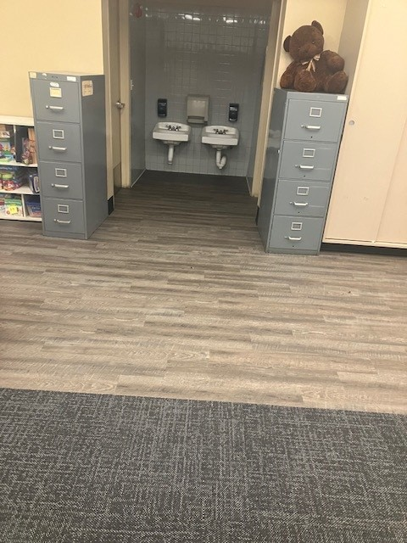
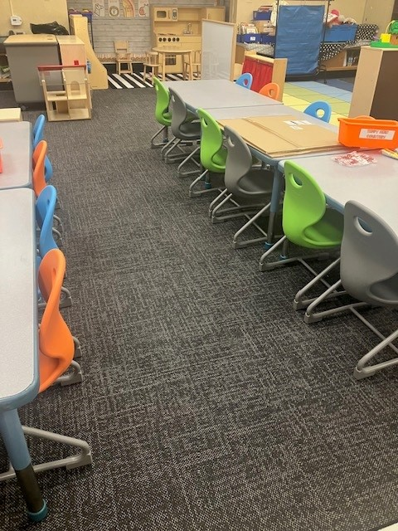
Projects Completed as of August 24, 2023 Wing Lane – K1 & K2 Flooring (6/2023)
BEFORE
BEFORE
AFTER
AFTER

Slide 4
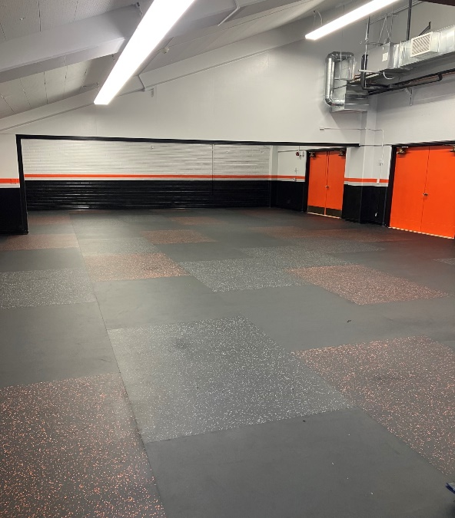
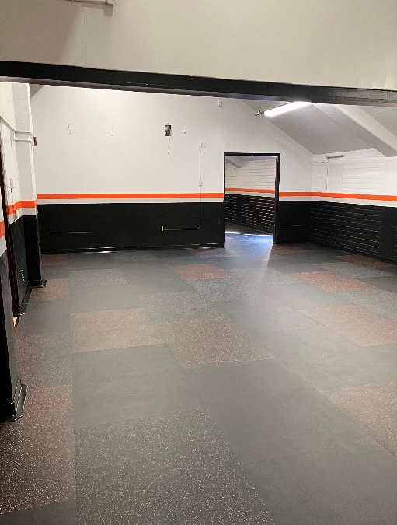
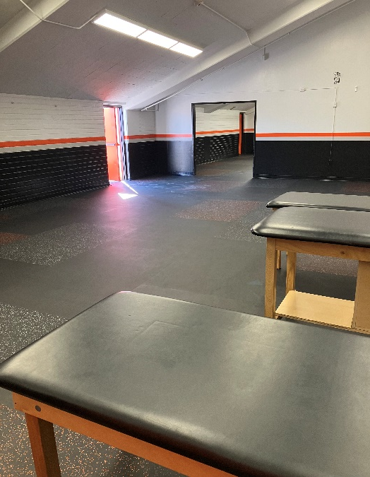
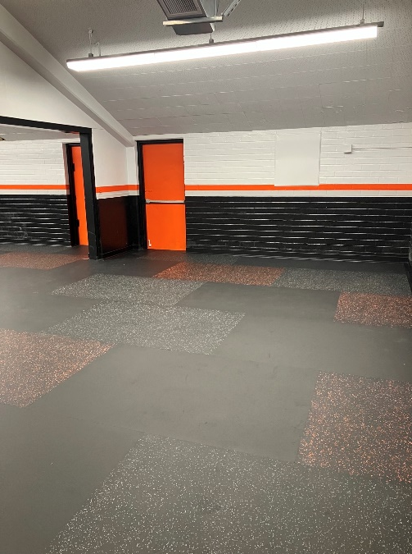
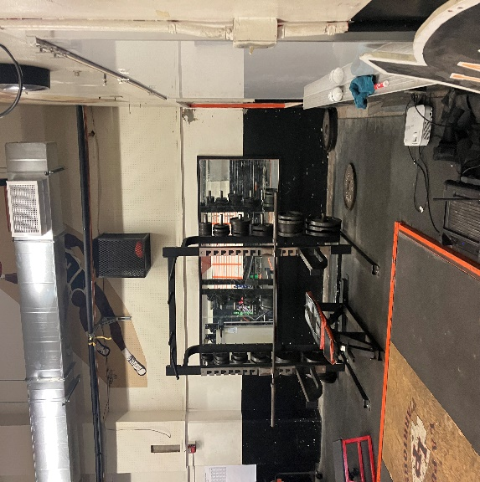
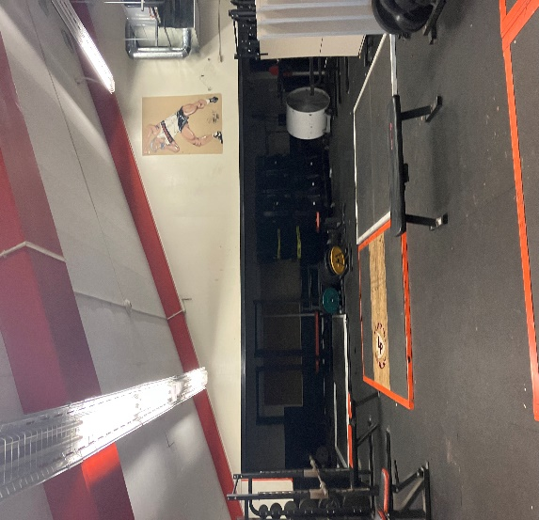
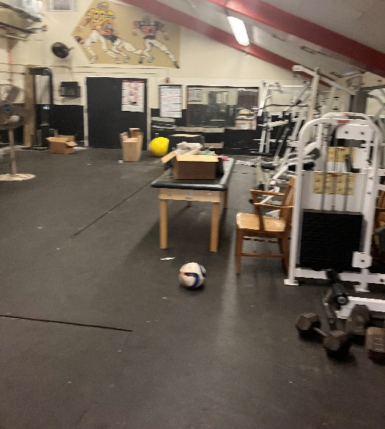
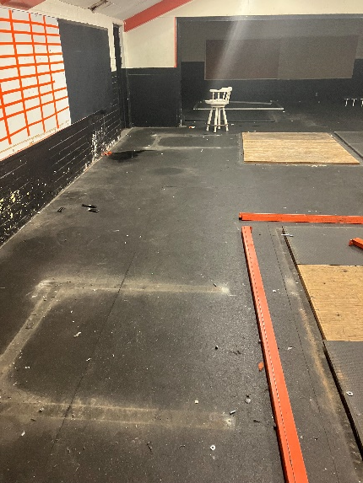
Projects Completed as of August 24, 2023 La Puente HS – Weight Room Flooring and Painting (6/2023)
AFTER
BEFORE
AFTER
Before
BEFORE
BEFORE

Slide 5
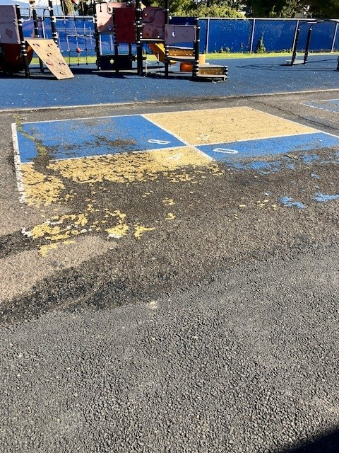
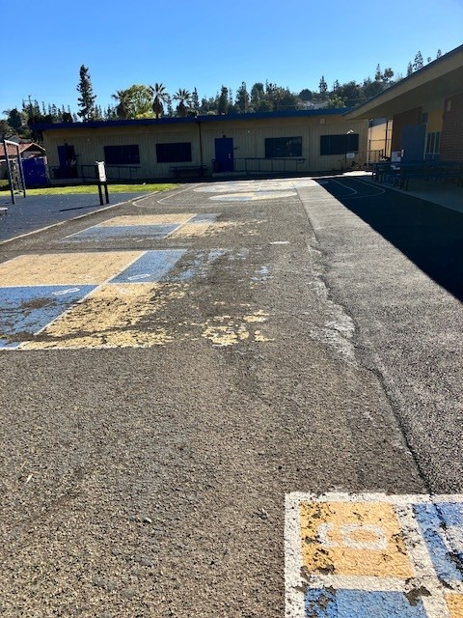
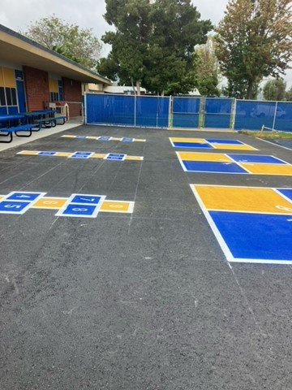
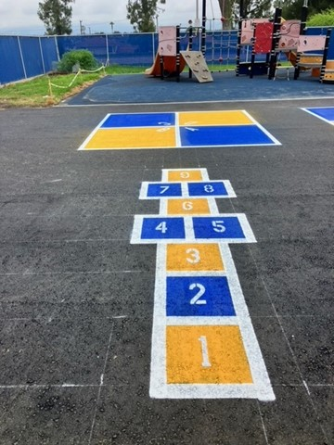
Projects Completed as of August 24, 2023 Mesa Robles – Kinder Asphalt (6/2023)
BEFORE
AFTER

Slide 6
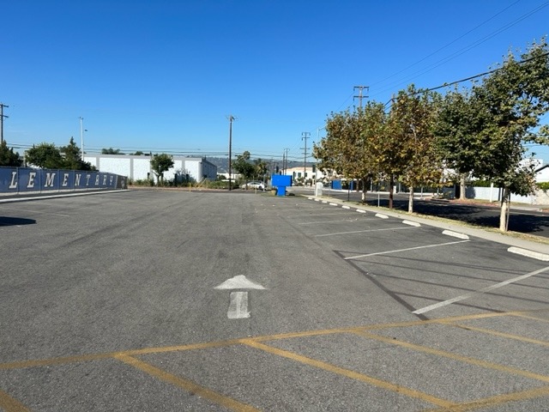
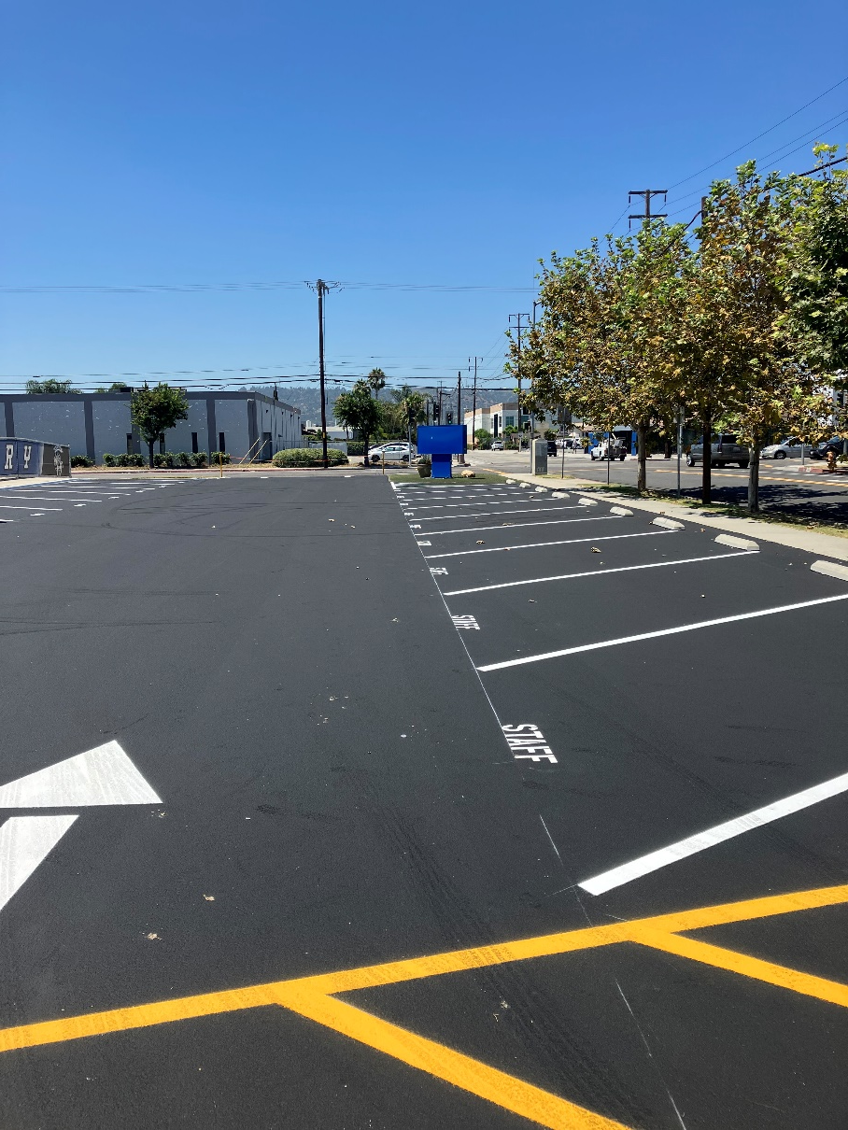
Projects Completed as of August 24, 2023 Nelson – Asphalt Slurry & Paint (7/2023)
BEFORE
BEFORE
After
Before
After

Slide 7
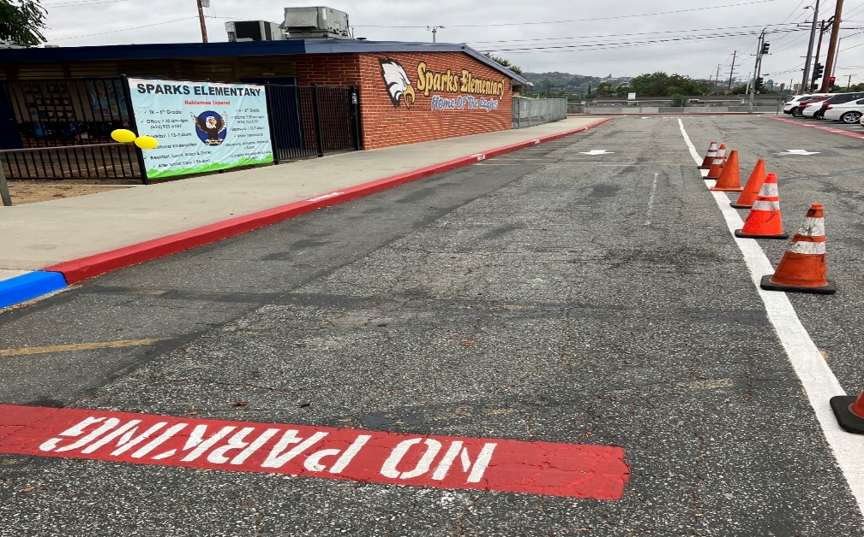
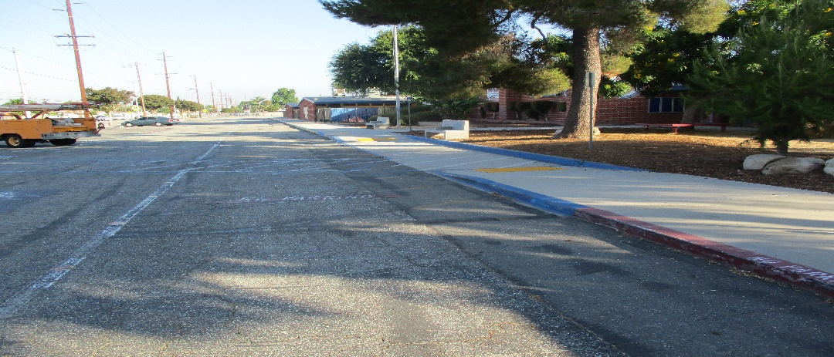
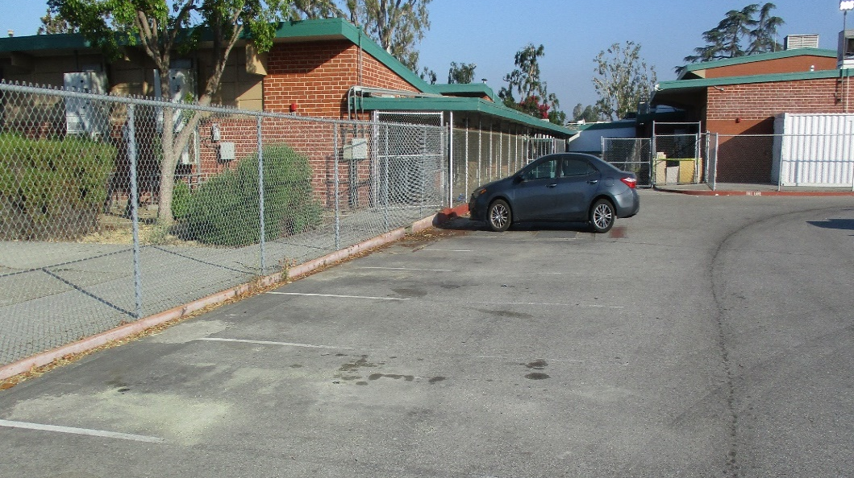
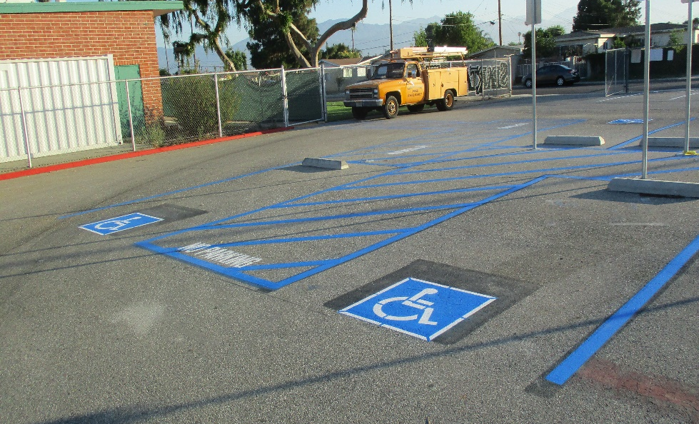
Projects Completed as of August 24, 2023 Parking Lot Striping at Various Sites (7/2023)
Sparks ES
BEFORE
AFTER
Sparks ES
AFTER
Sparks MS

Slide 8
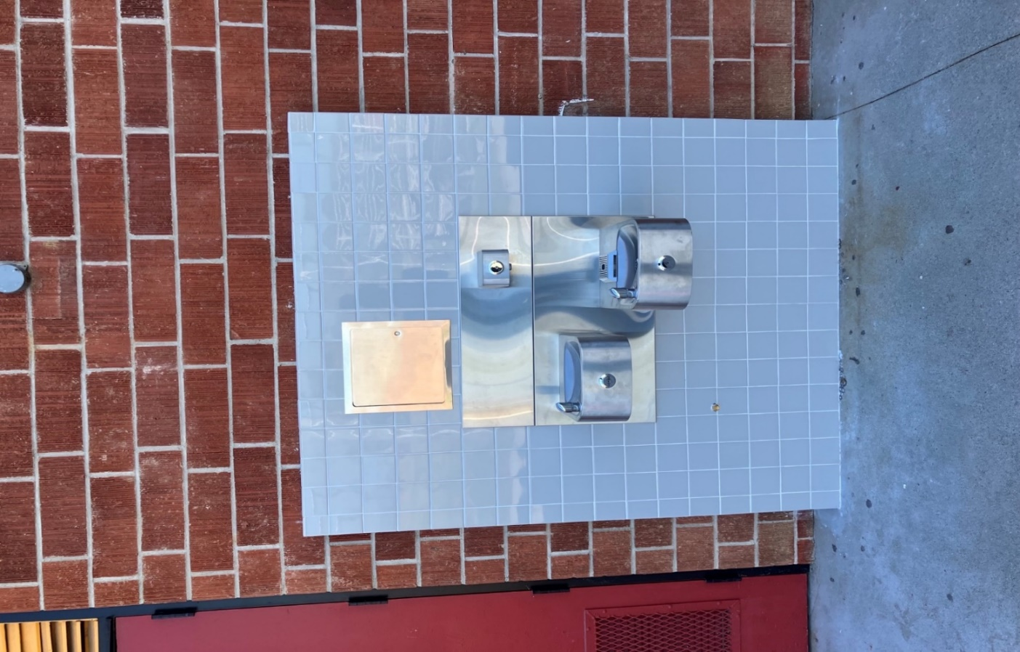
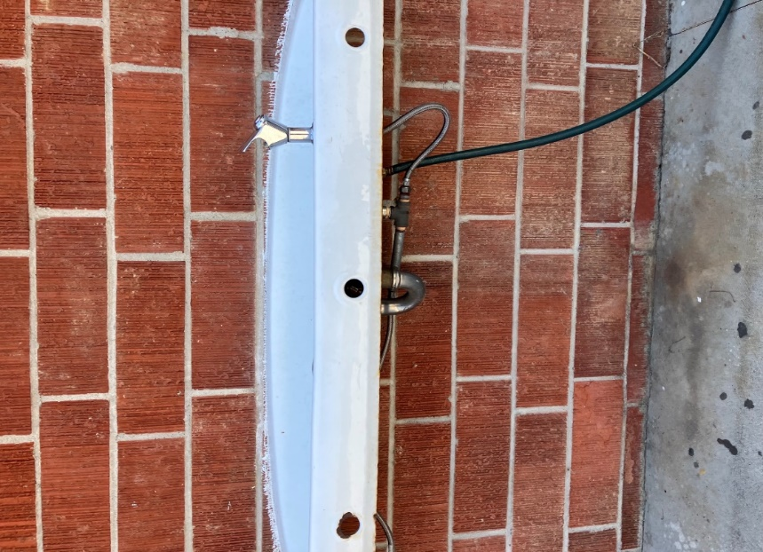
Projects Completed as of August 24, 2023 Bottle Filling Stations at Various Sites (7/2023)
BEFORE
AFTER
BEFORE
AFTER
AFTER
Before
BEFORE

Slide 9
Bottle Filling Stations
Site: | # of Stations | Site: | # of Stations | Site: | # of Stations
Baldwin Academy | 3 | Lassalette | 3 | Sparks ES | 2
Bixby ES | 2 | Los Altos ES | 1 | Sparks MS | 3
California Academy | 2 | Los Altos HS | 3 | Sunset ES | 3
Cedarlane | 3 | Los Molinos ES | 1 | Valinda School of Academics | 2
Del Valle ES | 0 | Los Robles Academy | 0 | Valley Alternative | 0
Fairgrove Academy | 2 | Mesa Robles | 3 | Wedgeworth ES | 0
Glen A Wilson HS | 4 | Nelson ES | 2 | William Workman HS | 2
Grandview, College Preparatory Academy | 3 | Newton MS | 3 | Wing Lane ES | 2
Grazide ES | 3 | Orange Grove MS | 1 | Workman ES | 2
Kwis ES | 3 | Palm ES | 2
La Puente HS | 2 | Sierra Vista MS | 3
BEFORE
AFTER

Slide 10
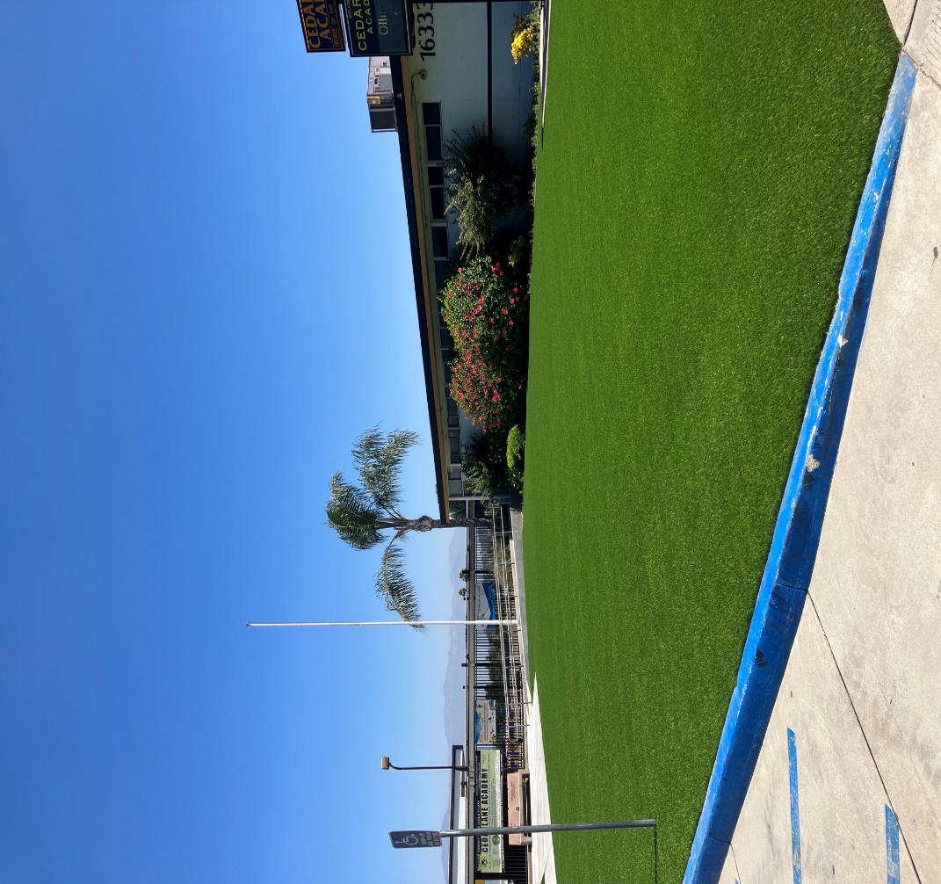
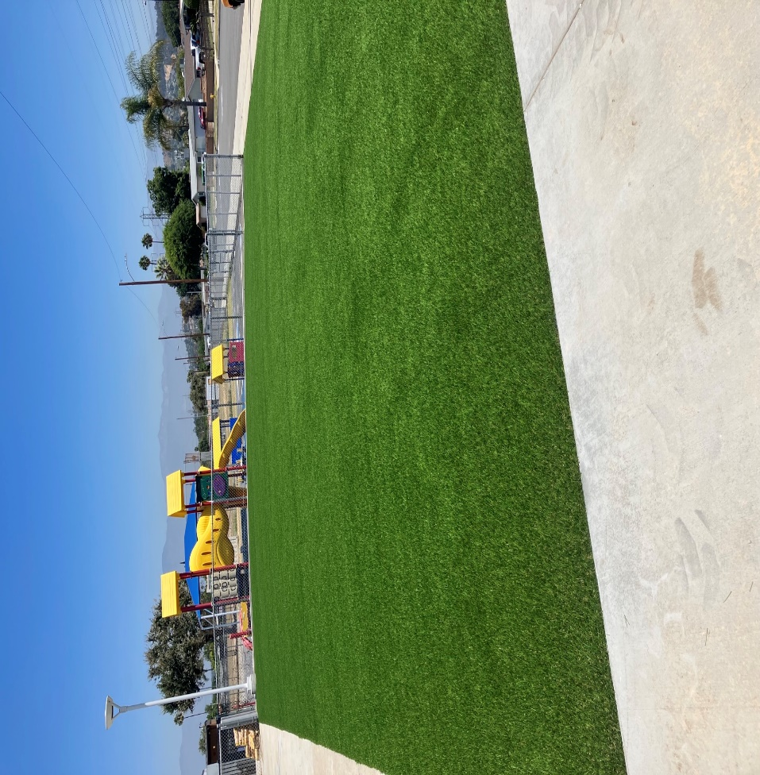
Projects Completed as of August 24, 2023 Cedarlane – Artificial Turf (7/2023)
BEFORE
AFTER
AFTER

Slide 11
Projects In Progress
2023-2024

Slide 12
Projects In Progress as of August 24, 2023
Site | Item Description | Architect Plans | DSA Approval | Procurement | Construct | Funding Source | Target Completion Date
Workman HS | Phase II Stadium and Baseball Field (Phase I Track & Field and Softball Field Complete) | Complete | Complete | Pending | Pending | Various - Estimate Cost $18 M | 12/2024
Baldwin ES Cedarlane Fairgrove Lassalette | Blacktop Asphalt & Striping | NA | NA | Bidding | Pending | Facilities | 12/2023
California ES Cedarlane District Office Bldg C Grazide ES Lassalette Los Altos HS SSC (Sierra Vista) Sparks ES Stimson LC Valley Alt HS – CDS Workman ES 6/27 Workman HS | Reroof Various Buildings | In Progress | NA | Bidding | Pending | Deferred Maint. | 01/2024
Wedgeworth | K-5 Permanent School | Complete | Complete | Complete | 9/2022 | COPS | 06/2025
Dibble AS | HVAC Replacement | Complete | NA | Complete | In Progress | Adult Ed | 12/2023
Willow AS | HVAC Replacement | Complete | NA | Complete | In Progress | Adult Ed | 12/2023
Willow AS | Fire Alarm Installation | Complete | NA | Complete | In Progress | Adult Ed | 12/2023

Slide 13
Projects In Progress as of August 24, 2023
Site | Item Description | Architect Plans | DSA Approval | Procurement | Construct | Funding Source | Target Completion Date
Dibble AS | Fire Alarm Installation | Complete | NA | Complete | In Progress | Adult Ed | 12/2023
District Office | Fuel Station Repairs | NA | NA | Complete | Pending | Facilities | 09/2023

Slide 14
Projects with Division of State Architect (DSA) Waiting on Approval
Site | Item Description | Architect Plans | DSA Approval | Procurement | Est. Construct Start | Target Completion Date
Los Altos HS | Gym & Locker Room HVAC (65 tons of temporary HVAC units have been installed) | Complete | Pending | Complete | TBD | Approx. 3 months after DSA approval
Kwis Elementary | Baseball Fields (Two Youth) | Complete | Approved (7/5/23) | In Progress | 9/2023 | 8/2024
Center for the Performing Arts | Site Demolition | Complete | N/A | In Progress | 08/2023 | 10/2023
Center for the Performing Arts | Construction of NEW Performing Arts Center with approx. 500 seat capacity | Complete | Pending | Pending | TBD | 2/2025
Projects in Design
Site | Item Description | Architect Plans | DSA Approval | Procurement | Est. Construct Start | Target Completion Date
Districtwide | HVAC System Replacements | Pending | Pending | Pending | TBD | TBD
District Office | Portable Installation meeting/flex space | In Progress | NA | Pending | 9/2023 | 1/2024
Changes And Progress Since Last Report - Blue

Slide 15
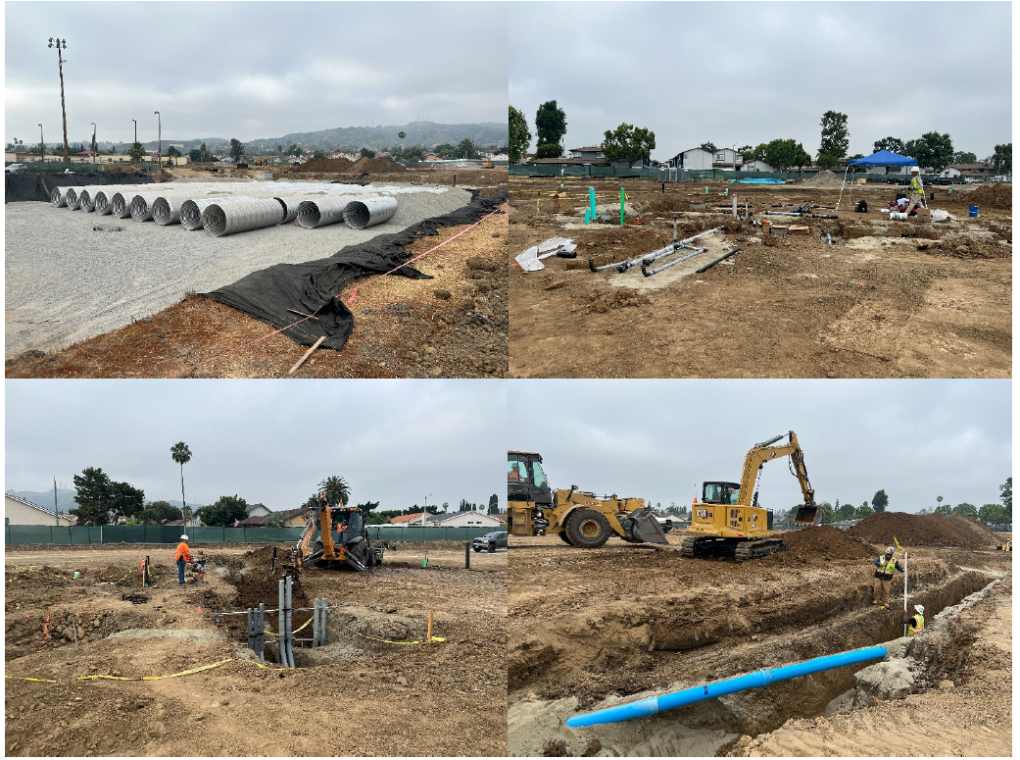
Projects In Progress of August 24, 2023 Wedgeworth Update
-Install of retention basin system continues
-Continuation of conduit routing for UG utilities
-Backfilling and compacting of trenches
BEFORE
BEFORE
AFTER
AFTER

Slide 16
Wedgeworth Update

Slide 17
Next Report – September 26, 2023

