Slide 1
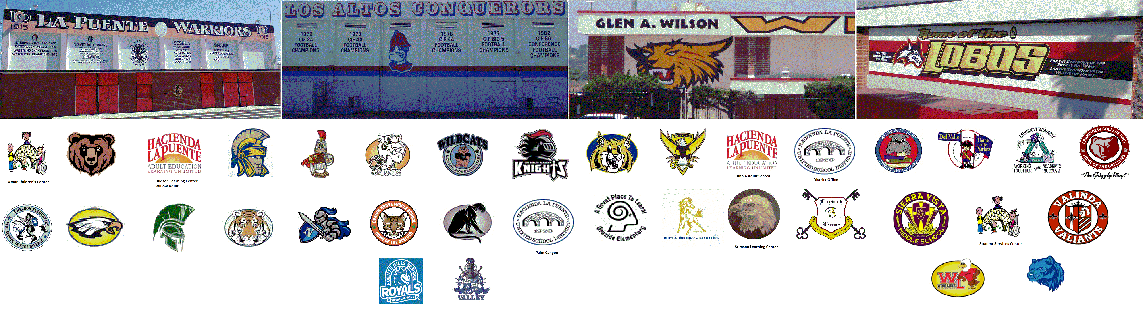

HACIENDA LA PUENTE UNIFIED SCHOOL DISTRICT
La Puente Quad
Los Altos Quad
Wilson Quad
Workman Quad
School Site Improvement Projects
Regular Board Meeting September 26, 2023
Business Services

Slide 2

PROJECT COMPLETE LIST
2023-2024
Site | Item Description | Funding Source | Completed Date
District Office | Wayfinding & Police Handicapped Striping | Facilities | 8/2023
Lassalette | Restroom Upgrades | Facilities | 8/2023
Wing Lane | K1 & K2 Flooring | Facilities | 6/2023
La Puente HS | Weight Room – Flooring and Painting | Facilities | 6/2023
Amar | Ramp Repair | Child Development | 6/2023
Mesa Robles | Kinder Asphalt | Facilities | 6/2023
Nelson ES | Asphalt Slurry and Paint | Site | 7/2023
Bixby | Parking Lot Re-Striping | Facilities | 7/2023
Del Valle | Parking Lot Re-Striping | Facilities | 7/2023
Nelson Elementary | Parking Lot Re-Striping | Facilities | 7/2023
Sierra Vista MS | Parking Lot Re-Striping | Facilities | 7/2023
Sparks ES | Parking Lot Re-Striping | Facilities | 7/2023
Sparks MS | Parking Lot Re-Striping | Facilities | 7/2023
Fairgrove | 3 Bottle Filling Station | Facilities | 7/2023
Kwis | 3 Bottle Filling Station | Facilities | 7/2023
La Puente HS | 2 Bottle Filling Station | Facilities | 7/2023
Sparks MS | 3 Bottle Filling Station | Facilities | 7/2023
Wilson HS | 3 Bottle Filling Station | Facilities | 7/2023
Stimson Building / Adjacent District Equity & Access | Refurbish (Facilities, Flooring, Painting, Ramp, and Roofing) | Facilities | 7/2023
Valley HS | C1 & C2 Renovations (Ceiling Tiles, Flooring and Painting) | Facilities | 7/2023
Cedarlane | Synthetic Turf | Facilities | 7/2023
Changes And Progress Since Last Report - Blue

Slide 3

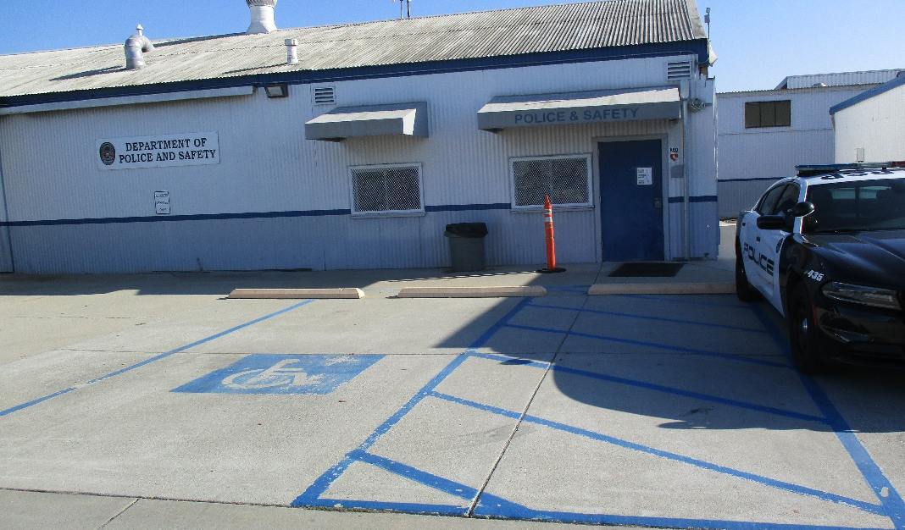
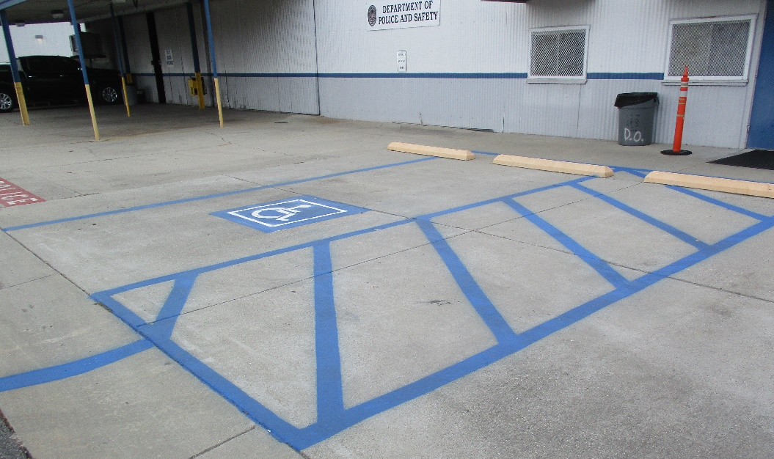
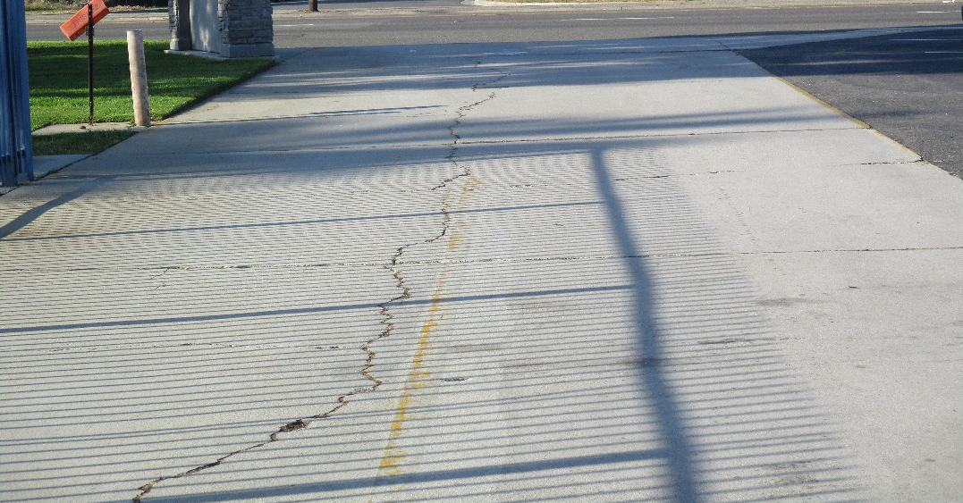
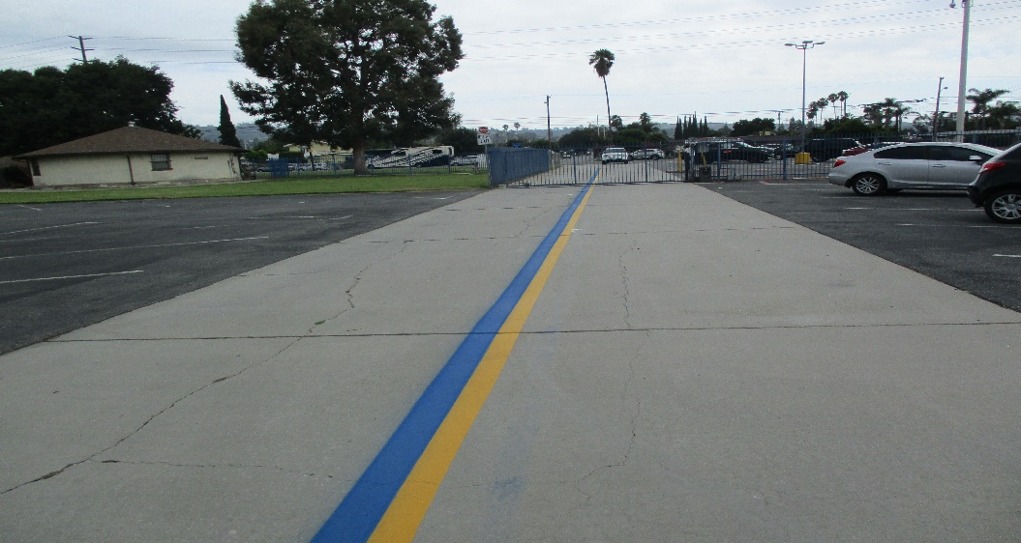
Projects Completed as of September 26, 2023
District Office – Wayfinding & Police Handicapped Striping
(8/2023)
AFTER
BEFORE
BEFORE
BEFORE
AFTER
AFTER

Slide 4
Projects Completed as of September 26, 2023
Lassalette – Restroom Upgrades (8/2023)
BEFORE
BEFORE
BEFORE
AFTER
AFTER
Notes:
Boys & Girls Restrooms new floors, Boys & Girls new doors, Girls new paint work, Boys new frp paneling

Slide 5
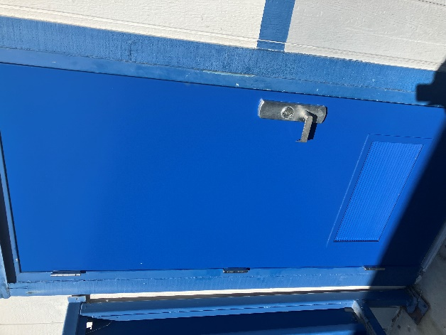
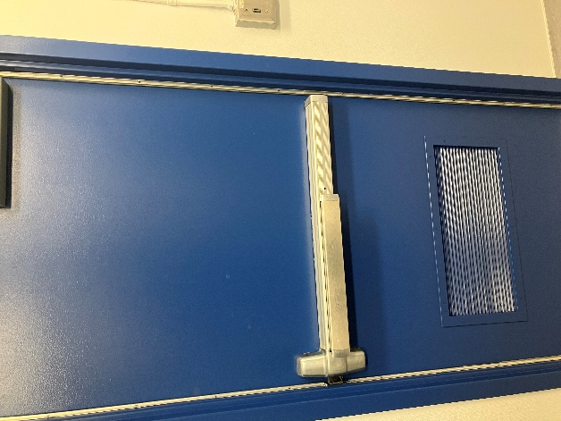
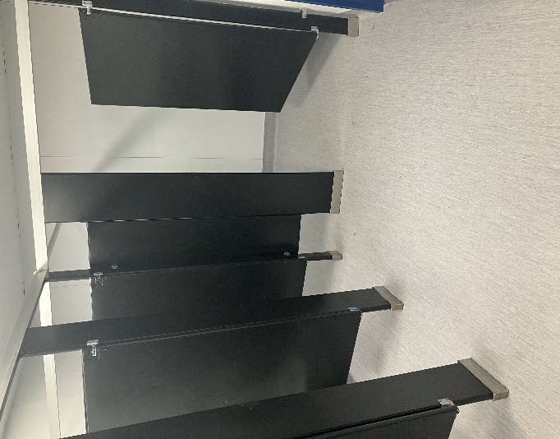
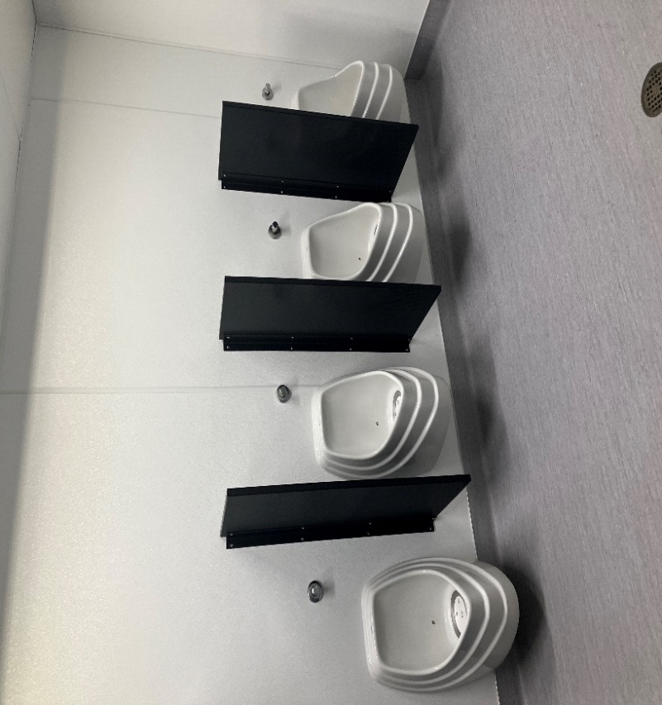
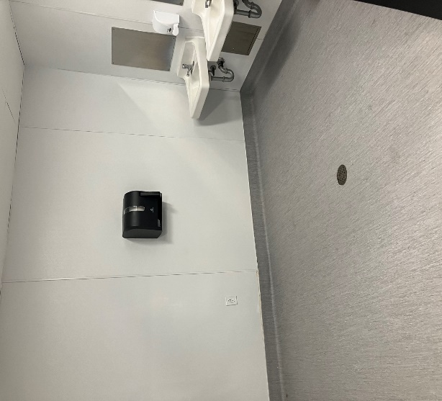
Projects Completed as of September 26, 2023
Lassalette – Restroom Upgrades (8/2023)
AFTER
BEFORE
BEFORE
AFTER
AFTER

Slide 6
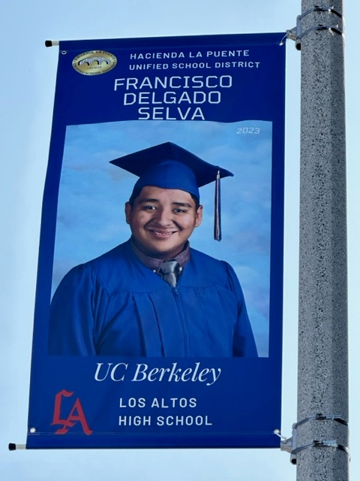
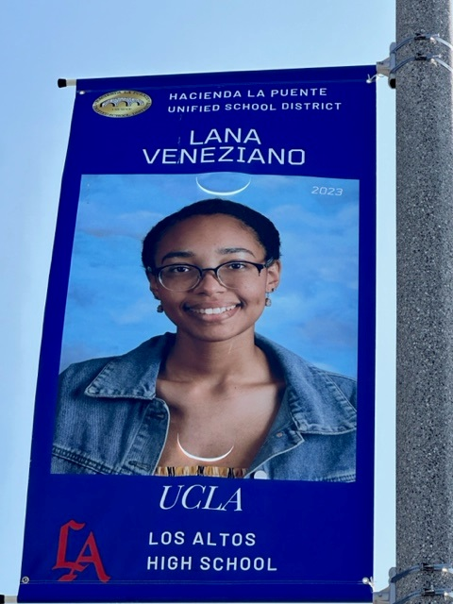
Projects Completed as of September 26, 2023
District Wide – College Banners
Los Altos Quad

Slide 7
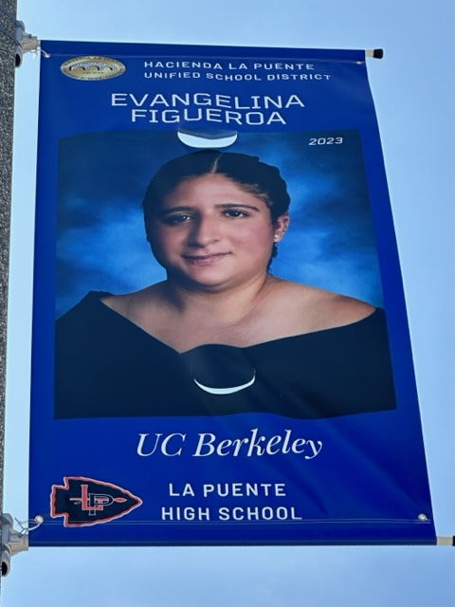
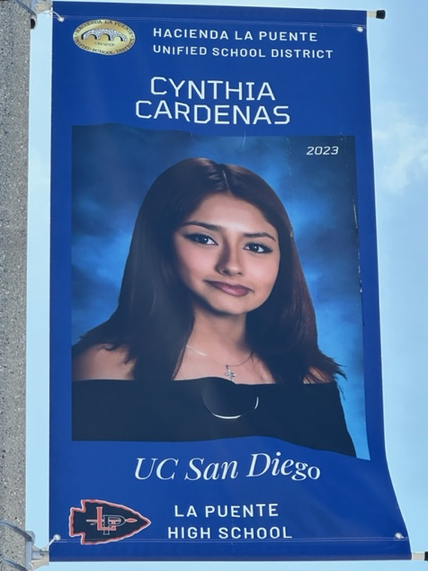
Projects Completed as of September 26, 2023
District Wide – College Banners
La Puente Quad

Slide 8
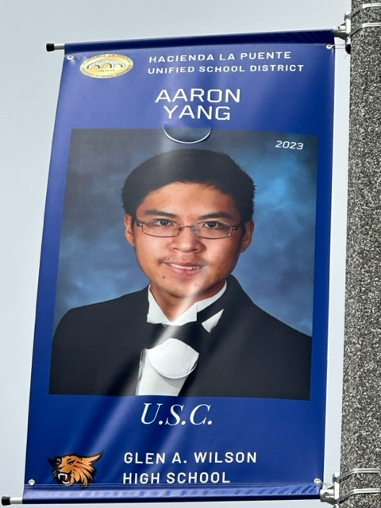
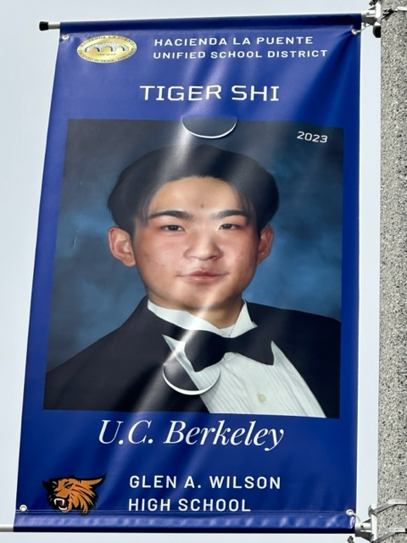
Projects Completed as of September 26, 2023
District Wide – College Banners
Wilson Quad
AFTER
AFTER

Slide 9
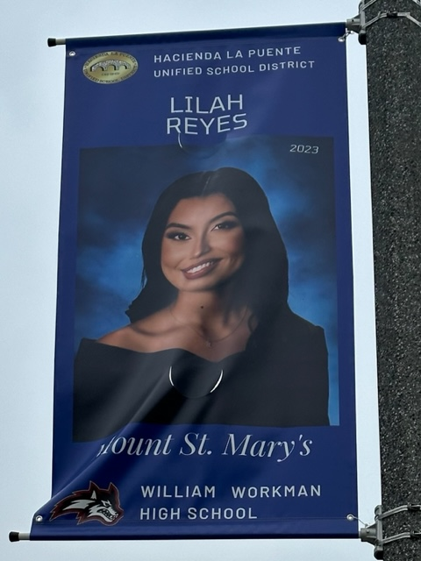
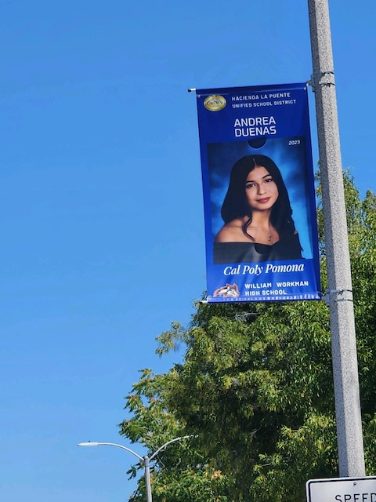
Projects Completed as of September 26, 2023
District Wide – College Banners
Workman Quad
AFTER
AFTER

Slide 10

Projects In Progress
2023-2024

Slide 11
Projects In Progress as of September 26, 2023
Site | Item Description | Architect Plans | DSA Approval | Procurement | Construct | Funding Source | Target Completion Date
Workman HS | Phase II Stadium and Baseball Field (Phase I Track & Field and Softball Field Complete) | Complete | Complete | In Progress | Pending | Various - Estimate Cost $18 M | 12/2024
Baldwin ES Cedarlane Fairgrove Lassalette Sparks ES | Blacktop Asphalt & Striping | NA | NA | Bidding | Pending | Facilities | 12/2023
California ES Cedarlane District Office Bldg C Grazide ES Lassalette Los Altos HS SSC (Sierra Vista) Sparks ES Stimson LC Valley Alt HS – CDS Workman ES 6/27 Workman HS | Reroof Various Buildings | In Progress | NA | Complete | In Progress | Deferred Maint. | 01/2024
Wedgeworth | K-5 Permanent School | Complete | Complete | Complete | In Progress | COPS | 06/2025
Dibble AS | HVAC Replacement | Complete | NA | Complete | In Progress | Adult Ed | 12/2023
Willow AS | HVAC Replacement | Complete | NA | Complete | In Progress | Adult Ed | 12/2023
Willow AS | Fire Alarm Installation | Complete | NA | Complete | In Progress | Adult Ed | 12/2023

Slide 12
Projects In Progress as of September 26, 2023
Site | Item Description | Architect Plans | DSA Approval | Procurement | Construct | Funding Source | Target Completion Date
Dibble AS | Fire Alarm Installation | Complete | NA | Complete | In Progress | Adult Ed | 12/2023
Center for the Performing Arts | Site Demolition | Complete | NA | Complete | In Progress | Adult Ed | 10/2023
District Office | Fuel Station Repairs | NA | NA | Complete | 09/2023 | Facilities | 10/2023
District Office | Portable Installation meeting/flex space | Complete | NA | Pending | 11/2023 | Facilities | 02/2024
Willow AS | Two Story Renovation | Complete | NA | Complete | In Progress | Adult Ed | 02/2024
District Office | Warehouse Freezer | Complete | NA | Pending | Pending | Food Services | 04/2024
Wing Lane ES | Headstart Portable | Complete | Pending | Pending | Pending | Child Development | 02/2024

Slide 13
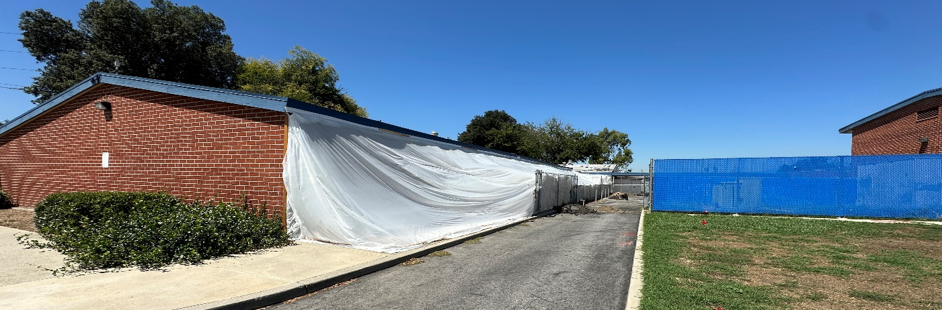
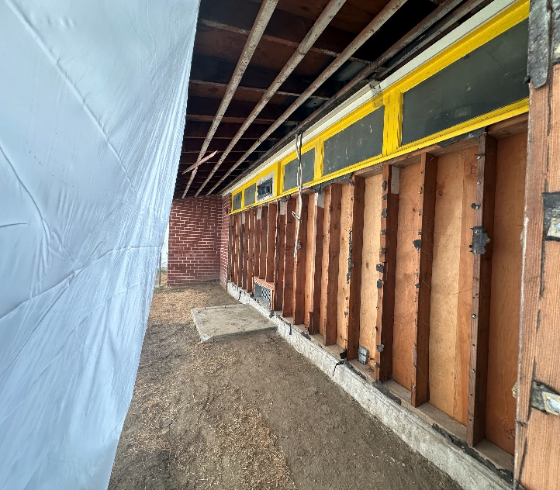
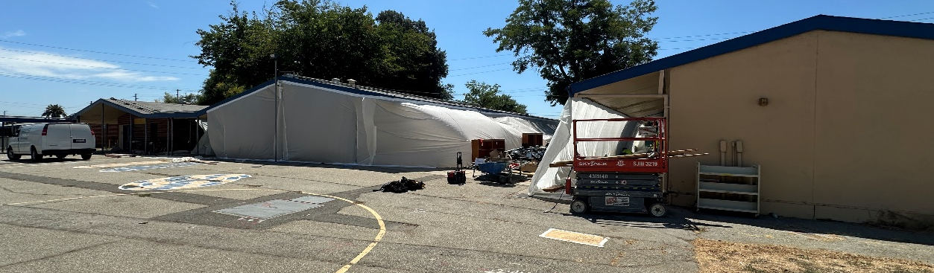
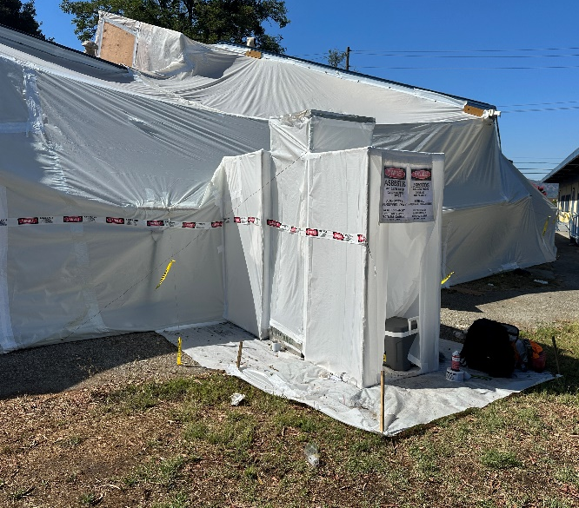
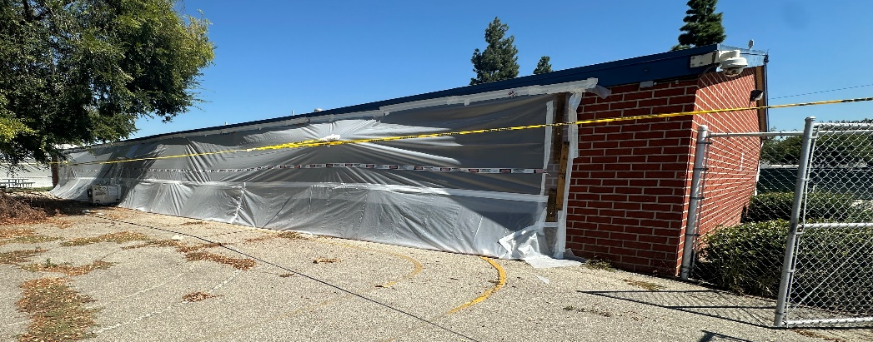
Projects Completed as of September 26, 2023
Center for the Performing Arts Update
BEFORE
AFTER
AFTER

Slide 14
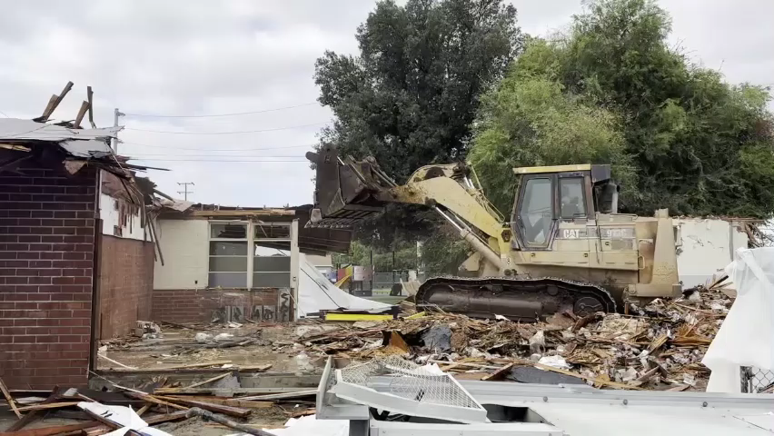
Projects Completed as of September 26, 2023
Center for the Performing Arts Update

Slide 15
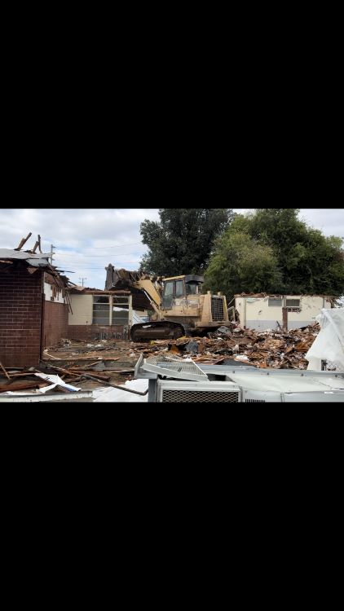
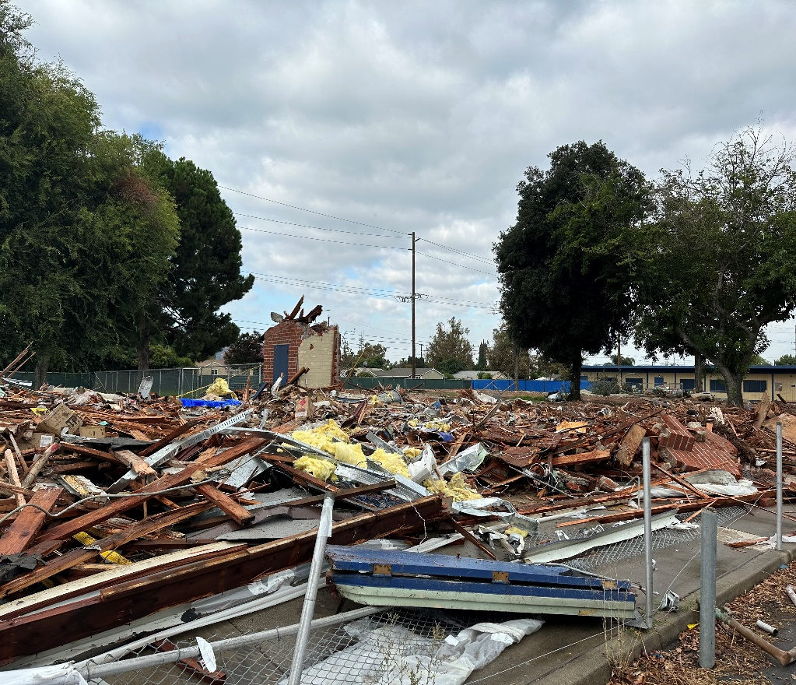
Projects Completed as of September 26, 2023
Center for the Performing Arts Update
AFTER

Slide 16

Projects with Division of State Architect (DSA)
Waiting on Approval
Site | Item Description | Architect Plans | DSA Approval | Procurement | Est. Construct Start | Target Completion Date
Los Altos HS | Gym & Locker Room HVAC (65 tons of temporary HVAC units have been installed) | Complete | Pending | Complete | TBD | Approx. 3 months after DSA approval
Kwis Elementary | Baseball Fields (Two Youth) | Complete | Approved (7/5/23) | In Progress | 11/2023 | 05/2024
Center for the Performing Arts | Construction of NEW Performing Arts Center with approx. 500 seat capacity | Complete | Pending | Pending | TBD | 02/2025
Projects in Design
Site | Item Description | Architect Plans | DSA Approval | Procurement | Est. Construct Start | Target Completion Date
Districtwide | HVAC System Replacements | Pending | Pending | Pending | TBD | TBD
Changes And Progress Since Last Report - Blue

Slide 17
Next Report – October 26, 2023

