Slide 1
HACIENDA LA PUENTE UNIFIED SCHOOL DISTRICT
La Puente Quad
Los Altos Quad
Wilson Quad
Workman Quad
School Site Improvement Projects
Regular Board Meeting November 9, 2023
Business Services

Slide 2
PROJECT COMPLETE LIST
2023-2024
Site | Item Description | Funding Source | Completed Date
District Wide | National Blue Ribbon Banners | District | 10/2023
Valinda | Bottle Filler (MPR) | Facilities | 10/2023
Wedgeworth | Bottle Filler (MPR) | Facilities | 10/2023
Newton | Exterior Paint Basketball Backboards | Facilities | 10/2023
La Puente HS | Pool Gate Closures | Facilities | 9/2023
Los Altos HS | Boys Locker Room Wall Repairs | Facilities | 9/2023
Equity & Access | Parking Lot Re-Striping | Facilities | 9/2023
District Office | Reflooring (Education Services) | Facilities | 9/2023
District Office | Wayfinding & Accessible parking in Police Dept. | Facilities | 8/2023
Lassalette | Restroom Upgrades | Facilities | 8/2023
Wing Lane | K1 & K2 Flooring | Facilities | 6/2023
La Puente HS | Weight Room – Flooring and Painting | Facilities | 6/2023
Amar | Ramp Repair | Child Development | 6/2023
Mesa Robles | Kinder Asphalt | Facilities | 6/2023
Nelson ES | Asphalt Slurry and Paint | Site | 7/2023
Bixby | Parking Lot Re-Striping | Facilities | 7/2023
Del Valle | Parking Lot Re-Striping | Facilities | 7/2023
Nelson Elementary | Parking Lot Re-Striping | Facilities | 7/2023
Sierra Vista MS | Parking Lot Re-Striping | Facilities | 7/2023
Sparks ES | Parking Lot Re-Striping | Facilities | 7/2023
Sparks MS | Parking Lot Re-Striping | Facilities | 7/2023
Changes And Progress Since Last Report - Blue

Slide 3
PROJECT COMPLETE LIST
2023-2024
Site | Item Description | Funding Source | Completed Date
Fairgrove | 3 Bottle Filling Station | Facilities | 7/2023
Kwis | 3 Bottle Filling Station | Facilities | 7/2023
La Puente HS | 2 Bottle Filling Station | Facilities | 7/2023
Sparks MS | 3 Bottle Filling Station | Facilities | 7/2023
Wilson HS | 3 Bottle Filling Station | Facilities | 7/2023
Stimson Building / Adjacent District Equity & Access | Refurbish (Facilities, Flooring, Painting, Ramp, and Roofing) | Facilities | 7/2023
Valley HS | C1 & C2 Renovations (Ceiling Tiles, Flooring and Painting) | Facilities | 7/2023
Cedarlane | Synthetic Turf | Facilities | 7/2023
Changes And Progress Since Last Report - Blue

Slide 4
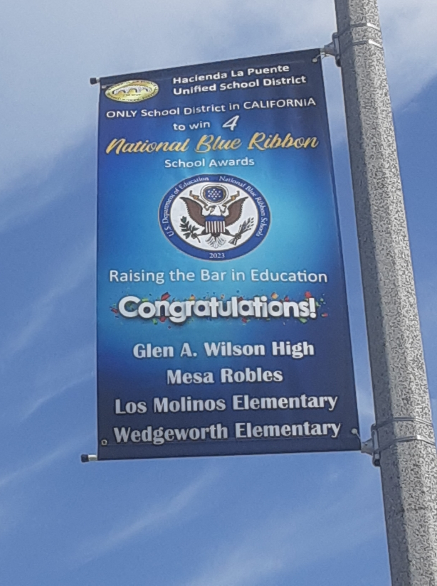
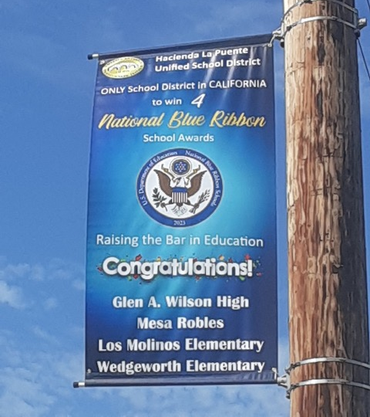
Projects Completed as of October 26, 2023 District Wide – National Blue Ribbon Banners (10/2023)
BEFORE
AFTER

Slide 5
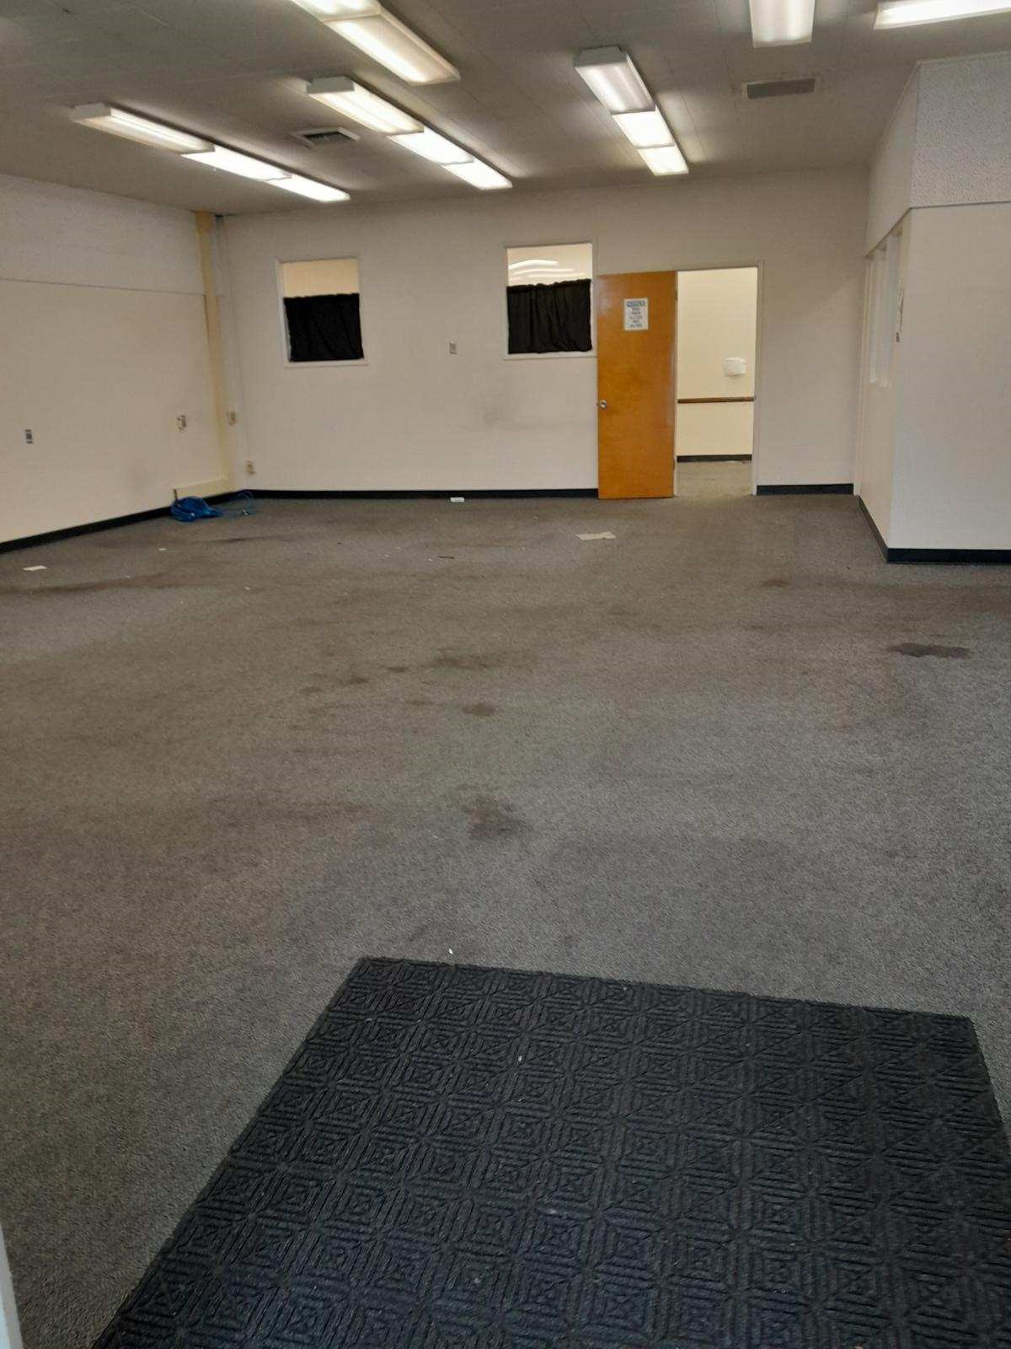
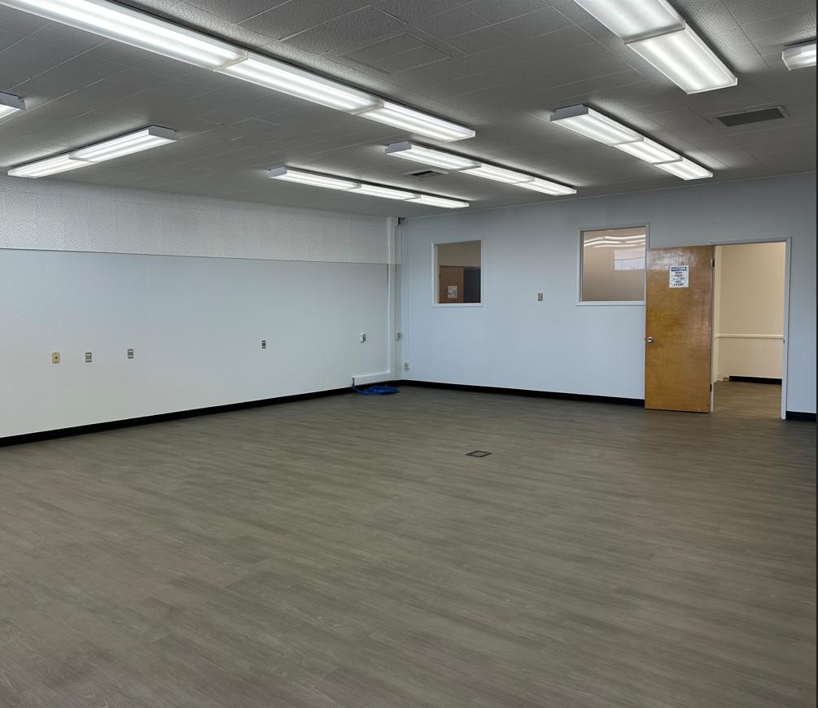
Projects Completed as of October 26, 2023 District Office – ReFlooring Education Services (9/2023)
BEFORE
BEFORE
AFTER

Slide 6
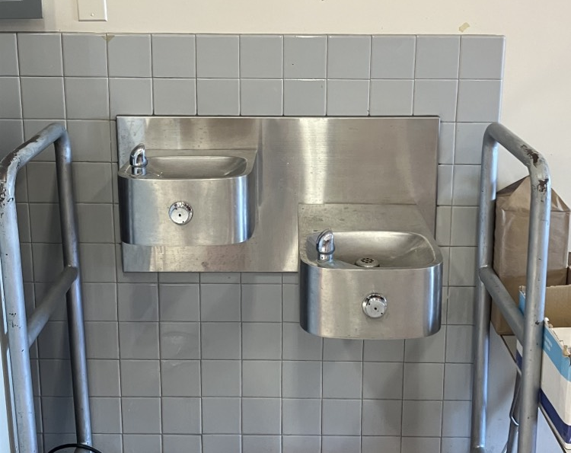
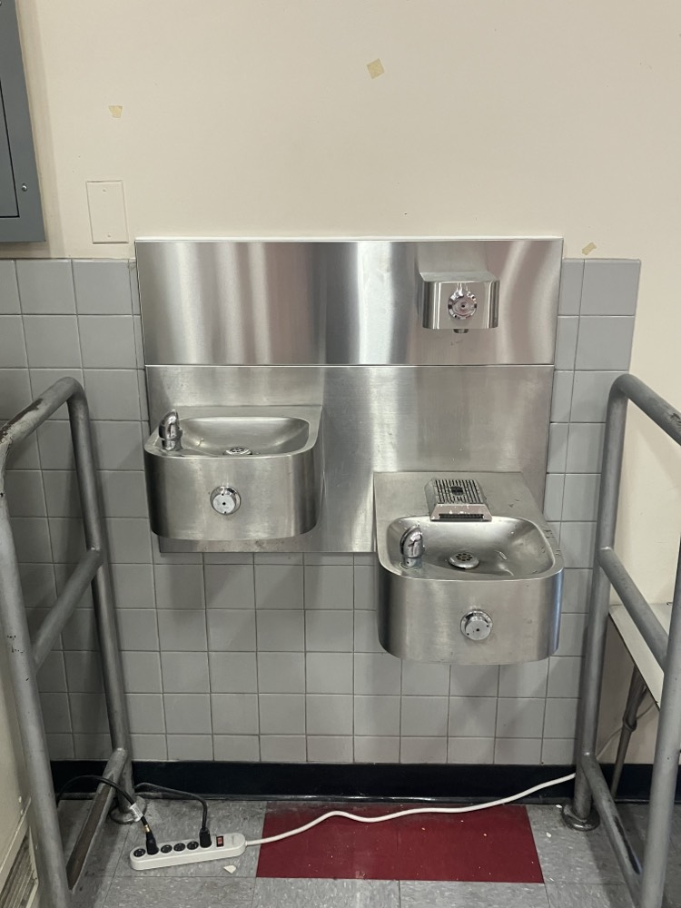
Projects Completed as of October 26, 2023 Valinda MPR – Bottle Filler (10/2023)
BEFORE
AFTER
BEFORE

Slide 7
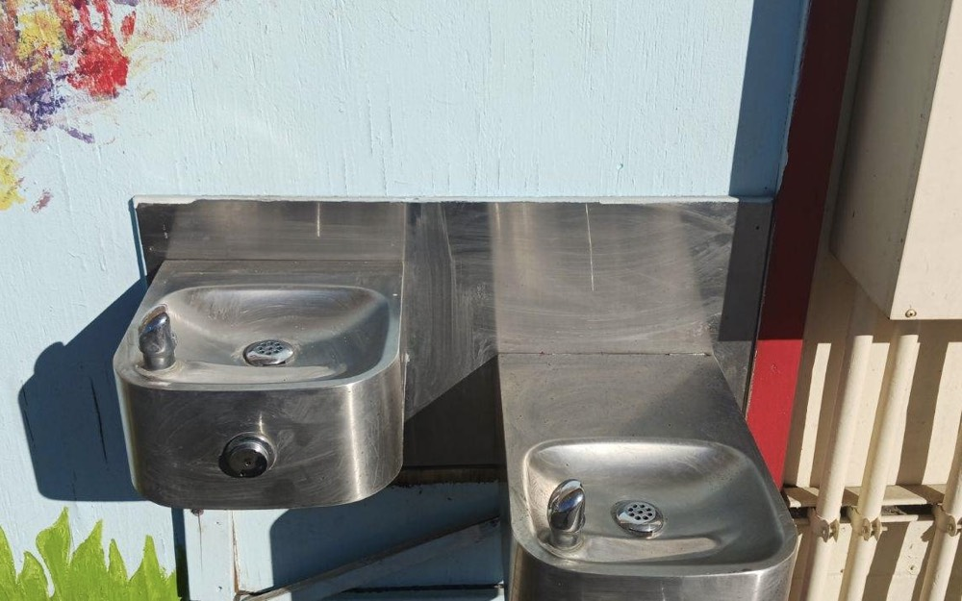
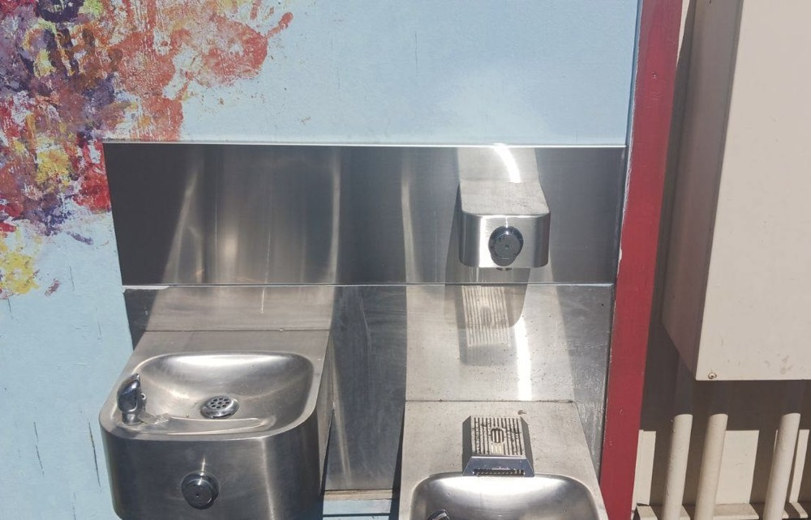
Projects Completed as of October 26, 2023 Wedgeworth – Bottle Filler (10/2023)
BEFORE
AFTER
BEFORE

Slide 8
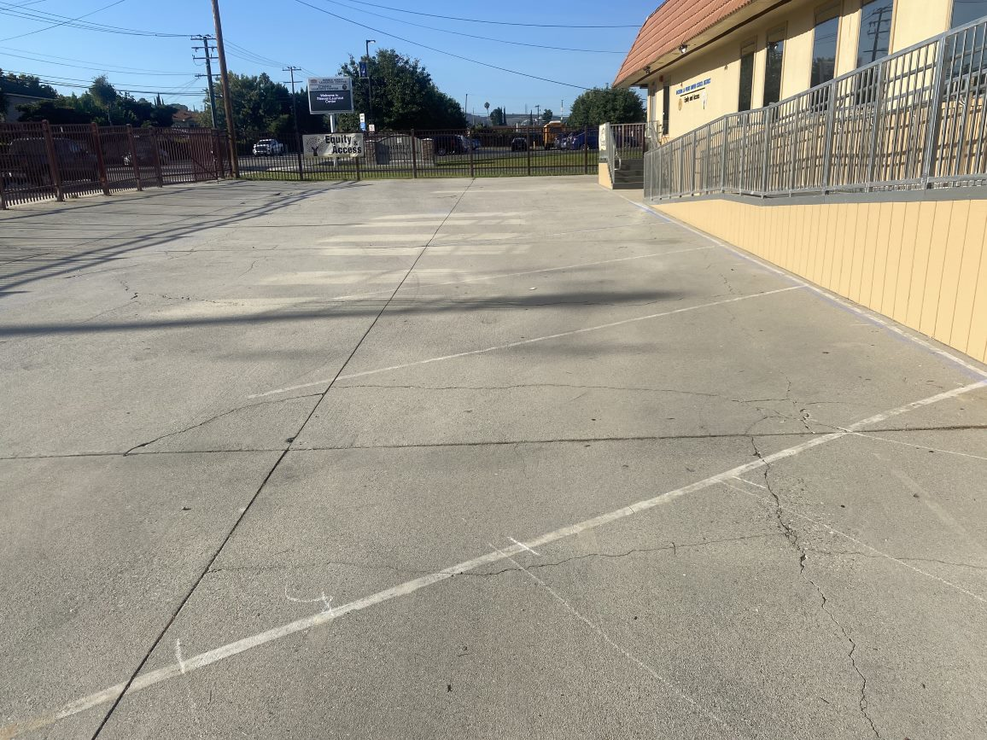
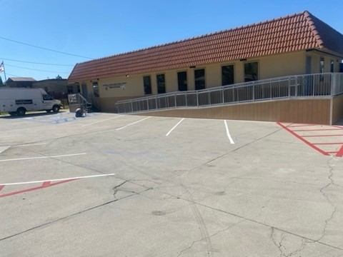
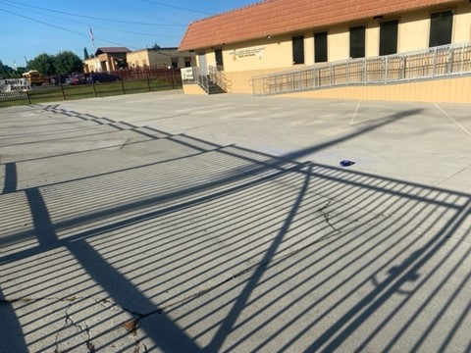
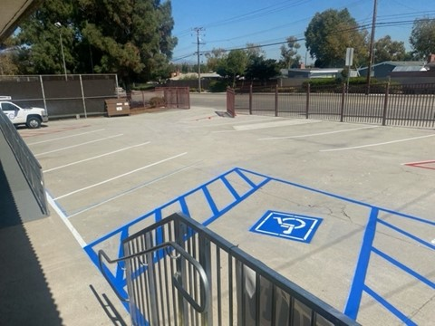
Projects Completed as of October 26, 2023 Equity & Access – Parking Lot Re-Striping (9/2023)
BEFORE
AFTER
BEFORE
BEFORE
AFTER
AFTER

Slide 9
Projects In Progress
2023-2024

Slide 10
Projects In Progress as of October 26, 2023
Site | Item Description | Architect Plans | DSA Approval | Procurement | Construct | Funding Source | Target Completion Date
Baldwin ES Cedarlane Fairgrove Lassalette Sparks ES | Blacktop Asphalt & Striping | NA | NA | Bidding | Pending | Facilities | 12/2023
Willow AS | Fire Alarm Installation | Complete | NA | Complete | In Progress | Adult Ed | 12/2023
Dibble AS | HVAC Replacement | Complete | NA | Complete | In Progress | Adult Ed | 12/2023
Willow AS | HVAC Replacement | Complete | NA | Complete | In Progress | Adult Ed | 12/2023
Wedgeworth | K-5 Permanent School | Complete | Complete | Complete | In Progress | COPS | 06/2025
California ES Cedarlane District Office Bldg C Grazide ES Lassalette Los Altos HS SSC (Sierra Vista) Sparks ES Stimson LC Valley Alt HS – CDS Workman ES 26/27 Workman HS | Reroof Various Buildings | In Progress | NA | Complete | In Progress | Deferred Maint. | 01/2024
Workman HS | Phase II Stadium and Baseball Field (Phase I Track & Field and Softball Field Complete) | Complete | Complete | In Progress | Pending | Various - Estimate Cost $18 M | 12/2024
Changes And Progress Since Last Report - Blue

Slide 11
Projects In Progress as of October 26, 2023
Site | Item Description | Architect Plans | DSA Approval | Procurement | Construct | Funding Source | Target Completion Date
Kwis Elementary | Baseball Fields (Two Youth) | Complete | Complete | In Progress | 01/2024 | County & TBD | 07/2024
Dibble AS | Fire Alarm Installation | Complete | NA | Complete | In Progress | Adult Ed | 12/2023
District Office | Fuel Station Repairs | NA | NA | Complete | 09/2023 | Facilities | 11/2023
Center for the Performing Arts | Site Demolition | Complete | NA | Complete | Complete | Adult Ed | 10/2023
Center for the Performing Arts | Construction of NEW Performing Arts Center with approx. 500 seat capacity | Complete | Complete | Pending | 02/2024 | Adult Ed | 08/2025
District Office | Portable Installation Meeting/Flex Space | Complete | NA | Pending | 11/2023 | Facilities | 04/2024
Willow AS | Two Story Renovation | Complete | NA | Complete | In Progress | Adult Ed | 02/2024
District Office | Warehouse Freezer | Complete | NA | Pending | Pending | Food Services | 04/2024
Changes And Progress Since Last Report - Blue

Slide 12
Projects with Division of State Architect (DSA) Waiting on Approval
Site | Item Description | Architect Plans | DSA Approval | Procurement | Est. Construct Start | Target Completion Date
Los Altos HS | Gym & Locker Room HVAC (65 tons of temporary HVAC units have been installed) | Complete | Pending | Complete | TBD | Approx. 3 months after DSA approval
Wing Lane ES | Headstart Portable | Complete | Pending | Pending | TBD | TBD
Projects in Design
Site | Item Description | Architect Plans | DSA Approval | Procurement | Est. Construct Start | Target Completion Date
Districtwide | HVAC System Replacements | Pending | Pending | Pending | TBD | TBD
Changes And Progress Since Last Report - Blue

Slide 13
Next Report – January 2024

