Slide 1
FISD PTO Training
2023-2024

Slide 2
Before we begin ...
Will work through manual together.
Manual page numbers are on the slides.
Ask questions as they arise.
The manual is a fluid document. If guidelines change, we will make an amendment.
The manual is posted to the Booster Club/ PTO section on the Finance Department webpage.

Slide 3
Resources - Pg 3
IRS (Internal Revenue Service)
IRS Exempt Organization (EO) hotline |  | 877-829-5500
 | · EIN or Exempt status verification · Tax questions
Texas Comptroller’s Office
General questions – Sales tax number, Filing help, Exemption | 800-252-5555
WebFile help – WebFile number, login | 800-442-3453
Franchise Tax help | 800-252-1381
University Interscholastic League
UIL Booster Club Contact | policy@uiltexas.org | 512-471-5883

Slide 4
Calendar - Pg 4
2023 | Month | Day | Item due
 | September | 1 | Audit packets due to Business Manager via fax, email or mail.
 | October | 20 | Quarterly sales tax due to Texas Comptroller’s Office (3rd quarter) ⁽¹⁾
 | November | 15 | Form 990-N (e-postcard), 990-EZ or 990 due to IRS ⁽²⁾
 | December | NOTHING DUE

Slide 5
Calendar - Pg 4
2024 | Month | Day | Item due
 | January | 20 | Quarterly sales tax due to Texas Comptroller’s Office (4th quarter) ⁽¹⁾ ---or---- Annual sales tax due to Texas Comptroller’s Office ⁽¹⁾
 | February | NOTHING DUE
 | March | NOTHING DUE
 | April | 20 | Quarterly sales tax due to Texas Comptroller’s Office (1st quarter) ⁽¹⁾
 | May | 15 | Franchise tax due to Texas Comptroller’s Office ⁽³⁾
 | June | NOTHING DUE
 | July | 20 | Quarterly sales tax due to Texas Comptroller’s Office (2nd quarter) ⁽¹⁾
 | August |  | District Held PTO Training
 | September | 1 | Audit packets due to Business Manager via fax, email or mail.

Slide 6
Calendar - Pg 4 cont.
Notations
(1) PTO’s either file quarterly or annual sales tax. Check with your predecessor on how the club files. Please call the Texas Comptroller’s Office with any questions.
(2) Federal taxes are due 15 days after the 5th month of the club’s year end. The majority of clubs have a year-end of June 30, which calculates to a due date for federal taxes of November 15.
(3) Tax-exempt organizations should not have to file Franchise Tax. If the club receives a notice to file, please log into WebFile and file for the year. Afterwards, please call Becky Yawn for information on removing this requirement via Form AP-204.

Slide 7
Definition of Roles - Pg 9
Members
Work with sponsor
Members cannot direct the activities of a sponsor
Sponsor
Liaison between you and the school
Should work with you during budget time
District Administration
Approves new booster clubs
Has the option to dissolve booster club for in supportability
FISD may audit booster club at any time

Slide 8
Bylaws - Pg 7
Operating rules of club
Will help resolve or avoid conflict
May need to be updated as circumstances arise
What happens if President resigns?, etc.
Business Manager does not need to see every year unless a change has been made

Slide 9
Student privacy / Social Media - pg. 25
Respect parents and student's privacy
Establish media release
Social media etiquette is expected of all parents
Principal will step in if violations are brought forth

Slide 10
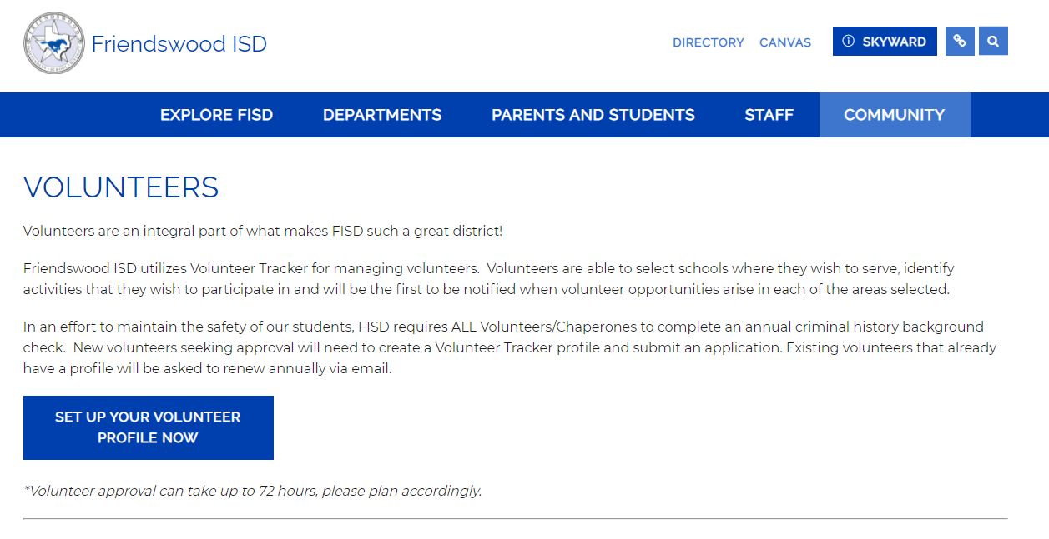
Background Checks

Slide 11
Three Buckets of Money – pg. 14
General Fund
Activity Fund
PTO Account

Slide 12
General Fund
Money is allocated each year by Department or Campus
Used for general needs of program
Use it or lose it. Balance does not roll into next year

Slide 13
Activity Fund
Money is NOT allocated by Principal or Department Head
Funded primarily by fundraisers or donations
Sponsor controls the use of funds through a District purchase order or check request
Balances roll from year to year
Activity Funds cannot reimburse Booster Clubs – TEA RULE

Slide 14
PTO Account
Exclusively Used by PTO
Sponsor cannot be a signer
PTOs control use of money
If PTO dissolves; all money must go back to the program at the school

Slide 15
Activity Funds – pg. 15
Manual (pg. 15) includes list of what school must buy vs. PTO may purchase
Donated money goes directly to the program and the school controls payments of invoice

Slide 16
Direct Funding
PTO pays invoices directly
Make sure you are clear that the invoice is for the PTO and NOT for FISD
Avoid sending invoices to campus unless you donate money to campus

Slide 17
Banking – pg. 17
PTO name on checks…not campus name
Bank statements should be reconciled within 30 days
Two signers are recommended
FISD employees CANNOT be check signers. FISD policy
Change signers immediately after elections
Refer to bylaws for additional guidance

Slide 18
Cash Handling Guidelines – pg. 21-22
Receiving Money
Receipt should be given
Two members should verify all deposits under dual signature
Deposit funds immediately in to PTO bank account
PTO funds should NEVER be deposited into personal bank accounts
Disbursing Money
All checks should be supported by an invoice
Blank/signed checks should not be given
Two signatures on checks, best practice

Slide 19
Safeguarding Money – pg. 22
Do not keep PTO funds in a car, unlocked drawer, or any other unsecure place
District will NOT replace stolen funds
Money received and not yet deposited should not be used for personal purchases, check cashing, loans, etc.

Slide 20
E-Commerce: Accepting Credit Cards – pg. 19
Okay to use Square, PayPal, Venmo, etc.
Discounts available for 501c3 status
Save receipts!

Slide 21
Donations – pg. 17-18

Slide 22
Outside donors PTO
PTO receives monetary or non-monetary donations from outside donors
Provide tax-deductible receipt if club is tax-exempt

Slide 23
Outside donors Booster club
Monetary Donation
PTO donates money to school to cover cost of camp, costumes, travel, etc.
Bookkeeper/Secretary should issue you a Donation Form
Non-Monetary Donations
Check with school or coach first to see if District can accept
FISD pays title and insurance on vehicles or trailers donated
Donation becomes property of District
If District needs to dispose of asset, the funds will be placed in the activity fund account

Slide 24
PTO Another cause
PTO may donate a small amount to local charity
Example – student medical fund
However – IRS defines “not a substantial portion” may go to another cause
Cannot donate from an Activity Fund Account
If you host an event of which the proceeds benefit an outside cause, let your donors know

Slide 25
Fundraising – pg. 19-20
Principals should approve your fundraiser in advance to avoid simultaneous campaigns
Students cannot be excluded from an activity if they do not fundraise

Slide 26
Crowdfunding – pg. 16
Be careful and aware of fees. Many providers will offer lower rates for 501c3 entities.

Slide 27
Raffles – pg. 22-23
The Charitable Raffle Enabling Act under the authority of the Attorney General of Texas governs raffles
Money prohibited as prize. Money includes coins, paper currency, CD’s, etc.
May host two raffles per year if a qualified 501c3 organization
Refer to statute and seek legal advice prior to hosting a raffle
Bingo’s are governed under the Bingo Enabling Act and are NOT permitted

Slide 28
Scholarships – pg. 25
Not required. Offer if your club is able to provide.
Budget accordingly.
Be fair and consistent. Detail procedures in bylaws or scholarship applications.
Funds should be sent directly to the university. Never to the student.
Students who receive a “full-ride” may not be able to accept scholarship – check with university to see.

Slide 29
Gifts/awards – pg. 21
Students
Only Seniors are allowed a $70 gift which must be used on a memento such as a plaque or award. Award must be given after UIL eligibility no longer applies. No cash or gift cards. See UIL Guidelines
Volunteers
Money or gift cards given as a “thank you” or incentive are considered compensation per the IRS
Donations
Donated gift cards can be used in silent auction or raffle or to purchase items for the organization; not individuals

Slide 30
Audit – pg. 16
Required each year.
Template can be downloaded from the Finance Department website.
2022-23 officers must complete before handover to 2023-24 officers.
New officers should implement recommendations.
Mail or email to Becky Yawn, ryawn@fisdk12.net

Slide 31
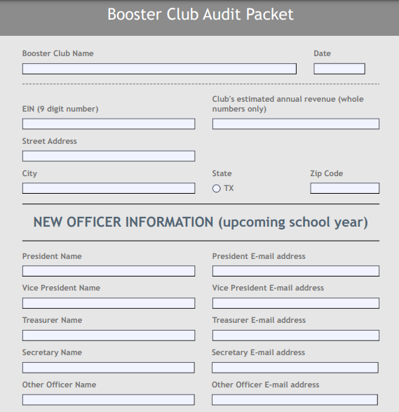

Slide 32
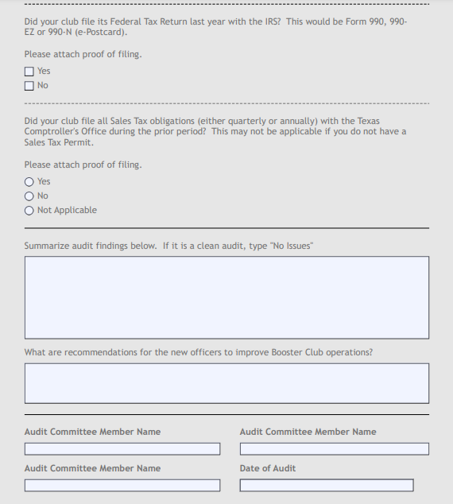

Slide 33
Carryover Balance – pg. 17
A small carryover is necessary for start-up for the following year.
No defined amount.
Budget will help figure out how much you need.
NOT required to distribute money to campus at the end of the year.
Do NOT save money for future years, unless voted by members.

Slide 34
Record Retention – pg. 42
IRS says keep records for 5 years.
You can scan and keep electronic copies.
All taxes, all bank statements, all receipts.

Slide 35
Dissolution of Club – pg. 7
PTOs can be shut down due to lack of support by majority vote of members or a District Administrator
Please do not walk away!
File and pay all taxes
Funds must be sent back to Activity Fund within 30 days
Give files sponsor

Slide 36
Advertising & Sponsorships – pg. 16
FISD manages advertising contracts on FISD property.
Email or call the Business Manager with questions.

Slide 37
Insurance – pg. 21
All PTOs are required to hold a General Liability policy
Send general liability certificate or insurance to Business Manager each year
Special events may require an additional coverage. Please contact your insurance agent for assistance.

Slide 38
IRS – pg. 35

Slide 39
Employer Identification Number
9 digit number - begins with any number
Must have your own EIN – apply online
Never use District EIN beginning in 74-600
Just because you have an EIN does not mean you are tax-exempt.
REMEMBER – always use YOUR EIN. NEVER FISD EIN

Slide 40
501c3 Rule #1 – pg. 37
Tax-exempt organizations must benefit a group as a whole instead of benefiting individual members.
All members of the student group should receive the same financial benefits.
Exception – Financial hardship
If the financial need criteria are met, the PTO may provide the necessary funds to allow the individual to participate, thus providing individual benefit due to special circumstances.

Slide 41
IRS Tax Filing Requirements – pg. 38
Federal tax return is due once per year
4 ½ months after the PTO’s year end
There are 3 different forms available for exempt organizations (990, 990-EZ, 990-N).
The form filed is determined by the PTO’s total income.

Slide 42
Which one to file? Pg. 38-40
Form 990
Form 990-EZ
Form 990-N or E-postcard

Slide 43
Form 990
Large PTO’s with revenues of more than $200,000
Not many PTO’s file this one
Paper form only
Must have Business Manager help you.
Very lengthy; lots of financial information requires.

Slide 44
Form 990-EZ
Medium sized PTO’s with revenue between $50,000 - $200,000
May be able to file 990-N based on averaging rule
Paper form
Requires disclosure of financial information.
Not many PTO’s file this form.

Slide 45
Form 990-N or E-postcard
Most Common
PTOs with revenues of $50,000 or less
PTOs with $50,000 average over 3 yrs.
Online only
Simple! No financials required.
Get accept/reject notice in 7 minutes.
If rejected, there is a reason!

Slide 46
990-n Rejection Reasons
Your PTO was revoked for failure to file taxes for the past 3 years.
Exemption never got filed.
Gross receipts are >$50,000.
CALL IRS TO CORRECT

Slide 47
State Comptroller’s Office – pg. 37

Slide 48
State Tax Basics – pg. 28
Must apply for federal 501c3 status 1st
Must apply for state exemption 2nd
Having a FEDERAL EXEMPTION does NOT mean the PTO has a State Exemption!
Form AP-204 – Application
Franchise Tax? If required to file, the PTO is not tax-exempt.
Texas Taxpayer ID is 11 digits
Begins with 1, 2, or 3

Slide 49
Sales Tax Permit – pg. 28
Must apply for one online if PTO plans to host more than two taxable fundraisers per year.
What is taxable? Page 42.
Do not apply for one if the PTO WILL NOT host more than two taxable fundraisers per year. (Jan-Dec)
Sales tax permits require you to file Sales Tax every quarter!

Slide 50
WebFile – pg. 32
All state taxes filed online.
State will not give FISD much info. You have to call!
Must have WebFile ID (begins with XT or RT)

Slide 51
Sales Tax Due Dates – pg. 33
Taxes due quarterly; 20 days after qtr.
March 31 > due April 20
June 30 > due July 20
September 30 > due October 20
December 31 > due January 20
Missed/Late Filing: $50 per occurrence
Can apply to file annually after 1 year of filing on time. Call the State

Slide 52
Change of Address
IRS
Address change processed through paper form (8822-b).
Will not receive notification that it has been processed.
Texas Comptroller’s Office
Change of addressed processed online.
Will receive confirmation.
PTO
Refrain from using campus address.
PO box recommended

Slide 53
Questions?

Slide 54
Contacts
Amber Petree Chief Financial Officer apetree@fisdk12.net 281-996-6609
Becky Yawn Business Manager ryawn@fisdk12.net 281-996-6619
Paula Pierce Director of Finance ppierce@fisdk12.net 281-996-6617

