Slide 1

Title I Clerks Meeting
Monday, September 29, 2014

Slide 2

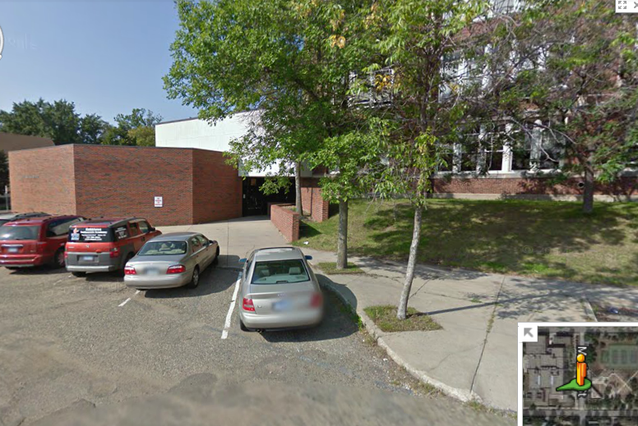
Title I Team
TITLE I OFFICE

Slide 3
Title I Team
Sherry Carlstrom
  General Title I, School Improvement, Budgets, Title I Programs
Lynn Moore
  General Title I, Non Public Programs,
Megan Cole
  General Title I, Neglected and Delinquent Programs, School Improvement
Jessica Kaul (Smith)
  Title I Accountability all Programs, Support to Director
Diane Brings
  Title I Clerk III, supporting Title I and Homeless Project REACH

Slide 4
Title I Team
Project REACH Staff
  Anne McInerney
  Homeless Program Supervisor, District’s Homeless Liaison
  Andrea Lindorfer
  Evening Tutoring Coordinator
  Wijit Xiong, Tracey Jackson, Karla Stewart and Laura Vallejo
  Home School Liaisons

Slide 5
Title I Team
Project REACH Staff
  Beth O’Keefe
  Social Worker
  Lily Tharoor
  Social Worker
  Cindy McGowan
  Transportation Coordinator
  Breelynn Lein
  Social Worker Intern

Slide 6

Accounting – Supporting TI
Located at 360 and part of the Business Office Supporting Title I
  Pamela Sanders Accounting Tech
  Peggy Cihlar Accounting Clerk

Slide 7
Highlights
Review of Title I Requirements
Title I Handbook
Policies and Procedures
Purchasing, Contracts, Inventory

Slide 8
Resources
The information discussed today will be available online at the Title I Website and we can email information as well.
http://title1.spps.org

Slide 9
Project REACH
Realizing the Educational Achievement of Children Experiencing Homelessness

Slide 10
Homeless Education Services
There is a homeless contact at each school
  Work with school’s homeless contact when coordinating referrals and transportation.
Use online referral system to refer for services: http://reachref.spps.org
  There are paper forms that can be used to gather information and then entered by the homeless contact person into online referral system.

Slide 11
Homeless Education Services
Use online referral system to refer for services: http://reachref.spps.org
  SPPS staff can consult on the appropriateness of a referral before making an online referral
  Before making a referral, the school should notify the family that the referral is being made
Project REACH staff determine eligibility; services are not guaranteed
  Principals can request enrollment clerks receive automated Project REACH emails regarding students at your school (confidential)

Slide 12
Points For Transportation Services For Project REACH Students
Regular busing should be accessed when available
“1 Unknown Address” - used by MARSS.
“1 No Address” - used when there is no address (i.e. living in car)
“1 New Address” – as a place holder when address has to be verified
Accurate address must be in Campus prior to making a referral to Project REACH
  If an address is changed after the bus has been routed, Transportation will need to reroute the bus.
  Change addresses with caution and check with Project REACH before changing addresses of siblings at other schools.
Work with your homeless contact to determine how you will receive transportation information on Project REACH students

Slide 13
Other Points to Remember
Non-custodial parents do not have the authority to request transportation changes
Daycare addresses should be confirmed and updated in Campus before making a referral to Project REACH
We have experienced delays after transportation has entered the address in Campus; please check regularly for added addresses
Do not change an address until the family moves. Homeless families often experience delays out of their control and do not move when expected.

Slide 14
Other Points to Remember
Students residing in shelter sites listed on the directory should be assigned the coded address in Campus under PRIMARY ADDRESS
List found on http://elearn.spps.org/
Use 360 Colborne #_____ with the above list of confidential addresses
If the address is not on the list, the address usually is a published address and the actual address can be entered in Campus
Remember the confidential nature of this information; do not share or copy the directory

Slide 15
New feature to reachref.spps.org
You can now add a sibling after referring a student on reachref.spps.org
After the first student is added, simply “click here to add an inclusion request for a sibling”
Parents name and address will pre-fill making it easier to add multiple siblings

Slide 16
Project REACH Information
Project REACH referral http://reachref.spps.org
Anne McInerney
anne.mcinerney@spps.org
Homeless Education
651-744-2565
www.homeless.spps.org

Slide 17
Title I Program of ESEA
Documentation and Compliance of Title I Requirements

Slide 18
Purpose
Improve education of disadvantaged students, especially those affected by poverty.
Provide supplemental funds that support student achievement.

Slide 19
Reframing Title I through the Lens of Racial Equity
To eliminate the racial achievement gap
  Implementing educational changes to promote racial equity and disrupt systemic racism by prioritizing Title I resources to improve teaching.
Title I priorities for 2014-15
  Family Engagement
  Intervention
    Math and Reading Instruction
    PBIS
  Professional Development
  K-Teaching Assistant (implementation of new K- model)

Slide 20

Schoolwide Title I Model
Title funds used to support schoolwide reform efforts to improve learning for all students.
Resources are tied to the school improvement plan (SCIP). If it doesn’t support the goals in the plan… don’t pay for it with Title I funds. www.scip.spps.org
    Resources are used to improve teaching and increase academic success.
    Reduce barriers for parents to be involved in their children’s education.

Slide 21

Title I Funding Threshold
Percent of students qualifying for Free or Reduced priced lunch.
  Elementary – 40%
  Secondary – 40%
    Middle/Jr. High Schools
    High Schools

Slide 22
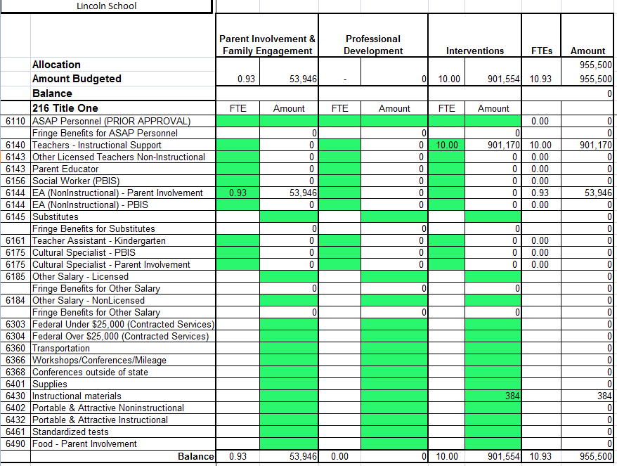
Title I Budget

Slide 23
Title I Funding – Class 2300
Parent Involvement | Professional Development Set Aside 20% | Title I Regular
Salary of PI person | Portion of salary - | Intervention Staff Salary
Taxi Cab/Bus Tokens | Priority Schools, Focus and Continuous Improvement Schools | Instructional Supplies
Food for Academic Events |  | Bus tokens for afterschool tutoring
Other Salaries (child care, interpreting) |  | Equipment (under $5,000) Portable and Attractive
Supplies for parent Inv.

Slide 24
Budget Process
Provide your principal with budget updates if he/she isn’t involved directly.
Proposed Budget expenditures must directly support key strategies in SCIP (this will get tighter).

Slide 25

Justification…
What it is…
Justification for the budget line item tied specifically to the SCIP.
Supports the SCIP goals and strategies.
  Should be able to align the expenditure with the plan.
Expenditure (WHAT) (WHY?)
Cuisenaire Rods for Math
Addition, Subtraction,
Fractions
Describe how it will support the goals and strategies in the SCIP, why is it necessary to the success of the grant.

Slide 26
Narrative -
The Principal should have a good idea of how his/her resources support overall school improvement and initiatives in the school for the year.
  If he/she needs help, the principal should be getting advice from a Principal mentor, his/her supervisor or his/her accountant should be meeting in conjunction with a program person or persons.

Slide 27

Budget Revisions
Revisions happen 2 times per year.
  October revision – if needed.
  February revision (final revision)
  Revisions outside of those dates must be in done in consultation and discussed prior to any decisions being made.
Title I eProcurement Close Date – March 27, 2015
  Be sure that Pam Sanders is included in budget decisions and Megan Cole or myself are part of the discussion when it involves complicated changes.

Slide 28
Title I Budget Revisions
There may be a need to do some revisions in October, but I am going to assume that those revisions will be few as compared to what has happened in the past.
  Based on information from Marie Schrul
  Not going to swap people from General Fund to Title or vs. versa.

Slide 29
Parent and Family Engagement
Parent Academy
  Supported by Title I through Family Engagement and Community Partnerships Office
  Coordinated and supported by school staff.
School Activities
  Conferences
  Title I Annual Meeting
  Compact (creation, review, sharing, dissemination),
  Family Engagement Plan (creation, review and sharing, dissemination)
  Family Events (Academic)

Slide 30
Parent Engagement
Post for Parents on Website:
  Notifications
    Parents Right to Know Teacher Qualifications
    School’s MMR Status (Priority, Focus, Continuous Improvement, Celebration Eligible/Celebration, Reward)
  Other Title I Required Documents
    Family Engagement Plan
    Family Friendly Copy of SCIP and Link to Full SCIP.

Slide 31
Parent Engagement
Provided Schedules for the Year
  Parent Academy
  Various District Parent Advisory Councils

Slide 32
Food for Parent Events (6490)
PREAPPROVAL REQUIRED
Submitting the Title I Order Form
Before the Event
Necessary and reasonable
Removes barriers to parent participation
Light snacks, not big meals
No desserts, cakes, ice cream, cookies, candy, etc.
Does it have an academic focus?
Did you attach a flyer/agenda?
Reasonable amounts of food are ordered for # of attending.
Shows academic focus, and sponsored by TI
Reasonable costs for food for number of people attending.
After the fact documentation includes original receipts.
Pcard shows includes TI approval and receipts.
Sign in sheets, show parents in attendance out number staff
Send to Peggy Cihlar

Slide 33



CAB POLICY
Title I cannot guarantee cabs will always be available to meet demand.
ALL Title I authorized cab rides must be logged into the Log. Failure to log rides may result in these actions:
  Occasionally - charges will be moved to the school general fund account.
  Persistent failure:
    1st time - warning and moved charges to general fund;
    2nd time - meeting with principal;
    3rd time - remove authorization to use Title I funds for cabs.
Taxi Cab service should only be used as a last resort. It is not a reliable form of transportation and not always a parent friendly form of transportation.
Pg. 36-38

Slide 34
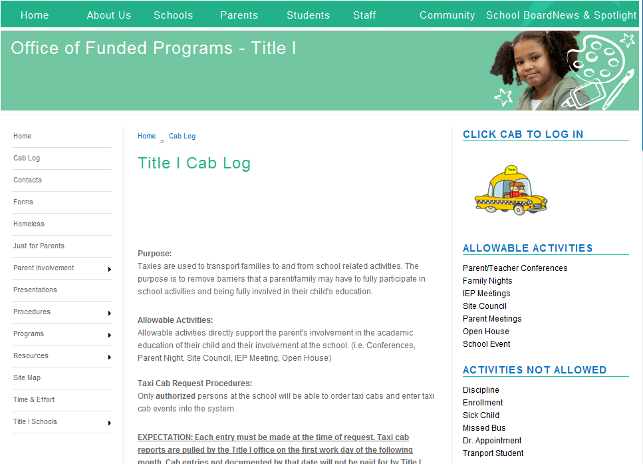
Step 1
Step 2
Click on Cab

Slide 35
Taxi Cabs and Bus Tokens Under Parent Involvement
Ordering Procedures
  City Wide- personal 3 digit ID assigned by Title I.
  Yellow Cab – 3 digit business ID.
Logging Orders
  Cab Log on Title I website.
  Identify yourself by your assigned 3 digit ID when entering.
City Wide
Yellow Cab
Please do not put in your district ID

Slide 36

Bus Tokens / Bus Cards
Pre Approved
Parent involvement or students staying for tutoring / academic support after school.
Must keep a disbursement log. Attach the log when you order new cards/tokens.
When approved, order the tokens from Transportation.
Purchases not pre approved will be moved to general fund budget.
Pg. 34

Slide 37
Bus Tokens / Bus Cards
Pre Approved
Submit TI Order Form for Preapproval
  Attach your bus log if you have one from previous rides.
Once approval has been given, the approval will show up in the your work list.
Email the approved Title I Order Form to Sean Johnson in transportation to place your order. Do not order directly from Metro Transit.

Slide 38
Personnel Activity Reporting
(Time and Effort)
Employee is paid from multiple funding sources (federal, non-federal) regardless of job duties.
  Bi-weekly time and effort through PeopleSoft.
  Supervisor must approve bi-weekly through PeopleSoft.
Employee is 100% funded by federal funds.
  Semi-Annual certification completed on PeopleSoft by supervisor. (January 1 and July 1)
Notes:
If there are issues with this (employees no longer on Title I, etc… contact Pam Sanders).

Slide 39
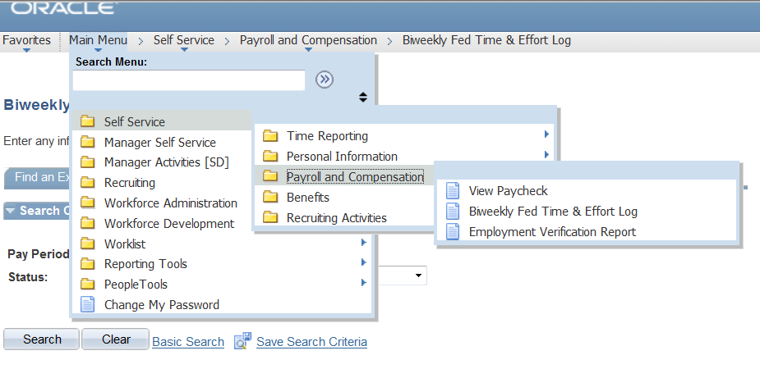
Personnel Activity Reporting
(Time and Effort)

Slide 40
Hiring Teachers – Title I
Teachers who are hired on a variance may not be paid for with Title I funds.
To be paid by Title I, the teacher can only work in the areas for which he/she has a full license.
  Middle school licensed teacher is not licensed to teach in the elementary.
  Elementary teacher cannot teach mathematics to 7th and 8th grade students unless their license includes grades 7 & 8 mathematics.
Schoolwide TI Schools must be 100% HQ Teachers – Letters will be sent to families if a teacher – teaching core is not HQ.
Pg. 15

Slide 41
Other Salaries
(account code 6184 – Non Licensed and 6185 Licensed)
Regardless of the code the following is true.
  You don’t need pre-approval for child care, interpreting.
  You do need pre-approval to pay additional salaries for any other purpose.
Title I Order Form for Pre--Approval

Slide 42
Other Salaries (object code 6184/6185)
6184 (non-licensed)
  Child care provider
  Some interpreters
  Possibly someone to coordinate PI activities after hours.
6185 (licensed)
  Licensed staff (teachers, social workers, etc).
Please Send to Peggy before Payroll!
Supplemental Pay Form
Time Sheets
Proper payment to workers from Title I

Slide 43

Substitutes (6145)
Substitutes (6145) to support professional development activities only.
Title I Order Form
Will be given an event code.
We are still waiting to find out exactly how billing will work.

Slide 44

Substitutes (6145)
Key is to be sure to include number of substitutes needed, the purpose or activity requiring the need for subs.
  To allow classroom teacher to participate in Math workshops.
  Allow teachers to work together in PLC / Leadership meetings

Slide 45
Instructional Supplies (6430, 6432)
Almost all supplies paid for with Title I funds in a schoolwide program should be 6430 or 6432.
  Supplemental instructional materials
  For instruction of students
  Tied to goals and strategies in SCIP
Best advise: If you have Title I money for Supplies – use it for big instructional purchases, not little supplies and materials.
Send invoices, etc. to Inna in Accts. Payable

Slide 46
Non Instructional Supplies (6401)
Only time to use 6401 is when you are purchasing professional development materials for teacher use (books).
Send invoices, etc. to Inna in Accts. Payable
Pg. 47

Slide 47
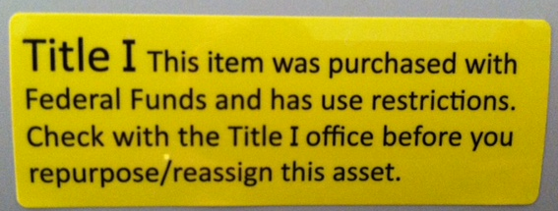

Portable and Attractive - Jim
(6432, 6402 – not used by TI Schools, mainly program staff)
Portable and Attractive

Slide 48
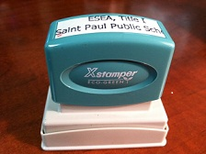
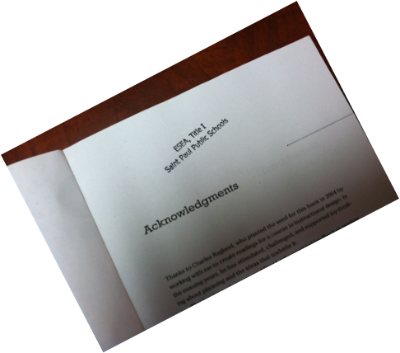
Other Materials Purchased with Title I
Anything with a shelf-life of more than one year must be labeled as “Property of Title I.”
Contact our office for inked stamps to use on books, etc.

Slide 49

Consultants and Contracts 6303/6304
Contract must include specific deliverables and time lines.
Can make periodic payments for work completed, no lump sum payments.
Contract must be in place before the work begins.
6303 used for consultants and contracted services up to $25,000.
6304 used for consultants and contracted services over $25,000
Use district procedures for contracting.

Slide 50
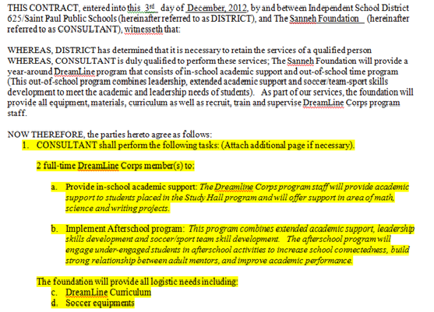
Contract template
Deliverables

Slide 51
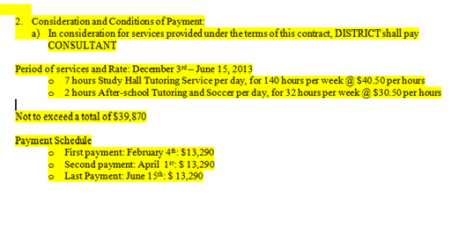
Contract Template
Deliverables need to be specific so you can determine if contractor provided service you paid for.
Conditions of Payment

Slide 52
Contract Scenario
An Artist in Residence will be coming to the school for 2 months and to provide classes for all 6th grade students. The resident artist will also provide support and professional development to the teachers of those same students to incorporate the arts into their lessons.

Slide 53
Contract Terms
Deliverables
  Provide art class for 6th grade students; 1 class per week for each of 4 classrooms total over the course of 2 months (not to exceed a total of 32 lessons. $50 per teaching hour and 12.50 per class hour for prep.
  Provide1 hour of consultation with each teacher, each week and one, 1 hour classroom model/co-taught lesson with each teacher, each week.

Slide 54
What are the contract terms?
4- 6th grade classes meet once a week for 1 hr.
Paid $50.00 per hour for teaching, and consulting
12.50 per 1 hour of course work for preparation
  2 months (8 days x 4 classes per day) =32 classes
    32 x $50.00 = $1600.00
    32 x $12.50 = $ 400.00
4 -6th grade teachers meeting two sessions per week for consulting and demonstration lessons
  2 months (16 sessions x 4 ) = 64
    64 x $50.00 = $3200.00
TOTALS…$1600.00+$400+$3200 = $5200

Slide 55
Contract Terms
NOW THEREFORE, the parties hereto agree as follows:
CONSULTANT shall perform the following tasks: This is where you put what they will be doing… In Consideration of the Terms of this Contract…
Consideration and Conditions of Payment:
  In consideration for services provided under the terms of this contract, DISTRICT shall pay CONSULTANT:
Lump Sum payment of $ ______.
  Per unit rate at the rate of $_2600___ per month not to exceed $_5200____.
Payments shall be made by DISTRICT within 35 days after receipt of a valid complete invoice. Invoice must be presented after receipt of satisfactory services and/or materials/equipment. Invoice shall include the following: complete name and address of

Slide 56
Contract Issues
Contract for services was not developed until the day of or after services were delivered.
Contract is signed and dated after date of service and entered into eprocurement after date of service.
Terms of the contract are vague.
Terms of the contract require payment before all services are rendered or does not allow for partial payment of rendered services.

Slide 57
Contract Issues
Lump Sum Payment
  Look at dates of service happen after date of payment due.
Partial Payments (monthly, quarterly, after so much work is completed)
  Partial payments are expected, but not clear what services the partial payments cover in the deliverables.
Vendor must be told how they SPPS expects to receive a detailed invoice with detailed accounting of deliverables that are aligned to the contract terms.

Slide 58

Conferences and Travel 6366 – No Overnight stay
No overnight stay and the meeting or conference is in Minnesota
Complete the Title I Order Form
  Include supporting documents.
When approved.
  Submit a voucher for payment to the vendor.
  Include the approval, and copies of brochure, registration, etc.

Slide 59
Conferences and Travel 6366/6368
6366- In State Conferences with Over Night Stay, and
6368- Out of State Conferences
Authorization must first be given by Title I
Do not register for the conference, make hotel or airline reservations prior to receiving your Travel Authorization Code.
Send to Peggy Cihlar
If you want Title I to register and pay registration, send the completed registration form.
District Travel
Authorization Form
Conference Agenda
Send to Travel Clerks
Signed Travel Expense Report
Original Receipts

Slide 60
Accounting Reviews
Monthly review of expenditures.
  Remove items if pre approval was required and not given.
  Remove items that are not appropriate.
Spend funds throughout the year, Goal is 75% by December and 100% by March 27th .
Please review monthly expenditure reports…

Slide 61

School Visits and Assistance
Customer Focused!
We will provide on site support as much as we are able.
  Email and phone support as well.
Fewer TI team members, but …
  SIS, Team Leads are informed of TI and can provide some guidance.
When in doubt, call.

Slide 62

TITLE I ORDER FORM
ONE FORM AND ONLY ONE FORM SERVS ALL FUNCTIONS
  ORDER FORM – Permission for ordering 6430/6401 or purchasing under other codes not requiring eprocurment entries.
  FOOD FORM – Permission for purchasing food 6490 regardless of nutrition services or other.
  PROFESSIONAL DEVELOPMENT – when it doesn’t include district travel forms.
  “When not one of the other uses fill in with NA or zeros”

Slide 63
Financial System Changes
Result is Petty Cash is No Longer Available –
  PCard process takes its place.
  Oversight of purchases on PCards are very difficult to monitor in the way we did for petty cash.
    Purchases separately show up on separate report that has to be reviewed each month for each person, by school site and by program, after the fact.
    PCard allows person to charge up-to $1,000 $2500 (schools) or $5000 (programs) on a card without having to use eprocurement (depending on card limits).

Slide 64
PCard Policy
PCard Procedures if Charged to TI Codes
  PREAPPROVAL REQUIRED
    Title I Order Form Submitted on PeopleSoft – Advanced knowledge of PCard purchase
      Tied to grant purpose.
      Thoughtful and not used as quick purchase to fulfill a need “at that time”
      Is articulated in budget narrative as part of planned purchases.
    Approval is given and then PCard holder is authorized to make purchase.
    RISK – Making purchase prior to obtaining approval (3 strikes rules, items returned, other budgets charged)
  Prior approval ensures items are appropriate for TI; no items will be denied after the fact.

Slide 65
PCard Policy -
Make the Purchase once Approval Has been Given
  Make the purchase and save receipts and the Title I Order Form Approval and any packing slips.
Reconciliation of your PCard Account:
  Reconcile your PCard account according to district procedures.
  Changing budget codes to appropriate codes.
  Include your TI order form approval with your reconciled PCard documentation and with food orders include the event flyer as well when you submit your paperwork to the Business Office with the PCard Statement and Receipts.
  ** THIS IS AN IMPORTANT PAPER TRAIL** and part of the accountability and responsibility for being able to use the PCard.

Slide 66
PCard Policy -
Monitoring of Purchases:
  The Title I Accounting Clerk will monitor PCard Statements against Title I Order form permissions. Unallowable expenditures will be moved to a school’s general fund budget. Unallowable program expenditures will be moved to other general fund budgets determined by the supervisor of the program or their supervisor.

Slide 67
Failure to Comply PCard Procedures for TI Purposes
All district PCard procedures must be followed.
  In addition to district PCard procedures, these additional procedures must also be followed when a PCard is used for Title I purchases. Failure to follow these procedures could result in suspension of your PCard privileges.
First time, if pre approval was not requested, employee will be asked to produce missing documentation after the fact, and/or if an inappropriate item is purchased, the item will have to be paid for by another budget or returned.
Second time, if pre approval was not requested, employee will again be reminded to produce missing documentation after the fact, will be reminded to read the procedures manual about PCard procedures and/or if an inappropriate item is purchased, the item will have to be paid for by another budget or returned.

Slide 68
Failure to Comply PCard Procedures for TI Purposes
Third time, if pre approval was not requested, and/or if an inappropriate item is purchased, employee’s PCard will be suspended.
Multiple occurrences within a program or school (multiple instances, multiple people) will result in the program or school losing all privileges to use a PCard to charge to Title I for the year unless there is a corrective action plan implemented (Plan will be implemented with approval of Director of Federal Programs).
If the corrective action plan is implemented and failure to comply after one to two months of the plan implementation, all use of PCards for TI purposes is terminated and program or school will have to use other means to purchase. If the corrective action plan is successful within the first two months, PCard use will be tightly monitored for one year.

Slide 69
PCard Policy
There are 60 plus schools and programs assigned to Title I.
  Important for Title I to know who the designated PCard purchasers will be for each program and school. (Limiting 2 per school or program)
  Submit names to Title I Accounting Staff.
    May want to check with your principal if you are unsure if the form has been submitted or if you are to be one of the designated purchasers.
    High level of responsibility.

Slide 70

Title I Handbook
  Guide your side-by-side support.
    Page that list codes and page numbers.
    Contact information.
  Call for help when you aren’t sure.
  Get support from Peggy Cihlar – Title l Accounting Clerk if needed.

Slide 71
Office of Title I
Federal Programs
www.title1.spps.org
Main Number: 651-632-3790
Jessica Kaul (formerly Smith) - Accountability Assistant
Diane Brings - Clerk
Sherry Carlstrom - Director

