Slide 1
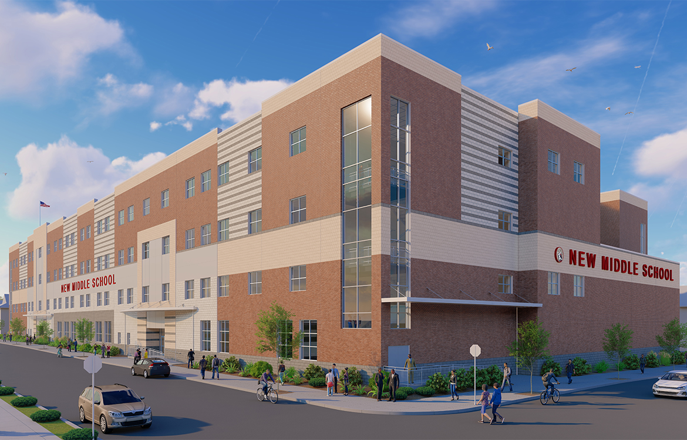
Welcome to the Joseph A. Taub School!
Mrs Browne - 8th Grade Science class

Slide 2
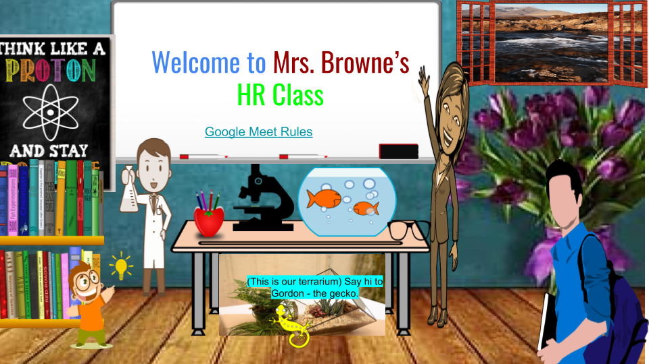
Notes:
When you go to your google classroom this is what you will see.

Slide 3
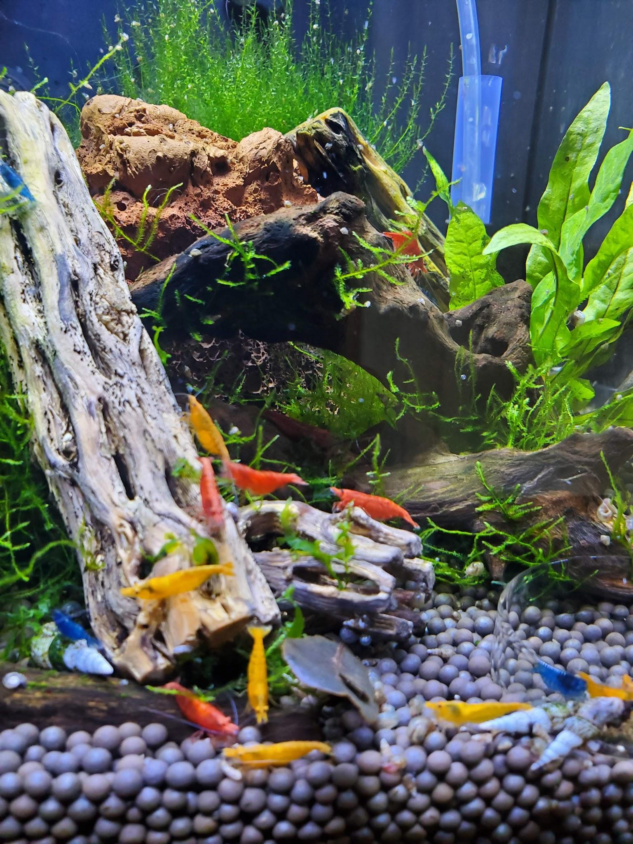
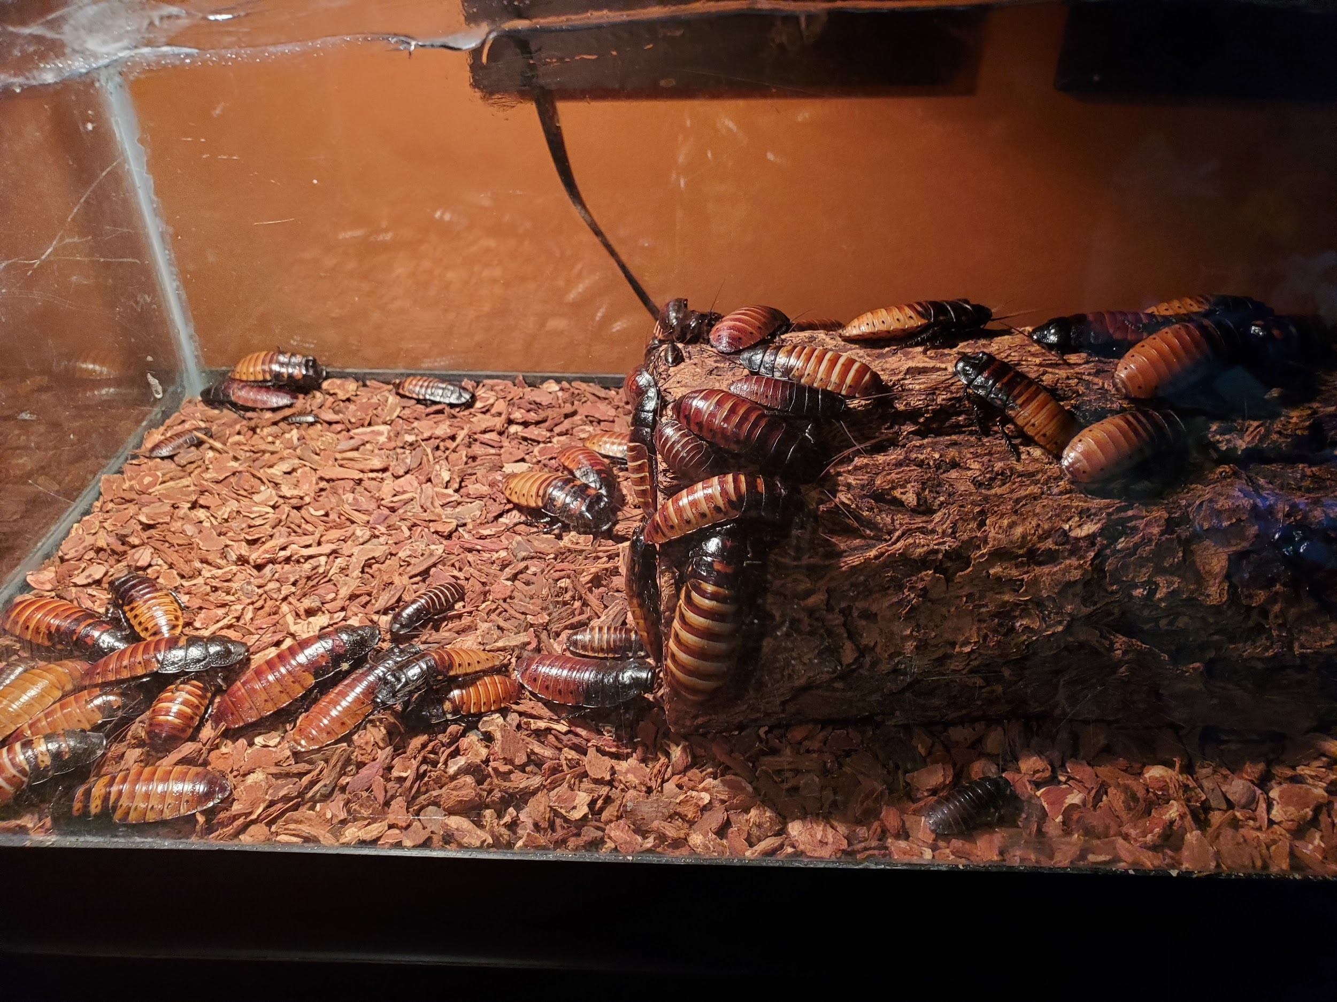
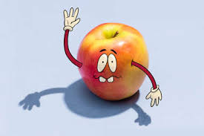
ebrowne@paterson.k12.nj.us or ebrowne@patersonschools.org
NASA Games

Slide 4
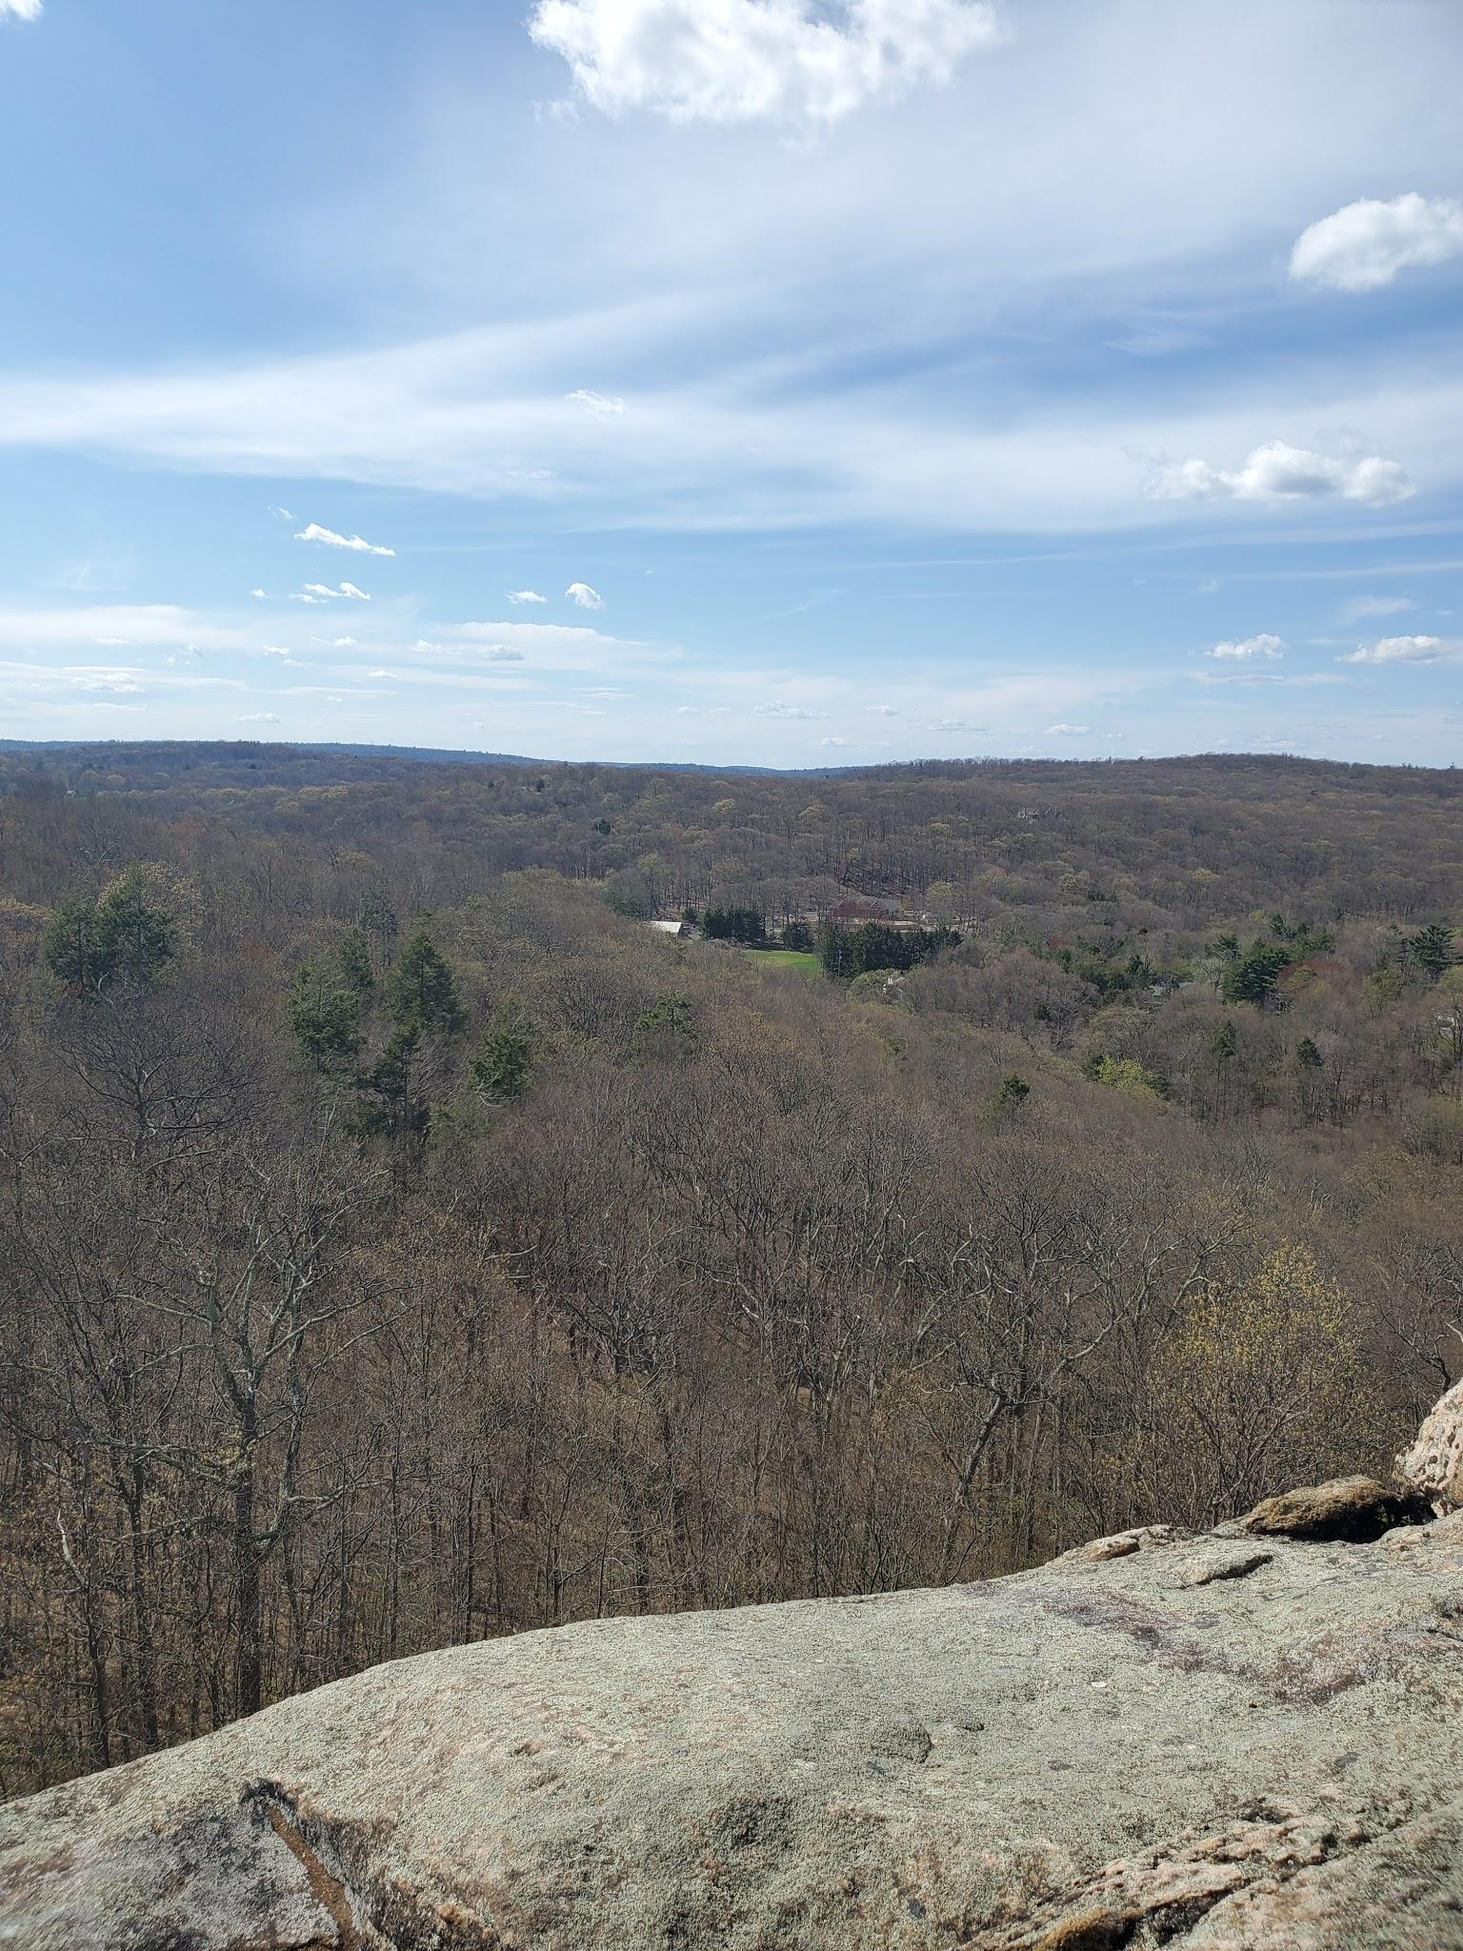
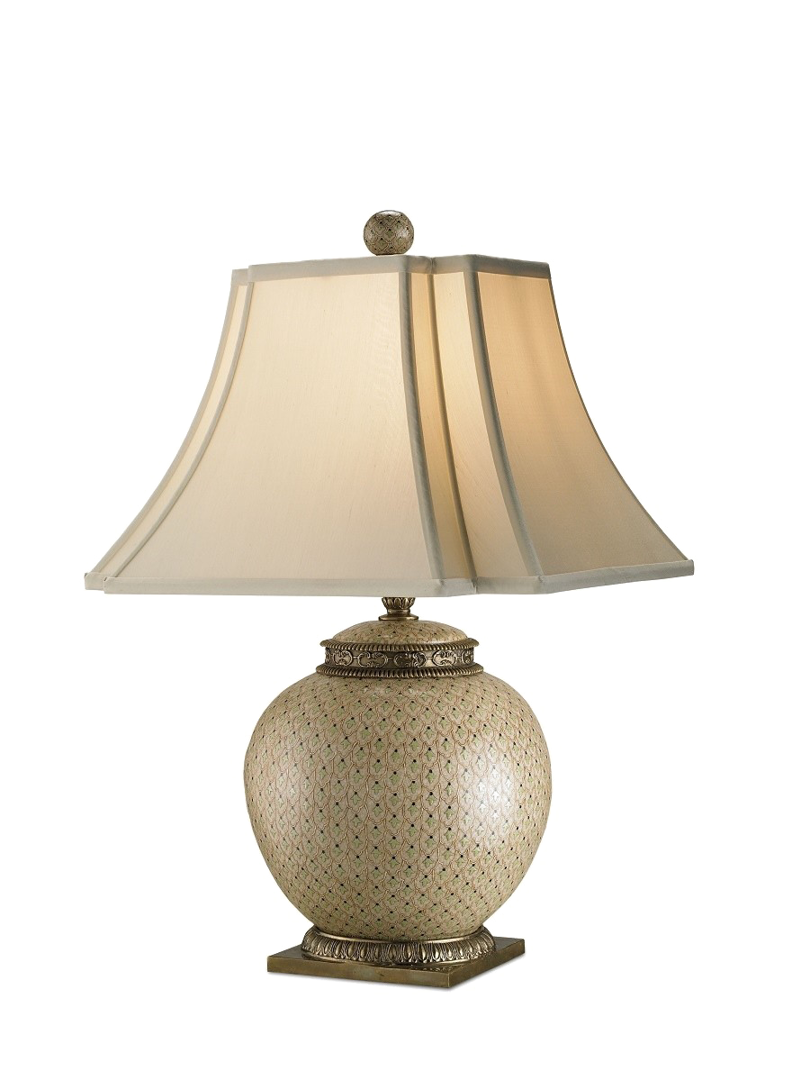
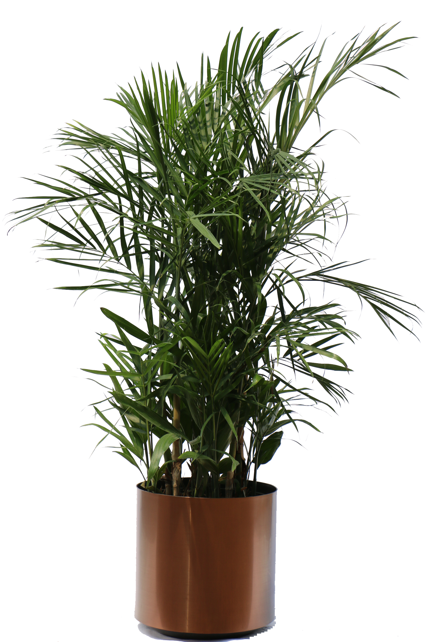
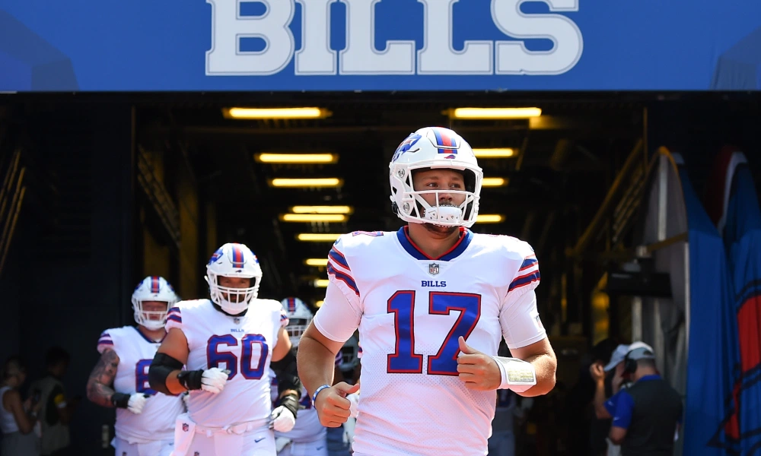
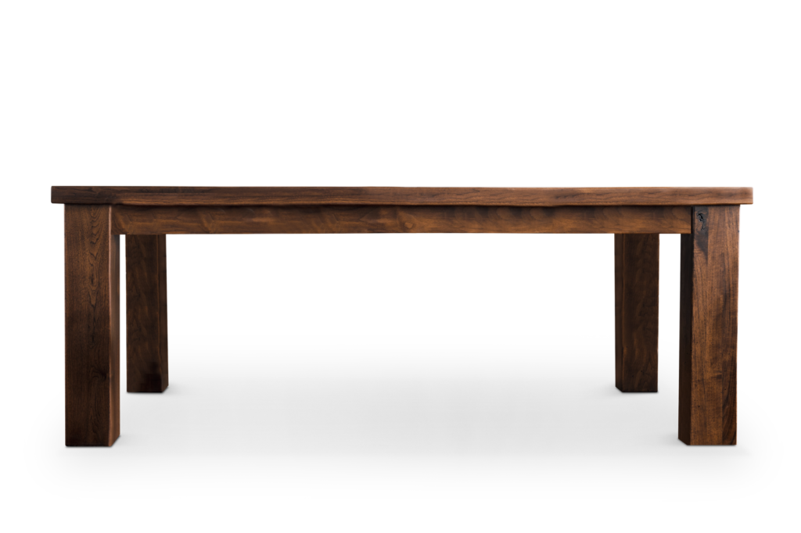
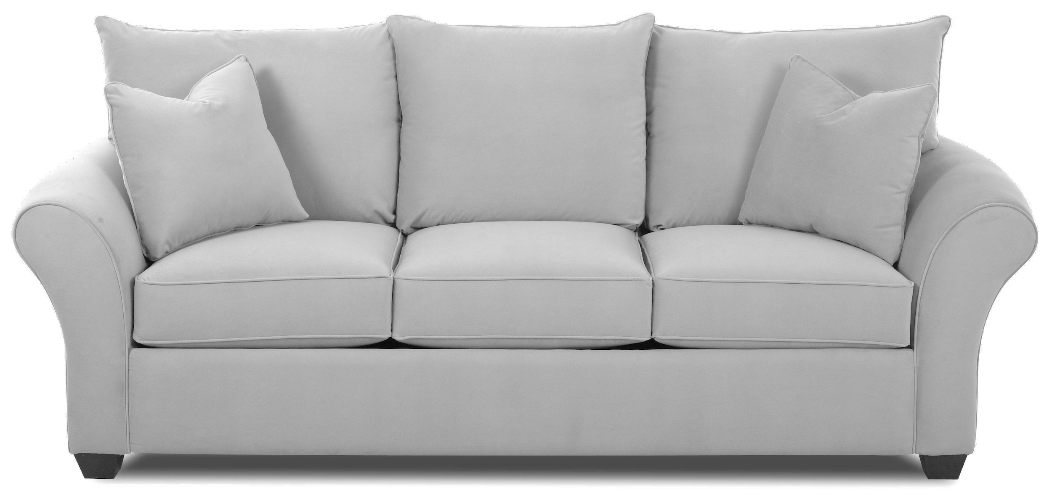
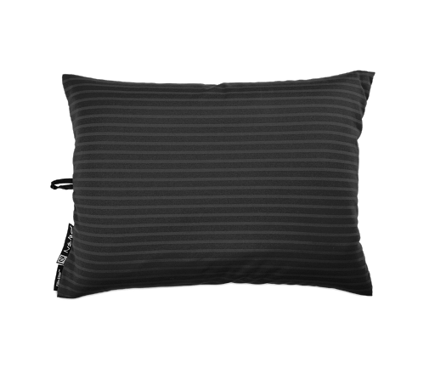
Google Classroom for - Periods: 1, 2, 5, 7, & 9
Each class has their own google classroom
All the assignments are posted in Google Classroom
A parent emails should be added for each student
Teacher communicates with the parent via email.

Slide 5
Infinite Campus
Check your child’s grade in infinite campus
Email me if you have any questions
ebrowne@paterson.k12.nj.us or ebrowne@patersonschools.or

Slide 6
Attendance
Students can not have more than 20 unexcused absences during the school year.
Students who are chronically late or absent are referred to Interventional and Referral Services.

Slide 7
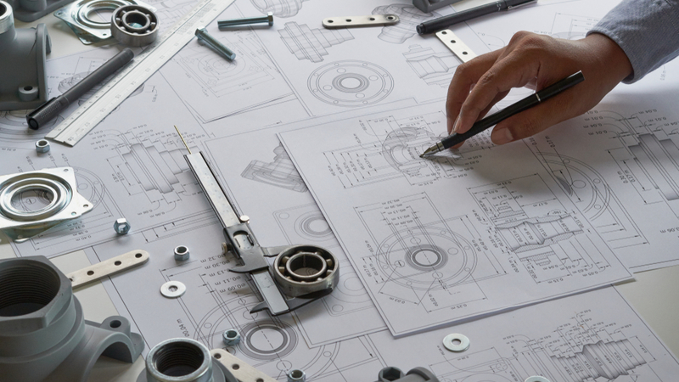
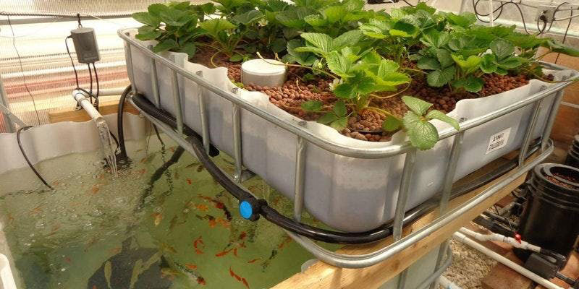
Classroom Rules
Listen and follow directions.
The use of cellphone is prohibited.
Be prepared to work when you enter the room.
Be respectful of all.
Keep your hands and feet to yourself.
Talk quietly when allowed.
Please do not throw any object across the
classroom
NO HOODIES, NO EXCEPTIONS!!!!

Slide 8
Classroom Rules Cont.
Enter quietly and begin working on your DO-NOW
Treat everyone the way you would like to be treated
Remain seated unless you are given permission to move.
Please raise your hand to speak.
Leave all food and gum outside the classroom
Please adhere to the dress codes
Follow directions, school policies, and rules.
Do Your Best Work!!!

Slide 9
Consequences for Breaking Rules
1st Verbal Warning
2nd. Student teacher Conference
3rd. Calling Home & or Lunch Detention
4th Parent Teacher Conference and Guidance Counselor Referral
5th Administrative Intervention

Slide 10
Classroom Routines
Lockers are available for use two times daily: morning & evening.
Immediately upon entering the building, place all coats, sweaters, hoodies, jackets, and backpacks in the locker.
Remove all necessary materials.
Immediately before the p.m.
Homeroom, remove all your belongings.
Take your assigned seat.
Place all phones in the box provided.
Complete the Do-Now.
Sit quietly and wait for the lesson to begin.
DISMISSAL: Remain seated until your bus is called.

Slide 11
Classroom Norms for Discussion
You have the right to:
Odd ideas
Ask questions help you understand
Agree or disagree with explanation
Have your ideas discussed
Be treated with respect
You are obligated to:
Speak for everyone to hear
Take turn to speak
Listen for understanding
Agree or disagree with explanation
Assess ideas, not people

Slide 12
Syllabus
Based on:
*Welcome Letter
*Classroom Goals & Expectations
*Attendance
*Homework & Make-up Work Policy
*Technology: Internet & Phone Policy
Notes:
Syllabus is sent home for both parents and students to read and sign

Slide 13
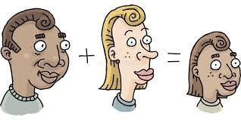
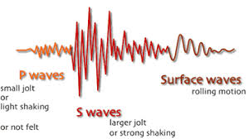
8th Grade Units
*Unit 1: Waves*
*Unit 2: Planetary Science
*Unit 3: Heredity & Adaptations*
*Unit 4: Human Systems Interactions*
FOSS E-Textbooks and Vocab. Definition posted in Google Classroom

Slide 14
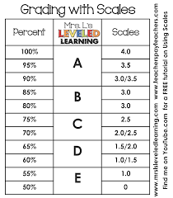
Grading
Based on:
*Summative Assessments 50%
*Classwork 20%
*Homework 10%
*Participation 10%
*I-Checks/Test Reviews 10%

Slide 15
Late Work Policy
8th grade science units are build
from previous concepts
So, it is very important that students complete all assignments on time

Slide 16
Make-up Work
Students who are absent from school for any reason will complete all missing assignments, including homework.
If missing work is not completed this will affect your grade.

Slide 17
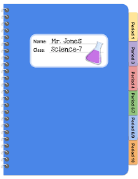
Important Links

Slide 18
Getting Our Best Work Done

Slide 19
Getting Our Best Work Done
Notes:
If there is ever a need.

Slide 20
Contact Me!
I am here to help you.
ebrowne@patersonschools.org
ebrowne@paterson.k12.nj.us

