Slide 1
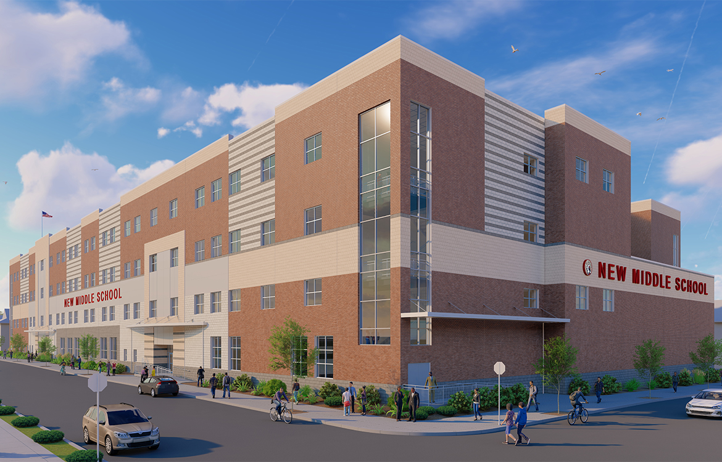
Welcome to the Joseph A. Taub School!
Technology Ms. Romano

Slide 2
Google Classroom
Classroom assignments are always posted and student should make up work when absent.
Parents can get summaries to their email

Slide 3
Technology Grades are based on the Following:
Participation/Classwork(20%)
Coding (40%)
Google/Desktop Publishing (40%)

Slide 4
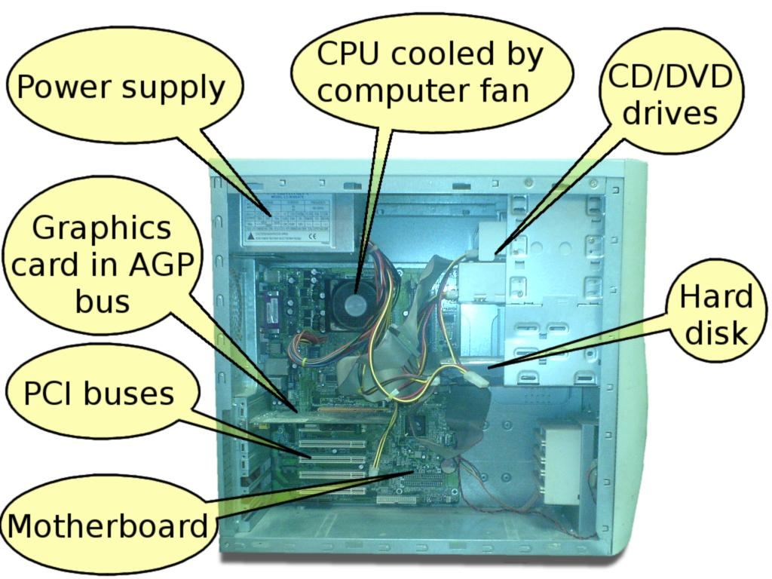
Topics
Typing on Typing.com
Coding on Code.org
Google Applications
Desktop/Publishing
Cyber Safety and Etiquette
Computer Hardware and Software

Slide 5
CLASSROOM RULES
Be Kind
Be Respectful
Be Ontime
Do Your Best
Ask For Help When Needed
Complete All Assigned Work
Treat All Technology And School Equipment Appropriately
Do Not Disturb Others
Do Not Take Your Phone Out

Slide 6
HOMEROOM 8:20-8:42
Period 1 8:44-9:24
Period 2 9:26-10:06
Period 3 10:08-10:48
Period 4 10:50-11:30
Period 5 11:32 - 12:12
Period 6 12:14 - 12:54
Period 7 12:56 - 1:36
Period 8 1:38 - 2:18
Period 9 2:20 - 3:00
BELL SCHEDULE

Slide 7
Contact Me!
I am here to help you.
sromano@patersonschools.org
*Joseph A. Taub 973-321-0700
Paterson School District

