Slide 1
DePaul Catholic High School College Prep Night
Ninth and Tenth Grade Presentation
Thursday, October 26, 2023

Slide 2
To-Do… for 9th Graders
Study, Study, Study! Your Freshman Grades DO matter!
Everything counts! Your permanent record/transcript starts NOW! AIM HIGH!
There will be more challenging classes with more homework and more requirements.
There will be more work so, WORK HARD from the start!
Get involved, both in school and in your community. Remember, you are building a resume for colleges. Give colleges a reason to want you.
Utilize Naviance Resume to assist with this. The resume should be updated regularly (end of each quarter).
Understand your strengths and weaknesses.

Slide 3
Freshman Year
Establish strong study habits, organization and time management techniques.
Make the most of the time you spend in class. Participate.
Complete all homework assignments thoroughly and keep a clean and organized backpack and locker.
READ… and work on enhancing your writing abilities and vocabulary. Earn strong grades. Freshman year final grades establish your GPA.
Take the PSAT as practice for Junior year admissions tests.
Become involved with 1-3 extracurricular activities/sports.
Use Naviance to help figure out your interests and how they might translate into career opportunities.
Consider meaningful summer experience/employment, volunteer opportunities, travel, etc.

Slide 5
Sophomore Year
EVERYTHING COUNTS!! Make sure your high school transcripts is one that you can be proud of.
Maintain your grades or strive to improve if you are not satisfied with where you stand.
Do your best on the PSAT. It is used for course placement, is a predictor of college success and college admissions.
Mold and shape your resume… Look for leadership opportunities!
Begin your research into Colleges and Universities.

Slide 6
To-Do… for 10th Graders
Continue to read a variety of books, magazines and newspapers to increase your writing ability and vocabulary.
Meet with your counselor to review Naviance career exploration activities.
Consider junior year classes and “moving up” to Honors and Advanced Placement Courses if abilities permit and you meet the criteria.
Attend College Fairs and speak with college representatives. Become familiar with general college entrance requirements.
Start to consider what qualities your are looking for in a college (Naviance-Game Plan)
Consider a meaningful summer experience – employment, volunteer opportunities, travel or enrichment classes.

Slide 7
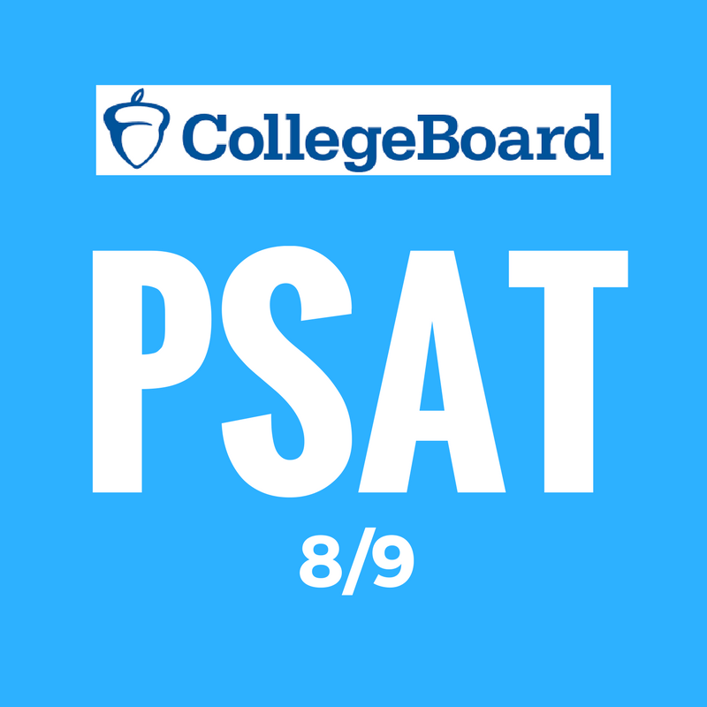
Standardized Testing
All 8th, 9th and 10th take the PSAT in October.
Juniors also take the PSAT in October. Counselors will then advise each student to take either the SAT or ACT beginning in December of their Junior year.

Slide 8
Graduation Requirements
4 years (20 credits) Theology 3 years (15 credits) Social Studies
4 years (20 credits) English 3 years (15 credits) Science
4 years (20 Credits) Mathematics 2 years (10 credits) World Language
Electives= 40 + credits
Also: Physical Education, Health, Fine Performing and Practical Arts, Technology, and Career Education must be taken to meet the New Jersey State requirements for graduation. Some requirements are infused in course curriculum.

Slide 9
National Honor Societies
National Honor Society: 3.7 GPA
Holy Spirit Chapter of the National Honor Society
Scholarship
Service
Leadership
Character
Application Process
Advisor- Ms. Wiltshire

Slide 10
Academic Honor Societies
Mu Alpha Theta Mathematics Honor Society
Advisor- Mrs. Amols
Alexander Hamilton Historical Honor Society
Advisor- Mr.Trommelen
World Languages Honor Society
Advisor- Mrs. Meza
National Science Honor Society
Advisor- Mrs. Burd and Ms. Carnevale
Induction into Honors Societies are based on GPA in Honors courses, teacher recommendation and participation in subject clubs/activities.

Slide 11
What are Colleges and Universities Looking For?
Transcripts – Rigor!!!
Standardized Testing- SAT scores, AP scores
Recommendations
Extracurricular Activities
College Essay
Interview/Demonstrated Interest

Slide 12
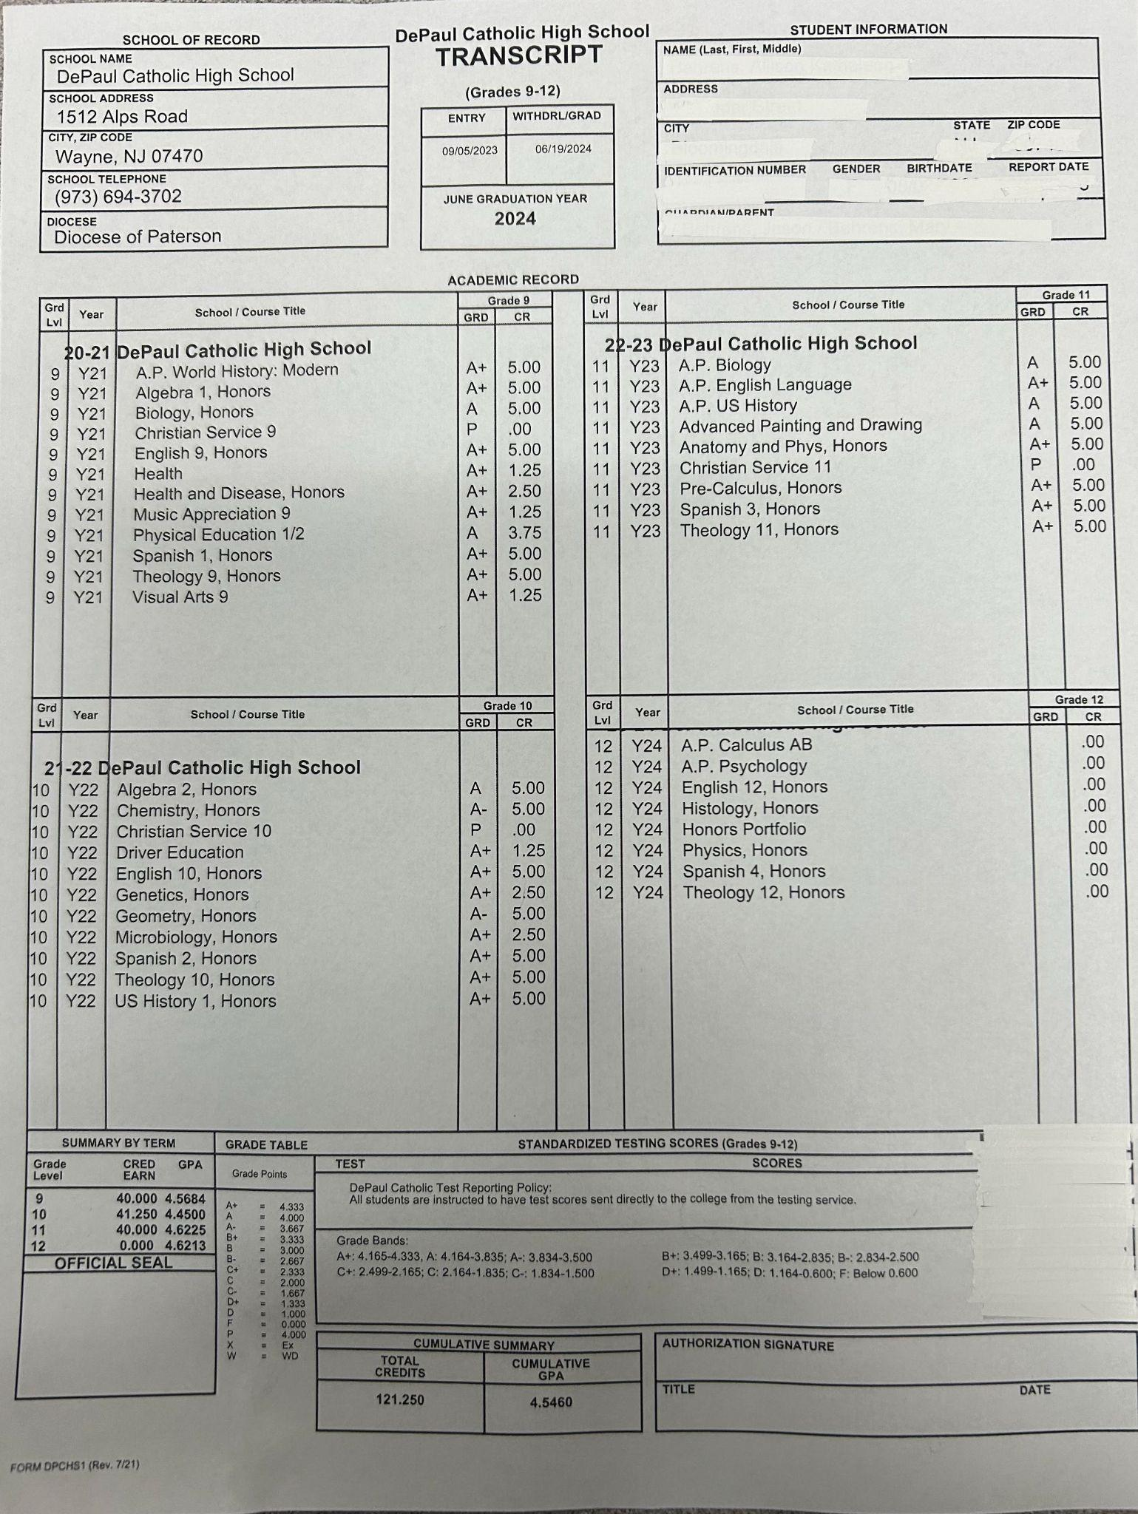
SAMPLE
Senior Transcript
First Semester

Slide 13
DPCHS Course Advisement and Selection
DePaul Catholic helps advise which courses are most appropriate for each student. We take into account the student’s G.P.A., course prerequisites, standardized test scores, and teacher recommendations.
Our goal is to challenge each student to reach above and beyond their potential…Strive for Excellence!

Slide 14
What Courses Should I be Taking?
Colleges are looking at the rigor of each student’s transcript, and yes, all courses play a part in your admissions criteria.
What type or course load is appropriate for me?
Advanced Placement (AP)
Honors (H)
College Prep (CP)
Are there benefits in taking additional courses in Foreign Language, Science, other core disciplines?

Slide 15
AP Requirement and College Credits
In order to be enrolled in an Advanced Placement course, the following criteria will be considered:
Grades
Standardized Test Scores
Teacher Recommendation
Possible Essay as determined and prompted by the specific department chairperson.

Slide 16
Dual Enrollment/Project Acceleration
DePaul is partnered with Seton Hall University -Project Acceleration. Students who take approved SHU courses while at DP can register at SHU and receive (up to 22) college credits. They must obtain a grade of B or better. These credits can be transferred to any college that they attend.
The cost for SHU is $110.00 per credit so, a 3 credit course will cost $330.00. More information will be distributed to juniors and seniors (sophomores must be approved) if you choose to enroll.

Slide 17
2023-2024 Seton Hall University-Project Acceleration Accepted Courses
AP English Literature (Ms. Sullivan) Spanish III Honors (Ms. Meza)
AP Environmental Science (Dr. Rajakaruna) Spanish IV Honors (Meza)
AP European History (Mr. Sokolewicz) Theology 10 Honors (Ms. Zaccardi Or Fr. Ditullio)
AP Psychology (Mr. Sokolewicz) Theology 11 Honors (Fr. Ditullio)
AP United States History (Mr. Trommelen) US History I Honors (Mr. Trommelen)
English 11 Honors (Ms. Sullivan) US History II Honors (Mr.Trommelen & Mr.Sokolewicz)
English 12 Honors (Ms. Sullivan)
Italian III Honors (Ms. Espinoza)
Italian IV Honors (Ms. Espinoza)
Human Anatomy and Physiology Honors (Ms. Ferrito)
Human Anatomy and Physiology Honors Lab (Ms. Ferrito)

Slide 18
What is Naviance Student ?
Naviance Student is a Web-based program designed for students and parents.
It assists students and parents in helping to make decisions about colleges and careers as well as assist in finding scholarship monies.
Information is specific to DePaul Catholic High School.
Counselors can update students and parents about upcoming meetings, news, events, and other Web resources for college and career information.

Slide 19
Accessing Naviance
To use Naviance, go to the DePaul Catholic High School website: www.depaulcatholic.org , click School Counseling in the top right-hand side. Then click on Naviance and the link will be provided.
OR
Use the web address: www.naviance.com
All students have been logged into Naviance.
Parents use activation code to your email to create parent login and password.

Slide 20
NCAA Eligibility
Standards are different for Division 1,2,3
NCAA Accredited Courses
Sliding Scale
Transcript – end of Junior Year
Website - https://web3.ncaa.org/

Slide 21
Team Work
Remember, we are all in this together. The School Counselors are always available to speak with students and or parents/guardians. Every year we meet individually with students to:
Check on their progress
Address any individual needs,
Help advise with class scheduling
Help students choose courses that will benefit their anticipated college major
Counselor Assignments:
Cyndi Covello: 8th and 9th grades covelloc@dpchs.org Extension 312
Nick Campanile: 10th grade Advisor campanilen@dpchs.org Extension 314
Kelsey Hall: 11th - 12th grade A-M hallk@dpchs.org Extension 313
John Galka: 11th- 12th grade N-Z galkaj@dpchs.org Extension 310

