Slide 1
Spring 2023 Standardized Assessment Results
Presentation to the Woodbridge Board of Education
Presented by:
Jimmy Sapia - Assistant Principal
Cheryl Tafel - Assistant Principal
October 16, 2023

Slide 2
Foundational Points
Smarter Balanced Assessment assesses grades 3-8 students in literacy & mathematics
Next-Generation Science Standards (NGSS) Assessment assesses grade 5 students in science
Accurately describes student achievement and growth
Measures students’ progress/attainment of knowledge and skills
Provides an annual snapshot of student achievement
Aligned to Common Core State Standards
Utilizes computer adaptive testing
Includes one math performance task

Slide 3
Achievement Levels
Four Achievement Levels:
•Level 1 = Does not meet the achievement standard
•Level 2 = Approaching the achievement standard
•Level 3 = Meets the achievement standard
•Level 4 = Exceeds the achievement standard
Achievement levels:
Specify the knowledge and skills at a certain level
Are less precise than scale scores
Note: characterizing a student’s achievement solely in terms of a level is an oversimplification

Slide 4
Average Vertical Scaled Score

Slide 5
Background Information: English Language Arts
Areas of Knowledge and Skills Measured | Statement About Student Learning From Which the Assessment was Built
Reading | Students can read closely and analytically to comprehend a range of increasingly complex literary and informational texts.
Writing | Students can produce effective and well-grounded writing for a range of purposes and audiences.
Listening | Students can employ effective speaking and listening skills for a range of purposes and audiences.
Research/Inquiry | Students can engage in research/inquiry to investigate topics, and to analyze, integrate, and present information.

Slide 6
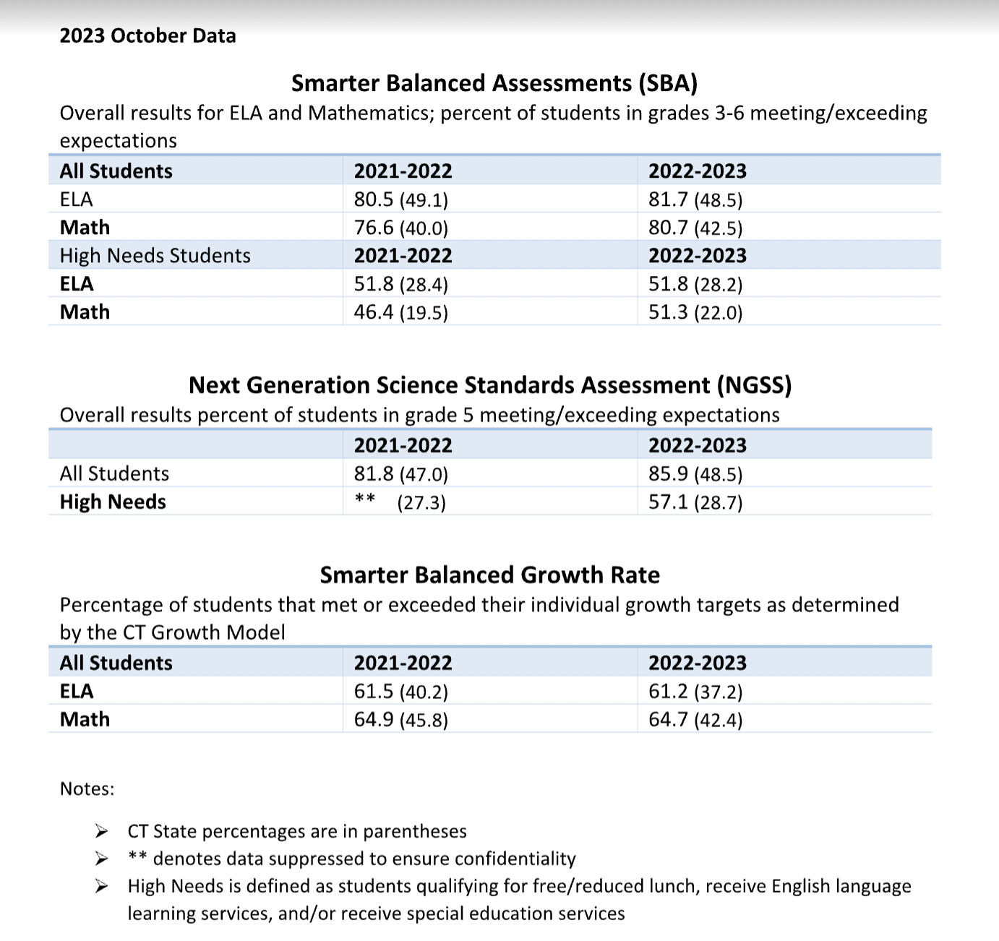

Slide 7
Smarter Balanced Literacy
2022- 2023 | Levels 3 + 4 (Met or Exceeded Grade-Level Standard) | Level 3 (Met Grade-Level Standard) | Level 4 (Exceeded Grade-Level Standard)
Grade 3 | 75.5% | 27.4% | 48.1%
Grade 4 | 84.6% | 19.7% | 65%
Grade 5 | 84.4% | 19.5% | 64.8%
Grade 6 | 81.4% | 33.9% | 47.5%

Slide 8
Background Information: Mathematics
Areas of Knowledge and Skills Measured | Statement About Student Learning From Which the Assessment was Built
Concepts and Procedures | Students can explain and apply mathematical concepts and interpret and carry out mathematical procedures with precision and fluency.
Problem Solving | Students can solve a range of complex well-posed problems in pure and applied mathematics, making productive use of knowledge and problem-solving strategies.
Communicating Reasoning | Students can clearly and precisely construct viable arguments to support their own reasoning and to critique the reasoning of others.
Modeling and Data Analysis | Students can analyze complex, real-world scenarios and can construct and use mathematical models to interpret and solve problems.

Slide 9
Smarter Balanced Mathematics
 | Levels 3 + 4 (Met or Exceeded Grade-Level Standard | Level 3 (Met Grade-Level Standard) | Level 4 (Exceeded Grade-Level Standard)
Grade 3 | 75.7% | 32.7% | 43%
Grade 4 | 87.2% | 34.2% | 53%
Grade 5 | 82.8% | 20.3% | 62.5%
Grade 6 | 76.5% | 26.1% | 50.4%

Slide 10
NGSS Science - A Deeper Look
 | Levels 3 + 4 (Met or Exceeded Grade-Level Standard) | Level 3 (Met Grade-Level Standard) | Level 4 (Exceeded Grade-Level Standard)
Grade 5 | 86% | 38% | 48%

Slide 11
The Results: ELA- All Students
Grade | Percent Scoring Level 3 and Above |  |  | Average Vertical Scale Score
 | 2021-2022 | 2022-2023 | 2023-2024 | 2021-2022 | 2022-2023 | 2023-2024
3 | 73.4% | 75.5% |  | 2489 | 2487
4 | 79.1% | 84.6% |  | 2547 | 2555
5 | 83.5% | 84.4% |  | 2588 | 2593
6 | 85.4% | 81.4% |  | 2609 | 2609
All Grades | 80.35% | 81.7% |  | N/A | N/A
Notes:
Statewide trend was a decrease in LA
Not a matched cohort-- students have moved in and out
Note growth across years-- Grade 3 to grade 6 there is consistent growth
DRG growth across grades not as high

Slide 12
The Results: Math- All Students
Grade | Percent Scoring Level 3 and Above |  |  | Average Vertical Scale Score
 | 2021-2022 | 2022-2023 | 2023-2024 | 2021-2022 | 2022-2023 | 2023-2024
3 | 79.8% | 75.7% |  | 2497 | 2488
4 | 80.6% | 87.2% |  | 2545 | 2552
5 | 66.1% | 82.8% |  | 2557 | 2586
6 | 79.7% | 76.5% |  | 2614 | 2609
All Grades | 76.55% | 80.7% |  | N/A | N/A
Notes:
Asked state to verify results of grade 5 students
State cohort trend: Grade 3 in 2014-2015: 47.7%
Grade 4 in 2015-2016: 47.9%
Grade 5 in 2016-2017: 42.9% (Overall downward trend)

Slide 13
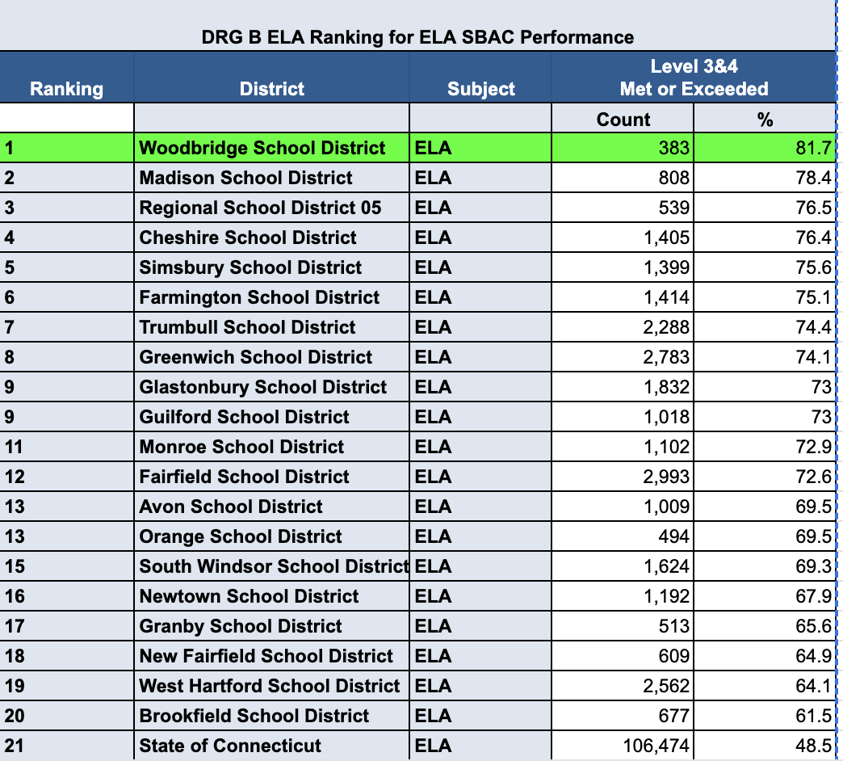
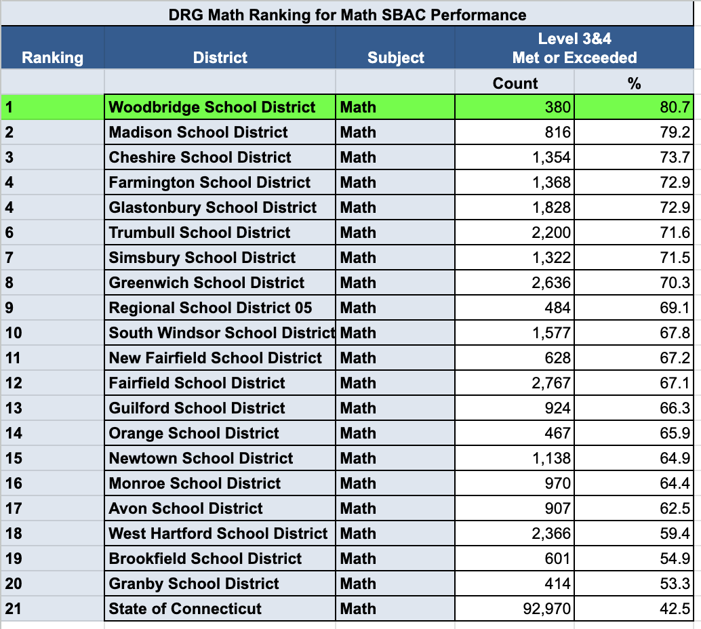

Slide 14
Follow Up and Next Steps
Grade level analysis by homeroom and former students
Continued professional learning and curriculum development
Give students appropriate exposure and practice to the tools necessary to demonstrate knowledge
Continuation of Coaching in Math/ELA
Progress monitoring using STAR and Dibels (specifically with intervention students)
School-wide data team- regular monthly meetings
Feedback and coaching within the classroom and PLC meetings
Interim Assessment Blocks administered at all grade levels and utilizing data to support students.

