Slide 1
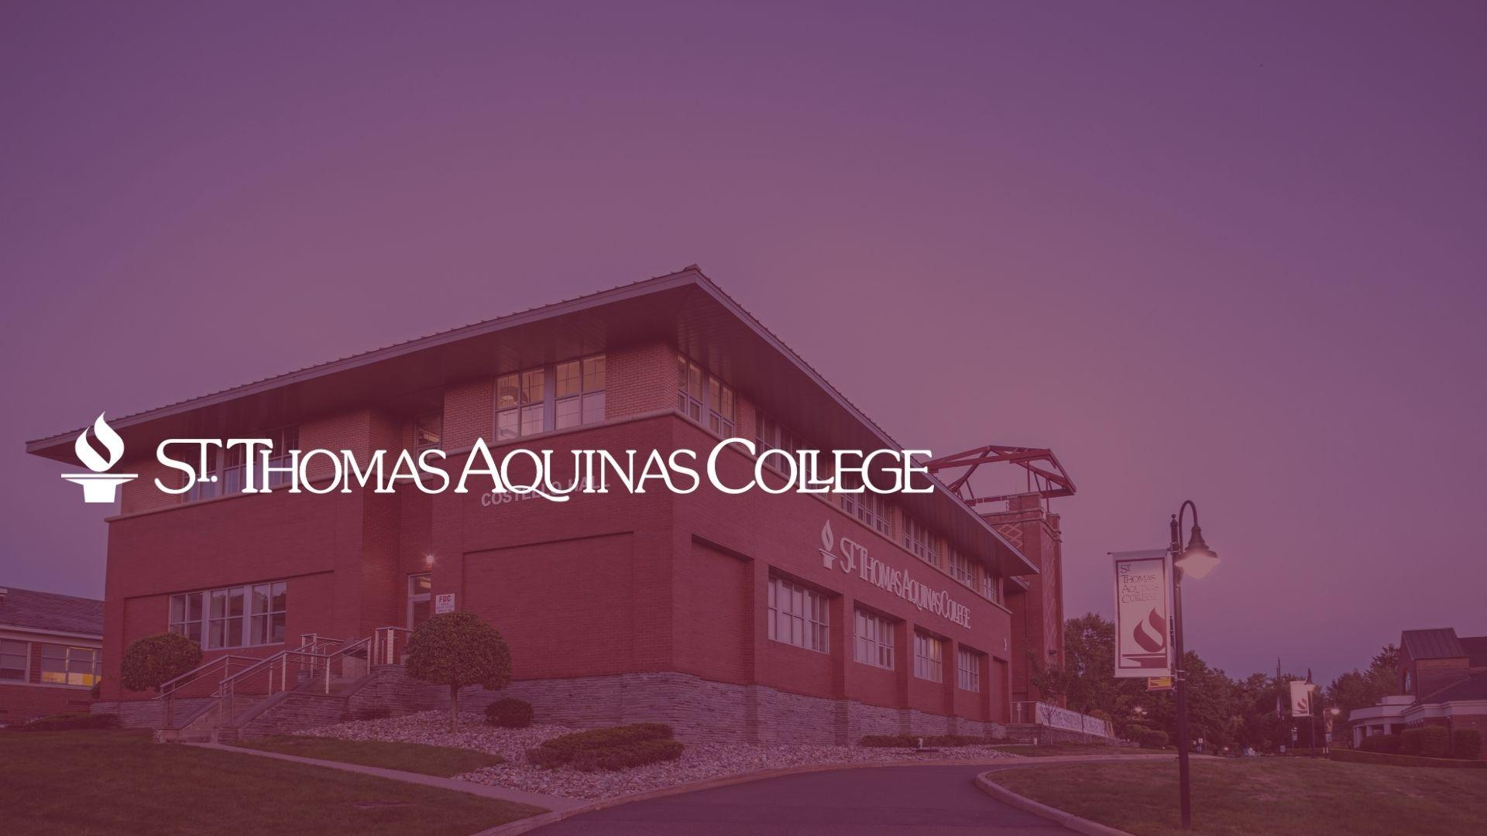
INSIDE TRACK TO COLLEGE ADMISSIONS
Mike DiBartolomeo, Ed.D.
Vice President for Enrollment Management

Slide 2
Basic Information
2600+ Four-Year Colleges in America
25 Four-Year Colleges in NJ
19 Community Colleges
5 Proprietary Institutions
Class of 2021 – 95,000+ High School Graduates
76,000+ (80%) attended college

Slide 3
The College That’s Right For You
Make Choices Based on Who You Are
Size matters: You don’t have to go to a college bigger than high school
Name Brand vs. Generic – college pedigree doesn’t always count
You don’t need to pick a major to pick a college
Don’t be scared by the stories
Most Importantly – Make Sure the College is a FIT!

Slide 4
What to Look for in a College
Location
City vs. Country
Large vs. Small
SAT Averages
SAT vs. ACT / SAT-Optional
Class Rank and GPA
Average Class Size
Lecture Halls / Teaching Assistants
Retention
% of students that return after first year

Slide 5
MYTH: Anyone can get into a public university, but it’s harder to get into a private college.
REALITY: Some public universities are among the most competitive to get into, while other public universities are required to take nearly all applicants.

Slide 6
Different Methods of Applying
Regular Admissions – you can apply to as many schools as you’d like, and weigh financial-aid packages before making a decision.
Early Decision – you apply in the fall and find out in December if you are admitted.
The decision is binding; if you are admitted, you must withdraw all your other applications.
Early Action – apply early and find out in December.
The decision is nonbinding; you are also allowed to apply to schools through the regular admissions.
Direct Admissions
Students don’t submit applications, but colleges provide “soft offers” of admission

Slide 7
MYTH: Courses and grades in the spring of senior year aren’t important because students already have been accepted.
REALITY: Most colleges make statements in their admissions materials that they will look as a senior’s spring grades. If the student’s academic performance has dropped off substantially, colleges can cancel an offer of admission.

Slide 8
What Should I Have Taken in High School?
English – 4 Units
Social Studies – 3 Units
Algebra I
Geometry
Algebra II
Foreign Language – 2 Units
Laboratory Science – 3 Units
Academic Electives – 3 Units

Slide 9
MYTH: If my SAT scores are super strong, I'll be admitted to highly selective colleges
REALITY: While you clearly need to prepare for your standardized exams, it's important to remember that they are NOT college entrance exams.
They are simply one piece of the admissions puzzle.

Slide 10
Standardized Testing
1900+ schools that have dispensed with the standardized testing requirement for Fall 2023
37 in NJ
171 in NY
22 in CT
SAT-Optional doesn't mean “easier” admissions
More emphasis on GPA and rank
SAT – Evidence-Based Reading/Writing, Math
ACT – less sections and shorter in time than SAT

Slide 11
MYTH: The college with the lowest price will be the most affordable.
Some of the colleges with a high “sticker price” have raised significant amounts of money for scholarships from their graduates and friends. As a result, they have more money to give to students in the form of scholarships.
After taking financial aid into consideration, a seemingly more expensive college may be more affordable than a college with a lower price list.

Slide 12
Types of Financial Aid
Grants
Tuition Aid Grant (TAG) - $9,496/year
Pell Grant - $7,395
Loans
Stafford Loan – student is borrower; $5,500-$7,500
PLUS Loan – parent is borrower; COA – Fin Aid
Scholarships
Need-based – financial situation is primary determinant
Merit-based – recipient may determined by students’ athletic, academic, artistic or other abilities

Slide 13
Interesting Websites
College Scorecard
Search and compare colleges: their fields of study, costs, admissions, results, and more
scorecard.ed.gov
Integrated Postsecondary Education Data System (IPEDS)
Primary source for information on U.S. colleges, universities, and technical and vocational institutions
nces.ed.gov/ipeds
Federal Student Aid
Main source for federal financial aid
Studentaid.gov
NJ Higher Education Student Assistance Authority
Main source for NJ state financial aid
https://www.hesaa.org/Pages/Default.aspx

Slide 14
QUESTIONS?
Thank you!
Mike DiBartolomeo
Vice President for Enrollment Management
St. Thomas Aquinas College
(845) 398-4233
mdibarto@stac.edu

