Slide 1
Waterloo CSD COUNSELING & STUDENT SUPPORT SERVICES TEAM ADVISORY COUNCIL
May 2023

Slide 2
Advisory Council Purpose:
Provide feedback on program goals
Review program results
Make recommendations
Advocate for the school counseling program
Required to have diverse representation of stakeholders and to meet no less than twice each year

Slide 3
Goals 2022-2023
1. To increase attendance rate for each building to 94%.
2. Graduation rate to 85%-- TBA

Slide 4
Attendance Data Goal: To increase attendance rate for each building to 94%.
2021-2022
9/7/22-5/19/23
Skoi-Yase Primary (K-2): 91.14 %
Lafayette Intermediate: 92.44 %
Waterloo Middle School: 91.33 %
Waterloo High School: 89.11 %
Skoi-Yase Primary (K-2): 91.83 %
Lafayette Intermediate: 92.34 %
Waterloo Middle School: 91.59 %
Waterloo High School: 89.88 %

Slide 5
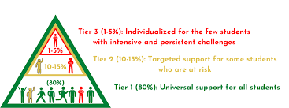

Slide 6
Action Plan Goal #1: To increase Attendance to 94%
Daily attendance calls and letters home
Re-entry Plans for extra support
Student Staffings/Parent Meetings
Individual Counseling
CICO-Check In's/PBIS
Building relationships and connections
Home visits
Referrals/
Collaboration with outside agencies
Attendance Team Meetings
Tutoring/Specialized Scheduling and Alternatives for Learning
SSST Contact Sheet sent to all families throughout year
CPS
Notes:
We will have another meeting End of September or early October

Slide 7
Skoi-yase and Lafayette Contact sheets

Slide 8
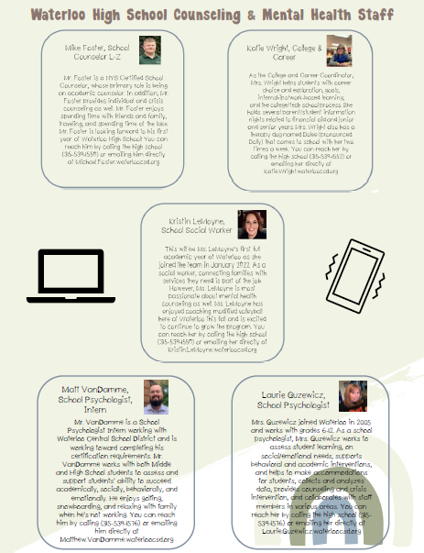
Waterloo Middle School and High School Contact sheets

Slide 9
Skoi-Yase Primary School
TIER 1 – ALL STUDENTS
* 199 Classroom Guidance Lessons (K-2)
* 38 Mindfulness Lessons taught (PK-2)
------------------------------------------------------
TIER 2 & TIER 3 SUPPORTS
*SAEBRS completed by teachers in Oct/Jan/March/June
*SEL skills groups/Check & Connect: 83 students
Daily Attendance Check-Ins: 26 students
TOTAL: 109 students
*102 students received some type of tier 2 or tier 3 support through the year (7 kids had both SEL & Attendance)

Slide 10
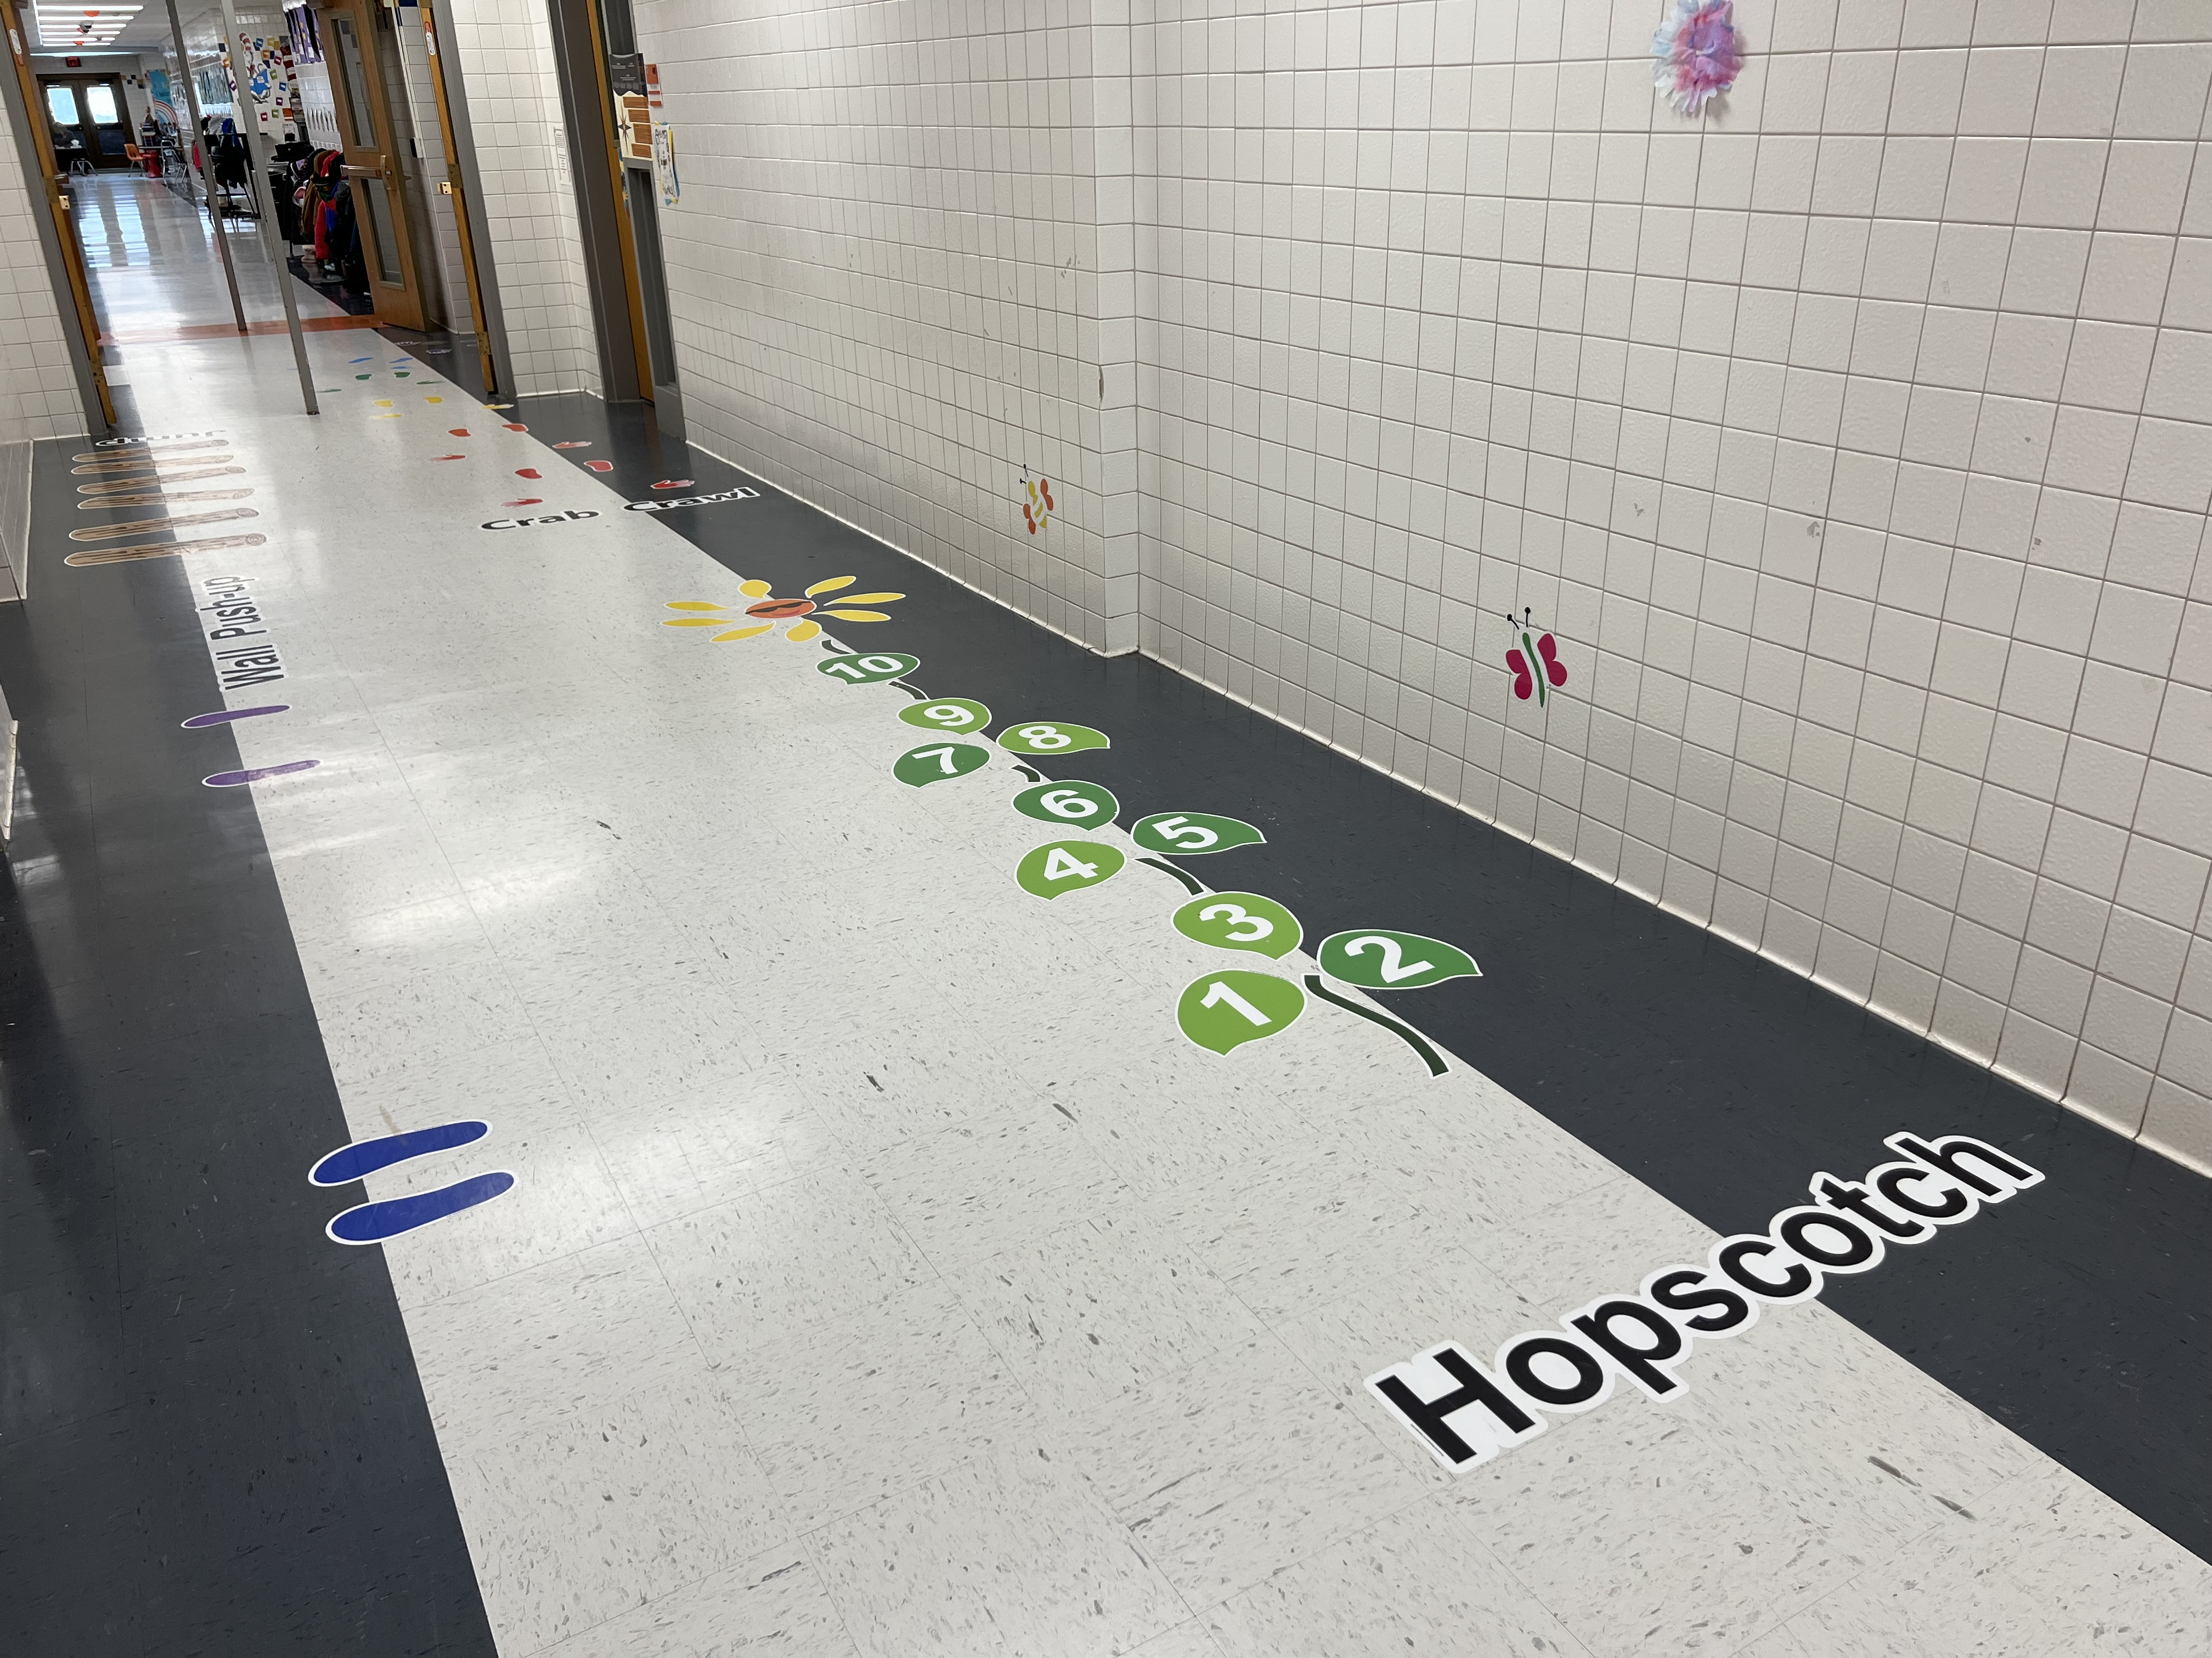
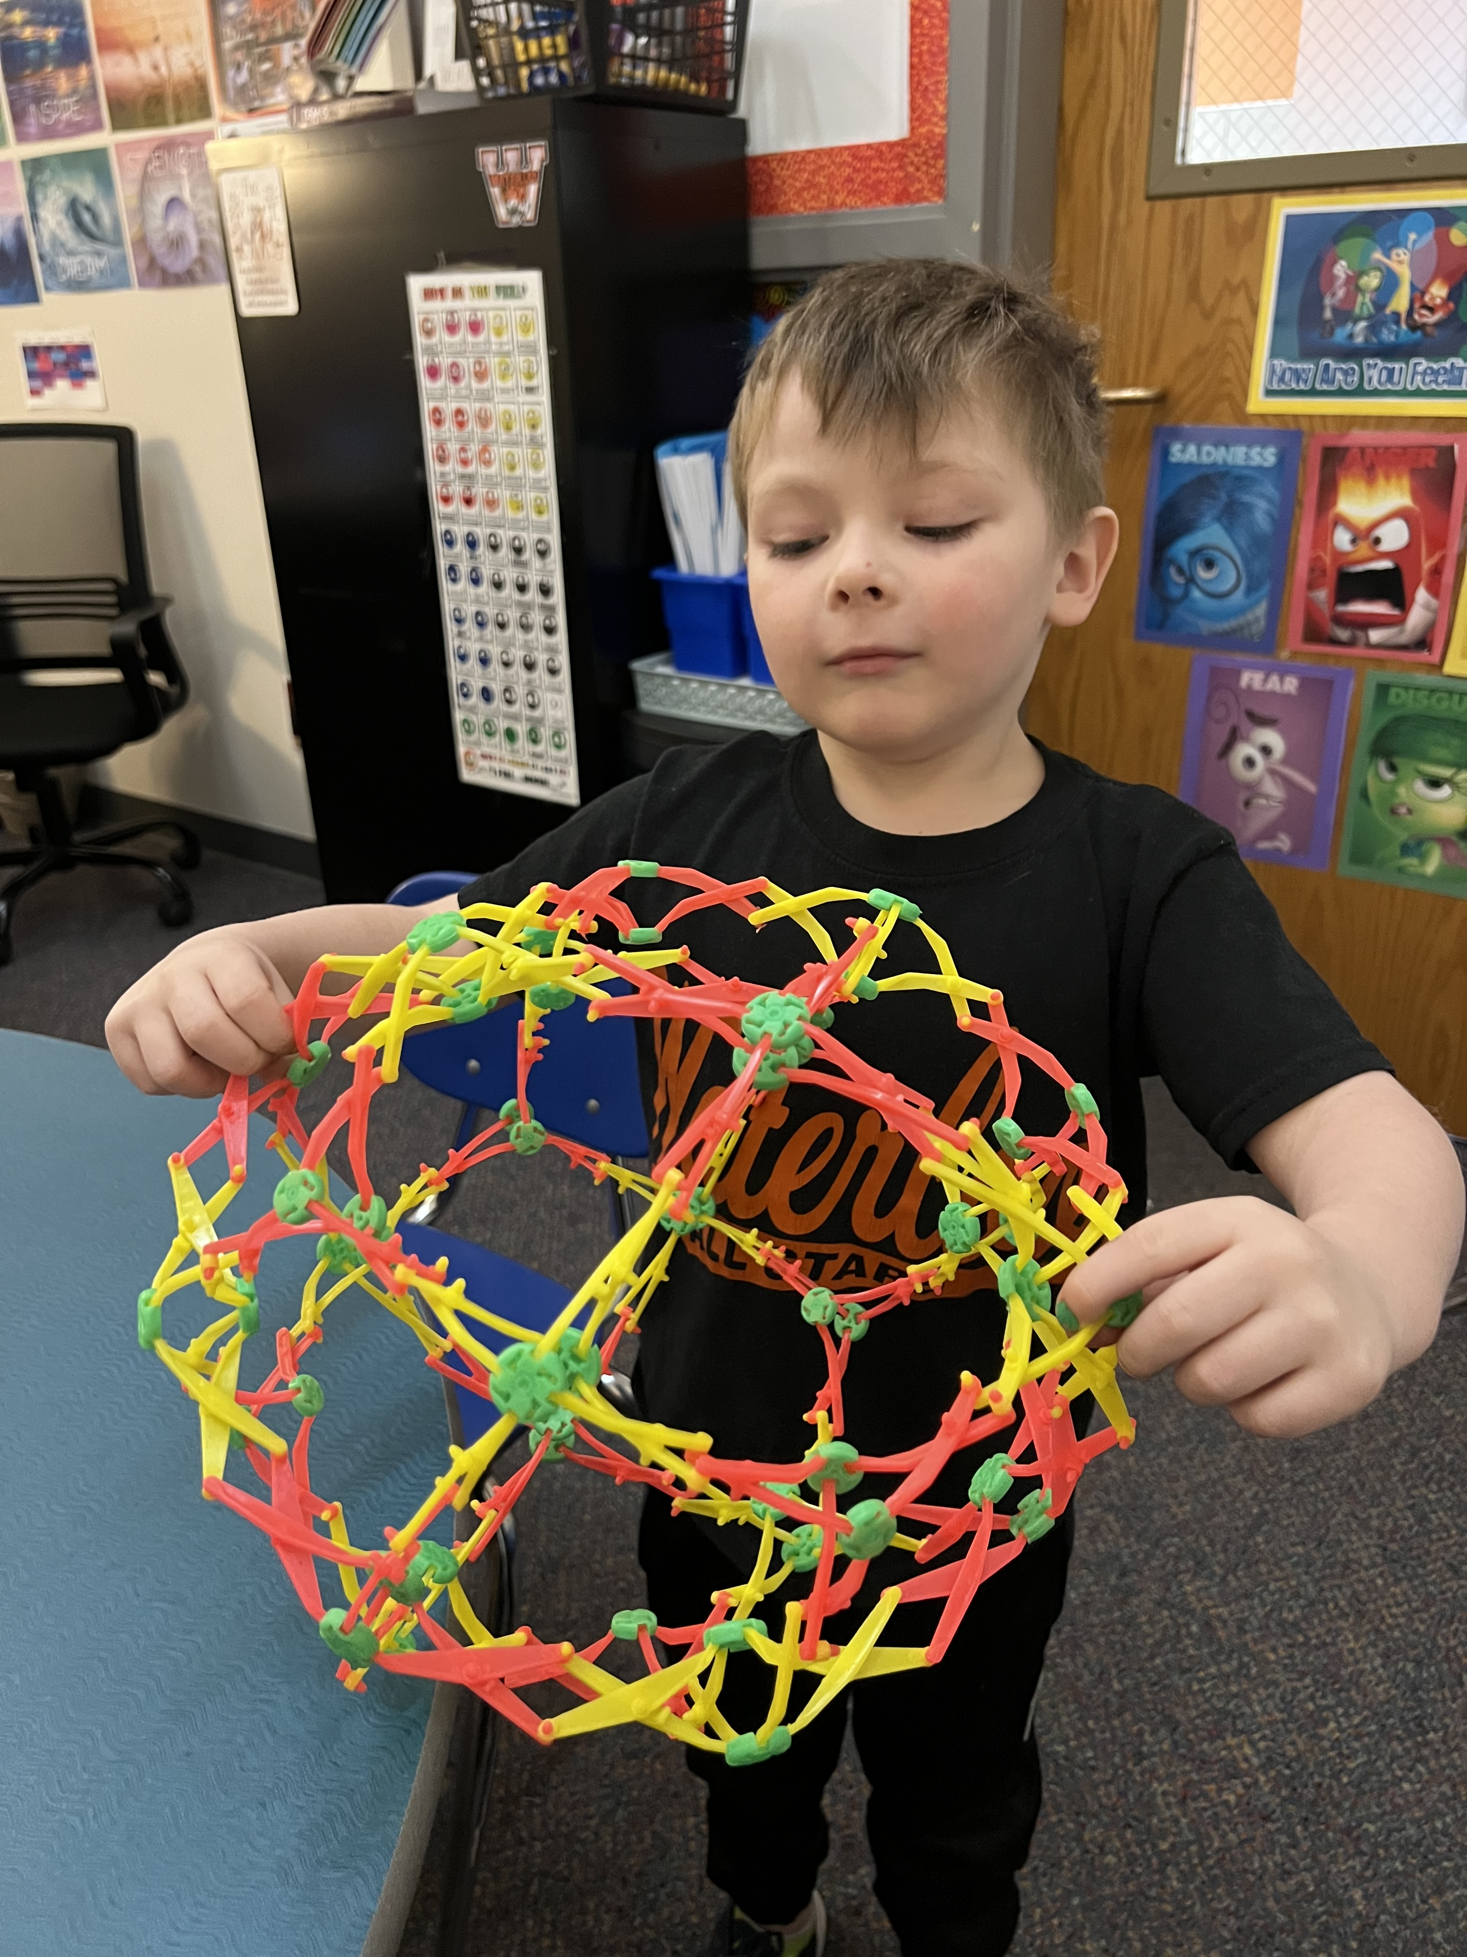
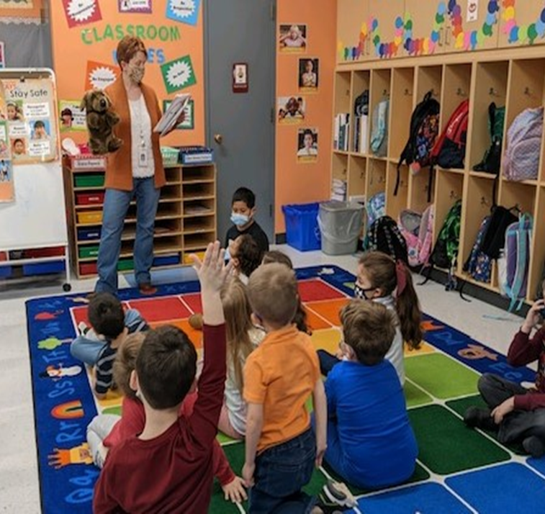
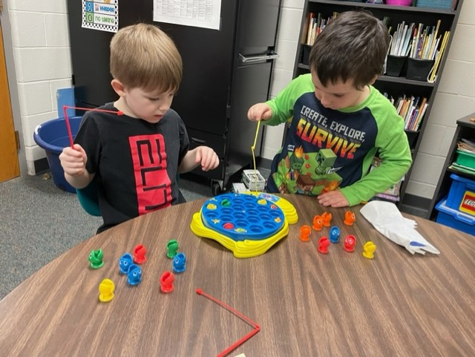
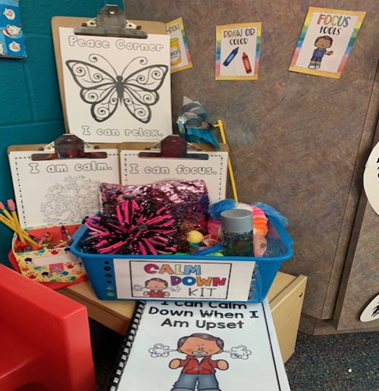
Skoi-Yase teaches self-regulation and coping skills
SEL Skills Groups
Classroom Guidance Lessons
Mindful Minutes every morning during Morning Announcements
Sensory Path & Sensory Room
Peace Corners
Bucket Fillers

Slide 11
Lafayette Intermediate School
TIER 1 – ALL STUDENTS
* 288 Classroom Guidance Lessons (3-5)
* Mindfulness Lessons taught to all classes (3-5)
------------------------------------------------------
TIER 2 & TIER 3 SUPPORTS
*SAEBRS completed by teachers in Oct/Jan/March/June
*SEL skills groups/Check in Check Out: 115 students received some type of tier 2 or tier 3 support

Slide 12
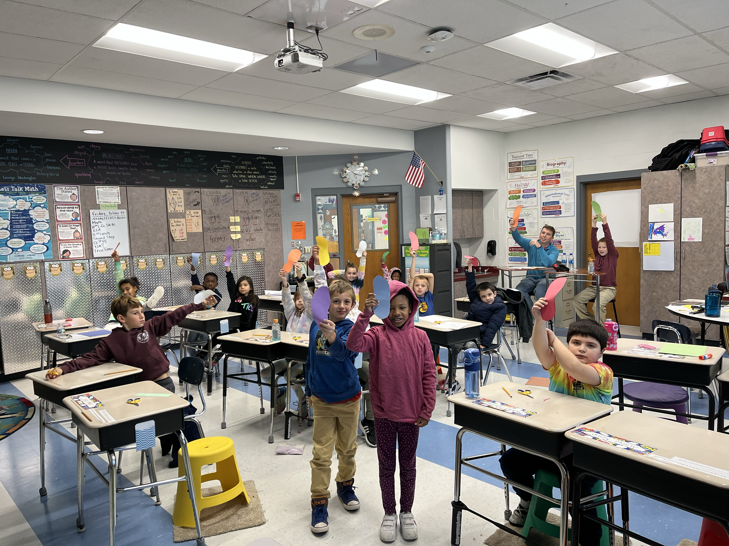
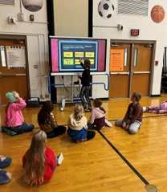
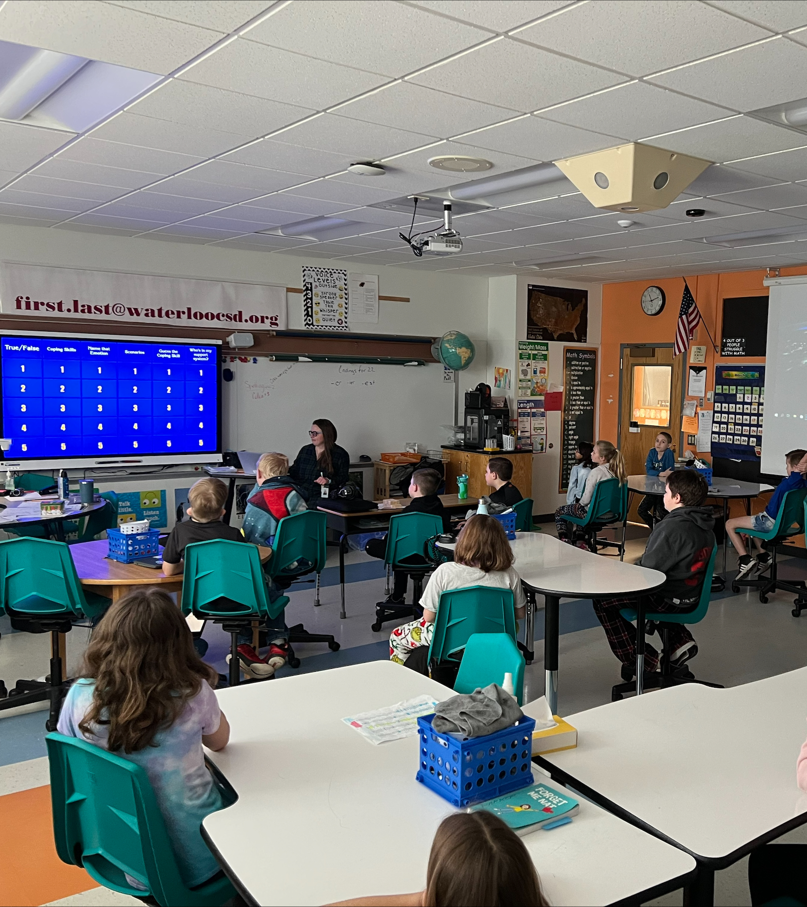
Life Skills
LaFayette Intermediate

Slide 13
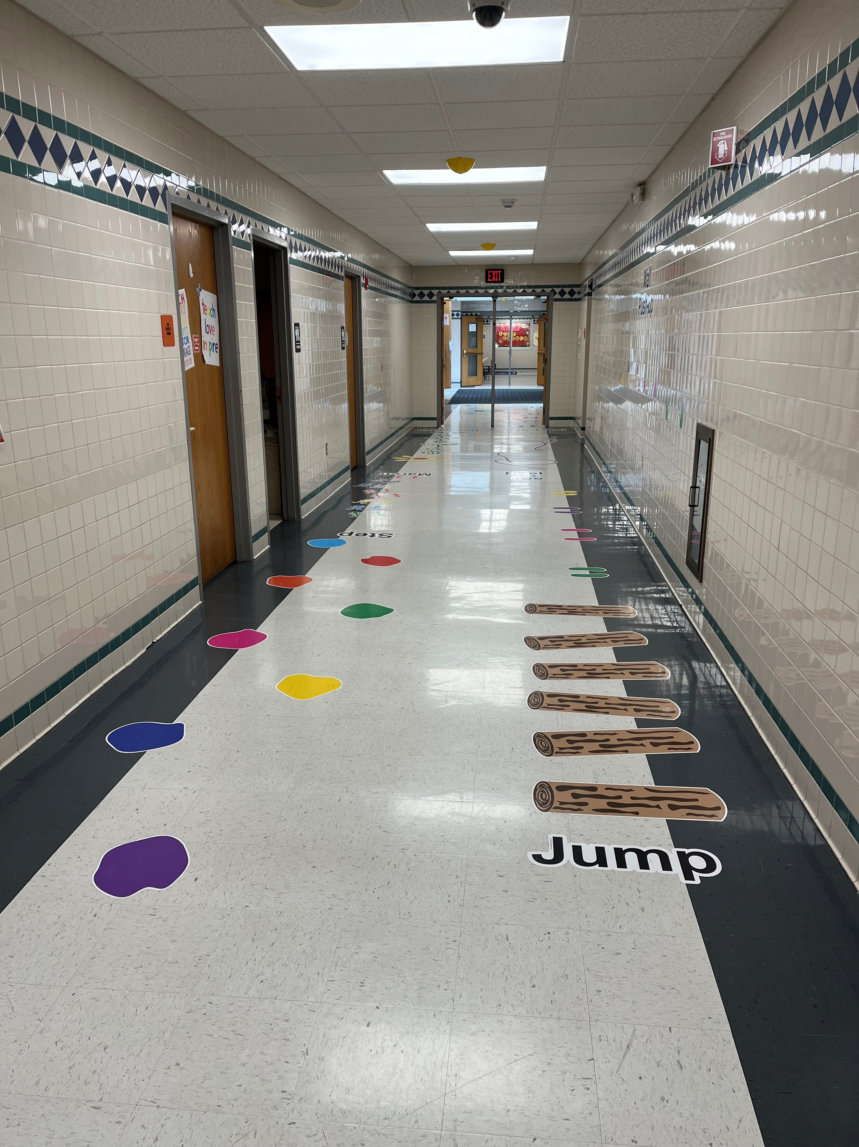
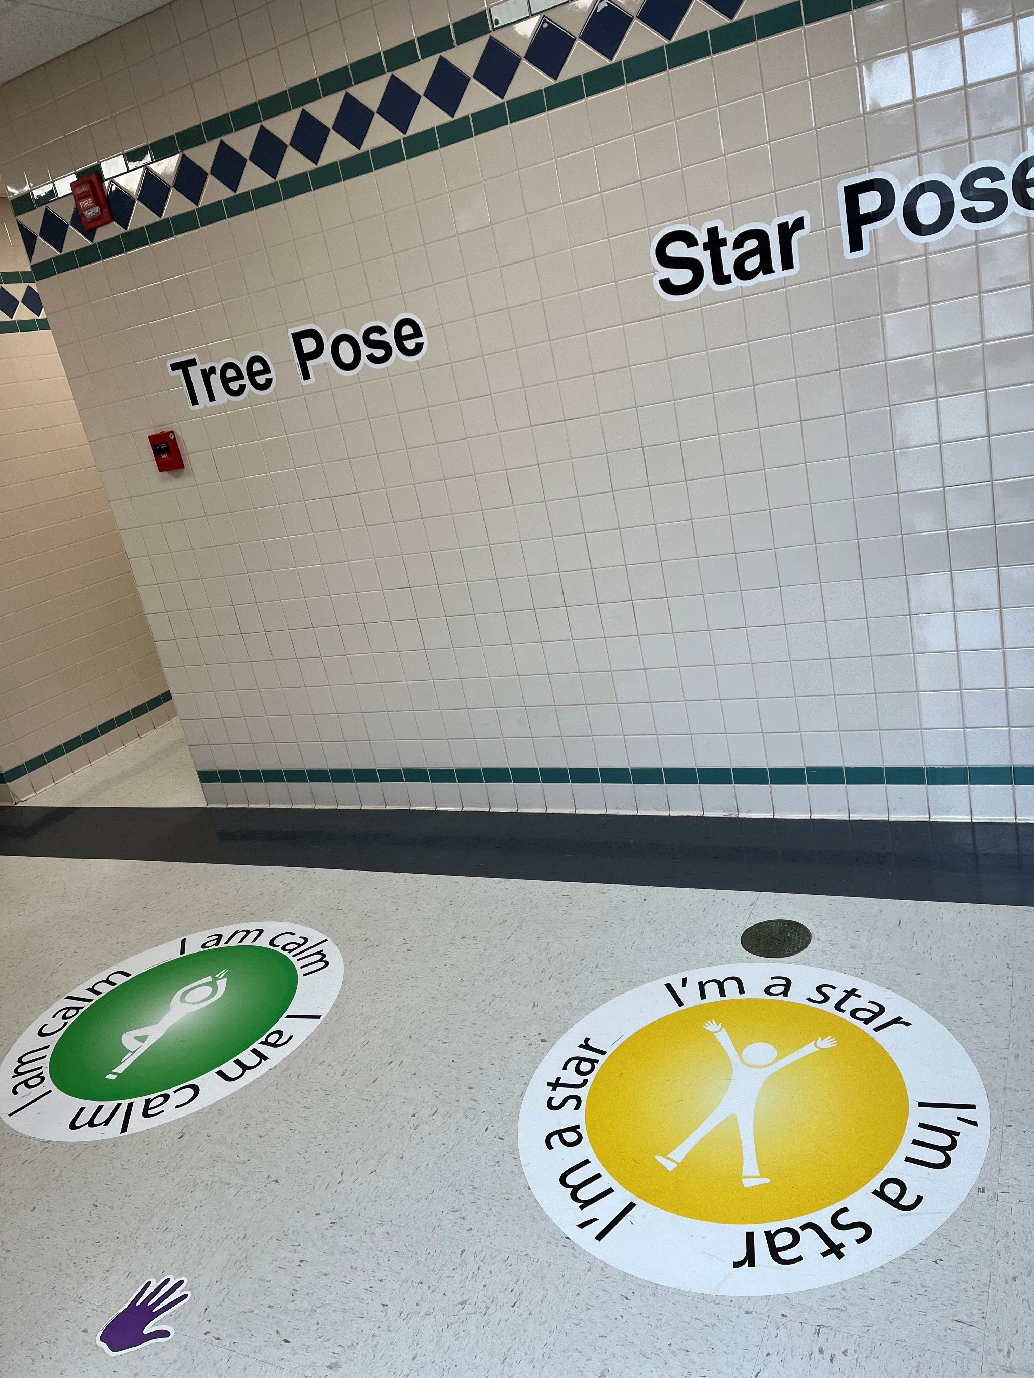
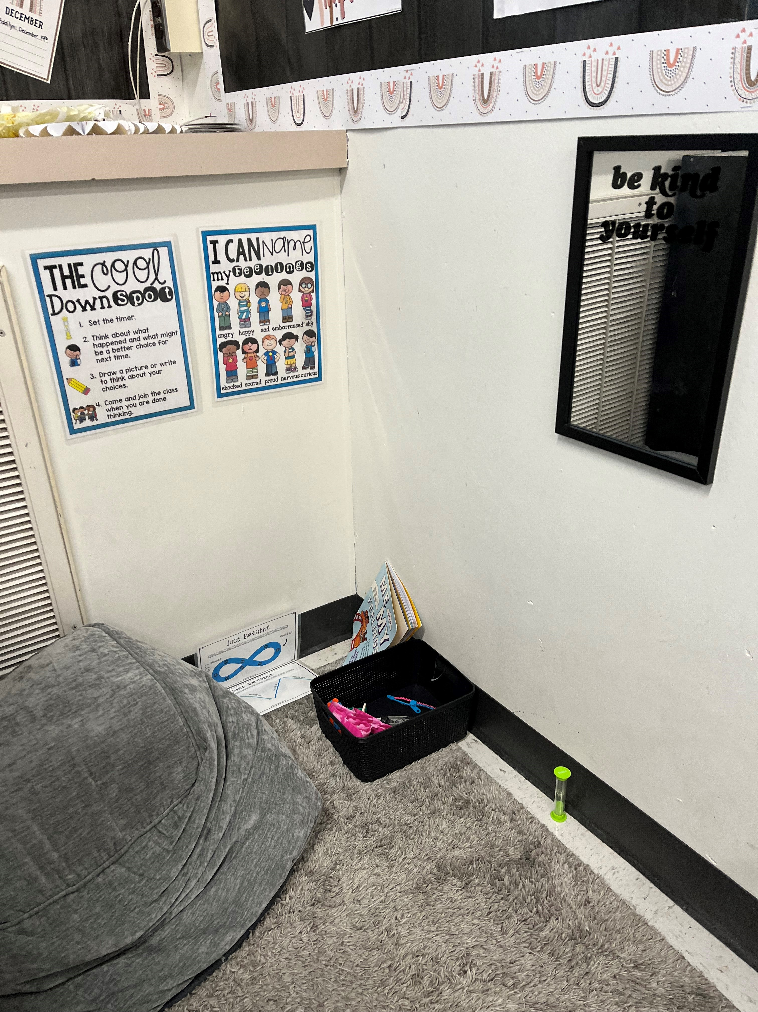
SEL Skills Groups
Peace Corners
Mindful Moments every morning on the announcements in March
Sensory Path
Life Skills Classroom Lessons
Peace Corner in Mrs. Mangogna's room

Slide 14
MIDDLE SCHOOL GUIDANCE PRESENTATIONS
CAREER PRESENTATION: What path will you choose?
DASA PRESENTATION: We all have "baggage"

Slide 15
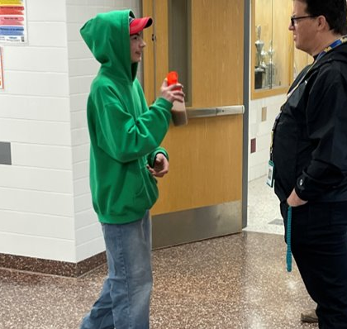
BUILDING RELATIONSHIPS & MAKING CONNECTIONS
Waterloo MIDDLE SCHOOL

Slide 16
SOCIAL SKILLS LUNCH GROUP
WATERLOO MIDDLE SCHOOL

Slide 17
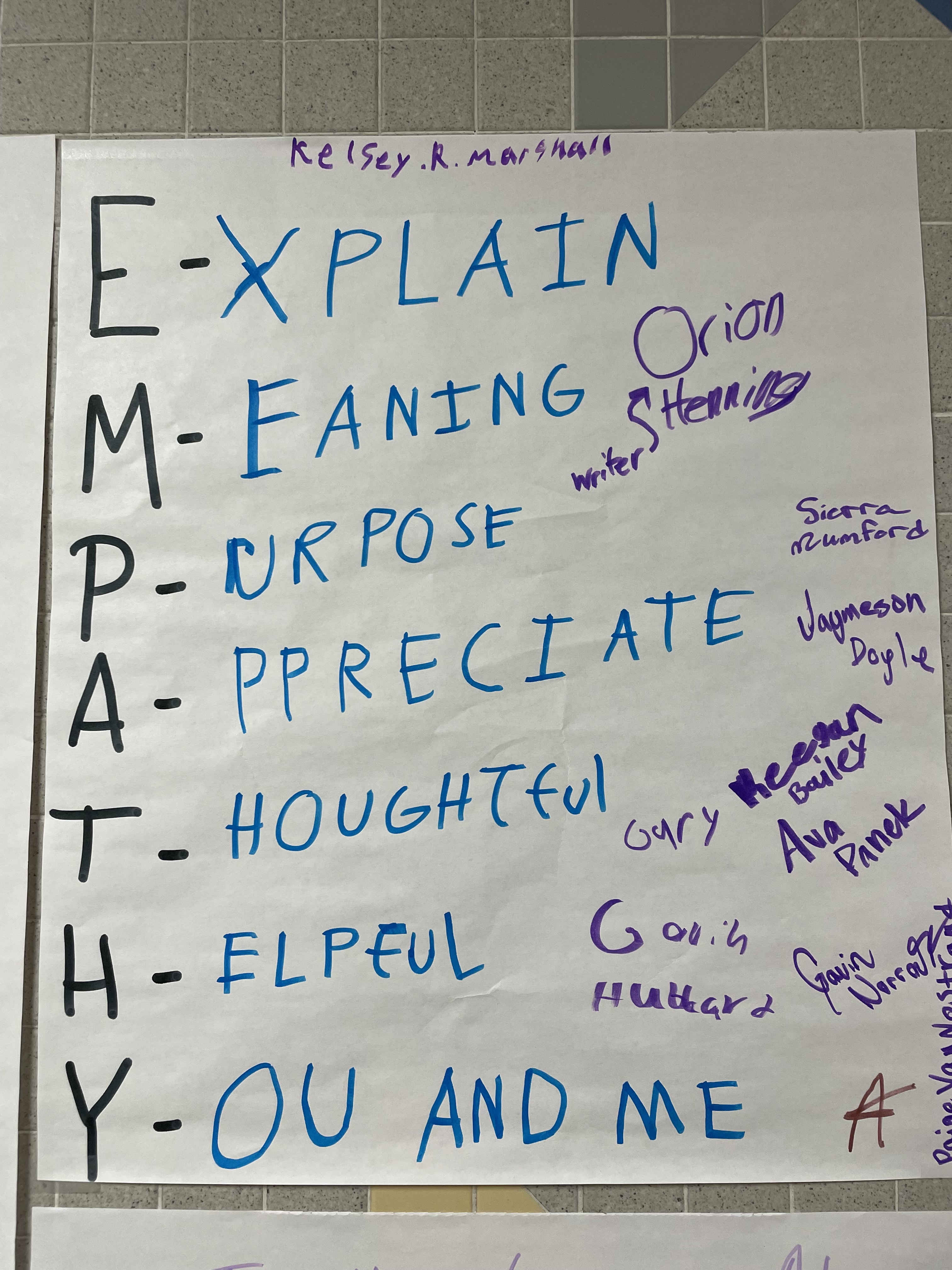
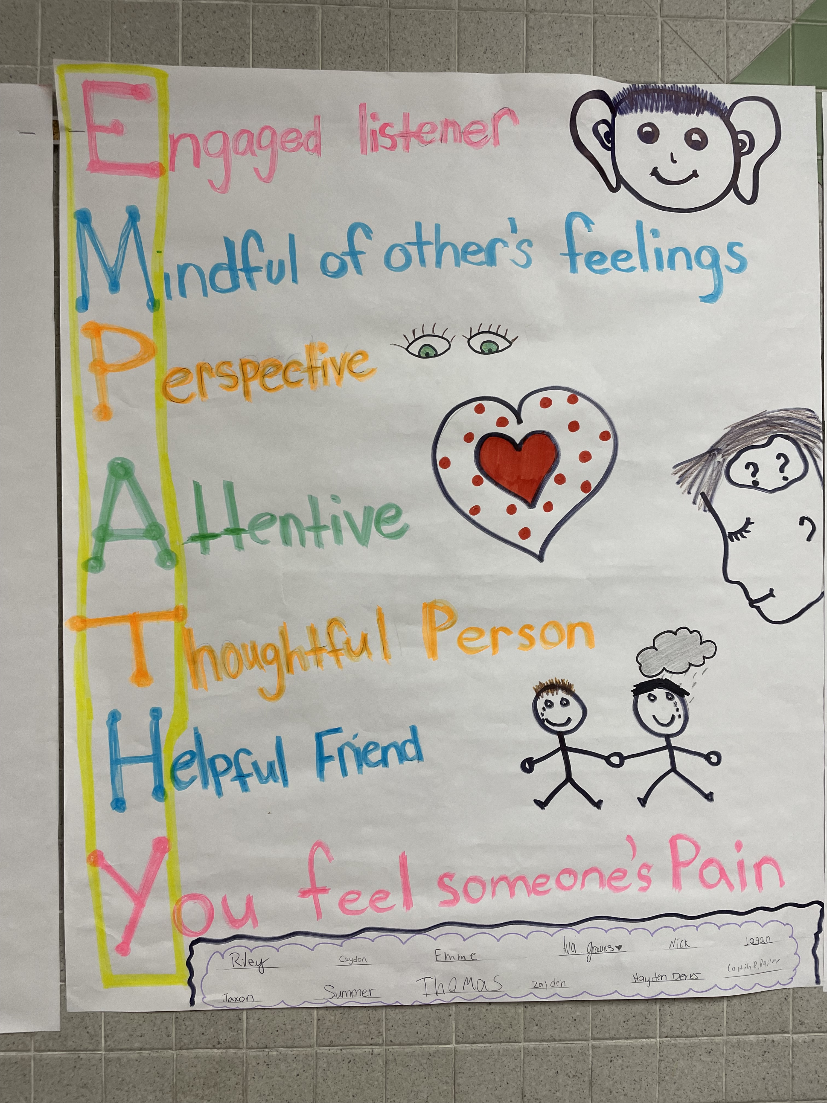
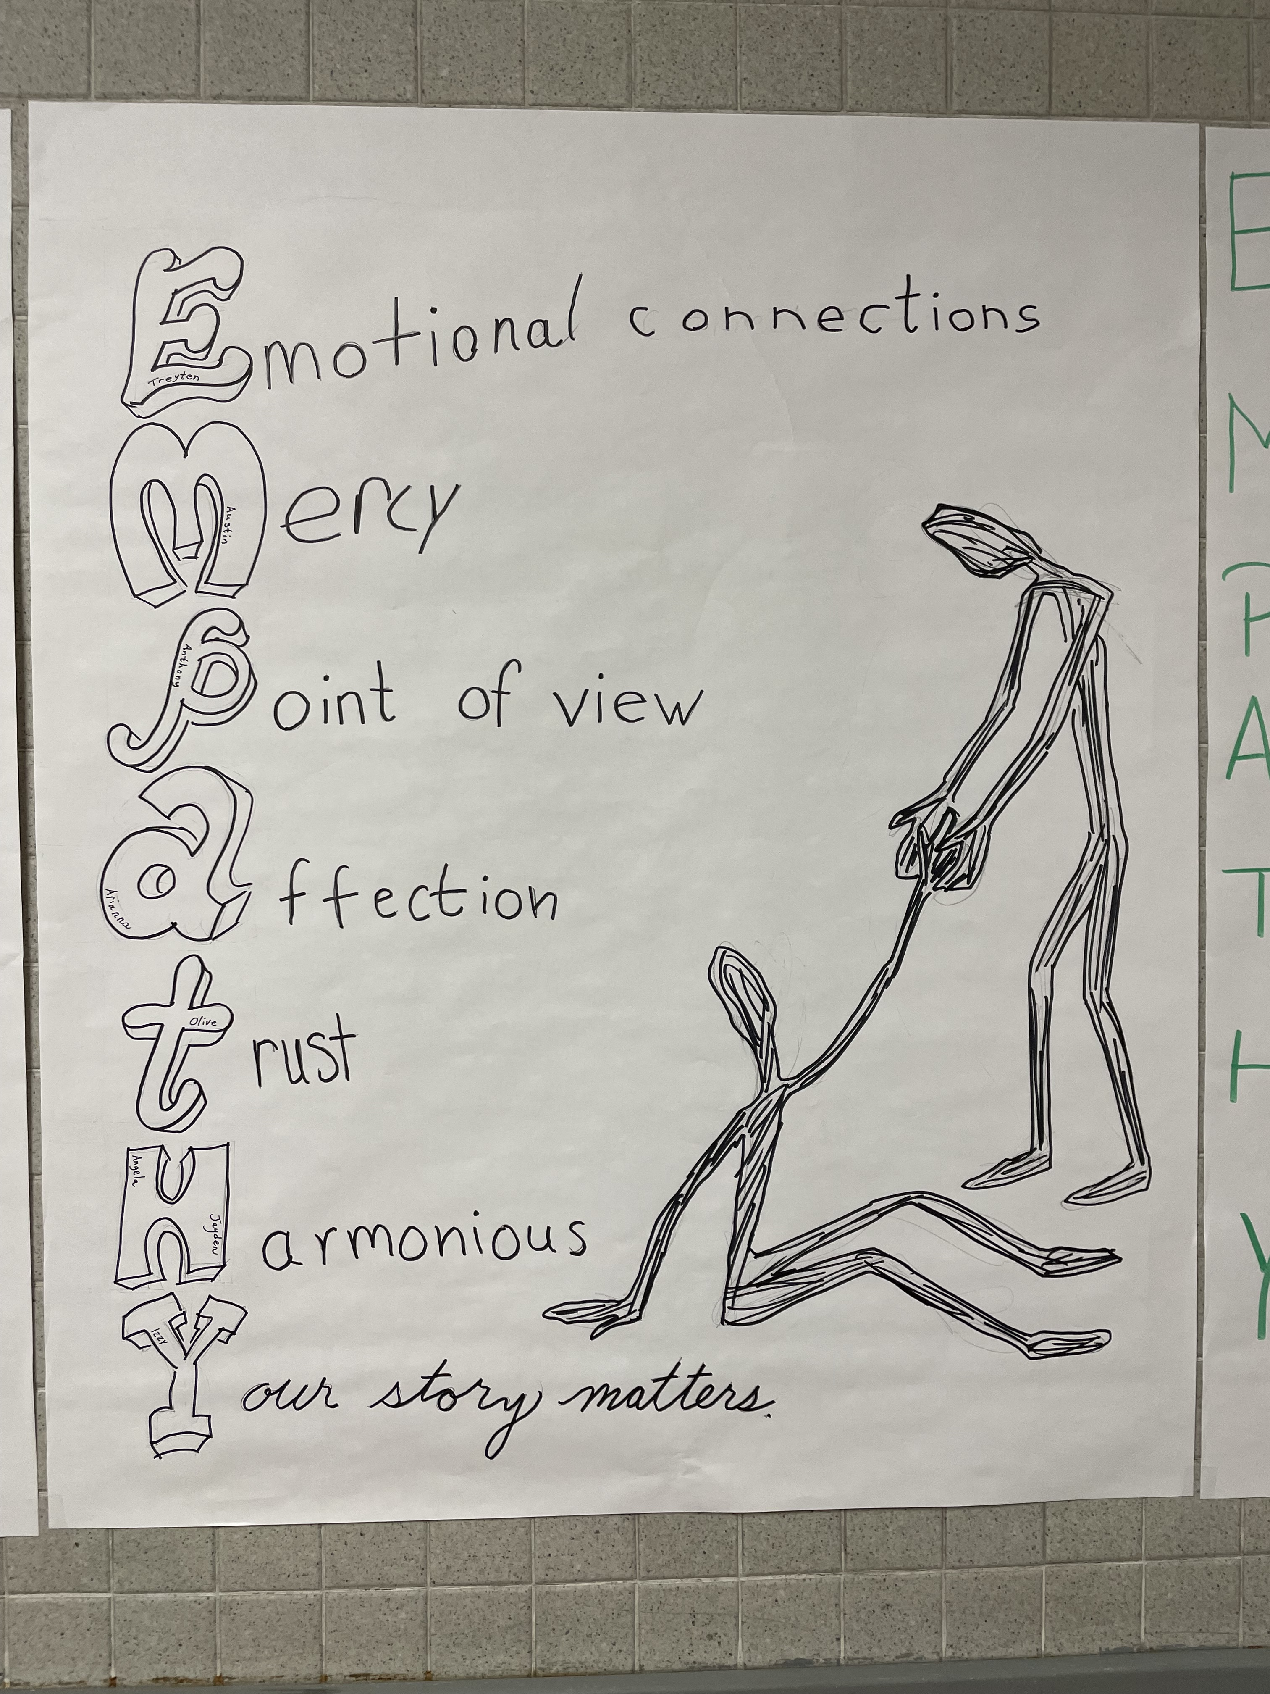
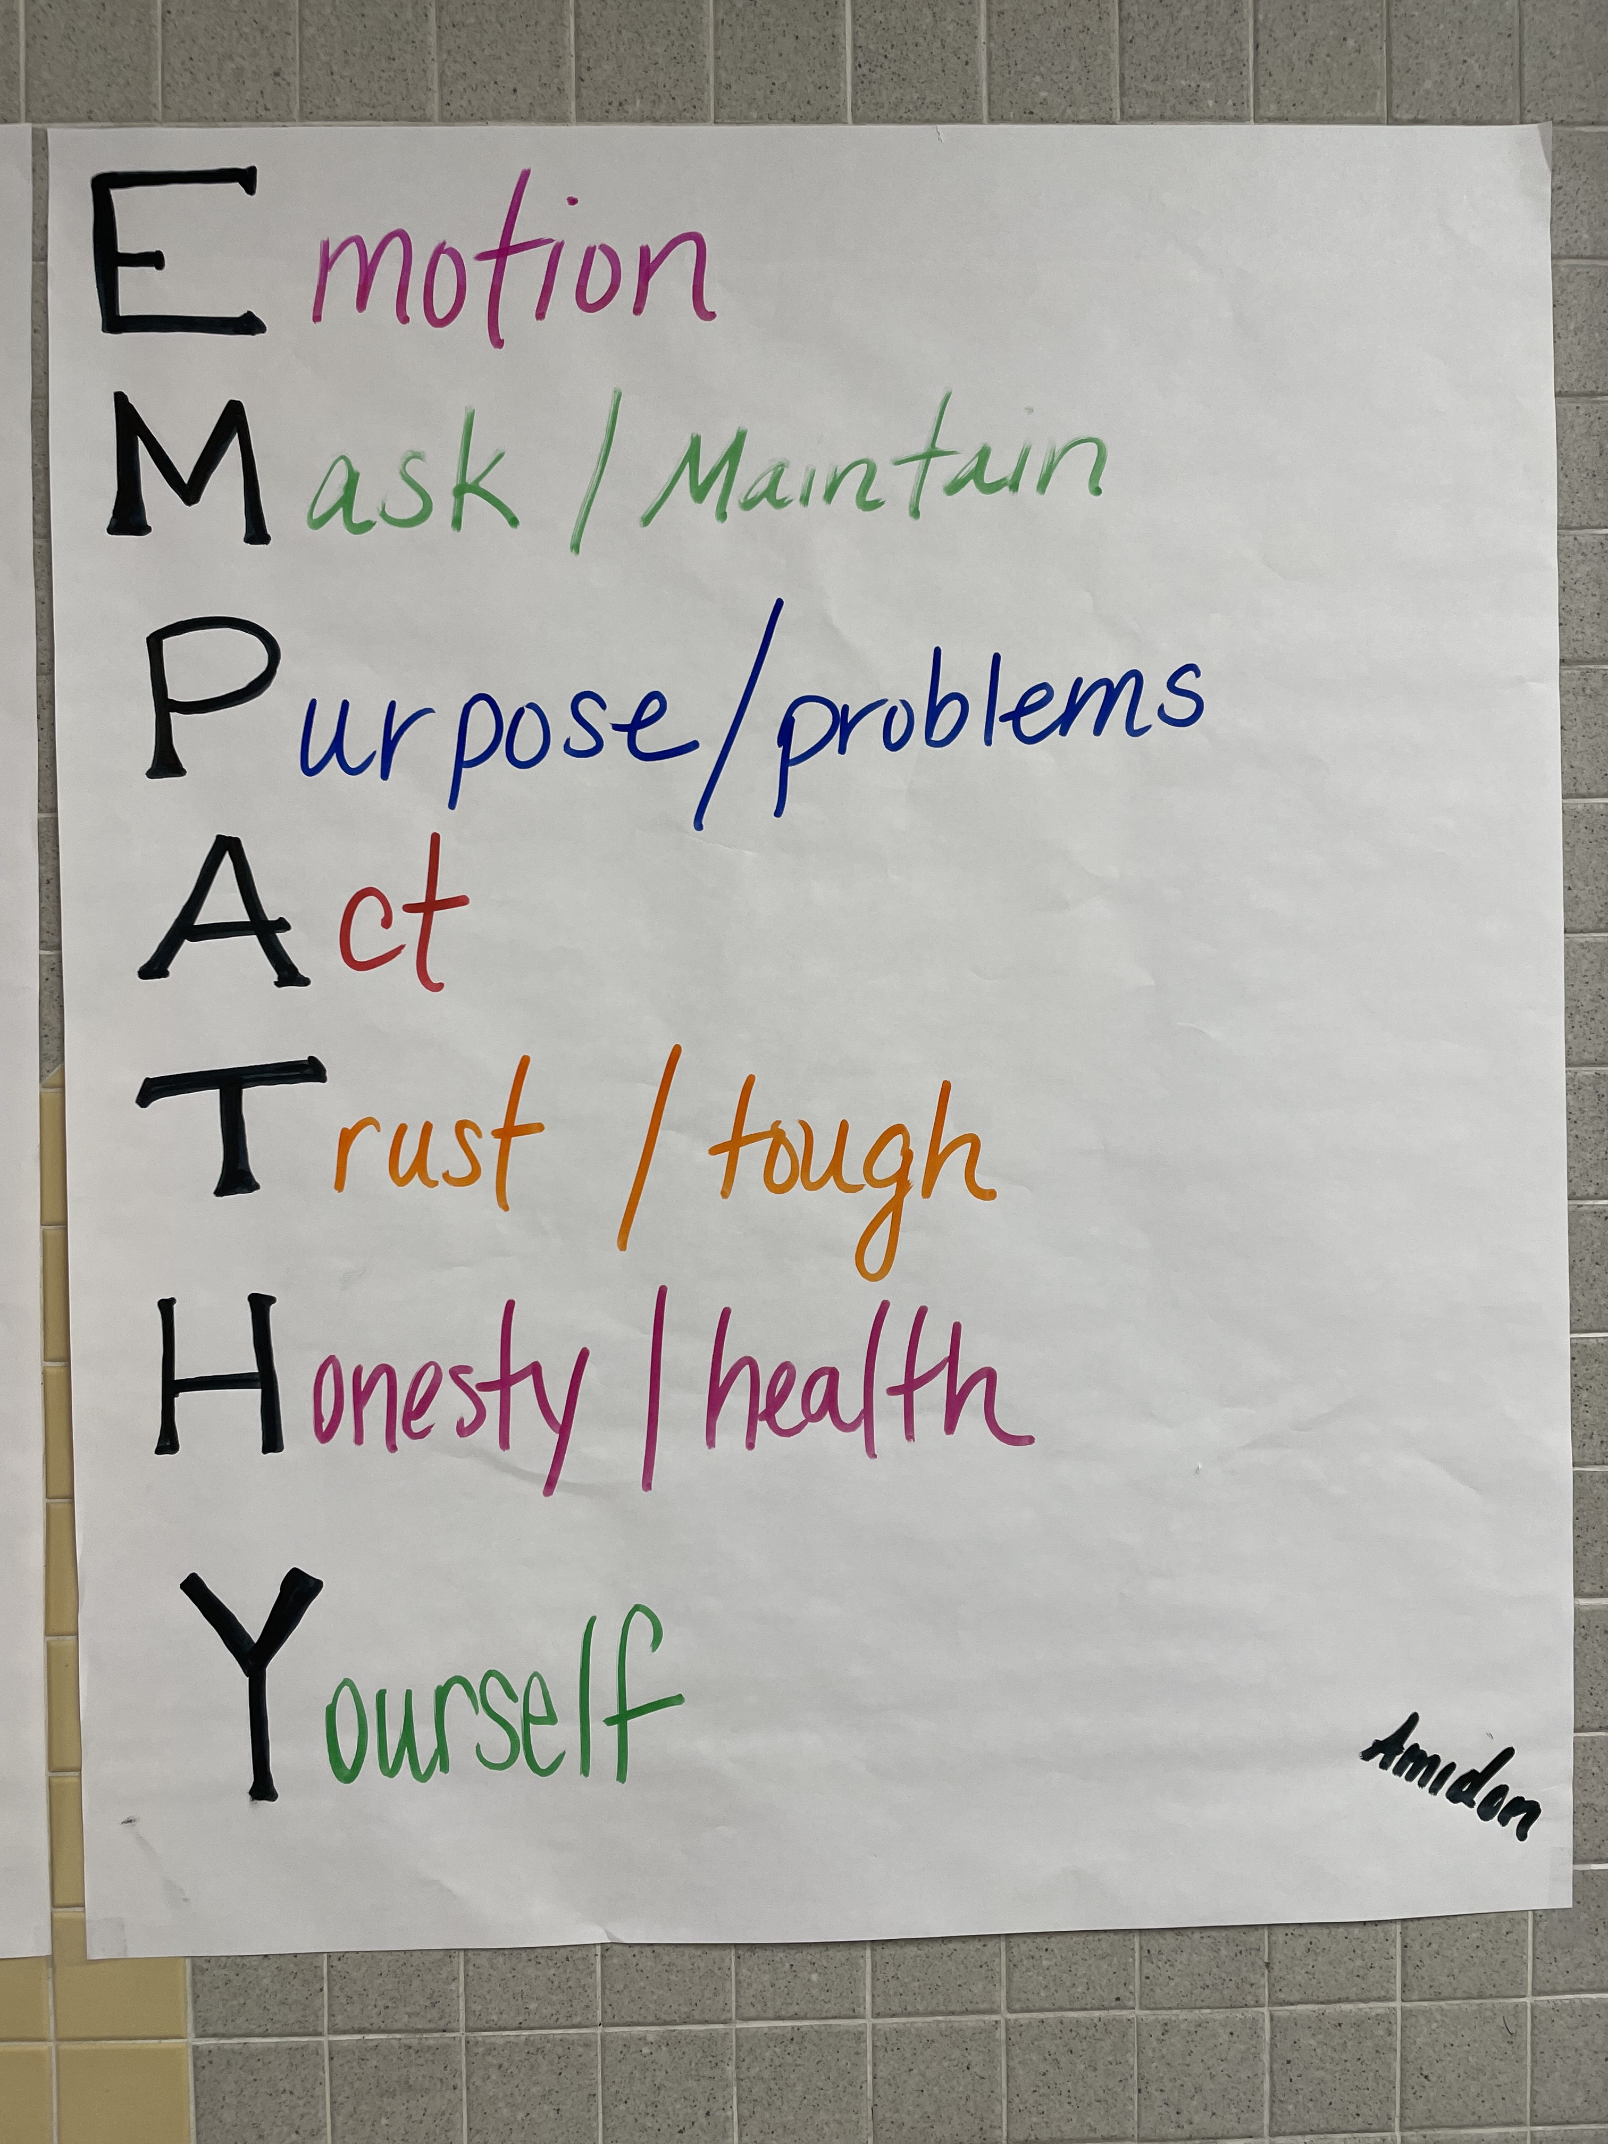
EMPATHY LESSONS
Waterloo MIDDLE SCHOOL

Slide 18
ACTION PLAN
GOAL #2: HIGH SCHOOL GRADUATION RATE TO 85%
Academic Reviews
Individual Pathway programming
Student staffings/parent meetings
Senior reviews
Attendance tracking
Grade level meetings
Home visits
career, military and college exposure
Mandatory 9th Period
RtI
Internships
Grade Level Presentations
Notes:
We will have another meeting End of September or early October

Slide 19
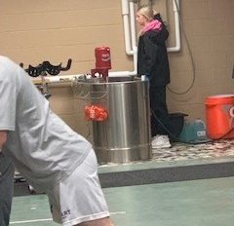
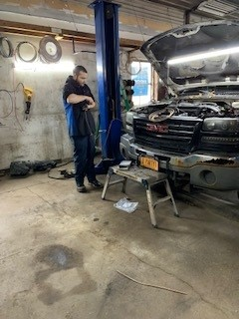
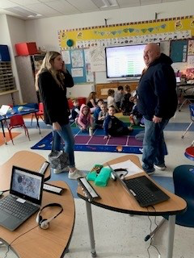
WATERLOO HIGH SCHOOL
HWS Athletic Trainer
Auto Mechanic
Elementary Teacher
STUDENT INTERNSHIPS

Slide 20
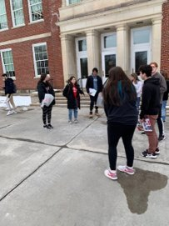
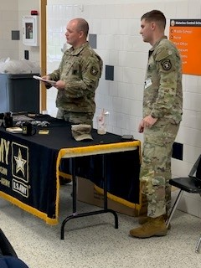
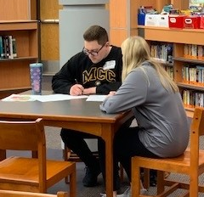
College/Career Presentations and College Visits

Slide 21
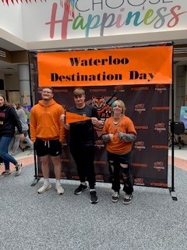
DESTINATION DAY 2023

Slide 22
Minutes:
Present:
Shelli Tam- Director of Pupil Personnel Services
Jada Bryant- Skoi-Yase Primary School Counselor, Counseling & SSST Dept. Chair
Corinne Turchetti- Skoi-Yase Social Worker
Taylor Vogler- School Psychologist- Skoi-Yase & Lafayette Intermediate
Suzie Burroughs- Lafayette Intermediate Social Worker
Catherine Rieck- Lafayette Intermediate School Counselor Lisa Andino- WMS School Counselor
Abigail Held- WMS Social Worker
Katie Wright- WHS College & Career Coordinator
Michael Foster- WHS School Counselor
Kristin LeMoyne- WHS Social Worker
Sarah Marchitell-Skoi-Yase Principal
Molly Lahr- District MTSS Coordinator
Sabrina Palmer- WHS student
Tammy Anhorn- parent/teacher representative

Slide 23
Shelli Tam- many members of Advisory Council unable to attend due to conflicts with spring sports/activities, and in prior years the fall advisory council is better attended than the spring meeting. Discussion around moving Advisory Council up to March to avoid conflicts next year. All agreed to have it in late March following our annual BOE presentation. Tammy Anhorn- great to see a name change for Destination Day as in past and in other schools it typically is referred to as ‘College Decision Day’. Excited to see that all students recognized and included in this tradition that previously focused on college bound students. Inclusivity and individualization is critical for students. Sabrina Palmer- possible ideas for pride points, to gather student input. Rewards for tier 3 attendance students at elementary levels- possible ice cream party or large group celebration? Ask community for coupons, certificates for students/families. Possibly call parent(s) when they are present in school vs. only calling when they are absent to recognize the family for improved attendance. Possibly have students call home with a buddy when improved attendance is made. Connects families and students to school. Maybe also have families into school for celebrations of improved attendance. Sarah Marchitell: love the ideas from Sabrina to help improve our attendance interventions at Skoi-Yase and will be discussing w/attendance team for ways to incorporate these next year. Jada Bryant: Fall and Spring dates will be set at our June Dept. Meeting.
Minutes Continued:

