Slide 1
The Civil War (War Between the States) 1861-1865
Mountain View Elementary School
Harrisonburg, VA 22801
Music Credit: http://www.txrebel.com/dixie.html

Slide 2
The War Between States
The war lasted from 1861 to 1865
The war started and ended at Wilmer McLean’s house
Picture Credit:
http://www.26nc.org/PhotoGallery/CommandChangePhotos/McLeanHouseMusic.jpg

Slide 3
Main Causes
State’s Rights
Slavery
Cotton Gin by Eli Whitney in 1793
Preserving the Union
Uncle Tom’s Cabin by Harriet Beecher Stowe
Slave vs. Free States
Picture Credit: http://www.disciples.org/convo/Slavery.jpg

Slide 4
Civil War Facts
1/2 million people were killed or wounded in the Civil War
60 % of the fighting took place in Virginia
Picture Credit: volusia.com/civilwar/

Slide 5
North | South
23 States | 11 States
Union | Confederate
Yankee | Rebel
Blue Coats | Grey Coats
USA | CSA
Army of the Potomac River | Virginia
Federal

Slide 6
Border States (Kentucky, Maryland, & Missouri) were States that had soldiers fighting for both sides!
In the battle of Vicksburg, there were 17 Confederate armies and 22 Union armies from the state of Missouri!

Slide 7
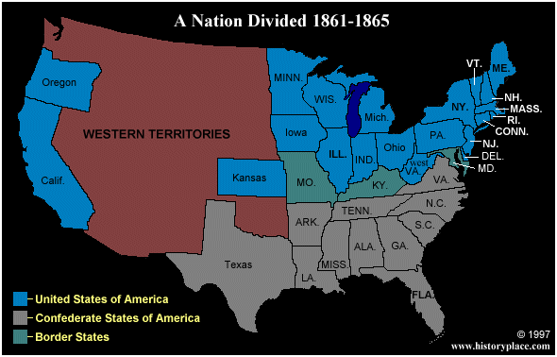
Picture Credit: http://www.historyplace.com/civilwar/cwar-pix/civmap.gif

Slide 8
Abolitionist
Abolitionist were people who wanted to end slavery or get rid of it.
Frederick Douglass (on left) was a well-known abolitionist.
Picture Credit: http://www.historyplace.com/lincoln/lincpix/fred-doug.jpg

Slide 9
The Underground Railroad
Was a system setup to help slaves (African Americans) escape to the Northern USA or Canada.
Slaves hid in barns and houses
Picture Credit: http://www.fs.fed.us/r9/wayne/ur_project/siebertmap.jpg

Slide 10
Nat Turner
Nat Turner lead a rebellion against plantation owners in 1831 and killed 60 people
http://www.millersville.edu/~tweis/fall98/272/turner/Nat_Turner.html

Slide 11
John Brown
Was a white man that lead a raid on Harper’s Ferry, Virginia in 1859 so that he could help free the slaves.
He was later hung at Charleston, West Virginia
http://jefferson.village.virginia.edu/jbrown/jbrown1.gif

Slide 12
Abe Lincoln
Was the president for the North
The North’s Capital was Washington D.C.
http://www.lincolnstore.com/page5.html

Slide 13
Jefferson Davis
Was the president for the South.
The South’s Capital was Richmond, Virginia
http://www.heritagephotographs.com/presjefdav18.html

Slide 14
Clara Barton
She was a Northern woman who gave water to dying soldiers
She continually risk her life to do this
http://www.lkwdpl.org/wihohio/bart-cla.htm

Slide 15
Sally Thompkins
Was the only women given the title Captain of the Confederate army
She ran one of the South’s most successful hospitals
http://womenshistory.about.com/library/prm/blcaptainsally1.htm

Slide 16
Front Sumter, South Carolina
Since South Carolina had seceded from the United States, it didn’t want Northern soldiers on its land at Fort Sumter
Southern General Bueargard tried to get the northern general Anderson to peacefully surrender Fort Sumter.
Picture Credit: members.aol.com/larrykench/ W1861001.html

Slide 17
Fort Sumter
The first major battle of the Civil War began on April 12, 1861.
After 2 days, the North surrendered to the South.
No one was killed but 1 soldier who was killed when a cannon backfired during the surrendering ceremony.
Picture Credit: http://library.thinkquest.org/3055/graphics/battles/images/sumteranim.gif

Slide 18
The 1st Manassas or 1st Bull Run, VA
July 21,1861
The general for the confederates was Stonewall Jackson & Buearegard.
The general for the Yankees was McDowell.
The North had 387 soldiers killed while the South lost 460.
The South won the battle.
Picture Credit: http://www.multied.com/civilwar/Bull.gif

Slide 19
The Battle of the Ironclads
March 8-9, 1862
The battle took place in Hampton Roads, VA.
The South had built an iron ship called the Merrimac or the Virginia.
The North challenged the Confederate ship with the northern iron ship called the Monitor.
Picture Credit: http://www.mandia.com/kelly/webpage/99_student_pages/merrimack_monitor/battle.jpg

Slide 20
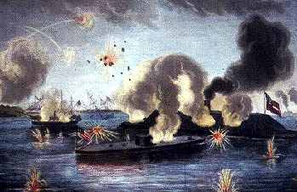
The Ironclads
The two iron ships fought for 5 hours and even collided 5 times. Neither side won except the North kept the South from getting supplies from the rest of the world.
Picture Credit: http://www.mandia.com/kelly/webpage/99_student_pages/merrimack_monitor/battle.jpg

Slide 21
2nd Manassas or 2nd Bull Run, VA
August 29-30, 1862
The general for the Confederate was Stonewall Jackson.
The general for the Yankees was John Pope.
The North lost 16,000 soldiers while the South lost only 9,000
The South won the battle.
Picture Credit: www.multied.com/civilwar/ SecondManassas.html

Slide 22
Stonewall Jackson
He led a valley campaign for 3 months in 1862.
He liked to suck on lemons all the time.
He said, “If this Valley is lost, Virginia is lost.”
His military reputation is perhaps greater than any other Civil War General because he won with a smaller army the majority of the time.
Picture Credit: www.lib.utexas.edu/photodraw/ portraits/

Slide 23
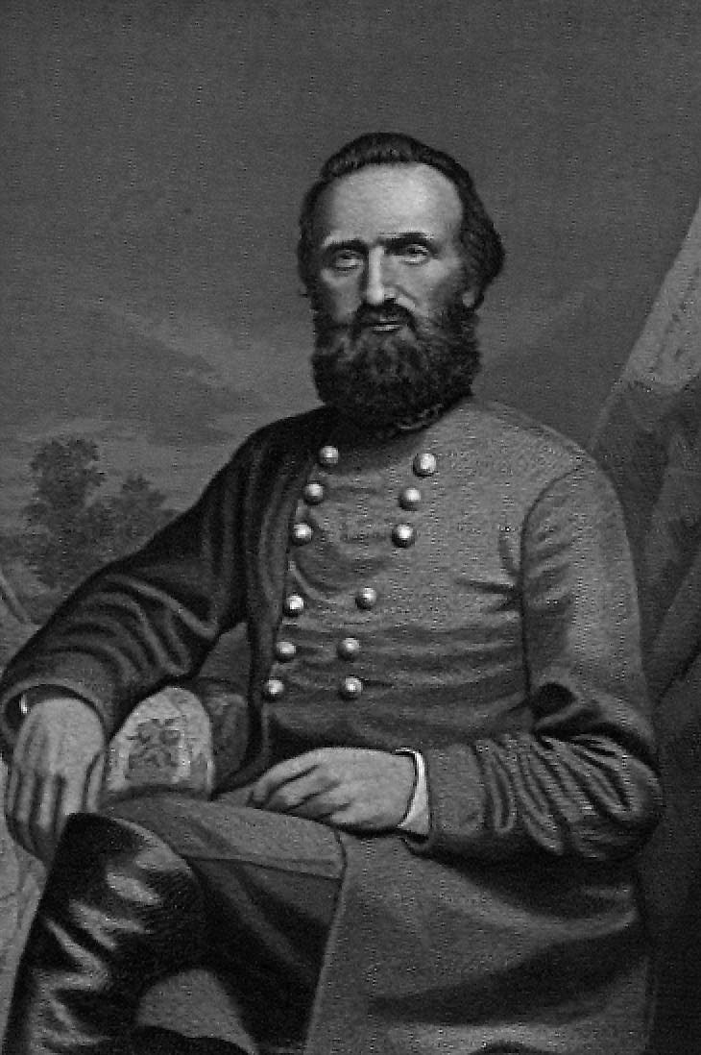
Stonewall Jackson
He knew that the Valley was the bread basket for the South.
Edinburg produced the most wheat.
Jackson only lost in the Kenstown.
He loved to suck on lemons.
He didn’t use chairs because he believed that standing was good for you.
Picture Credit: www.lib.utexas.edu/photodraw/ portraits/

Slide 24
Belle Boyd
She was a Southern spy that told Jackson that the Yankees were at Front Royal.
Picture Credit: www.civilwarhome.com/ boydbio.htm

Slide 25
Antietam or Sharpsburg, Maryland
September 17, 1862
The general for the Confederates was Robert E. Lee.
The general for the Yankees was McClellan.
A Union soldier found 3 cigars that helped the North to know what General Lee planned to do.
Picture Credit: memory.loc.gov/.../newsletter/ august01/feature.html

Slide 26
Antietam
The Battle took place in Farmer Miller’s cornfield.
The battle is known as the Single bloodiest day in the Civil War.
23,500 men were killed in the Bloody lane.
The name of the bridge where the confederates held the Yankees for 4 hours is called, Burnside.
The south used rocks when they ran out of ammunition.
South won the battle.
Picture Credit: www.trubador.com/bridge.htm

Slide 27
Battle Of Fredericksburg
Dec. 13-15, 1862
The general for the Confederates was Robert E. Lee
The general for the Yankees was Burnside.
The North had 122,000 soldiers while the South had 78,500
Picture Credit: www.multied.com/civilwar/ frederick.html

Slide 28
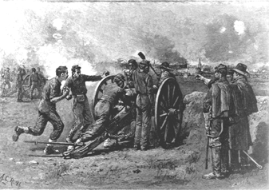
Battle Of Fredericksburg
9,000 Union soldiers were killed while only 1,500 Southern soldiers were killed.
The South won the battle.
Lee said, “It is well that was is so horrible, else we should grow too fond of it.’
Picture Credit: www.multied.com/civilwar/ frederick.html

Slide 29
Abraham Lincoln
President Abraham Lincoln on Jan, 1, 1863, declared the Emancipation Proclamation that freed all the slaves!
President Lincoln’s 4 brother-in-laws were Confederates.
He was the 1st president to wear a beard.
Picture Credit: www.branchburg.k12.nj.us/.../ Abe%20Main%20Page.htm

Slide 30
Chancellorsville
May 1-14, 1863
The general for the Confederates was Robert E. Lee
The general for the Yankees was Joseph Hooker.
South had 45,000 soldiers and North had 70,000 soldiers.
Picture Credit: www.civilwarcentral.com/ ShirtDetail.asp?prod=

Slide 31
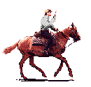
Chancellorsville
Major battle on May 2 at 6 in the evening. With the smoke thick in the air some Yankees killed Yankees and Confederates killed Confederates.
Stonewall Jackson was shot 3 times by his own men in the confusion. His last words were “Let us cross over the river and rest under the shades of the trees.”
South won the battle.

Slide 32
Brandy Station
Brandy Station occurred on June 9, 1863.
It is known as the largest cavalry battle on the North American continent. 17,000 cavalry soldiers fought in this battle.

Slide 33
The Battle of Gettysburg, PA
The battle of Gettysburg, PA took place on July1-3, 1863.
Major fighting occurred around Little Round top hill.
The North won this battle.
On November 19,1863. President Lincoln gave Gettysburg Address.
Picture Credit: www.pennhomes.com/loc.htm

Slide 34
The Battle of New Market
On May 15, 1864 The Battle of New Market.
The VMI cadets help fight and so the South won this battle.
Picture Credit: www.svta.org/new-market/

Slide 35
October 1864
In Oct. 1864, Sheridan (North) burns the Valley.
This way Grant was able to defeat the South.

Slide 36
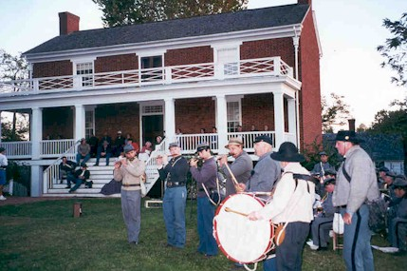
Appomattox Court House
April 9, 1865 Lee surrenders to Ulysses S. Grant at Appomattox, court house, Virginia.
Picture Credit:
http://www.26nc.org/PhotoGallery/CommandChangePhotos/McLeanHouseMusic.jpg

Slide 37
Robert E. Lee
He named his horse Traveller.
He said, “I don’t see how we could have an army without music.” Lee owned a pet hen. The hen went with him everywhere. At Gettysburg, he had his Generals help him find his lost hen.
Picture Credit: www.guyartgallery.com/ civil%20war%20gallery.htm

