Slide 1
PARENT ADVISORY COMMITTEE
October 18, 2023

Slide 3
Introductions
Principal - Dr. Andy Glatfelter
Vice Principal - Mr. John Kleespies
Title I Coordinator - Mrs. Elizabeth Pineda
Presenter/Facilitator - Dr. Jennifer Slater-Sanchez, Director of Categorical and Special Programs
Attendee Introductions

Slide 4
AVUHSD - MISSION, VISION, AND WHY
Our mission is to provide a safe and secure learning environment that promotes a rigorous curriculum and enables our students to develop the necessary academic, technical, and work-related skills of the 21st century.
Our vision is that every student who graduates will be prepared to pursue college and any career to which he or she aspires.
“To give our best everyday so that those we serve are inspired & empowered to become their true best.”

Slide 5
AGENDA
Purpose of Committee
LCFF/LCAP Defined
Agenda
LCAP Requirements & Development Process
Review Current AAV LCAP Goals & Actions
Dashboard Updates
Grants Update
Parent Involvement Opportunities

Slide 6
This committee:
Reviews the current Local Control Accountability Plan (LCAP)
Shares/Solicits information from site educational partners
Provides input, advice, and comments on revising the LCAP and related plans
Purpose of Committee
Notes:
EC code sections:
The governing board of a school district shall consult with teachers, principals, administrators, other school personnel, local bargaining units of the school district, parents, and pupils in developing a local control and accountability plan.
The superintendent of the school district shall present the local control and accountability plan or annual update to the local control and accountability plan to the parent advisory committee established pursuant to Section 52063 for review and comment. The superintendent of the school district shall respond, in writing, to comments received from the parent advisory committee.
The governing board of a school district shall establish a parent advisory committee to provide advice to the governing board of the school district and the superintendent of the school district regarding the requirements of this article.

Slide 7
LCFF AND LCAP OVERVIEW
California's main education finance law is known as the Local Control Funding Formula (LCFF).
LCFF assigns money to districts based on the number of students that are attending.
Under LCFF, districts also receive extra money to invest in the education of English Language Learners, Foster Youth, and children living in poverty (Low Income).
The LCFF requires districts to provide a description to demonstrate how the district is increasing or improving services for students who are Low Income, English Learners, or Foster Youth as compared to the services provided to all pupils.

Slide 8
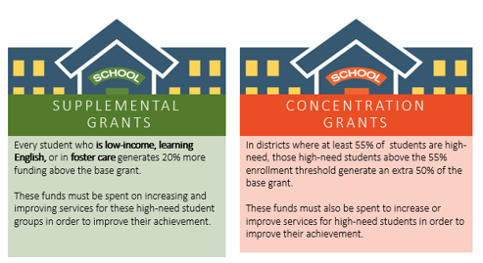
LCFF (STATE FUNDING)
Unduplicated Count
Projected
2023/24
____

Slide 9
LOCAL CONTROL ACCOUNTABILITY PLAN
All school districts and Charter Schools in California are required to produce an LCAP, demonstrating how the Local Control Funding Formula (LCFF) funds are linked to meeting the needs of all students.
The LCAP is a three-year plan that describes the goals, actions, services, and expenditures to support positive student outcomes that address state and local priorities.
The LCAP provides an opportunity for school districts to share their stories of how, what, and why programs and services are selected to meet their local needs.
The majority of the LCFF funds are District driven, however this formula also targets funding to specific student populations (subgroups):
English Learners / Long Term English Learners (LTELs)
Foster Youth
Socio-Economically Disadvantaged

Slide 10
LCAP REQUIREMENTS
THE LCAP INCLUDES GOALS, SPECIFIC ACTIONS, AND MEASURABLE STUDENT OUTCOMES FOR EACH OF THE EIGHT STATEWIDE PRIORITIES
Each district’s LCAP must include the following:
Goals
Actions
Related Expenditures
LCAPs must include services that target the following student groups:
English Learners/LTELs
Foster Youth
Low Income
LCAPs must address the 8 state priorities
Notes:
LTELs (7 years ) *box

Slide 11
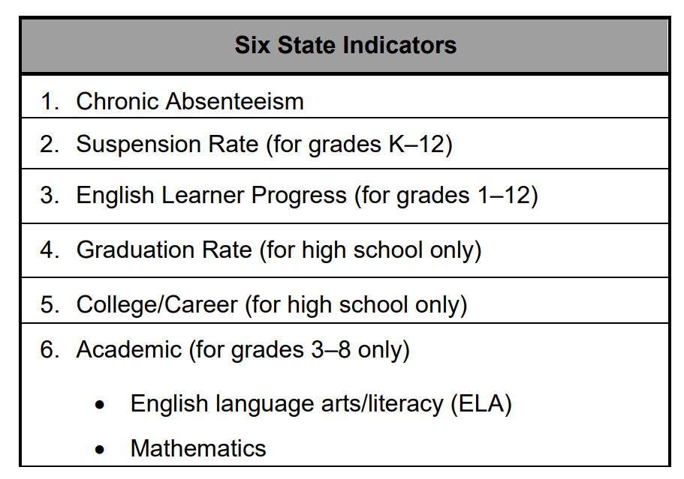
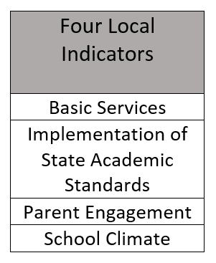
State Accountability The Local Control Funding Formula (LCFF) required the State Board of Education (SBE) to develop an accountability tool, known as the evaluation rubrics, that: Include state and local performance indicators for ALL Local Control Funding Formula state priorities. Assists local educational agencies in identifying strengths, weaknesses, and areas in need of improvement for LEAs and schools. Identifies a process for using the performance standards to identify LEAs in need of additional assistance or intervention.

Slide 12
EDUCATIONAL PARTNER FEEDBACK
Community Engagement Meetings (Roadshow)
- Parents/Guardians
- Students
- Staff
Advisory committees
- District Site Leadership Team (DSLT)
- District Parent Advisory Committee (DPAC)
- District English Learner Committee (DELAC)
Labor Groups
- AVTA
- CSEA
SELPA
Board of Trustees
Los Angeles County Office of Education

Slide 13
TIMELINE OF LCAP DEVELOPMENT
Connect with Educational Partners (FALL)
Present LCAP to Advisory Committees (WINTER/SPRING)
Share LCAP with Public and Collect Further Input (SPRING)
Finalize LCAP & Present to Board for Adoption (JUNE)

Slide 14
ACADEMIES OF THE ANTELOPE VALLEY
2023/24 LCAP

Slide 15
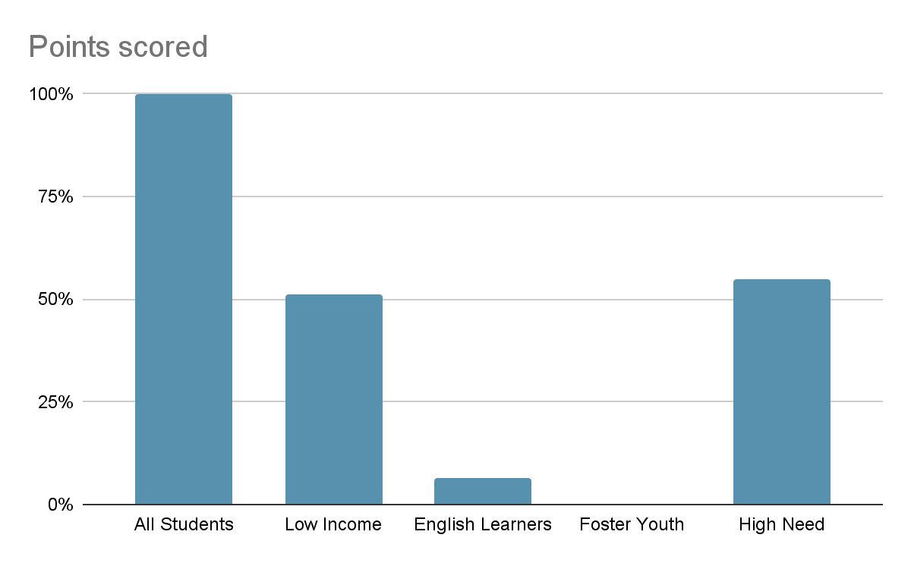
STUDENTS WE SERVE at AAV
Notes:
Add LTELs & students with Disabilities?

Slide 16
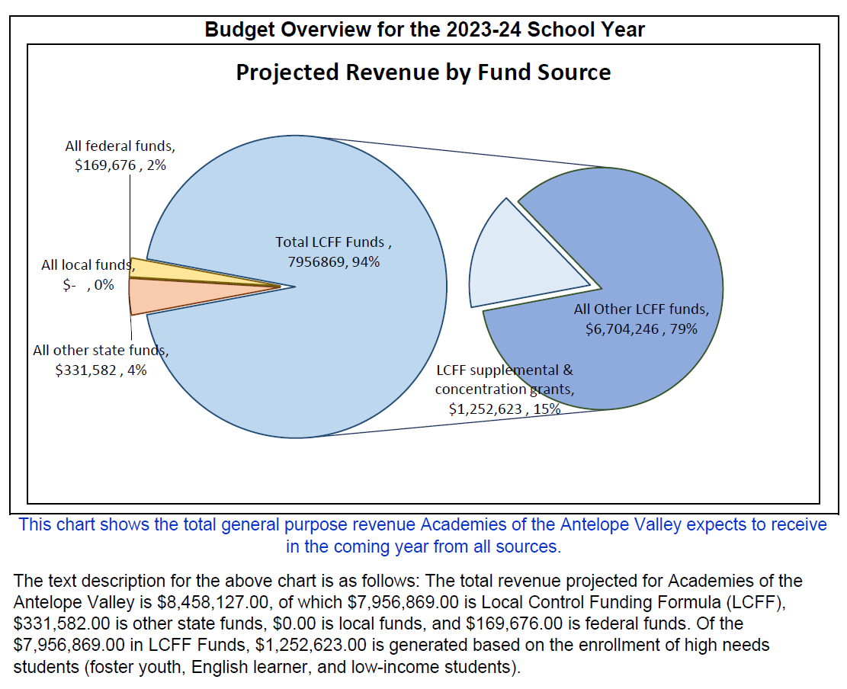
BUDGET OVERVIEW FOR PARENTS (BOP)
Of the $7,956,869 in LCFF Funds, $1,252,623 (Supplemental & Concentration) is generated based on the enrollment of high needs students (Foster Youth, English Learners, and Low-Income students).

Slide 17
LCAP GOALS AND ACTIONS
Goal 1 – Ensure that all students are academically proficient and college and career ready.
Goal 2 – Provide a 21st Century learning environment and rigorous curriculum that allows students to have multiple experiences and opportunities for academic, collegiate, professional and personal growth.
Goal 3 – Cultivate a safe and secure, positive school culture that supports all students' personal and academic growth.
Goal 4 - Communicate effectively with all educational partners and continue to build relationships in the community that help provide our students with innovative educational opportunities.

Slide 18
MTSS Tier 2 – Supplemental and Interventions
MTSS : Implementation of Multi-Tiered System of Support
Building Tier 2 Teams: Tier 2 teams provide targeted interventions to struggling students, fostering collaboration among educators to identify and support those needing extra help.
Targeted Interventions: Tailored strategies and supports are used to address individual student needs, guided by data and evidence-based methods to improve outcomes.
Data Analysis: Collecting and analyzing student performance and behavior data helps identify needs, track progress, and make informed decisions about interventions.
Administration & Support: District and school leadership are pivotal in program development, providing resources and alignment with district goals.
Ongoing Staff Development: Continuous professional development on instructional practices, data analysis, and collaboration supports effective MTSS implementation.
Instructional Observations & Assessments: Regular observations and assessments inform decisions about student support and guide instructional improvements.
Key Themes in 2023/24 LCAP

Slide 19
MTSS Tier 3 - Intensive, individualized supports
Support for EL Program: We will provide additional support for English Learners, including teacher professional development, targeted interventions, and improved collaboration between general education and EL teachers.
Enhanced Student Support Centers: We are strengthening Tier II and III supports through Student Support Centers to help academically, behaviorally, socially, or emotionally struggling students.
Academic Acceleration: To boost academic progress, we'll enhance technology, use formative assessments, and monitor progress using tools like NWEA Map assessments, Data Central, Ed Central, Elevation, SWIS-PBIS, and PowerSchool, with ongoing teacher training.
Expanded MTSS: We're expanding our Multi-Tiered Systems of Support (MTSS) to include enhanced Tier II and III interventions, addressing academic, behavioral, social-emotional, and physical well-being. Additional staff such as counselors, social workers, pupil service technicians, and student support coordinators will coordinate services.
Key Themes Continued

Slide 20
AVID Program: AVID (Advancement Via Individual Determination) is an educational program that prepares underrepresented students for college and career success through academic and organizational skills, integrated into classroom instruction.
Ancillary Instructional Materials: These resources, like textbooks, workbooks, and software, support classroom instruction and enhance student learning, aiding in differentiation and engagement.
Counseling Services: School counselors provide academic, social-emotional, career counseling, crisis intervention, and referral services to address students' holistic needs.
Parent, Guardian, and Community Engagement: Involving families and communities in education through activities like conferences, events, and partnerships to boost student performance and well-being.
Professional Development: Ongoing training for educators through workshops, conferences, and coaching to ensure high-quality instruction and support for students.
Additional Themes Embedded Throughout the 2023/24 LCAP

Slide 21
CONTRIBUTING ACTION
Scope of the Action: Who will receive the action or service?
Limited: An action that only serves foster youth, English Learners, and/or Low-Income students
LEA wide: The action provides the action/service to all schools in the LEA
Schoolwide: The action provides the action/service to certain school(s) or grade span(s)
An action being provided on a LEA wide or Schoolwide basis must be designed to address the unique needs of low income, EL, and/or foster youth students
The action increases or improves services for unduplicated (targeted) pupils as compared to the services the LEA provides to all students
Notes:
Jen - contributing is above and beyond the base (3 Ts or William’s)

Slide 22
Goal 1
Ensure that all students are academically proficient and college and career ready.
1.1 - Student Field Trips - Guided tours of Colleges, Universities, and career-related destinations (LEA-Wide - All Schools) | 1.8 - Student-Free Professional Development Days - Three professional development days (LEA-Wide - All Schools)
1.2 - College Readiness Exams - Administer the PSAT and SAT annually (LEA-Wide - All Schools) | 1.9 - Variable Credit Recovery - Increased credit retrieval options (LEA-Wide - All Schools)
1.3 - AP Training and Tutoring - AP Teachers will attend AP training annually (Limited - 10th/11th graders only) | 1.10 - Ancillary Instructional Materials - Providing EL, FY, and LI students with ancillary instructional materials (LEA-Wide - All Schools)
1.4 - Expanded Learning Opportunities - Provide extended day tutoring (LEA-Wide - All Schools) | 1.11 - Focus on Writing - Additional professional development, coaching and ancillary writing curriculum supports (LEA-Wide - All Schools)
1.5 - Formative Assessment - NWEA Map assessments three times per year (LEA-Wide - All Schools) | 1.12 - Intervention Materials and Supplies - Supplemental instructional materials & supplies (Title I Funded)
1.6 - EL Program Implementation - Additional enrollment and monitoring supports (Limited - ELs) | 1.13 - Saturday Tutoring - Extended day and Saturday tutoring (Title I Funded)
1.7 - EL Reclassification Support and Monitoring - Ellevation, Data Central, and PowerSchool Database systems (Limited - ELs) | 1.14 - Supplemental Interventions - Interventions, supports, and monitoring to students with IEPs and 504 plans (Title I Funded)
Notes:
After gathering feedback from our educational partners and analyzing local metrics, we have decided to maintain Goal 1 and its associated actions with some minor modifications. We will work to expand the number of college and career-based field trips.
Goal 1.1 - Student Field Trips
Our plan is to enhance the students' learning experience by increasing the number of field trips to college and career-based destinations.

Slide 23
Goal 2
Provide a 21st Century learning environment and rigorous curriculum that allows students to have multiple experiences and opportunities for academic, collegiate, professional and personal growth.
2.1 - Enhanced Counseling & Student Support Services - Proactively address students academic, social-emotional, behavioral and physical well-being (LEA-Wide - All Schools) | 2.9 - 21st Century Learning Environments - Classroom walkthrough feedback (LEA-Wide - All Schools)
2.2 - Professional Development - Ongoing professional development for certificated staff (LEA-Wide - All Schools) | 2.10 - Enhanced Data Systems - Training on Ed Central and Data Central (LEA-Wide - All Schools)
2.3 - Classroom Walkthroughs - “DigiCOACH” classroom walkthrough tools (LEA-Wide - All Schools) | 2.11 - NGSS Supports - Additional professional development, feedback and lesson planning support (LEA-Wide - All Schools)
2.4 - AP Placement/Exams/Tutoring - Equitable access to AP classes (Limited - 10th/11th graders only) | 2.12 - AVID Professional Development - Professional Development on AVID strategies (Title I Funded)
2.5 - Career Technical Education (CTE) opportunities - CTE course offerings (Limited - 9th-12th graders only) | 2.13 - AVID Tutors - Tutors for the AVID elective classes (Title I Funded)
2.6 - AVID Elective - AVID elective sections (LEA-Wide - All Schools) | 2.14 - Intervention Technology - Virtual intervention programs (Title I Funded)
2.7 - Technology - Renovated classrooms that are outfitted with technology, wireless capacity and online access (LEA-Wide - All Schools) | 2.15 - Arts Integration and Visual and Performing Arts Program - VAPA program (Title IV Funded)
2.8 - STEM Support - STEM exposition and competition opportunities (LEA-Wide - All Schools)
Notes:
Based on the feedback from our educational partners, data analysis of our local metrics, and our continuing commitment to meeting the needs of your FY, LI, and EL students, we have decided not to make any changes to our current LCAP actions and services for Goal 2

Slide 24
Goal 3
Cultivate a safe and secure, positive school culture that supports all students' personal and academic growth.
3.1 - Access to Standards-Aligned Instructional Materials - Full access to standards-aligned instructional materials (BASE FUNDED) | 3.7 - Student Support Services - Multi-Tiered Systems of Support via support personnel (LEA-Wide - All Schools)
3.2 - Facilities in “Good” Repair - Maintenance and operational expenses (BASE FUNDED) | 3.8 - Implement PBIS - PBIS and Habitudes curriculum (LEA-Wide - All Schools)
3.3 - Fully Credentialed and Appropriately Assigned Teachers - Fully credentialed and appropriately assigned teachers. (LEA-Wide - All Schools) (BASE FUNDED) | 3.9 - Classified Professional Development - Professional development opportunities to Classified staff (LEA-Wide - All Schools)
3.4 - Special Education Program - Fulfill requirements of Special Education program (BASE FUNDED) | 3.10 - Transportation - Transportation for Low Income and Foster Youth students (Limited - Low Income)
3.5 - CTE Programs - Teachers and staff for Career Technical Education programs (BASE FUNDED) | 3.11 - Safe, Secure, and Positive Learning Environments - Proactively monitor the school environment, mentoring , and build positive relationships (LEA-Wide - All Schools)
3.6 - Improve Attendance - Tiered re-engagement interventions and utilize A2A: Attention to Attendance (LEA-Wide - All Schools) | * 3.12 - Multi-Tiered System of Supports (MTSS) - Implementation of MTSS Tier 2 and 3, PD, resources, site teams, etc. (LEA-Wide - All Schools)
Notes:
After receiving feedback from our educational partners, analyzing state and local metrics and our continuing commitment to meeting the needs of your FY, LI, and EL students, we determined to make the following adjustment to our current LCAP actions:
Action 3.13 - We will be increasing our allocation of resources in order to enhance our “Independent City” event and implement “Resilient Scholar” meetings in order to serve additional Foster Youth and to be able to provide additional resources and support than we currently are.
One improved action/service has been added to the 2023/24 LCAP for Goal 3.
Action 3.15 - Multi-Tiered System of Supports (MTSS)
The successful implementation of the District's Multi-Tiered System of Supports (MTSS) model and vision will be led by the Director of MTSS, along with District coordinators, directors, and various support personnel. This effort will focus on providing Tier II and Tier III interventions for English Learner (EL), Foster Youth (FY), and Low Income (LI) students in order to enhance their academic achievement, as well as their behavioral, and social-emotional well-being. They will support MTSS school site teams, provide professional training for school staff and teachers, offer resources related to MTSS, guide school-based processes, and monitor data to establish goals and provide academic, behavioral, and social-emotional tiered interventions to English Learner (EL), Foster Youth (FY), and Low Income (LI) students. This will enhance their academic achievement, as well as their behavioral and social-emotional well-being, which will be demonstrated through improved academic achievement, increased attendance, decreased suspensions, and improved local climate survey results.

Slide 25
Goal 4
Communicate effectively with all educational partners and continue to build relationships in the community that help provide our students with innovative educational opportunities.
4.1 - PowerSchool - Student Information System (BASE FUNDED) | 4.5 - Increase Communication - Utilizing various agencies to increase communication and outreach efforts (LEA-Wide - All Schools)
4.2 - Parent Link - The “Parent Link” system (LEA-Wide - All Schools) | 4.6 - Increase Parent and Community Outreach - Plan and participate in community events (LEA-Wide - All Schools)
4.3 - Parent/Family Collaboration - Virtual and in-person parent workshops (LEA-Wide - All Schools) | 4.7 - Expand Parent University - Additional conferences and workshops to empower parents (Title I Funded)
4.4 - EL Parent Workshops - Provide college information, goal setting, financial aid and parenting workshops, for non English speaking parents (Limited - ELs)
Notes:
After reviewing the feedback from our educational partners, analyzing the local metrics data, and maintaining our dedication to catering to the needs of our FY, LI, and EL students, we concluded to implement the subsequent modifications to our existing LCAP actions:
4.4/4.6 - EL Parent Workshops/Parent/Family Collaboration
PIQE was offered from January to June 2023. We plan to offer these workshops throughout the 2023/24 school year in order to engage as many families as possible and provide them with the tools to support their students in high school and beyond.

Slide 26
CA SCHOOL DASHBOARD 2023
CA School Dashboard
2023
STATE INDICATORS INCLUDED STATUS, CHANGE, AND PERFORMANCE COLORS BASED ON DATA FROM THE 2022/23 AND 2021/22 SCHOOL YEARS
LOCAL INDICATORS WERE SUBMITTED BY LEAS
SCHOOLS AND LEAS WERE IDENTIFIED FOR SUPPORT (CSI) USING 2022/23 AND 2021/22 DATA
Notes:
What will Accountability look like in 2023?
State Indicators will include status, change, and Performance Colors based on data from the 2022–23 and 2021–22 school years
Local indicators will be submitted by LEAs
Schools and LEAs will be identified for support using 2022–23 and 2021–22 data

Slide 27
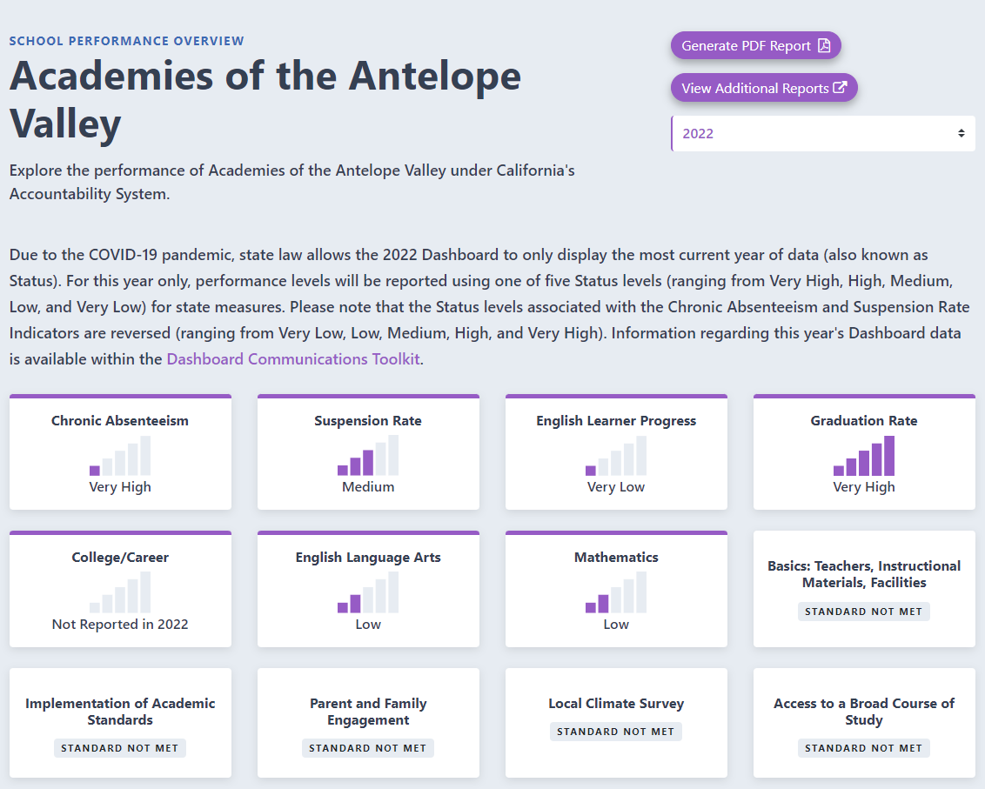
2022/23 DASHBOARD

Slide 28
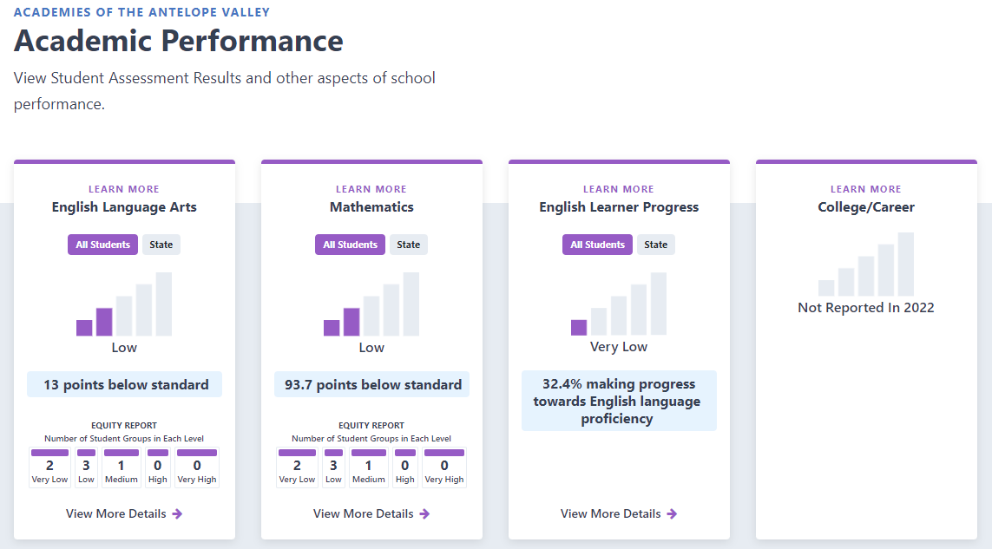
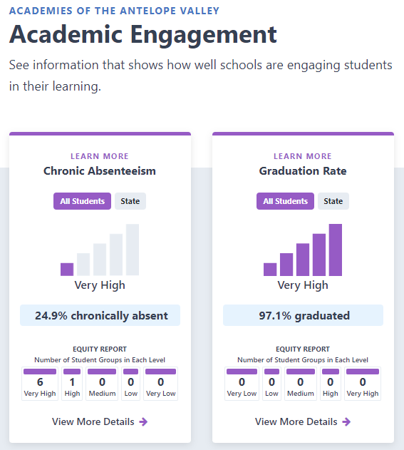
2022/23 DASHBOARD

Slide 29
NEXT STEPS
December 2023
Review Previous & Current Progress [Goals & Actions]
Review 2023 Dashboard Results
March 2024
Review Data Outcomes
[Surveys & Feedback]
May 2024
Review and Comment on Draft 2024/25 Plan
June 2024
Public Hearing
Plan Adoption
LACOE Approval

Slide 30
SUPPLEMENTAL FUNDING -
GRANTS UPDATE
FEDERAL GRANTS
STATE GRANTS
A-G Grant
COVID Relief Funds
Arts, Music, and Instructional Materials Grant
Educator Effectiveness Grant
Learning Recovery Emergency Block Grant

Slide 31
Educational Partner Engagement Opportunities
Date | Time/Place | School

Slide 33
THANK YOU!
DR. JENNIFER SLATER-SANCHEZ - JSLATER-SANCHEZ@AVHSD.ORG

