Slide 1
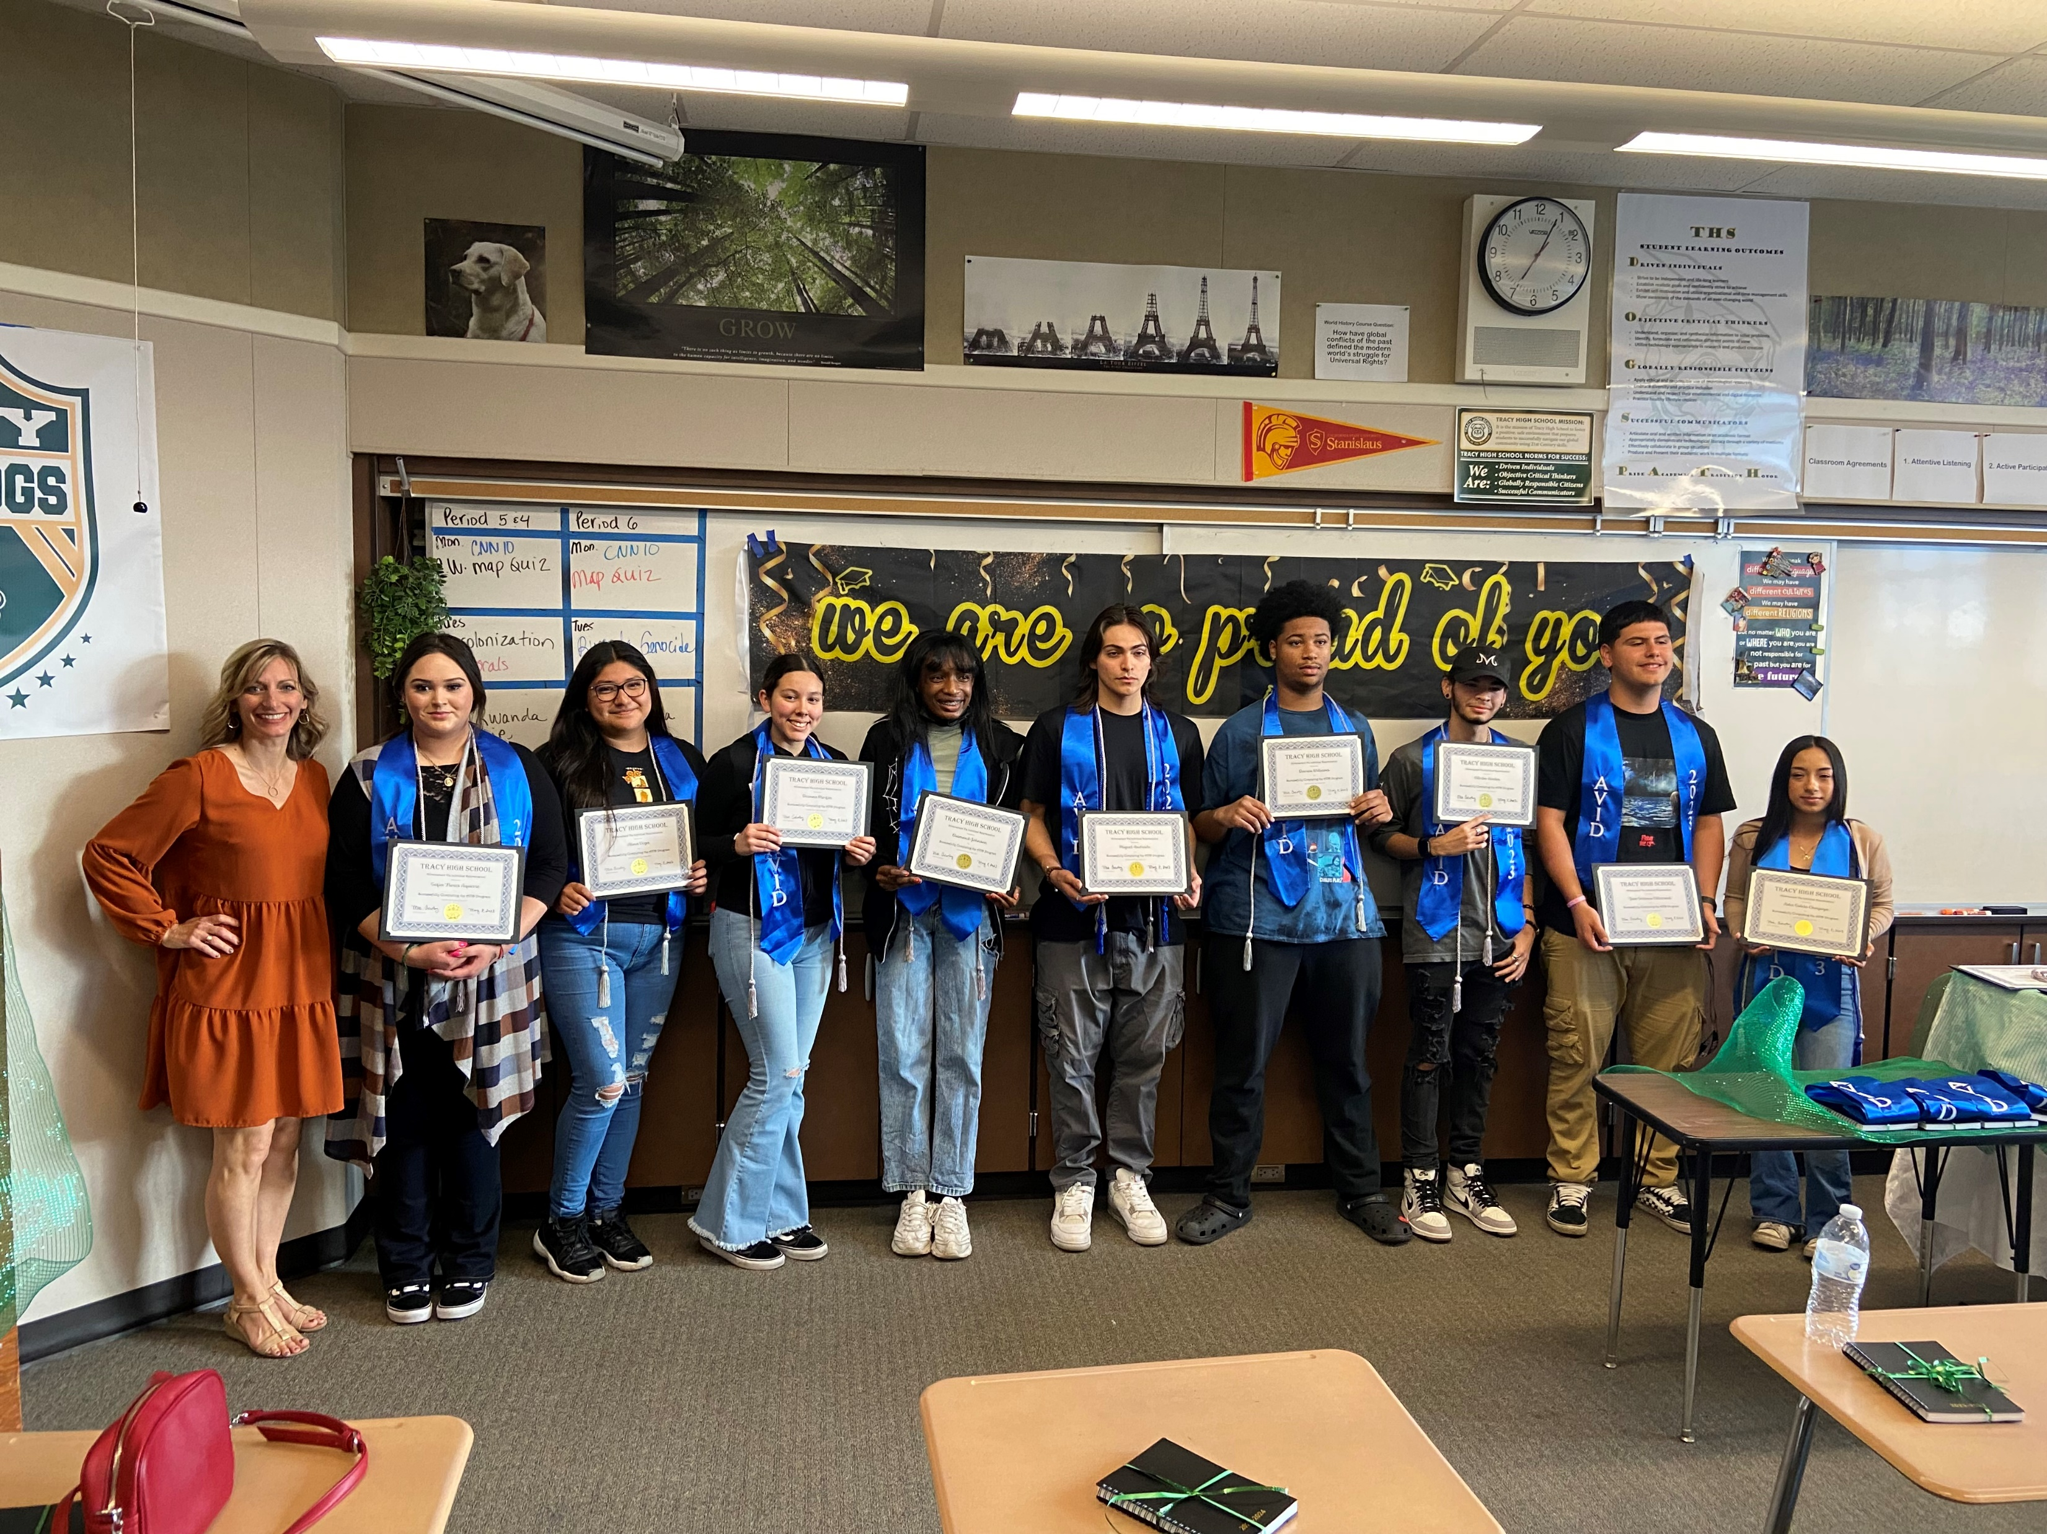
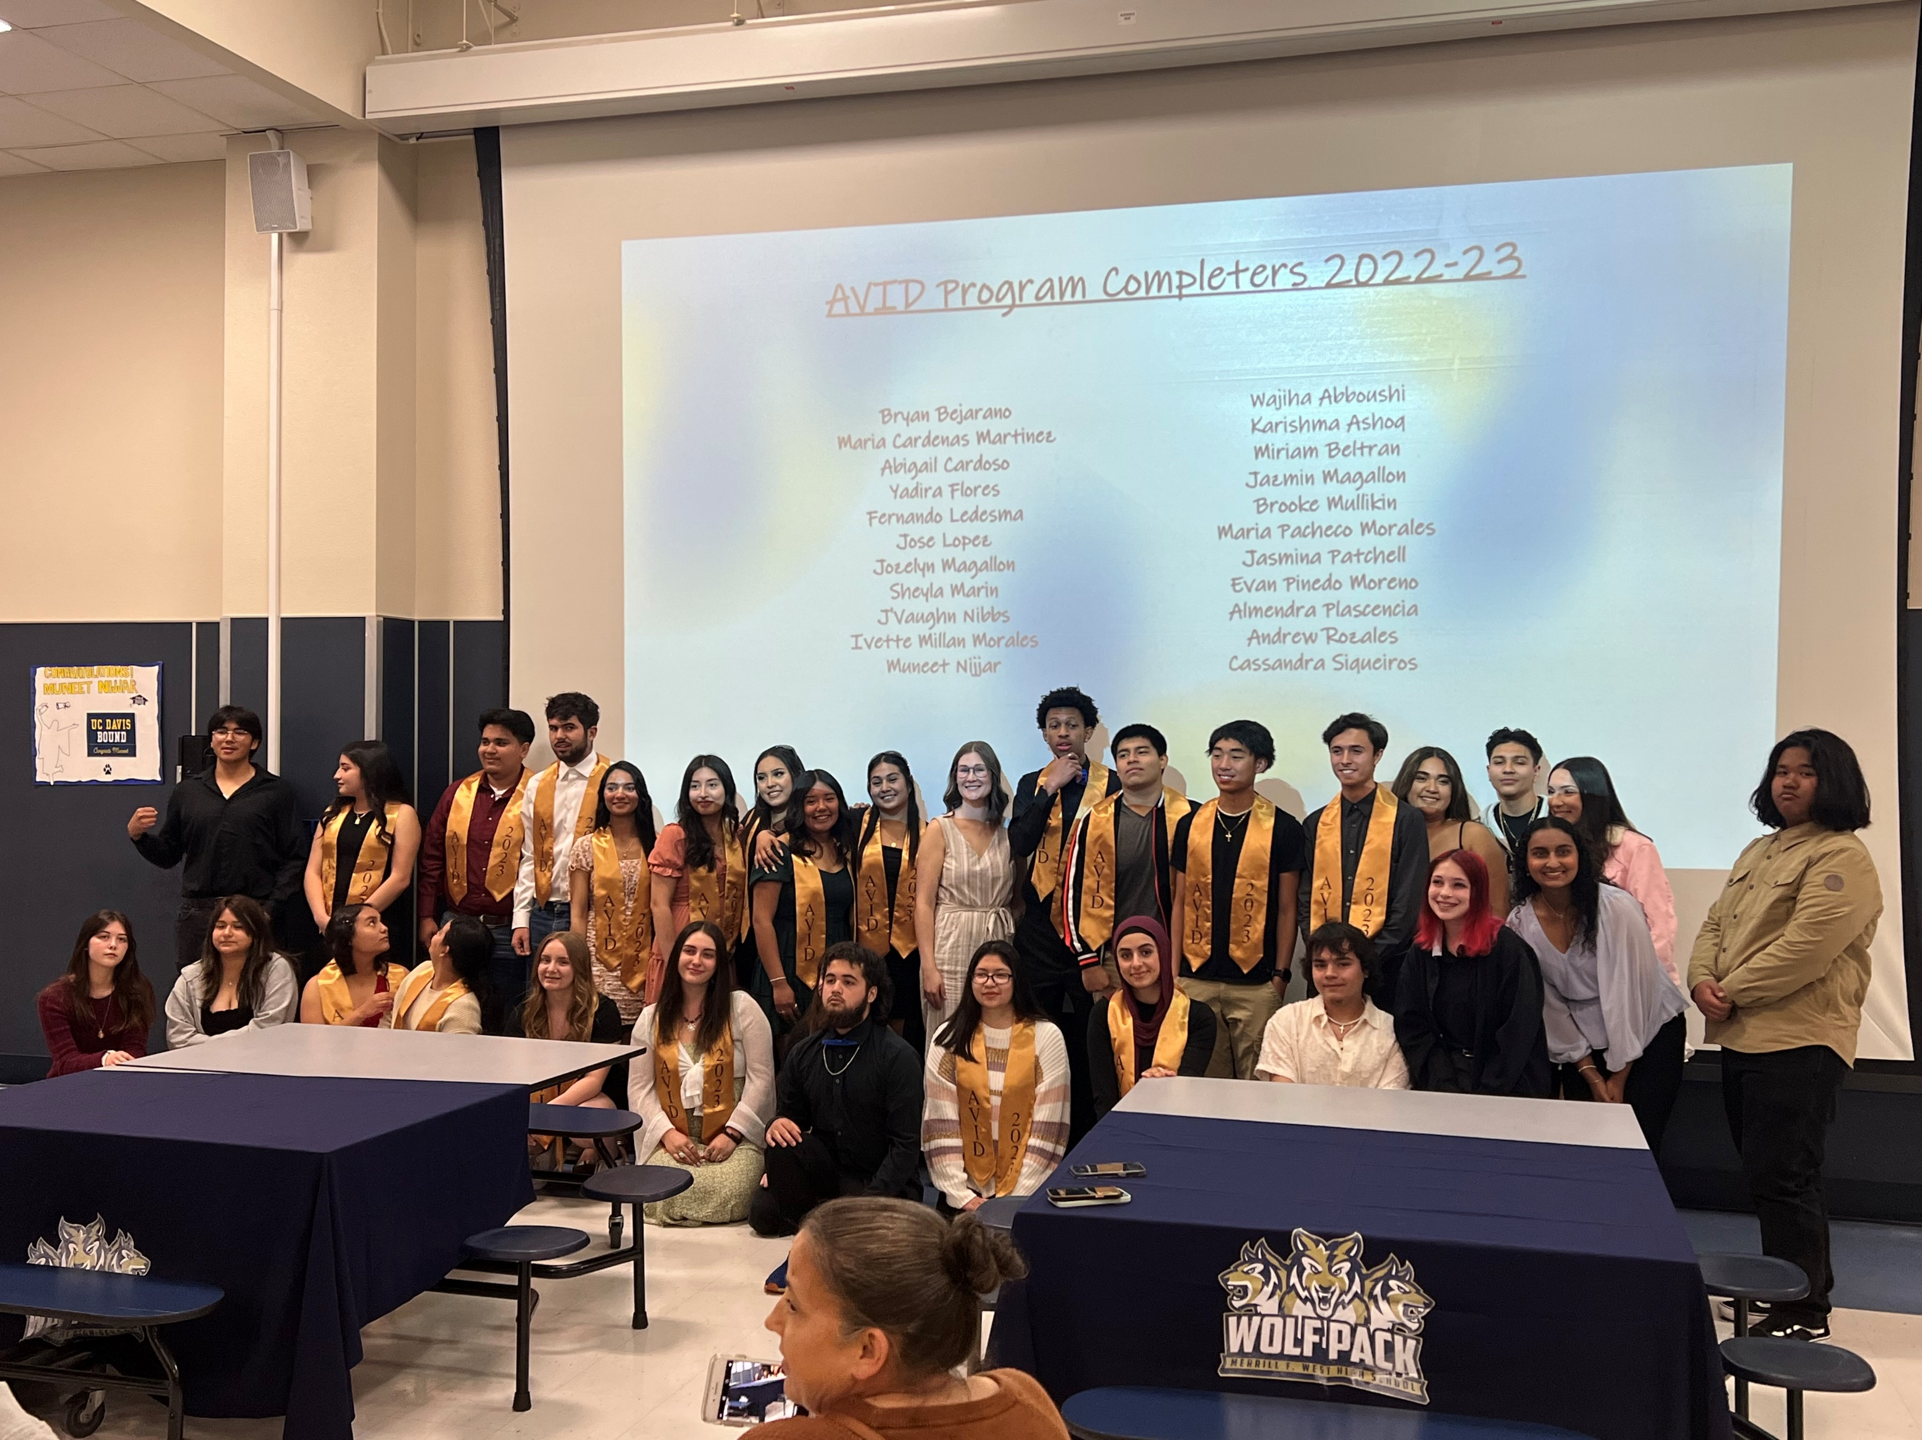
TUSD AVID

Slide 2
What is AVID?
Stands for Advancement Via Individual Determination
A schoolwide college and career readiness system
Direct support structure for life-long learners
Notes:
Dave
WHAT IS AVID?
AVID is a schoolwide college-readiness system that works to influence the instruction, systems, leadership, and culture of the entire campus.
AVID addresses college readiness for ALL students, particularly those who would be first-generation college-goers.

Slide 3
The AVID Elective Student Profile
Has academic potential
Meets one or more of the following criteria
Average to high test scores
Academic middle
2.0 – 3.0 (Flexible)
College potential; with support
Desire and determination
First in family to attend college
Historically underserved in post secondary institutions
Low-income
Special circumstances
Notes:
Dave
Who is an AVID elective student?

Slide 4
AVID is not…
Study Hall
A Remediation Program
For students looking for a free ride
Notes:
Dave
AVID is not

Slide 5
WICOR
WRITING
Cornell Note-Taking
Learning Logs
Quickwrites and Reflections
Process Writing
Peer Evaluation
Authentic Writing
READING
Deep Reading Strategies
Note-Taking
Graphic Organizers
Vocabulary Building
Summarizing
Reciprocal Teaching
INQUIRY
Skilled Questioning Techniques
Costa’s Levels of Thinking
Socratic Seminars
Tutorials
Investigations
Questions That Guide Research
ORGANIZATION
Binders and Organizational Tools
Calendars, Planners, and Agendas
Graphic Organizers
A Focused Note-Taking System
Tutorials and Study Groups
Project Planning and SMART Goals
COLLABORATION
Socratic Seminars
Tutorials
Philosophical Chairs
Group Activities and Projects
Peer Editing Groups
Service Learning Projects
Notes:
Stephanie
WICOR is a collection of teaching and learning strategies to guide students in comprehending concepts and articulating ideas at increasingly complex levels.
WICOR strategies support student learning in any classroom on campus.

Slide 6
AVID Student Benefits/Outcomes
Support with rigorous classes
Meeting college entrance requirements
Focus on study skills, organization, goal-setting, time management, etc.
Notes:
Dave
Benefits/Outcomes

Slide 7
AVID at a Glance
Team Building
College Visits/Guest Speakers
Organizational Tools
Tutorials/Focused Note Taking/Public Speaking
College Tech Application/Financial Aid
Community Service
Notes:
Dave
AVID at a Glance

Slide 8
AVID Student Responsibilities
Take classes meeting A-G requirements
Learn and apply AVID skills in content classes and beyond
Apply to colleges, universities, and/or tech
Participate in community service
Notes:
Stephanie
AVID Student Responsibilities

Slide 9
A – G Requirements
A: History/Social Science (3 years)
B: English (4 Years)
C: Math (3 Years)
D: Science (2 Years)
E: Foreign Language (2 Years)
F: Visual & Performing Arts (1 Year)
G: College Prep Elective
Notes:
Troy
A-G

Slide 10
TEAM BULDING

Slide 11
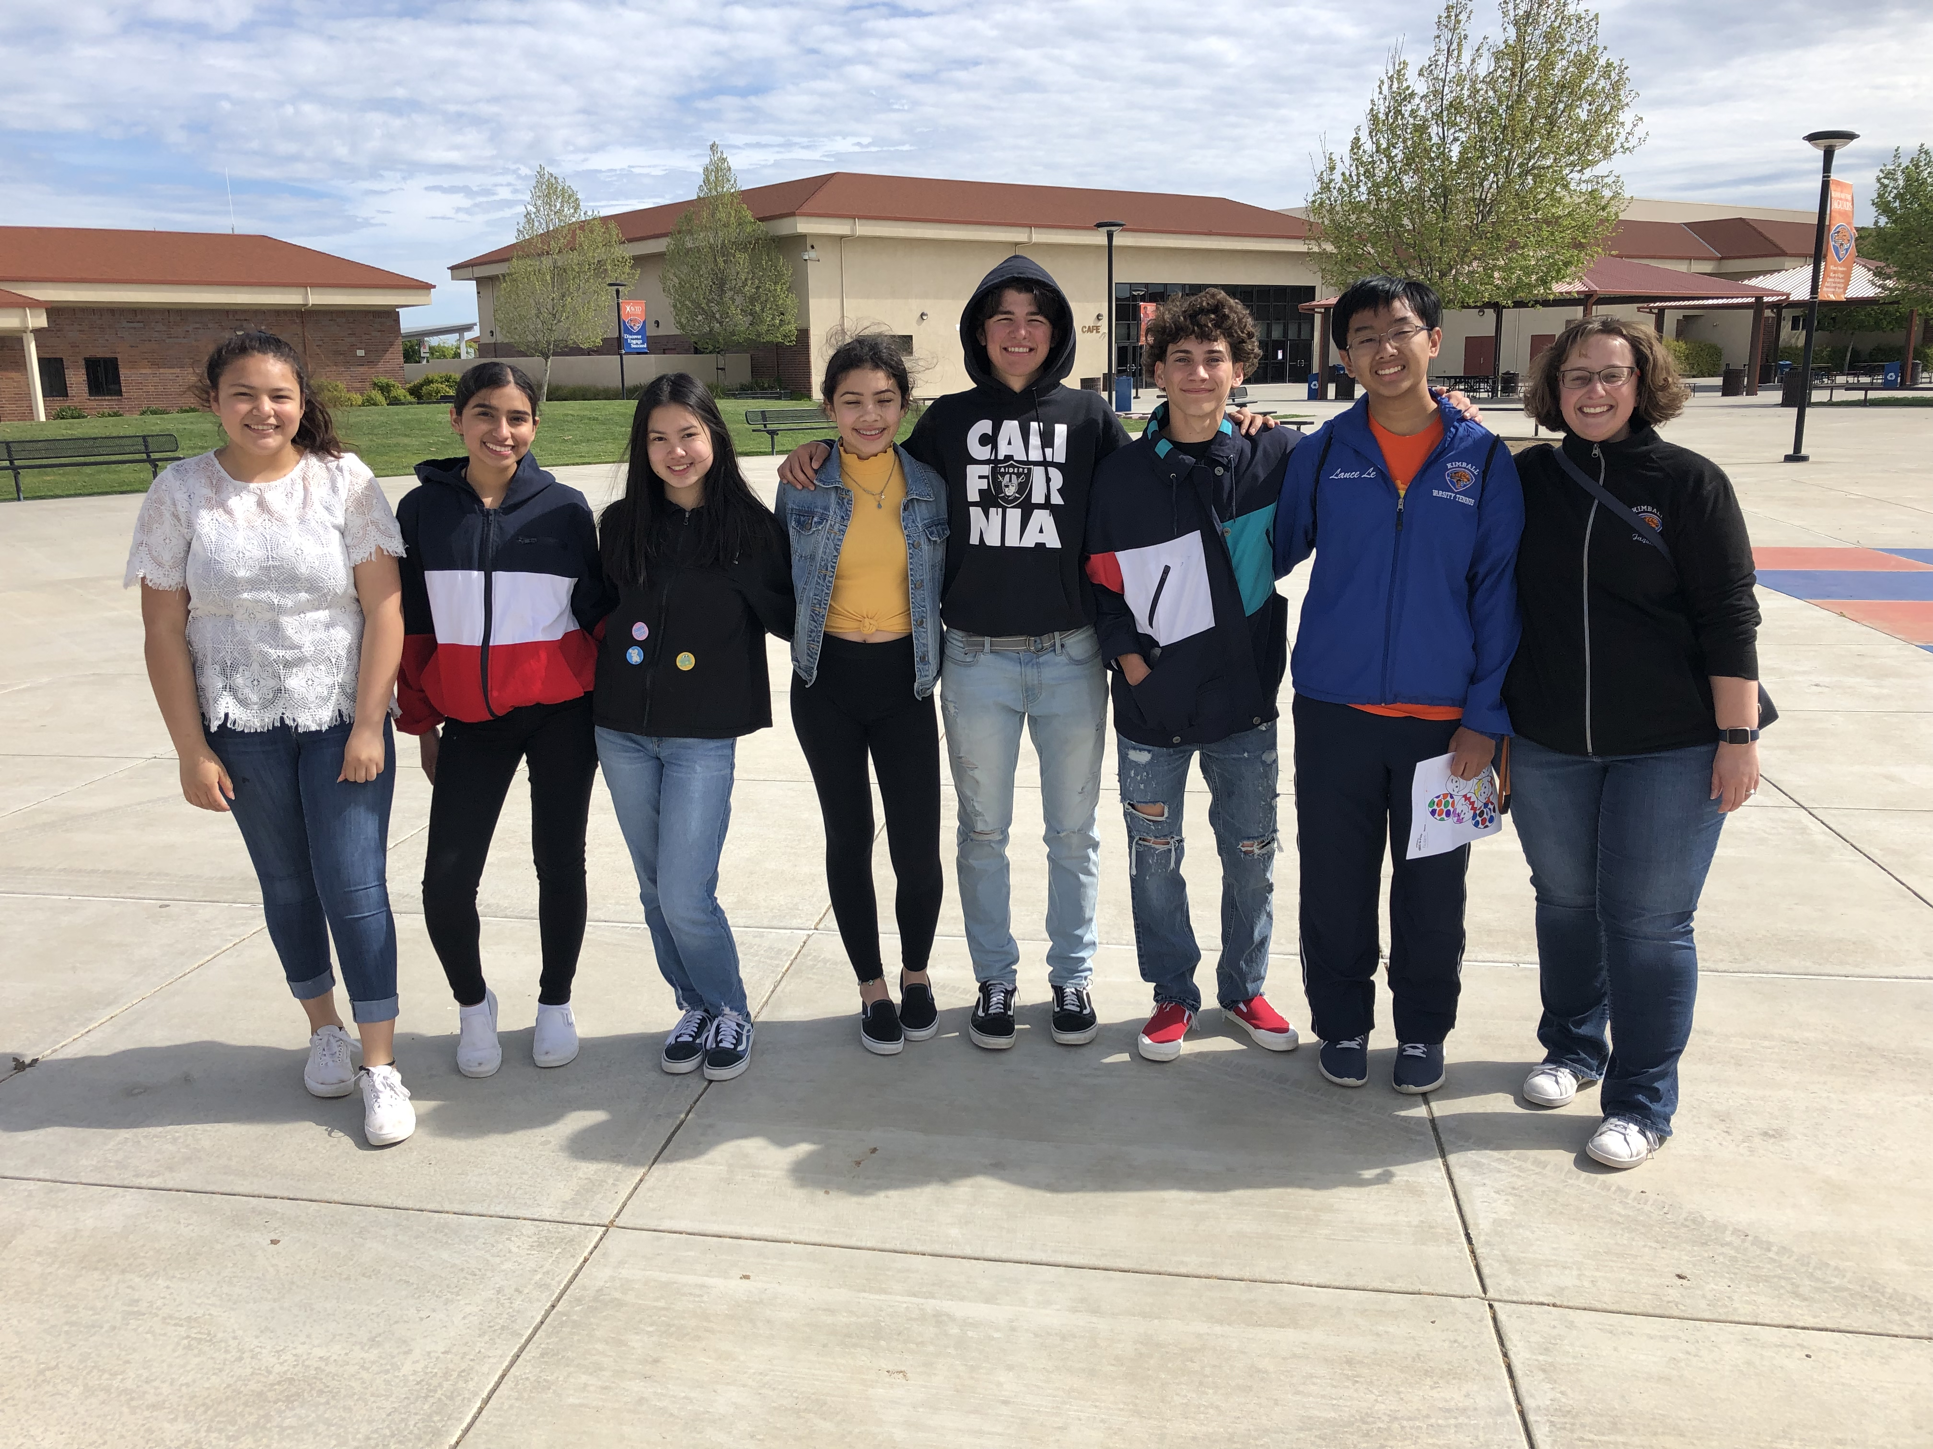
Community Service
Community Egg Hunt
Notes:
Stephanie/Dave

Slide 12
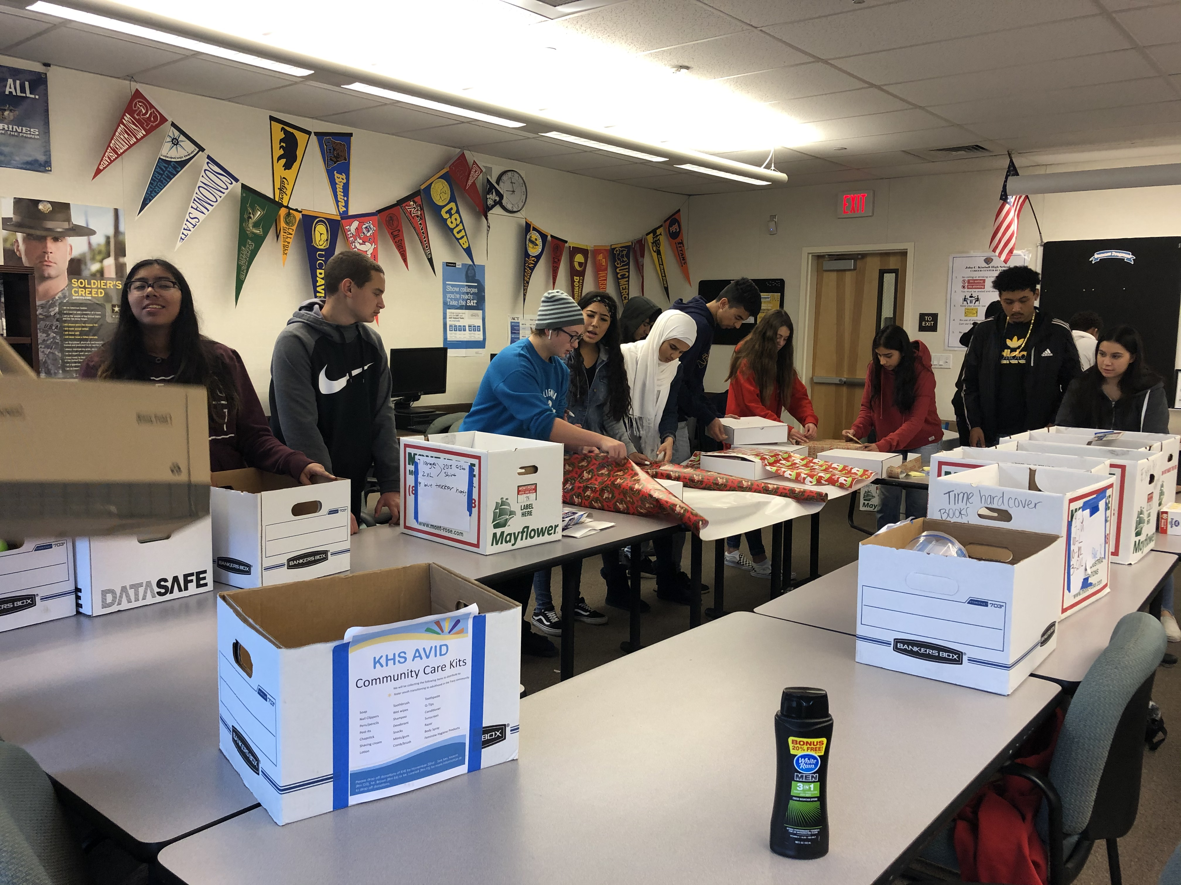
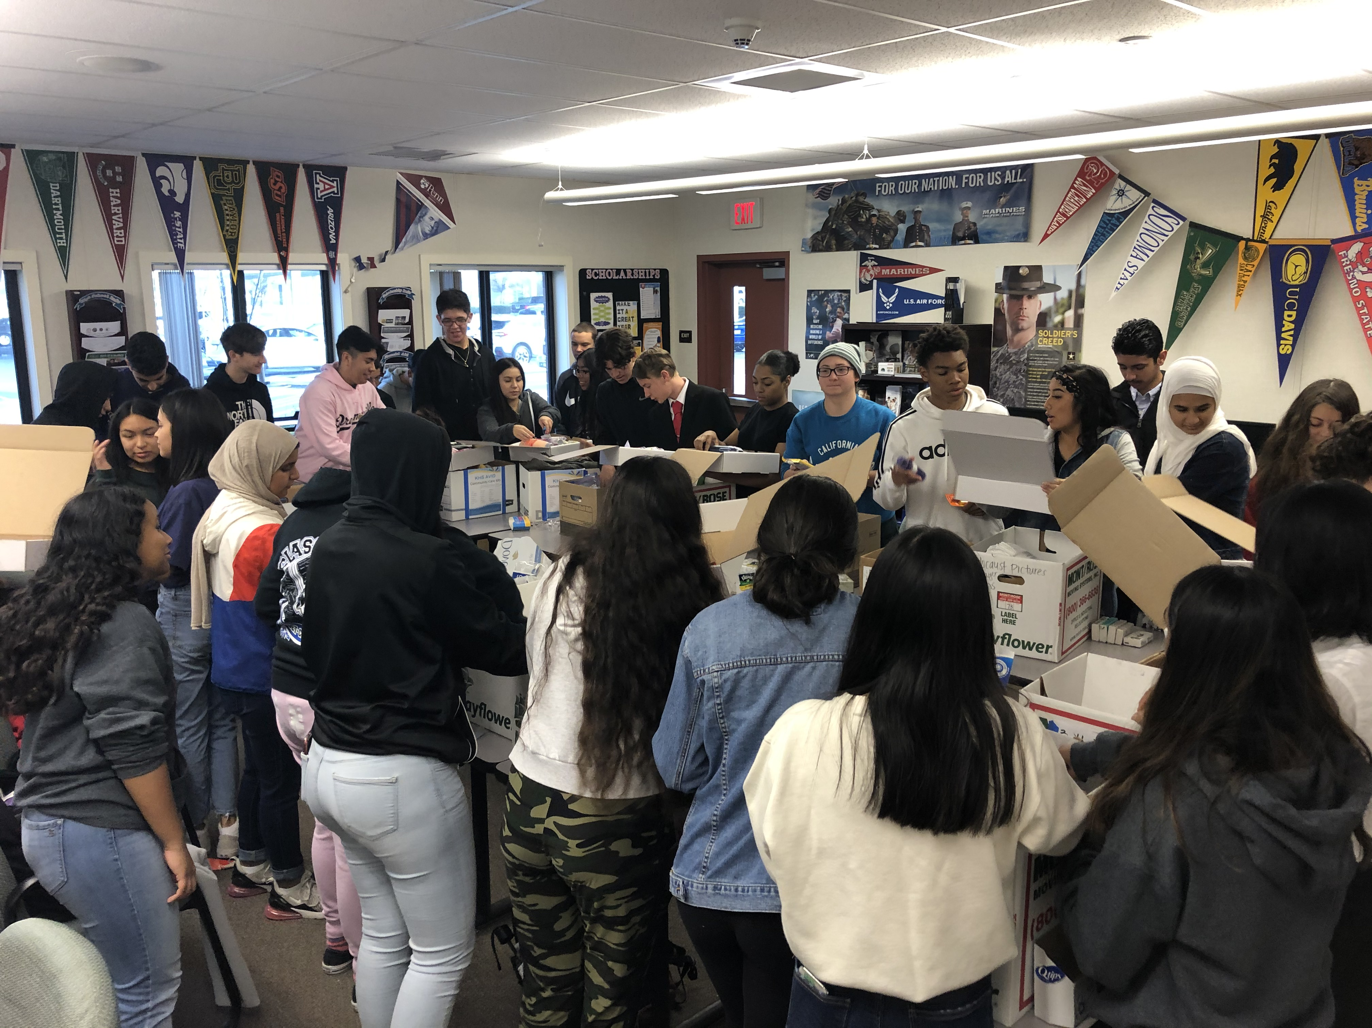
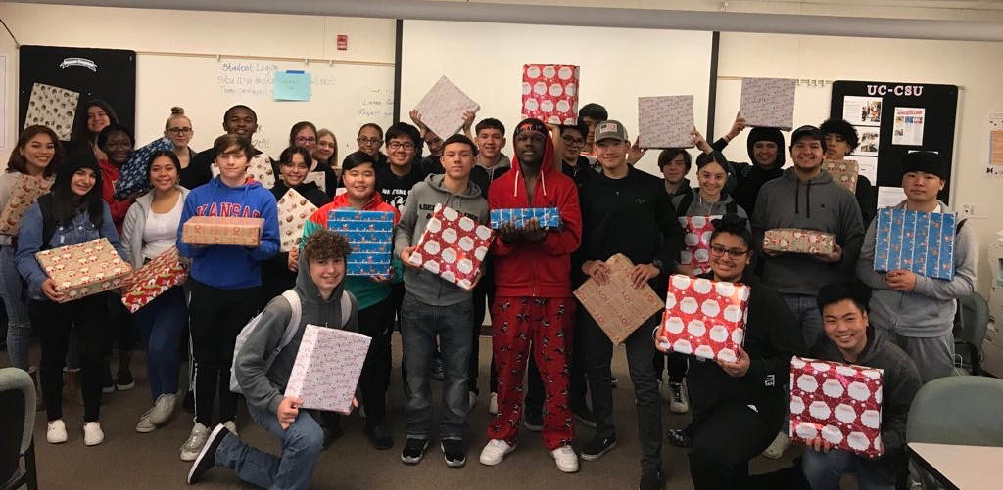
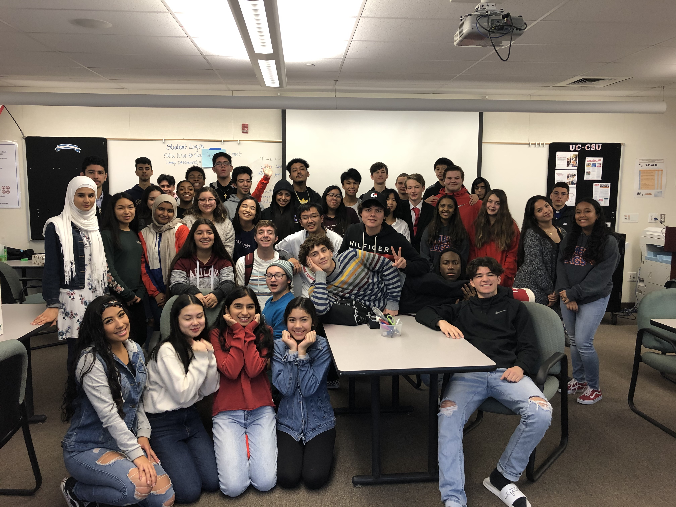
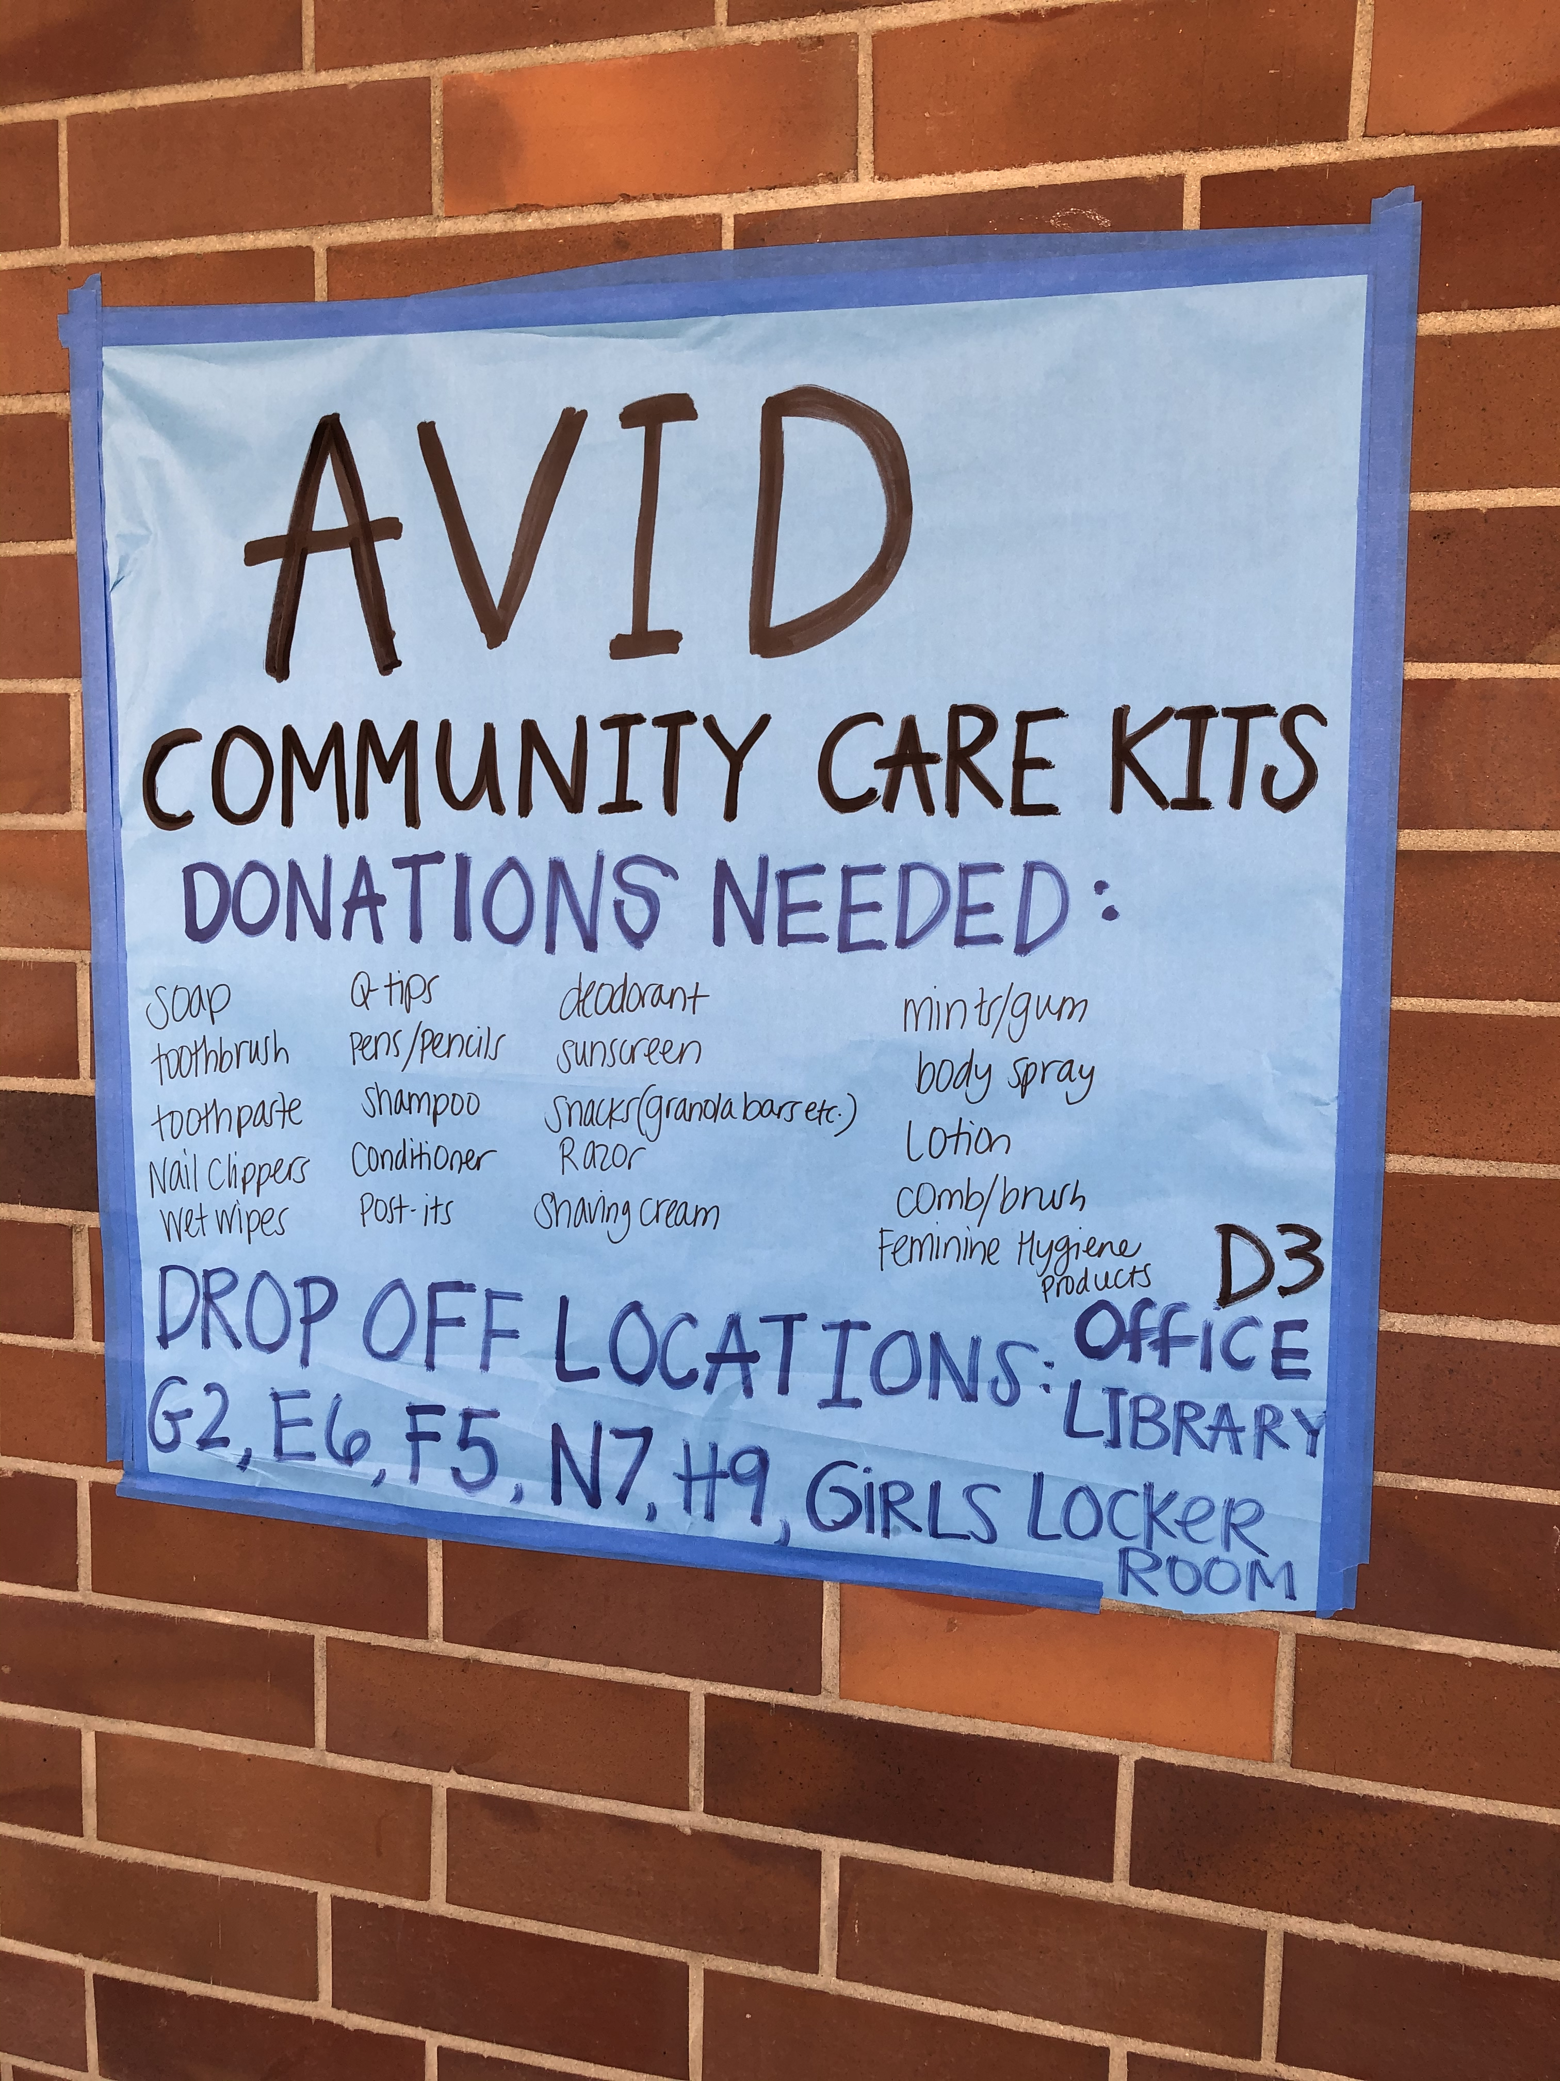
Community Service
Hygiene Kits for Foster Kids
Notes:
Stephanie/Dave

Slide 13
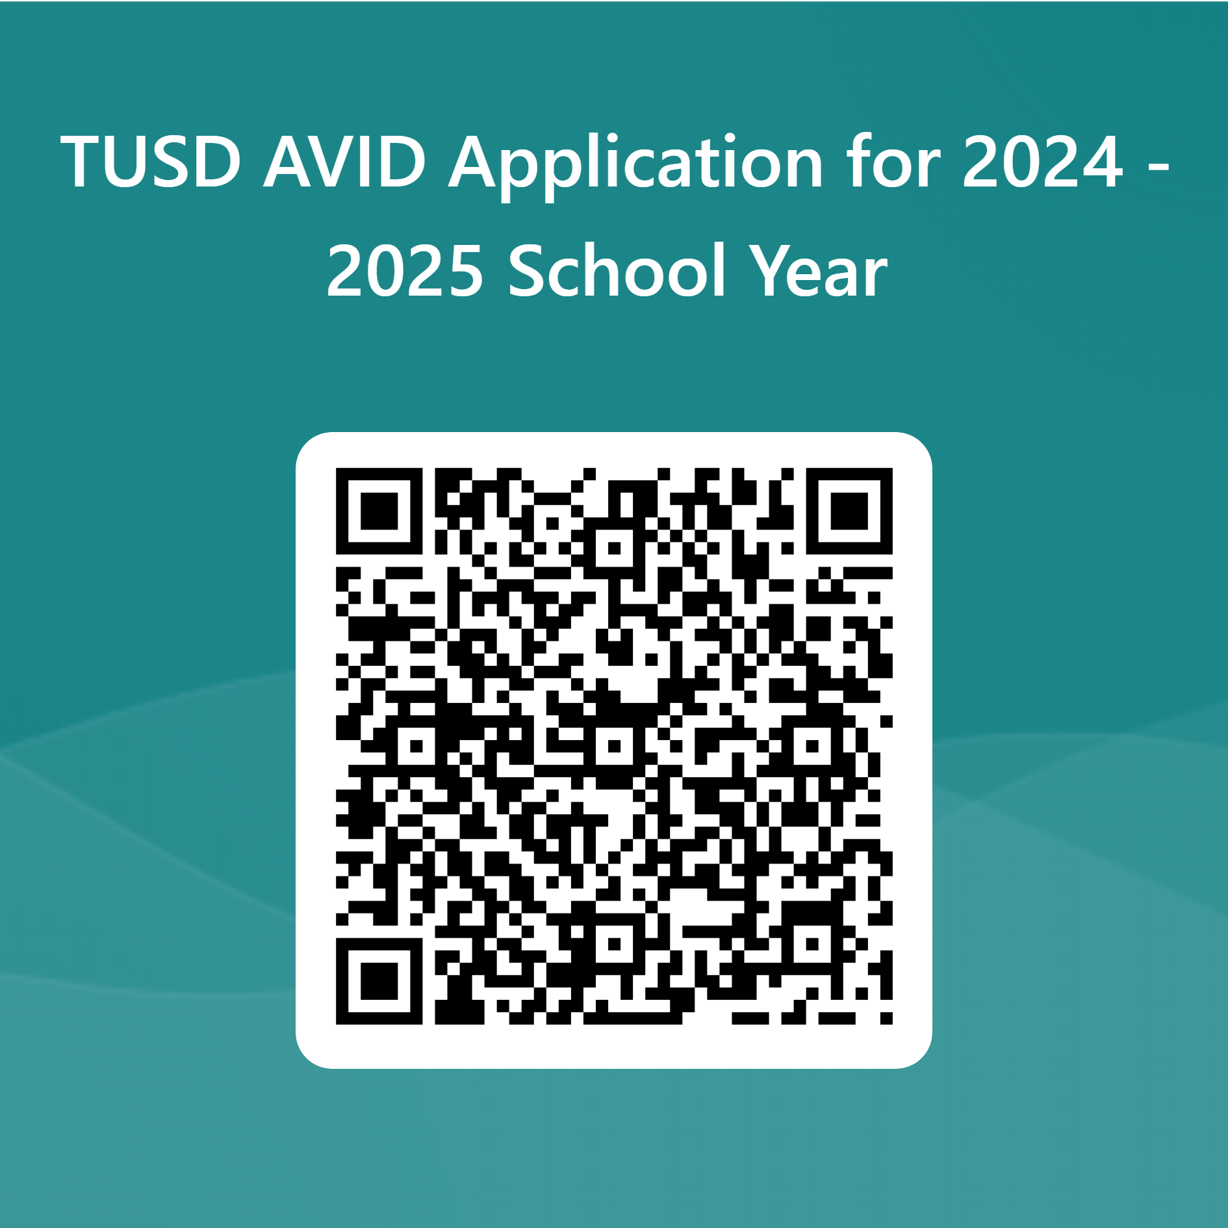
To Apply
Complete the application by visiting the link below or by scanning the QR code.
Deadline to apply is December 8, 2023
For additional information please contact David Brown at davbrown@tusd.net
AVID Application 2024-2025
Notes:
Dave
To Apply

