Slide 1
Charles County
Public Schools
State of The Schools
Thomas Stone
High School

Slide 2
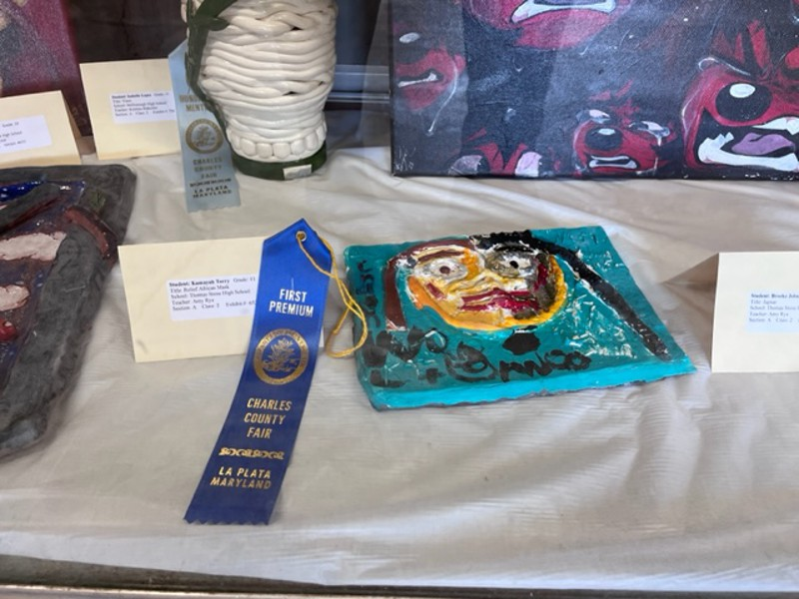
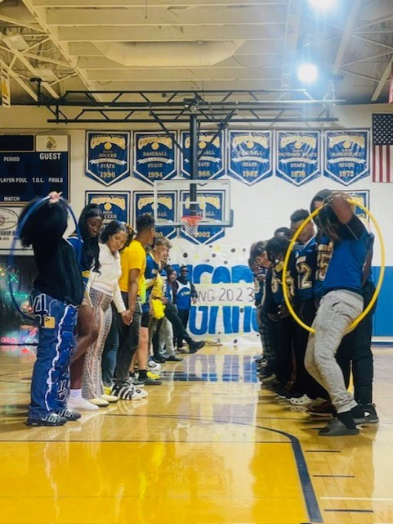
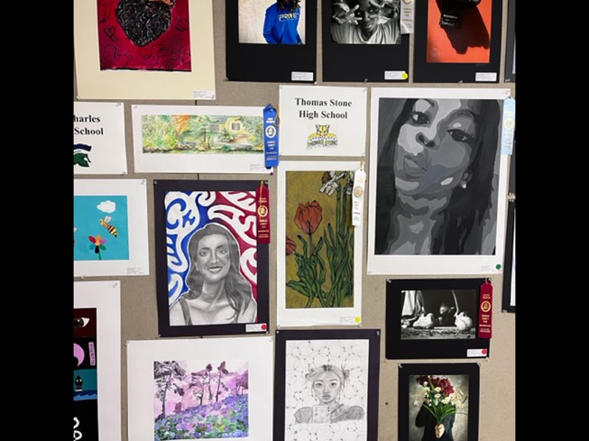
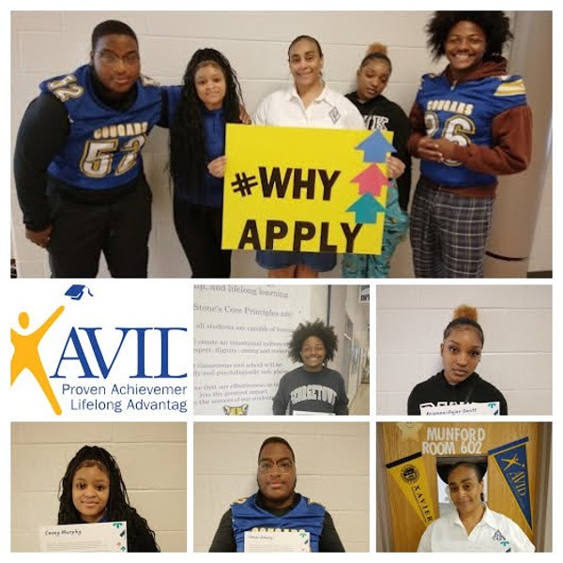
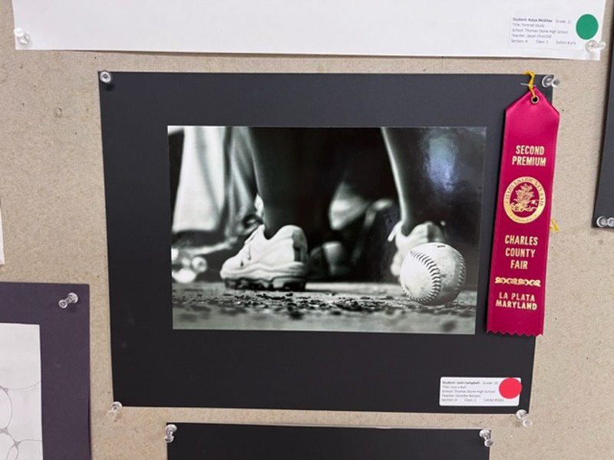
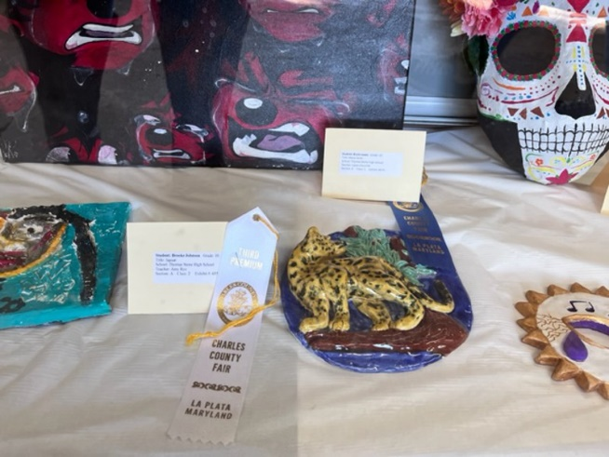
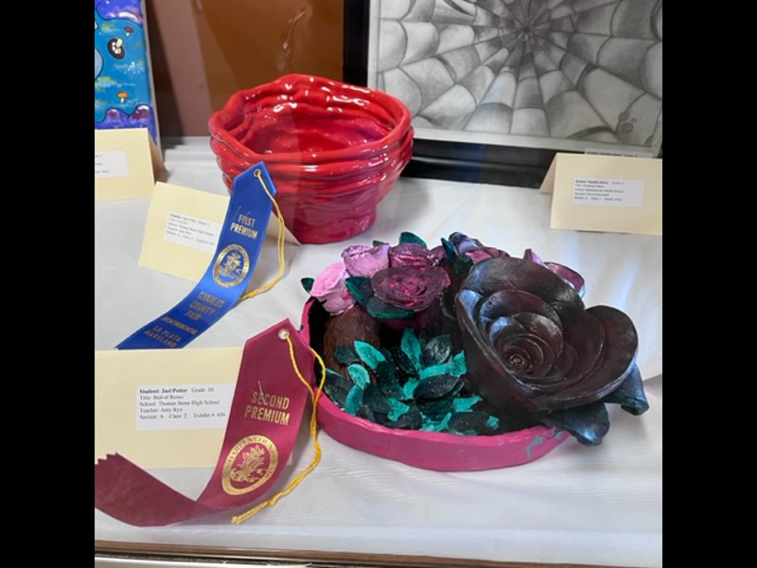
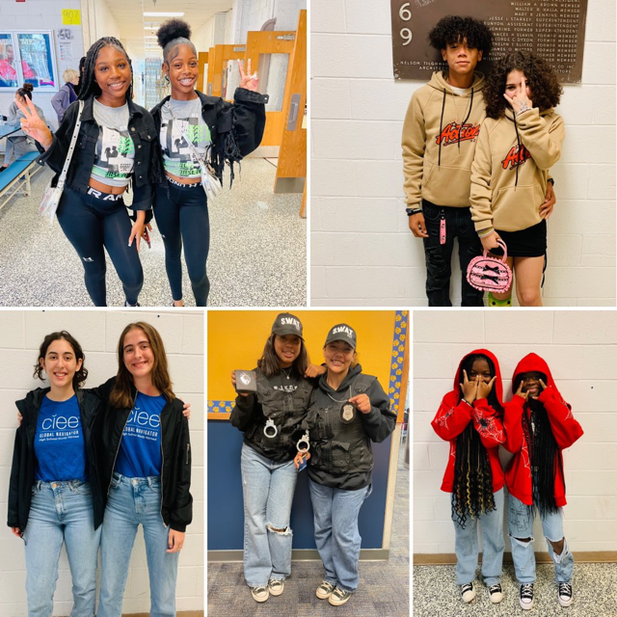
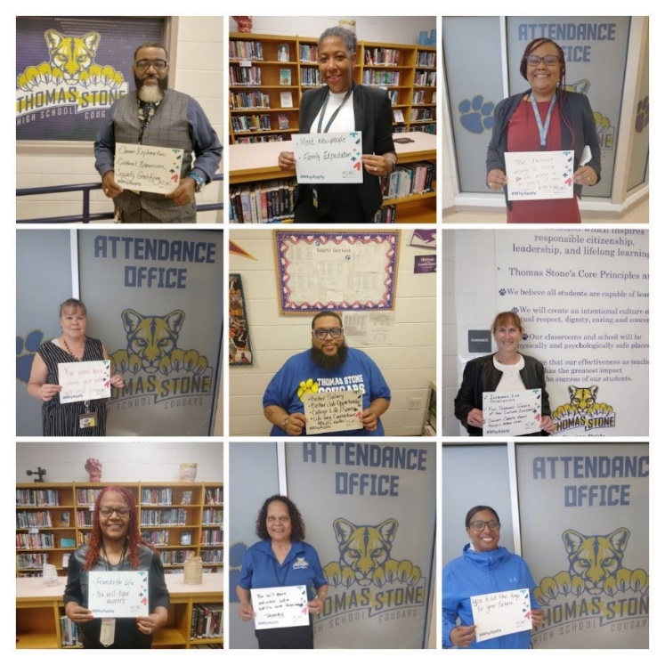
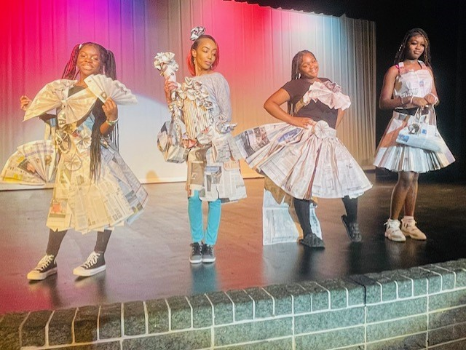
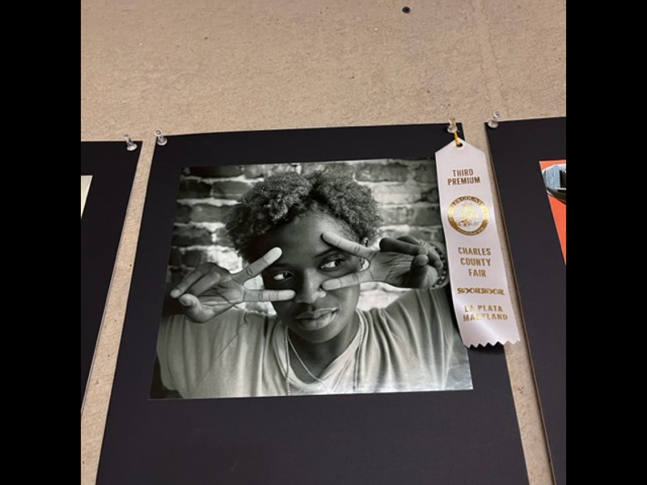
We Are Off To A Great Start!
Homecoming Pep Rally
Why Apply Campaign
County Fair Winners
Fashion Design Class Newspaper Dress Model Show
Twin Day

Slide 3
School Improvement
School Improvement is a decision-making model that schools utilize to ensure programming, teaching and learning, and culture and community, provide all students access, opportunity, and support to achieve at high levels.
Each school develops a School Improvement Plan (SIP). The SIP identifies priority goals, instructional and culture strategies, and supports schools will implement to raise student achievement and prepare students for college and career pathways.
This works starts at the elementary school and continues through high school.

Slide 4
Student Learning & Achievement
Data Summary:
MCAP English - there was a slight increase in proficiency.
MCAP Mathematics – overall room for improvement.
Goal: We will increase student achievement in English and Mathematics by 10% as indicated on MCAP.
Strategies to support Reading and Math Instruction:
Extension Periods added to the daily schedule
Common Assessments, I-Ready & Common Lit Data
Focus on Academic Vocabulary
Notetaking and annotating to build stronger writers (Thomas Stone Thinking Notes)
Student learning by encouraging students to unpack text to respond with prompt analysis and evidence-based analysis.
Push-In/ Push-Out Support
FEV Tutoring

Slide 5
Student Learning& Achievement
Access & Opportunity
Data Summary:
Low enrollment in some of our course offerings for Honors and AP Courses
Students do not fully utilize our CTE Pathways , Early College, & Dual Enrollment
Access and Opportunity Goal: We will increase students’ awareness of course options and increase the access and number of students for enrollment by 10% by the end of the course selection timeline.
Strategies to Support Access and Opportunity Goal:
AP Fair with students only
Virtual AP Fair with Parents
Emails to staff, students, and parents
One on one Counselors Meetings with each student
Class meetings (Recruitment)
AP Course Selection
Group sessions for students interested in AP
Parent phone/in person conversations about signing students up for AP courses
AP signing and course selection week
Seminar Class for first students taking an AP course

Slide 6
School Climate and Culture
Data Summary:
Fostering positive student involvement in positive aspects of school and not negative, such fight culture mentality. To start the year, suspensions are down for fighting.
Student activity involvement in sports has room for growth, many teams only have a Varsity team.
Culture and Climate Goal: We will increase community engagement by 10% utilizing our key stakeholders through community events and school activities that will foster a positive and collaborative culture.
Strategies to Support Access and Opportunity Goal:
We would like to highlight cultural and diverse hosted by our school to include student activities within classrooms and greater community.
Fall Festival – Trunk or Treat (Oct 28)
Holiday Baskets – Thanksgiving
Blood Drive – Spring 2024
Spirit Days – Throughout the year
.
Notes:
Being Present for school – attendance matters, being on time for class

Slide 7
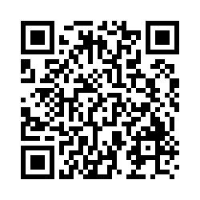
Before you depart, we want to hear from you. Please respond to our feedback survey.
To respond electronically, use your smartphone to scan the QR Code.

Slide 8
Thank
You For Attending!
Working Together To Achieve Excellence For Every Student . . .
We Appreciate Your Partnership!

