Slide 1
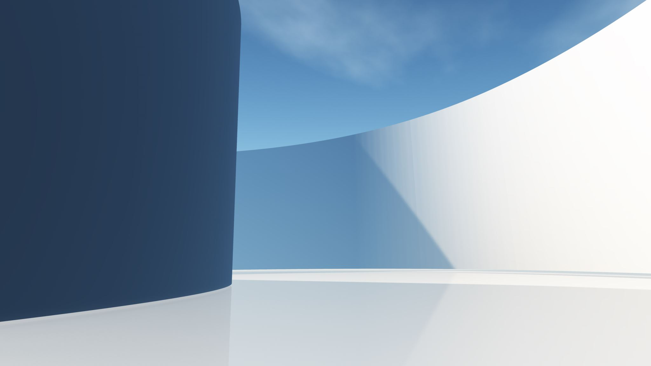

CDBG Public Meeting
Monday, October 16, 2023
Hosted by the Office of Planning, Development & Sustainability

Slide 2
Purpose:
To discuss the Consolidated Annual Performance Evaluation Report (CAPER) for the previous program year, outlining accomplishments and current uses of funds, and elicit input from low and moderate-income residents, social service agencies, and the public-at-large on the future use of Community Development Block Grant funds.

Slide 3
CDBG overview:
Community Development Block Grant (CDBG), is a program of the U.S. Dept. of Housing and Urban Development (HUD) that began in 1974
The CDBG Grant benefits low- and moderate-income (LMI) persons ( ≤ 80% Area Median Income)
Flexible annual grant for entitlement communities to address the causes and consequences of poverty
Uses include public facilities, parks, public service agencies, housing, and economic development
Projects need to show they benefit at least 51% LMI persons

Slide 4
Low-to-Moderate Income (LMI):
FY 2023 Income Limit Category | Household/Family Size | Size
 | 1 | 2 | 3 | 4 | 5 | 6 | 7 | 8
Extremely Low-Income Limits | 31,150 | 35,600 | 40,050 | 44,500 | 48,100 | 51,650 | 55,200 | 58,750
Very Low (50%) Income Limits | 51,950 | 59,400 | 66,800 | 74,200 | 80,150 | 86,100 | 92,050 | 97,950
Low (80%) Income Limits | 82,950 | 94,800 | 106,650 | 118,450 | 127,950 | 137,450 | 146,900 | 156,400
Over Income Limits | 82,951+ | 94,801+ | 106,651+ | 118,451+ | 127,951+ | 137,451+ | 146,901+ | 156,501+

Slide 5
Annual Timeline:
Program year runs July 1- June 30 each year
Request for Public Service Proposals (up to 15% of available funds) opens in January/February
Draft Annual Action Plan for next year will be available for comment for 30 days beginning in April
Public Hearing with City Council scheduled in early May when PDS will request that the Medford City Council authorize the Mayor to submit the 1-year Annual Action Plan to HUD
Annual Action Plan due by May 15th
Consolidated Annual Performance & Evaluation Report (CAPER) due September 30th for previous program year (extended to October 31 for FY23)

Slide 6
Accomplishments PY48:
Public Facility Improvements:
Roadway, sidewalk and utility reconstruction at Pinkert Street and Prescott, Allston and Cottage Streets
Design work for improvements to Gourley and Dwyer Streets
Work at Logan Park, and completion of reconstruction at Morrison Park
Various upgrades at Medford Fire Department Engine 3/Ladder 2 and Engine 5
Stump removal and subsequent tree planting in low-to-moderate income areas
Affordable Housing:
Housing staff worked on creating additional affordable units through private partnership with developers as a leveraged activity
The Housing Production Plan was approved and identifies obstacles, opportunities, and recommendations to develop affordable housing in Medford
Adoption of the Affordable Housing Trust ordinance, to be implemented in the coming year
The City will be launching a pilot Housing Rehabilitation Program in the coming year

Slide 7
Accomplishments PY48 Cont.
Public Services:
Funds provided to non-profit service agencies to support housing legal aid, referral and counseling services; services for the elderly; resources for individuals at risk of homelessness, residents in crisis, and the physically and emotionally disabled population; elementary after-school care; food security; and vocational and educational opportunities for residents.
Economic Development:
The City continued its façade grant program for local businesses to upgrade signage, awnings, exterior lighting and other exterior enhancements.
The City continues to foster connections between commercial developers and workforce training programs to create economic opportunities for low-to-moderate income Medford residents.
The City’s Comprehensive Plan, which was adopted in FY23, prioritizes support for minority and women business enterprises through the provision of resources and setting a target rate for utilization of MWBE firms for municipal contracts.

Slide 8
Upcoming Projects:
Street and sidewalk improvements at Gourley/Dwyer Streets
ADA street redesign for curbs and crossings
Engine 3 improvements
Renovation of the McGlynn School Playground
Development of a pilot Housing Rehabilitation Program
Community Gardens at Medford Housing Authority Properties
  Improvements to existing gardens at La Prise Village and installation of new garden beds at Tempone Apartments

Slide 9
Comments and Suggestions:
What needs are there for low- and moderate-income residents in Medford?
Where should the City focus its CDBG resources?
What should the priorities be?
  Parks
  Public facilities
  Infrastructure
  Housing
  Economic development
  Public services (15% cap)

Slide 10
Contact Information:
Laurel Siegel
CDBG & Grants Manager
City of Medford, Office of Planning, Development & Sustainability
85 George P. Hassett Drive, Room 308
Medford, MA 02155
Phone: (781) 393-2480
lsiegel@medford-ma.gov

