Slide 1
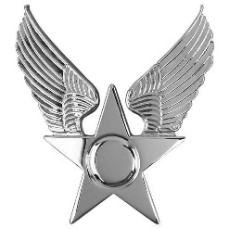


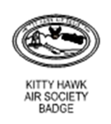
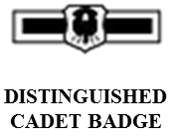
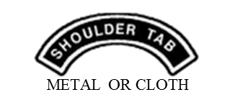
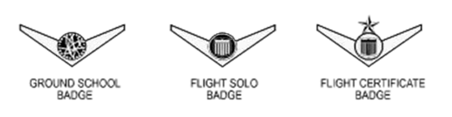
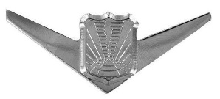
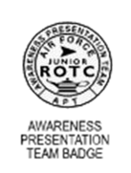

Attachment 7-1
Added. Hands in pockets are allowed while standing or walking and beverage consumption as indicated while walking.
Hap Arnold Optional Enlisted/Officer Service Cap Insignia
UNMANNED AIRCRAFT BADGE
Cadets may only wear one of these badges on their uniform
Cadets can choose only one badge, Either the APT badge or the Marksmanship Shield. Follow APT placement criteria if cadets wear the Marksmanship Shield.
Badges/Insignia not listed here are unauthorized for wear.

Slide 2
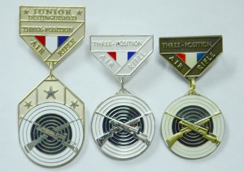
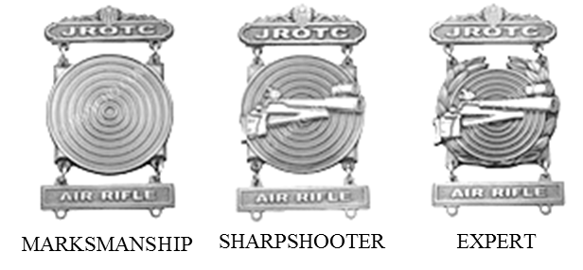
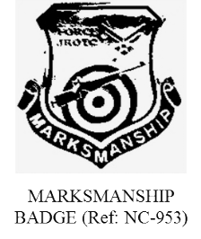
Attachment 7-1 (continued)
AUTHORIZED AIR FORCE JROTC
BADGES AND INSIGNIA
Marksmanship Badges – Wear Only One
CMP Awarded Badges
Unit Awarded Badges
If earned choose only one – CADETS MAY ONLY WEAR ONE on their uniform. Place directly underneath ribbons. Cadets may NOT wear Marksmanship Shield (see below) with Marksmanship Badge.
Do not wear Marksmanship badges with medals
Choose either the APT or Marksmanship Shield and a Marksmanship Badge.
Only one may be worn.
Marksmanship Shield
Males and females may wear the marksmanship badge (may only wear one) below the ribbons on the blue shirt or service dress uniform or
Marksmanship badges will not be worn with medals.
Badges/Insignia not listed here are unauthorized for wear.

Slide 3

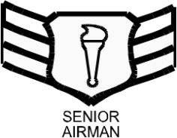
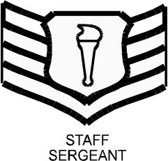
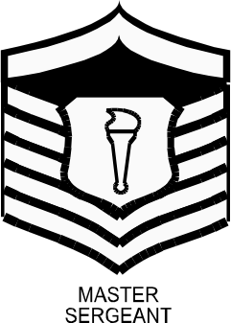
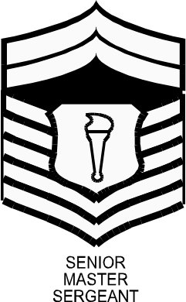
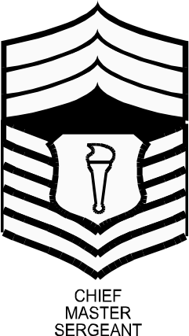
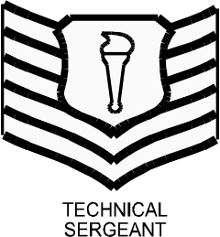
Attachment 7-2
AIR FORCE JROTC RANK INSIGNIA
CADET OFFICER RANK
SECOND LIEUTENANT
FIRST
LIEUTENANT
CAPTAIN
MAJOR
LIEUTENANT COLONEL
COLONEL
NOTE: Cadet Officer rank used is either cloth epaulet or collar rank, depending on specific uniform worn.
CADET ENLISTED RANK
AIRMAN BASIC:
NO RANK INSIGNIA
AIRMAN
For SFJROTC Spec 1 Spec 2 Spec 3 Sgt
NOTE: Cadet Enlisted rank used is small collar rank only, regardless of uniform worn
Rank insignia not listed here is unauthorized.
The First Sergeant device is not authorized.

Slide 4



Attachment 7-3
CADET MALE HEADGEAR
SERVICE CAP
Centered
Solid Blue Color with no embroidery
Black hat band
Plain Black
Service Cap – Solid dark Air Force blue color only. Cadet officers may wear the AFJROTC officer hat insignia or the large Hap Arnold Wings insignia. Enlisted cadets may only wear the large Hap Arnold Wings insignia
FLIGHT CAP*
1 ½”
Enlisted Ranks will have no hat insignia on the flight cap.
The former officer flight cap emblem will not be worn on the flight cap.

Slide 5
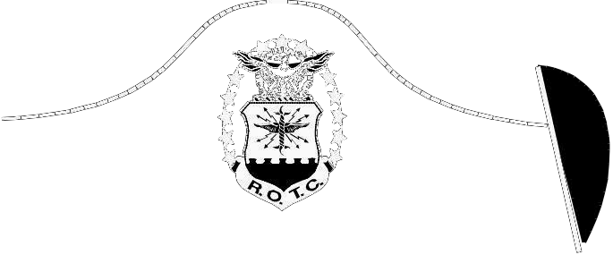
Attachment 7-4
CADET FEMALE HEADGEAR
SERVICE CAP
Solid Blue Color with no embroidery
Centered
Service Cap - Solid dark Air Force blue color only. Cadet officers may wear the AFJROTC officer hat insignia or the large Hap Arnold Wings insignia. Enlisted cadets may only wear the large Hap Arnold Wings insignia.
FLIGHT CAP*
1 ½”
Enlisted Ranks will have no hat insignia on the flight cap.
The former officer flight cap emblem will not be worn on the flight cap.

Slide 6
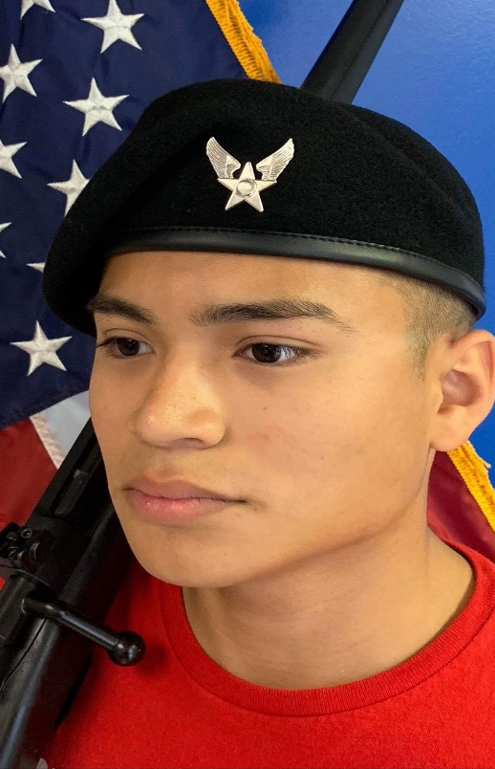
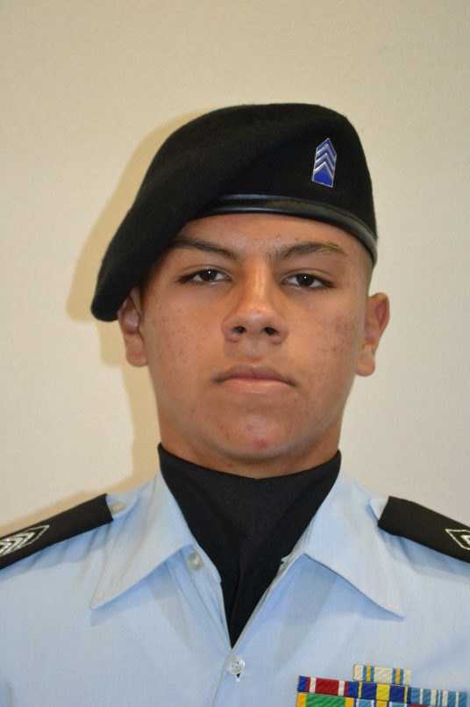
Attachment 7-5
CADET BERET HEADGEAR
BERET
Berets.
1. Solid Color white, dark blue or black ONLY, with AFJROTC officer rank insignia or mini-Hap Arnold Insignia pin. The former officer/enlisted flight cap emblems will not be worn on the beret. The wear of a “Beret Flash” or mini unit patch is not authorized.
2. Position headband straight across the forehead, 1 inch above the eyebrows. Drape the top over the right ear. Wear the stiffener with the aligned insignia above the left eye. Adjust ribbon for comfort, tie in a knot, and tuck inside or cut-off. The insignia will be centered, ¼ inch above and parallel to the headband.
3. The wear of a “Beret Flash” is not authorized.

Slide 7
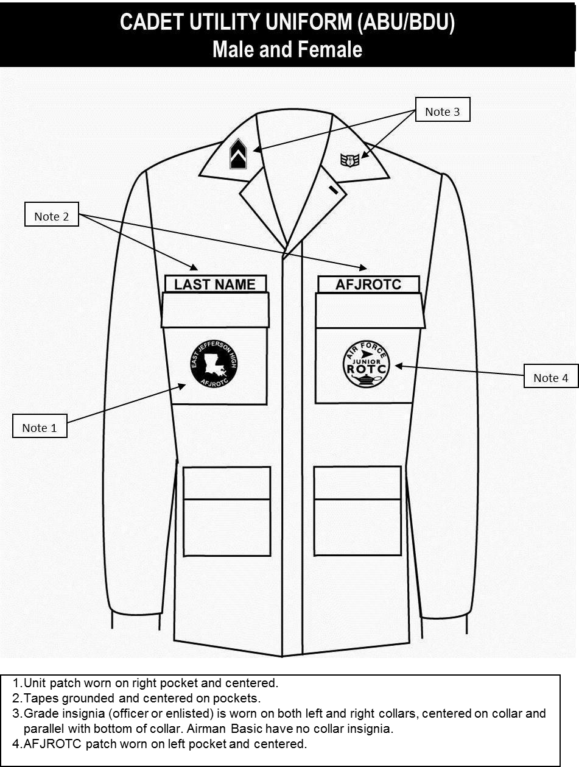
Attachment 7-6a
CADET ABU
Male and Female
Unit patch (optional). If worn, will be placed on right pocket and centered.
Last Name and AFJROTC or SFJROTC tapes. Letters are dark blue on digital camo background (mandatory). Tapes are grounded and centered on pockets. Name tape only may be held with Velcro to enable reuse/reissue to a different cadet.
Grade insignia (officer or enlisted) (mandatory). Will be worn on the left and right collars, centered 1-inch up from the bottom of the collar and parallel to the ground while remaining centered on the collar
AFJROTC Patch (white, Lamp of Knowledge) or SFJROTC Patch (black, Lamp of Knowledge) - WHITE/BLACK patch only (mandatory). Will be worn on left pocket and centered.
Berets, ascots, and shoulder cords will not be worn with ABUs.
ABU sage green boots and Coyote Brown boots may be reissued to cadets. Spray boots with disinfectant spray before reissuing ABU boots. (Black boots will not be worn with ABUs)

Slide 8
Attachment 7-6b
CADET OCP
Male and Female
Full Color American Flag will be worn centered at the top and the Unit Patch may be worn below flag on the right sleeve.
White Lamp of Knowledge Patch will worn be on left sleeve
AFJROTC
OCPs are Not Authorized for Cadet Wear At This Time
T-Shirt. T-Shirt will be Desert Sand, Tan or Coyote Brown color.
The American Flag patch (mandatory) and will be full color (cloth), will be placed on right sleeve using Velcro attachment (centered at the top of the Velcro area).
Unit patch (optional) full color. If worn, will be placed on right sleeve using Velcro attachment (centered in the middle of the Velcro area).
Last Name and AFJROTC tapes. Letters are Spice Brown color (mandatory using Velcro attachment.
Grade insignia (officer or enlisted) (mandatory). The standard miniature blue/silver AFJROTC rank will be worn.
AFJROTC Patch (white, Lamp of Knowledge): WHITE patch only (mandatory). Will be worn on left shoulder using Velcro attachment (centered in the middle of the Velcro area).
Berets, ascots, and shoulder cords will not be worn with OCPs.
OCP Coyote Brown boots may be reissued to cadets. Spray boots with disinfectant spray before reissuing OCP boots. (Black boots will not be worn with OCPs)
Tan Rigger Belts maybe worn with OCPs.
OCPs may be bloused; the trousers will not extend below the third eyelet from the top of the boot.

Slide 9
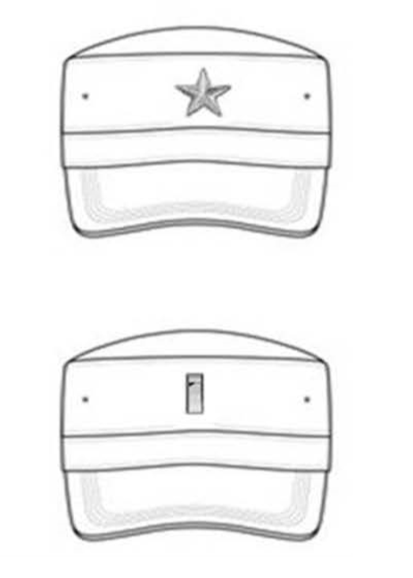
Attachment 7-7
CADET ABU and OCP HEADGEAR
Enlisted Cadets will not wear rank on the ABU/OCP cap.
Officers will wear rank insignia on the ABU/OCP cap.
No other style of head gear is authorized for wear with ABUs/OCPs.
Exception is for Cadet Leadership Course (CLC) specific headgear that will ONLY be worn during the period of the CLC course.

Slide 10
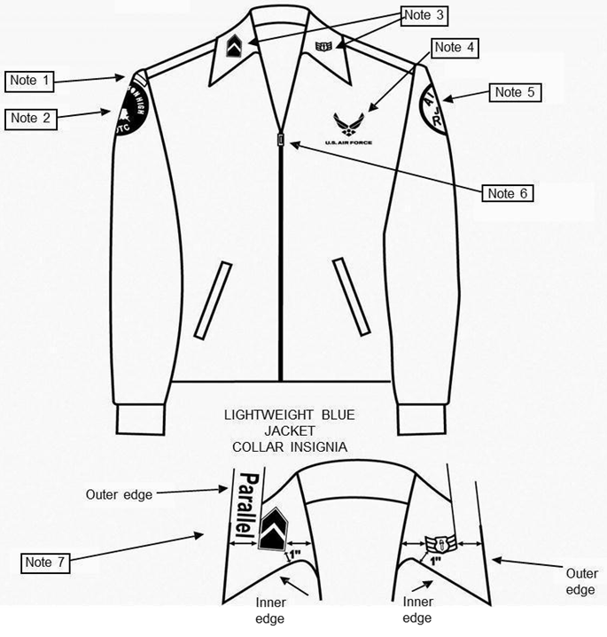
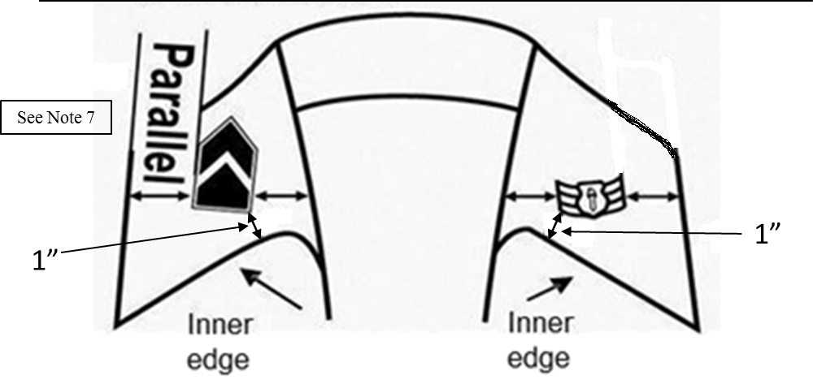
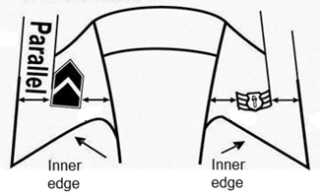
Attachment 7-8
CADET LIGHT WEIGHT BLUE JACKET
NOTE: The epaulet rank is no longer authorized on the lightweight blue jacket.
Centered halfway
See Note 7
1”
1”
Drawing not to scale
(Picture Not To Scale)
Shoulder tabs are centered between unit patch and shoulder seam. If no patch, then 1 inch below shoulder seam.
Unit patch on right ½ to 1 inch below shoulder seam and centered.
Grade insignia (officer and enlisted) will be worn on both lapels, mandatory. For placement see Note 7.
Optional item: center vertically between the shoulder seam and where the underarm side seam joins the armhole sleeve and center horizontally between the center zipper and the sleeve armhole seam. Per AFJROTCI 36-2010, para 6.1.1.10.1. The words “U.S. Air Force” must appear directly below the symbol, or units can choose to use “AFJROTC.” Embroidery expenses must be at no cost to the Air Force.
AFJROTC Patch (white, Lamp of Knowledge), mandatory. Center ½ to 1 inch below left shoulder seam
Jacket will be closed to at least the halfway point.
Center insignia horizontally on collar. Place 1 inch from bottom of collar and parallel to the outer edge of the collar.
Enlisted rank insignia MUST be worn on the blue shirt while wearing the light weight jacket.
Ascots and shoulder cords will not be worn on this uniform.

Slide 11
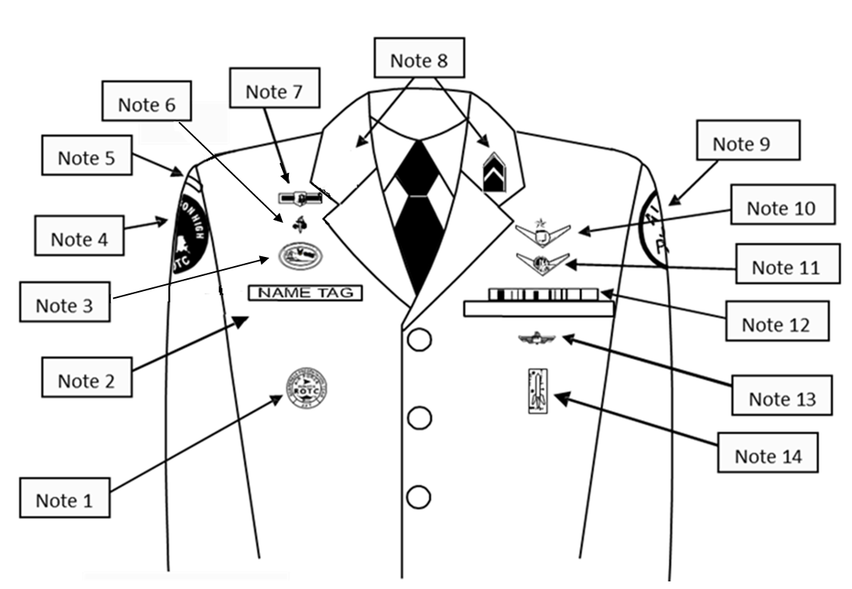



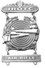
Attachment 7-9
CADET MALE SERVICE DRESS
Note 17
Note 16
Note 13
Drawing not to scale
Awareness Presentation Team (APT) Badge. Centered 3 inches below the bottom of the silver name tag.
Silver Name tag, mandatory. Center on the right side between arm seam and lapel with bottom edge parallel to top of welt pocket.
Kitty Hawk Badge. See Note 15 below.
Unit patch. Place ½ to inch below shoulder seam and centered.
Shoulder tab: Center between unit patch and shoulder seam. If no patch, then 1 inch below shoulder seam.
Aerospace Education Foundation (AEF) Badge. See Note 15 below.
Distinguished Cadet Badge. # 1 See Note 15 below.
Grade insignia (officer and enlisted) worn on both lapels, mandatory. Place insignia halfway up the seam, resting on but not over it. Bottom of insignia is horizontal with the ground.
AFJROTC Patch (white, Lamp of Knowledge), mandatory. Center ½ to 1 inch below left shoulder seam.
Deleted.
Cadets will only wear one of the following badges, Flight Solo Badge, Unmanned Aircraft Badge, Aviation Ground School, and Flight Certificate Badge. See Note 15 below.
Ribbons, mandatory. Centered, on but not over edge of pocket. Wear 3 or 4 in a row. Wear all or some ribbons earned.
Marksmanship Badge - Marksmanship competition awards/badges may be worn on the AFJROTC uniform. Males and females will wear the badge (may only wear one) below the ribbons on the blue shirt or service dress uniform. Marksmanship badges will not be worn with medals.
Model Rocketry Badge. Worn 2 inches below the pocket.
Except marksmanship badge. Wear first badge placed ½ inch above silver name tag or ribbons and is centered horizontally. Additional badges are placed ½ inch above previous badge. Order of precedence for badges are as show on the diagram. Distinguished Cadet Badge, then the AEF Badge, then the Kitty Hawk Badge and lastly the CyberPatriot National Finalist Badge. No more than one Flight badge is authorized.
Shoulder Cord. No wider than 1 inch and will be grounded to the seam of the left shoulder. May be solid or multi-colored.
Enlisted rank insignia MUST be worn on the blue shirt while wearing the service dress.
Medals are not authorized for wear on this uniform with ribbons. Ribbons and medals may not be mixed.

Slide 12
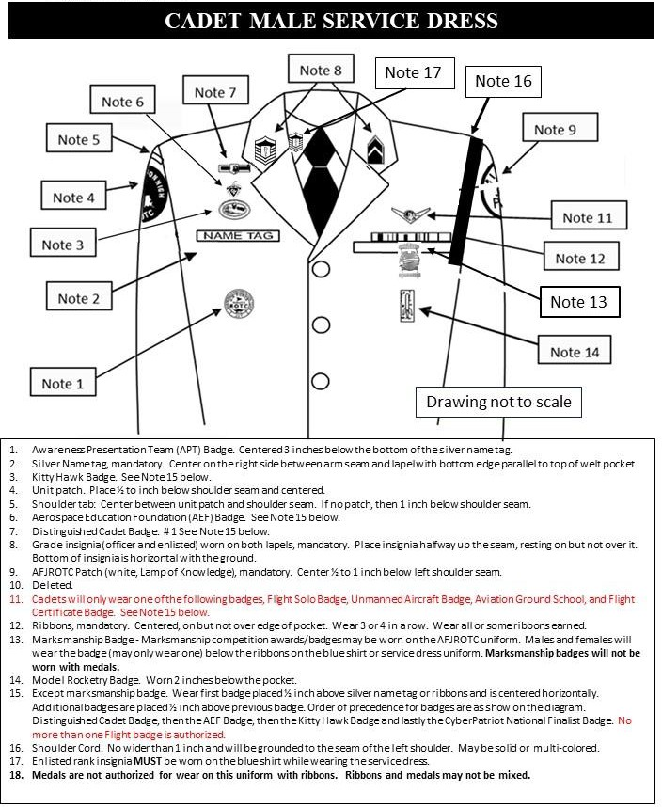


Attachment 7-9A
Space Force JROTC Cadets
Note 19
19. USSF Lapel pin will be centered on lapel, parallel with each other and the floor. Green circles only denote location and are not part of the uniform

Slide 13
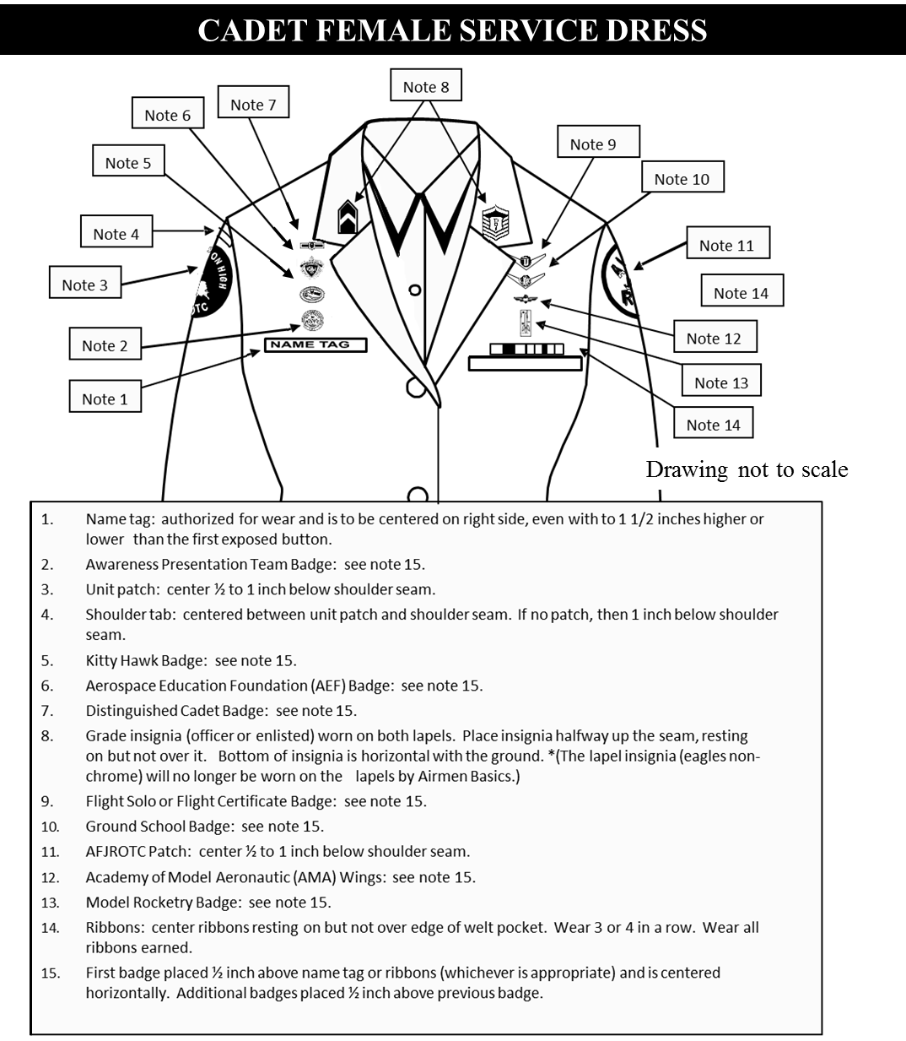

Attachment 7-10
SFJROTC
Note 16
Note 17
Drawing not to scale
Silver Name tag, mandatory. Center on the wearer’s right between the sleeve seam and lapel and the bottom of the name tag will be parallel with the bottom of ribbons.
Awareness Presentation Team Badge. See Note 15 below.
Unit patch. Center ½ to 1 inch below shoulder seam
Shoulder tab: Center between unit patch and shoulder seam. If no patch, then 1 inch below shoulder seam
Kitty Hawk Badge. See Note 15 below.
Aerospace Education Foundation (AEF) Badge. See Note 15 below.
Distinguished Cadet Badge. See Note 15 below.
Grade insignia (officer and enlisted) worn on both lapels, mandatory. Place insignia halfway up the seam, resting on but not over it. Bottom of insignia is horizontal with the ground.
Deleted
Cadets will only wear one of the following badges, Flight Solo Badge, Unmanned Aircraft Badge, Aviation Ground School, and Flight Certificate Badge. See Note 15 below.
AFJROTC Patch (white, Lamp of Knowledge), mandatory. Center ½ to 1 inch below left shoulder seam.
Marksmanship Badge - Marksmanship competition awards/badges may be worn on the AFJROTC uniform. Males and females will wear the badge (may only wear one) below the ribbons on the blue shirt or service dress uniform. Marksmanship badges will not be worn with medals.
Model Rocketry Badge. See Note 15.
Ribbons, mandatory. Center ribbons resting on but not over edge of welt pocket. Wear 3 or 4 in a row. Wear all or some ribbons earned.
Except marksmanship badge. Wear first badge placed ½ inch above silver name tag or ribbons and is centered horizontally. Additional badges are placed ½ inch above previous badge. Order of precedence for badges are as show on the diagram. Distinguished Cadet Badge, then the AEF Badge, then the Kitty Hawk Badge , then the Awareness Presentation Team Badge and lastly the CyberPatriot National Finalist Badge. No more than one Flight badge is authorized.
Shoulder Cord. No wider than 1 inch and will be grounded to the seam of the left shoulder. May be solid or multi-colored.
Enlisted rank insignia MUST be worn on the blue shirt while wearing the service dress.
Medals are not authorized for wear on this uniform with ribbons. Ribbons and medals may not be mixed.

Slide 14
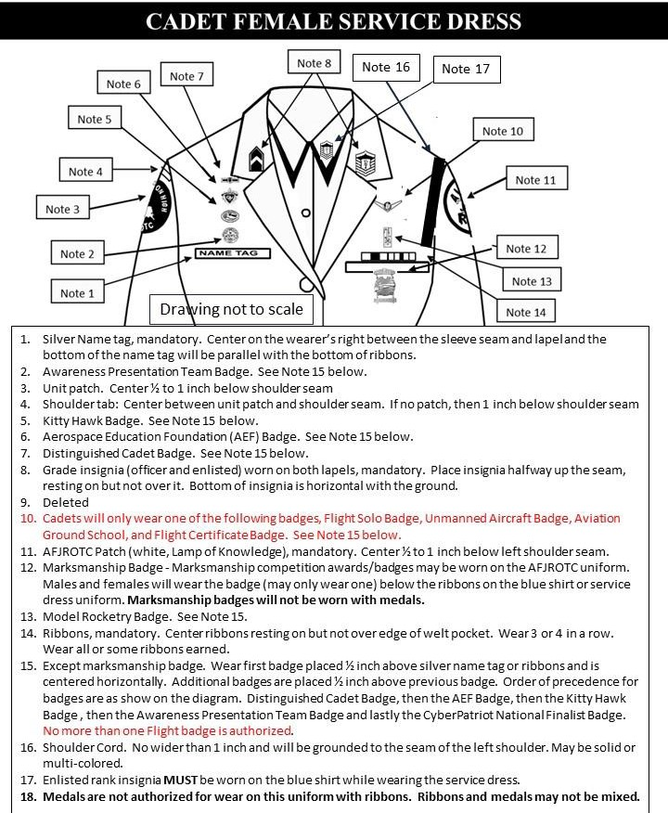
Attachment 7-10A
Space Force JROTC Cadets
Note 19
19. USSF Lapel pin will be centered on lapel, parallel with each other and the floor. Green circles only denote location and are not part of the uniform.

Slide 15
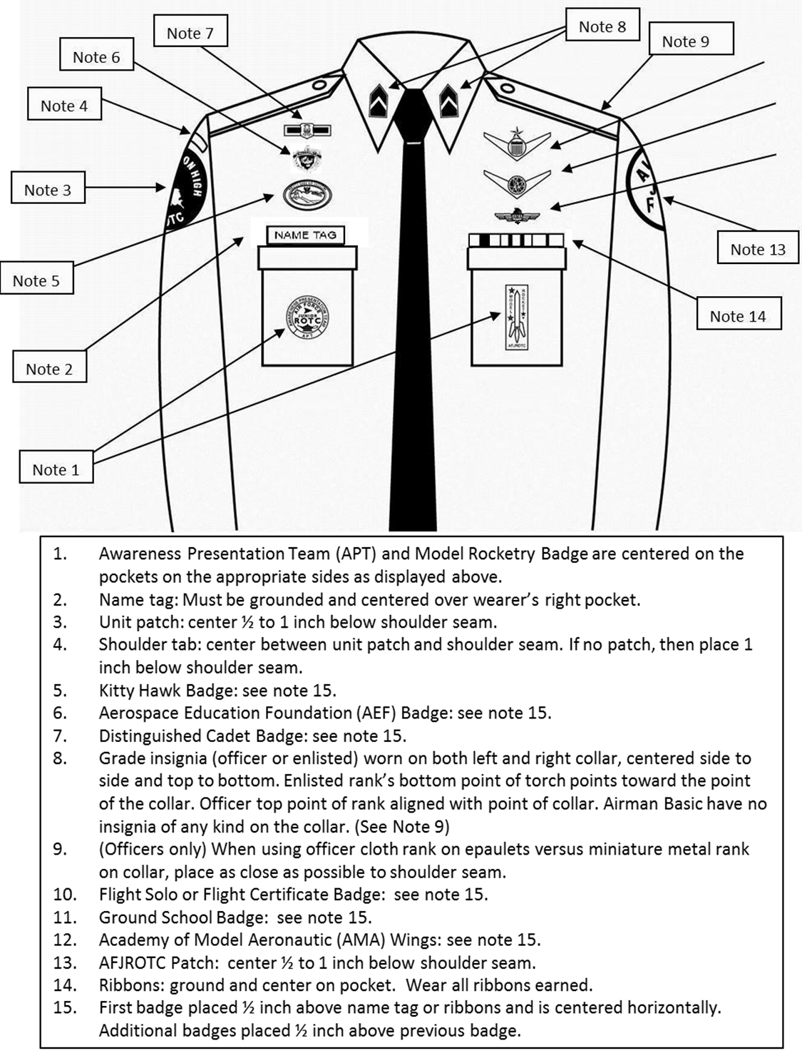

Attachment 7-11
CADET MALE BLUE SHIRT
Note 9
Note 16
Note 11
Note 12
Drawing not to scale
Awareness Presentation Team (APT) and Model Rocketry Badge are centered on the pockets on the appropriate sides as displayed above.
Name Tag: Mandatory wear. Blue Plastic with white letters. Must be grounded and centered over wearer’s right pocket.
Unit patch. Centered ½ to 1 inch below the shoulder seam.
Shoulder tab. Centered between unit patch and shoulder seam. If no patch, then place 1 inch below shoulder seam.
Kitty Hawk Badge. See Note 15.
Aerospace Education Foundation (AEF) Badge. See Note 15.
Distinguished Cadet Badge. See Note 15.
Grade insignia, mandatory (officer and enlisted) worn on both left and right collar, centered side to side and top to bottom. Enlisted rank’s bottom point of torch points towards the point of the collar. Officer top point of rank aligned with point of collar. Cadet/Amn Basic have no insignia of any kind on the collar.
Officers only. When using officer cloth rank on epaulets versus miniature metal rank on collar, place as close as possible to shoulder seam. (Use larger male epaulets only).
Deleted
Cadets will only wear one of the following badges, Flight Solo Badge, Unmanned Aircraft Badge, Aviation Ground School, and Flight Certificate Badge. See Note 15 below.
Marksmanship competition awards/badges may be worn on the AFJROTC uniform. Males and females will wear the badge (may only wear one) below the ribbons on the blue shirt or service dress uniform. Marksmanship badges will not be worn with medals.
AFJROTC Patch (white, Lamp of Knowledge), mandatory. Center ½ to 1 inch below left shoulder seam.
Ribbons are optional. Wear all, some or no ribbons earned. If worn, ribbons will be centered, resting on, but not over the edge of the pleated pocket on the wearers left.
Except marksmanship badges. First badge placed ½ inch above name tag or ribbons and is centered horizontally. Additional badges placed ½ inch above previous badge. Order of precedence for badges are as show on the diagram. Distinguished Cadet Badge, then AEF Badge, then Kitty Hawk Badge, and finally the CyberPatriot National Finalist Badge. No more than one Flight badge is authorized.
Shoulder Cord. No wider than 1 inch and will be grounded to the seam of the left shoulder under epaulet. May be solid or multi-colored.
Medals (regardless of what type) are not authorized for wear on this uniform.

Slide 16
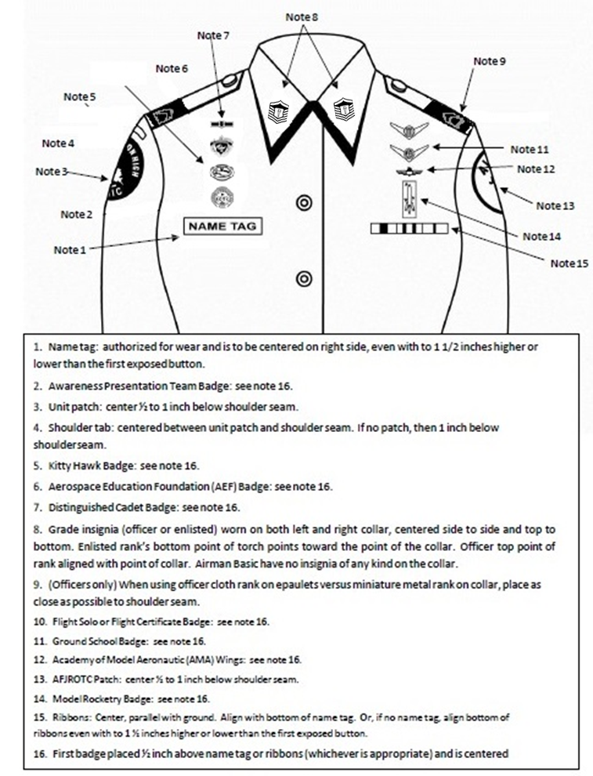

Attachment 7-12
CADET FEMALE BLUE SHIRT
Note 9
Note 5
Note 17
Note 4
Note 12
Drawing not to scale
Name Tag: Mandatory wear. Blue Plastic with white letters. Without ribbons: centered on right side, parallel to ground and within 1 ½ inches higher/lower than topmost exposed button. With Ribbons: Even with bottom row of ribbons, centered on right side, parallel to ground and within 1 ½ inches higher/lower than topmost exposed button.
Awareness Presentation Team (APT) Badge. See Note 16
Unit Patch. Centered on sleeve and ½ to 1 inch below shoulder seam.
Shoulder Tab (Metal or cloth). Centered between unit patch and shoulder seam. If no patch, then 1 inch below shoulder seam.
Kitty Hawk Air Society Badge. See Note 16.
Aerospace Education Foundation (AEF) Badge. See Note 16.
Distinguished Cadet Badge. See Note 16.
Grade insignia, mandatory (officer and enlisted) worn on both left and right collar, centered side to side and top to bottom. Enlisted rank’s bottom point of torch points towards the point of the collar. Officer top point of rank aligned with point of collar. Cadet/Amn Basic have no insignia of any kind on the collar
Officers only. When using officer cloth rank on epaulets versus miniature metal rank on collar, place as close as possible to shoulder seam. (Use smaller female epaulets only)
Deleted.
Cadets will only wear one of the following badges, Flight Solo Badge, Unmanned Aircraft Badge, Aviation Ground School, and Flight Certificate Badge. See Note 16 below.
Marksmanship Badge - Marksmanship competition awards/badges may be worn on the AFJROTC uniform. Males and females will wear the badge (may only wear one) below the ribbons on the blue shirt or service dress uniform. Marksmanship badges will not be worn with medals.
AFJROTC Patch (white, Lamp of Knowledge), mandatory. Center ½ to 1 inch below left shoulder seam
Model Rocketry Badge. See Note 16.
Ribbons are optional. Wear all, some or no ribbons earned. If worn, center ribbons on wearer’s left, parallel with ground. Align bottom of the ribbons with the bottom of the name tag.
Except marksmanship badge. Wear first badge placed ½ inch above silver name tag or ribbons and is centered horizontally. Additional badges are placed ½ inch above previous badge. Order of precedence for badges are as show on the diagram. Distinguished Cadet Badge, then the AEF Badge, then the Kitty Hawk Badge, then the Awareness Presentation Team Badge and lastly the CyberPatriot National Finalist Badge. No more than one Flight badge is authorized.
Shoulder Cord. No wider than 1 inch and will be grounded to the seam of the left shoulder under the epaulet. May be solid or multi-colored.
Medals (regardless of what type) are not authorized for wear on this uniform.

Slide 17
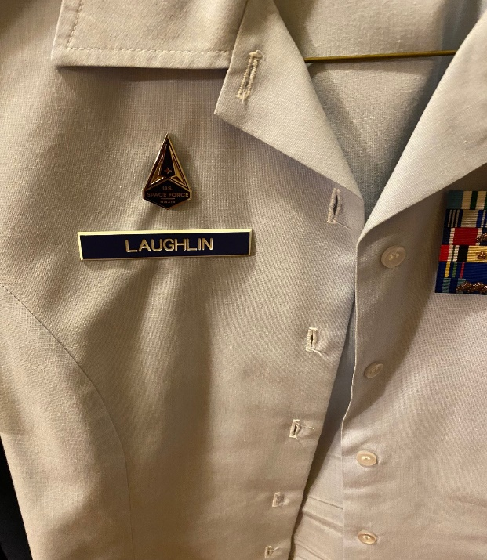
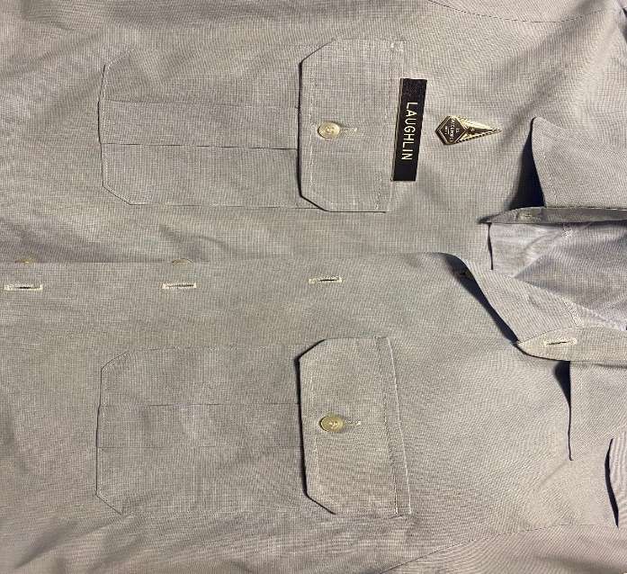
Attachment 7-12A
SPACE FORCE JROTC BLUE SHIRT
Note 4
Female Uniform
Male Uniform
Only one of the USSF Distinguished Lapel Insignia will be worn on the men’s blue shirt and the women’s blue blouse. Both men and women will wear one insignia centered ½ inch above the nametag. The Lapel Insignia is mandatory and not subordinate to other identification badges worn in the same position above the nametag on women’s blue blouse.

Slide 18
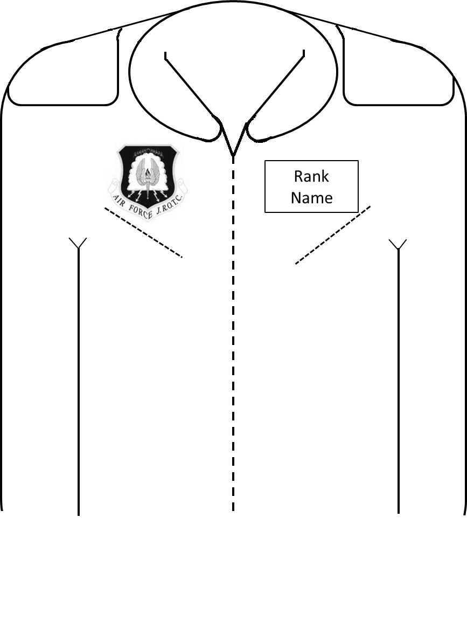
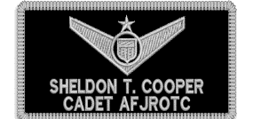
Attachment 7-13
FLIGHT SUIT (Male and Female)
Note 2
Note 3
Note 1
Note 4
* AFJROTC Command Patch (mandatory). Patches may be sewn directly onto the flight suit or attached using Velcro. This style of patch may only be worn on the Flight Suit. Cadets can only wear ONE ground school, flight solo or flight certificate badges upon successful completion one of those. (see Ops Supplement, Chapter 7, paras 7.2.1 - 7.2.4).
The unit patch will be worn on the right sleeve (shoulder) of the Flight Suit, if the unit patch is unavailable then the white, Lamp of Knowledge will be worn. Patches may be sewn directly onto the flight suit or attached using Velcro.
* American Flag Patch (mandatory) on left shoulder. Patches may be sewn directly onto the flight suit or attached using Velcro .
Cadet Name Patch (mandatory). Velcro attached only. Black background with silver or white border (if unit has a unit patch, units may substitute background color/border with unit patch colors). Cadet Name Badge – Top line will be Cadet Name and second line will be “CADET AFJROTC”.
See paras 7.2.4 and 7.2.5.1 for more details on flight suit wear.
Flight patches and Velcro may be purchased from a vendor using MilPer funds.
Flight Suits maybe purchased through WINGS/FEDMALL (contact HQ Logistics for assistance.)
Flight Suits are accountable uniforms items and must be issued/returned via WINGS.

Slide 19
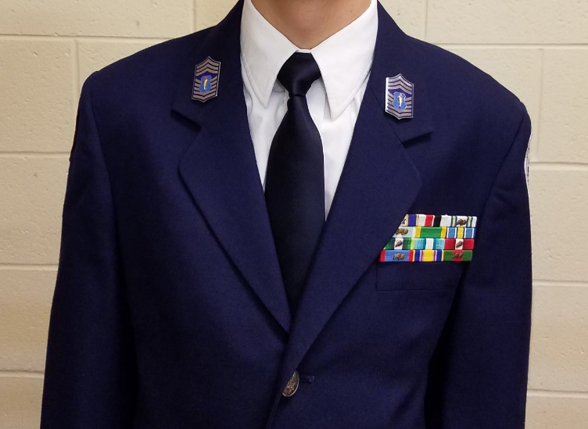
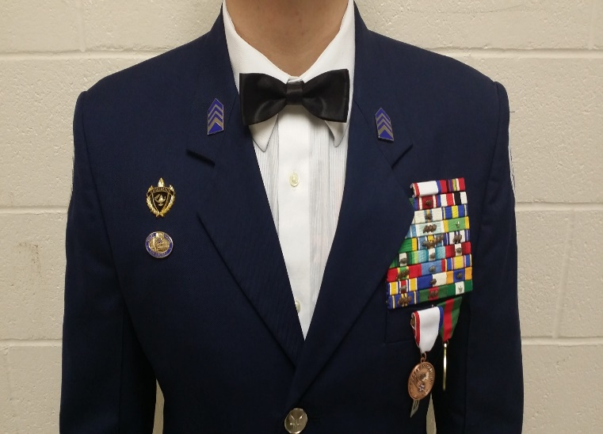

Attachment 7-14
Semi-Formal Dress Uniform
Note 1
Note 2
Note 7
Note 3
Note 6
Note 4
Note 5
The blue or white long-sleeve shirt will be plain, knit or woven, commercial type with a short or medium point collar, with button or French cuffs.
Enlisted members do not need to wear two sets of ranks on the semi-formal uniform.
The Silver Name Tag will not be worn on the semi-formal dress uniform.
Black or Blue bow tie may be worn with the semi-formal uniform (white shirt only).
Large medals will be worn on the semi-formal uniform coat ½ inch below the top of the welt of the pocket, centered on the pocket. If medals are worn, ribbons will not be worn (no mixing).
AFJROTC ribbons may be worn on the semi-formal uniform. If ribbons are worn, medals will not be worn (no mixing).
Authorized badges may be worn on the semi-form dress uniform. If medals are worn, badges that are normally worn directly under the ribbon rack will not be worn.
Headgear is not worn with the semi-formal dress uniform.
Per Chapter 7 para 7.8.4.8. Mess Dress Uniforms are not authorized for wear by AFJROTC cadets.

Slide 20
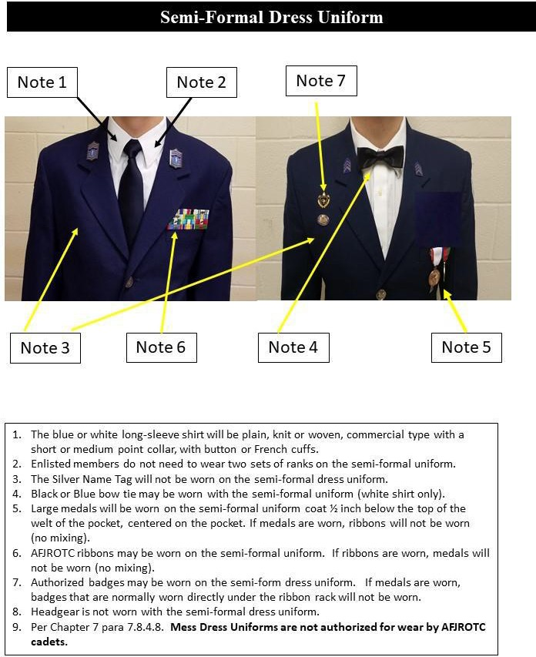

Attachment 7-14A
Space Force JROTC Cadets
Note 10
10. USSF Lapel pin will be centered on lapel, parallel with each other and the floor. Green circles only denote location and are not part of the uniform

Slide 21

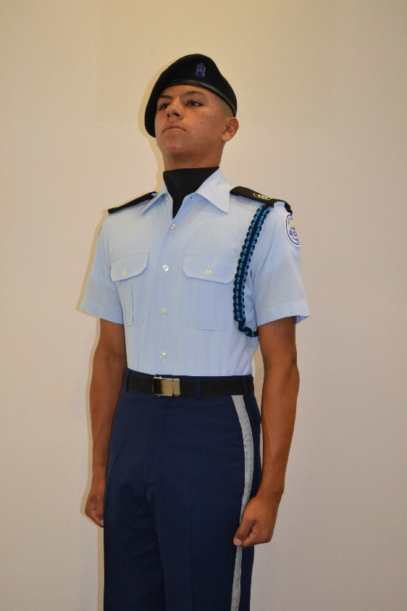
Attachment 7-15
Sample Exhibition Uniform
¾ inch
stripe
Solid Color white, dark blue or black ONLY, with AFJROTC officer rank insignia or mini-Hap Arnold Insignia pin. The former officer/enlisted flight cap emblems will not be worn on the beret. The wear of a “Beret Flash” or mini unit patch is not authorized.
Shoulder Cord. Cadets are authorized to wear one shoulder cord on the left shoulder. This will be a single “infantry” style cord, without metal tips, no more than 1-inch wide. On the blue shirt the cord will be under the epaulet, grounded to the left shoulder seam and pinned to the shoulder with the pin hidden beneath the cord. May be solid or multi-colored.
Blue/Silver Name Tags and ribbons may be omitted on uniforms where a drill rifle or other equipment may damage the item or injure the performing member. This does not apply to uniforms worn during regular uniform days.
Blue pants may be modified to have a ¾ inch stripe on the outside length of the pants, silver, blue, or black only. These items will not be worn on regular uniform days. .
Solid color ascots may be worn (embroidery or a unit patch is authorized on the ascot), colors may be locally-determined (school colors), but must be conservative and in good taste, and defined in the Cadet Guide or Unit Operations Instruction. Ascots will not be worn on regular uniform days.
Embroidery on the Air Force blue drill team uniform is not authorized, i.e., on the back of the blue shirt collar or shoulder yoke.
Specialized unit rank/shoulder boards are not authorized.
Wrist bands are not authorized.
AFJROTC Patch (white, Lamp of Knowledge), mandatory. Center ½ to 1 inch below left shoulder seam.
Black Boots/corfams may be issued on an as required basis to the unit Color Guard or Drill Team. This is for restricted use and is not intended for use across unit's entire cadet corps. Black boots/corfams may be reissued to cadets. Spray boots/corfams with disinfectant spray before reissuing.

Slide 22
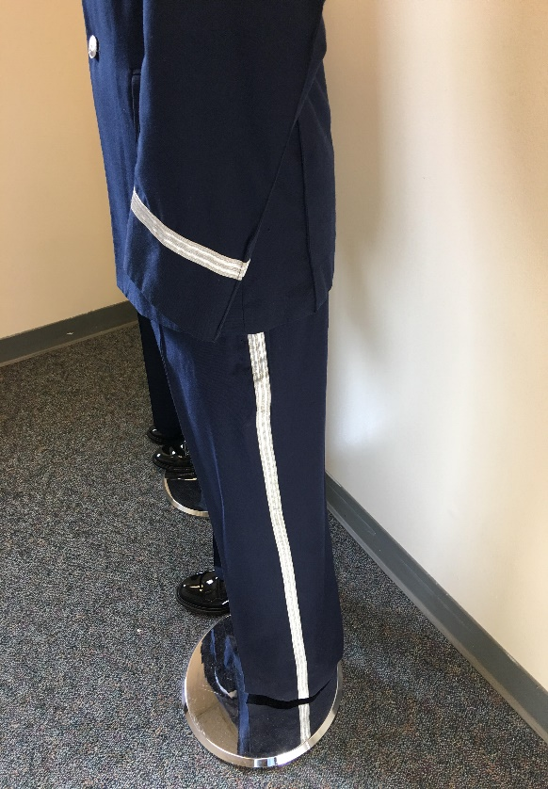
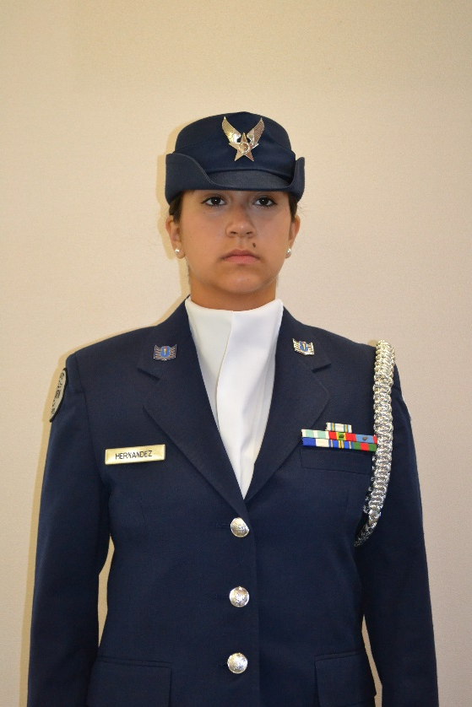
Attachment 7-15 (continued)
Sample Exhibition Uniform
1/2 inch braid
¾ inch
stripe
Women’s Service Caps may be worn with the Hap Arnold Wings insignia or Officer Service Cap may also be worn with the large officer service cap insignia large officer’s . Service Caps (wheel and bucket hats) will be a solid color and free of any embroidery.
Shoulder Cord. Cadets are authorized to wear one shoulder cord on the left shoulder. This will be a single “infantry” style cord, without metal tips, no more than 1-inch wide. On the blue shirt the cord will be under the epaulet, grounded to the left shoulder seam and pinned to the shoulder with the pin hidden beneath the cord. May be solid or multi-colored.
Blue/Silver Name Tags and ribbons may be omitted on uniforms where a drill rifle or other equipment may damage the item or injure the performing member. This does not apply to uniforms worn during regular uniform days.
Blue pants may be modified to have a ¾ inch stripe on the outside length of the pants, silver, blue, or black only. These items will not be worn on regular uniform days. .
Solid color ascots may be worn (embroidery or a unit patch is authorized on the ascot), colors may be locally-determined (school colors), but must be conservative and in good taste, and defined in the Cadet Guide or Unit Operations Instruction. Ascots will not be worn on regular uniform days.
Embroidery on the Air Force blue drill team uniform is not authorized, i.e., on the back of the blue shirt collar or shoulder yoke.
Specialized unit rank/shoulder boards are not authorized.
A ½ inch silver, dark blue, or black only sleeve braid, 3 inches from the end of the sleeve, may be worn.
AFJROTC Patch (white, Lamp of Knowledge), mandatory. Center ½ to 1 inch below left shoulder seam.
Black Boots/corfams may be issued on an as required basis to the unit Color Guard or Drill Team. This is for restricted use and is not intended for use across unit's entire cadet corps. Black boots/corfams may be reissued to cadets. Spray boots/corfams with disinfectant spray before reissuing.

Slide 23
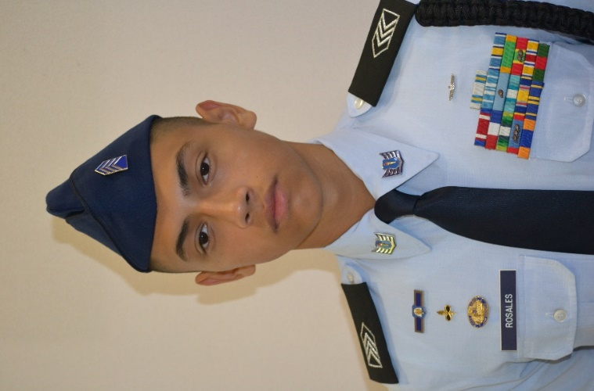
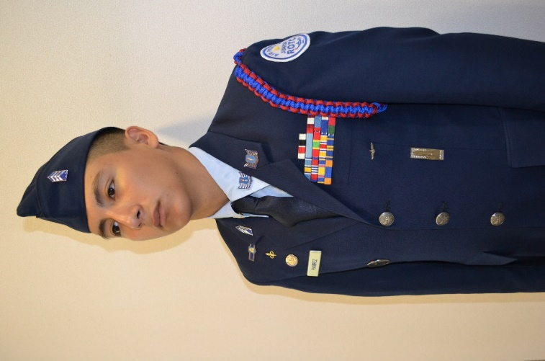
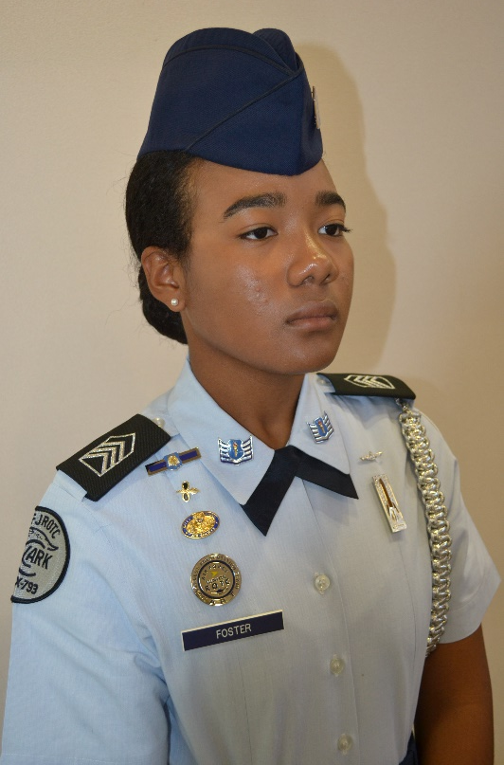
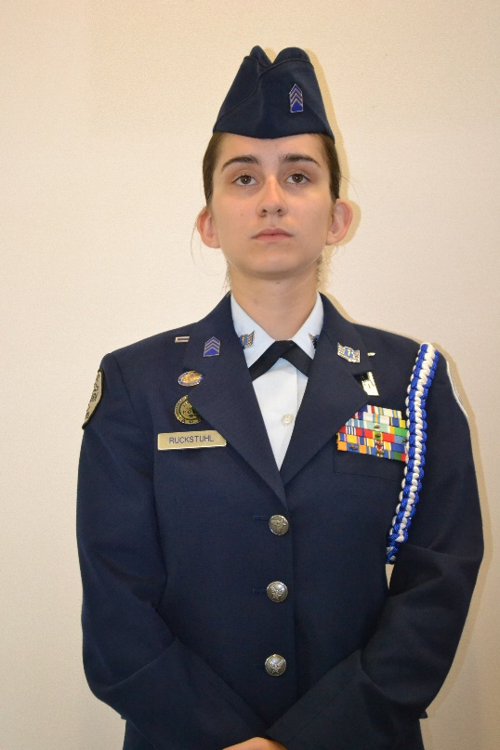
Attachment 7-16
Sample Uniform Pictures
Cadets will not wear both officer and enlisted rank on their uniforms … these are sample pictures only

Slide 24
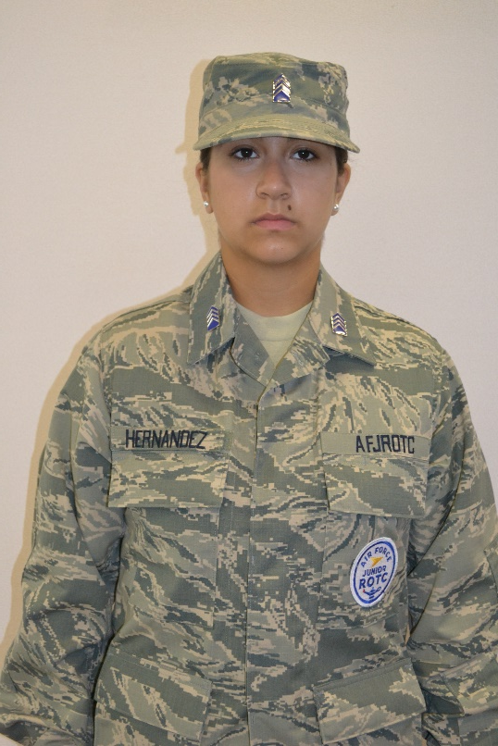
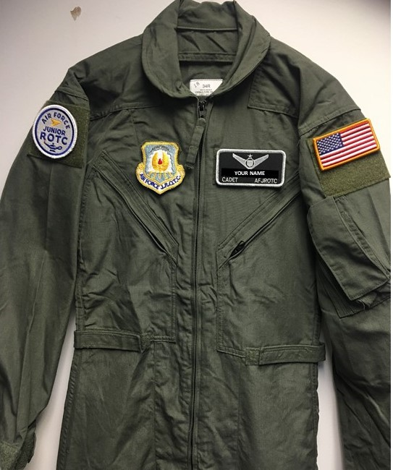
Attachment 7-16 (continued)
Sample Uniform Pictures

Slide 25
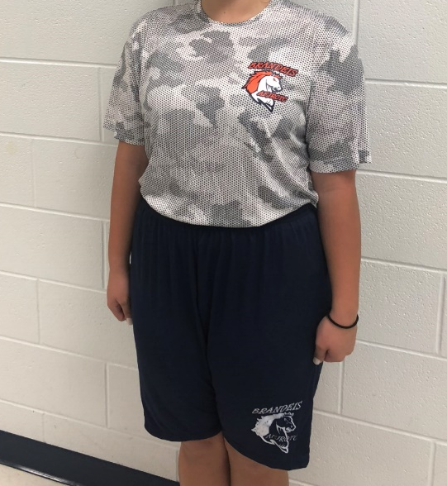
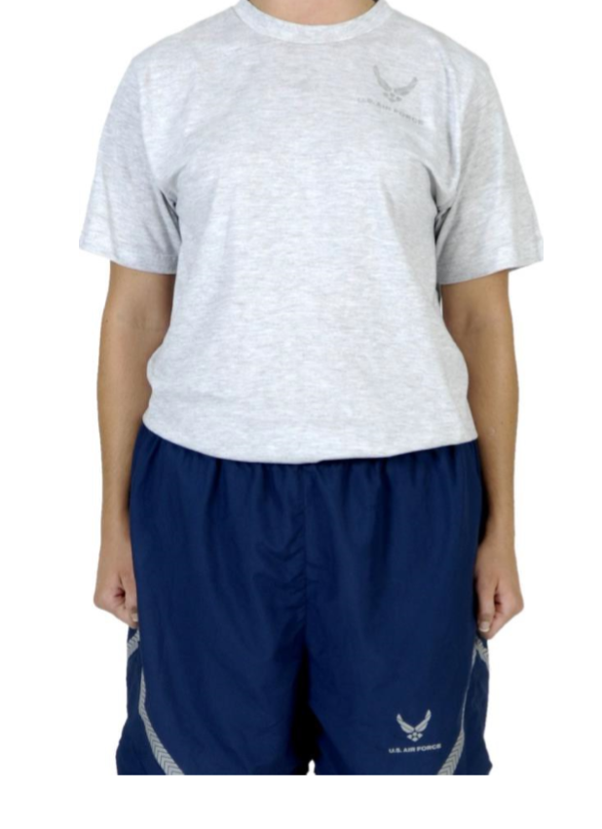
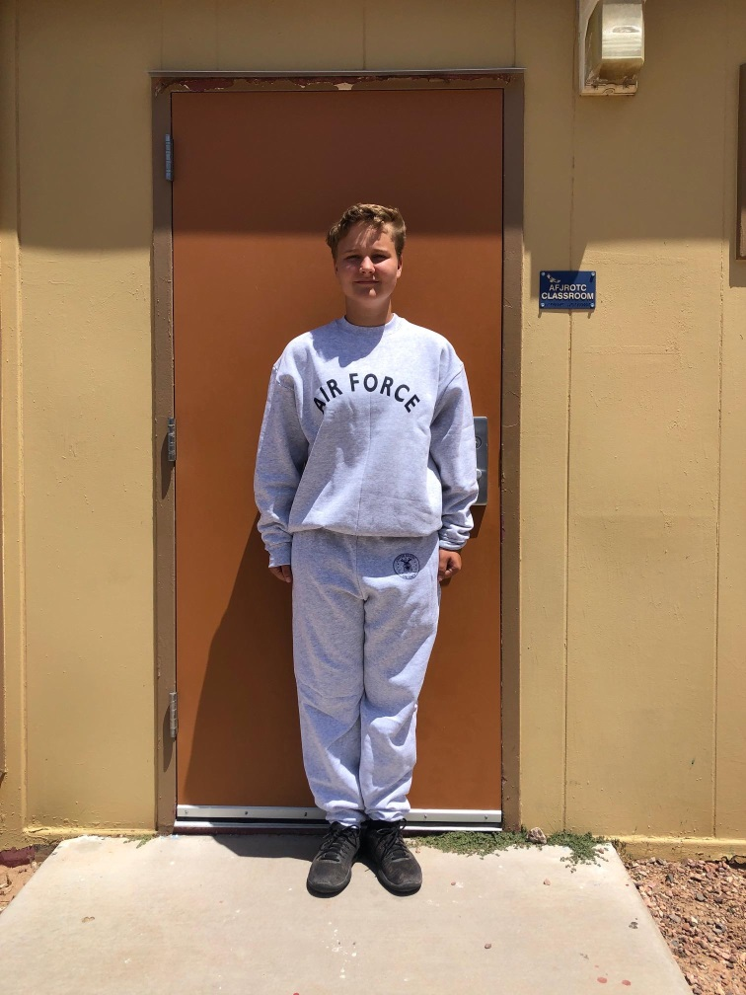
Attachment 7-16 (continued)
Sample Uniform Pictures
Local Purchased PFT Gear
FEDMALL Purchased Air Force PTG
FEDMALL Purchased Air Force Sweat Shirt and Pants

