Slide 1
DALEVILLE CITY SCHOOLS
PROPOSED FY 2023 BUDGET
8-24-2023 & 9-13-2023

Slide 2
MISSION OF BUDGET PROCESS
The mission of the budget process is to help decision makers make informed choices about the services and needs of a particular department, activity or local school function.
The budget process includes planning resources, prioritizing needs among the school district, and the approval process provides the legal authority to spend money.

Slide 3
DCS Mission Statement
The mission of the Daleville City Schools is to provide our diverse student body with a variety of educational experiences and successes in a safe environment that will enable them to become confident, self-directed, lifelong learners in an increasingly complex world.

Slide 4
FY24 Foundation Program Units
 | FY 2024 | FY 2023 | Change
System ADM | 1,090.70 | 1,127.30 | (36.60)
Foundation Program Units
Teachers | 63.52 | 65.59 | (2.07)
Principals | 3.00 | 3.00 | 0.00
Assistant Principals | 1.00 | 1.00 | 0.00
Counselors | 2.50 | 2.50 | 0.00
Librarians | 3.00 | 3.00 | 0.00
Career Tech Directors | 1.75 | 1.75 | 0.00
Total Units | 74.77 | 76.84 | 2.81

Slide 5
Units by School
 | FY 2024 | FY 2023
Windham Elementary
ADM / Teacher Units | 449.10/ 29.68 | 466.20/ 30.94
Daleville Middle
ADM / Teacher Units | 352.85/ 17.75 | 374.35/ 18.68
Daleville High
ADM / Teacher Units | 288.75 / 16.09 | 286.75 / 15.97
Notes:
WES Decreased BY 17.10 STUDENTS
DMS Decreased 21.50 STUDENTS
DHS Increased 2 STUDENTS.
The current numbers are available in your packet, and we are seeing increases at each school. DHS is at 346, DMS @ 364, & WES @ 465, not including pre-k. This is as of Monday, September 11 and as we know the adm is based off of the first three weeks after labor day… so we have just a few more days to go before those numbers will be considered final. This will help us gain more teacher units in foundation for NEXT year… We were hopeful that the WES number would reach the magic number of 500 for an Assistant Principal next year, however that is not looking likely. There is talk in the legislature about reducing that threshold, so hopefully we will still receive funding for an AP.

Slide 6
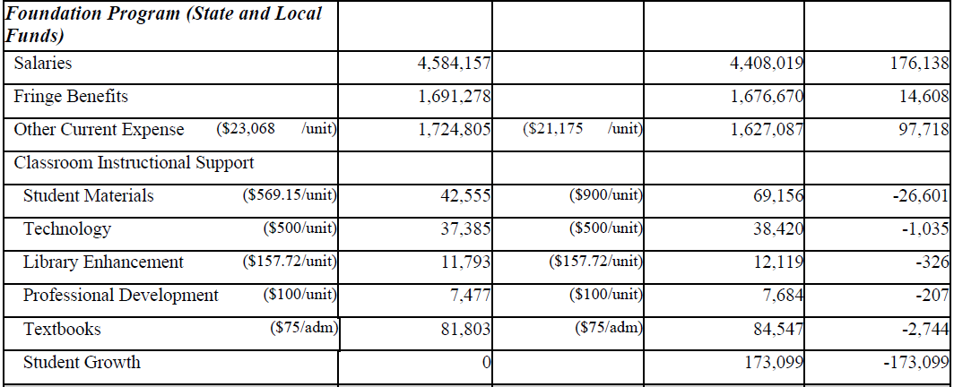
Foundation Funds
Notes:
We do see a decrease in Student Materials from 900 to 569.15. I would like to clarify that the amount for this school year is $1000.00, but the legislature “prefunded” these accounts.. So our teachers have already received 430.85 to begin the school year and they will receive the remaining $569 after October 1. This is a huge WIN because typically the teachers would have to wait until after October 1 to receive any funds.

Slide 7
FY 2024 Total Budget Revenues
 | 2024 | 2023 | Diff
STATE REVENUES | $9,493,901.00 | $9,461,869.44
FEDERAL REVENUES | $4,348,417.25 | $5,938,938.75
LOCAL REVENUES | $2,016,188.03 | $2,250,524.17
OTHER REVENUES | 32,300.00 | $32,300.00
TOTAL | 15,890,806.28 | $17,683,632.36 | (1,792,826)
Notes:
From the information that has been provided to us up until this point, we are expecting 15.8 million dollars in revenues this year.
As expected, we are seeing an increase in State Revenues. This is related to the salary & benefit increases from the state mandated 2% raise.
Federal Revenues are down, but this is also expected!! This is mostly due to the ESSER 2 Funds expiring at the end of this month. Since these are one-time ‘covid dollars’ this federal amount will continue to decrease until we have spent these funds, with the last amount (ESSER 3 ) expiring in 2024.
Our indirect cost that we collect from federal funds is a ‘local revenue’ and with less federal expenditures this year, this amount will decrease.

Slide 8
Notes:
Again, just another representation of our fy 2023 revenues. 53% coming from state and 34% coming from Federal. As expected, for thE current FY 2022 budget, federal revenues made up 41% and state 46%. We are starting to see that shift back to state revenues due to these dollars expiring or being spent.

Slide 9
FY24 State Funds
Funding Source | Allocation | Funding Source | Allocation
School Nurses | $ 155,158 | Technology Coordinator | 68,327
Career Tech O and M | 16,074 | Transportation Operations | 620,690
AL Reading Initiative | 80,000 | Fleet Renewal | 98,553
At Risk | 32,828 | Capital Purchase | 348,638
Gifted | 13,303 | English Second Lang | 25,537
State Pre-K Grant | 20,487

Slide 10
FY24 Federal Funds
IDEA - Part B | $ 355,302
IDEA - Pre-school Part B | 9,810
Basic Grant/CTE | 27,154
Title I, Part A | 701,922
Title II, Part A - Teacher Training | 79,104
Title III, English Language Learning | 9,861
Title IV, Part A | 53,127
Title V, Rural Education | 37,062
Notes:
3210 – Increased 10K
3220 – Dereased $300
3310 – Decreased 9,000 dollars
Title I – Increased 24,196.00
Title II – Decreased 22,842
Title IV Increased 11,138
Title V –Increased 7000

Slide 11
New Funds for FY2024
CAPITAL OUTLAY (1764) -$677,103
Property Insurance
Secure Vestibule @ DHS
STRONGER CONNECTIONS (4165) - $99,000
3 years
Behavior Interventionist
Paraprofessional @ Alternative School
SAFETY GRANT $60,600
Upgrades to Intercom System District Wide
AEDs
Metal Detectors Wands
Voice Over IP Phones for every classroom
Security Camera Upgrades
COLLEGE & CAREER READINESS (1768) - $50,000
Campus/Industry Tours & Career Fairs
Middle School College & Career Readiness Programs

Slide 12
FY24 Federal Funds
ESSER (expires 9/30/2022) GEER (expires 9/30/2022) | 0.00 0.00
ESSER 2 (expires 9/30/2023) ESSER 2 State Reserve (expires 9/30/2023) ESSER 3 | 0.00 0.00 $ 2,208,847.09
 | $ 2,208,847.09
Notes:
ESSER & GEER EXPIRE as of 9.30.22 as I stated before. I have included the other LARGE ‘COVID’ funds here (as I like to call them). Esser 2 began with 1.4 million, so we have spent about half of that fund. The state reserve is mostly used for purchased services, such as behavioral therapy, speech therapy, physical therapy, interpreters, etc. We started with 61 thousand there, and have also spent about half. Our ESSER 3 original allocation amount was right at 4 million. So, if you go back to the previous slide that I showed with the federal funds 2 million dollars less than last year, this is why! We are doing everything that we can to get this money spent. Esser 2 deadlines are September 2023 and Esser 3 are September 2024. These numbers may fluctuate as a I shift things around, but I will reflect any of those changes in the September budget hearing.

Slide 13
Debt Service
This fund reflects the annual debt payment (principal and interest) of the Daleville City Board of Education on its outstanding debt as of October 1, 2022.
Principal $ 405,880
Interest 219,446
Total $ 625,326
Notes:
We will make our final payment on SunTrust in October 23. This was for the energy management system that was originally financed in 2009.

Slide 14
Debt Service
The debt of the Daleville City Board of Education will be funded with the following funding sources:
Public School Fund $ 348,638
General Fund 178,135
Transportation Fleet Renewal 98,553
Notes:
The Public School Fund is for the capital outlay that we use on debt every year. This number decreased by $12,000.00
If you recall, we were able to set aside funds from the Series 2020 bond for debt in 2020. We set aside $300,000 and FY22 was the last year that we had funds remaining for that. Both of these things caused our general fund allotment towards debt to have to increase about 70K since last year.
We do see an increase in fleet renewal funds… which is great because the buses we finance in 2018/2019 are about 82K a year… of course, any buses that we have purchased since have not been financed due to ESSER & Advancement & Technology Funds. The “overage” amount from fleet renewal funds is used to purchase new buses.

Slide 15
Response to Proposed Annual Budget
Public response form available
Submit to the Board Office with attention to Chief School Financial Officer
Provide your name, address and phone number
Please sign the form

