Slide 1
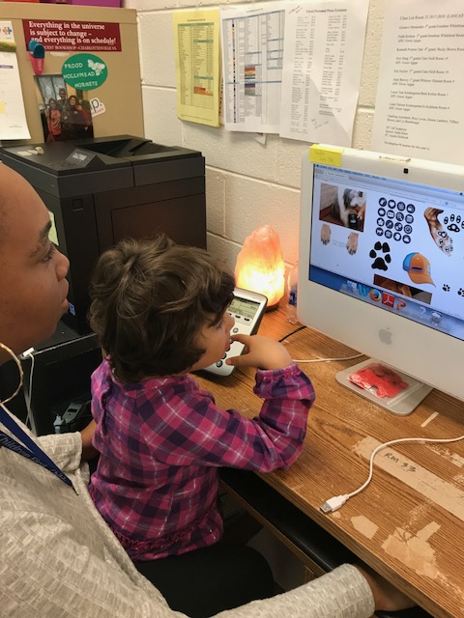
CBASE

Slide 2
What is CBASE?

Slide 3
What is CBASE?
Teacher who specializes in teaching an adapted curriculum.
Designated Staff
CBASE
A service delivery model for a student who is eligible for special education services and has a significant cognitive disability which allows them to participate in an alternate curriculum (VESOL)
Designated classroom for instruction.
Access to ACPS BCBAs
Notes:
Changed names over the past few years- names that we have used- functional skills, CBIP, VAAP classroom
Curriculum BASE- Building accessible supports with evidence
VESOL- Virginia Essentialized Standards of Learning- starts grade 3. Grades 3-8 and high school
Other important components of a CBASE classroom
Teacher who specializes in teaching an adapted curriculum and modifying the general education curriculum
Designated staff based on student need
Designated classroom for instruction
The philosophy of CBASE is not a self-contained model in which students start in a special education classroom and are pushed out as opportunities arise but rather a service delivery model in which students begin with inclusion in the general education environment and are pulled back into the CBASE classroom based on each individual student’s needs- whether that is small group or individualized instruction, behavior, communication, or physical needs. This is why you may see some CBASE students in the general education environment more than others.
Access to ACPS Behavior analyst team for support with curriculum development, IEP and assessment, behavior interventions and data collection
ESSA limits the participation in an alternate curriculum to 1% of population- students with a IQ score of 70 fall in the 2% of population.
Significant disability cognitive score 65 or lower
Will change the student’s trajectory in school
Limits their diploma options
Limits their access to peers
Limits their post secondary options
Can be more challenging to change a student from an adapted curriculum to a general curriculum than the other way around
We also know that cognitive tests become more stable age 8-10 (cognitive scores can change beforehand- see less fluctuation by 8)
Alternate assessments also begin in third grade in addition to the standard assessments
Er on the side of caution and give the student the benefit of the doubt first- Two children with autism might look very similar at 4 and then very different in middle school so why not wait until we have more information and back out as needed
Choose CBASE if the student’s specialized instruction is not adaptable to the classroom- can not be met solely through accommodations or differentiation

Slide 4
1. Students have a regular education classroom they are part of. 2. Can attend all specials, lunch, and classroom activities. 3. Opportunity to attend field trips. 4. Access to adult support through out the school day. 5. Opportunity for 1:1 instruction. 6. Safe space for children to overcome learned helplessness and learn life skills. 7. Curriculum focuses on Virginia Essentials Standards of Learning (VESOLs) 8. Alternative testing to meet State standards.
BENEFITS

Slide 5
According to the World Health Organization, life skills are: “A group of psychosocial competencies and interpersonal skills that help people make informed decisions, solve problems, think critically and creatively, communicate effectively, build healthy relationships, empathize with others, and cope with and manage their lives in a healthy and responsible manner.”
What Are Life Skills?

Slide 7
Some Examples would be: Time management Money management Housekeeping Communication Positive self-image development Growth mindset and self-improvement Stress management

Slide 8
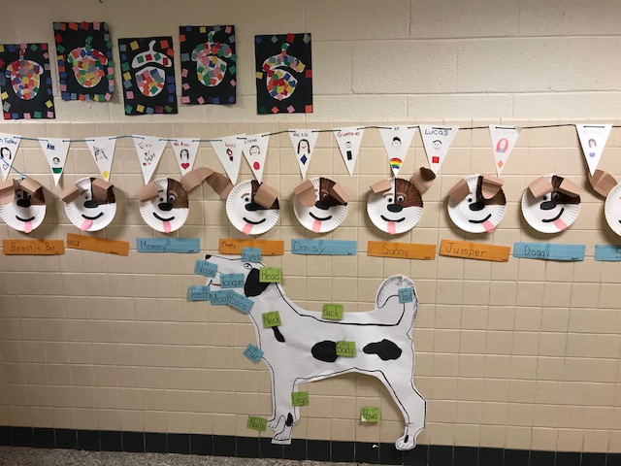
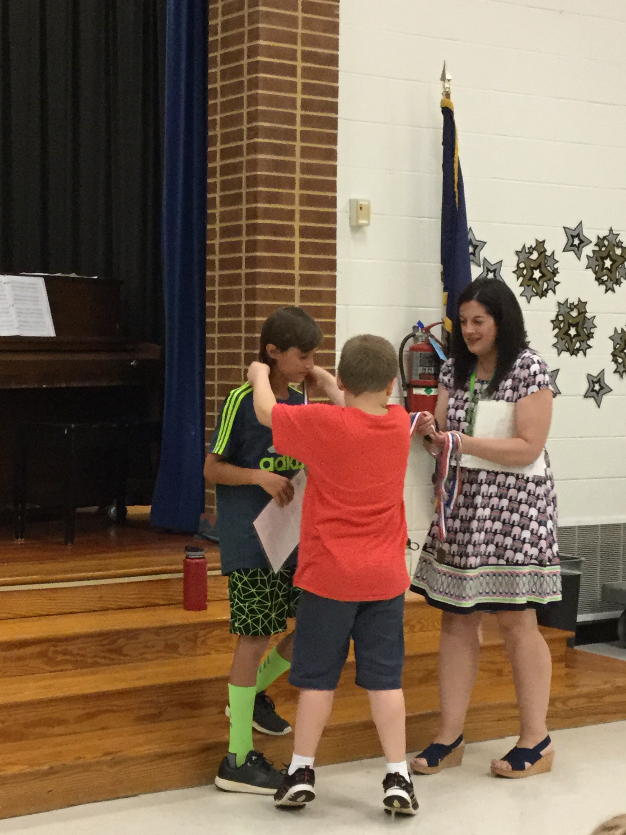
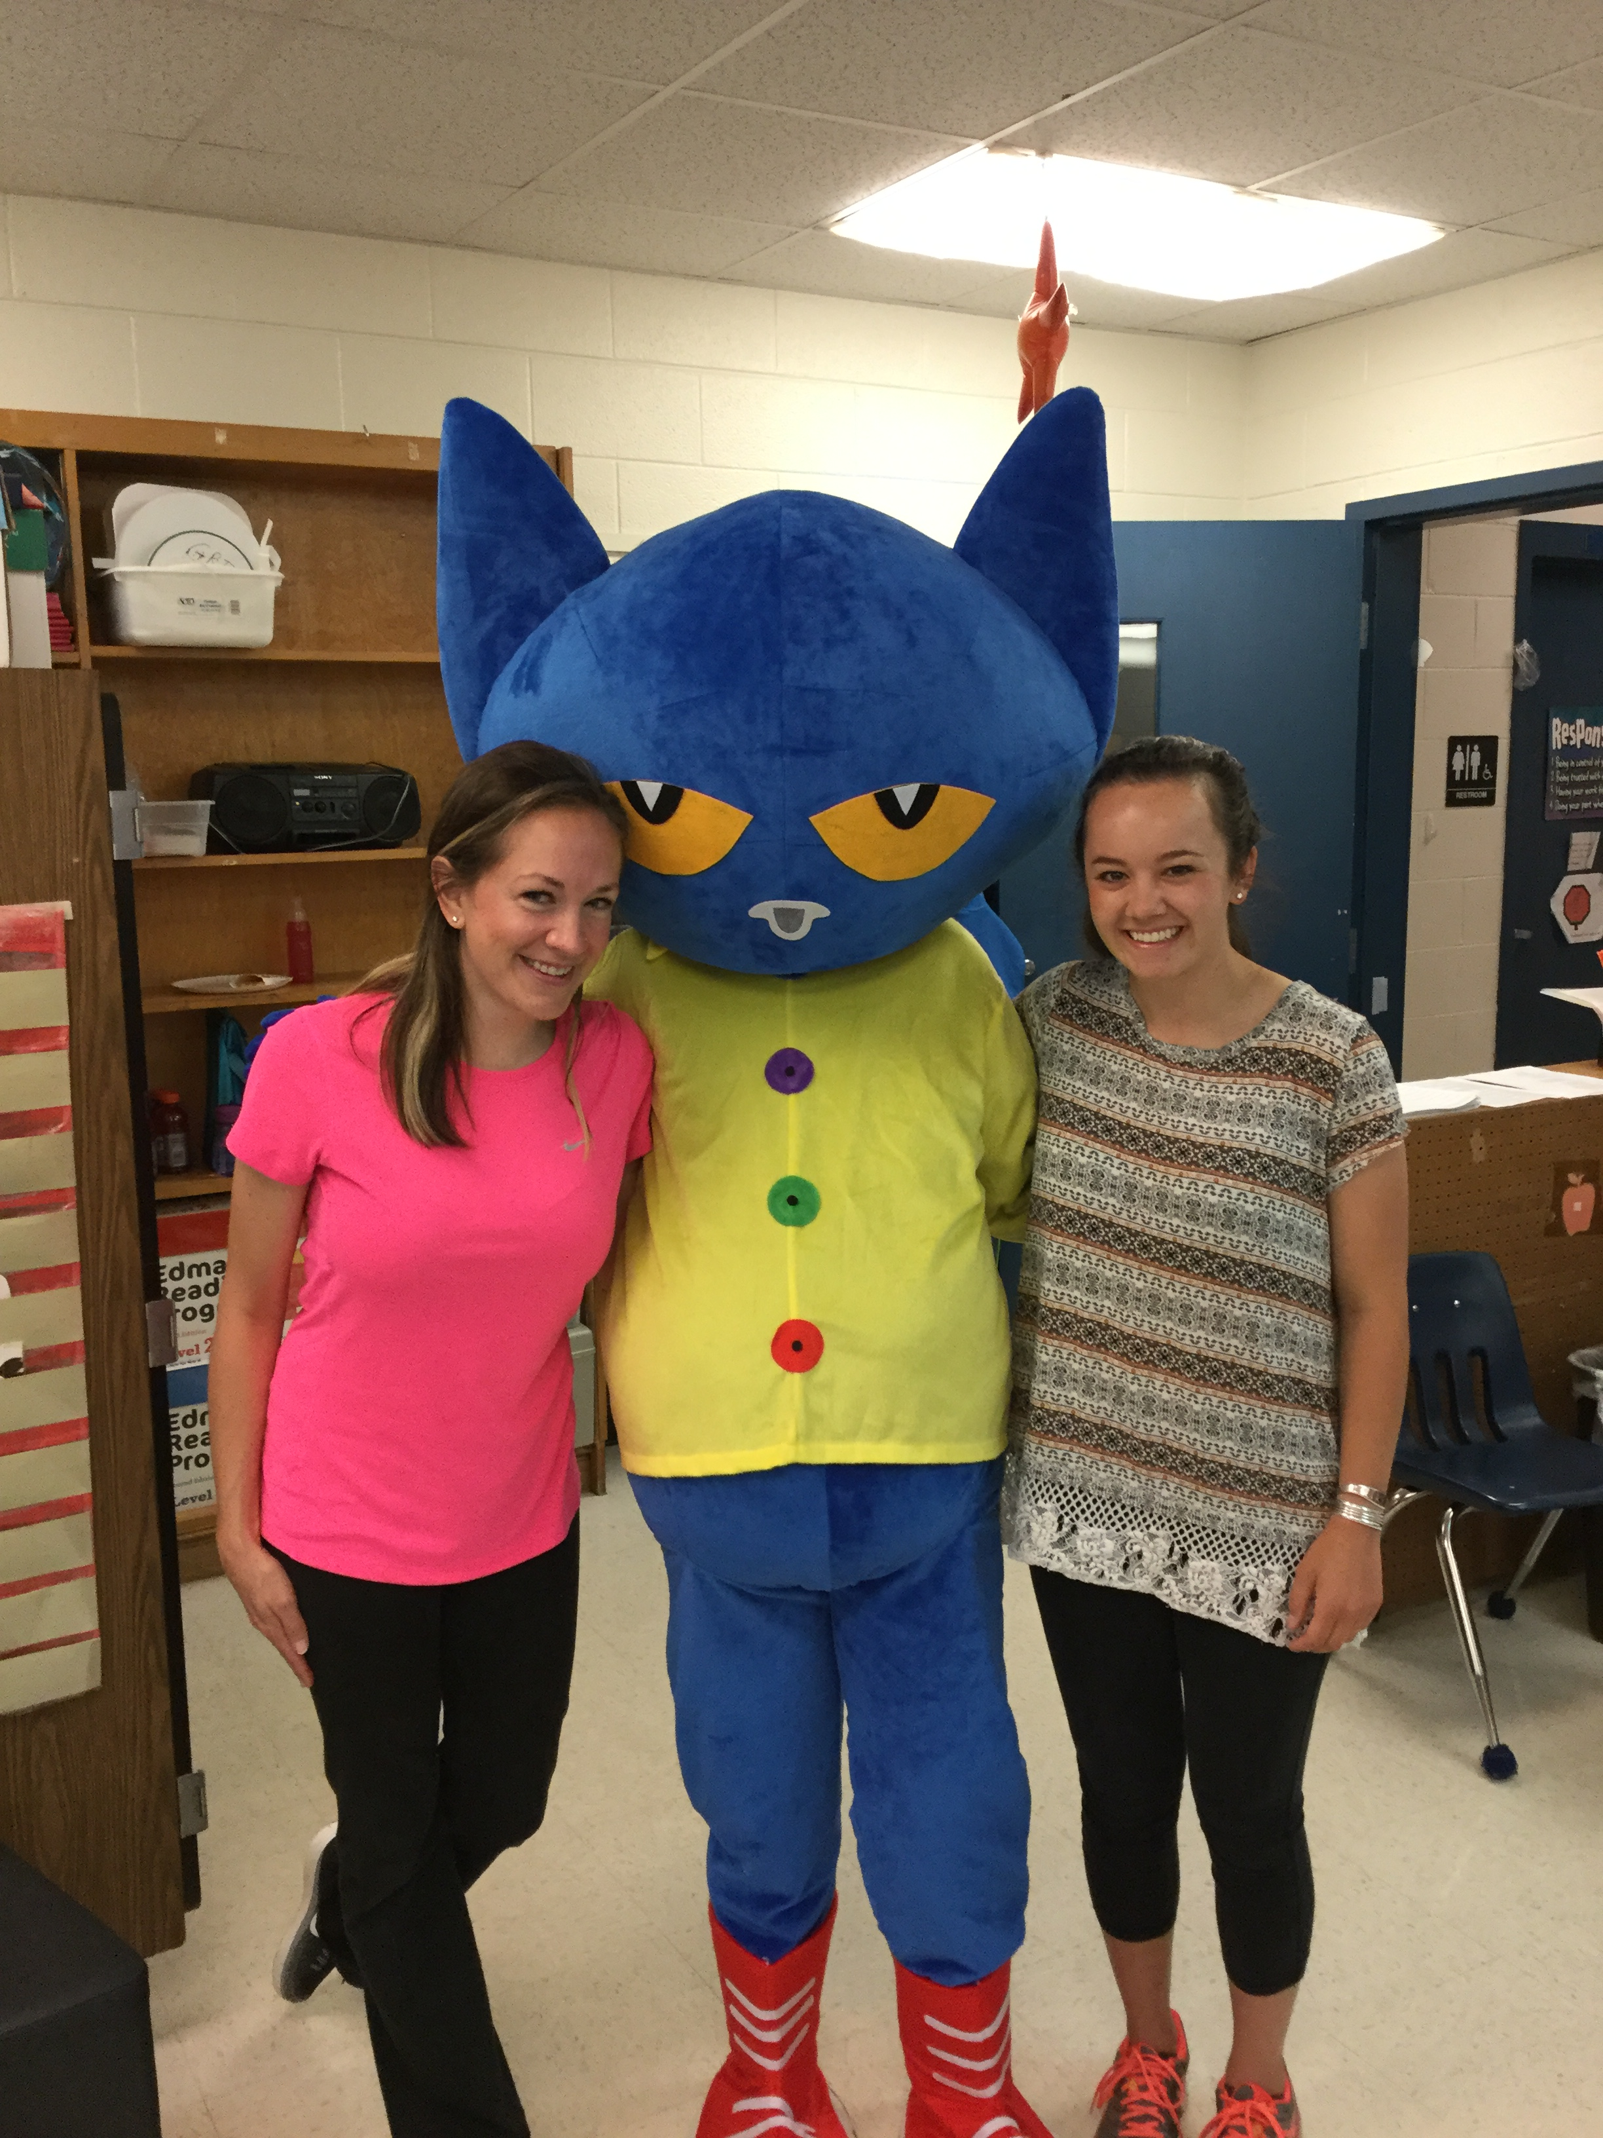
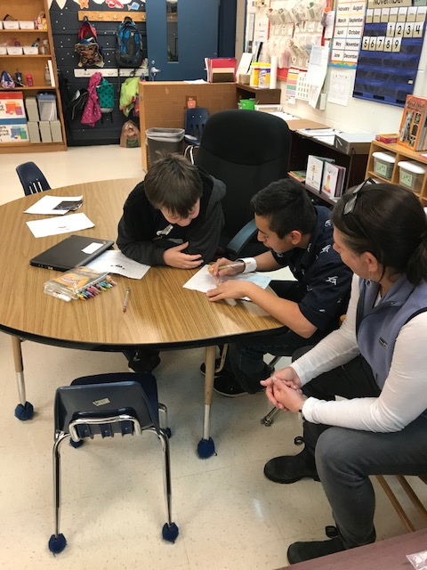
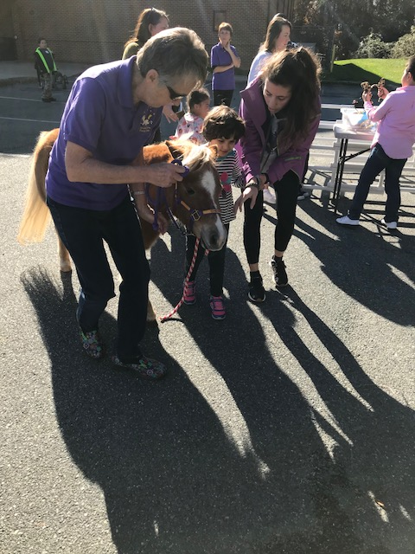
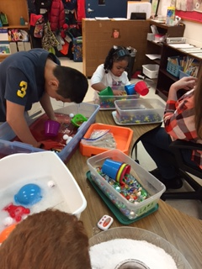
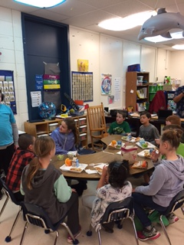
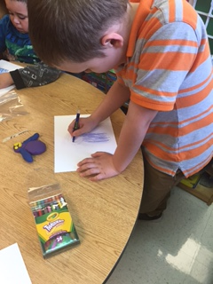
IT IS A SAFE SPACE TO LEARN TO LOVE LEARNING!

Slide 9
CBASE and the IEP

Slide 10
CBASE/ VESOL Justification
The student demonstrates (check at least one box):
❑ Communication difficulties that affect self-determination, behavior, social interaction and participation in multiple learning environments.
❑ Uneven learning patterns in all domains including cognition, communication, socialization and self-help.
❑ Multiple disabling conditions concurrent with an intellectual disability, including physical disabilities, sensory challenges and medical needs that impact health stamina, and engagement in learning activities.
❑ Motor impairments, in addition to cognitive / developmental delays, that makes participation in routine tasks challenging.
❑ Difficulty learning new tasks, maintaining new skills, and generalizing skills to new environments.
❑ Individualized methods of accessing information in alternative ways (tactile, visual, auditory, and multi-sensory).
The student has a disability that creates significant difficulty in learning skills and then transferring them across different settings. In particular, this student has impairments in adaptive skills in the areas of (must check at least two boxes):
❑ Conceptual skills, that impact language reading and writing, money, time and number concepts,
❑ Social skills, that affect things like interpersonal skills and social problem solving
❑ Practical skills that limit activities of daily living
Notes:
No longer vaap VESOL( virginia essentialized standards of learning)

Slide 11
CBASE/ VESOL Justification cont.
Read each item aloud and indicate confirmation of consideration by checking EACH box
❑ As a result of the information provided in the present level of performance which includes previous psychological testing, educational data and observation and the results of the Virginia Essentialized Standards of Learning (VESOL) participation criteria forms completed by the IEP Team, the IEP team agrees that the VESOL s the most appropriate State Assessment for this student.
❑ This student’s disability that impacts his/her cognitive functioning requires instruction in aligned Standards of Learning.
❑ As a result, the VESOL is the most appropriate assessment given the instruction and modifications that are required in order for him/her to benefit from his/her educational program.
❑ The IEP team has considered and understands that the student’s participation in the VESOL will limit his/her ability to graduate with a standard or advanced studies diploma.
❑ The IEP team agrees that participation in the VESOL was not decided based on the following factors: excessive absences; social, cultural or economic differences; identification in a specific disability category; specific special education placement or services; anticipated scores on SOLs; or concerns for accreditation calculations for the school or division.

Slide 12
Student Snapshots

Slide 13
Student Snapshot (Elementary One)
Although academic growth has been noted, Brandon is below grade level in all areas.
He receives math and reading instruction on his level.
He has difficulty learning new tasks, maintaining new skills, and generalizing skills to new environments.
He has impairments in adaptive skills in the areas of Conceptual skills, that impact language reading and writing, money, time and number concepts, and Social skills, that affect things like interpersonal skills and social problem solving
Brandon requires adult supervision across his day to provide consistent intervention to make progress academically, socially, and behaviorally.

Slide 14
Student Snapshot (Elementary Two)
Natalie is a student with autism with expressive and receptive language delays.
She needs intensive, specialized instruction in small groups or individually in all content areas to continue to progress.
She needs visual supports for his schedule, directions, self-care tasks, communication, and behavior.
She has difficulty attending to instruction and may walk away from her work area.
When she becomes escalated she may throw objects, climb furniture, attempt to leave the room, spit, grab others' faces or masks, or bite.
She engages in unsafe behaviors, she needs close, constant supervision for her safety.
Natalie has difficulty joining his regular peers, and needs adult assistance to attempt to join in with morning meeting and specials.

Slide 15
Student Snapshots (Secondary)
The student is a beginning reader. He has mastered the alphabet and letter sounds. The student engages in several obsessive and compulsive behaviors that interfere with learning, including hitting items multiple times and preservation (saying things multiple times), however, when redirected, he will usually comply and participate in the learning task without further disruption. The student presents with moderate articulation difficulty and uses 1-2 understandable words, although he relies more on augmentation and signs. He has a full cognitive index score of 53.
The student transferred to ACPS with special education eligibility under Neurological Disability. She has challenges with working memory and processing that affect her ability to access the curriculum. She requires opportunities to frequently review basic, functional academic skills for success within the classroom and needs accommodations to access her curriculum. She also struggles with self monitoring and organization which result in the need for frequent adult support to stay on task and complete assignments. Her overall Full Scale IQ score of 72 falls within the very low range.
VS.

Slide 16
CBASE: Elementary
Baker Butler (x2)
Broadus Wood
Brownsville
Greer
Hollymead
Mountain View (x2)
Murray Elementary
Stone-Robinson

Slide 17
CBASE - Middle Burley Henley (x2) Journey Lakeside (x2)* Walton CBASE - High Albemarle (x3) Monticello (x2) Western Albemarle Post High Program (x3)

Slide 18
WHAT ARE VESOL’s

Slide 19
Q&A

Slide 20
Thank You!

