Slide 1
Spring 2023 State Testing Data
October 9, 2023
Notes:
Challenges: influx of students coming to school for the first time between KDG -3rd. Some students coming in at the age of a second grader, but did not complete KDG or 1st grade. Due to the age we have to place them in 2nd grade. They are not prepared to be in a classroom - including not being potty trained. Special ed is staffed for PT/OT, but still need Speech pathologist.
Family Engagement plans - training parents to support students in Literacy and Math
Piloting Social Studies and Art in Grades K-5.

Slide 2
About State Data
State assessments are summative assessments designed to be a snapshot in time of student performance
State assessments are one part of a balanced assessment system that uses multiple and varied assessments to provide all users with information needed to support teaching & learning.
State assessments do not measure many desirable student outcomes, such as learner engagement, confidence, connectedness to school, and joy.
State assessments help policy makers and decision makers understand overall levels of achievement & identify schools/groups/students for support.
State assessments are not designed to be diagnostic or drive day-today teaching & learning.
***From Oakland Schools Teaching and Learning

Slide 3
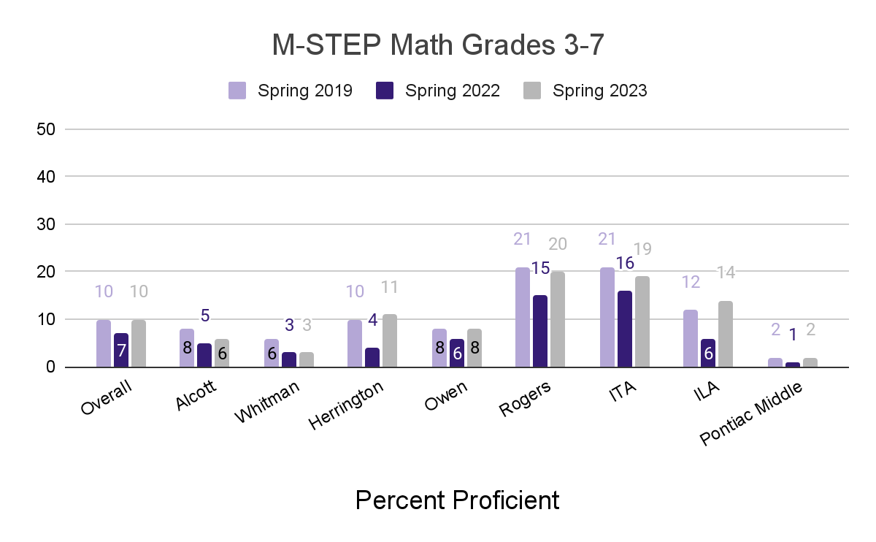
M-STEP Math by School

Slide 4
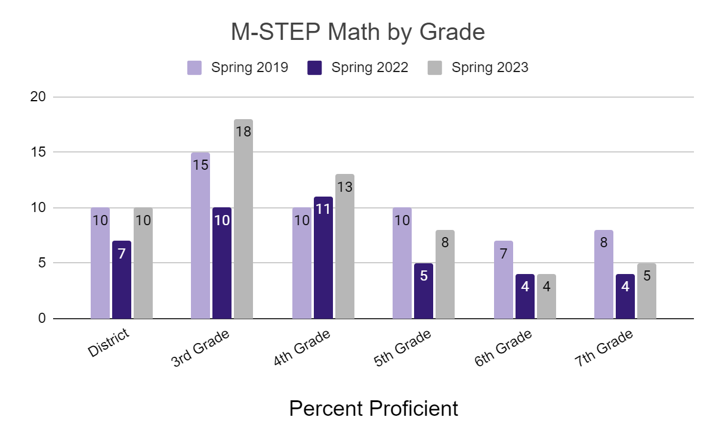
M-STEP Math by Grade

Slide 5
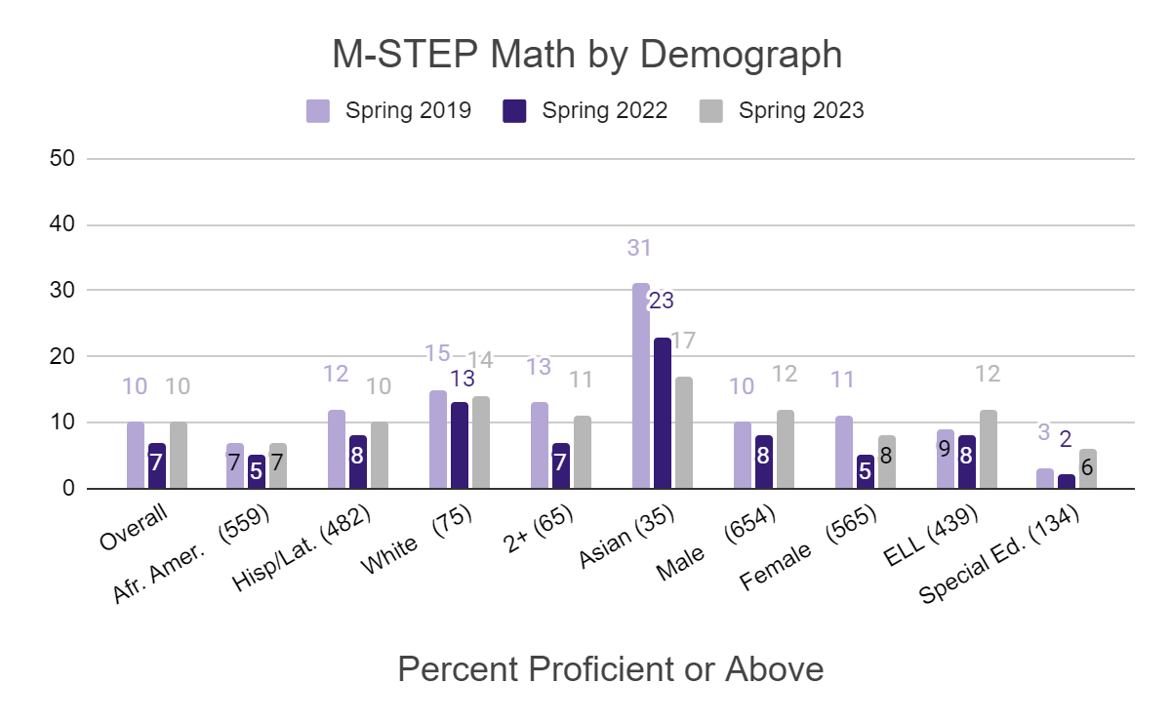
M-STEP Math
Demographic Groups

Slide 6
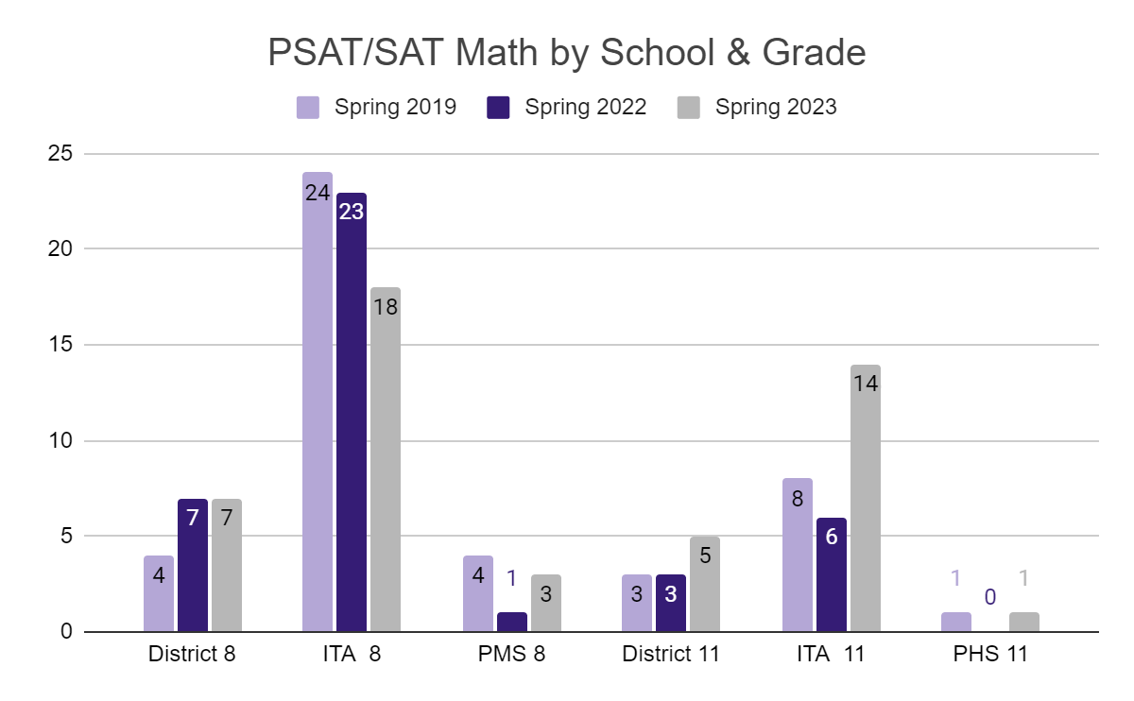
PSAT/SAT Math
by School & Grade
Grades 8 & 11 Evidence Based Reading and Writing

Slide 7
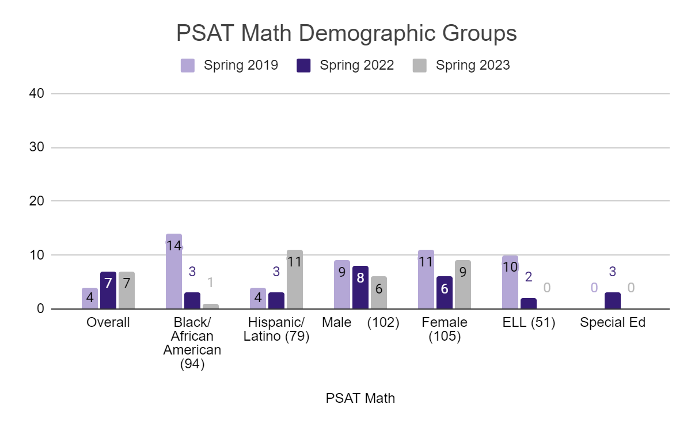
PSAT Math
Demographic Groups

Slide 8
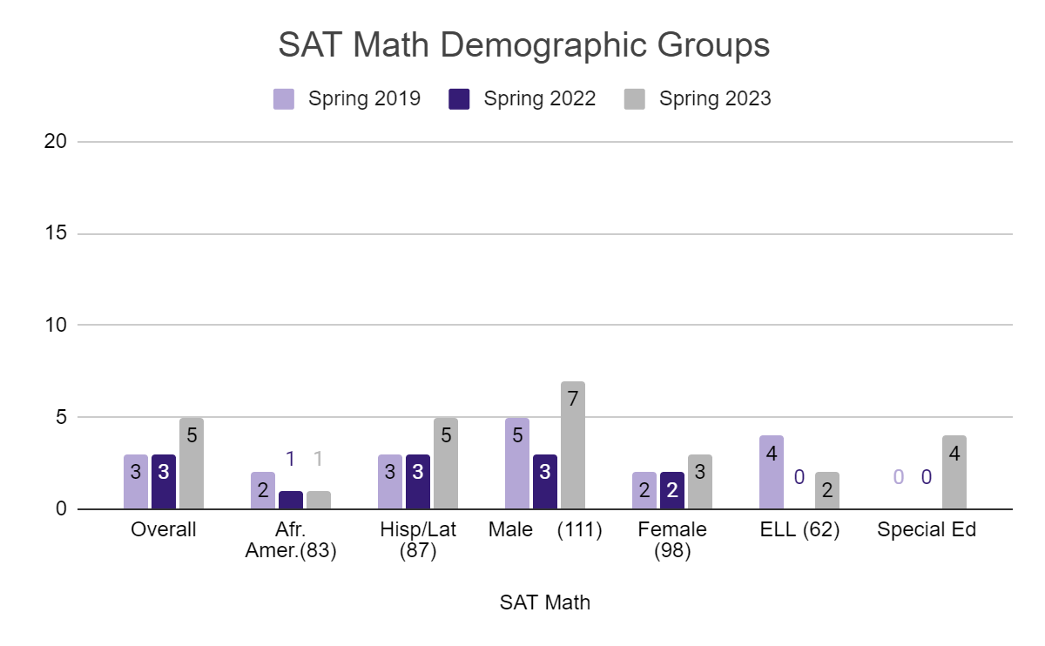
SAT Math
Demographic Groups

Slide 9
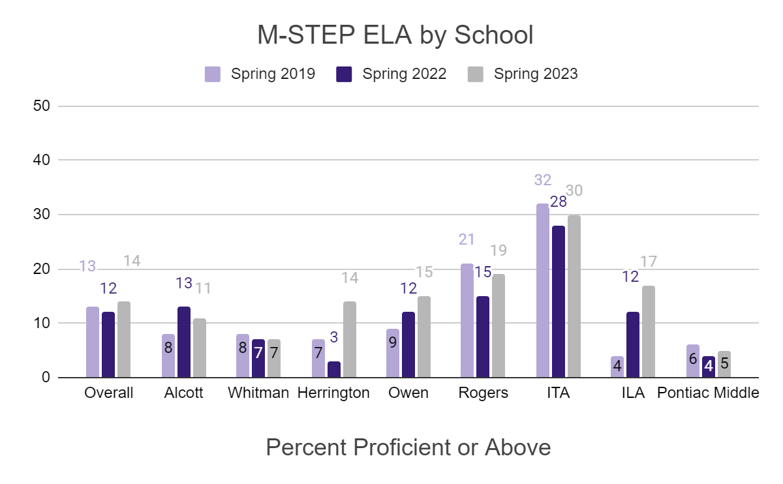
M-STEP ELA by School

Slide 10
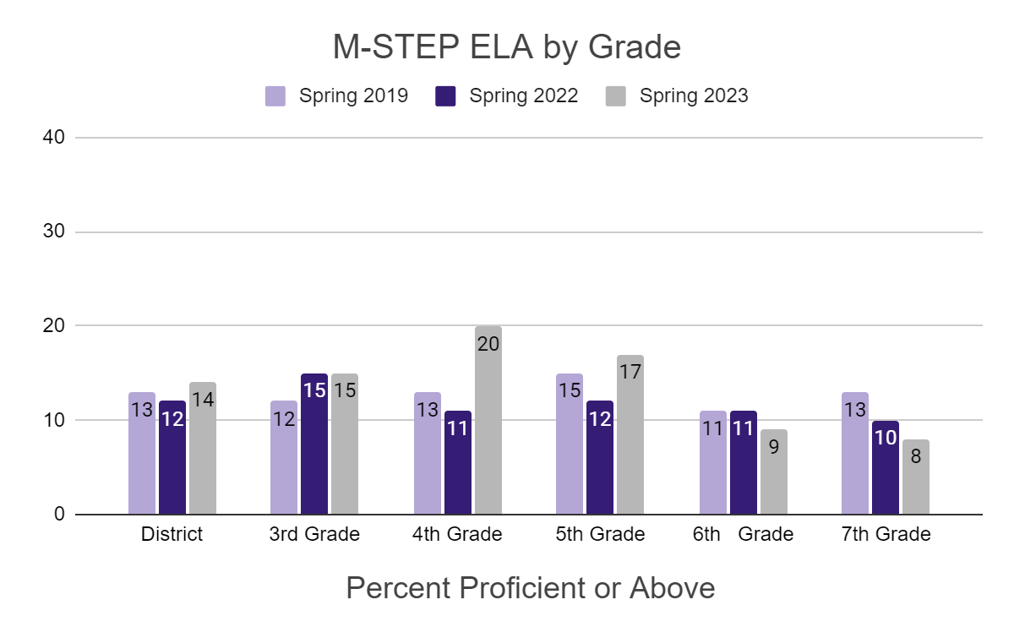
M-STEP ELA by Grade

Slide 11
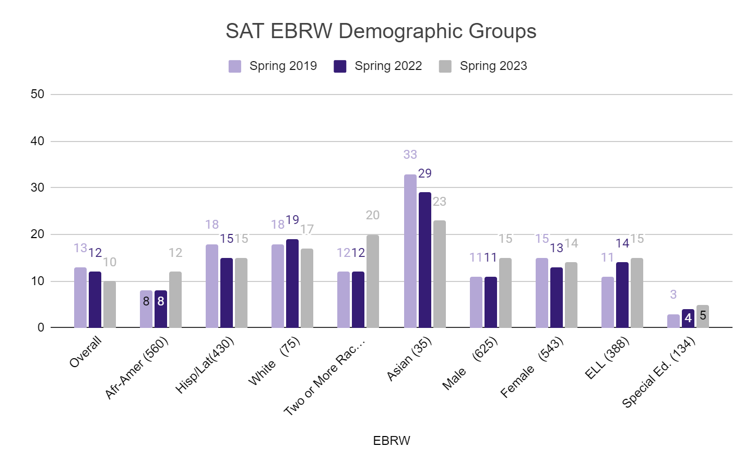
M-STEP ELA
Demographic Groups

Slide 12
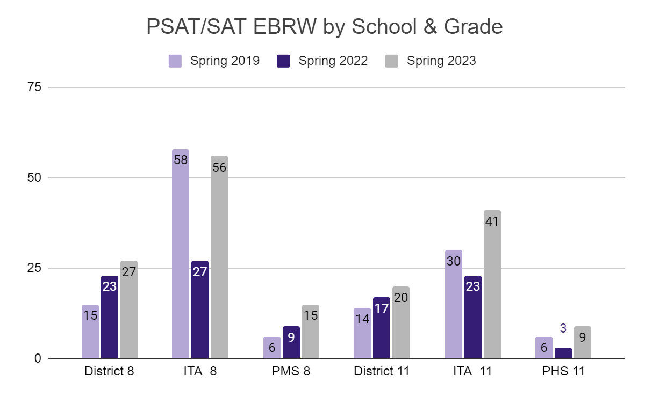
PSAT/SAT ELA
by School & Grade
Grades 8 & 11 Evidence Based Reading and Writing

Slide 13
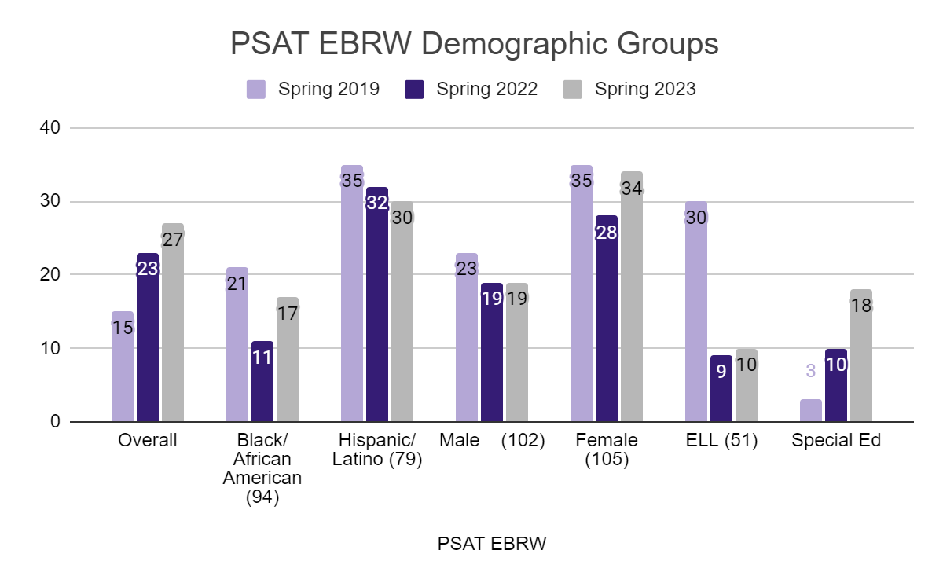
PSAT ELA
Demographic Groups

Slide 14
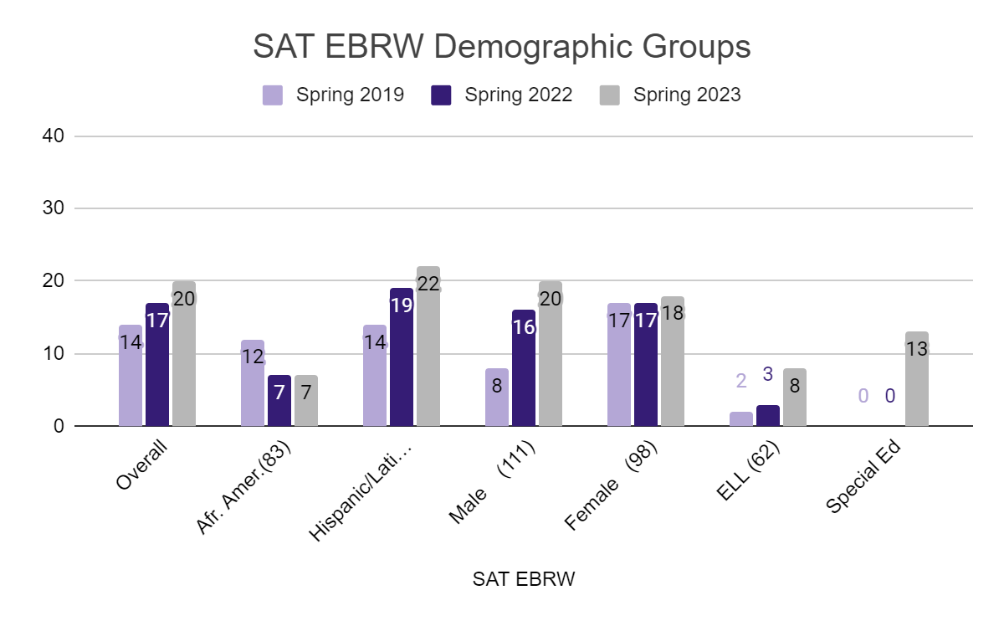
SAT ELA
Demographic Groups

Slide 15
Partnership School Updates
3rd-5th Grade Academic Goals:
Math proficiency in grades 3-5 will increase at least 3 percentage points from 2022 to 2025, based on the M-STEP Math test
ELA proficiency based on M-STEP will increase at least 4 percentage points from 2022 to 2025

Slide 16
Herrington
M-STEP Percent Proficient or Above
ELA | Herrington Overall | 3rd Grade | 4th Grade | 5th Grade
Spring 2019 | 11 | 13 | 16 | 5
Spring 2022 (baseline) | 6 | 8 | 2 | 4
Spring 2023 | 14 | 7 | 26 | 10
M-STEP Percent Proficient or Above
Math | Herrington Overall | 3rd Grade | 4th Grade | 5th Grade
Spring 2019 | 11 | 4 | 7 | 13
Spring 2022 (baseline) | 5 | 5 | 7 | 6
Spring 2023 | 12 | 18 | 12 | 2
Source: MISchool Data

Slide 17
Pontiac Middle School
M-STEP/PSAT Percent Proficient or Above
ELA | PMS Overall | 6th Grade | 7th Grade | 8th Grade
Spring 2019 | 13 | 13 | 13 | 28
Spring 2022 | 14 | 11 | 10 | 23
Spring 2023 | 14 | 9 | 8 | 27
M-STEP/PSAT Percent Proficient or Above
Math | PMS Overall | 6th Grade | 7th Grade | 8th Grade
Spring 2019 | 8 | 7 | 8 | 10
Spring 2022 | 5 | 4 | 4 | 7
Spring 2023 | 5 | 4 | 5 | 7
Source: MISchool Data

Slide 18
Academic Goals
9th -12th Grade Goals:
Math proficiency in grade 11 will increase at least 3 percentage points from 2022 to 2025, based on the SAT math test
ELA proficiency in grade 11 will increase at least 3 percentage points from 2022 to 2025, based on the SAT math test

Slide 19
Pontiac High School
SAT Percent Proficient or Above
 | EBRW | Math
Spring 2019 | 14 | 3
Spring 2022 (baseline) | 17 | 3
Spring 2023 | 20 | 5
Source: MISchool Data

Slide 20
Graduation Rate
Our goal is to provide families with opportunities to be empowered in their students' education and increase the graduation rate to 70% by the 2023-24 school year.
Official rates have not been released, but we are expecting to reach that goal with our 2022-23 graduation rate.

Slide 21
Challenges
Special Education Staffing:
Short Speech Pathologists - many willing to work virtual however we need in person.
Students coming back from COVID
Many student coming to school as 2nd graders for the first time.
These students are not prepared for the classroom, including not being toilet trained.

Slide 22
Next Steps
Family Engagement Plans
Parent nights to include training parents in literacy and math skills to support students at home
Engaging families in the importance of attendance at every grade level to support graduation
Book Breaks (K-5)
Zoom calls with authors that students can identify with

Slide 23
Next Steps
Curriculum Pilot
K-5 Social Studies - My World
Teachers piloting full year to get full picture of the series.
K-12 Art -Art of Education

