Slide 1
NO! It’s My Body!
Presented by:
Amy Ramsey
Director of Community Outreach & Education
Hunt County Children’s Advocacy Center
Recommended for Ages 5yo-7yo
Credits: “I Said No!” by Zack & Kimberly King, RAINN, Google, Hunt County Children’s Advocacy Center

Slide 2
MY BODY!

Slide 3
Private Parts…They are Special !
Private parts are the parts of your body that are covered by your swim suit or your underwear and undershirt.
They are very special!
NO ONE should look at or touch your private parts!

Slide 4
What are the names of my Private Parts?
What do YOU call your private parts?
DOCTORS call them…
Breasts
Bottom
Tee-Tee area

Slide 5
NO! It’s MY Body!!!
NO! Touching
NO! Looking
NO! Pictures

Slide 6
Special Rules about Private Parts! ….It’s OK if…
It’s OK…If you need help wiping after going to the potty.
It’s OK…If a doctor needs to look at your private parts because you may be hurt…ONLY if your mom or dad are in the room.
Green Flag people!
Mom, Dad, Doctor, Other people that take care of you?

Slide 7
If someone, even if it is a Green Flag person, touches you and makes you feel YUCKY or uncomfortable… that is NOT OK! Who could you tell? Who is safe for you?

Slide 8
If someone Touches you or looks at your private parts and makes you feel…
Upset
Confused
Uncomfortable
Sad
Scared
Yucky!
In Danger…
Who can you tell?
RED FLAG

Slide 9
WHAT IF…
Kids or other grown ups offer you things like candy, money or toys to look at or touch your private parts or their private parts? RED FLAG
You get that feeling inside that something that is going on just isn’t right, even if somebody else tells you it is? RED FLAG
RED FLAG

Slide 10
SAY…NO!
It’s
MY Body!
RED FLAG

Slide 11
NO SECRETS! Surprises are GREAT! No one should ever tell you to keep a secret from your Green Flag people!
NO!
NO!
NO!
NO!

Slide 12
GREEN FLAG people….
Adults Relatives (aunt/uncle)
Neighbors
Police
Firemen
Teachers
Adult Friends
Emergency Operator/911
SAFE / GREEN PEOPLE

Slide 13
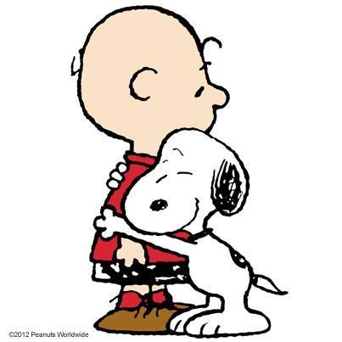
Safe touch…It’s Your Choice…
You can “High 5”
You can Fist Bump
You can Hug
Or NOT…
It’s YOUR choice!

Slide 14
Questions???

