Slide 1

School Health Advisory Council
2022-2023 School Year
Annual Progress Report
To the Board of Trustees
May 2023
Notes:
1

Slide 2
School Health Advisory Council
Every independent school district is required by law to have a school health advisory council (SHAC) of which the majority of members must be parents who are not employed by the school district. The SHAC is annually appointed by the local education agency Board of Trustees.
Texas Education Code
Title 2, Chapter 28, Section 28.004
Notes:
2

Slide 3

State Legislated SHAC Requirements
Committee-related
The following are requirements of
local SHACs per legislation
Texas Education Code, Chapter 28, Section 28.004:
A parent must serve as a co-chair
A minimum of five members must be appointed to serve on the SHAC by Board of Trustees
Majority of members must be parents who are not employees of the district
SHAC must meet at least 4 times a year
SHAC must deliver an annual report to the Board of Trustees
SHAC is required to submit recommendations regarding the districts’ health and human sexuality education curriculum

Slide 4
State Legislated Requirements
District/Campus-Related
SHACs can provide oversight for the following activities
required of local campus/districts per legislation
Texas Education Code, Chapter 28, Section 28.004:
Provide written notice, course content and parents’ rights regarding sexuality education if taught
Ensure that full-day pre-k students participate in 30 minutes of daily vigorous activity
Include goals and objectives for CSH in HS and MS Campus Improvement Plans
Administer FitnessGram® to all students in grades 3-12
Choose an evidenced based alcohol awareness instructional program
Use the PAPA program in MS or HS health classes

Slide 5

Lackland ISD SHAC Members
2022-2023
LaTanya Sheehan, Parent, Co-Chair Tonya Hyde, Asst. Supt. Co-Chair
Brandy Briggs, Parent Jennifer Dominguez, Counselor
Crystal Gajkowski, Parent Erika Adams, Nurse
Vanessa Lockey, Parent Alfredo Concha, Operations
Christena Montoya, Parent Daniel Rigney, Coach
April Leiva-DeHoyos, Parent Michelle Tarvin, Admin.
Robert Walker, Parent Jaden Deejan, Student
Marquise Mahaffey, Parent Alexandria Ho, Student
Luza Meza, Parent
Notes:
5
This slide is a typical representation of members. Adjust to match your district composition. Remember that the law now states that a parent must be the chairperson or at least co-chair of the SHAC and that the majority of members must be parents.

Slide 6
2022-2023 SHAC
Meeting Dates
General Council Meetings
October 2, 2022
December 13, 2022
February 8, 2023
April 12, 2023
Physical Fitness Sub-Committee
Worked together to complete wellness evaluation components. No formal meeting was scheduled.
https://www.lacklandisd.net/community/school-health-advisory-council
Notes:
6

Slide 7
Review of SHAC Activity & Accomplishments
  Recruited new members
  Performed evaluation of local wellness policy – FFA (Local) – posted on District webpage
  Updated the LISD Bloodborne Pathogen Guidelines
  Continued approval of Safeschools training for bloodborne pathogens, child abuse and maltreatment, bullying and harassment, substance abuse, mental health promotion, and suicide prevention.
Notes:
7

Slide 8
SHAC Recommendation
Focus on identified areas for growth from the 2022-2023 wellness plan evaluation.
Continue to support student social-emotional needs
Consider continued support of free breakfast and lunch for all students

Slide 9
FitnessGram

Slide 10
FitnessGram

Slide 11
District -Wide Accomplishments
  Completed the 2022-2023 TEA School Health Survey
  Year long Wellness Wednesdays Newsletters (Staff)
  Participation in TRS and Edwards Risk Management Spring and Fall Fitness Challenges (Staff)
  Participated in National School Lunch Week and School Breakfast Week
  District-wide support for nutrition, counseling, and mental health
  Partnership with the Texas Child Mental Health Care Consortium and Texas Child Health Access through Telemedicine (TCHATT)
Notes:
11

Slide 12
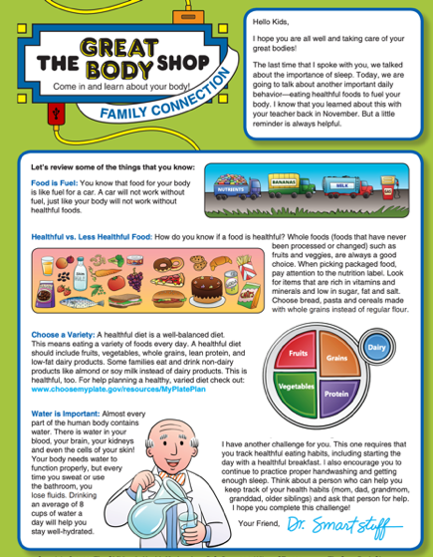


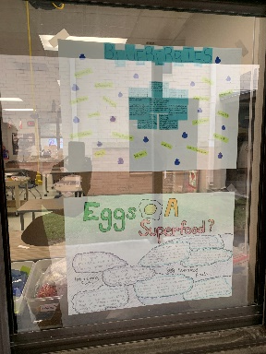
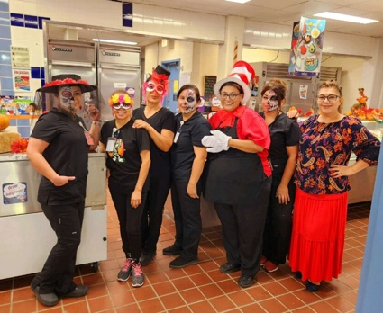

Slide 13

Useful Web Sites
Texas School Health Advisory Committee:
  www.dshs.state.tx.us/schoolhealth/shadvise.shtm
TXPTA Healthy Lifestyle web page:
www.txpta.org/programs/healthy-lifestyles
TEA Fitness Data: www.tea.state.tx.us./index4.aspx?id=397
Youth Risk Behavior Surveillance (YRBS) Survey: www.dshs.state.tx.us/chs/yrbs/query/yrbss_form.shtm
Weight of the Nation: http://theweightofthenation.hbo.com/films
CDC Coordinated School Health: www.cdc.gov/HealthyYouth/CSHP
Texas Department of Agriculture Square Meals: www.squaremeals.org/fn/home/page/0,1248,2348_2349_0_0,00.html
Regional Education Service Centers: http://ritter.tea.state.tx.us/ESC
Texas online help for childhood obesity: www.reshapingtexas.org
Texas Legislature Online: www.capitol.state.tx.us

