Slide 1

EAS Curriculum Night
Celebrating 25 years of
learning,
service,
adventure,
community,
and SUCCESS!

Slide 2


Meeting Agenda
Staff Introductions
PTO overview and budget
Program info from the EAS Staff
Grade level break-out groups

Slide 3

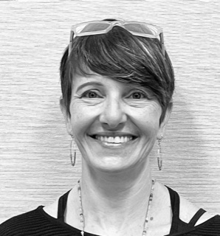
School Administration
Principal – Jennifer Cleaves
Associate Principal – Stacy Mehlberg

Slide 4
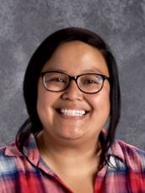
Marie Jo Andrada
Co-Lead Teacher
Language Arts
Pre-Algebra I
Orca Clan Leader
Character Strong Lead
Backpack Naturalists CSP
504 Coordinator

Slide 5
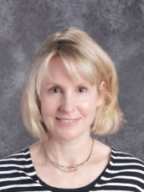
Laura Bartoletti
Volunteer Coordinator
Grants Coordinator

Slide 6
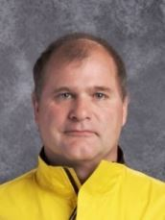
John Hamilton
EAS Co-Founder
Art
6th Grade Orientation
Bear Clan Leader
8th Grade Leadership
Excursion Coordinator
Greenhouse CSP
Finn Hill Badminton Coach

Slide 7
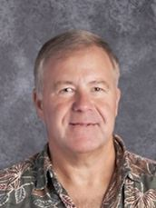
Brian Healy
EAS Co-Founder
Co-Lead Teacher
Science
Pre-Alg. 2
Osprey Clan Leader
Green Team
Yearbook Advisor
EcoStewards CSP
Finn Hill Basketball Coach

Slide 8
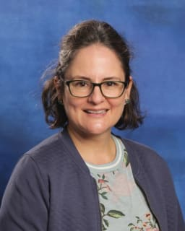
Cristina Kollinger-Collesei
8th Grade Spanish 2
Also teaches Spanish at Kamiakin Middle School

Slide 9
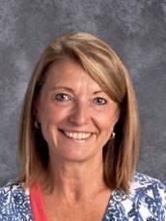
Colleen McLaughlin
Office Manager
Staff “Mom” ☺
Registrar
Attendance
News Bulletin Editor
Health Room
School Budget
Webmaster

Slide 10
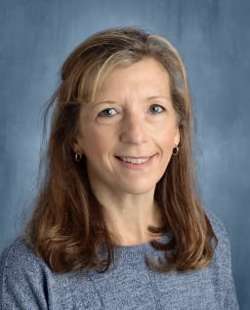
Amy Lofquist
Wednesday Electives
Coordinator

Slide 11
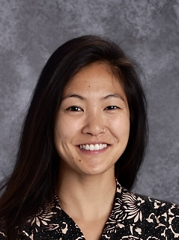
Michelle Minato
Social Studies
Geometry
Math-6
Wolf Clan Leader
Equity Team
Helping Hands CSP
504 Coordinator

Slide 12

Maria Reynoso
7th Grade Spanish 1
Also teaches Spanish 1 at Finn Hill

Slide 13
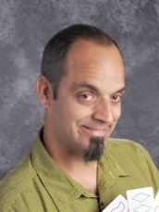
Marcus Rose
STEM
Career & Technical Education (CTE)
Algebra 1
Raven Clan Leader
Furniture Friends CSP

Slide 14
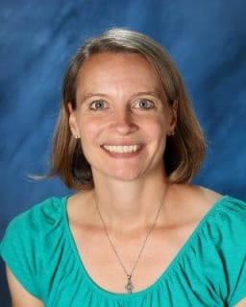
Kirstin Doughty
EAS Counselor
Primary 504 coordinator

Slide 15
We Appreciate Our Parents
Volunteer Involvement –
~ 25 hrs. needed per family per year on average
Many ways to volunteer on- & off-campus
Family Contributions
  Funding benefiting ALL students
  In lieu of other ALL other fundraisers

Slide 16

PTO Agenda
Introductions
EAS PTO Info
Website
Raise Right Program
Volunteer Opportunities
Proposed Budget

Slide 17

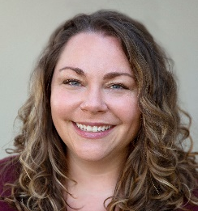
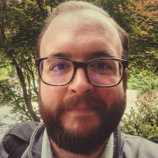
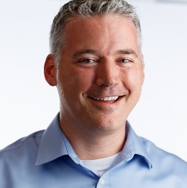
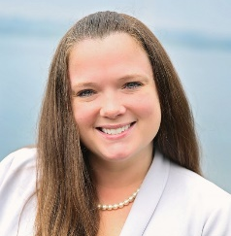
PTO Officers
Beth McIntire & Lindsey Yocum, Co-Presidents
Bryan Hardaway & Brennan O’Reilly, Co-Treasurers
Amy Falcone, Secretary

Slide 18
EAS PTO
What is the PTO & PTO Board?
Membership Fee & Donations
  Yearly fee & donation
    $25 yearly PTO membership fee
    $425 donation is tax deductible
      Please send receipt requests to treasurer@pto.org
  Corporate Matching
    Connected to company matching sites like Benevity
    Donations and volunteer hours will be matched by many companies if submitted through matching sites

Slide 19


EAS PTO
Use Zelle to send donations and payments to PTO
This includes elective fees!
DONATE HERE

Slide 20

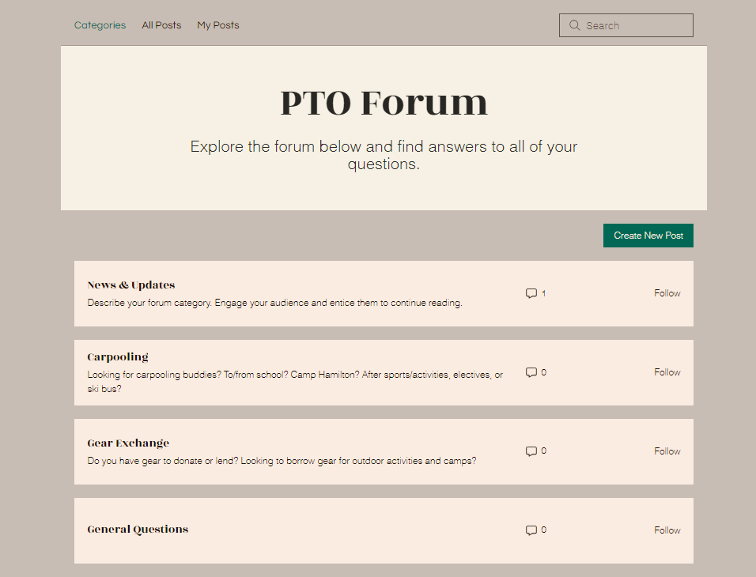
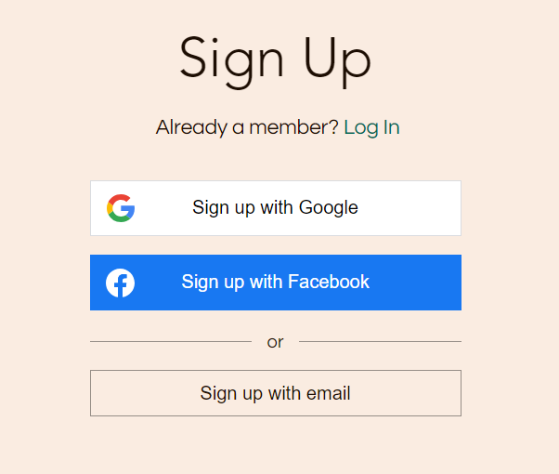
Website

Slide 21

EAS Raise Right Program
A Fundraiser for YOU!
It’s simple: Buy gift cards, then get % rebates!
Gift card rebates deposited directly into your family’s PTO account monthly
Funds applied to school expenses of your choice, such as:
  Expedition fees
  Wednesday elective session fees
  Lab/Spanish/Art fee
  PTO membership fee
  EAS family donation
DONATE HERE

Slide 22
Volunteer
Current PTO Volunteer Openings:
  Co-Yearbook Chair
  8th Grade Events Chair
  End of Year BBQ Chair
  Health Fair Chair
  Community Building Chair
DONATE HERE

Slide 23

PTO Proposed Budget
DONATE HERE

Slide 24
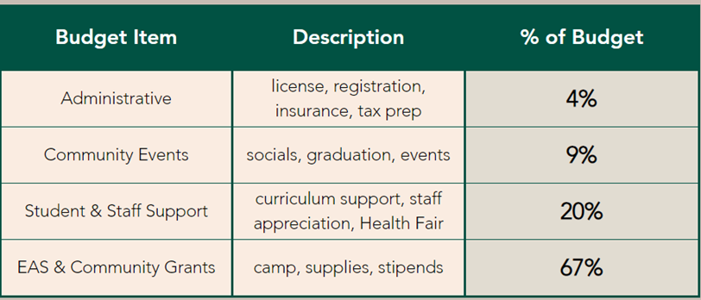
PTO Proposed Budget
EAS PTO Budget:
  Funds raised are integral to the EAS program
  Enables activities and initiatives that enhance your student’s journey and growth
  More than 96% of funds raised go directly to fund student programs and events
  Largest budget item funds:
    Fall and Spring camp fees, supplies, and counselor stipends
    Advisor support for green team, student leadership, and yearbook
    Staff and student support for electives, stewardship, and excursions

Slide 25
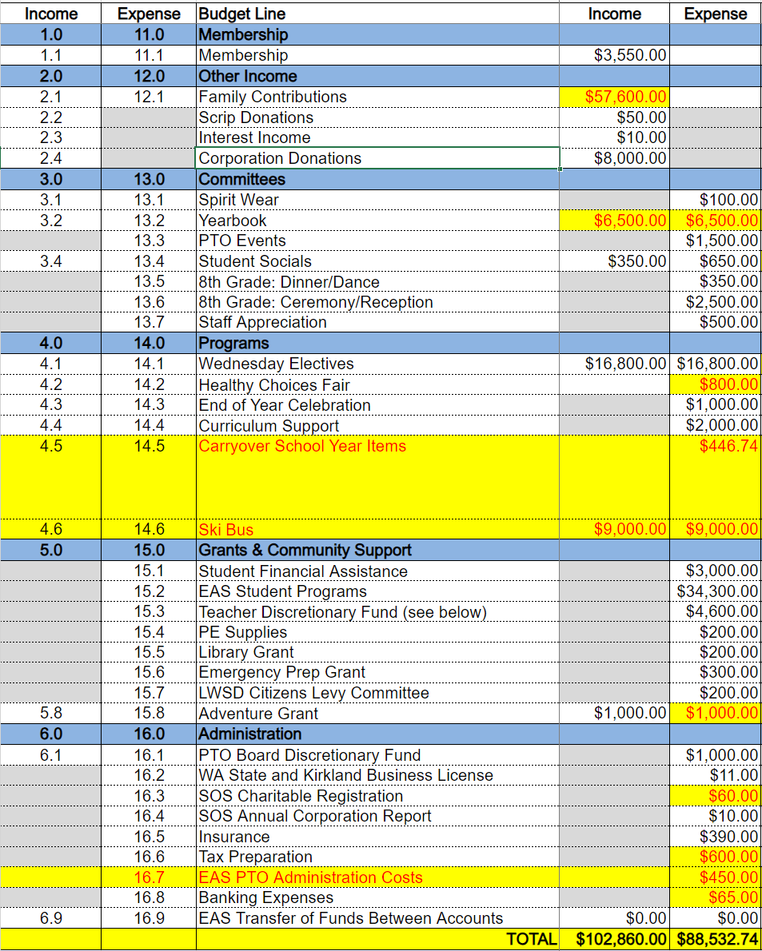
  Ask Increased from prior years
  Surplus from COVID paid off
  New line items added for Ski Bus
  Carryover item for late expenses from last year’s budget
  Depending on family contribution goal PTO may pay yearbooks

Slide 26

Vote on Proposed
PTO Budget Changes
We need someone to make a motion. To do that, say “I move that we update the 2023-2024 EAS PTO budget to make the changes shown on the previous slide.”
Then we need someone to say, “second”
Then we need everyone in favor to say “aye”
Then anyone opposed to say “nay”
That’s it! Well done!
DONATE HERE

Slide 27


Volunteering
EAS needs families to:
Contribute 25 hours/year of volunteer service or in-kind donations of needed resources
    PTO officer positions, committee positions, and program work
    Driving/chaperoning for CSPs or excursions
    Facilitating Wed. Electives sessions
    Assisting with EAS Office clerical tasks (at school or home)
    Special projects as needed (at school or home)

Slide 28

Volunteering
Take the time to apply as a volunteer or renew now!
Visit www.lwsd.org/get-involved/volunteering-in-lwsd
Approved applications are good for 2 years
Reach out to lbartoletti@lwsd.org if you have questions about your application or status

Slide 29


Wednesday Electives
Program offers a wide variety of electives.
Drivers and instructors will be needed for some sessions and will be assigned on a week-by-week basis.
Monitor the EAS News Bulletin for announcements.
NEW! – Social/Emotional Learning activities!

Slide 30



Excursion Program
Camp Hamilton (Sept.)
November Academic Adventures
April Adventures
  Trip options will be communicated in mid-November.
  Range of trip options and costs
Bowman Bay (June)
Volunteer roles and expectations

Slide 31

Extra-Curricular Opportunities
Finn Hill Sports - 4 seasons
Math Club†
Science Olympiad†
Robotics†
Orienteering†
8th Grade Leadership
Green Team
School Socials
Media Club
Campus Drama Production
  †Contingent on parent volunteer leaders

Slide 32
Academic Agreement
Students will…
Families will…
Apply themselves to studies in all classes
Take steps to improve skills and study habits
Work toward a 3.0 average in order to participate on EAS trips and electives
Continue to support their child’s academic learning in all classes
Work with teachers as needed to address areas for improvement

Slide 33

Home Study Environment
Key Elements
Area free from disruptions where student can work with purpose
Access to needed materials
Reasonable parental supervision of screens (phone, laptop, TV, etc.)
Consistent routine w/ breaks
Proper planner use

Slide 34
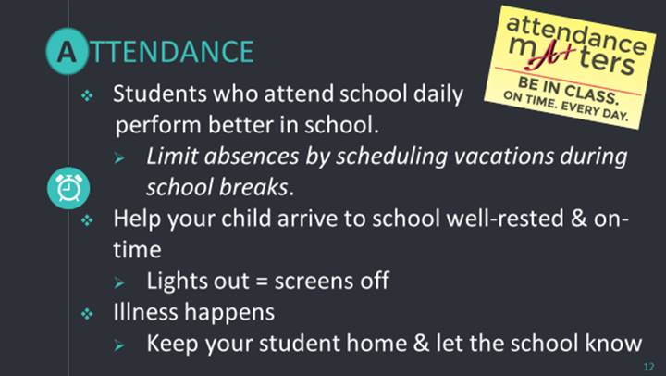
Attendance is Important!

Slide 35

Planned Absences
EAS strongly recommends parents avoid taking students out of school for family vacations other than on LWSD holidays.
Missed class time affects learning and may impact grades.

Slide 36


Grading

Slide 37
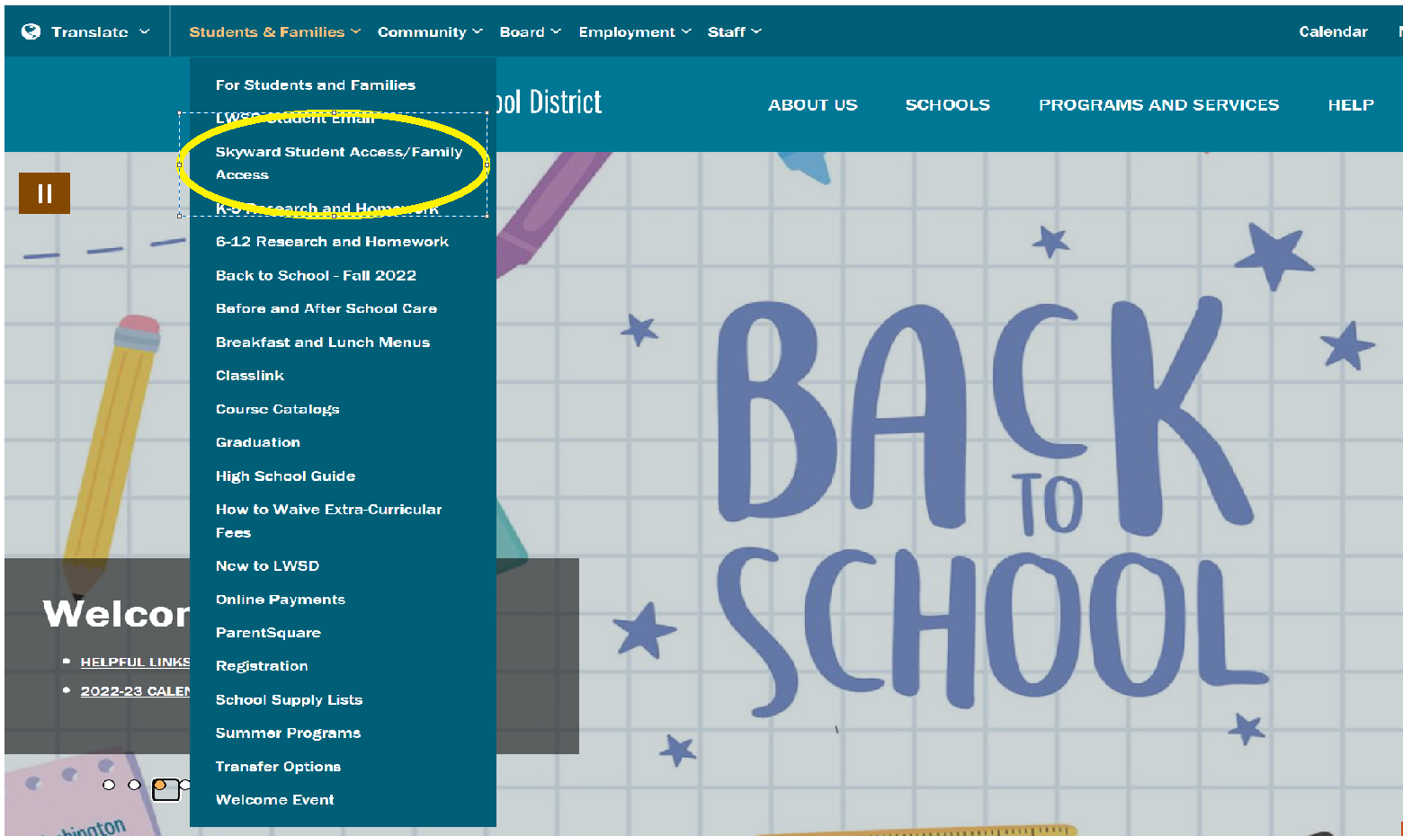
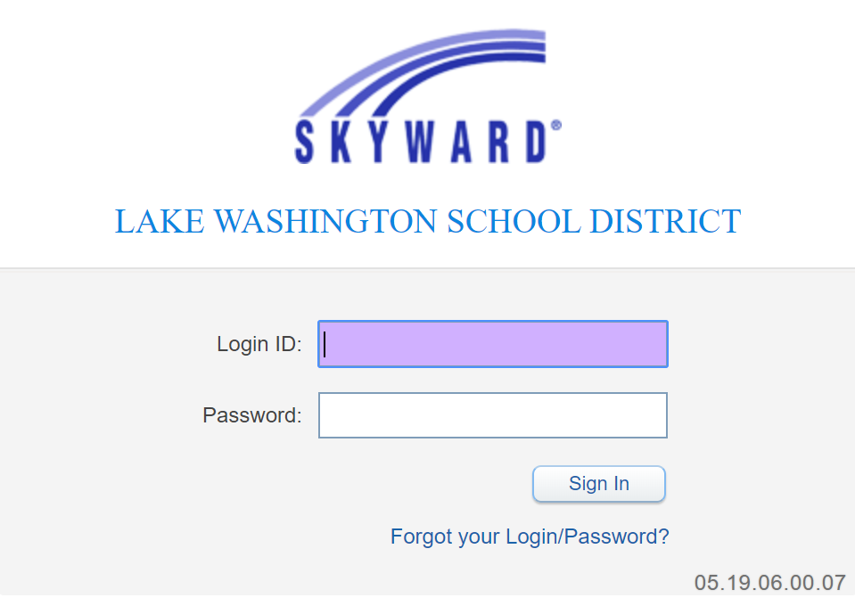
Skyward Gradebook
Families access grades through the “Students & Families” tab on the LWSD website.
Students can access via ClassLink

Slide 38
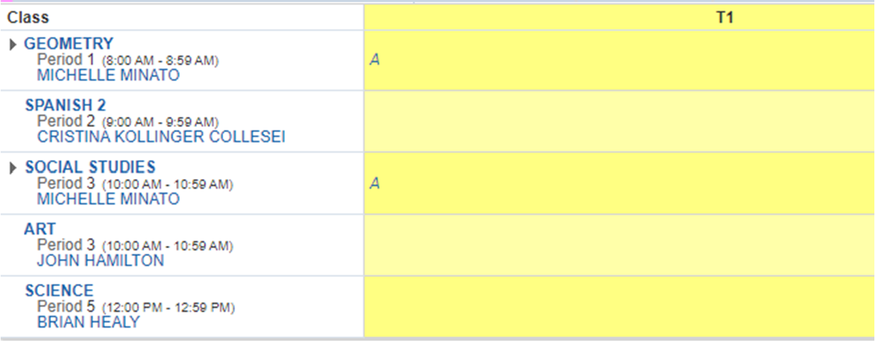

Viewing Skyward Gradebook
Click on any grade to show a detailed report of individual assignments, scores, and teacher comments.

Slide 39
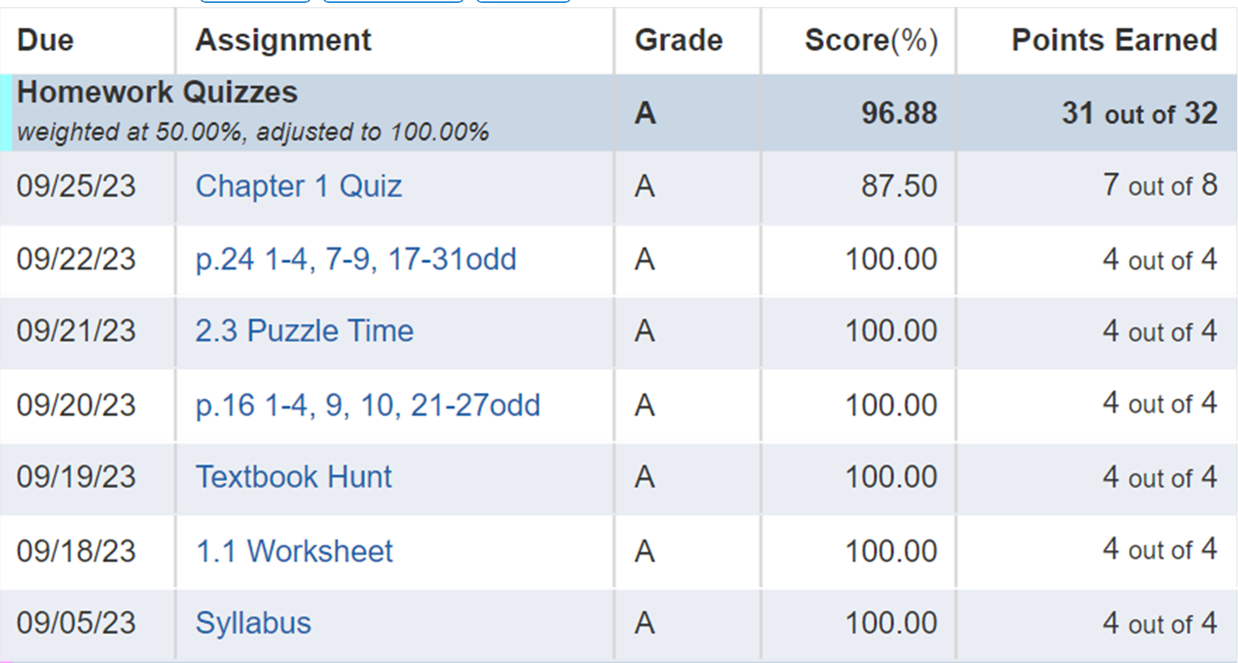

Viewing Class Assignments & Grades
Here you see the 4-point scale scores for each assignment

Slide 40
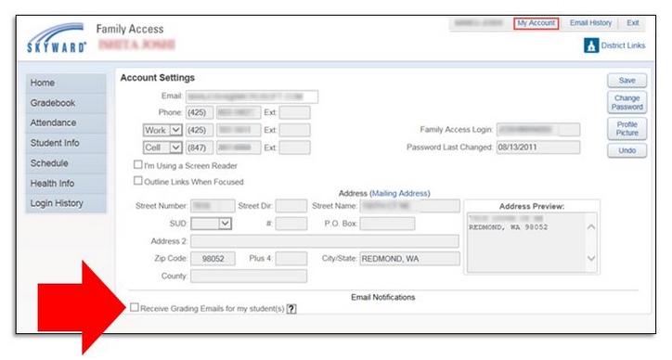
Opt-In to Receive Missing Assignment Emails!

Slide 41

Communication Process
Question related to specific class –teacher of the class
General question – advisory teacher or EAS office
School concern – Lead Teacher
Continued concern – Dr. Mehlberg
Non-urgent: Email
Urgent: Phone call
Always get all sides of a story before making a judgment!

Slide 42
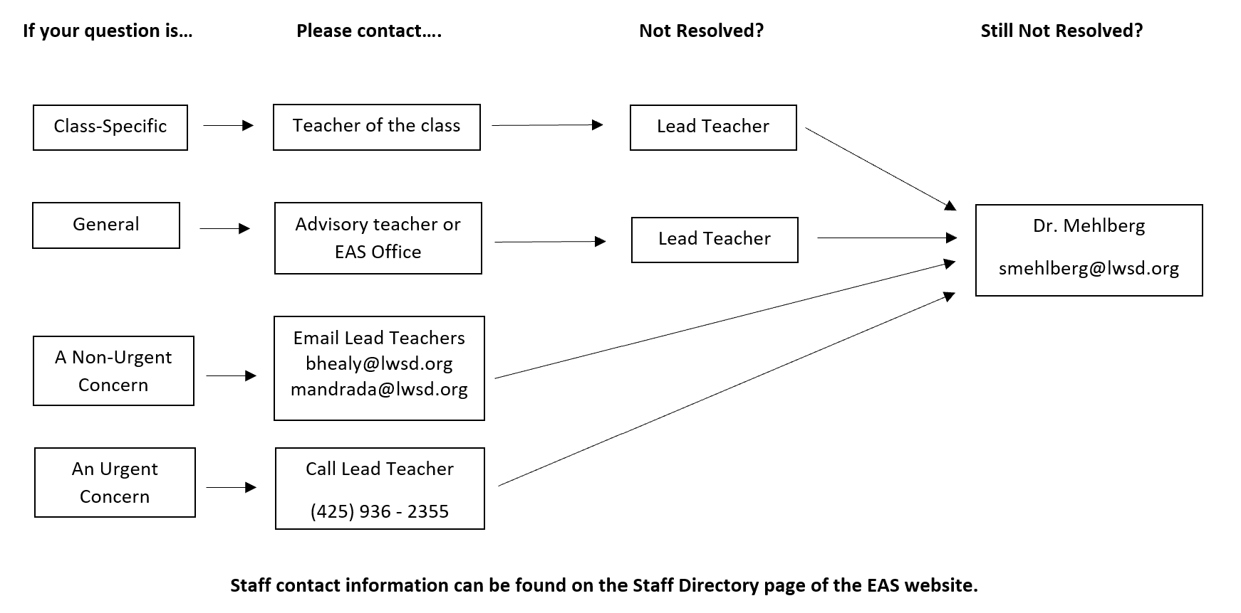
Communication Process

Slide 43

Conferences
Signups will begin in late October
6th Grade Families
Week of Nov. 27
7th & 8th Grade Families
Feb. 13-14, Feb. 20-21

Slide 44


Social Dynamics
Expectations IN and OUT of school
Social media guidelines
NO Tolerance for: Bullying, Teasing, Harassment

Slide 45

EAS – A Culture of Literacy
Independent Reading
Reading and writing instructed and emphasized in all classes and on excursions
Emphasis placed on various forms of writing
Presentation skills in all classes

Slide 46
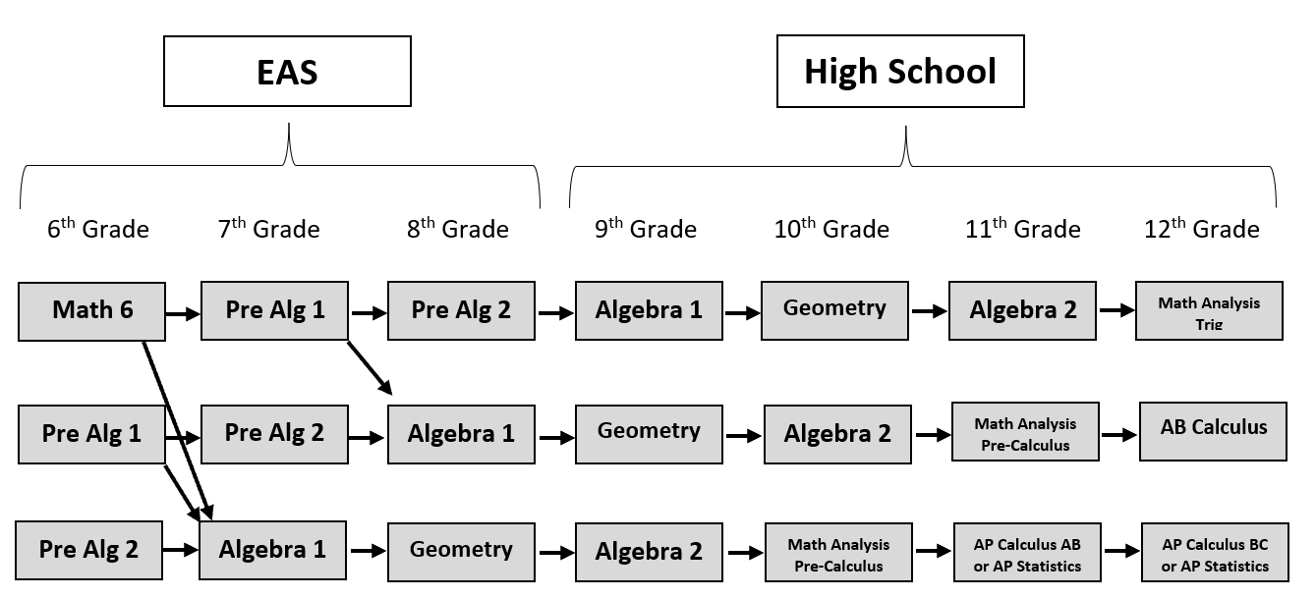
EAS Math Pathways

Slide 47


Opportunities for Math Acceleration
At the end of the school year Math 6 and Pre-Algebra 1 will discuss and communicate with families all opportunities for math acceleration.

Slide 48

Curriculum
Year A: Where Have the Salmon Gone?
Spanish – Sr. Hamilton, Sra. Reynoso, Sra. Kollinger
Math – Ms. Minato, Ms. Andrada, Mr. Rose, Mr. Healy
Science/STEM – Mr. Healy, Mr. Rose
Language Arts – Ms. Andrada
Social Studies – Ms. Minato
Art and Fitness – Mr. Hamilton

Slide 49

Grade Level Break-out Sessions
6th Grade parents to EAS Commons
7th Grade parents to Mr. Rose’s room
8th Grade parents to Ms. Andrada/Ms. Minato room

